Slide 1
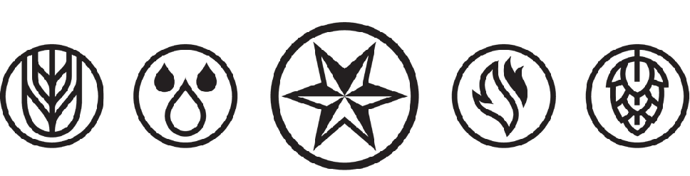
Beer 101
Max Finnance, Advanced Cicerone®
mfinnance@sixpoint.com

Slide 2
About Me
Advanced Cicerone®, Certified BJCP, GABF Judge
Beer Education & Field Quality Specialist for Sixpoint
5 years Navy
B.S. Biological Sciences from UConn
8 years in all facets of running a bar
2 years part time running brewery events
2 years as a brewery sales representative

Slide 3

Sixpoint Brewery
Founded in 2004 by Shane Welch as a draft only brewery out of a garage in Red Hook, Brooklyn.
Began canning beer for distribution in 2011.
Launched an aggressive small-batch innovation program in 2017 for sale DTC through the proprietary Sixpoint app.
Currently distributed in 25 states.
Merged with Victory & Southern Tier under the Artisanal Brewing Ventures umbrella in late 2018.

Slide 4
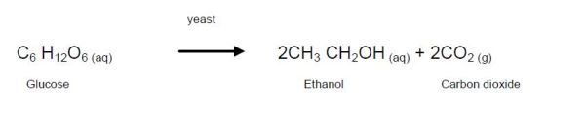
Fermentable Grains
Beer is an alcoholic beverage that is derived from the fermentation of grain-based sugars.
We call these grains “malt” as a broad term, but they can include malted barley, wheat, oats, rice, corn, rye, etc.
Fermentation of fruit-based sugars results in wine.
If distillation is involved, it becomes liquor or spirits.
Notes:
Sake, though commonly called “rice-wine”, is actually a beer since it is made from grain.
When fruits are used in beer, they are used for flavor, not for the fermentable sugars.

Slide 5
What is in beer?
Malt (Grain Bill): the grains which provide a source of sugar also provide proteins, coloring, and flavoring.
Hops: the flower added to provide a bitter balance to malt sweetness, but can also provide a large amount of the flavors and aromas depending on style.
Yeast: microorganisms that convert sugars to ethanol (alcohol) and carbon dioxide, and can also provide flavors and aromas, particularly in German and Belgian styles.
Water: not all water is equal, some particulates (iron) make for bad beer, others (CaCO₃) limit styles.
Notes:
Barley is the most popular choice for several reasons, but its inclusion of enzymes which convert starches to sugars is a big reason.
Hops came to be a popular addition by the 13-1400’s, with England being the last European holdout.
Hops are very close cousins to marijuana. Hop flowers look like marijuana buds, but it grows as a vine.

Slide 6
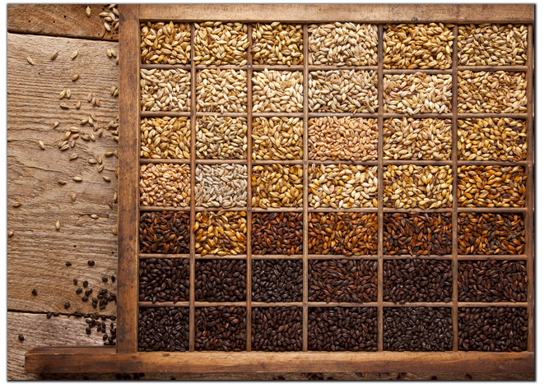
Malt
Photo courtesy Briess Malting Co.

Slide 7
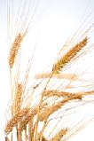
Malt Flavors and Aromas
Flavors and aromas from malts range directly proportionally to color of the malt, except smoked or acidulated malts.
For very pale (pilsner) malts; doughy or uncooked flour.
Pale base malts; white bread, wheat bread, saltines.
Vienna or Munich; bread crust, graham cracker, biscuit, ranging to toast and caramel notes.
Dark Specialty malt additions; nutty, toffee, chocolate, dried fruits, roasty notes, burnt flavors, coffee, and espresso.
Notes:
If you’re struggling to find malt descriptors, think “what would a bread or cereal this color taste like?”
With specialty malts, a little goes a long way, but the more there is the further towards espresso the flavors become.

Slide 8
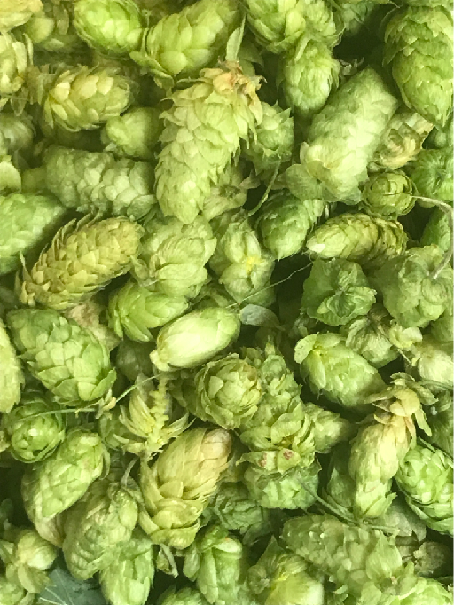
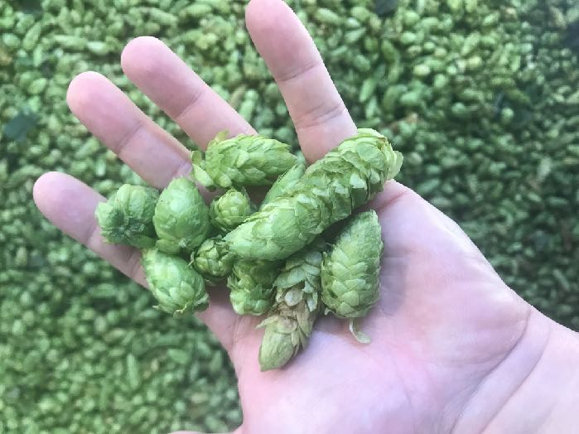
Hops

Slide 9
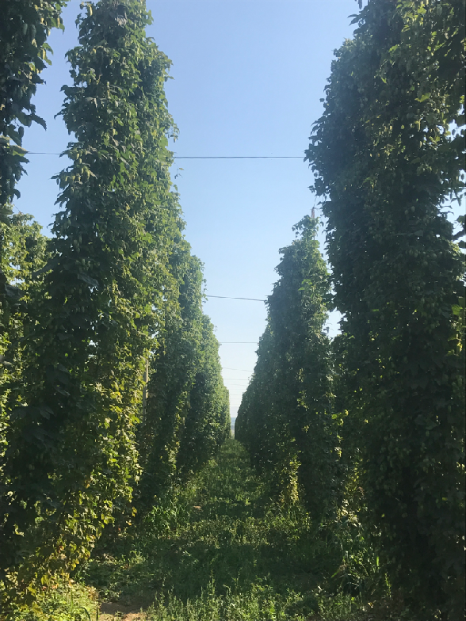
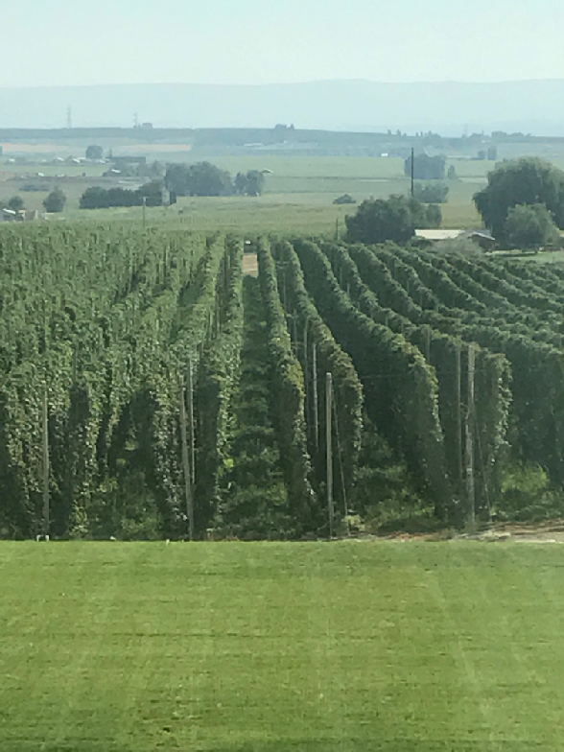

Slide 10
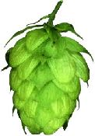
Hop Flavors and Aromas
American Hops (Centennial, Citra, CTZ, etc.) are described as citrusy (particularly grapefruit), piney, juicy, resinous (like cannabis, not pine) and bold.
British Hops (East Kent Golding, Fuggles, Challenger, etc) are typically referred to as herbal, woody, or earthy.
Noble Hops (Saaz, Hallertau, Tettnanger, Spalt) are grown in a specific region in continental Europe, share similar descriptors as British hops, but can also include minty, floral, and grassy.
European hops tend to be less bold, more subdued than their American counterparts.
Notes:
Hop production in America is predominantly in the Pacific Northwest (Yakima Valley)
Hops can be and are grown around the world. Japan has Sorachi Ace, Australia and NZ have many varieties (riwaka, motueka, wataka, etc)
Noble Hops are a protected EU distinction.

Slide 11
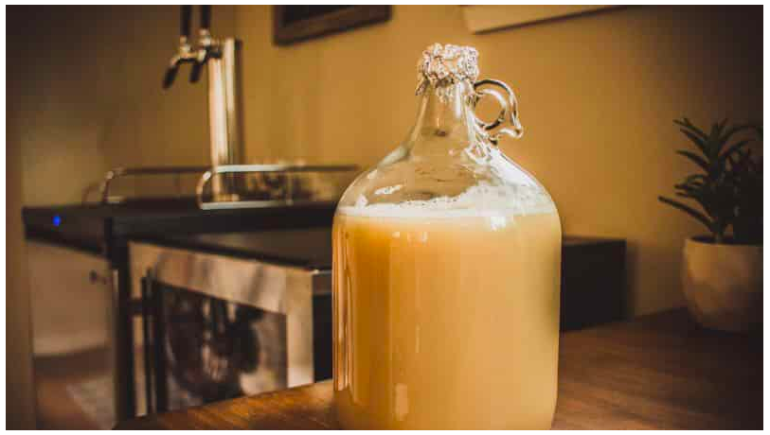
Yeast

Slide 12
Yeast Flavors and Aromas
American ale yeasts tend to ferment the cleanest compared to European counterparts.
British ale yeast strains tend to be more fruity, like apple and pear, and a low level of diacetyl is sometimes acceptable.
German weizen (wheat) yeasts are among the most distinctive. Banana and clove notes are common.
Belgian ale yeasts tend to be the most spicy, often with a pepper note present particularly in saisons.
Lager yeasts ferment the cleanest of all, with many less esters and phenols associated with the end products.
Notes:
Esters include fruit notes, banana, etc.
Phenols include clove, smoke, plastic, band-aids, etc.
Clove phenols come from POF(+) yeast strains.

Slide 13
Steps of Brewing
Mashing
Lautering
  Vorlaufing
  Sparging
Boiling
  Hop Additions
  Water Chemistry Changes
Whirlpool
Wort Cooldown
Yeast Pitching/Fermentation

Slide 14
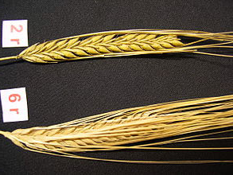
Pre-Mash: Malt Selection
Malted Barley is almost always the choice grain in craft beers. Wheat is used in certain styles (Weissbier, Witbier, Lambic) as >50% of the grain bill, but other adjunct grains are rarely used in quantities more than 10%.
Adjunct sugar sources are used for varying reasons, including flavor, protein, and starch contributions.
Barley comes in two main varieties, two-row and six-row. The biggest difference is protein content. Two-row is almost exclusively used currently.
Malt is broken into “base” and “specialty.”
Notes:
Standard American Lagers may contain up to 40% adjuncts. Premium American Lagers may contain 25%.
Why Barley? Starch content, enzyme content, husk allows for filtering, and dextrin/protein content

Slide 15
Malt Preparation: Kilning
Malted Barley is germinated, then dried, by a maltster, this begins the conversion of starches to sugars by enzyme activation.
The temperature and humidity/ventilation of the drying process affect which flavors and aromas will be developed in the finished malt.
Currently, most malt is kilned in indirect kilns which don’t allow smoke to contact the malt. Originally, nearly all malt was smoked over an open fire or in direct kilns to dry it, so all beers tasted smoky. (Smoked malt beers are generally called Rauchbiers these days.)
Notes:
Sam Adams, while probably not an actual brewer, was a maltster.

Slide 16
Mash Temperature
Generally, the temperature of the mash is held between 145°-160°F for about one hour.
Lower mash temperatures will convert more starches to fermentable sugars, which will leave a beer with a thinner body and a drier finish.
Higher mash temperatures will leave more unfermentable dextrin’s, which will translate to a fuller bodied beer with a sweeter finish.

Slide 17
Lautering
Lautering is also referred to as “mashing out”, it is the process of separating the wort from the spent grain.
Wort (rhymes with dirt) is the water which will become beer, but not until yeast is added.
Vorlaufing is the recirculation of wort to the top of the mashtun, with the desired affect of setting the grain bed.
Sparging is done after wort is drawn off the grains, or in conjunction with, and is the process of rinsing the remaining sugars from the grain.
Notes:
Professional brewers Fly Sparge, most homebrewers Batch Sparge.

Slide 18
Boiling
Generally, a 60 minute boil is used. This is when hops, brewing salts, and copper finings are added.
Hop additions are often scheduled by time REMAINING in the boil, so a 60 minute addition should be done when the boil is started, not ended.
The longer hops are boiled, the more alpha acids will be isomerized, which will contribute more bitterness (IBUs). Hops added towards the end of the boil, or post boil, will add more aromas and flavors.
Wort sterilization is achieved by boiling.
Notes:
>30 mins is considered bittering, 30-15 is considered flavor, and <15 mins is considered aroma hops.
Copper finings include Irish Moss and Whirlfloc, and help precipitate out solids during the ‘cold break’ later.

Slide 19
Whirlpool and Cooling
Whirlpooling is often done post boil to knock down the trub (pronounced troob, this is malt, protein, and hop debris that is undesirable in the final beer). As long as temperature is maintained high and DMS is not a concern, this can be a stage for late hop additions as well.
From the whirlpool, wort is cooled quickly, often using a counter-flow heat exchanger commercially.
Cooling wort quickly stops DMS production, creates a cold break, and allows the yeast to be pitched immediately, reducing the chances of infection.

Slide 20
Fermentation
As soon as the yeast is pitched, wort becomes beer.
Division process occurs immediately: yeast reproduce and consume oxygen to reach a healthy population.
Primary Fermentation: yeast consume sugars, convert to CO₂ and ethanol, along with other byproducts.
Secondary Fermentation: sugar consumption is complete, yeast begin consuming and reabsorbing other byproducts.
Flocculation: yeast become inactive, clump together, and drop out of solution to the bottom of the fermenter.
Notes:
Conical fermenters make yeast collection easy.

Slide 21
Lager vs. Ale
This is the primary differentiator between beer styles.
Ale yeast (saccharomyces cerevisiae) prefers fermentation temperatures over 55°F (occasionally as high as 90°F), and is known as “top-fermenting.” It produces fruity esters and occasionally spicy phenols.
Lager yeast (saccharomyces pastorianus) prefers colder fermentation temperatures (40°-45°F) and is known as “bottom-fermenting.” They create a very clean, crisp beer which allows the malt and hops to be central flavors.
Lager is German for “to store”, the cold storage time after fermentation is what allows lager yeast to “clean up” the beers, removing fermentation byproducts.
Notes:
Ale yeast is much faster fermenting, only taking a few days to a week. Lagers ferment much slower, and take several weeks to “lager”
Ale producers like to claim ales are more complex, lager producers like to claim lagers are more expensive to produce.
Both have advantages and disadvantages.
Ale vs. Lager has nothing to do with color, bitterness, malt or hop flavors.

Slide 22
Wild Yeast
Brettanomyces is the most common strain of wild yeast used in brewing, and is much more efficient at breaking down sugars than normal brewers yeast.
This leads to much drier beers, as more sugars that would be otherwise unfermentable are broken down.
Brett can have wide ranging character, depending on the strain, and is usually described as barnyard, horse-blanket, funk, cherry pie, and pineapple.
This process can take many months, and is often performed in wood barrels, which are where the Brett can come from.

Slide 23
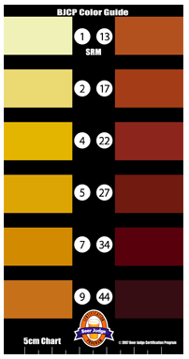
Standard Reference Method (SRM)
Standard Reference Method (SRM) is a number given to a beer to define its color. Called “Degrees SRM”
Scale ranges from 1-40
2 = Pale Straw
12 = Medium Amber
20 = Brown
24 = Ruby Brown
30 = Deep Brown
40 = Black
European Brewers Convention (EBC) = SRMx2
Notes:
Do you need to memorize these numbers? Not for CBS, but for Level Two and beyond absolutely. Its also important to have an idea of the scale and where colors would fall.
Remember these numbers next week when we really talk about malt, and you can see what Caramel 60 looks like.

Slide 24
International Bittering Units (IBU)
A theoretically limitless scale that quantifies how bitter a beer is. This is calculated based on the amount of hops added to the boil, and how long they are boiled for.
Beers typically range from about 5 to >100
Human threshold for bitterness is approx. 100 IBUs.
While IBU’s provide some idea of a beer’s bitterness, they are not an ideal qualitative measure. The scale doesn’t take into account things like sweetness and malt roastiness that can provide a lower “perceived bitterness.”
Notes:
A measure of how much alpha acids get isomerized in ppm.
Human threshold of 100 IBUs doesn’t stop brewers like Mikkeller from making 1000 IBU beers.
Balance is key. A well balanced beer will hide its IBU’s remarkably well.

Slide 25
Volumes of CO₂
This is the numeric measure for how carbonated a beer is.
Ranges from <1.0 for British Cask Ales to >4.0 for highly carbonated styles such as wheat beers and gueuzes.
The number is not particularly important except for brewing and balancing draft pouring systems, but developing a sense of whether a beer is under- or over-carbonated for the style is important.
Notes:
In home-brewing, a sense of the carbonation you want is necessary to calculate “priming sugar” additions.

Slide 26
How do we taste and smell?
The gustatory system describes our ability to taste and smell. Smell can account for up to 80% of our perceived taste.
The olfactory system describes our ability to smell, and is a combination of the orthonasal (nose) and retronasal (mouth and throat) systems.
Long, deep breaths will dry your mucus membranes and overwhelm your scent receptors. Short, quick sniffs is preferable.
Try to connect scents (and flavors) with memories, or known descriptors. No descriptor is too crazy.
Notes:
Ever seen the movie Somm? Those guys go crazy with descriptor words, like “fresh cut garden hose” and “new tennis balls”.

Slide 27
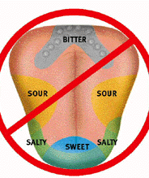
What do we taste?
All flavors are tasted on all parts of the tongue.
Six accepted flavors (Salt, sweet, sour, bitter, umami, and oliogustus.)
Emerging science shows evidence for metallic, carbonation, and receptors as well.

Slide 28
What is mouthfeel?
The physical sensation of the beer.
A combination of body, carbonation, (alcoholic) warmth, creaminess, astringency, and any other physical sensations.
“Body” is largely driven by how much sugar remains in a beer. A well attenuated beer will be crisp and light, one with more residual sugar will seem fuller, richer, and sweeter.
“Astringency” is a sense of dryness created in the mouth, often by tannins. This is similar to red wine or over-steeped tea.
Notes:
Proteins can also greatly affect body, and is why wheat or oats may be used.
Creaminess is inversely proportional to astringency, warmth, and carbonation.

Slide 29
How should you taste?
Smell a beer as soon as you get it. The most volatile aromatic compounds (like sulfur) are only present for a short time.
Observe the color, clarity, and any solids suspended in the beer.
Taste the beer, allow it to fully coat your mouth, think about flavors as well as mouthfeel, as well as the finish.
Look for known comparisons, and compare it to other beers of the same style you’re familiar with when possible.
Try to differentiate malt, hop, and yeast characteristics on both the nose and the palate.
Notes:
All of this gets easier with practice. The good news is, practice is fun!

Slide 30
“Off Flavors”
Oxidation (trans-2 nonenol): wet cardboard, papery, waxy, or lipstick, occasionally dark fruit and sherry at low levels. This is caused by over-aging, or brewhouse introduction of O₂.
Lightstruck (MBT): often referred to as “skunked,” this flavor originates when UV light interacts with chemicals from hops. Shielding from UV light is the best, easiest protection against lightstruck beers.
Bacterial Infection: caused most often by dirty draft lines, this is generally indicated by a buttery (diacetyl) and vinegar (acetic acid) flavor. It can also be indicative of sanitation issues by the brewer.
Notes:
Oxidation is not always bad, sometimes desirable in low levels in aged beers such as barleywines.
Lightstruck can happen in a matter of minutes. Clear glass (Corona) provides no protection. Green glass (Heineken) only blocks 20%. Brown glass blocks 98%.
ALL OFF FLAVORS ARE ACCELERATED BY WARM STORAGE.

Slide 31
Where do styles come from?
Defining styles honors tradition and provides a sense of order among a wide selection of beers.
Styles allow a consumer to develop a sense of what they should expect from a beer.
Older styles developed organically due to water sources, climate, and local preferences. Today, styles are often intentionally invented by experimental brewers or thanks to new technologies.

Slide 32
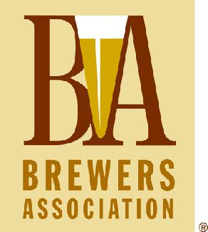
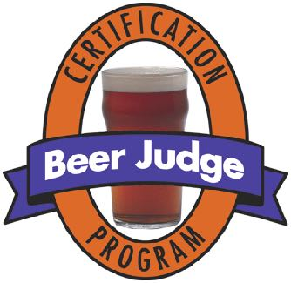
Who defines styles?
In the U.S., all styles are defined by both the Brewers Association (BA) and the Beer Judge Certification Program (BJCP). The BJCP is a volunteer run organization dedicated to homebrewing, the BA style guidelines are used for events like the GABF and WBC.
Notes:
Great American Beer Festival.
World Beer Cup.
Yes, styles are somewhat arbitrary, but they’re also necessary.

Slide 33
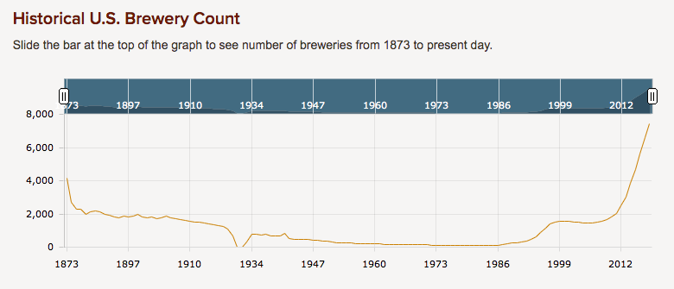
Golden Age of Beer
We are currently in the Golden Age of beer. Consumer access and choices are better than they’ve ever been, and brewers are producing a multitude of incredibly high quality offerings.
All statistics & graphs courtesy of Bart Watson, BA.
Notes:
June 9th, 2014: BA announces topped 3,000 breweries. Per capita 1873 would be >30,000
1970’s: “Beer” so bad it wasn’t even branded
1993: Miller Clear
Craft boom in the 90’s was profit driven, not passion driven. There was not a system for beer education.

Slide 34
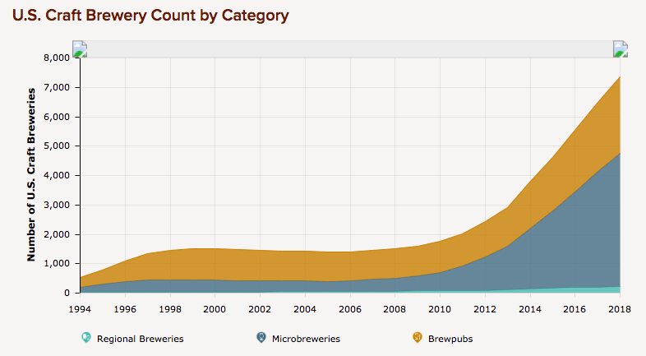

Slide 35
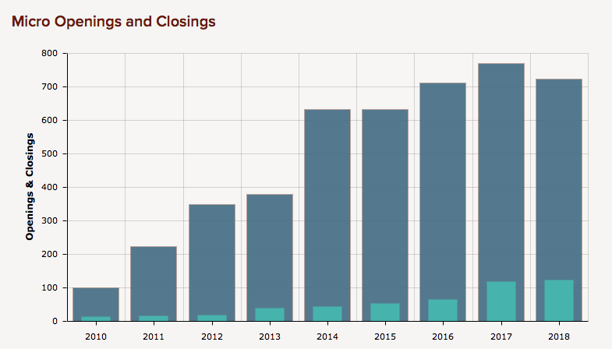

Slide 36
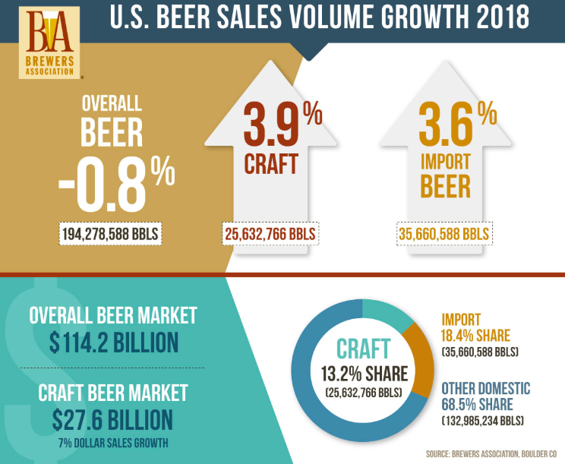

Slide 37
