Slide 1
Champagne & Sparkling Wine
HMGT 2402, Wine & Beverage Management
Prof. Roger Dagorn, MS and Karen Goodlad, CSW
For use by Prof. Christopher Struck and Prof. Adrian Murcia

Slide 2
Objectives
--Discuss wine making methods employed to make sparking wine using wine industry terminology
--Explain the factors that affect the taste of sparkling wine
--Identify geographical regions where sparkling wine is produced

Slide 3
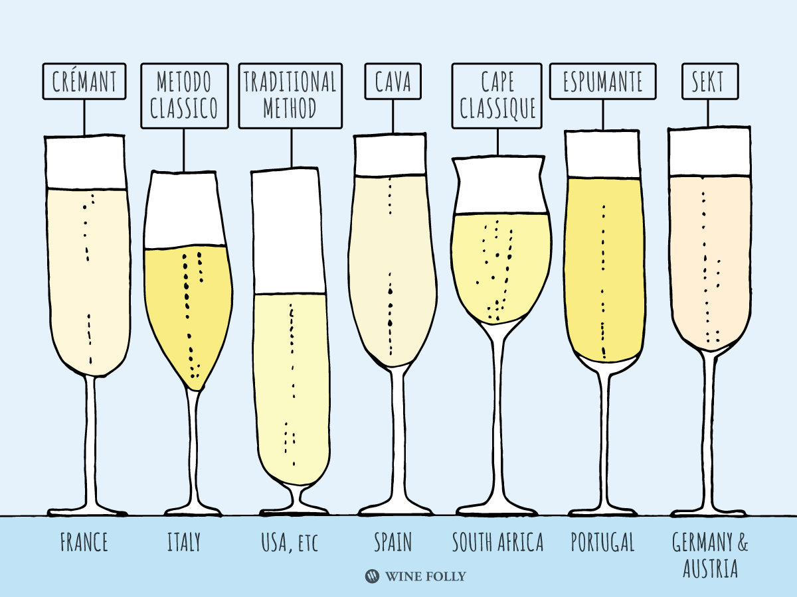
What do these wines have in common?

Slide 4
Define each Term for Méthode Champenoise
Harvest
Press
Fermentation
Assamblage/Blending
Liqueur de tirage
  Capped
  Transferred to pupitres/racks
  Sit on Lees (age)
Rémuage/Riddling
Dégorgement/Disgorging
Liqueru d’Expédition/Dosage
Cork/Cage/Seal
Age
Notes:
Blending creates consistent style of the “house”, can be up to 70 different areas, looking forward to aging, can blend reserve stock form previous years
“Bottling liquid”, still wine, sugar, yeasts
Sediment moves down neck, sur point
To disgorge neck is frozen
Dosage = sugar and wine

Slide 5
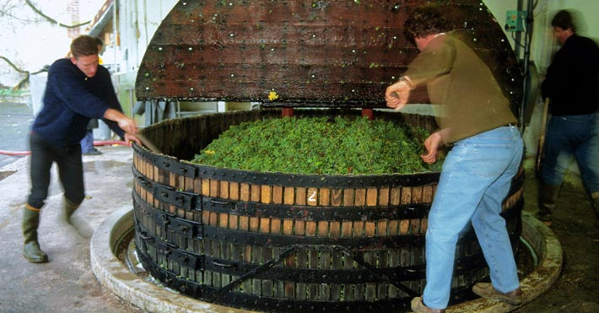
Méthode Champenoise: Press
Notes:
What is of concern here?
Why press 4 times?

Slide 6
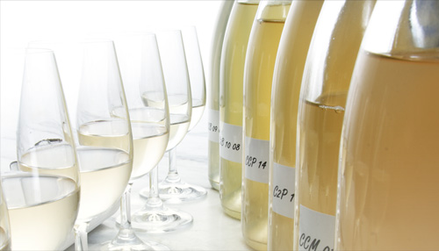
Méthode Champenoise: Assemblage http://www.champagne.us/en/champagne/the-keys-facts-about-champagne-wine/the-blending

Slide 7
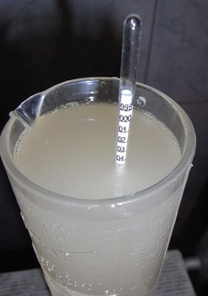
Méthode Champenoise: Liqueur de Tirage
What is the intended result when the wine maker adds _______ and _______ to the still wine?

Slide 8
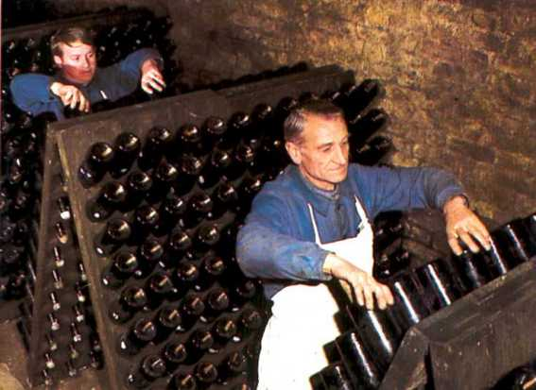
Méthode Champenoise: Remuage/Riddling http://www.champagne.fr/en/from-vine-to-wine/wine-making/maturation-on-lees

Slide 9
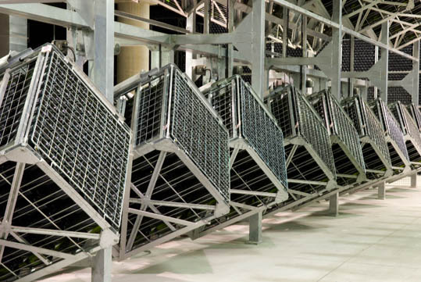
Gyropalettes

Slide 10
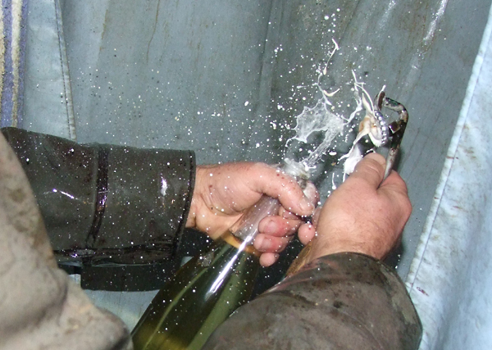
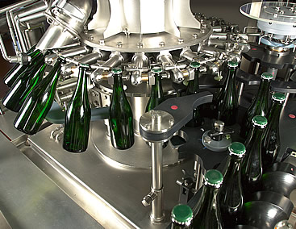
Méthode Champenoise: Dégorgement

Slide 11
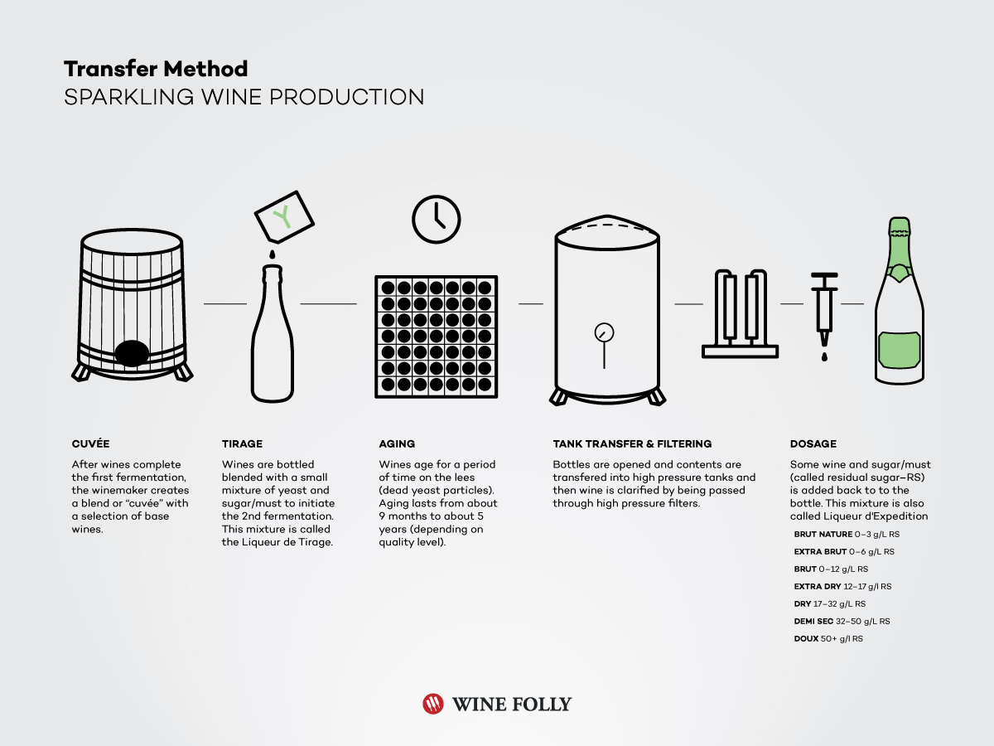
Transfer Method
Modified Méthode Champenoise
  Méthode Champegnoise techniques but wine is transferred into a large vat then filtered into individual bottles
Why would producers use this method of making sparkling wine?
Image available from Wine Folly, Click here to read the article How Sparkling Wine is Made.
Notes:
Sparkling wine made by the transfer process, follows the same procedure as Méthode Champenoise, up to the point of bottling. The secondary fermentation does not take place in the actual bottle sold to the customer. The wine is bottled en tirage. However, immediately following secondary fermentation, the fermentation bottles are emptied under pressure and the wine filtered. This replaces the rémuage, riddling, and dégorgement steps. The transferred wine is then bottled under pressure into a new set of bottles that are shipped to market.
In america it can me identified by The label statement "Fermented in this bottle" means Méthode Champenoise, whereas "Fermented in the bottle"
http://www.winepros.org/wine101/sparkling.htm

Slide 12
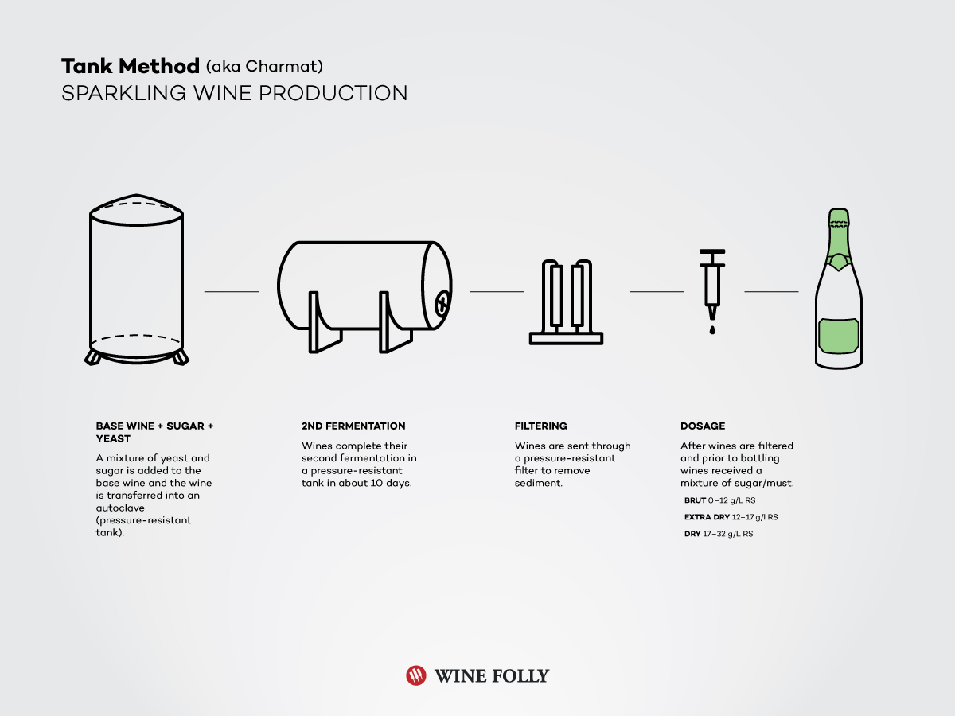
Charmat or Tank Method
Still wine placed in sealed pressurized tank
Sugar and yeast are added
Sparkling wine is filtered and bottled
Why would producers use this method of making sparkling wine?
Image available from Wine Folly, Click here to read the article How Sparkling Wine is Made.
Notes:
Eugene Charmat, a Frenchman, invented his process in 1907. Instead of individual bottles to produce the secondary fermentation, he invented the glass-lined tank. The wine stays under constant pressure in bulk, through the filtering and bottling process, which takes as little as ninety days from picking to bottling. Charmat is also known as the Bulk Process.
Both the transfer and Charmat process are time and money savers. There are knowledgeable wine critics who contend that the different methods of producing sparking wine can each produce equal quality product given the same fruit to begin with. These critics are in the minority and commercial attempts at high quality Charmat or bulk process sparklers are few and far between.
http://www.winepros.org/wine101/sparkling.htm

Slide 13
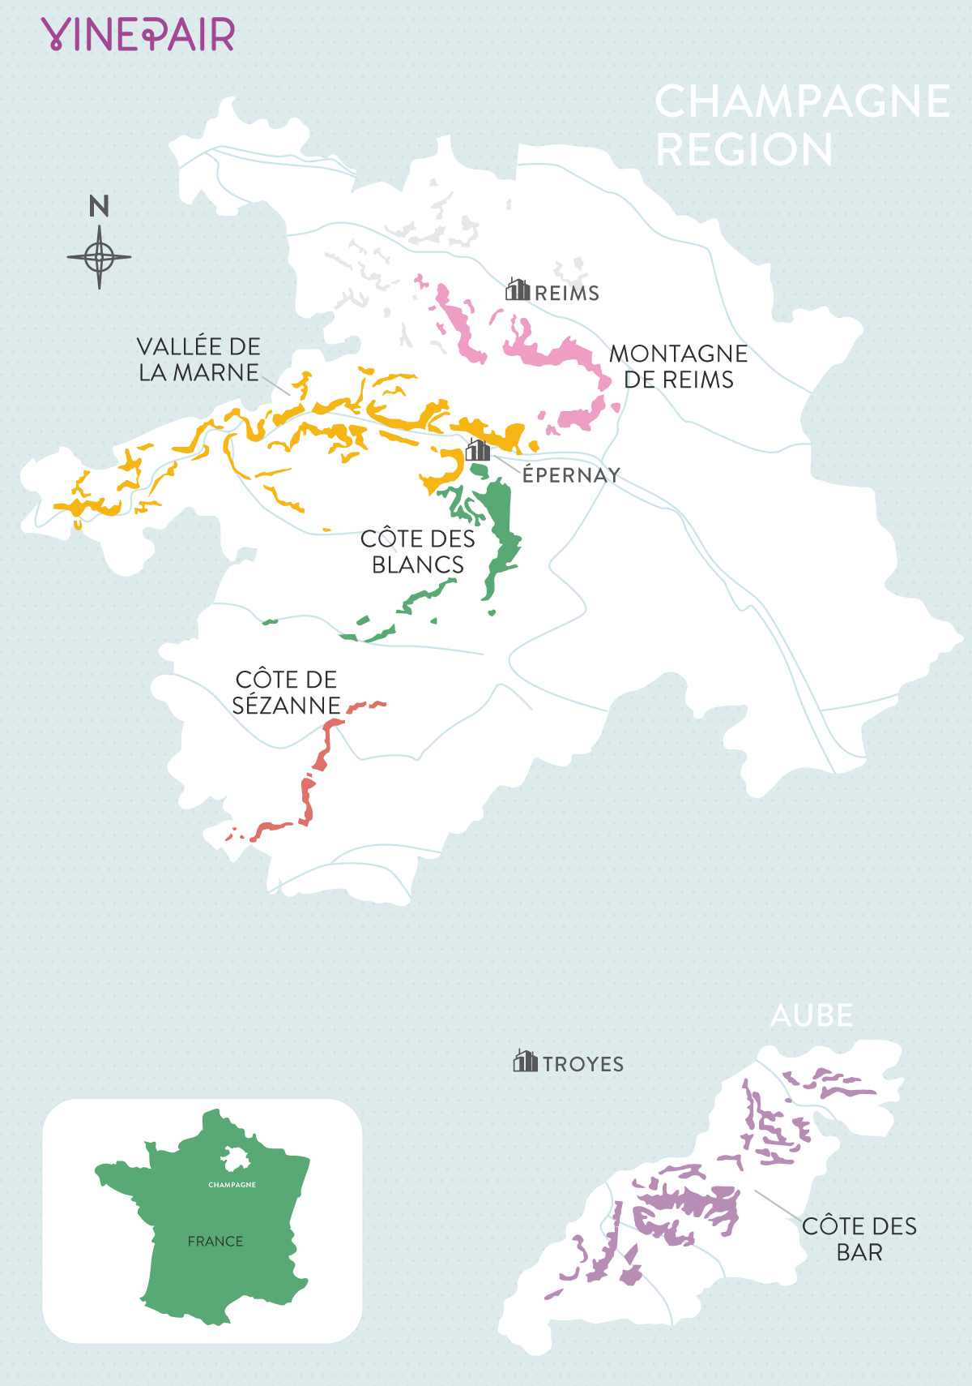
Champagne Appellations
Locate the Appellations on the Map:
Montagne de Reims
Vallée de la Marne
Côte des Blancs
Côte de Sézanne
Côte de Bar
Notes:
Montagne de Reims: Primarily Pinot noir elevation allows cool air to “slip away”
Vallée de la Marne: Primarily Pinot Meunier, easy drinking and fruity style
Côte des Blancs: Primarily Chardonnay, most popular finesse and delicate, mature well
Côte de Sézanne: Chardonnay more fruity than classic style
Côte de Bar: Pinot Noir, most southerly area

Slide 14
Champagne: Terroir
Watch this video about Champagne and answer the following questions
What influence causes the steady rain fall throughout the year?
What is the weather condition in the winter and spring that can damage vines and grapes?
Why are vines planted on hills?
What form of limestone makes up most of the subsoil of Champagne and why does it create favorable growing conditions?
What three grapes make up 99% of the grapes in Champagne?

Slide 15
Champagne: Industry
Learn more about the economic impact of Champagne here.
Champagne House
  Long distinguished brands of particular style
  Specialty: blending and producing wine
  Purchase almost all grapes
Growers
  Grow/harvest grapes
Trend: “Grower’s Champagne”
  Single estate grown and bottled, shows terroir
  Produce their own wine
  Growing in the export market
  In 2019 approximately 4000 growers are bottling their own wine
2009 Extension of Region
  40 more villages on perimeter of Champagne

Slide 16
Champagne: Rating System
Comité Interprofessionnel des Vins de Champagne (CIVC)
  Producers, Growers & INAO govern wine production
  Échelle de crus: village rating system, updated 1985
    Soil –climate relationship
    Until 1990 village rating determine price of grapes
Grands Cru (17)
Premier Cru (~32)
Cru
Notes:
All in vineyards in village have same rating
Hectare 10,000 square meters,
More Chardonnay = Lighter style
More Pinots = fuller richer
Aging requirements: NV=15 months, vintage 3 years
Recent vintages (1995, 1996, 1999, 2000, 2002)

Slide 17
Champagne: AOC Regulations, Harvesting and Pressing
Watch this video and read this page to answer the questions below
Pruning, height or the vine, spacing & density are all regulated
Name the three most widely planted grape varieties:
Why are grapes harvested by hand?
Define Cuvee and Taille in regard to pressing grapes. Is pressing regulated?
True or false: Yields in both the vineyard & pressing are limited
Notes:
Chardonnay 27%, Pinot Noir38%, Pinot Meunier 35%

Slide 18
Champagne: AOC Regulations, Harvesting and Pressing
Watch this video and read this page to answer the questions below
Pruning, height or the vine, spacing & density are all regulated
Name the three most widely planted grape varieties:
  Chardonnay, Pinot Noir, Pinot Meunier
Why are grapes harvested by hand?
  So whole clusters may be pressed
Define Cuvee and Taille in regard to pressing grapes. Is pressing regulated?
  First press and last press
  Highly regulated
True or false: Yields in both the vineyard & pressing are limited
Notes:
Chardonnay 27%, Pinot Noir38%, Pinot Meunier 35%

Slide 19
Blending and the Styles of Champagne
Watch this video about blending and wine styles
Blending is the most important step in determining the profile and style of the wine, what can be blended?
Why is blending so important?
Non Vintage
Blanc de Blancs
Blanc de Noirs
Vintage
Rosé
Cuvée de Prestige
Sugar Content
  Extra Brut
  Brut
  Extra Dry
  Sec
  Demi-Sec
  Doux
Notes:
Extra Brut: 0-6 grams per liter
Brut: 0-15 grams per liter
Extra Dry: 12-20 grams per liter
Sec: 17-35 grams per liter
Demi-Sec: 33-50 grams per liter
Doux: 50+ grams per liter, no longer commercially produced

Slide 20
Types of Producers
NM: Négociant Manipulant
RM: Récoltant Manipulant
CM: Coopérative Manipulant
SR: Société de Récoltants
ND: Négociant Distributeur
MA: Marque d’Acheteur
Notes:
NM: Négociant Manipulant, “House” purchase grapes, do not have vineyards
RM: grower producer
CM: a cooperative of growers that make champagne
SR: 2 or more related growers that come together to produce and market their champagne
ND: distributer of wine
MA: proprietary wine

Slide 21
Watch theVideo: Oz Clarke & James May in Champagne

Slide 22
Italy, Piedmont
Asti, DOCG, & Moscato d’ Asti, DOCG
  Region: Peimonte, Italy
  Grape: Moscato Bianco
  Predominately made in the Charmat Method
  Spumanti & Frizzante (respectively)
Notes:
https://www.guildsomm.com/public_content/features/articles/b/chris-tanghe/posts/prosecco

Slide 23
Italy, Vento
Prosecco, DOC
  Region: Veneto, Italy
  Grape: Glera
  Charmat Method
Prosecco Superiore, DOCG, to learn more watch this video
  Rive DOCG, Cartizze DOCG, Sui Lieviti DOCG
  delineates the area between the towns of Valdobbiadene in the west and Conegliano in the east.
  Traditional Method can be used
  Established in 2009

Slide 24

Italy, Lombardy
Franciacorta, DOCG
  Chardonnay, Pinot Noir, Pinot Bianco
  Traditional Method

Slide 25

Germany

Slide 26
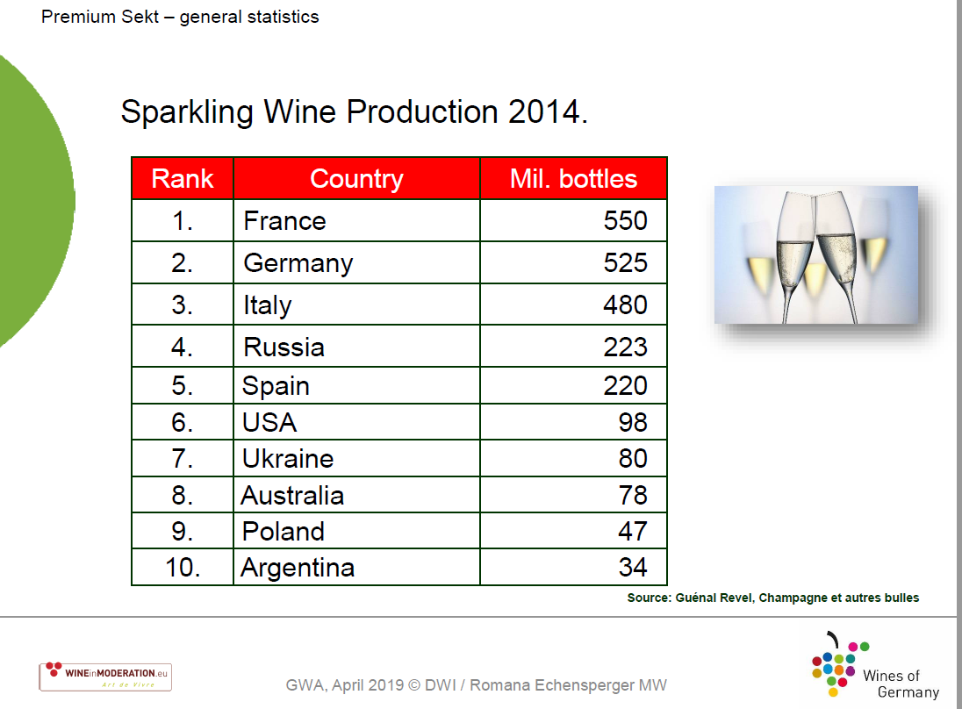
Germany

Slide 27
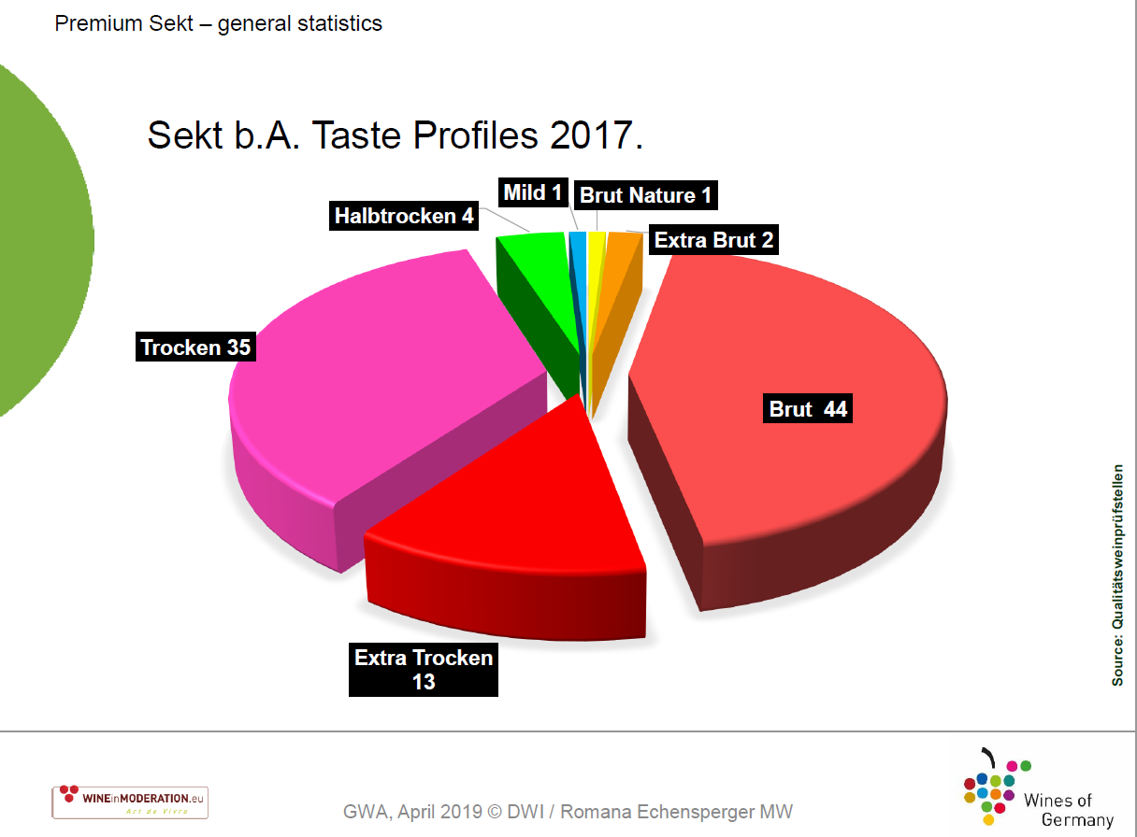

Slide 28
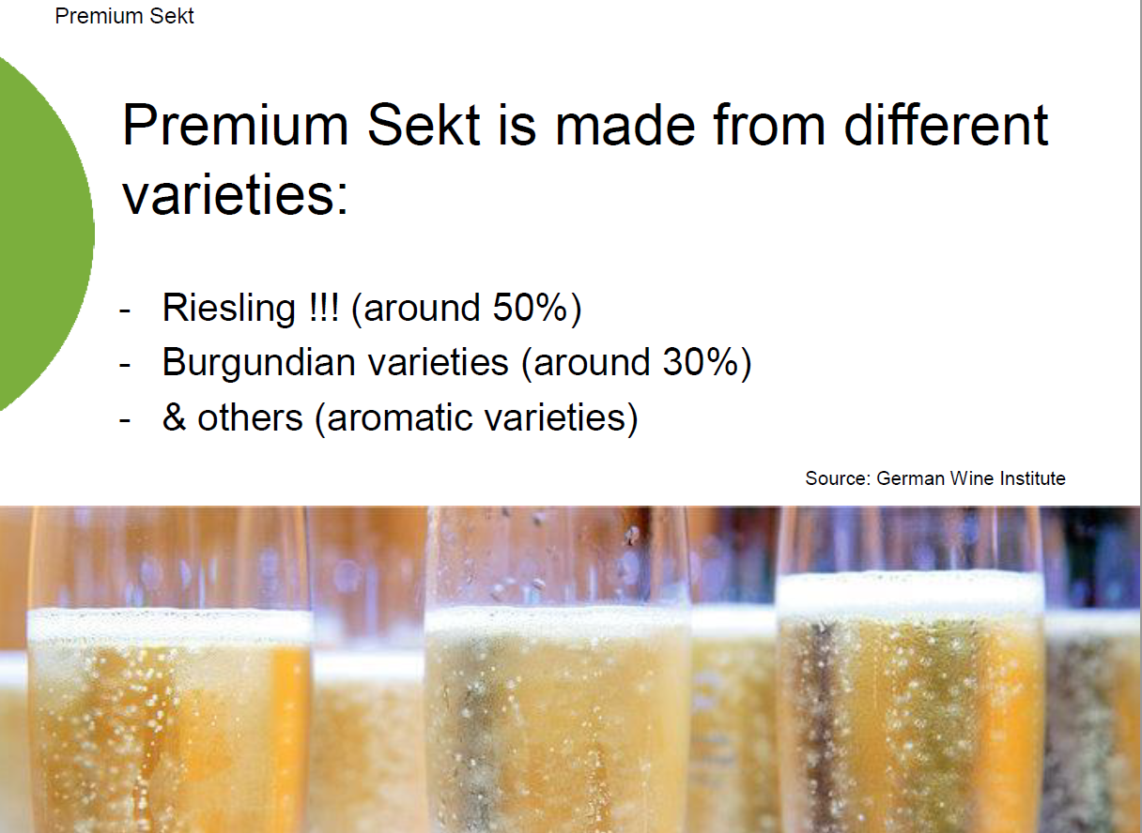

Slide 29
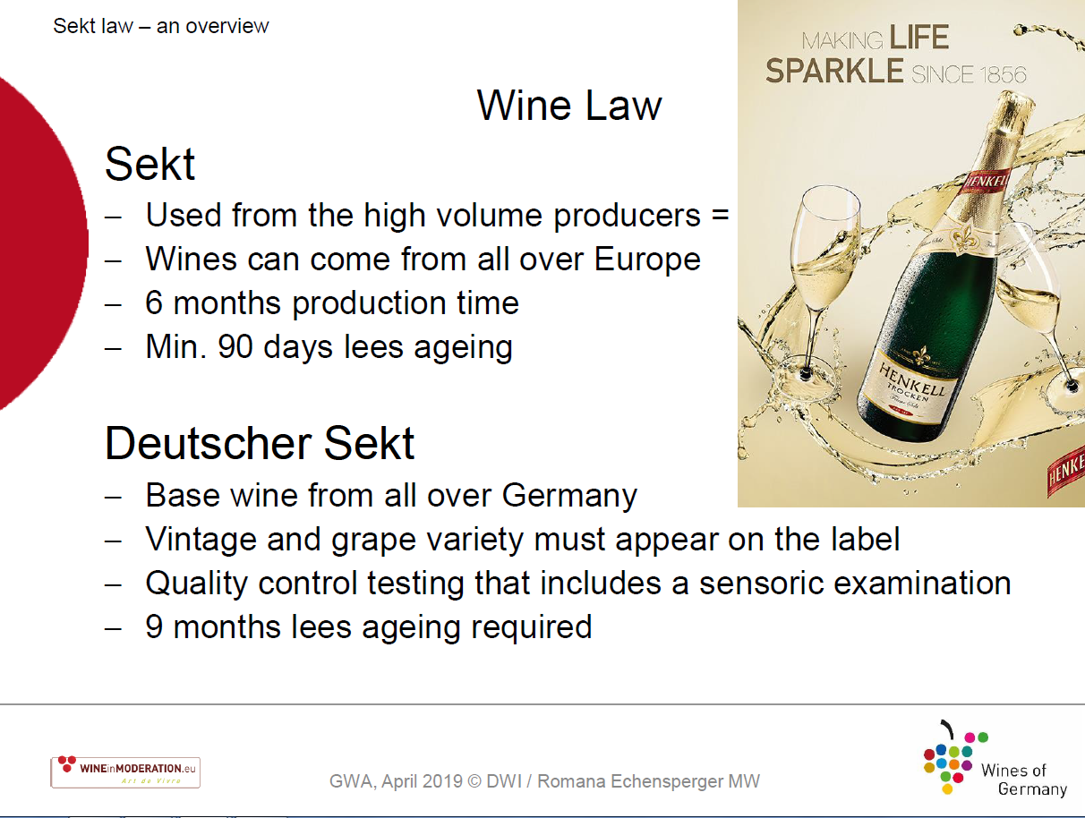

Slide 30
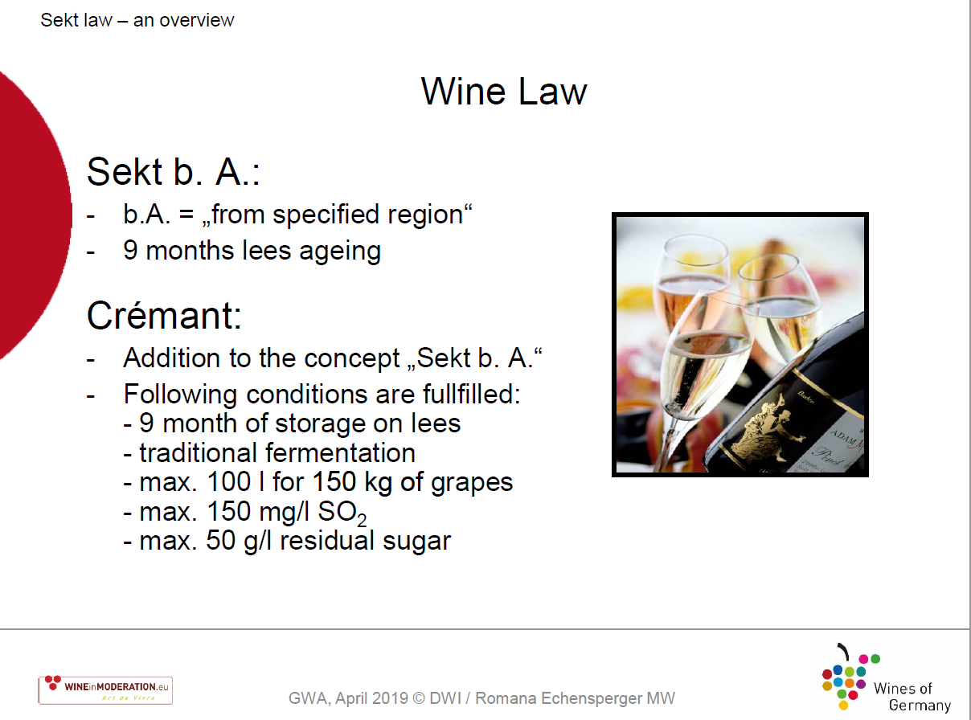

Slide 31
Spain: Cava
Penedès
Méthode Champenoise
Traditional Grape Varietals
  Parellada
  Macabeo
  Xarel-lo
Freixenet, Cordon Negro Brut
  Popular Producer
Cordoniu
  Most Popular Sparkling Wine in the world

Slide 32
North America
Washington State
  Predominately Chardonnay
  Leading Producer: Domaine St. Michele
    Methodé Champagnoise
    323,000 Cases in 2006
California
  Kluge Estate, Mumm, Domaine Chandon, Gloria Ferrer, Soter Vineyards, Laetitia, Roederer Estate, Schramsberg, Domaine Carneros, “J”

Slide 33
Opening a bottle of Sparkling Wine
Le Saberage
  Releasing the cork using a sword
    DO NOT TRY THIS ON YOUR OWN, THIS IS A DIFFICULT TECHNIQUE THAT REQUIRES TRAINING
Traditional Method

Slide 34
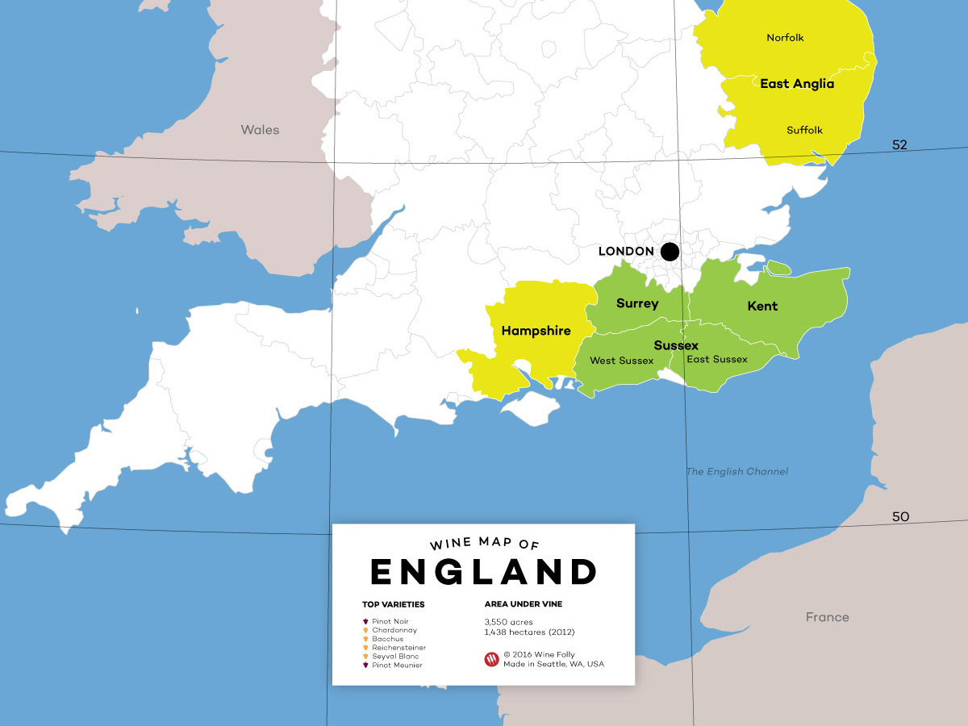

Slide 35
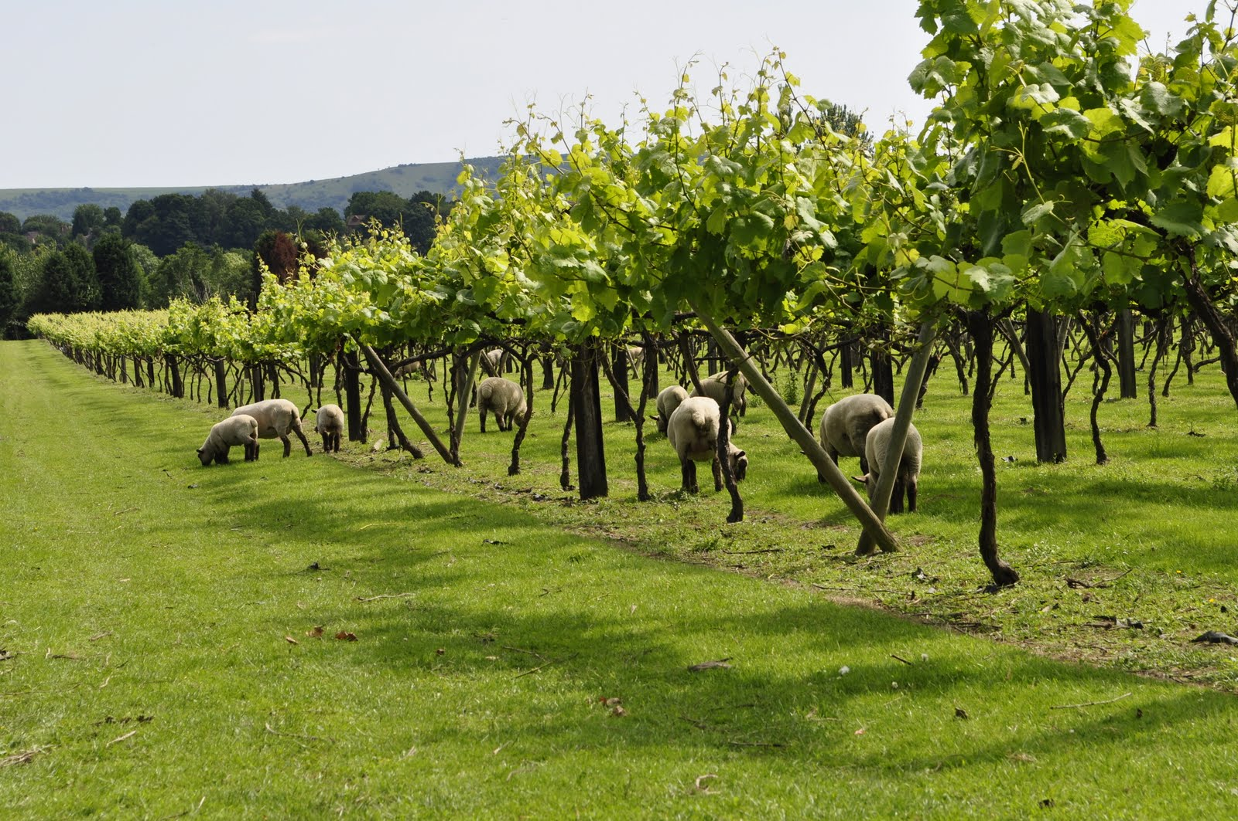
Chalk, Greensand, Clay
Cool coastal influences north of the 51 parallel
Warm September
Grape Varieties: Chardonnay, Pinot Noir, Pinot Meunier, Pinot Blanc, Pinot Gris
https://daily.sevenfifty.com/why-you-should-start-paying-attention-to-english-sparkling-wine/
Photo Credit: http://londoncosmopolitan.blogspot.com/2011/07/west-sussex-wine-trail.html

Slide 36
PDO Quality English Sparkling Wine
Sugar allowed in the production of the cuvee (still wine), not to exceed additional 3% alcohol from naturally occurring sugar
Cuvee can not be less than 9% alcohol, final
Sparkling wine can not be less than 10% and the tirage liqueur may not increase total alcohol by more than 1.5%
De-acidification of cuvee is allowed
Sweetening of cuvee is not permitted
Traditional Method
9 months aging in lees (12-24 is common)
Source: Retrieved from http://www.ukva.org.uk/wp-content/uploads/2017/03/DEFRA-GUIDANCE-PDO-ENGLISH.pdf

Slide 37
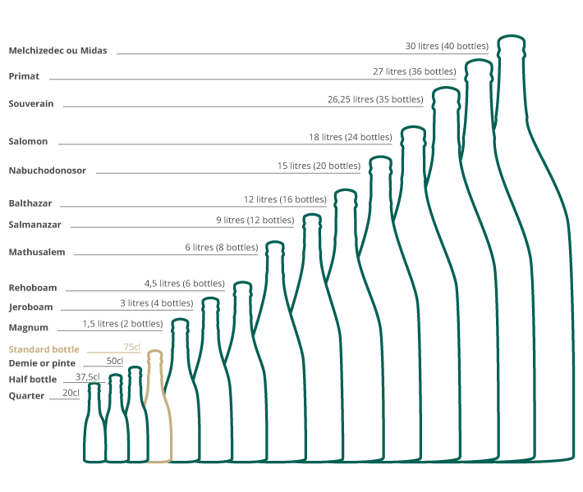
Champagne Bottle Sizes

Slide 38
Terms to Know
Méthode Champenoise (all related terms)
Champagne Grape Varieties
Charmat Method
Champagne
Prosecco
Cava
Champagne Sugar Content:
  Extra Brut, Brut, Extra Dry, Sec, Demi-Sec, Doux
Vintage
Rosé

