Slide 1
Wines of the Southern Hemisphere:
Australia, New Zealand & South Africa
New York City College of Technology, CUNY
Spring 2020
Prof. Karen Goodlad, CSW

Slide 2
Class Schedule
Return and Review Quiz
Review of Retail Shop Assignment
Lecture Objectives, New Zealand, Australia & South Africa
  Identify fermented beverages
  Discuss wine making methods using industry terminology
  Explain the factors that affect the taste of fermented beverages
  Identify geographical regions of NZ, AU, & SA

Slide 3
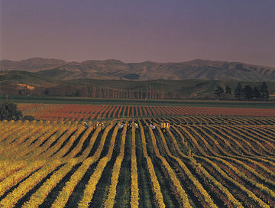
Wines of New Zealand
History:
  Little Wine Consumption
  Early 1900’s Prohibition + Phylloxera
  Restaurants Could Not Sell Wine Until the Late ’70s
Today:
  High Quality Wine/Intense Competition
  33rd Largest Wine Producer/Export 20%
  Labels are Regulated
    Represent 85% of Regions, Varietal and Vintage
Notes:
Videos http://www.nzwine.com/media-centre/video/

Slide 4
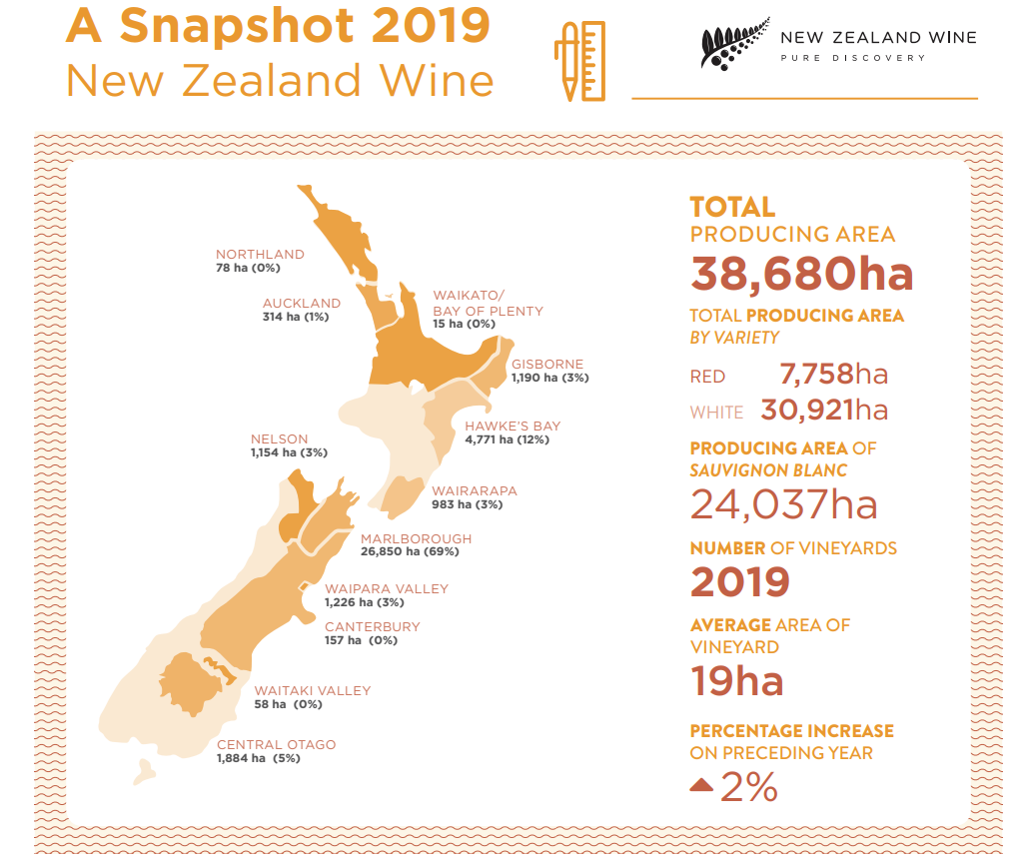
https://www.nzwine.com/media/12951/vineyard-register-2019_online.pdf

Slide 5
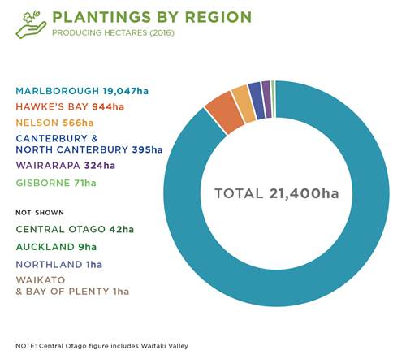
Varietal plantings of Sauvignon Blanc in New Zealand
Source: https://www.nzwine.com/en/our-winestyles/sauvignon-blanc/
Notes:
Climate is a major factor in defining regional styles.
Northern: warmer, milder growing conditions result in riper and richer styles, with melon, nectarine and other stonefruit flavours.
Southern: longer, cooler growing conditions that promote stronger, more vibrant fruit flavours and higher acidity levels.
The resulting wines are more pungent, and crisper, with passionfruit and other tropical fruit flavours, red pepper (capsicum) and gooseberry characters.

Slide 6
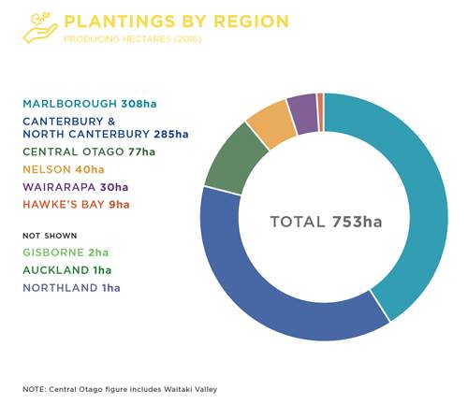
Regional plantings of Riesling in New Zealand

Slide 7
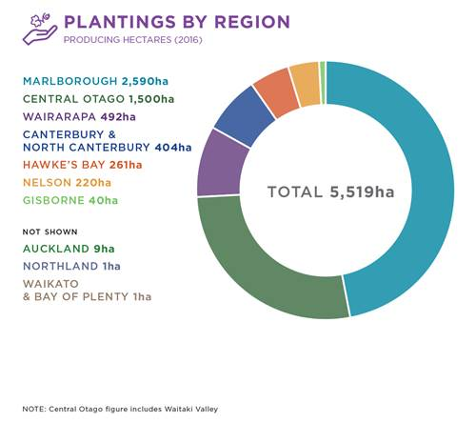
Regional plantings of Pinot Noir in New Zealand

Slide 9
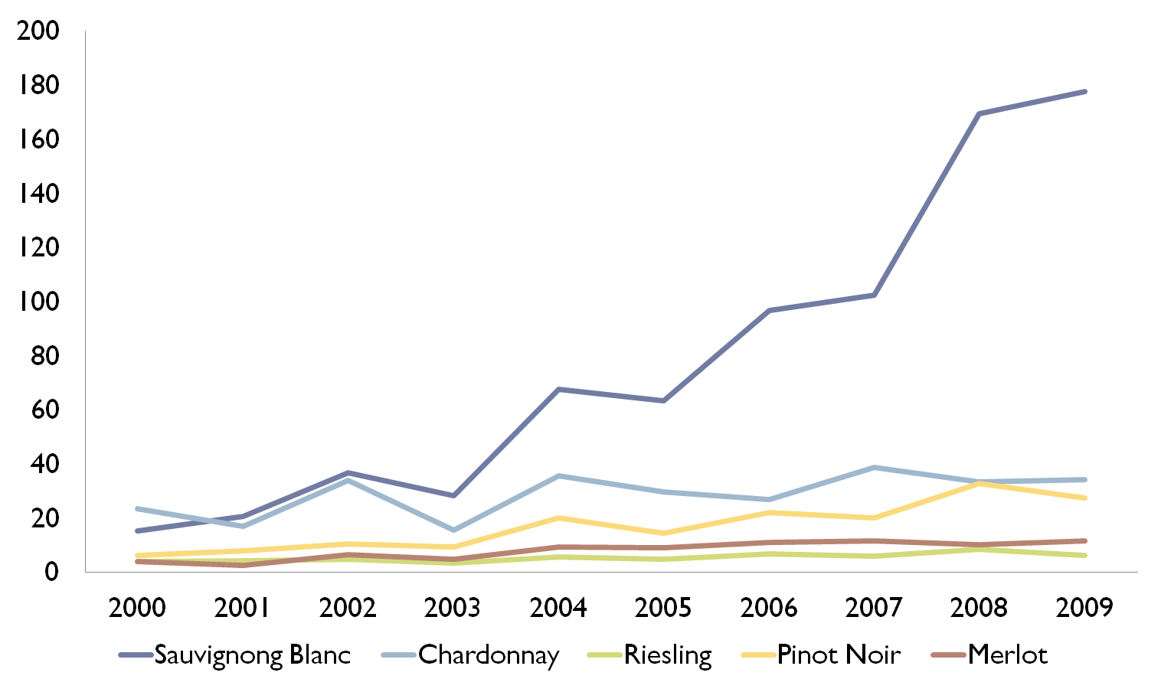
New Zealand Grape Varieties 2000-2009
Source: Wine of NZ Annual Report 2012
The First Sauvignon Banc: in NZ: https://grapecollective.com/articles/fun-facts-about-new-zealand-wine

Slide 10
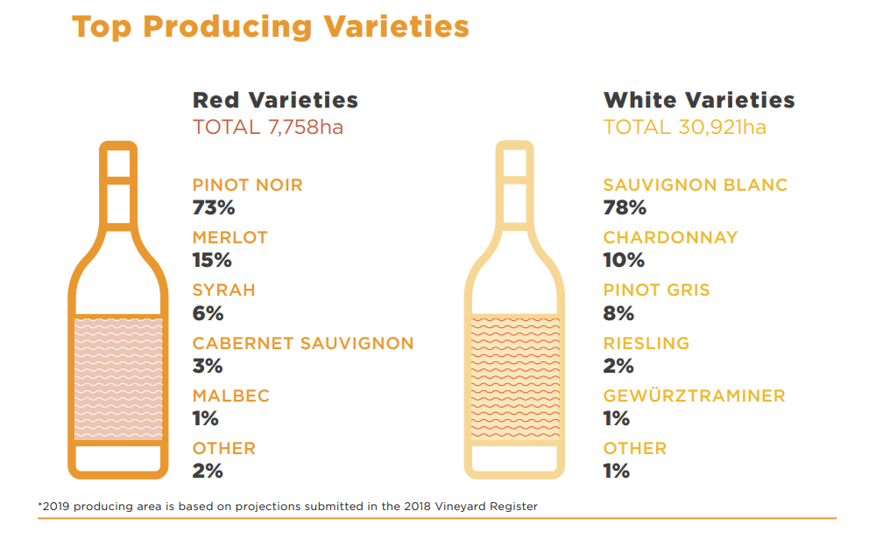
https://www.nzwine.com/media/12951/vineyard-register-2019_online.pdf

Slide 11
Marlborough, Plenty of Wine “Grows” There
66.4% of Total Wine Grape Acreage
First Planted in 1973
Topography
  Planted mostly on plains
  Protected, Kaikoura Range (Cold Southerly Winds)
  Protected, North Island (North Easterly Winds)

Slide 12
Marlborough Climate
Plenty of sunshine, moderate temperatures and strong diurnal variation are the keys to Marlborough’s piercing fruit intensity, strong varietal expression, and acid retention over long ripening periods.
The eastern coastal aspect bestows cooling sea breezes and protective mountains, providing relief from extreme rain and wind. Long Indian summers occasionally dice with drought but more often allow a wide range of styles to flourish.

Slide 13
Marlborough Soil
Ones of the keys to Marlborough’s success is its ancient, glacial, free-draining soil. The extensive braided river systems deposited a threaded legacy of stony sandy loam over very deep, stony gravels. Rapaura is stoniest; the lower Wairau has more loam and thus higher water retention. Clay is prevalent in the southern valleys, assisting Pinot Noir. While the Awatere is more fragmented, with gravelly silt-loams and wind-blown loess.

Slide 14
Central Otago Climate
This is the world’s southernmost wine region and the country’s highest. In this semi-continental climate, frosts are accepted and planned for but site selection is key. High sunshine hours and short, hot summers provide an idyllic, at times brutal, landscape for vines. The dry autumns and overall low humidity are significant assets, helping to coax both amazing purity and complexity.
From: https://www.nzwine.com/en/our-regions/central-otago/

Slide 15
Central Otago Soil
Central Otago soils comprise of moderately old, windblown loess (silt) formed over successive ice ages by glaciers grinding schist rock into a fine flour. Layers of loess, at various depths, are interspersed with river gravels and sandy soils formed by water erosion. Soils are free draining, even when heavy in texture.
Low rainfall keeps reduced leaching, maintaining a good level of minerality present, but low levels of organic matter. The result is soil low in vigour and high in mineral richness, where irrigation can be employed to control vine stress and optimise fruit quality.
All of these attributes have combined to result in Central Otago standing on the world stage as a unique winegrowing terroir, from which premium quality boutique wines are made.
From: https://www.nzwine.com/en/our-regions/central-otago/

