Slide 1
History and Evolution:
An Introduction to Australian Wine
April 2020
Notes:
To understand where Australia is today, we need to take a look at where we came from.

Slide 2
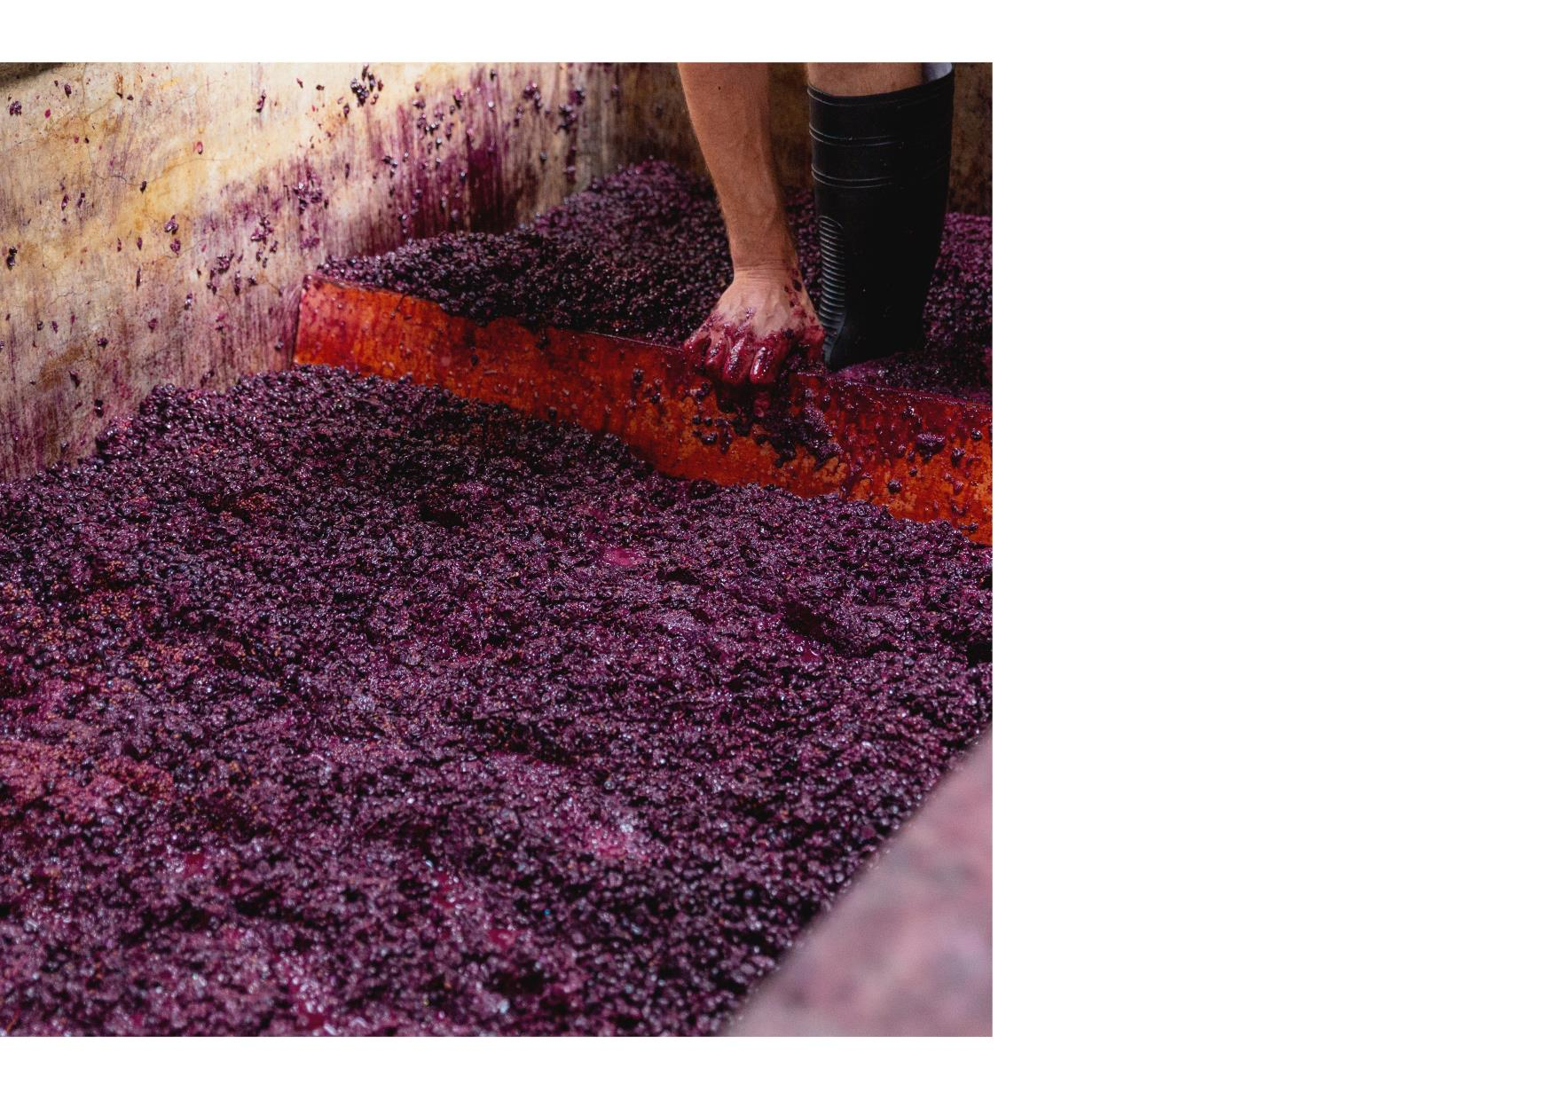
Australian Wine Discovered
History of Grape Growing and Winemaking in Australia
Overview of Climate, Geography and Soils
Labelling Laws and Geographic Indications
Key Varieties and Regional Wine Styles
TODAY’s session
Notes:
What we’ll cover
Australian Wine Discovered – a quick call out to our educational resource. All the slides in this presentation came this on-line resource.

Slide 3
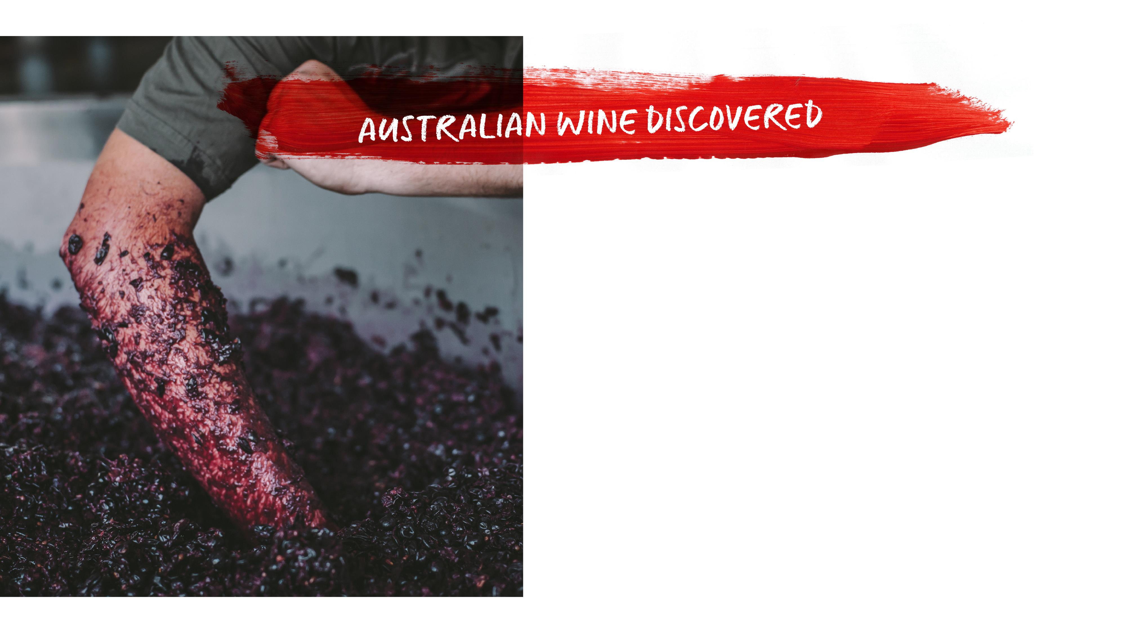
EDUCATION
MADE
OUR
WAY
Notes:
Australian Wine Discovered is a modern way to provide access to education.

Slide 4

FREE OPEN
GLOBAL ACCESS
Free program materials and resources
Unrestricted access
Global reach
www.australianwinediscovered.com
Notes:
25 Modules covering grapes, regions and various topics such as the Foundations of the Australian wine industry, old vines, sustainability – there’s even a comprehensive introduction to wine and winemaking module.
Each includes a powerpoint presentation – that is editable + what we call a facilitator’s guide which is a deep dive into the topic being covered.
These are
Comprehensive
Well-researched – you can trust what you’re reading – regions, MWs, winegrowers have been involved in putting these together
And… they are FREE.

Slide 5
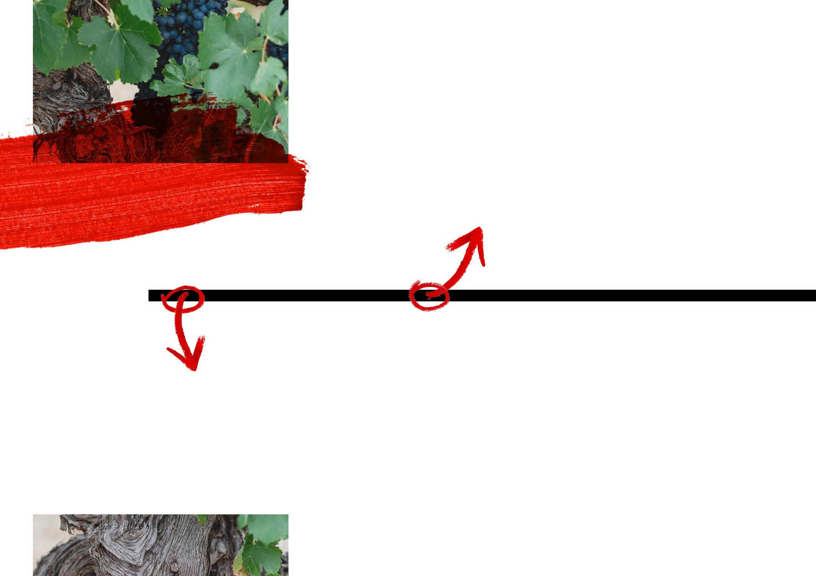
THE FORTIFIED ERA:
1900 TO 1940s
THE HISTORY
Driven by domestic and export demand, fortified wine dominated production and trade
Rutherglen Muscats and Muscadelles were a highlight of this era
The thirst for fortified
wines meant that old Shiraz, Mataró (Mourvèdre) and Grenache vines
were maintained – to
be rediscovered and treasured decades later
OF AUSTRALIAN
WINE
THE PIONEER ERA:
LATE 1700s, 1800s
Australia’s wine pioneers planted vines, expanded their vineyards and began exporting
Important regions were established, including the Hunter Valley, Tasmania, Yarra Valley, McLaren Vale, the Barossa and Rutherglen
James Busby brought back hundreds of cuttings from Europe, which today are the source of precious old vines
Notes:
Vines first came over with the first fleet in 1788
(interesting story from Jane Ferrari: grapes were brought over so they could grow an emergency harvest to make wine to add to the water in case the needed to make a sudden return journey. Because back then, wine was added to water to essentially sterilize it and make it safe to drink)
but grape growing really didn’t kick into gear until the 1830s when James Busby, a Scottish botanist brought over vine cuttings from France which were distributed across the country. (More on this in a few minutes)
Important to remember that Australia was initially a fortified wine country – we’ll see that in the grapes that were initially planted – varieties like grenache and semillon and syrah that do very well as a base for fortified wines….

Slide 6
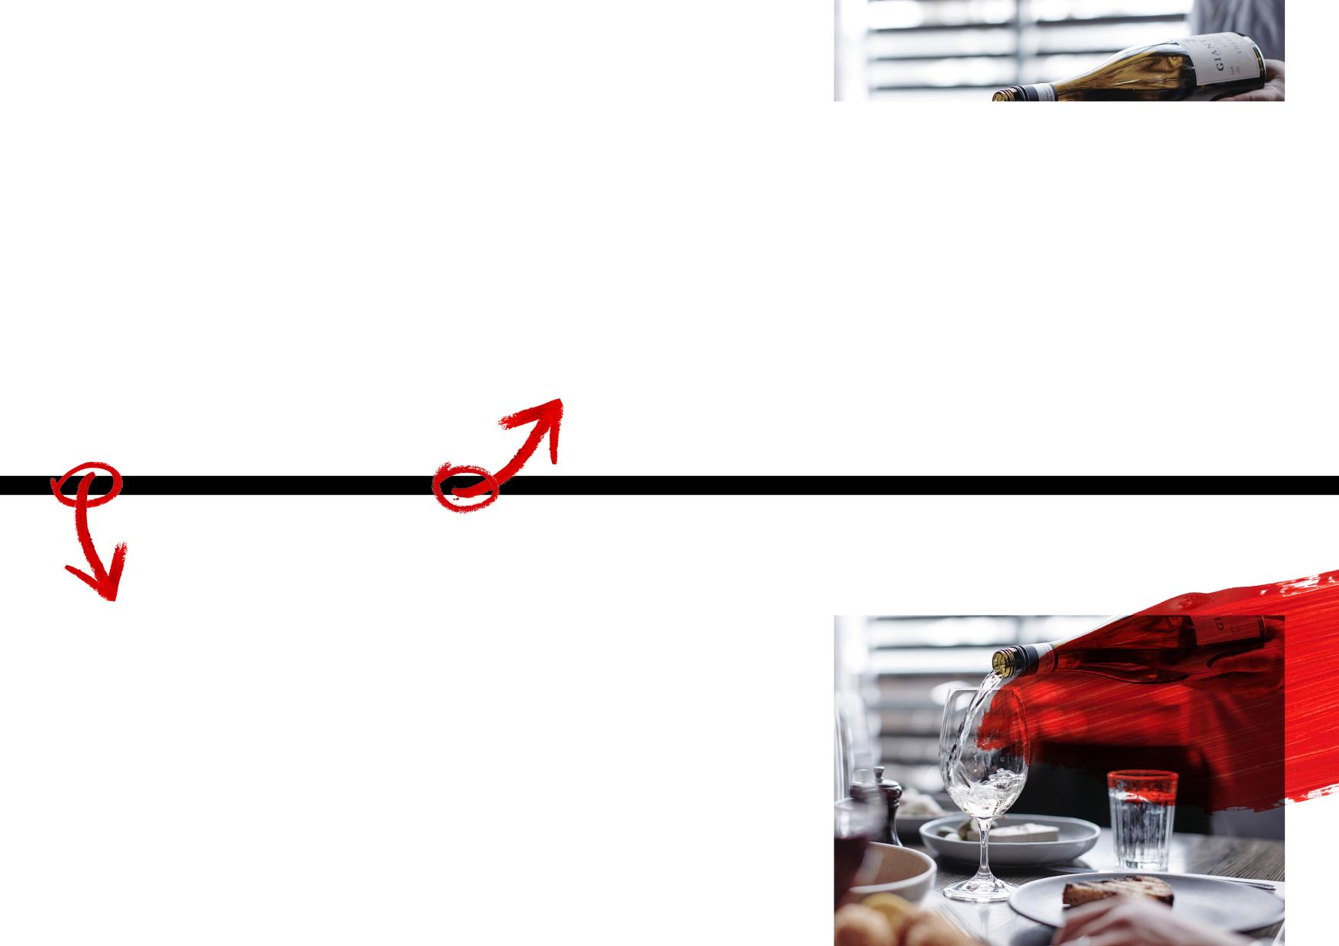
THE GOLDEN AGE:
1960s TO TODAY
Food and table‑wine culture grew, and trailblazing winemakers discovered or rediscovered an array of cool-climate regions
Red wine sales boomed in the 1970s and demand for white wine rose in the 1980s
By the early 1980s, Australia was the 18th largest wine exporter; by the early 1990s it was sixth
Today the Australian wine community is diverse, unique and truly world class
THE RENAISSANCE ERA:
1940s TO 1960s
Ambitious growers and winemakers defied consumer demands for fortifieds to produce
tiny amounts of some of Australia’s finest table wines
The popularity of fortified wine reached its peak and people began to develop a taste for table wines
Notes:
That changed after WWI – and especially after WWII when immigration patterns change (Greeks and Italians arrived, early immigration had been from England and (especially in the Barossa – Germanic/Silesia) and wine as part of a food culture took hold
Note on Silesia – formerly parts of Poland, Germany and the Czech Republic. In the effort to settle South Australia, particularly the Barossa, entire villages came to Australia. It’s why there are so many Germanic-sounding names, like Henschke!

Slide 7
Key Points About Vines Getting to Australia:
Vines arrived in Australia with the First Fleet in 1788
James Busby was a Scottish botanist and became involved in viticulture around 1825
In 1831 he went to Europe and collected 650 varieties - 362 survived the journey
A duplicate collection was planted at his Hunter Valley property and subsequent cuttings made their way to various parts of New South Wales, Victoria and South Australia
Some areas in Australia are phylloxera free and have very old, ungrafted vines
Notes:
Vines first arrived in Australia with the First Fleet in 1788
Heat and humidity was a problem for initial plantings at Sydney Cove although significant vineyards were established near Parramatta
James Busby was a Scottish botanist and became involved in viticulture around 1825 and in 1831 he went to Europe and collected 650 varieties
362 survived the journey and were planted in the Botanical Gardens in Sydney
A duplicate collection was planted at his Hunter Valley property and subsequent cuttings made their way to various parts of NSW, Victoria and South Australia
Many of Australia’s old vines can trace their history to the original Busby collection
Because phylloxera arrived late to Australia – and in many regions, it still hasn’t arrived – many of the oldest vines in the world for quite a few varieties are located in Australia → shiraz, grenache, mourvedre, pinot meunier, even chardonnay
For a new world country, we have some pretty cool “old world” stuff

Slide 8
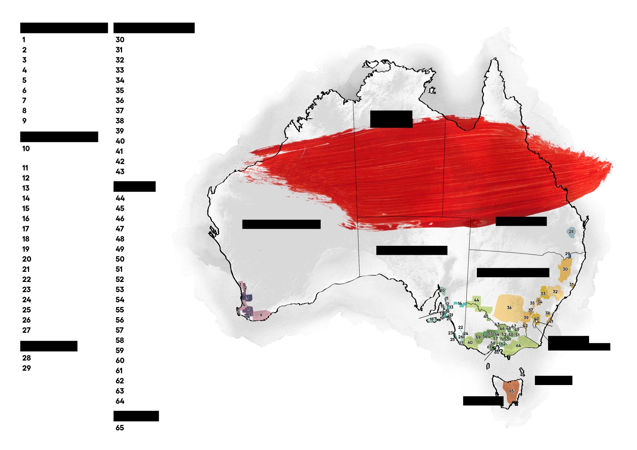
WESTERN AUSTRALIA
NEW SOUTH WALES
Swan District
New England Australia
Perth Hills
Hastings River
Peel
Hunter
Geographe
Mudgee
DARWIN
Margaret River
Orange
Blackwood Valley
Cowra
Pemberton
Riverina
Manjimup
Hilltops
NORTHERN TERRITORY
Great Southern
Southern Highlands
SOUTH AUSTRALIA
Gundagai
Southern Flinders
Ranges
Canberra District
WINE REGIONS OF
Shoalhaven Coast
Clare Valley
Tumbarumba
Barossa Valley
Perricoota
AUSTRALIA
Eden Valley
VICTORIA
Riverland
Murray Darling
Adelaide Plains
Swan Hill
Adelaide Hills
Goulburn Valley
WESTERN AUSTRALIA
QUEENSLAND
McLaren Vale
Rutherglen
Kangaroo Island
Glenrowan
BRISBANE
Southern Fleurieu
Beechworth
SOUTH AUSTRALIA
Currency Creek
King Valley
Langhorne Creek
Alpine Valleys
NEW SOUTH WALES
Padthaway
Strathbogie Ranges
Mount Benson
Upper Goulburn
PERTH
Wrattonbully
Heathcote
Robe
Bendigo
ADELAIDE
SYDNEY
Coonawarra
Pyrenees
CANBERRA
Mount Gambier
Macedon Ranges
QUEENSLAND
Sunbury
AUSTRALIAN
Grampians
CAPITAL TERRITORY
South Burnett
Henty
MELBOURNE
Granite Belt
Geelong
Yarra Valley
VICTORIA
Mornington Peninsula
Gippsland
TASMANIA
TASMANIA
HOBART
Tasmania
Notes:
Next few slides, we’ll talk a bit about geography – and some of the geographic perception challenges that Australia faces
Big country – but the vines are clustered in the south east and southwest – which is where it’s cool enough to grow vines
Within these regions, there is a lot of diversity
65 regions
Over 100 grape varieties
Close to 3000 wineries – the majority of which are small- to medium-sized family-owned business

Slide 9
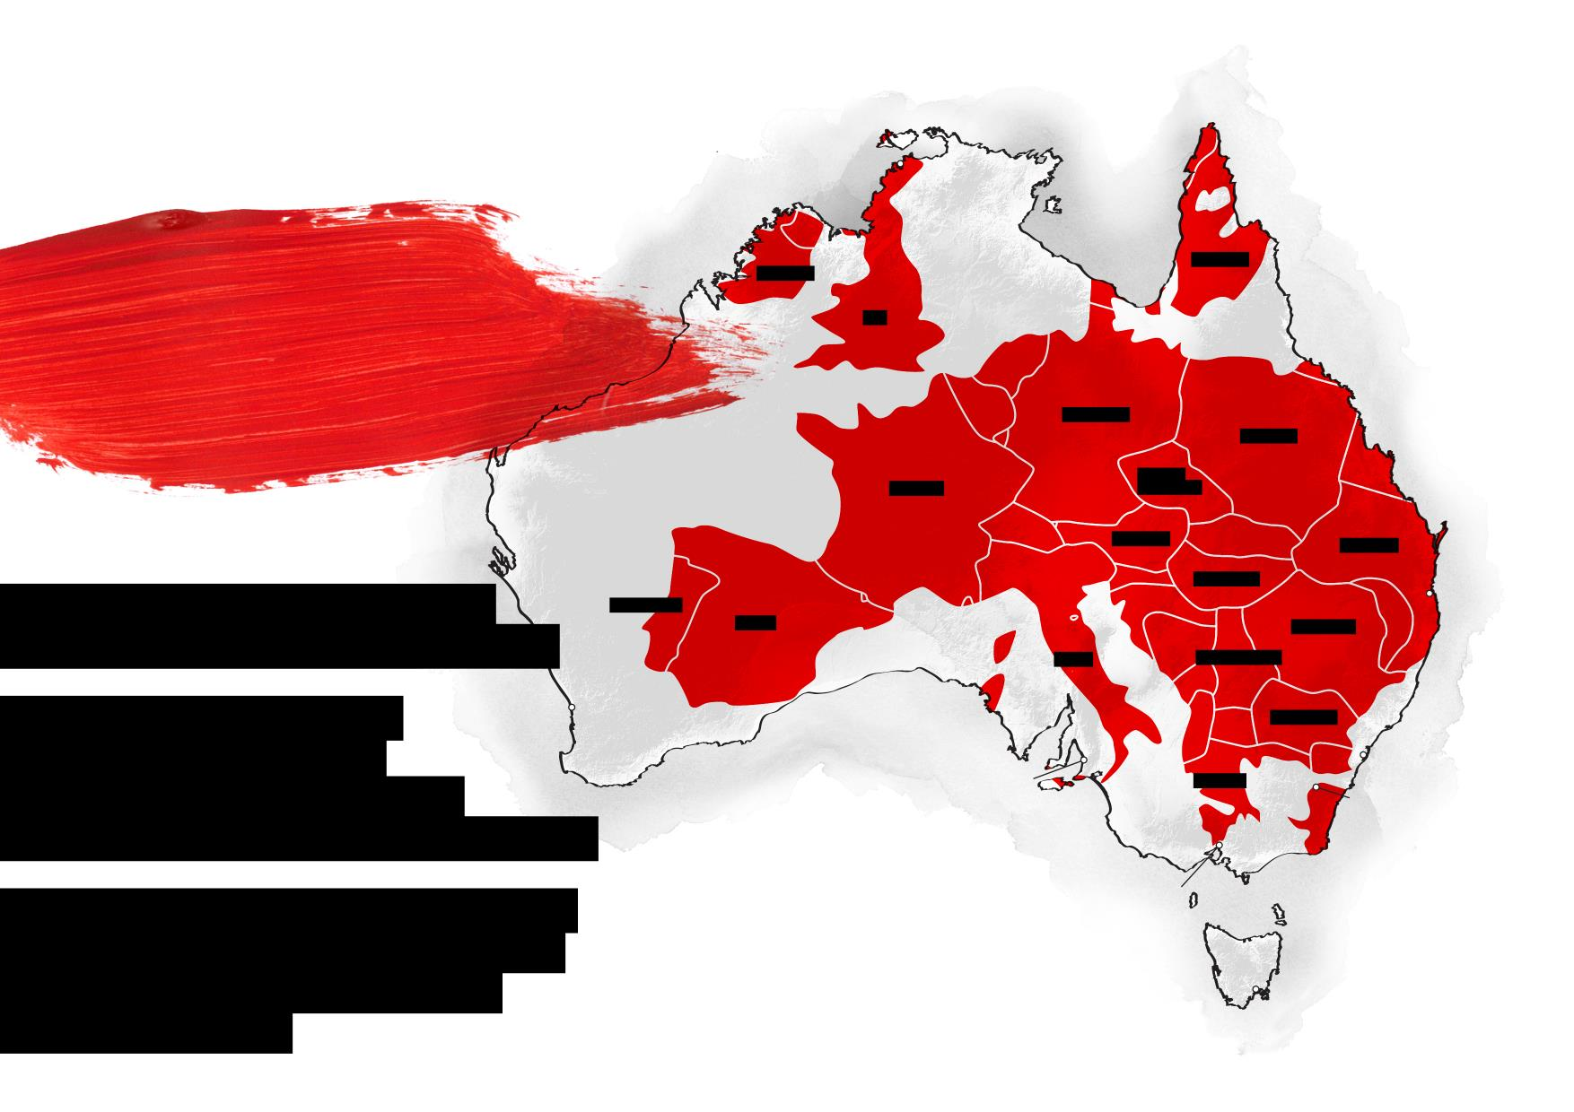
DARWIN
WORLD’S SIXTH-LARGEST COUNTRY,
BIGGER THAN EUROPE
IRELAND
SWEDEN
UK
GERMANY
POLAND
FRANCE
CZECH REPUBLIC
AUSTRIA
UKRAINE
GEOLOGICALLY ANCIENT
HUNGARY
BRISBANE
PORTUGAL
SPAIN
ROMANIA
AND BIOLOGICALLY DIVERSE
ITALY
YUGOSLAVIA
VINEYARDS ACROSS
PERTH
BULGARIA
THE COUNTRY, BUT
SYDNEY
CONCENTRATED IN THE
ADELAIDE
GREECE
CANBERRA
SOUTHEAST AND SOUTHWEST
THE COLD SOUTHERN OCEAN
MELBOURNE
KEEPS TEMPERATURES COOL
IN THE SOUTH, IDEAL FOR
MAKING WINE
HOBART
*Indicative only
Notes:
This map is to give a sense of how large Australia – and the diversity of climates we should expect from a country that size
No one asks: what was the weather like in Europe last year… but we hear that about Australia all the time…
This map shows that’s sort of silly question – the weather in Margaret River (to the west) has essentially no correlation with the weather in the Hunter Valley (near Sydney) or the Yarra Valley (near Melbourne)

Slide 10
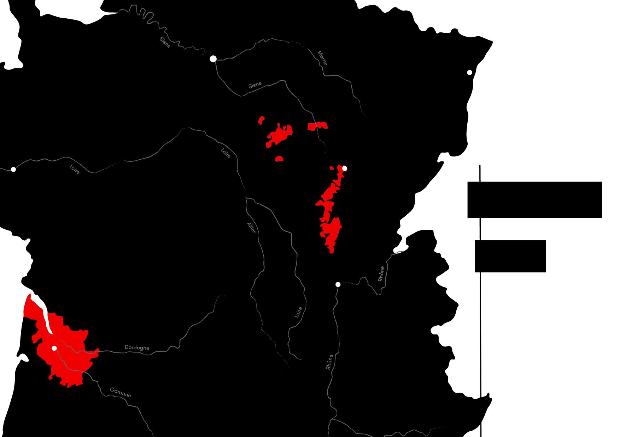
PARIS
STRASBOURG
BURGUNDY
NANTES
DIJON
ONLY
135,000
FRANCE
HECTARES
(0.02%)
LYON
OF AUSTRALIA’S TOTAL LAND MASS IS
UNDER VINE
BORDEAUX
This is slightly less than Bordeaux and Burgundy combined.
BORDEAUX
Notes:
This map is to give some context to the amount of land under vine
Australia is a big country…but it’s not that big in terms of production.
Land under vine = Burgundy + Bordeaux (or the Languedoc)
It’s not insubstantial, but because there are a few big brands that have done really well at global scale, there’s a perception that we are a big production country.
But we aren’t.

Slide 11
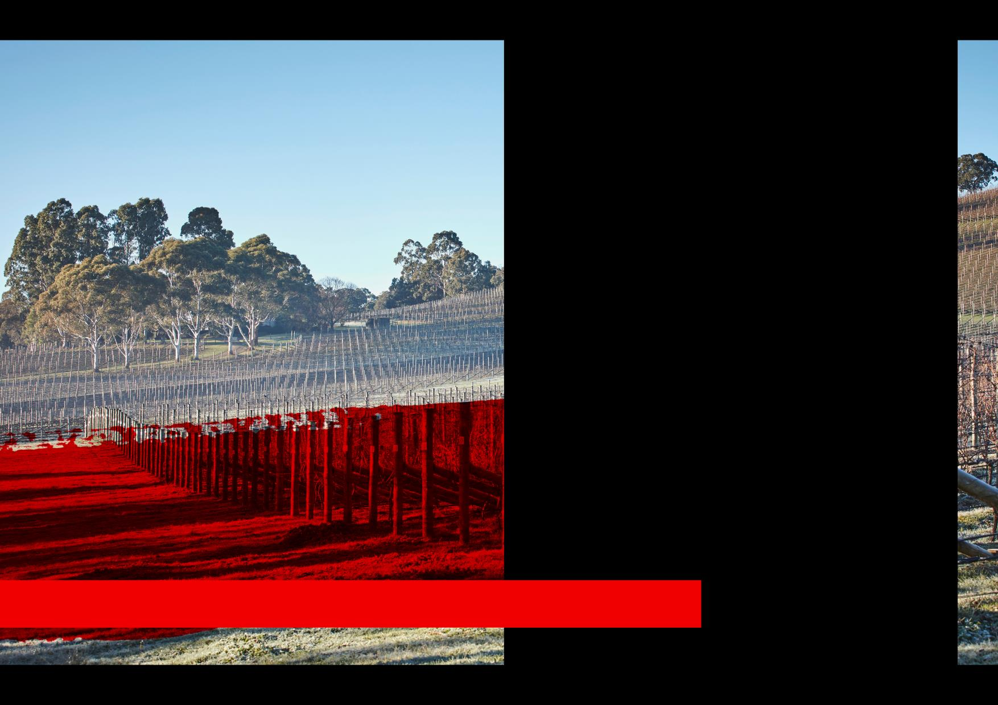
Australia’s latitude, maritime influences and elevation all contribute to a surprising diversity of climates
Premium wine regions located in the country’s temperate areas
Concentrated in NSW, South Australia, Tasmania, Victoria and Western Australia
THE VARIED
CLIMATES
OF AUSTRALIA’S WINE REGIONS
Notes:
Continuing on the diversity theme, the next few slides are just to highlight that there are many Australian wine regions represent many different climate types
We’ll also talk a bit about the factors the mitigate an otherwise a very hot climate so that grapes can be grown
Latitude
Proximity to the Ocean
Altitude

Slide 12
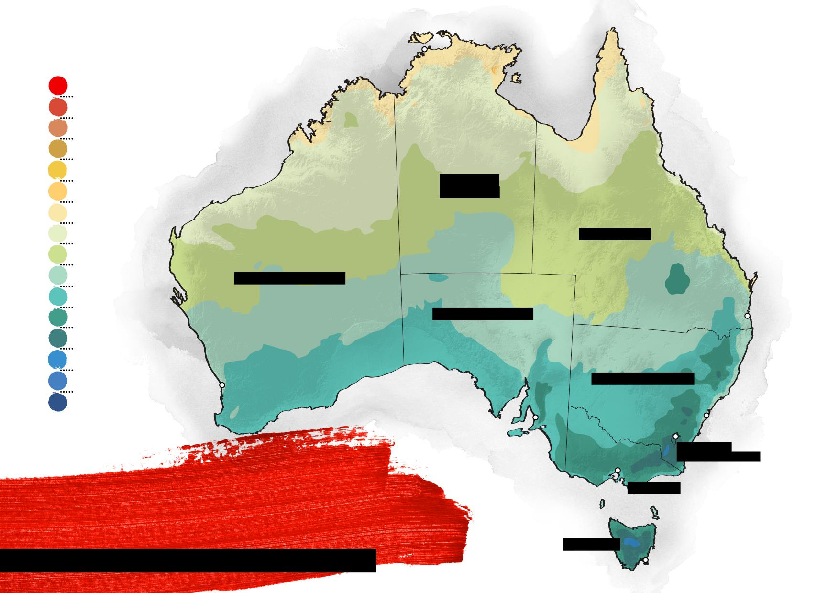
Temperature
DARWIN
39ºC / 102ºF
36ºC / 97ºF
33ºC / 92ºF
30ºC / 86ºF
27ºC / 81ºF
NORTHERN TERRITORY
24ºC / 75ºF
21ºC / 70ºF
18ºC / 64ºF
QUEENSLAND
15ºC / 59ºF
12ºC / 54ºF
WESTERN AUSTRALIA
9ºC / 49ºF
SOUTH AUSTRALIA
6ºC / 43ºF
BRISBANE
3ºC / 37ºF
0ºC / 32ºF
-3ºC / 27ºF
PERTH
NEW SOUTH WALES
CANBERRA
SYDNEY
MINIMUM
ADELAIDE
AUSTRALIAN
CAPITAL TERRITORY
MELBOURNE
VICTORIA
TEMPERATURE
Source: Bureau of Meteorology
TASMANIA
ANNUAL 30-YEAR AVERAGE 1976-2005
HOBART
Notes:
Latitude:
Minimum temp (not MAX.. There would be a lot more red)
Since we’re in the Southern Hemisphere it gets cooler as we head south
Wine regions are clustered in the south

Slide 13
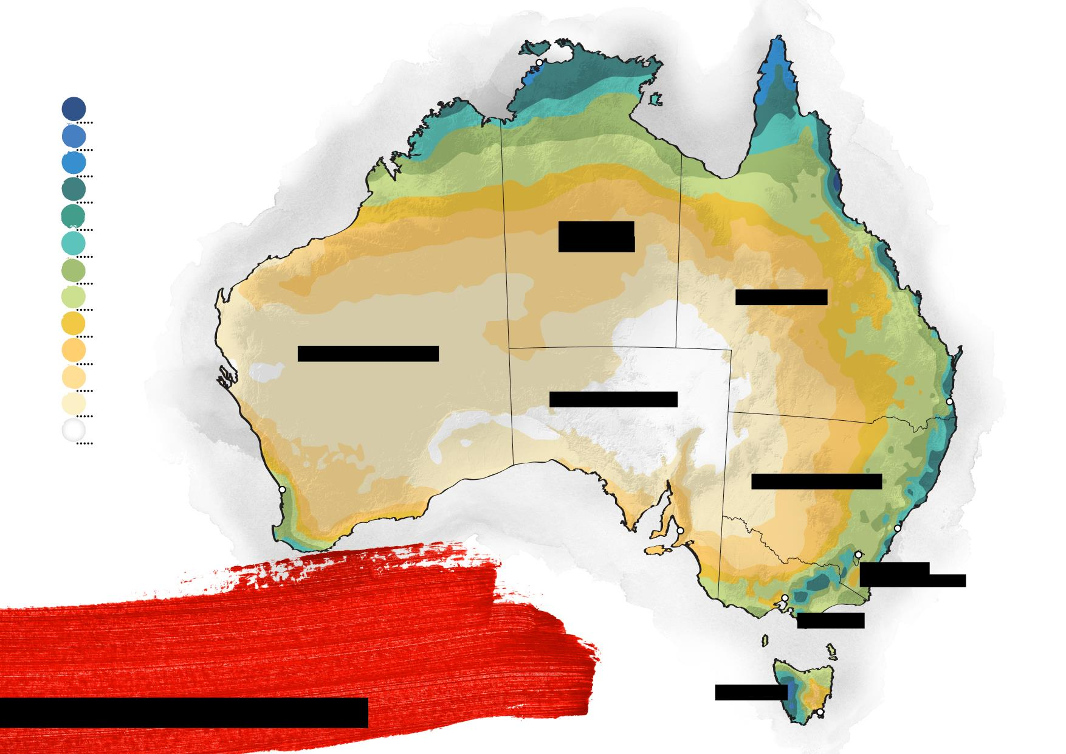
Rainfall
millimetres / inches
DARWIN
3200 / 126
2400 / 94.5
2000 / 78.7
1600 / 63
1200 / 47.2
NORTHERN TERRITORY
100 / 39.40
800 / 31.5
600 / 23.6
QUEENSLAND
500 / 19.7
400 / 15.7
WESTERN AUSTRALIA
300 / 11.8
SOUTH AUSTRALIA
BRISBANE
200 / 7.9
0 / 0
PERTH
NEW SOUTH WALES
ADELAIDE
SYDNEY
CANBERRA
ANNUAL
AUSTRALIAN
CAPITAL TERRITORY
MELBOURNE
VICTORIA
RAINFALL
Source: Bureau of Meteorology
TASMANIA
30-YEAR AVERAGE 1976–2005
HOBART
Notes:
There also isn’t a lot of rainfall in much of the country – but not surprisingly, there is some in the areas where grapes are grown

Slide 14
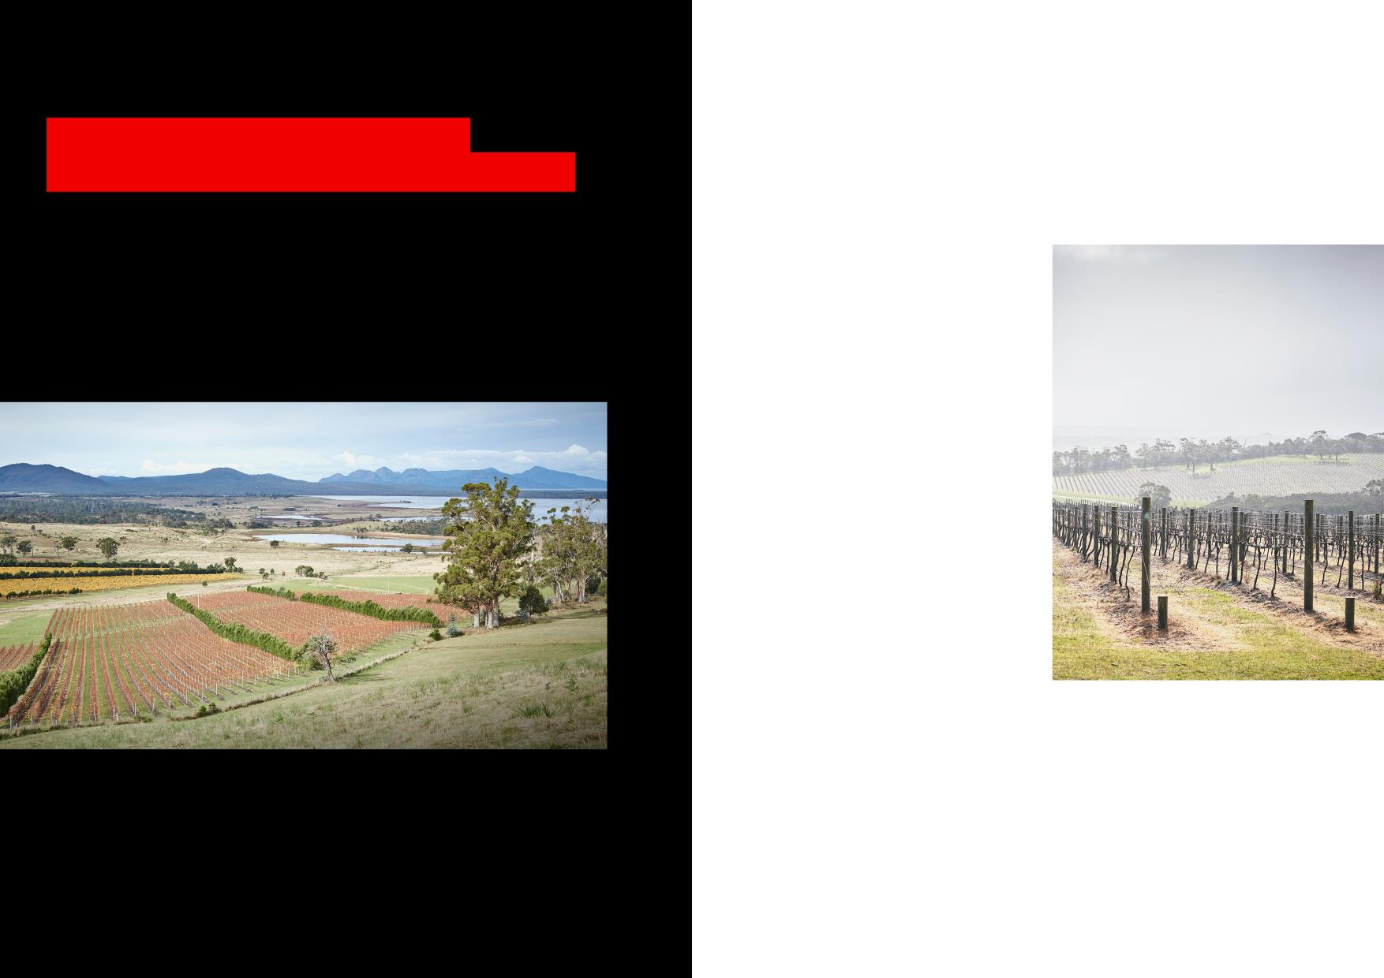
KEY FACTORS
INFLUENCING CLIMATE IN
PREMIUM VITICULTURAL AREAS
COOLING
LATITUDE
WEATHER
PATTERNS
COLD WINDS OF THE SOUTHERN OCEAN MODERATE THE WEATHER IN MANY OF AUSTRALIA’S FAMOUS WINE REGIONS
Areas at higher latitudes
– which are further from
the equator – are cooler, making southern Australia much cooler than the north
Notes:
In additional to latitude, the proximity to the ocean is a key factor
Most wine regions are within a hundred miles of the ocean, if not right on it.
The Great Southern Ocean acts as a an air conditioner for those regions.
It’s a very cold body of water – there’s nothing between Australia and Antarctica
(except sharks)

Slide 15
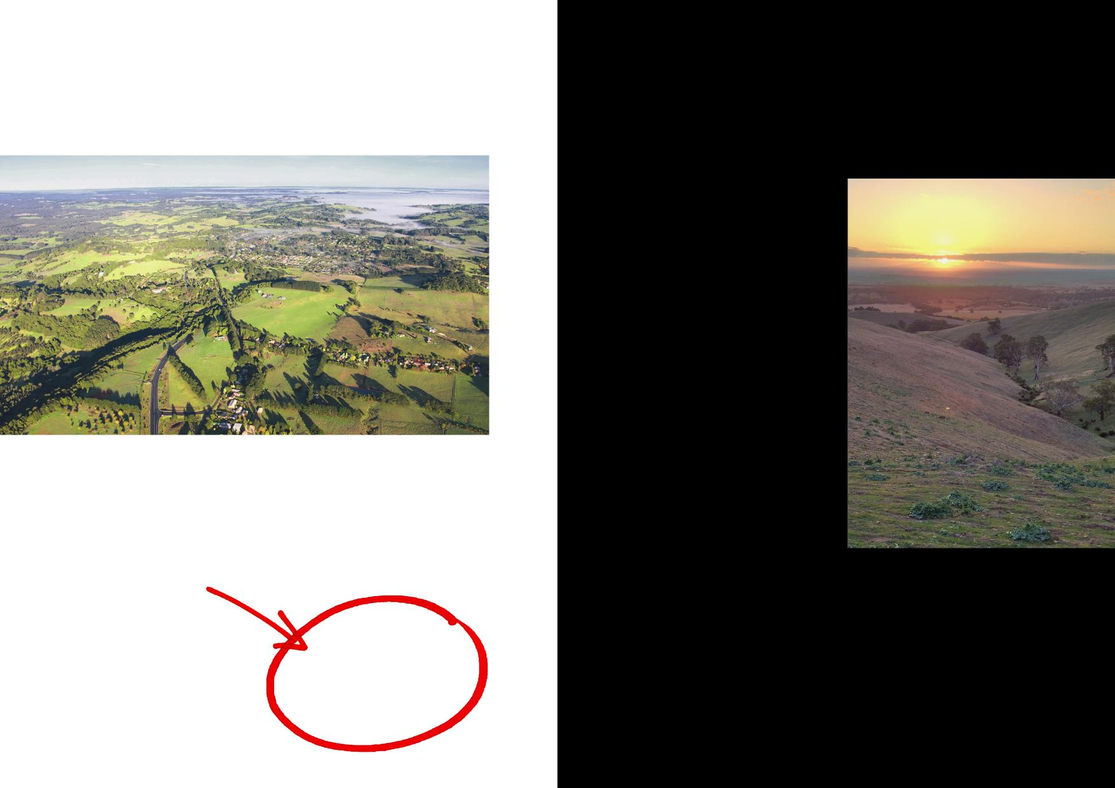
GEOGRAPHICAL
FEATURES
ALTITUDE
Temperatures decrease by approximately 0.65°c for every 100 metres (328 feet) in altitude; the highest Australian wine regions are up to
THREE MAJOR MOUNTAIN RANGES INFLUENCE CLIMATE AND WEATHER:
DARLING SCARP (WA)
MOUNT LOFTY RANGES (SA)
THE GREAT DIVIDING RANGE (QLD, NSW, VIC)
1,000-
1,200M
(3,281–3,937FT)
Notes:
Altitude is very important
The mountains in Australia have nothing compared to the Rockies – they used to be that high, but as an ancient landmass, they have been worn down over the eons
But a little goes a long way – and helps make these cooler climates possible

Slide 16
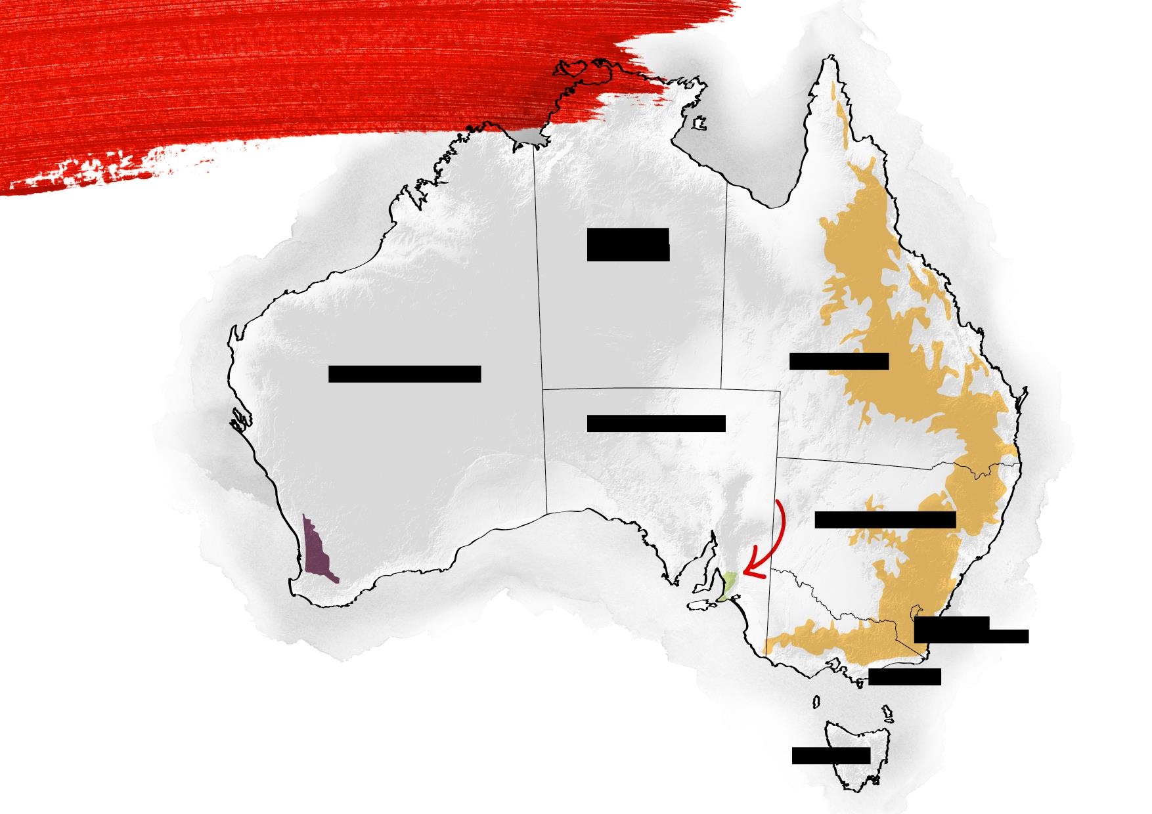
GEOGRAPHICAL
FEATURES
NORTHERN TERRITORY
GREAT DIVIDING
RANGE
WESTERN AUSTRALIA
QUEENSLAND
SOUTH AUSTRALIA
MOUNT LOFTY
RANGES
DARLING
SCARP
NEW SOUTH WALES
AUSTRALIAN
CAPITAL TERRITORY
VICTORIA
TASMANIA
*Indicative only
Notes:
Three main land masses that contribute altitude
Darling Scarp
quite low… the ocean influence is more important
Great Dividing Range
these are the tallest, impact regions within Victoria (e.g. the Yarra Valley) and New South Wales (e.g. Hunter Valley)
Mount Lofty Ranges
more like hills than mountains, but they block the hot air coming off the desert and make winegrowing in South Australia possible.
Without them, the Barossa, Clare Valley, McLaren Vale.. None of these most famous regions would be able to grow fine wine… it would be hot air meets ocean

Slide 17
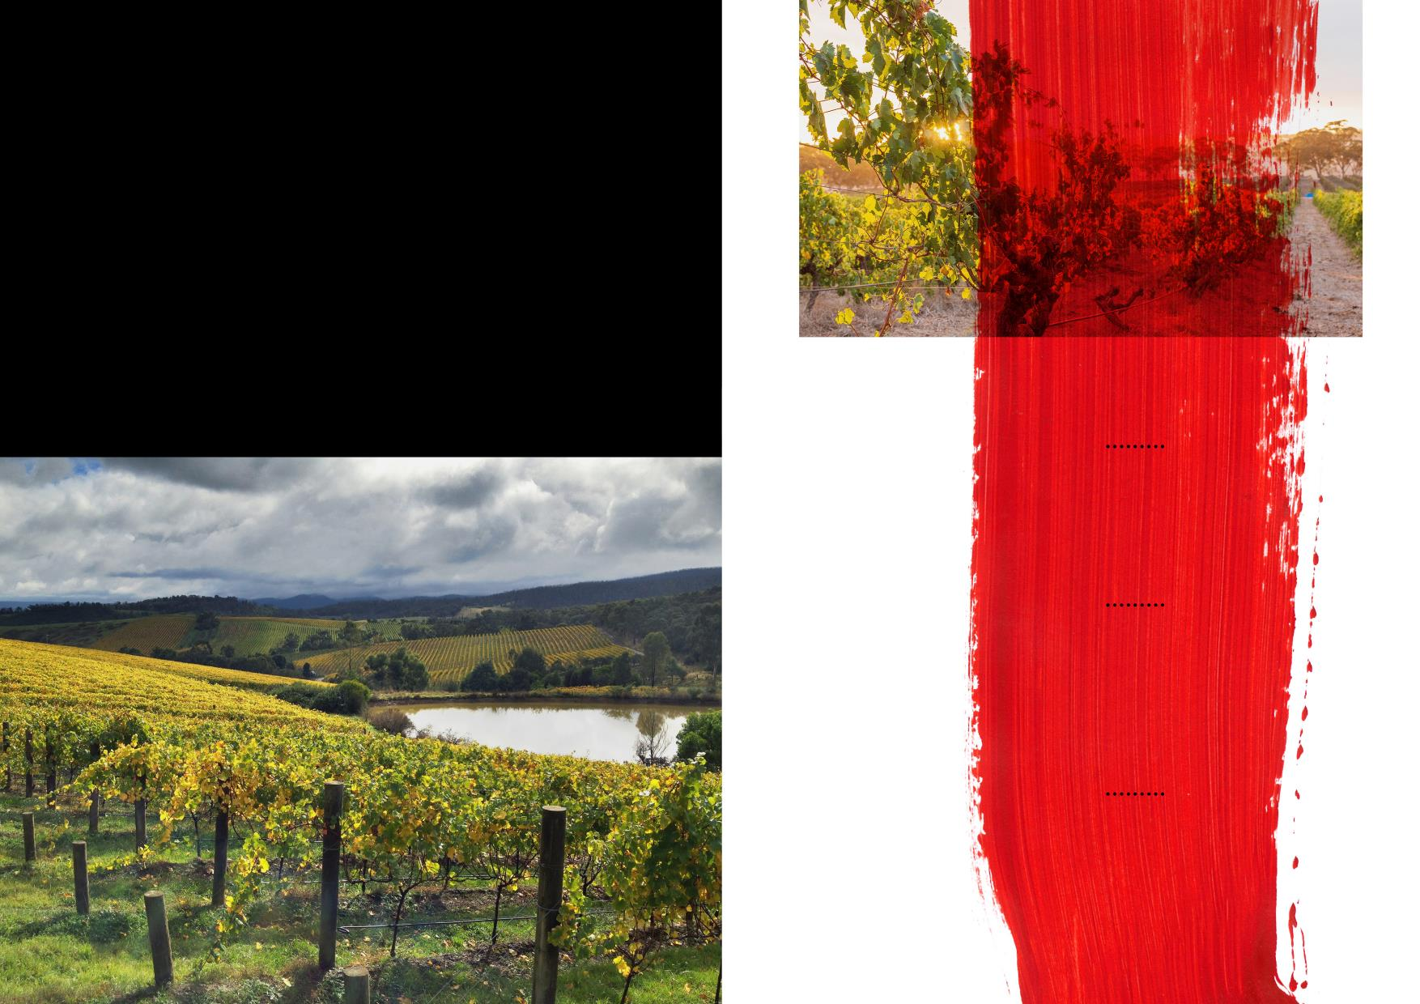
Regions in the centre of large land masses that tend to
have hotter summers and colder winters.
CLARE VALLEY
CONTINENTAL
EDEN VALLEY
CLIMATE
PARTS OF
GREAT SOUTHERN
YARRA VALLEY
Notes:
This is just to drive home that there is climate diversity in Australia
Continental – big swings between winter and summer temps. Summers are hotter and winters are colder.
Further inland, so less Ocean influence

Slide 18
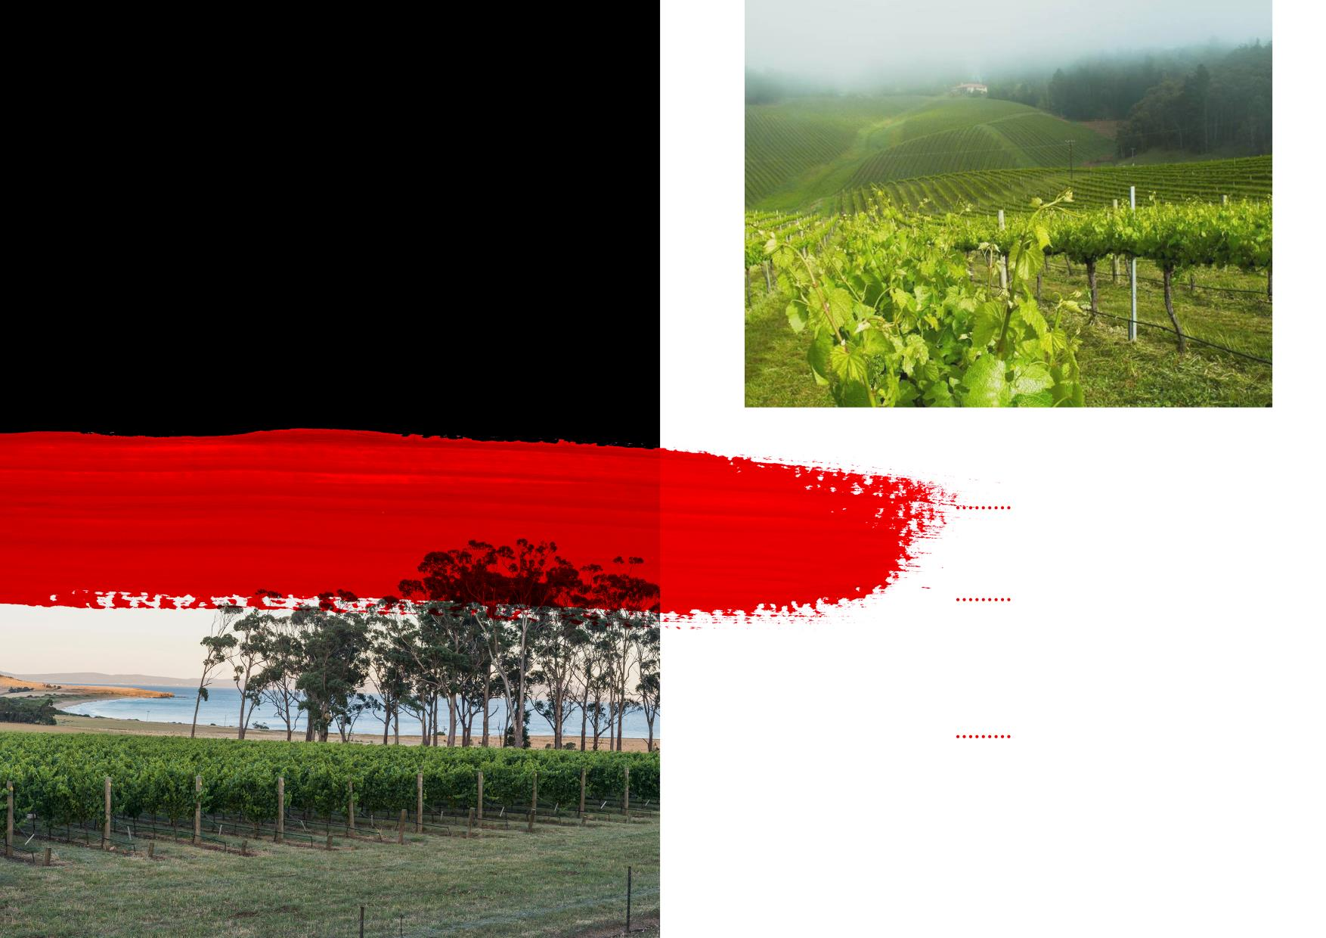
Regions near the coast, where the climate has a narrower range of temperatures and rainfall is spread more evenly throughout the year.
ADELAIDE HILLS
MARITIME
CLIMATE
COONAWARRA
MORNINGTON PENINSULA
TASMANIA
Notes:
Lots of ocean influence
A narrower range of temperatures than continental climates, with rainfall spread evenly through out the year.

Slide 19
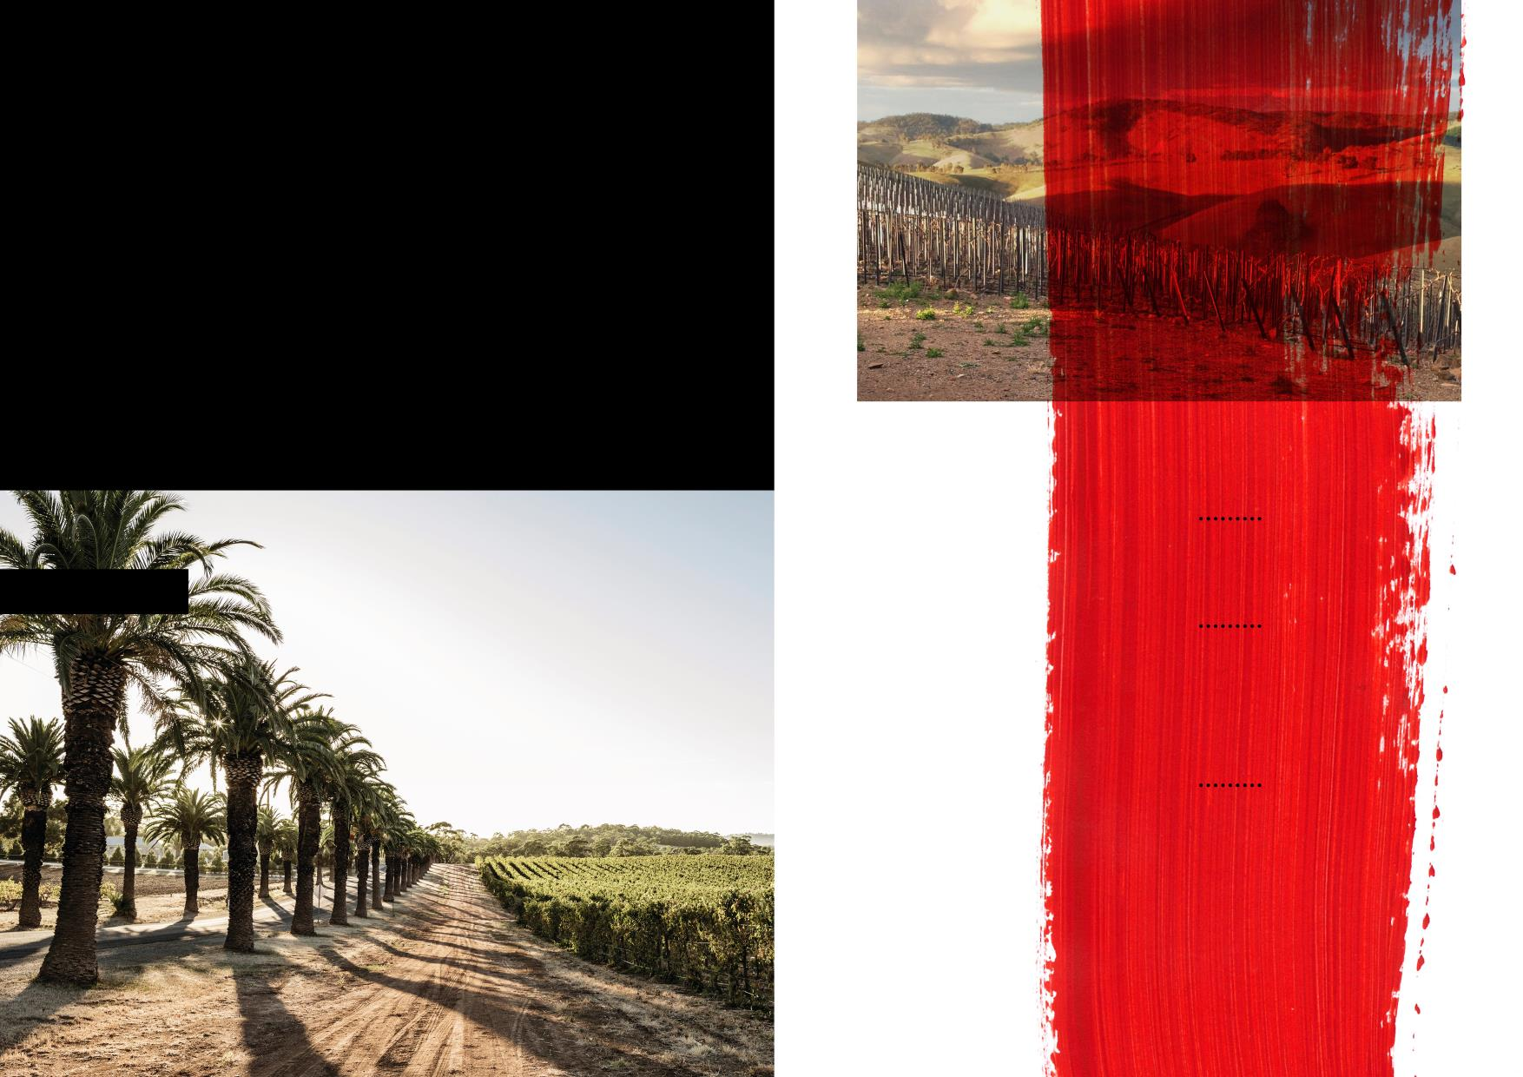
Similar to maritime climates,
but summers tend to be
warm and dry. There is less temperature variation between the hottest and coldest months.
BAROSSA VALLEY
MEDITERRANEAN
CLIMATE
GEOGRAPHE
McLAREN VALE
MARGARET
RIVER
(+ STRONG MARITIME INFLUENCES)
Notes:
Similar to Maritime climates, but summers are warner and drier
Note Margaret River technically has a Mediterranean climate but with very, very strong Maritime influence

Slide 20
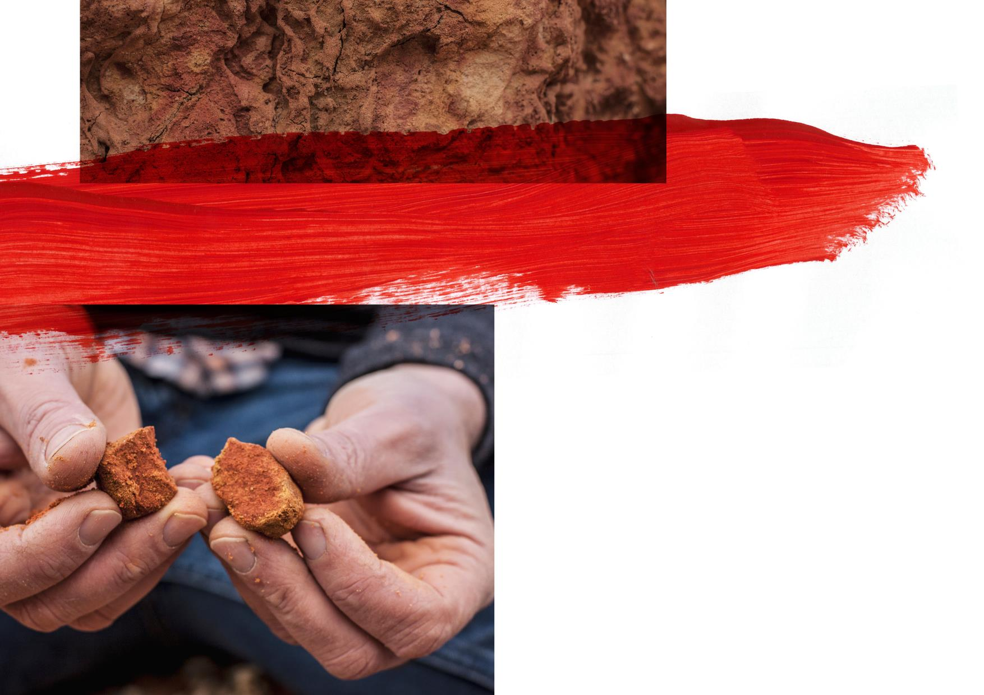
UNEARTHING AUSTRALIA’S
ANCIENT SOILS
Australia has been a land mass for over 100 million years
Its soils are some of the most ancient on Earth
There are also younger sand and limestone soils, and fertile volcanic soils
Soil types can vary greatly between wine regions and within the regions themselves – even across a single vineyard block
Notes:
A quick note on soil –
in terms of geology, Australia is OLD world and Europe is the NEW world.
Some of the oldest soils in the world
Soil types are extremely varied and the connection of grape to soil and what grows best where is being explored – it’s Australia’s next wave of evolution

Slide 21
Labelling Laws & Geographic Indications
Australia’s Label Integrity Program (LIP) controls truth in labeling
Australia’s Designated Wine Regions are called Geographic Indications (GI’s)
A GI is internationally protected and defined as a single tract of land that
usually produces at least 500 tonnes of wine grapes in a year, and comprises at
least five independently owned vineyards of at least five hectares each The area
of land must be discrete and homogeneous in its grape-growing attributes.
The 85% rule applies for a regional designation to appear on the label
The 85% rule also applies for varietal labelling
95% for the stated vintage
Notes:
Labeling law reviews
Similar to USA, etc – no restrictions on what grapes can be grown where

Slide 22
Geographic Indications – Zonal, Regional and Sub-Regional
The broadest region is South Eastern Australia
Then there are the individual State GI’s: e.g. Victoria, NSW, South Australia, Tasmania etc.
Then there are ZONES or Zonal GI’s: e.g. Adelaide Super Zone, Murray Darling Zone etc.
Each ZONE can be divided into REGIONS: e.g. Barossa Valley, Clare Valley etc.
Each REGION can be divided into SUB-REGIONS *
ZONES, REGIONS & SUB-REGIONS are all known as GEOGRAPHIC INDICATIONS (GI)
There are currently over 65 GI’s in Australia
*The legislation is a bit vague and the difference between a region and a sub-region is very subtle
Notes:
64 GIs – some are more common than others
South Eastern Australia – covers most of the country’s vineland
Zones you won’t see very often
Regions and sub regions are more common – although some are quite small and the difference between a region and sub-region is subtle (or vague) depending on your POV

Slide 23
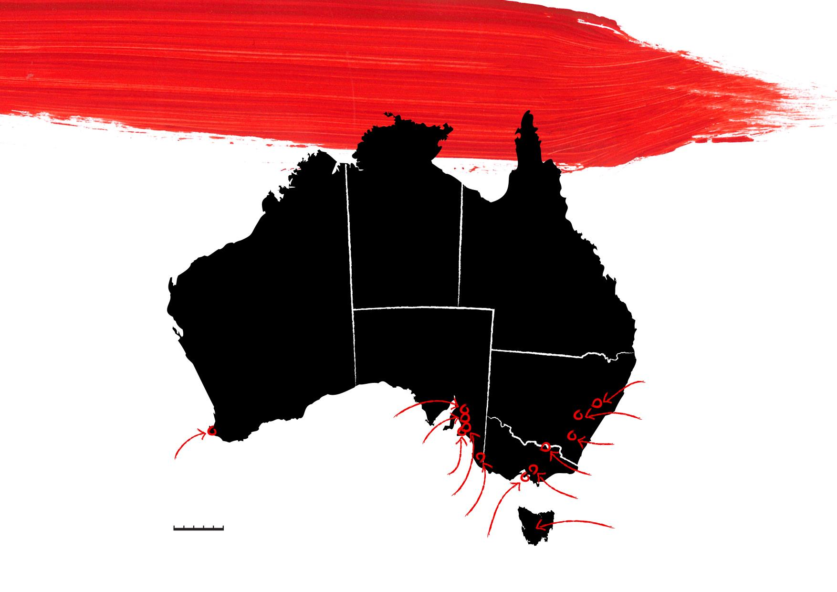
PROMINENT
R E G I O N S
NORTHERN TERRITORY
QUEENSLAND
WESTERN AUSTRALIA
SOUTH
AUSTRALIA
HUNTER
VALLEY
NEW SOUTH WALES
CLARE
VALLEY
ORANGE
BAROSSA
CANBERRA DISTRICT
MARGARET
RIVER
VICTORIA
McLAREN VALE
RUTHERGLEN
ADELAIDE HILLS
YARRA VALLEY
0
500
COONAWARRA
TASMANIA
Kilometres
MORNINGTON
PENINSULA
TASMANIA
Notes:
These are the GIs you are most likely to see in the US market
NOTE: Barossa = Barossa Valley + Eden Valley, both of which you would see in the US

Slide 24
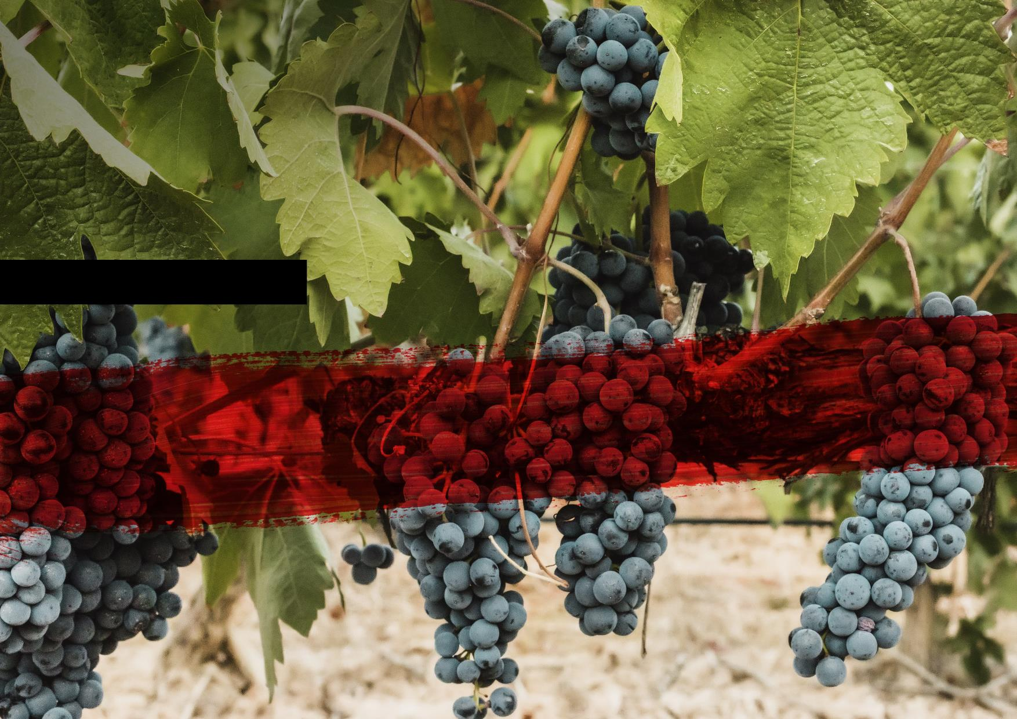
NOTEWORTHY
VARIETIES
AND STYLES
Notes:
65 regions + 100 grapes – and even more stylistic choses
We’re going to highlight a few – with reference to a specific region

Slide 25
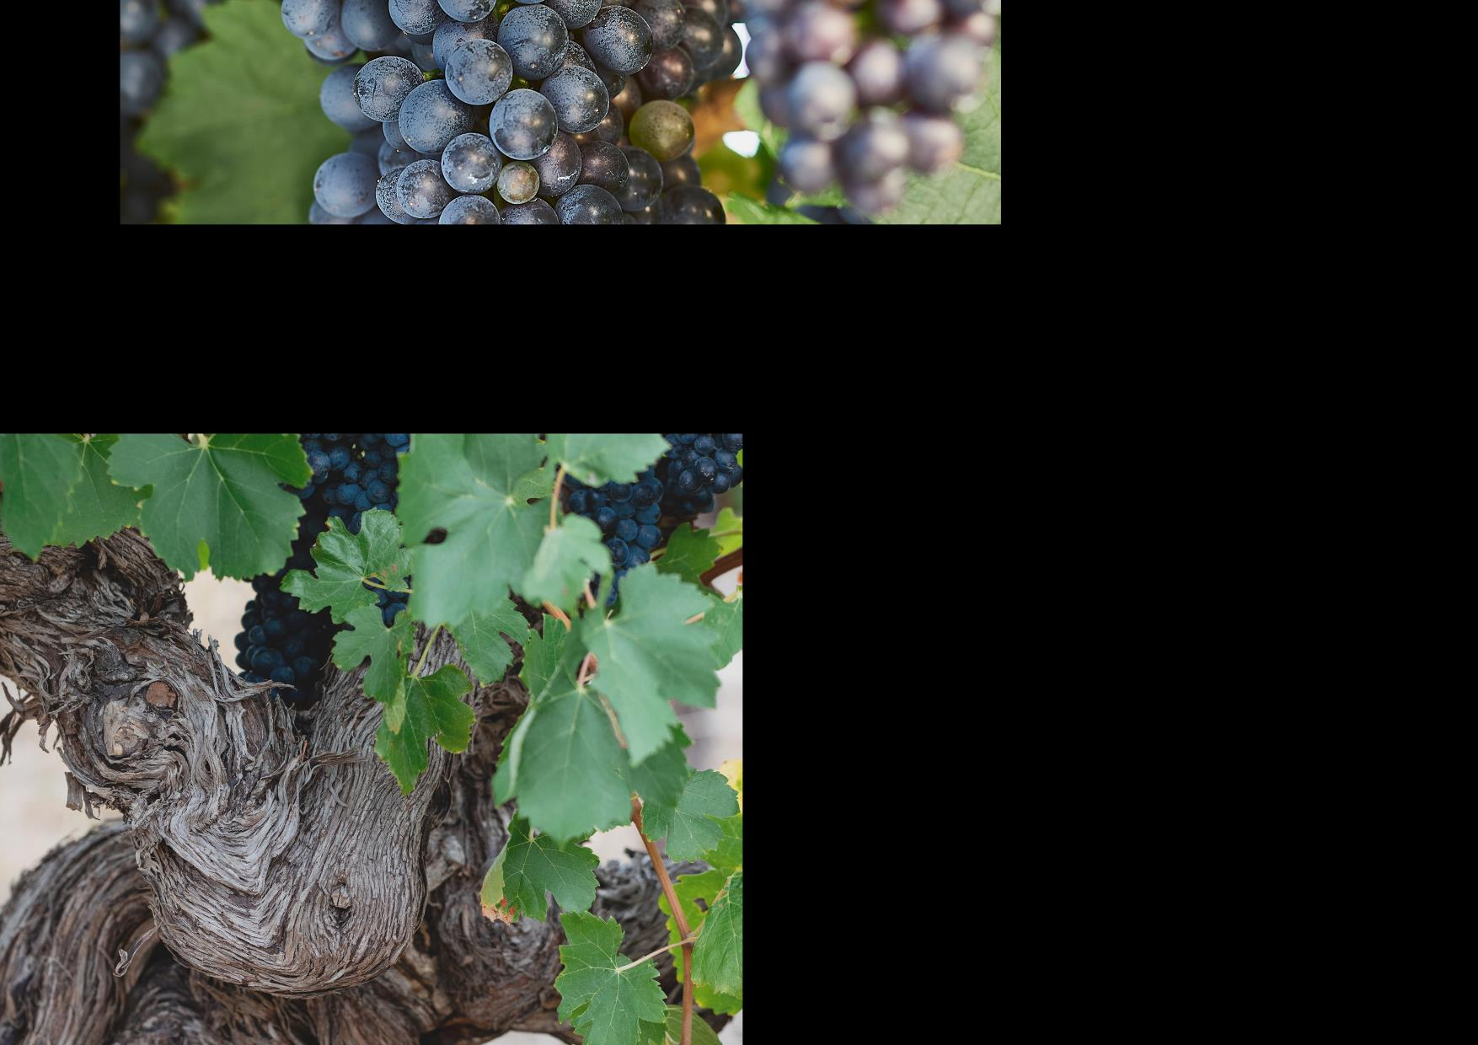
SHIRAZ:
AN AUSTRALIAN LEGEND
Australia’s iconic grape and its most famous wine export
Grown in almost every region and accounts for nearly one-quarter of total wine production
Produced in a wide range of expressions, from affordable, quaffable reds to age-worthy classics
Australia has one of the oldest continuously producing Shiraz vines in the world

Slide 26
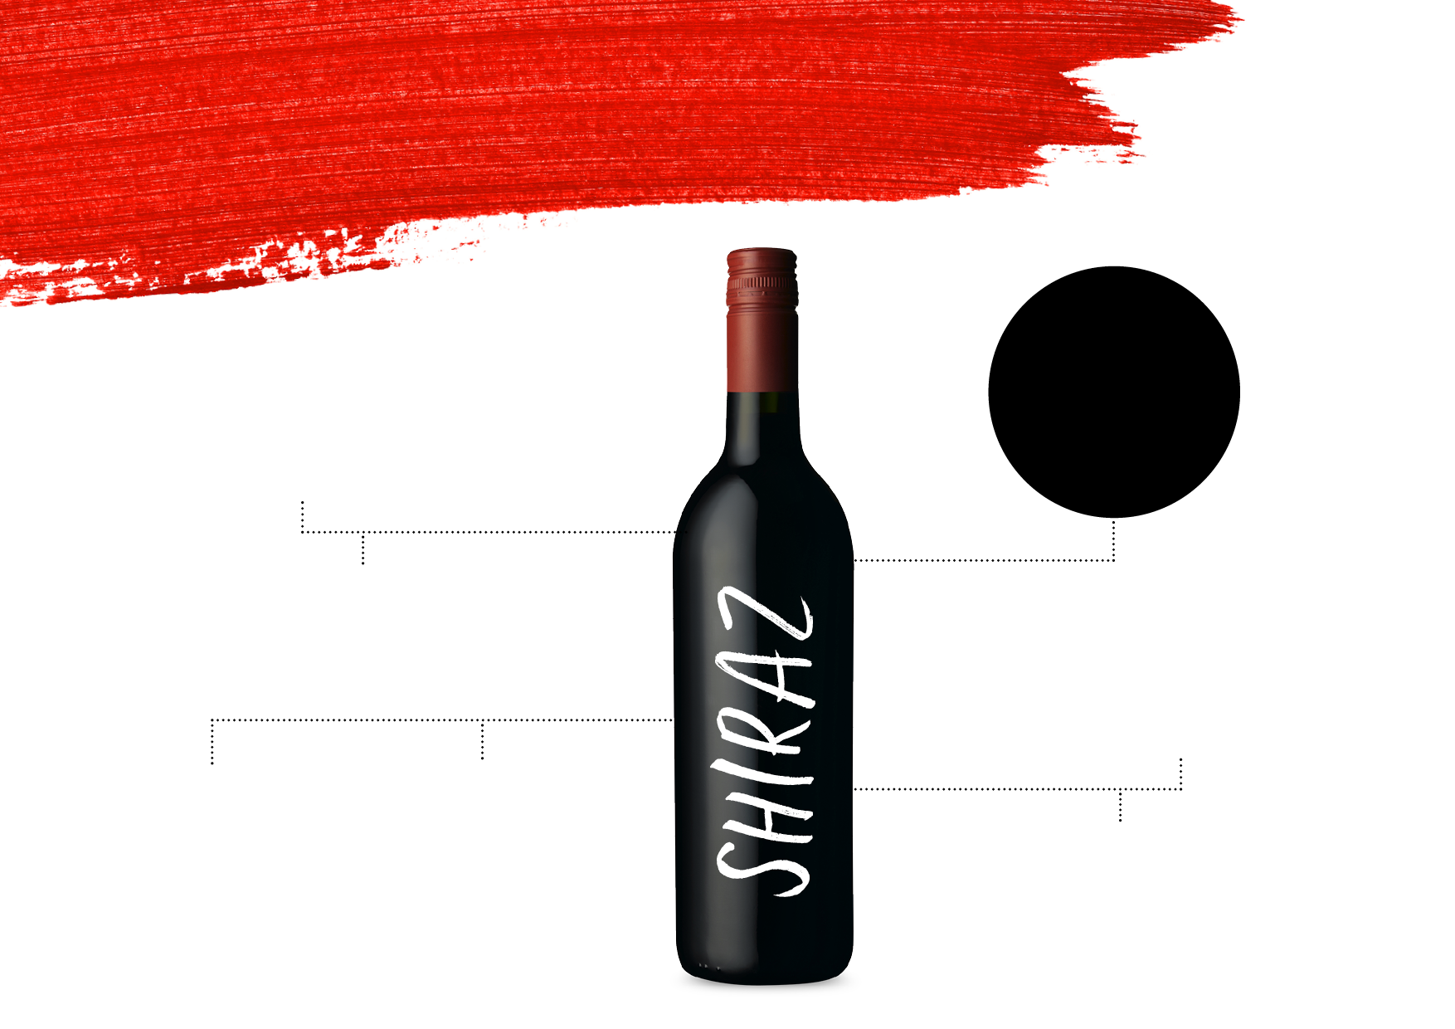
STYLES AND
CHARACTERISTICS
IDEAL BLENDING PARTNER –
GSM, SHIRAZ CABERNET, SHIRAZ VIOGNIER
WARM-CLIMATE
BOLD FLAVOURS, JUICY JAMMY DARK FRUITS, RIPE TANNINS AND SEAMLESS TEXTURE
STYLES
COOLER-CLIMATE
ELEGANT, FOOD-FRIENDLY, MEDIUM-BODIED
WARM CLIMATE
Dark cherry
Plum
Chocolate
YOUTHFUL
AGED
TYPICAL
FLAVOURS
Richly textured; ripe,
rich, dark fruits
Softer tannins; smoother character; spice, liquorice and earth characters
COOL CLIMATE
Ripe red fruits

Slide 27
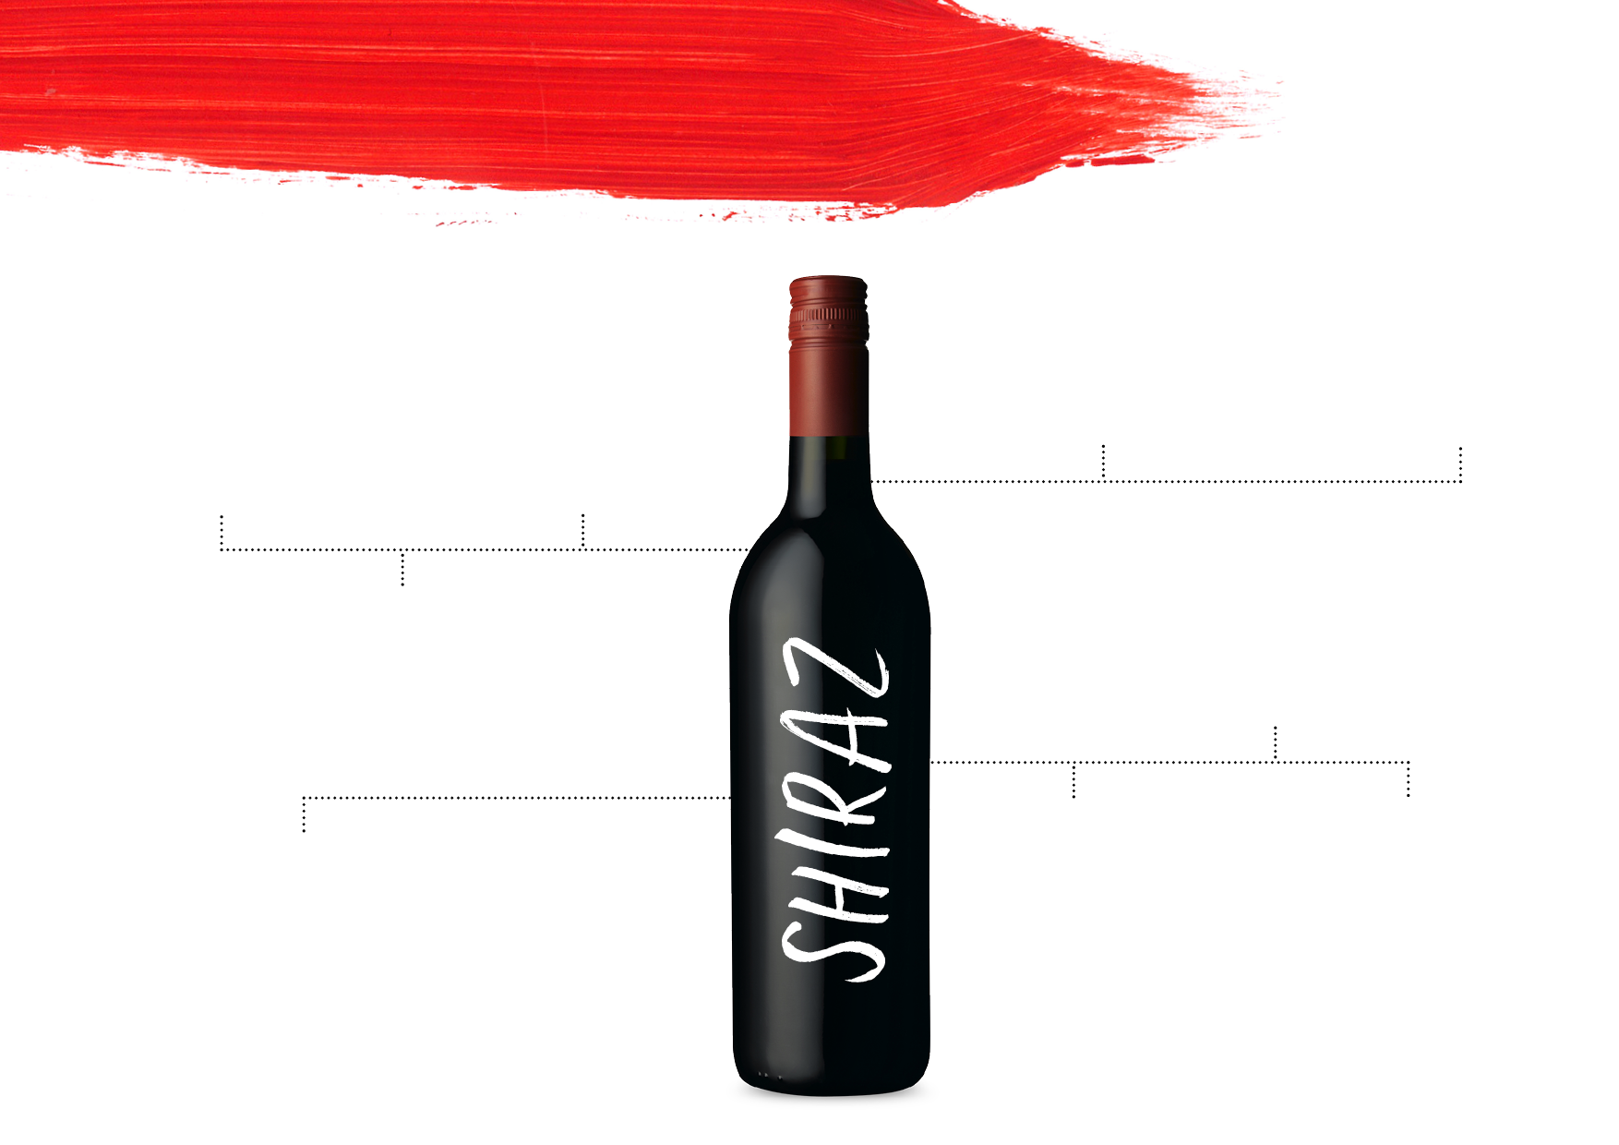
KEYREGIONS
EDEN VALLEY
THE GRAMPIANS
Medium-bodied
to full-bodied with classic berry, sage and pepper notes
ADELAIDE HILLS
Elegant, savoury and spicy; deeply purple in colour
Moderate alcohol levels, pepper and spice aromas, fine tannins and acids
BAROSSA VALLEY
Bold Shiraz bursting with flavour and character
CANBERRA DISTRICT
HUNTER VALLEY
Powerful yet elegant Shiraz that’s spicy, balanced and full-flavoured
Evolved into medium-bodied wines that are savoury, complex and food-friendly
McLAREN VALE
MOUNT BARKER
CLARE VALLEY
Full-bodied with rich blueberry fruit and chocolate characters
Silky, elegant Shiraz with notes of liquorice,
black cherry and peppery spice
Plush, full-bodied and richly textured, with flavours of blackberry, plum and liquorice

Slide 28
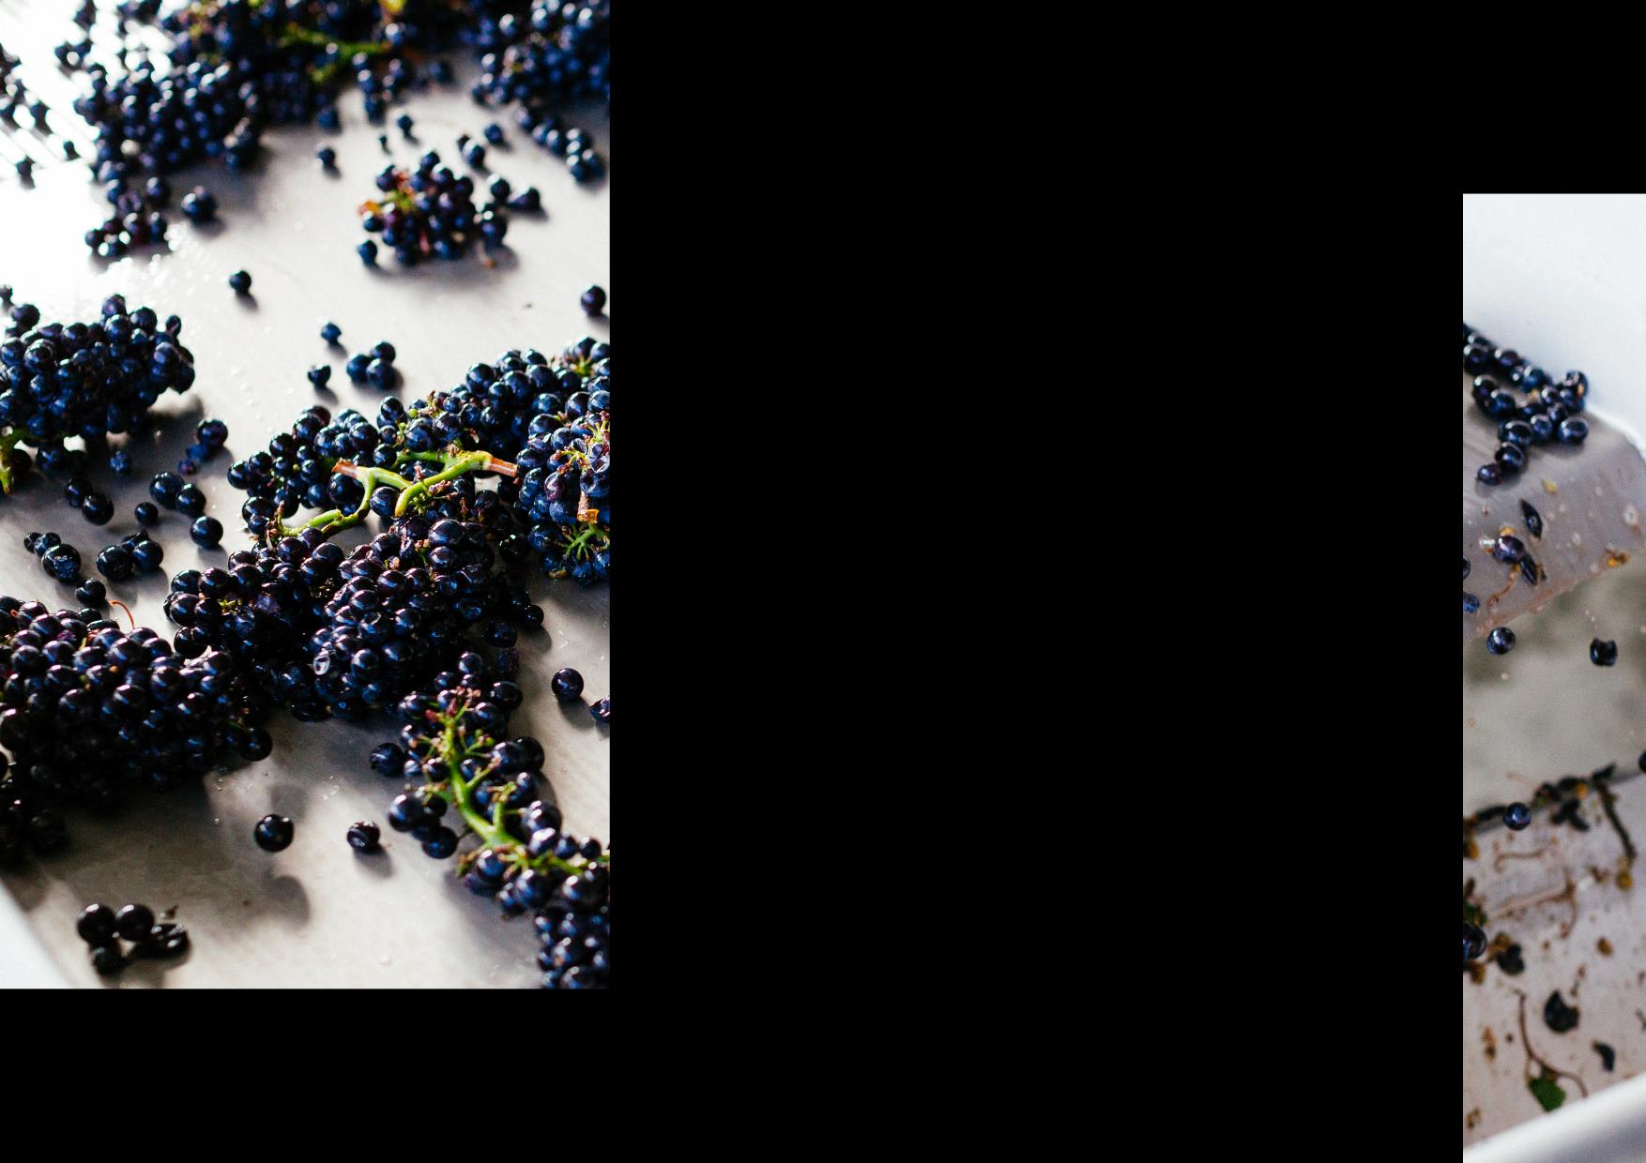
PINOT NOIR:
COOL-CLIMATE
CHARM
Relative latecomer to the commercial wine community but now an integral variety
One of the hardest grapes to grow
Best examples come from cool‑climate regions
Clonal diversity has been linked to an increase in wine quality and complexity

Slide 29
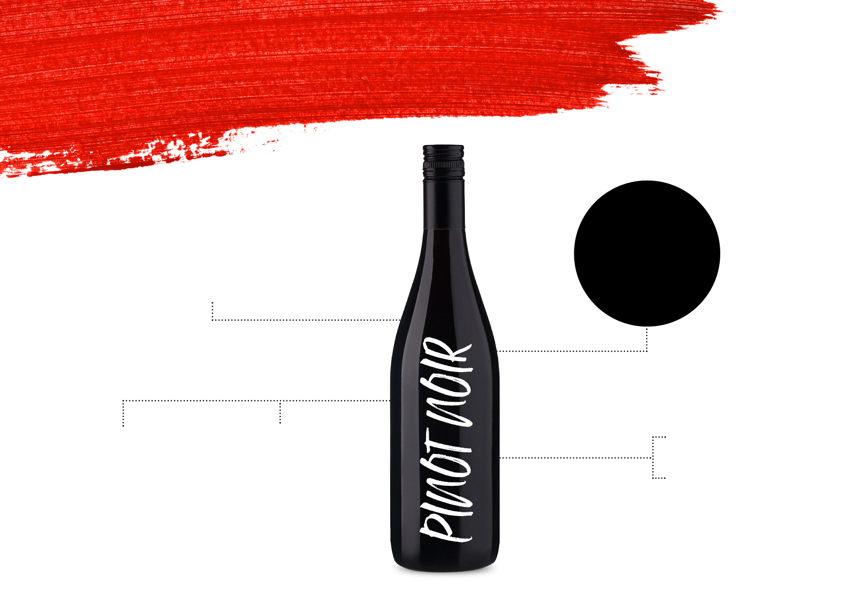
STYLES AND
CHARACTERISTICS
PREMIUM
WINES CHARACTERISED BY SUBTLETY
AND FINESSE
LIGHT-BODIED TO MEDIUM-BODIED AND RESTRAINED IN NATURE
YOUTHFUL
AGED
TYPICAL
FLAVOURS
Cherry
Strawberry
Raspberry
Fine cherry, red berry and herbal notes with silky or satiny texture
Develops
classic earthy
or ‘forest floor’ savoury characters

Slide 30
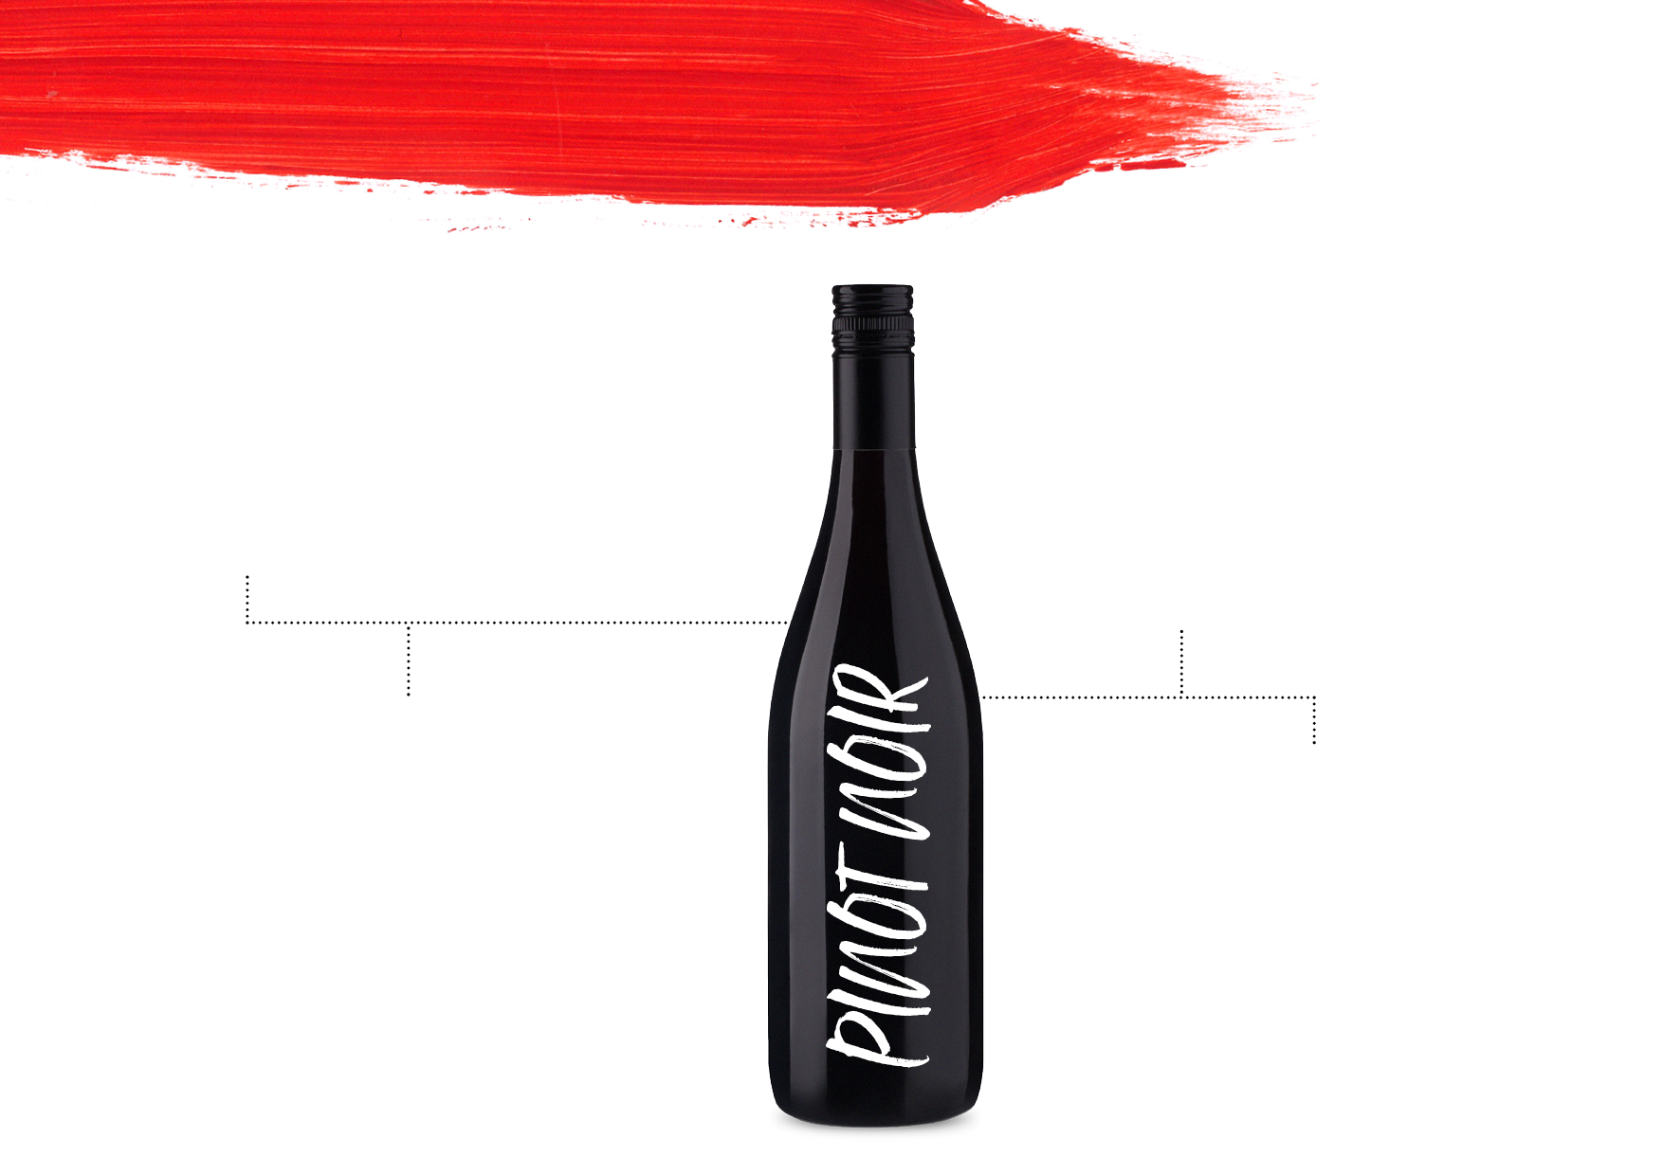
KEYREGIONS
ADELAIDE HILLS
TASMANIA
The elevation and cool climate produces medium‑bodied styles with richer, ripe cherry and berry flavours
Ideal for producing high‑quality Pinot Noir due to its cool climate; typically light-bodied to medium‑bodied with delicate cherry and strawberry flavours
MORNINGTON PENINSULA
YARRA VALLEY
Cool, seaside
region producing medium‑bodied
wines with characters
of strawberry
and cherry and a backbone of acidity
Produces various expressions due to different elevations and aspects; typically light-bodied to medium‑bodied, with flavours of cherry, strawberry and plum

Slide 31
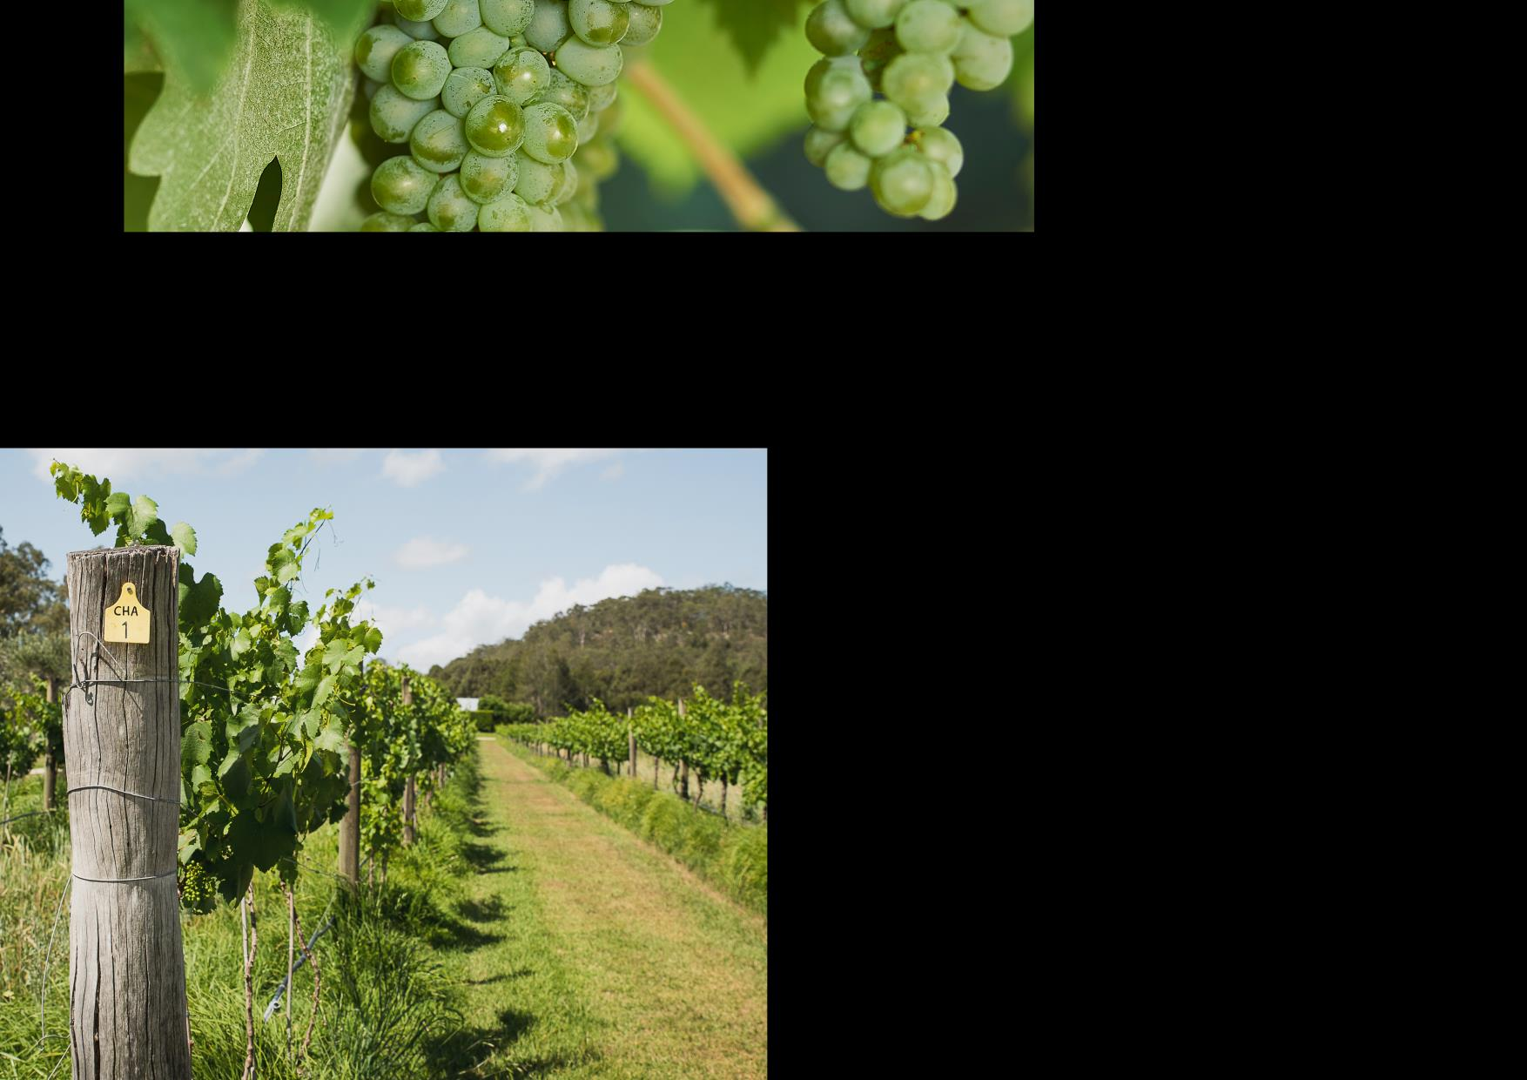
CHARDONNAY:
AUSTRALIA’S CLASSIC WHITE
The most planted white variety and accounts for more than half of white wine production
Australia has some of the oldest plantings in the world
This versatile variety is vinified into all manner of expressions
Evolved from the big, oaky wines of the 1980s and ’90s to more restrained and elegant styles

Slide 32
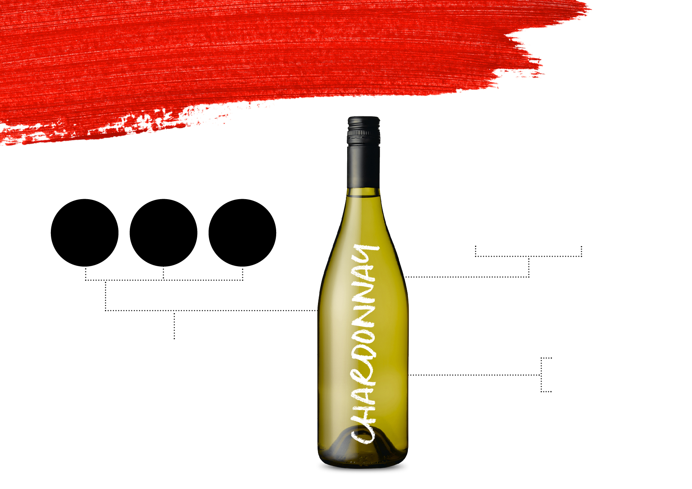
STYLES AND
CHARACTERISTICS
AUSTRALIAN WINEMAKERS HAVE EMBRACED ALL FLAVOURS AND CHARACTERISTICS OF THIS VARIETY
UNOAKED
OAKED
SPARKLING
THREE BROAD STYLES
STYLES RANGE FROM
Citrus
Stone fruit
nuts
LEAN AND LIGHT-BODIED COOL-CLIMATE EXPRESSIONS TO FULLER-BODIED, RICH AND RIPE VERSIONS FROM WARM CLIMATES
TYPICAL
FLAVOURS

Slide 33
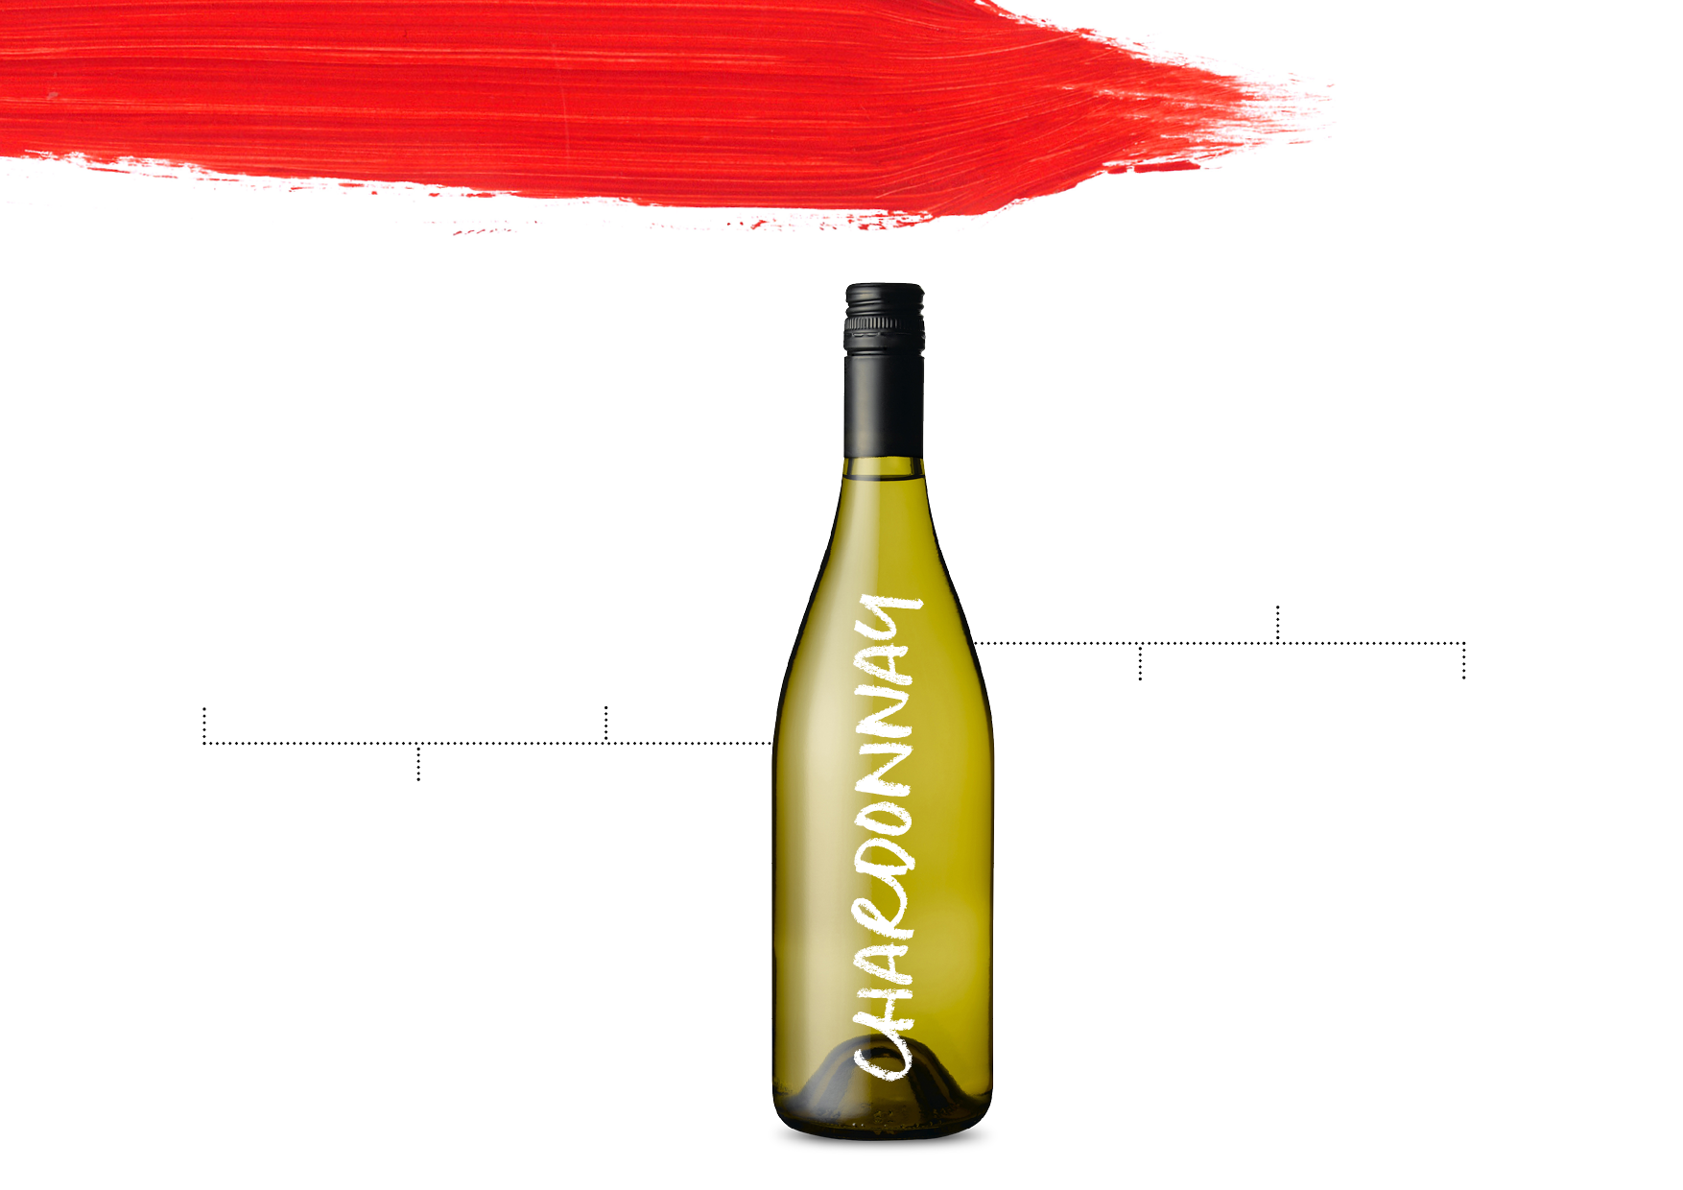
KEYREGIONS
MORNINGTON PENINSULA
Styles range from delicate and unoaked through to medium‑bodied wines with rich complexity. Typical flavours of melon, citrus and fig
ADELAIDE HILLS
HUNTER VALLEY
Elegant, textured and lean, these wines stand up against the finest cool-climate Chardonnays in the world
The previously oaky and rich styles of this warm-climate region have evolved into elegant and restrained yet full-flavoured wines
TASMANIA
YARRA VALLEY
Dry, delicate wines with piercing natural acidity and intense fine flavours
Elegant and
age-worthy cool-climate wines
with high levels
of acidity and flavours of citrus and stone fruit
MARGARET RIVER
World-class, age-worthy wines with fruit ripeness, flavour depth and refreshing acidity

Slide 34
Additional Resources www.australianwinediscovered.com
Additional Questions:
Christy.Frank@wineaustralia.com

Slide 35
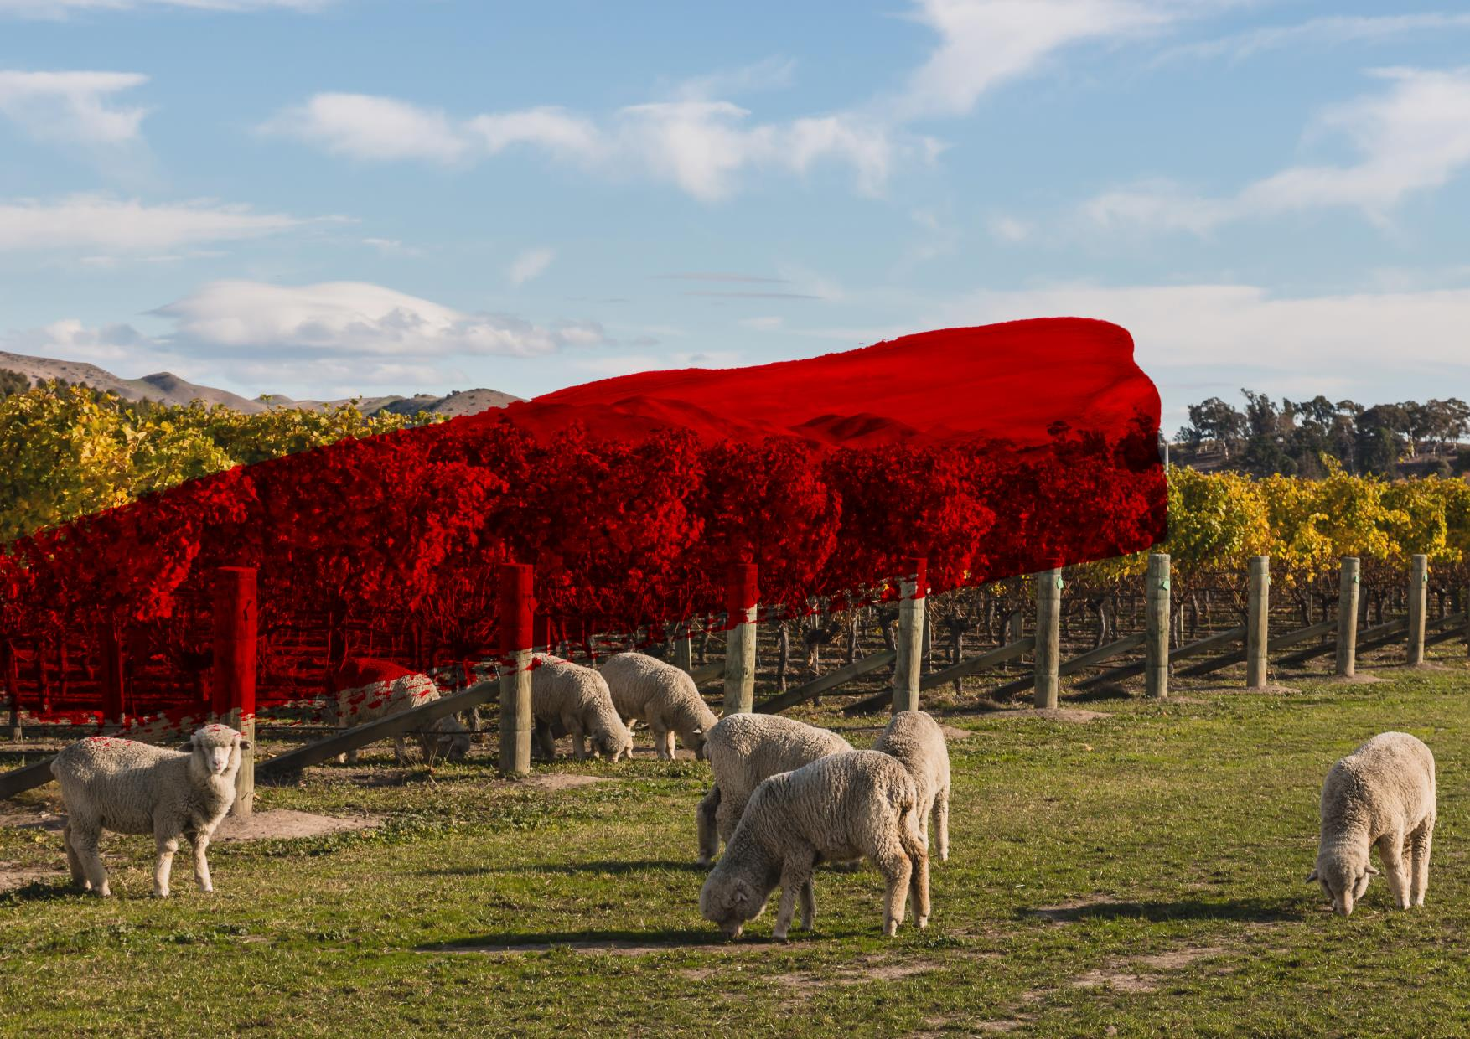
T H A N K Y O U

Slide 36
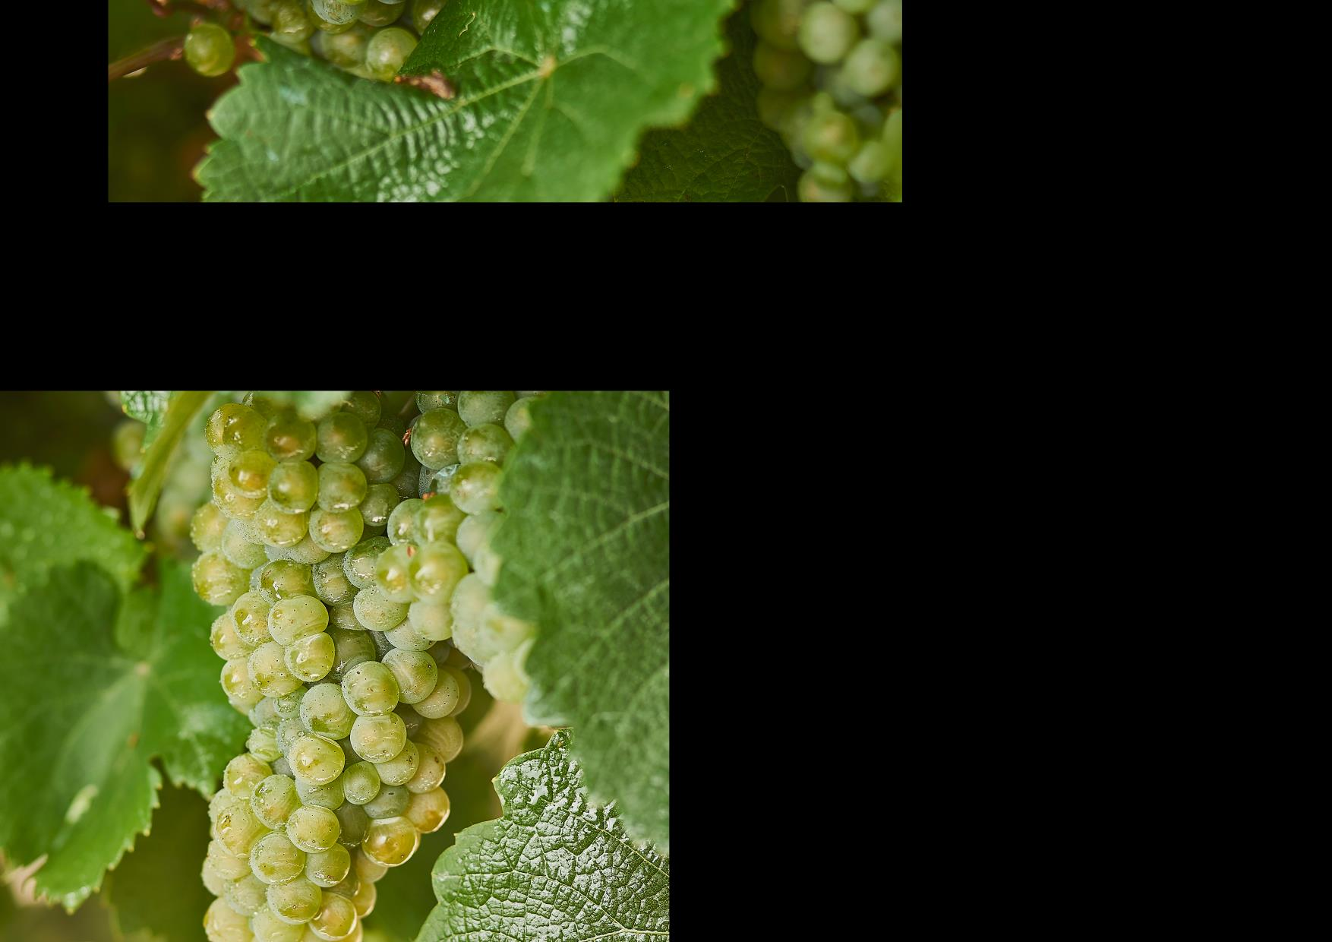
RIESLING:
DIVERSE AND DISTINCTIVE
Australia is one of the world’s top Riesling producers
Long history in Australia; today one of the most renowned varieties
Planted in most wine regions; best examples from cooler areas
Minimal-intervention winemaking approach is common

Slide 37
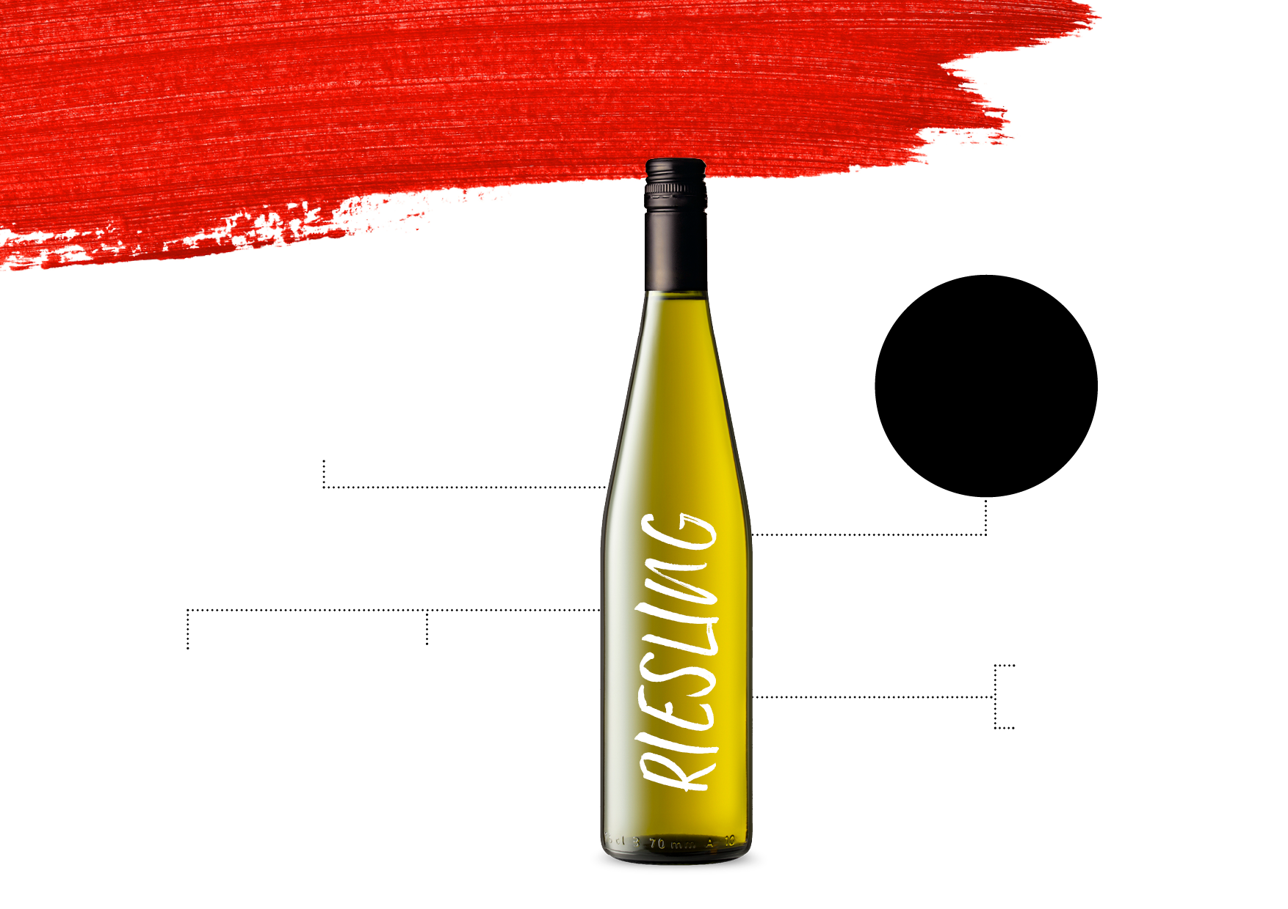
STYLES AND
CHARACTERISTICS
THE MOST COMMON STYLE
IS DRY, WITH
SOME OFF-DRY AND DESSERT WINES ALSO PRODUCED
AROMATIC, LIGHT‑BODIED TO MEDIUM‑BODIED, HIGH ACID PRESENCE
YOUTHFUL
AGED
TYPICAL
FLAVOURS
Citrus
Apple
Honey
Zippy, fresh and drinkable
Honeyed, smooth and rich

Slide 38
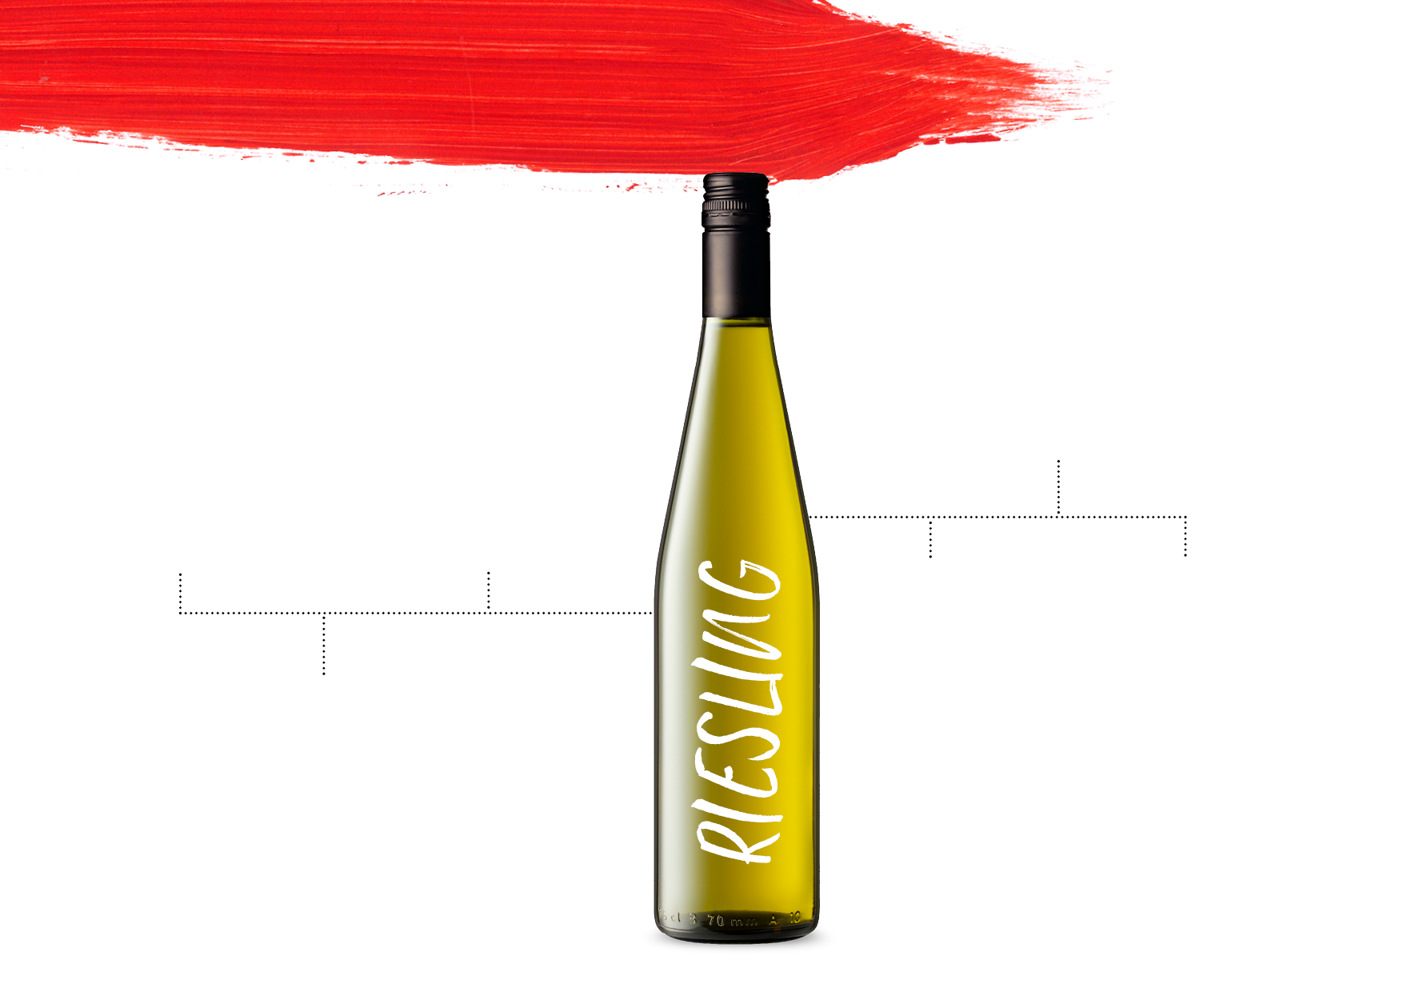
KEYREGIONS
GREAT SOUTHERN
CANBERRA DISTRICT
CLARE VALLEY
Rieslings of great intensity that are fresh and nervy in their youth and age superbly
Some of Australia’s best Riesling; signature notes of lemon and lime, with fruit richness and a long, lingering persistence
Typical style is crisp and dry; off-dry styles are making a comeback. Excellent ageing potential
SOUTH
WESTERN
VICTORIA
TASMANIA
Great length with citrus and mineral characters and high levels of natural acidity
EDEN VALLEY
Fine, lime-accented and
age-worthy
wines
Signature slate, mineral character, strong lime juice and fragrant
floral aromas; can take 10+ years to reach peak

Slide 39
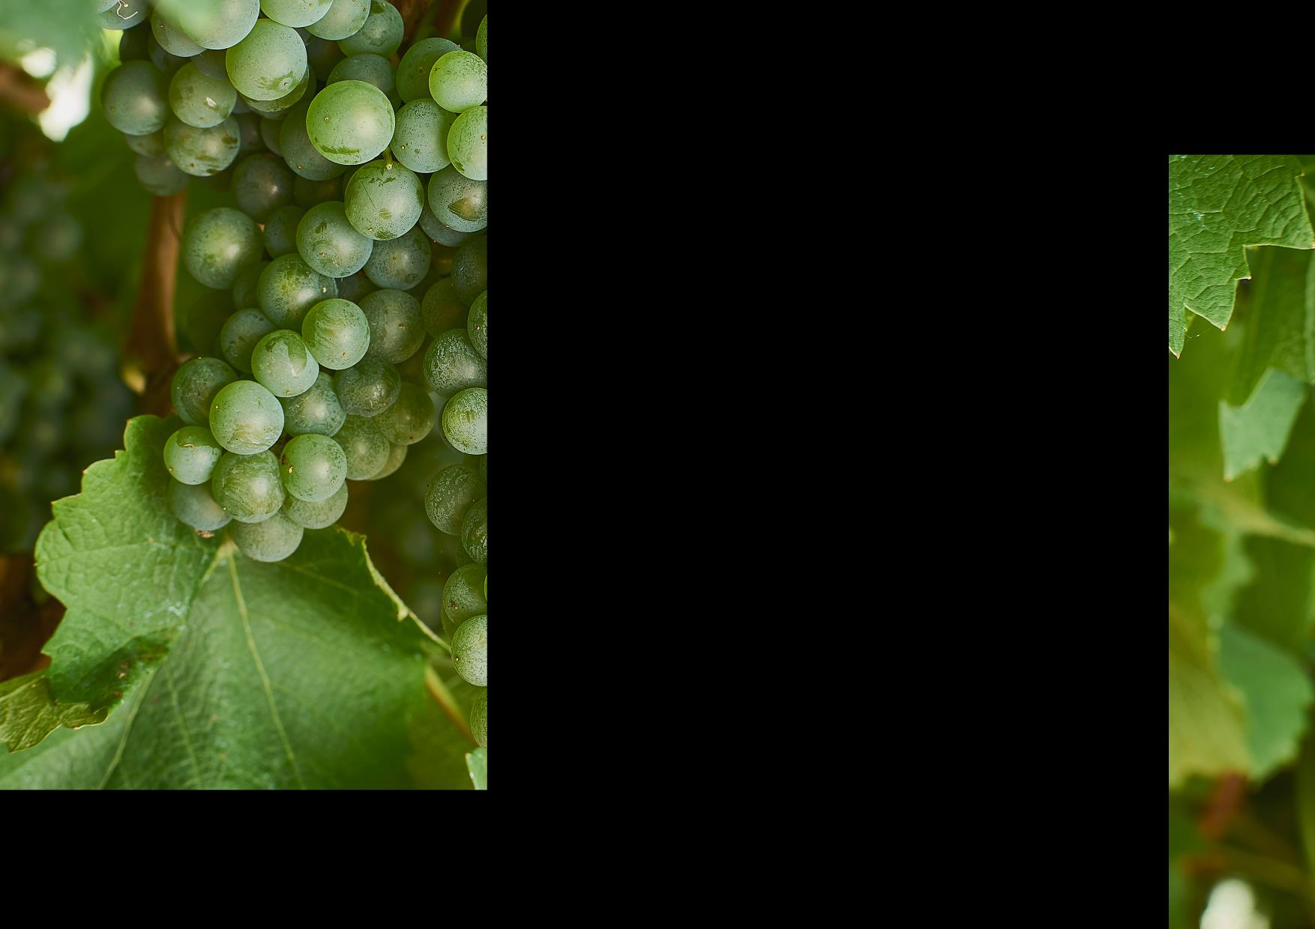
SEMILLON:
A TRULY UNIQUE EXPRESSION OF A CLASSIC
Long history in Australia
Delicate, versatile grape produced in a range of styles
Potential to age for many years
Lends itself to botrytis, or ‘noble rot’, to produce one of Australia’s most celebrated sweet wine styles

Slide 40
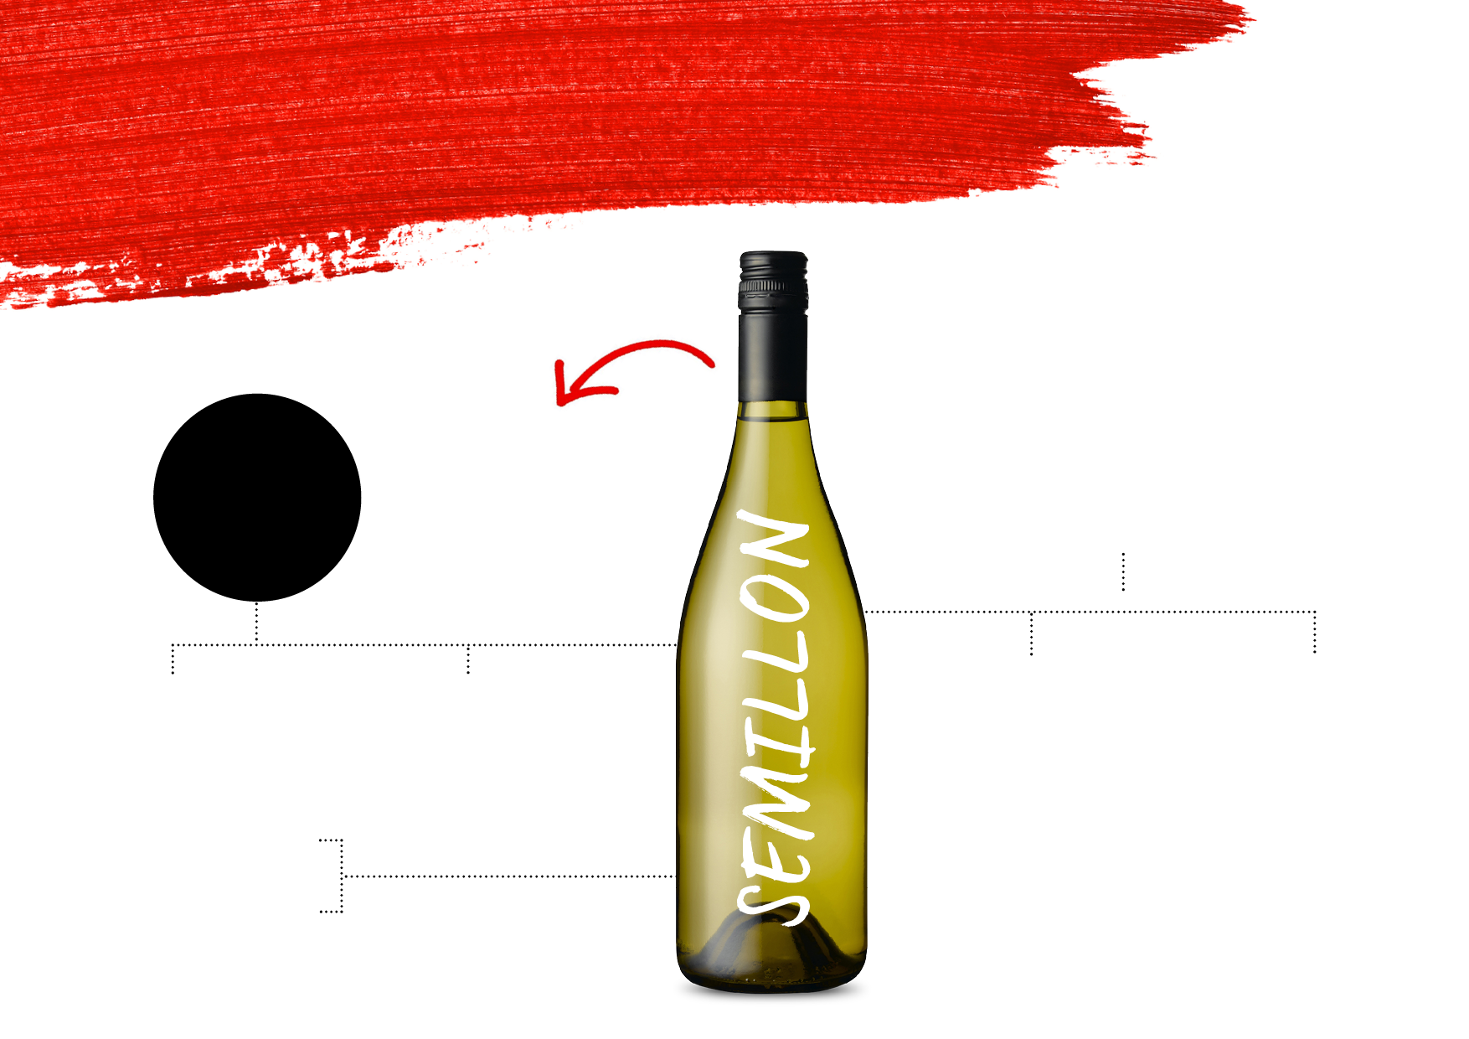
STYLES AND
CHARACTERISTICS
FOUR DISTINCT STYLES:
COMMONLY BLENDED
LIGHT-BODIED TO MEDIUM-BODIED DRY WINES
WITH OTHER VARIETIES INCLUDING SAUVIGNON BLANC
UNOAKED, OAKED, BLENDED,
DESSERT WINE
BLENDS
YOUTHFUL
AGED
SEMILLON CONTRIBUTES
CRISP, CLEAN, ELEGANT
Crisp, fresh and citrusy
Richer with notes of toast and honey
FLAVOUR AND ROUNDNESS TO THE SHARPER SAUVIGNON BLANC NOTES
AND FRUIT-DRIVEN, AND GENERALLY MADE FOR EARLY DRINKING
Citrus
Apple
Honey
TYPICAL
FLAVOURS

Slide 41

KEYREGIONS
BAROSSA VALLEY
Typically riper, richer styles that are often barrel fermented, however styles are becoming more crisp and delicate
MARGARET RIVER
Semillon Sauvignon Blanc blend is a signature style, known for its liveliness and bright personality
HUNTER VALLEY
Unoaked Hunter Valley Semillon is unique in the wine world, capable of ageing gracefully for well over 20 years
RIVERINA
Produces gloriously sweet, intense and complex botrytis Semillon dessert wines

Slide 42
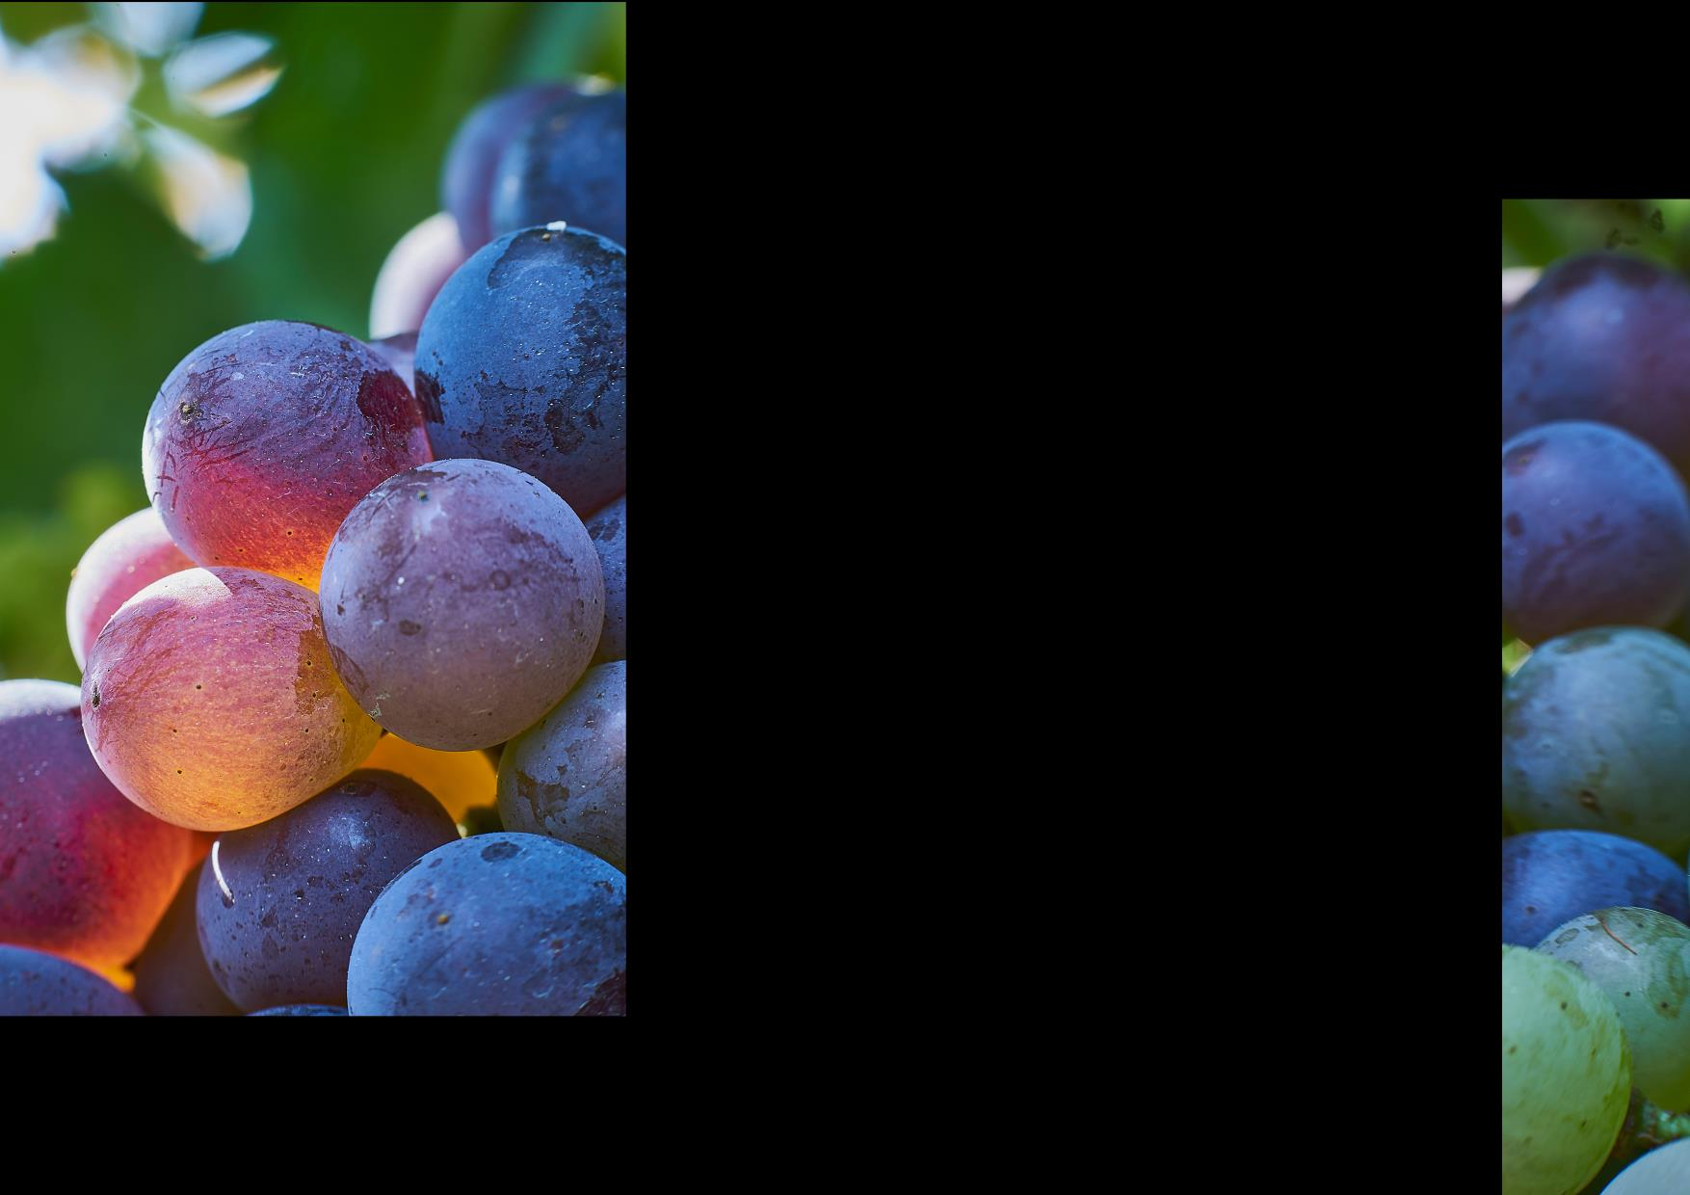
GRENACHE:
REBIRTH OF A CLASSIC
One of the original varieties planted in Australia
Australia boasts some of the oldest Grenache vines in the world
A workhorse grape somewhat overlooked in the early years
Today its enjoying a revival as winemakers recognise its exciting potential

Slide 43
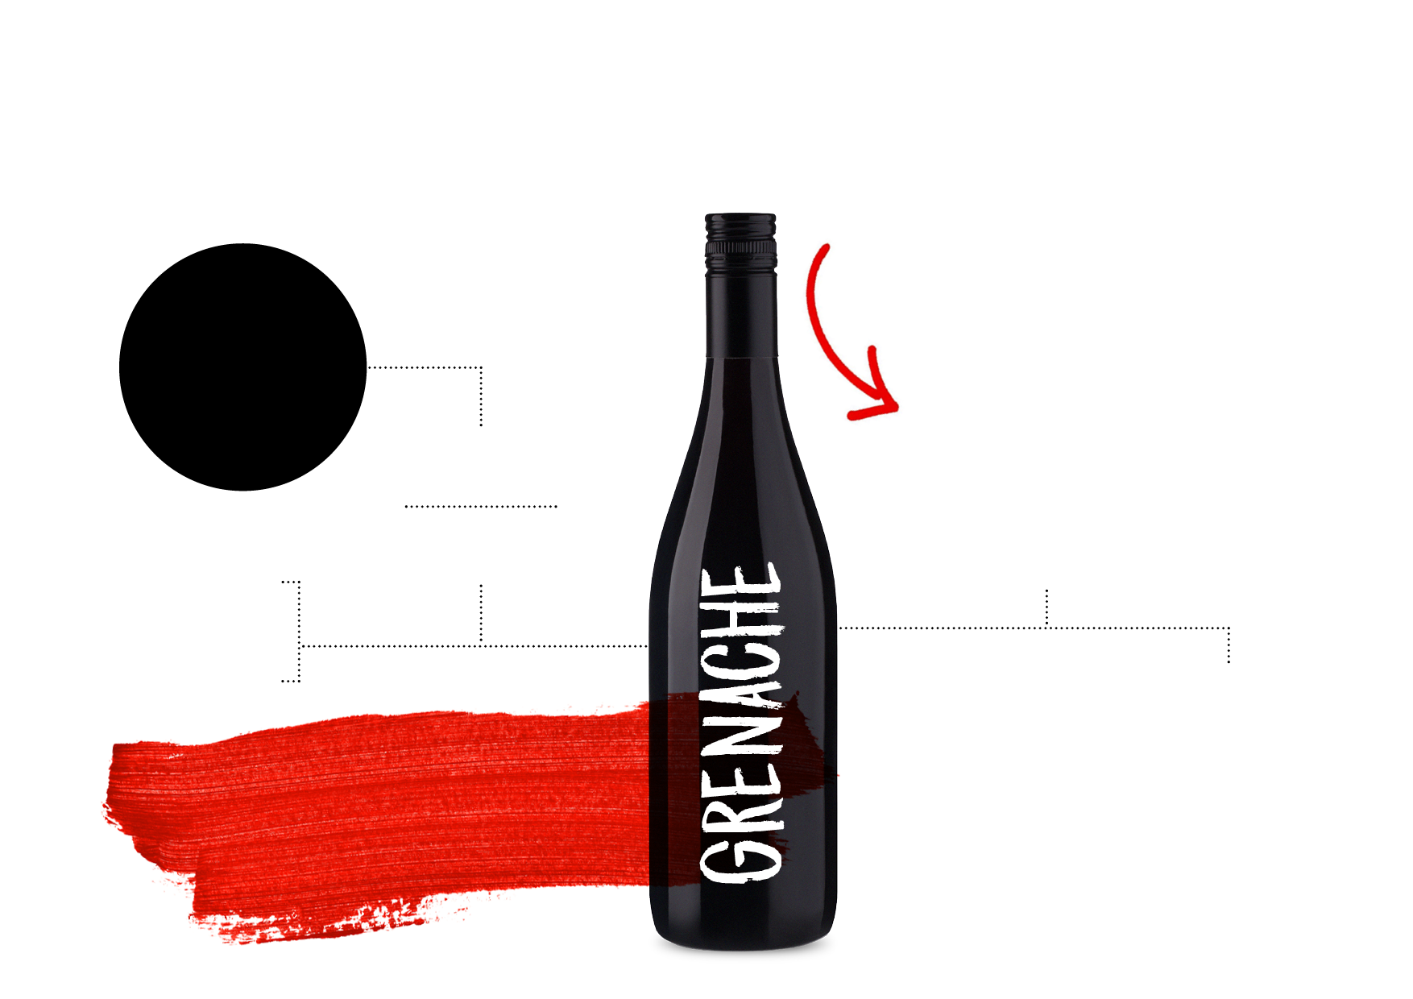
STYLES AND
CHARACTERISTICS
KEY
REGIONS
USED IN SEVERAL WAYS: AS A VARIETAL RED WINE, IN BLENDS, IN ROSÉS AND
IN FORTIFIED WINES
BAROSSA VALLEY
Warm conditions and cool nights produce medium-bodied to full-bodied wines with rich texture and notes of red fruit, earth and white pepper;
GSM blends often consist of Grenache from old vines
Typically medium-bodied to full-bodied
TYPICAL
FLAVOURS
Perfumed, elegant and food-friendly
Cherry
Berry
Spice
McLAREN VALE
Medium-bodied to full‑bodied wines with rich texture, spice and ripe, juicy fruit; GSMs are full-bodied, with a juicy mouthfeel, fine tannins and great length
TODAY’S STYLES VARY FROM RICH AND INTENSE TO LIGHTER, BRIGHTER WINES

Slide 44
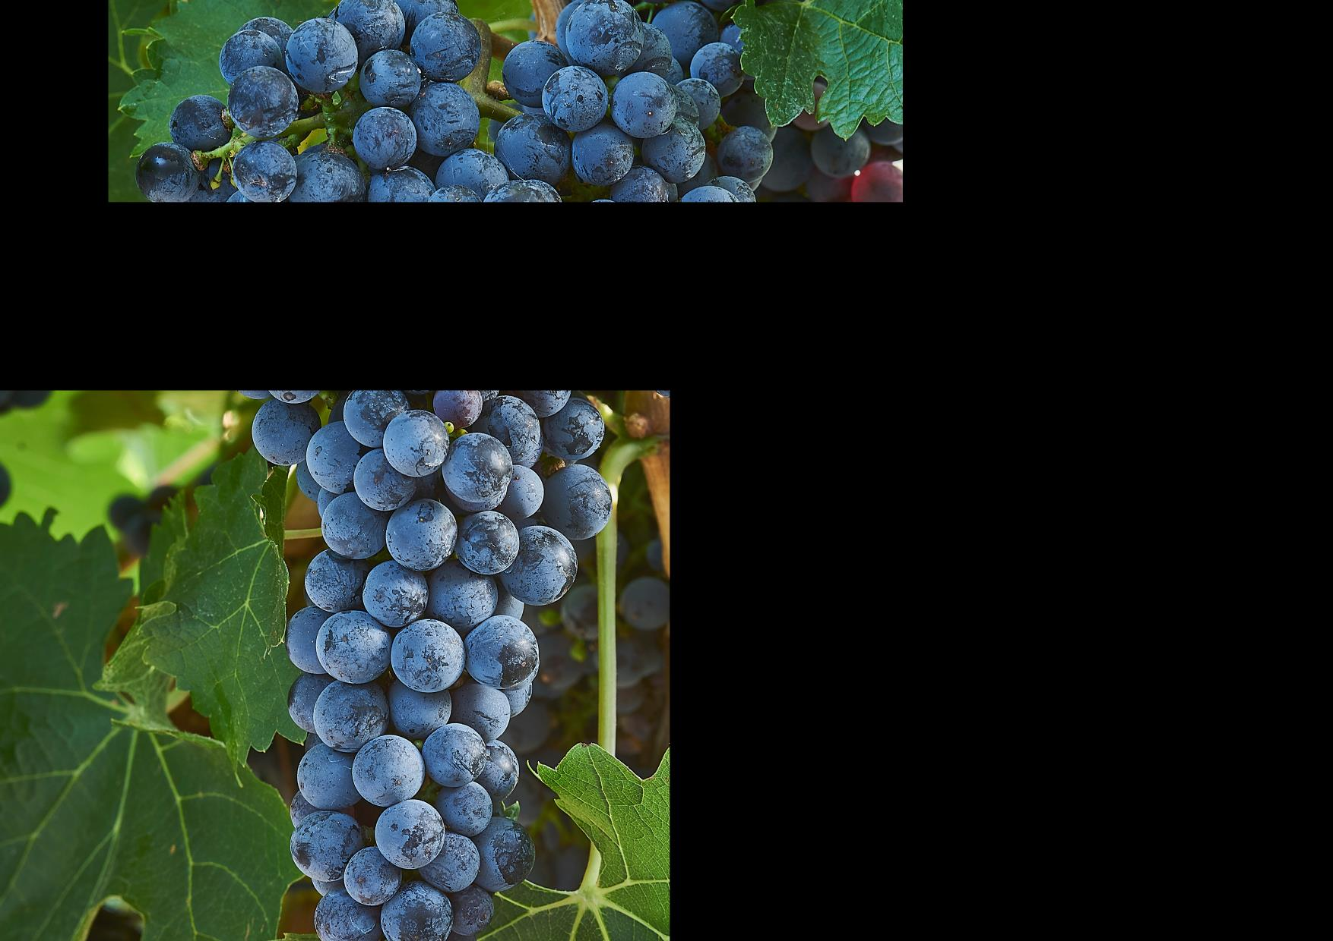
CABERNET SAUVIGNON:
POWERFUL AND AGE-WORTHY
Australia’s third most planted grape variety
Known for its intensity of colour, flavour, acidity and tannins, and its ability to age for many decades
A fixture in a lot of Australia’s most historic and successful wines
Grows best in warm to cool, dry regions

Slide 45
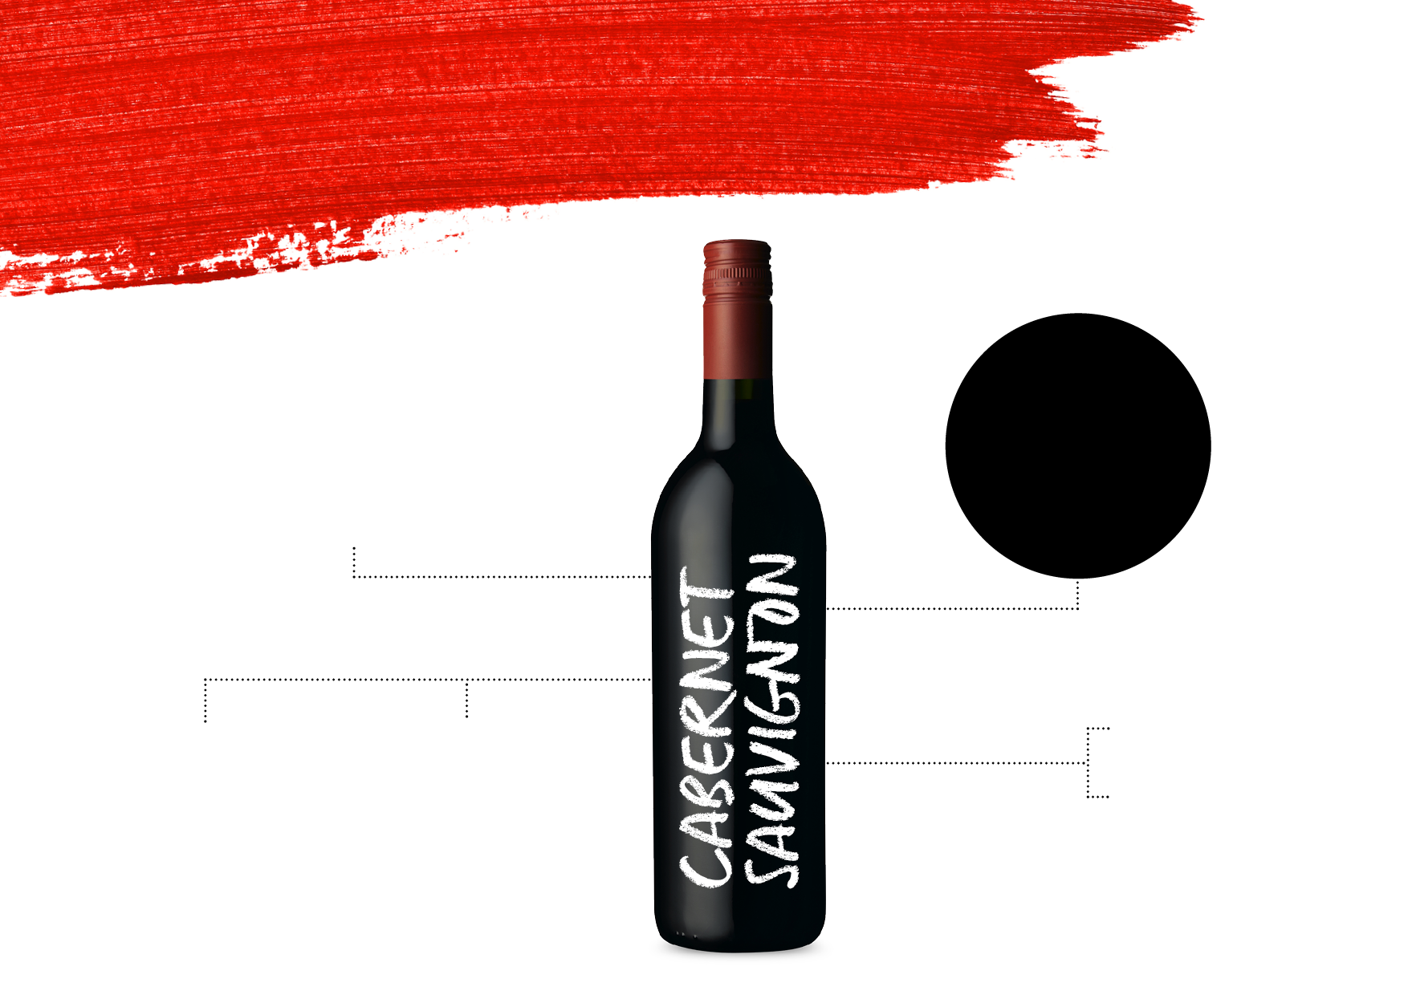
STYLES AND
CHARACTERISTICS
AUSTRALIA IS KNOWN
FOR FULLER-BODIED, CONCENTRATED CABERNET, BUT ALSO PRODUCES MEDIUM‑BODIED, TANNIN‑DRIVEN STYLES
SUCCESSFUL AS BOTH A SINGLE-VARIETY WINE AND A DOMINANT FEATURE IN CLASSIC BLENDS
YOUTHFUL
AGED
TYPICAL
FLAVOURS
Blackberry
Cherry
Mint
Firm tannins, high acidity, flavours of cassis, blackberry
and herbs
Tannins soften, mellow and smooth, characteristics of cedar, tobacco, earth, cocoa

Slide 46
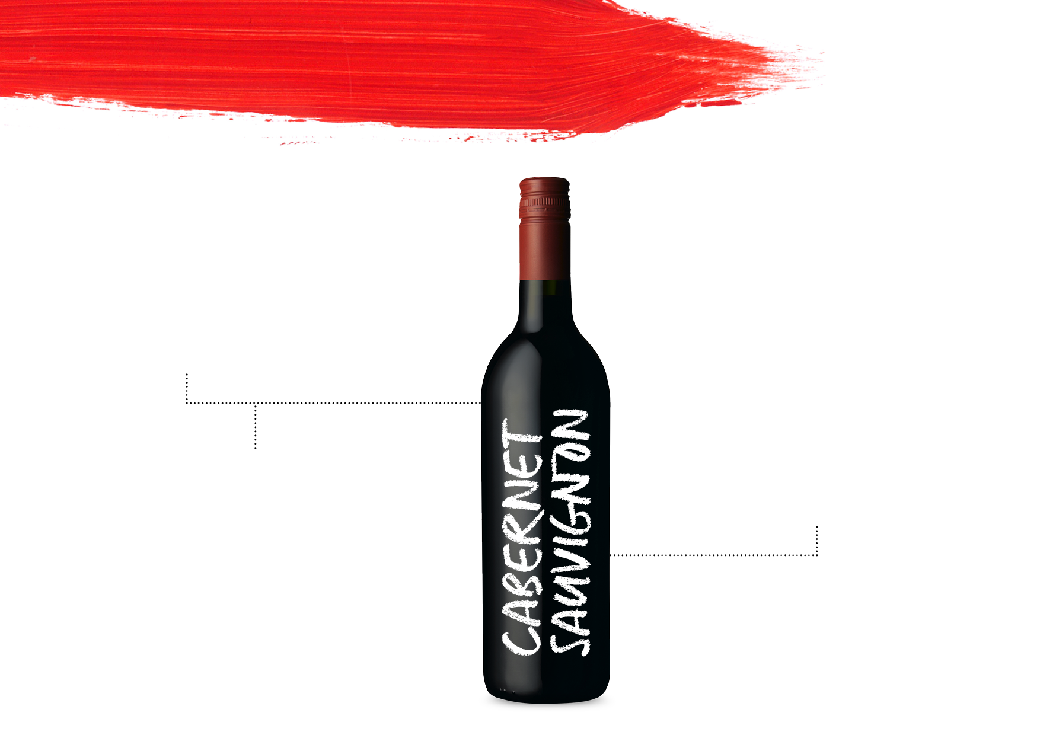
KEYREGIONS
COONAWARRA
Powerful, complex Cabernet wines; medium‑bodied to full-bodied with concentrated flavours of blackcurrant, mulberry, plum, blackberry and dark cherry
MARGARET RIVER
Medium-bodied to full‑bodied; richer
and more rounded
in texture than those of Coonawarra;
dark, blueberry fruit characters and bay leaf, bouquet garni or dried‑herb aromas
LANGHORNE CREEK
Full-bodied, rich, flavourful wines with soft tannins and ripe black-fruit flavours. Signature style blends Australian Shiraz with Cabernet

Slide 47
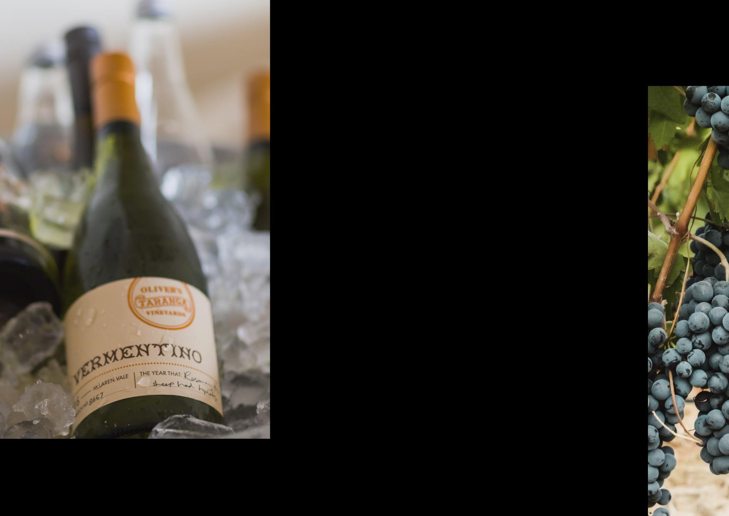
ALTERNATIVE VARIETIES:
INNOVATION AND DIVERSITY
Southern Mediterranean varieties well suited to Australia’s climate, food and lifestyle
Each year the number of alternative varieties being planted increases
They currently account for only 4% of Australia’s wine-producing vineyards, but are attracting attention worldwide

Slide 48
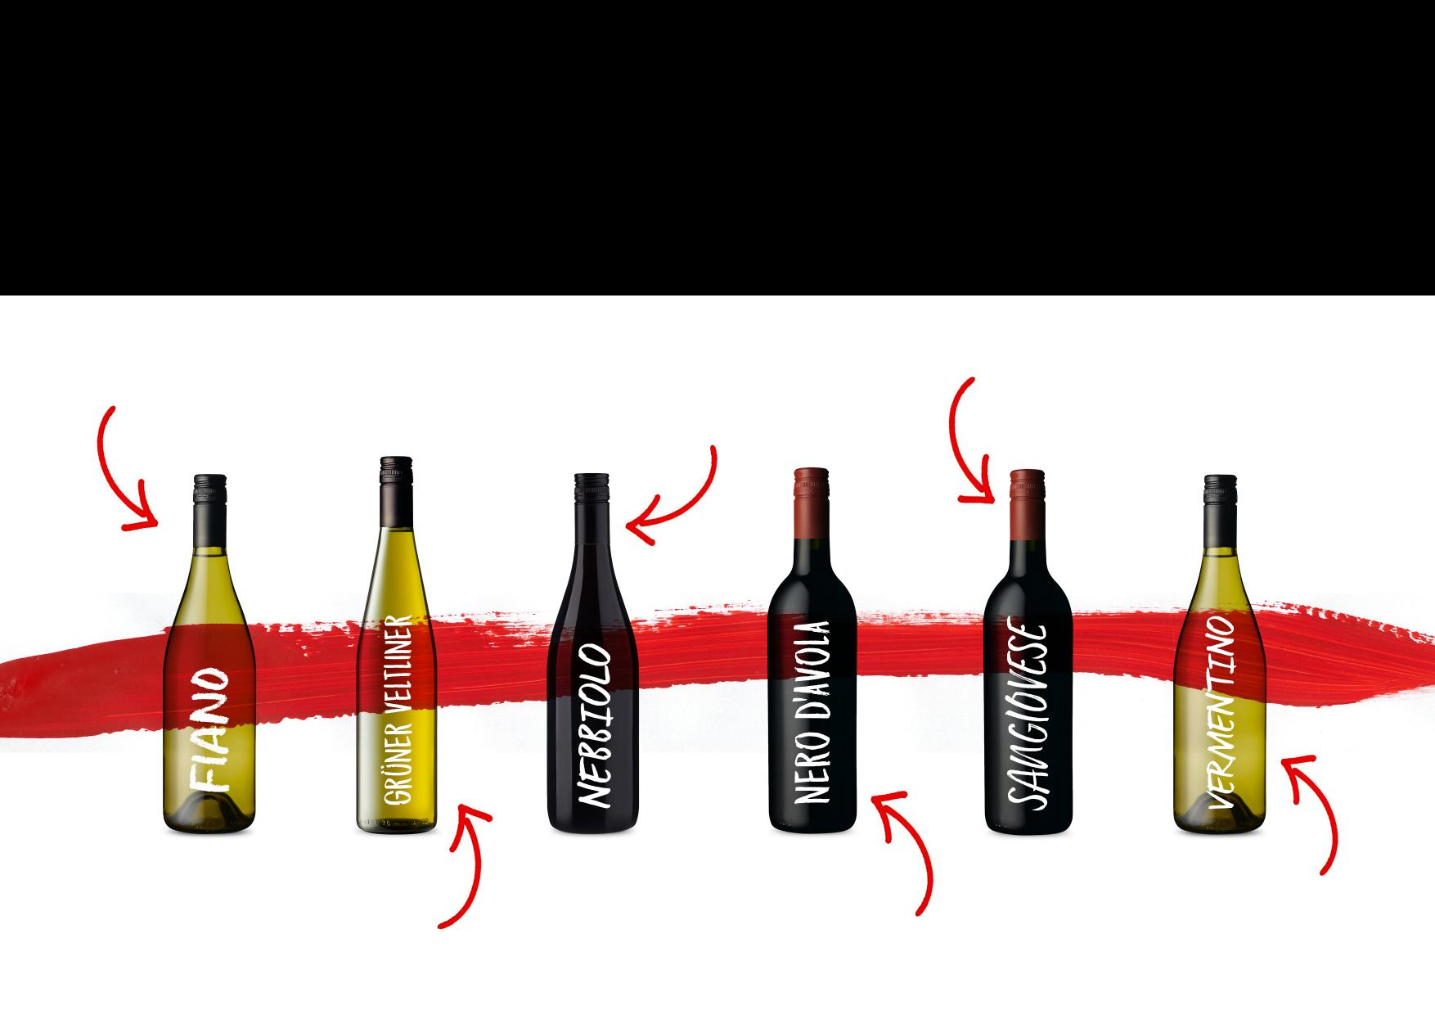
VARIETIES
ON THE RISE
FIANO: Crisp, fresh and aromatic; flavours range from citrus to stone fruit to hazelnut
NEBBIOLO: Fruit-pure and fresh to powerful, aged and age-worthy
SANGIOVESE: Firm tannins; aromatic notes of plum, cherry, herbs
GRÜNER VELTLINER: Aromatic and refreshing; quite dry,
savoury and somewhat fruity
NERO D’AVOLA: Medium‑bodied, naturally fresh acidity, generous tannins, food-friendly
VERMENTINO: Ranges from fresh to textural; notes of almond,
citrus, green apple and ‘sea spray’

