Slide 1
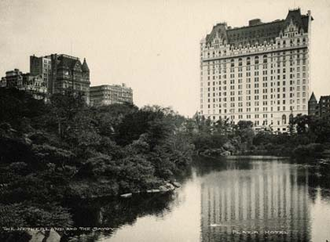
Chapter 2 & 3: The Hotel Business
Prof. Karen Goodlad
Spring 2020

Slide 2
Class Objectives
Identify the scope of the hospitality and tourism industry.
Explore the roles and responsibilities of key executives and department heads in the hospitality industry.
Differentiate hotel classifications.

Slide 3
NY Times, 36 Hours in…
Industry Research Assignment
Hotel and Lodging Industry Lecture
Small Group Discussion

Slide 4
Travel
36 Hours
What to do when you've got 36 hours to get to know a city.
Do you believe the author of this week’s “36 Hours in…” article provided a valid reason for someone to visit the location featured. Use your knowledge of how to assess a tourism experiences to justify your answer…

Slide 5
Industry Research Assignment
Peer Review

Slide 6
Hotel and Lodging
What does it mean to you that the lodging industry is a more than $155 billion industry, which includes approximately 54,200 properties with almost 5 million guestrooms.

Slide 7
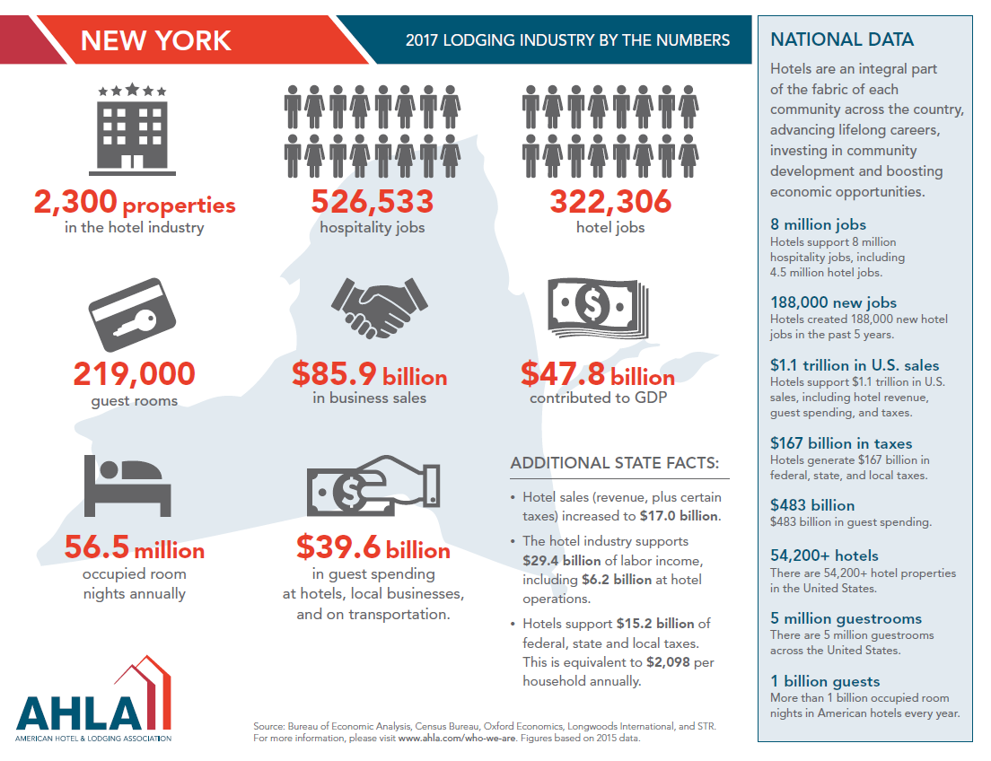
Notes:
What does this information mean to you?
With a partner, identify two pieces of information listed and explain what the information means to you.
With a partner, based on the information, develop two questions that arise based on the information presented.
The Economic Impact of Hotels (1 of 2)
Hotels provide direct and indirect economic impact to their communities.
Direct
Sales of rooms mean millions of dollars into the local community.
Indirect
The ripple effect (or Multiplier Effect) when money spent by tourists and employees is re-spent in the community.
The Economic Impact of Hotels (2 of 2)
Communities also benefit from the Transient Occupancy Tax (T O T), or the bed tax.

Slide 8
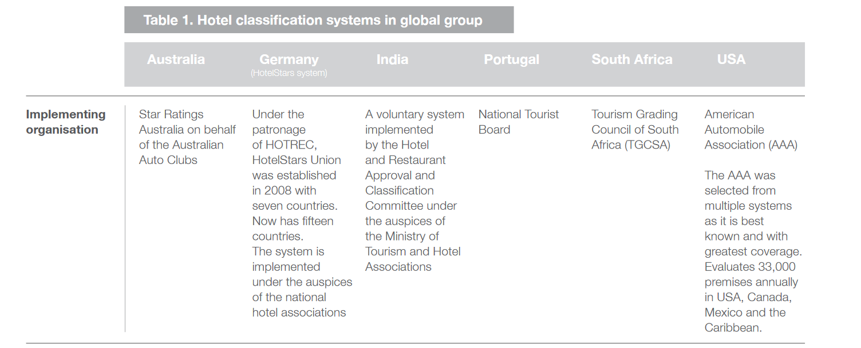
Hotel Classifications, Sample Countries
Source: http://cf.cdn.unwto.org/sites/all/files/pdf/hotel_classification_systems_recurrence_of_criteria_in_4_and_5_star_hotels_0.pdf

Slide 9
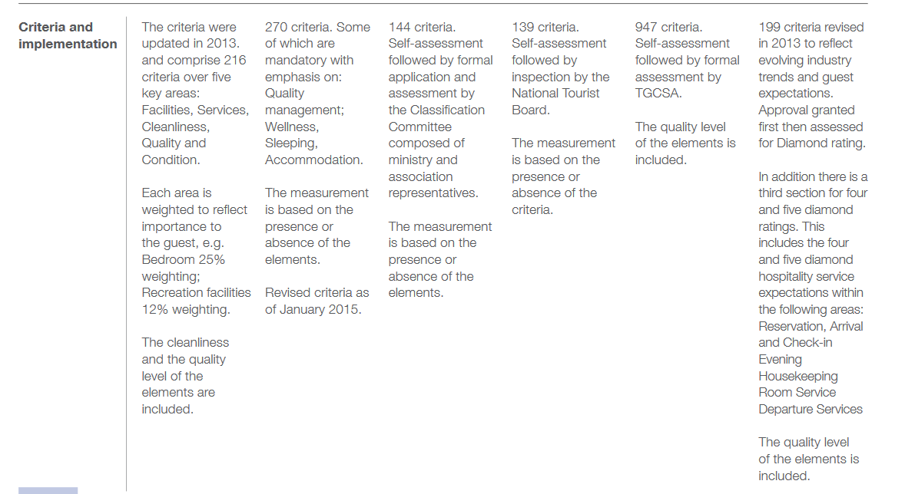

Slide 10
Hotel Classification AAA
AAA Diamond Award:
  Inspecting and rating the nation’s hotels since 1977
  Less than .4% are 5 Diamond
  6.3% are 4 Diamond
Resources
  Get the details: https://www.caaquebec.com/fileadmin/documents/PDF/Sur_la_route/Hotels_et_restaurants/Criteres_approbation_hotel_en.pdf
  2016 Awards: http://travel.usnews.com/features/aaa-announces-2016-diamond-award-winners/
What are the benefits of a classification system to the consumer/the hotel brand?
Notes:
Hotel classification is the ranking of hotels, usually by using nomenclature such as stars (or diamonds), with one star denoting basic facilities and standards of comfort and five stars denoting luxury in facilities and services. The purpose is to inform intending guests in advance on what can be expected in order to reduce the gap between expected and experienced facilities and service delivery. The terms ‘grading’, ‘rating’, ‘classification’ and ‘star rating’ are used to refer to the same concept, i.e. to rank hotels by their facilities and standards.

Slide 11
Hotel Classification by Rating System:
A A A and Forbes
About 3% of the 59,000 properties inspected by A A A in North America earn the 5-diamond award each year.
121 lodging properties received this highest award.
Forbes uses a 5-star rating system, with only a few dozen earning its highest awards.

Slide 12
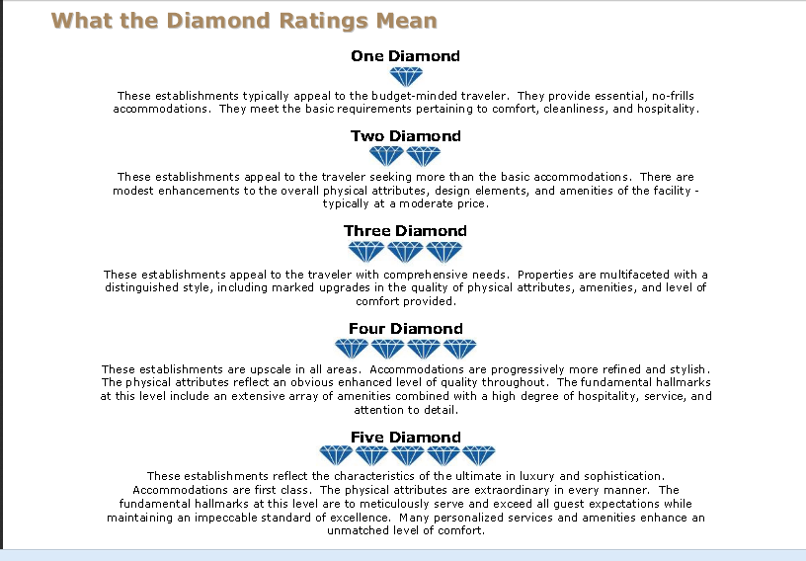

Slide 13
Types and Locations of Hotels
City center: Meets the needs of the traveling public for business or leisure reasons
Resort: Inclusive and diversified in accommodations
Airport: Guest mix consists of business, group, and leisure travelers; generally in the 200- to 600-room size and are full-service
Freeway hotel and motel: A convenient place to stay, reasonably priced, and with few frills
Casino: Coming into the financial mainstream; casinos make more money from the gaming than from the rooms
Convention: Provides facilities and meets the needs of groups attending and holding conventions

Slide 14
Types and Locations of Hotels
Full-Service: Offers a wide range of facilities, services, and amenities
Economy/Budget: Reasonably sized and furnished rooms without the frills
Boutique: Unique architecture, style, decor, and smaller in size
Extended-Stay: Majority of guests are long term
All-Suite Extended-Stay: Additional space in the form of a lounge and possibly kitchenette
Condotels: Combination of hotel and condominium
Mixed-Use: Hotel that may also have residences
Bed & Breakfast: Accommodations with the owner, who lives on the premises or nearby, providing a clean, attractive accommodation and breakfast

Slide 15
Hotel Development & Ownership
Franchising
Franchisee pays to use the brand/ name/logo/management practices/amenities of a proven organization. Must comply with franchisor's standards.
Owned and operated independently.
Referral
Associations
Management Contracts
Independent hotels Refer their clients to each other and share a central reservation system (CRS) Example: Leading Hotels of the World and Preferred Hotels and Resorts World Wide and Historic Hotels of America
Independent property owner or bank will utilize the management team of a hotel brand to manage the hotel. The owner also uses the brand/ name/logo/amenities of the management company.

Slide 16
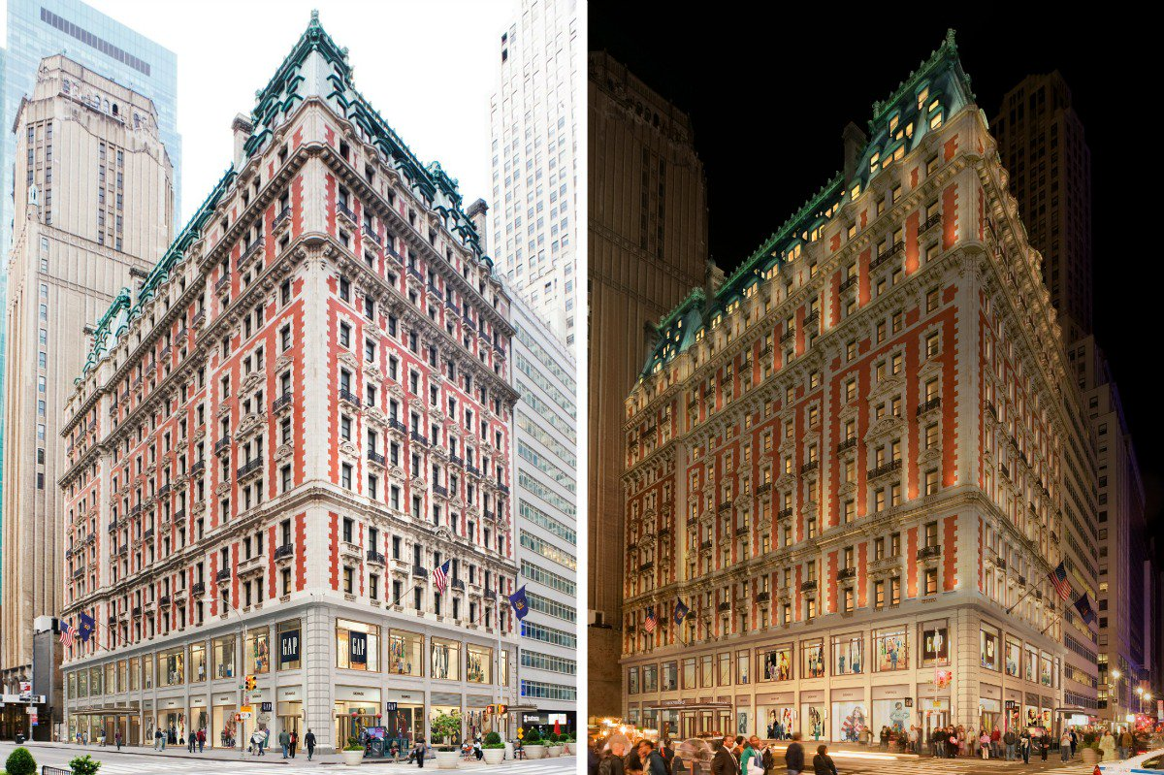
What differentiates a hotel franchise from a management contact?
Notes:
Franchising (1 of 4)
Franchising in the hospitality industry is a concept that allows a company to expand more quickly by using other people’s money, rather than using its own financing.
Franchising (2 of 4)
Under a franchise agreement, the company or franchisor grants certain rights—for example, the right to use the company’s trademark, operating procedures, reservation systems, marketing know-how, purchasing discounts, etc., for a fee.
Franchising (3 of 4)
In return, the franchisee agrees to operate the restaurant, hotel, etc., within guidelines set by the franchisor.
Franchising was the primary growth and development strategy of hotels and motels during the 1960s through the 80s.
Franchising (4 of 4)
Challenges to the franchise agreement include the maintenance of quality standards and the financial stability of the franchisee.
Franchise fees can vary tremendously and are often negotiated between the franchisor and the franchisee.
The average agreement is 3% to 4% of room revenues.
Management Contracts (1 of 3)
Management contracts are popular because there is little or no upfront financing or equity involved.
The management contract usually allows for the hotel company to manage the property for a period of years.
Management Contracts (2 of 3)
In return, the company receives a fee determined by a percentage of gross or net profit.
These contracts usually state a percentage of sales or operating profit at 2 + 2 percent.
Management Contracts (3 of 3)
Hotel companies enter into these contracts because less capital is “tied-up” in managing a property than is required in owning them.

Slide 17
In Class Activity:
Referral Associations

Slide 18
Real Estate Investment Trusts (R E I T)
About 300 R E I T s exist with a combined market value of $70 billion.
These companies do not pay corporate income taxes.
They are required to distribute 95% of net income to shareholders.
A R E I T must have 75% of its assets in real estate.

Slide 19
Executive Committee Members
General Manager
Dir. of HR
Dir. of F&B
Dir. of Rooms Division
Director of Marketing & Sales
Dir. of Engineering
Dir. of Accounting

Slide 20
What about Air B&B?
CBRE Air B&B Study 2017

Slide 21
U.S. Conference of Mayors Tourism, Hotel and Lodging Survey, 2017
Hotel and lodging businesses are mainstays of their communities, and an important source of quality jobs.
Seventy percent of mayors surveyed said hotel jobs provide the most opportunity, good benefits and wages within the tourism industry.
Hotels support their communities through increased tax revenue, capital investment, tourism-related development and promotion, civic leadership, and charitable contributions and sponsorship.
Hotels benefit the communities in which they operate, with nine out of 10 mayors saying they believe their community would benefit from additional hotels, inns or bed and breakfasts.
One-fifth of all mayors surveyed say tourism and hospitality is the largest sector of their economy – second only to healthcare as a top industry.

Slide 22
What is an OTA?
What is their impact on the hotel industry?

Slide 23
What is an OTA?
What is their impact on the hotel industry?
Online Travel Agency
Price competition
Secured room reservations
Easy comparison to like markets
Defecation in loyalty programs

Slide 24
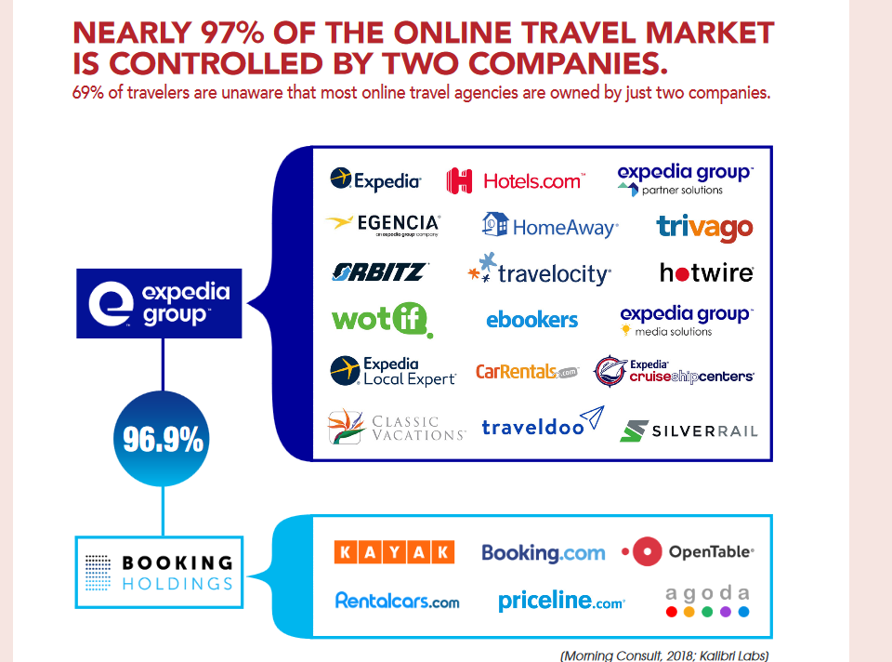
Source: https://www.ahla.com/sites/default/files/2019PolicyGuide1_8Pages.pdf

Slide 25
Expand Your Knowledge
Lodging trends for 2013: http://www.hospitalitynet.org/news/4058659.html
Sustainable Lodging trends for 2013 http://www.hotelnewsnow.com/Article/7958/5-trends-to-green-your-hotel
“Little Rooms, Big Profit” NYTimes
American Hotel and Lodging Association
HSMAI
The Plaza Hotel
  Company Website

