Slide 1



Hidden Careers in Hospitality Management
Prof. Karen Goodlad, CSW
HMGT 1101, Spring 2020

Slide 2


Make a List
What makes you happy?
What excites you?
What are you good at?
What do you

Slide 3
Food Service Paths
Currently Design and Operations Coordinator for BET.
Four jobs that helped me get here: Office Manager/HR Coordinator at Landmarc at the Time Warner Center, Floor Manager at Maison Kayser, Operations Coordinator for Sweetist, Jr. Floor Manager for Financier Patisserie
Currently the Executive Dining Manager for ViacomCBS.
Formally the Beverage director for the Met Museum. What got me here was my love for the industry, hard work, and dedication, plus all the people that believed in me. I’ve worked in hotel’s and independently owned restaurants.

Slide 4
What do the Two Career Paths have in Common
Current Professional Position: Director of Special Events at CUNY
Current Personal Business: Felix Vargas Management
Jobs that helped me get here:
1) Director of Events at Punto Space
2) Assistant Creative Producer at Fyre Festival
3) Exec Event Producer at The Style Marc
4) Assistant Manager at Cafe 2/Terrace 5 at MoMA
Owner and Wedding & Event Planner for my own company.
Formerly worked at The Sherry~ Netherland Hotel - Housekeeping,
Grand Hyatt - Culinary, pastry, banquet, catering department
The Peninsula NY Hotel catering department and Mandarin Oriental NY Food and beverage.
Notes:
Answer 2: hospitality has prepared me for crisis like theses. I have had electric fires in venue prior to an event 5 days prior, I have also had a decor company warehouse burn down and lost all inventory. So crisis I'm prepared.

Slide 5
Compare These Two Beverage Career Paths
Currently Marketing Manager for Wines of South Africa. Four jobs that helped me get here: Beverage Director at Megu and then Armani; Freelance writer; Teacher, English as a foreign language in Germany; Composer.
Before I got into this business, I was heavily involved in the music world from the age of 15. Worked in both musical instruments and record retail, booked and managed bands, did PR and worked from a CD one stop selling imports online back in the days of CD wow! Then spent several years as an executive assistant in home fragrance and non-profits before landing a gig as an associate director of a small non-profit where I had to write grants for 1st responders. 14 years into the alcoholic industry and still scratching my head on "how did I get here".

Slide 6
Management and Education Contrast the Path
I am a Chef Instructor/Hospitality Educator.
My NYCCT education, as well as jobs I've had have brought me to where I am now. Most recent jobs before my current one at Auguste Escoffier School of Culinary Arts, would be Le Cordon Bleu, Lenox Hill Neighborhood House, and PRINT. My culinary skills refine and just get better with teaching, as well as team/student management in the classroom, and my food costing skills have been better than they have ever been before! Teaching is a very rewarding job and I am very happy to help others grow!
General Manager at Jajaja Mexicana currently.
Previously: administrative assistant to the director of staffing at CXRA (catering by restaurant associates) and then went on to be a catering manager at a law firm here in NYC with Restaurant Associates. After that I took some time off and worked in a cocktail bar learning all things cocktails and then I was led to my current position as a manager and just recently was promoted to GM

Slide 7
I saw your post and thought of my years working at CitiField and in Sports and Entertainment - a sector I never thought of or was really introduced to while at school. I only came across it because of the difficulties we faced finding jobs after the 2008 crash. I am not currently working (due to an on the job injury) but I left Citi as a Restaurant Manager. That in itself is not a hidden career but running one in a stadium is very different than any standard operation. Some of the jobs I had (all within the same company) to get there were suite and catering supervisor, sales manager, Premium Manager at a minor league stadium - covering everything from menu creation, suites operations, private events, and overseeing the player meals. I never thought I would work at a stadium while in college but I enjoyed the high pace environment and spent 8 years with the company.

Slide 8
The Walt Disney Company as a Foundation
Currently operations manager for a school feeding facility in Trinidad and owner of limousine company.
Jobs that got me here are; Disney’s College Program, NYC schoolfood program, bartender in queens NY, lecturer in Trinidad and Tobago Hospitality and Tourism Institute
Current position: Specialist, Customer Engagement and Planning at American Airlines.
Jobs that helped me get here: Disney college program, vacation planner. Merchandising Intern and then Supervisor at Yankee Stadium. Sales Planning Intern at American Airlines.

Slide 9
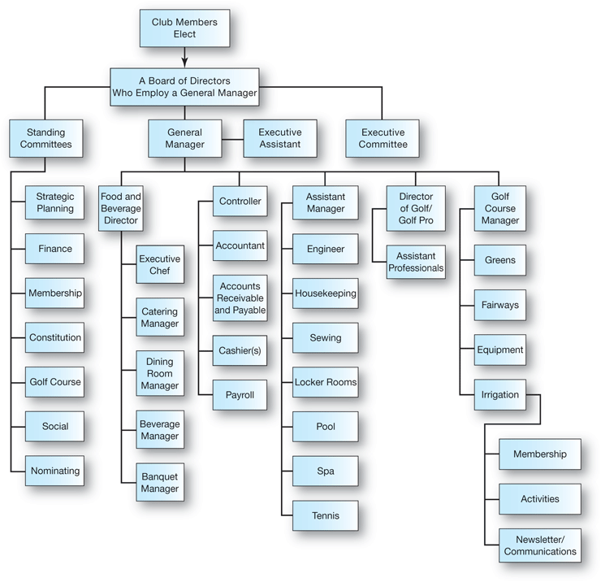
Source: Walker and Walker. (2020) Introduction to Hospitality. Chapter 10,

Slide 10
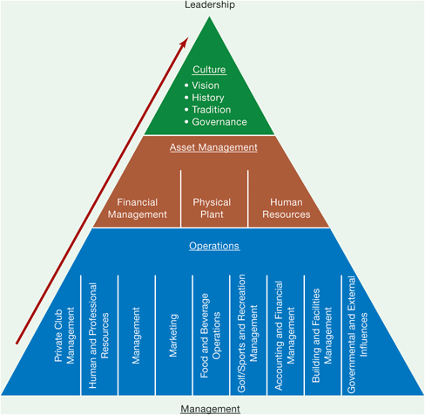
Source: Walker and Walker. (2020) Introduction to Hospitality. Chapter 10,

Slide 11
Operational Planning
How Do Managers Plan?
Planning is the first of the management functions, so it establishes the basis for the other functions. Planning involves two main parts: goals and strategies.
Operational plans are generally created for periods of up to one year and fit in with the strategic plan. Most hotel, restaurant, and other hospitality managers plan for periods from hourly, daily, weekly, monthly, and up to 90 days.
Operational plans provide managers with a step-by-step approach to accomplish goals. The overall purpose of planning is to have the entire organization moving harmoniously toward the goals.
There are seven steps in operational planning: 1. Setting goals. Goals should be specific, measurable, and achievable. 2. Analyzing and evaluating the environment. This involves analyzing political, economic, social, and other trends that may affect the operation. 3. Determining alternatives. This involves developing courses of action, sometimes requesting the input from employees. 4. Evaluating alternatives. This calls for making a list of advantages and disadvantages considering resources and effects on the organization. 5. Selecting the best solution. This results from the analysis of various alternatives and sometimes combining two or more alternatives. 6. Implementing the plan. This includes decisions on people, dates, resources, benefits, costs, reporting, and authority to be granted. 7. Controlling and evaluating results. This involves monitoring progress toward goals.
Operational Goal Setting
Goal setting is the process of determining outcomes for each area and associate. No one can work effectively without specific goals and monthly evaluation reports to gauge whether the effort is moving toward goal accomplishment, or whether adjustments must be made to change course.
Examples of goals and information for a sales department include: Group room nights (booked this month and year-to-date by market segment and salesperson, actual consumer room nights, actual average group room rates). Individual room nights (actual room nights booked, local corporate clients, occupancy compared to same time last year, rev par, and packages sold).
Another example of goals is productivity goals that measure the amount of labor required to do a task. Productivity is measured in labor costs, which are expressed as a percentage of sales, for each department.
Planning expert George Morrisey offers this four-point model for writing goals: 1. to (action/verb)……… “increase guest satisfaction scores” 2. the (single measurement result)…. “from 87 to 95 percent” 3. by (the target date/time span)…. “by December 31, 20xx” 4. at (cost in time and/or energy)… “at a cost of $500 for training”

Slide 12
Create a LinkedIn Account
Create an account
Keep in private
“friend” me before Friday, May 15, 10pm

