Slide 1

Travel and Tourism
HMGT 1101
Karen Goodlad
Spring 2020

Slide 2
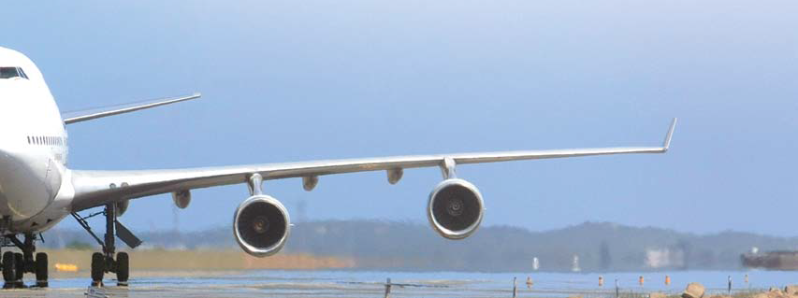
Class Learning Outcomes
Summarize Tourism and the impact of transportation on tourism
Define tourism and describe the important international tourism organizations
Discuss the economic impact of tourism
Summarize the sociocultural impact of Tourism

Slide 3
What Segments of The hospitality Industry are associated with Tourism
Notes:
https://www.oecd.org/industry/tourism/Tourism2016-Highlights_Web_Final.pdf
8- OECD TOURISM TRENDS AND POLICIES 2016: HIGHLIGHTS
© OECD 2016
The sharing economy is mainly apparent in four
sub
-sectors of tourism:
Accommodation , involving short -term rentals of all or part of private accommodation
. In many countries the sharing economy now accounts for a growing, and in some cases significant,
Share of all visitor accommodation. A small number of platforms dominate the marketplace. Airbnb
has close to 2 million properties in more than 190 countries and is the third most valuable
venture
-capital backed company in the world
, with an estimated worth of USD
25.5
billion
in
June 2015
. Small local or niche based platforms operate alongside the global players.
Transportation
includes car
-sharing, ride
-hailing and bike
-sharing.
Car
-sharing platform Uber
operate
s in
around 400
cities
in 68 countries
and was v
alued at USD
62.5
billion
in
January
2016
. Other major platforms include Blablacar, which is based on a sense of community
rather than a commercial transaction.
Dining
covers activity such as purchasing home
-cooked meals or attending dinners organised
by local residents. Platforms include EatWith, BonAppetour and Feastly.
Travel planning
includes itinerary planning and tours by locals who offer personal and customised experiences. Platforms include Vayable, ToursByLocals and VoomaGo. Within these areas, offers and models have been evolving, catering for both the leisure and business markets and including commercial co-operation with traditional tourism service
provider
s, as well as true
peer
-to-peer exchanges
.

Slide 4
What Segments of The hospitality Industry are associated with Tourism
Accommodations
Travel Promotion and Planning
Transportation
Dining
Activities
Notes:
https://www.oecd.org/industry/tourism/Tourism2016-Highlights_Web_Final.pdf
8- OECD TOURISM TRENDS AND POLICIES 2016: HIGHLIGHTS
© OECD 2016
The sharing economy is mainly apparent in four
sub
-sectors of tourism:
Accommodation , involving short -term rentals of all or part of private accommodation
. In many countries the sharing economy now accounts for a growing, and in some cases significant,
Share of all visitor accommodation. A small number of platforms dominate the marketplace. Airbnb
has close to 2 million properties in more than 190 countries and is the third most valuable
venture
-capital backed company in the world
, with an estimated worth of USD
25.5
billion
in
June 2015
. Small local or niche based platforms operate alongside the global players.
Transportation
includes car
-sharing, ride
-hailing and bike
-sharing.
Car
-sharing platform Uber
operate
s in
around 400
cities
in 68 countries
and was v
alued at USD
62.5
billion
in
January
2016
. Other major platforms include Blablacar, which is based on a sense of community
rather than a commercial transaction.
Dining
covers activity such as purchasing home
-cooked meals or attending dinners organised
by local residents. Platforms include EatWith, BonAppetour and Feastly.
Travel planning
includes itinerary planning and tours by locals who offer personal and customised experiences. Platforms include Vayable, ToursByLocals and VoomaGo. Within these areas, offers and models have been evolving, catering for both the leisure and business markets and including commercial co-operation with traditional tourism service
provider
s, as well as true
peer
-to-peer exchanges
.

Slide 5
Tourism is a social, cultural and economic phenomenon which entails the movement of people to countries and places outside their usual environment for personal or business/professional purposes. These people are called visitors (which may be either tourists or excursionists; residents or non-residents) and tourism has to do with their activities, some of which imply tourism expenditure. International Recommendations for Tourism
--Statistics 2008 UNWTO and United Nations
http://www.intracen.org/uploadedFiles/intracenorg/Content/Exporters/Sectors/Service_exports/Trade_in_services/ITC-UNWTO%20National%20Tourism%20Export%20Strategies.pdf

Slide 6
Promotors of Tourism
Government
Tourism Boards
Tour Operators
Travel Agencies
Tour Wholesale and Consolidators
Destination Management Companies
Notes:
Why Tourism: http://www2.unwto.org/content/why-tourism
Over the decades, tourism has experienced continued growth and deepening ‎diversification to become one of the fastest growing economic sectors in the world. ‎Modern tourism is closely linked to development and encompasses a growing number ‎of new destinations. These dynamics have turned tourism into a key driver for socio-‎economic progress.‎
Today, the business volume of tourism equals or even surpasses that of oil exports, ‎food products or automobiles. Tourism has become one of the major players in ‎international commerce, and represents at the same time one of the main income ‎sources for many developing countries. This growth goes hand in hand with an ‎increasing diversification and competition among destinations.‎
This global spread of tourism in industrialized and developed states has produced ‎economic and employment benefits in many related sectors - from construction to ‎agriculture or telecommunications.‎
The contribution of tourism to economic well-being depends on the quality and the ‎revenues of the tourism offer. UNWTO assists destinations in their sustainable ‎positioning in ever more complex national and international markets. As the UN agency ‎dedicated to tourism, UNWTO points out that particularly developing countries stand to ‎benefit from sustainable tourism and acts to help make this a reality.‎

Slide 7
What does it mean to be Promotor of Tourism?
Over the decades, tourism has experienced continued growth and deepening ‎diversification to become one of the fastest growing economic sectors in the world. ‎Modern tourism is closely linked to development and encompasses a growing number ‎of new destinations. These dynamics have turned tourism into a key driver for socio-‎economic progress.‎
Today, the business volume of tourism equals or even surpasses that of oil exports, ‎food products or automobiles. Tourism has become one of the major players in ‎international commerce, and represents at the same time one of the main income ‎sources for many developing countries. This growth goes hand in hand with an ‎increasing diversification and competition among destinations.‎
This global spread of tourism in industrialized and developed states has produced ‎economic and employment benefits in many related sectors - from construction to ‎agriculture or telecommunications.‎
The contribution of tourism to economic well-being depends on the quality and the ‎revenues of the tourism offer. UNWTO assists destinations in their sustainable ‎positioning in ever more complex national and international markets. As the UN agency ‎dedicated to tourism, UNWTO points out that particularly developing countries stand to ‎benefit from sustainable tourism and acts to help make this a reality.‎
Retrieved from UNWTO: Why Tourism: http://www2.unwto.org/content/why-tourism
Notes:
Why Tourism: http://www2.unwto.org/content/why-tourism
Over the decades, tourism has experienced continued growth and deepening ‎diversification to become one of the fastest growing economic sectors in the world. ‎Modern tourism is closely linked to development and encompasses a growing number ‎of new destinations. These dynamics have turned tourism into a key driver for socio-‎economic progress.‎
Today, the business volume of tourism equals or even surpasses that of oil exports, ‎food products or automobiles. Tourism has become one of the major players in ‎international commerce, and represents at the same time one of the main income ‎sources for many developing countries. This growth goes hand in hand with an ‎increasing diversification and competition among destinations.‎
This global spread of tourism in industrialized and developed states has produced ‎economic and employment benefits in many related sectors - from construction to ‎agriculture or telecommunications.‎
The contribution of tourism to economic well-being depends on the quality and the ‎revenues of the tourism offer. UNWTO assists destinations in their sustainable ‎positioning in ever more complex national and international markets. As the UN agency ‎dedicated to tourism, UNWTO points out that particularly developing countries stand to ‎benefit from sustainable tourism and acts to help make this a reality.‎

Slide 8
Promotors of Tourism: Governments
United Nations World Tourism Organization
  What is their mission?
  Look at the “Why Tourism” page: https://www.unwto.org/why-tourism
    List two observations you made from the information presented
  Look at the glossary page: https://www.unwto.org/glossary-tourism-terms
    Chose five terms that are new to you and list them
  Look at the events page: https://www.unwto.org/events
    Select an event and explain, in your own words the purpose of the event

Slide 9
Promotors of Tourism:
Tourism Boards
Notes:
Why Tourism: http://www2.unwto.org/content/why-tourism
Over the decades, tourism has experienced continued growth and deepening ‎diversification to become one of the fastest growing economic sectors in the world. ‎Modern tourism is closely linked to development and encompasses a growing number ‎of new destinations. These dynamics have turned tourism into a key driver for socio-‎economic progress.‎
Today, the business volume of tourism equals or even surpasses that of oil exports, ‎food products or automobiles. Tourism has become one of the major players in ‎international commerce, and represents at the same time one of the main income ‎sources for many developing countries. This growth goes hand in hand with an ‎increasing diversification and competition among destinations.‎
This global spread of tourism in industrialized and developed states has produced ‎economic and employment benefits in many related sectors - from construction to ‎agriculture or telecommunications.‎
The contribution of tourism to economic well-being depends on the quality and the ‎revenues of the tourism offer. UNWTO assists destinations in their sustainable ‎positioning in ever more complex national and international markets. As the UN agency ‎dedicated to tourism, UNWTO points out that particularly developing countries stand to ‎benefit from sustainable tourism and acts to help make this a reality.‎

Slide 10
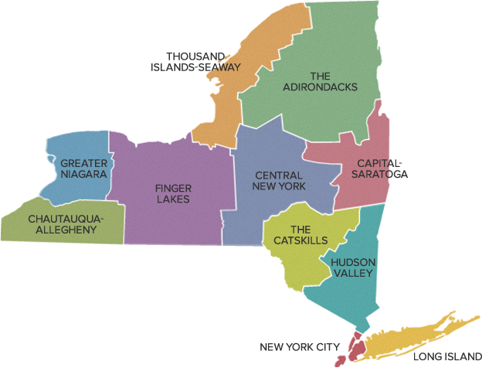
Promotors of Tourism:
Tourism Boards
I Love NY
New York City & Company
Uncork NY
The Power of Travel

Slide 11

Promotors of Tourism:
Other
Atlas Obsura: https://www.atlasobscura.com/

Slide 12
What are the forms of transportation that contribute to tourism?
Air
Road
Rail
Water
Other

Slide 13
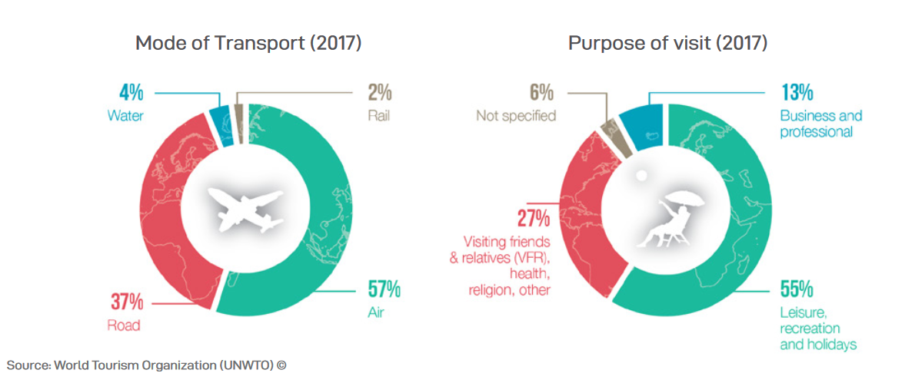

Slide 14
Reasons For travel
Business Travel
Visiting Family and Relatives (VFR)
Leisure and Recreation
Other

Slide 15
Categories of tourism
Food & Drink Tourism
Historic Tourism
Ecotourism
Sustainable Tourism
Cultural Tourism
Heritage Tourism
Fashion/Retail Tourism
Sports Tourism

Slide 16
Next class meeting
March 31, 2020
Post about the NYTimes 36 Hours article in the discussion board on OpenLab before 8:30am on March 31, Comment on another student’s post before 8:50am on March 31
Submit the weekly homework on Blackboard before 8:30am, March 31
Watch the videos posted about current events in tourism
Join the Blackboard Collaborate session by 9:15 on March 31
Submit class work by midnight March 31

