Slide 1
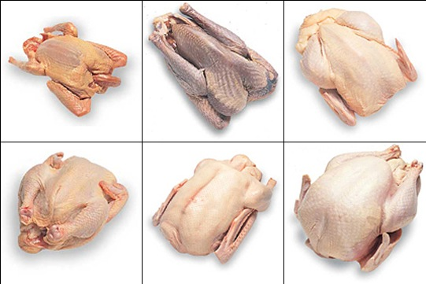
Poultry

Slide 2
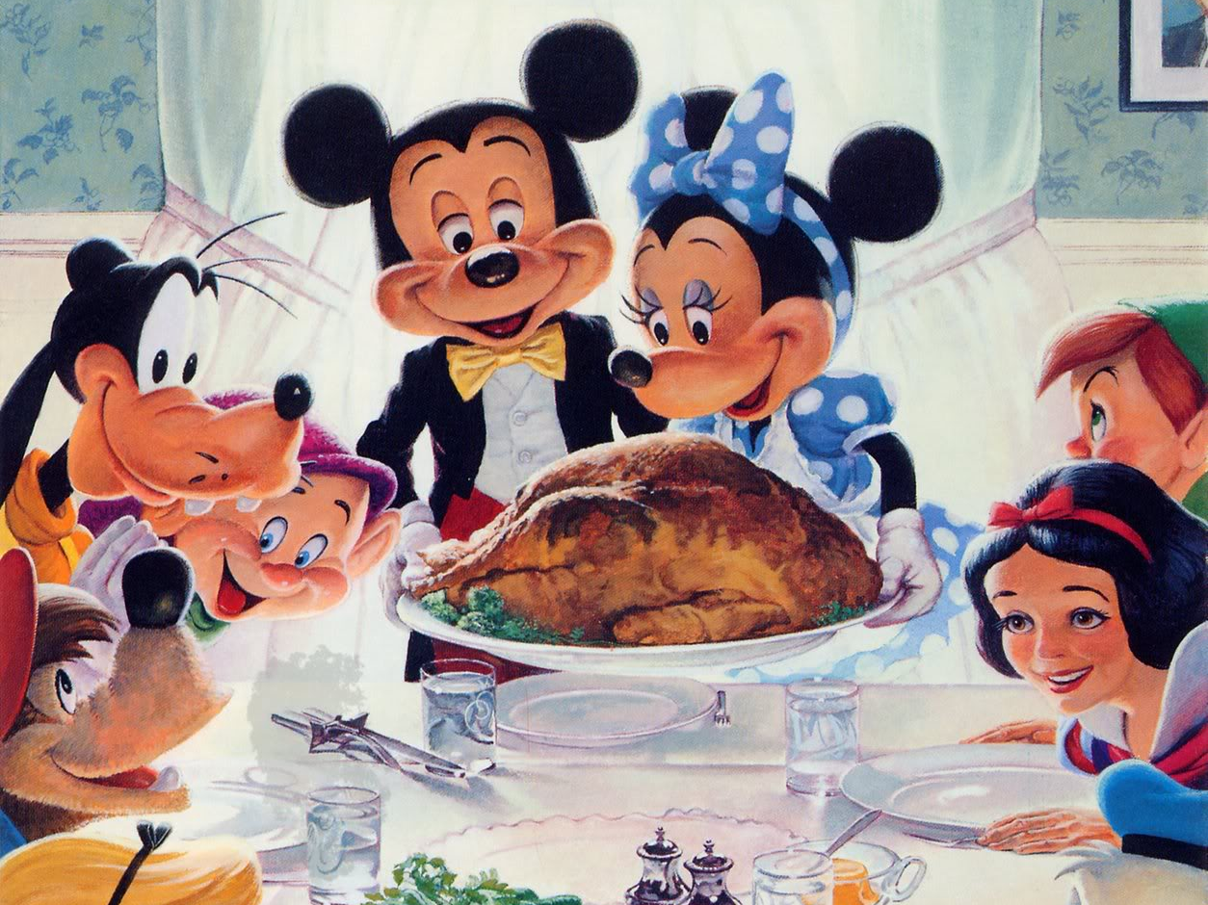

Slide 3
Grading
Inspection (state or federal) is mandatory but grading is voluntary.
USDA Grade A: chickens have plump, meaty bodies and clean skin, free of bruises, broken bones, feathers, cuts and discoloration.
USDA Grade B: the carcass or part may have moderate deformities, such as a dented, curved, or crooked breast, crooked back or misshapen legs or wings, which do not materially affect the distribution of flesh or the appearance of the carcass or part.
USDA Grade C: noticeable deformities, missing parts, feather remnants

Slide 4
Classes of Chicken
Broiler-fryer- a young, tender chicken about 7 weeks old which weighs 2 1/2 to 4 1/2 pounds when eviscerated.
Rock Cornish Game Hen - a small broiler-fryer weighing between 1 and 2 pounds.
Roaster - an older chicken about 3 to 5 months old which weighs 5 to 7 pounds.
Capon - Male chickens about 16 weeks to 8 months old which are surgically unsexed. They weigh about 4 to 7 pounds.
Stewing/Baking Hen (fowl) - a mature laying hen 10 months to 1 1/2 years old.
Cock or rooster - a mature male chicken with coarse skin and tough, dark meat.

Slide 5
Other Poultry
Similar classification and grading standards as chicken
Turkey
Goose
Duck
Guinea Hens
Pigeon (squab)

Slide 6
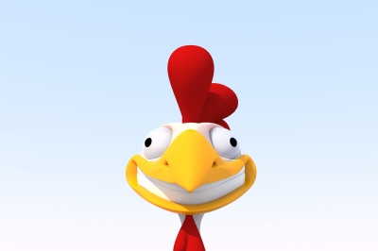
Other Factors to Consider
ethical treatment
flavor
toughness
cost

Slide 7
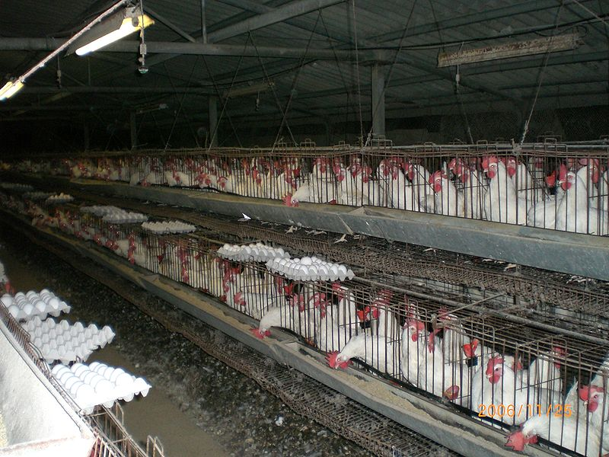
Battery-raised chickens

