Slide 1
YINGYANG ZHANG
COMD 4900 INTERNSHIP

Slide 2
HOW
I got this intern from one of my friends. It is a sign making company owned by my friend’s uncle. The reason I wanted to work there was that he told me it will be easy and I will also get paid. This is my last semester and I am having five classes. I thought to myself, an easy intern might be what I needed. So I just said ok and started working there.

Slide 3
INTRO
The company is called L.K. creative sign. The company is very small. They specialize in designing and making store signs and billboards. They also do awnings and different kinds of light box. There are only two people in the design team. Just me and my boss. I almost can’t find any information about this company on the internet. They don’t even have a website.

Slide 4
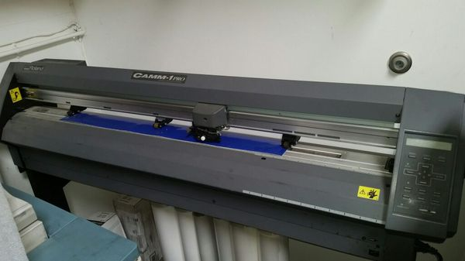
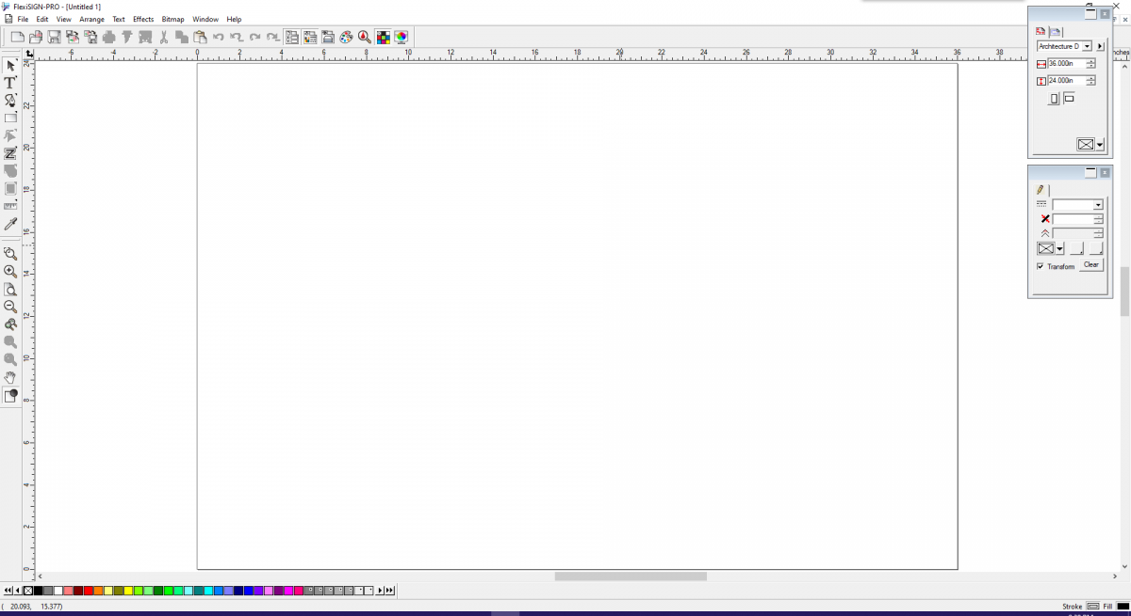
REPONSIBILITY
Store sign design
FlexiSign pro (software)
Vinyl cutting
Billboard design

Slide 5
PROJECTS
Hardware shop store sign
Dessert shop store sign
Off-price department store sign
Auto repair store sign
Clinic posters on front door
Dessert shop store sign redesign
Supermarket store sign redesign

Slide 6
RESULT
speak up more and express myself more
work faster
speak with the clients with more confidence

Slide 7
THANK YOU

