Slide 1
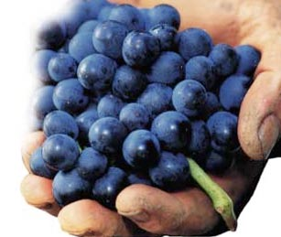

Prof. Karen Goodlad, CSW
Wine & Beverage Management
HMGT 2402
Fall 2019
Viticulture & Vinification

Slide 2
Overview
Attendance
Review of Syllabus
OpenLab
Viticulture
Notes:
Syllabus Speed Dating – Karen Eifler, an education professor at the University of Portland, designed this activity. Two rows of chairs face each other (multiple rows of two can be used in larger classes).
Students sit across from each other, each with a copy of the syllabus that they’ve briefly reviewed. Eifler asks two questions: one about something in the syllabus and one of a more personal nature. The pair has a short period of time to answer both questions. Eifler checks to make sure the syllabus question has been answered correctly.
Then students in one of the rows move down one seat and Eifler asks the new pair two different questions. Not only does this activity get students acquainted with each other, it’s a great way to get them reading the syllabus and finding out for themselves what they need to know about the course. - See more at: http://www.facultyfocus.com/articles/teaching-professor-blog/first-day-of-class-activities-that-create-a-climate-for-learning/#sthash.R0MHLnQw.dpuf

Slide 3
Identify the
Factors Affecting the Taste of Wine

Slide 4


Factors Affecting the Taste of Wine
Grape Variety
Viticulture
Soil
Physical Location
Climate
Vinification
Luck of the Year

Slide 5
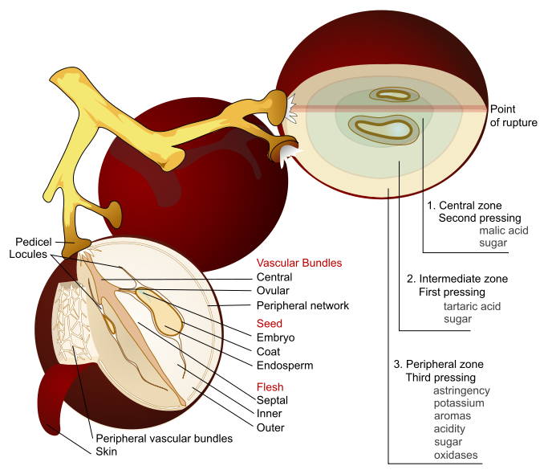
By Mariana Ruiz Villarreal (LadyofHats) - This image was created as part of the Philip Greenspun illustration project., Public Domain, https://commons.wikimedia.org/w/index.php?curid=4546784

Slide 6
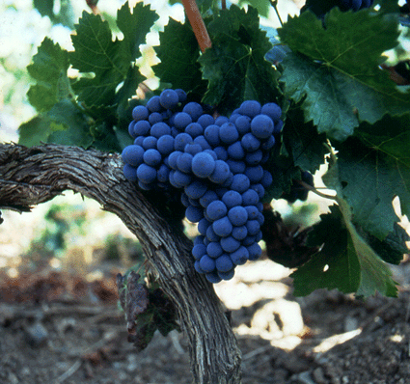
The Grape
The most important factor
influencing the taste of wine.
Kingdom:
Genus:
Species:
Variety :
Notes:
Genus: Vitis (a class of things that have common characteristics and that can be divided into subordinate kinds.)
Species: Scientific grouping (vines) genetically similar and can reproduce (about 60 including Vinifera and labrusca)
Variety: subspecies of grape
Clone: Vines descended from a single plant (asexual) exact replica
Cross: two different subspecies reproducing

Slide 7
The Grape
The most important factor
influencing the taste of wine.
Kingdom: Plantae
Genus: Vitis
Species:
Vinifera/Lambrusca (79 total)
Variety: there are thousands
Cabernet Sauvignon
Chardonnay…
Notes:
Genus: Vitis (a class of things that have common characteristics and that can be divided into subordinate kinds.)
Species: Scientific grouping (vines) genetically similar and can reproduce (about 60 including Vinifera and labrusca)
Variety: subspecies of grape
Clone: Vines descended from a single plant (asexual) exact replica
Cross: two different subspecies reproducing

Slide 8
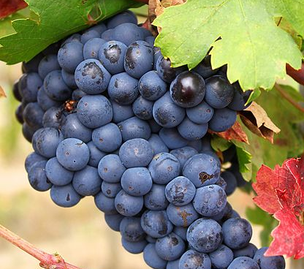
Share what you know: What are the two most commonly utilized genus and species grown for wine making?

Slide 9
Share what you know: What are the two most commonly utilized genus and species grown for wine making?
Vitis Vinifera & Vitis Labrusca

Slide 10
Factors Affecting the Taste of Wine
Grape Variety
Viticulture
Soil
Physical Location
Climate
Vinification
Luck of the Year

Slide 11
Viticulture
The science of growing grapes
Vineyard Management
Physical Structure of the Vine
Life Cycle of the Vine
Vine Maintenance

Slide 12
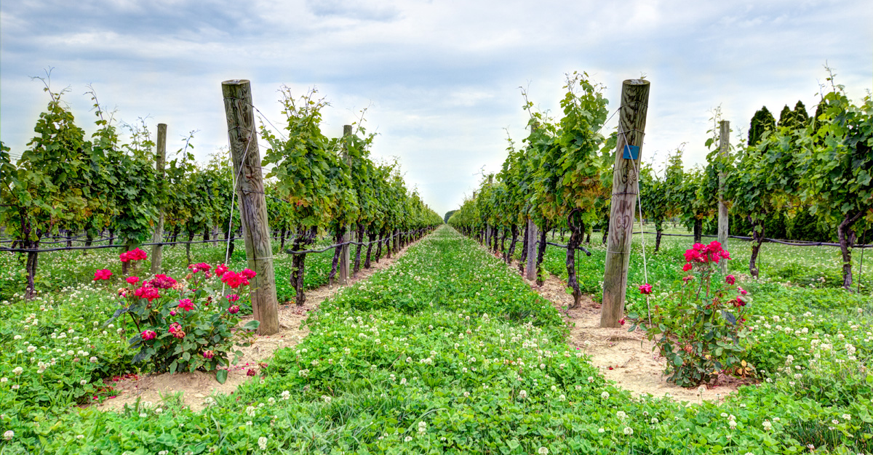
Vineyard Management
Conventional, Organic,
Biodynamic, Sustainable
Notes:
Decisions of Environmental Stewardship
Conventional, Sustainable, Organic, Biodynamic
Mike Benziger of Benziger Winery Discusses Organic and Biodynamic Viticulture

Slide 13
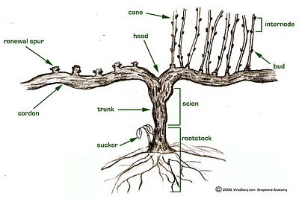
The Grape Vine

Slide 14
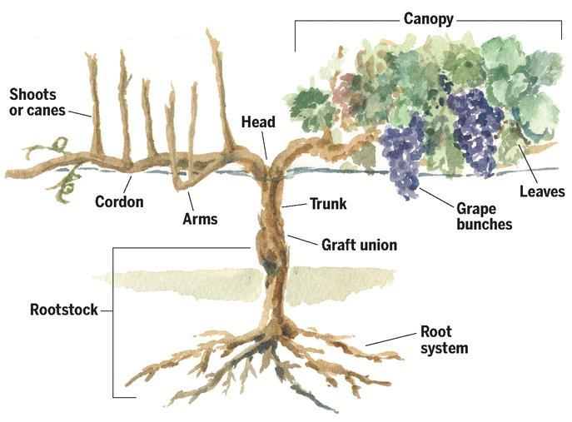
Retrieved from : https://www.evineyardapp.com/blog/2017/05/30/overview-of-grapevine-structure-and-function/

Slide 15
Vine Functions
Photosynthesis
Translocation
Transpiration
Respiration
Form more information, visit this site: http://www.viti.com.au/pdf/MVWGG%20Fact%20Sheet%20-%20Grapevine%20Biology.pdf

Slide 16
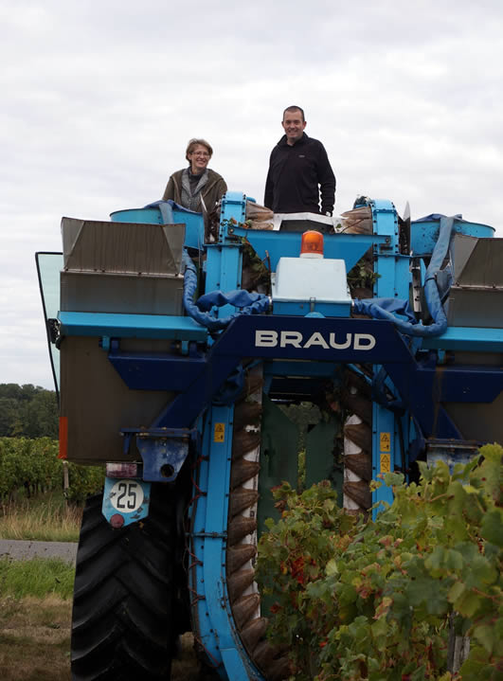
Harvest: Mechanical

Slide 17
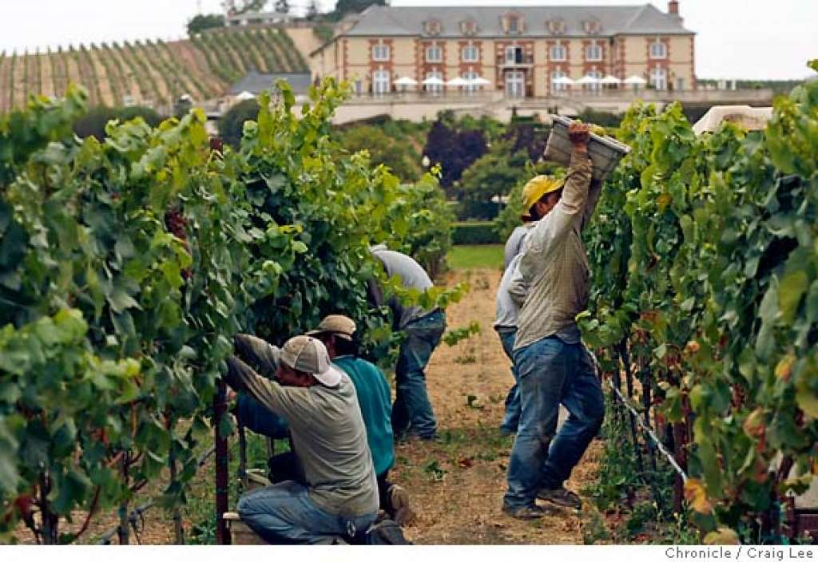
Harvest: Manual

Slide 18
Factors Affecting the Taste of Wine
Grape Variety
Viticulture
Soil
Physical Location
Climate
Vinification
Luck of the Year

Slide 19
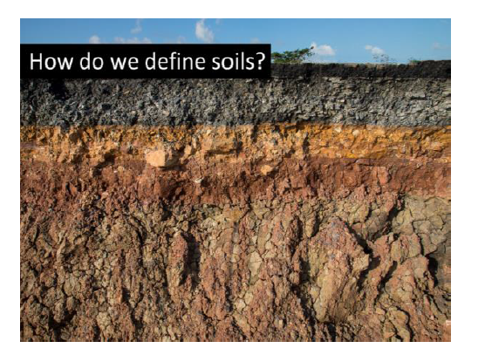
What is important to know about Soil?

Slide 20
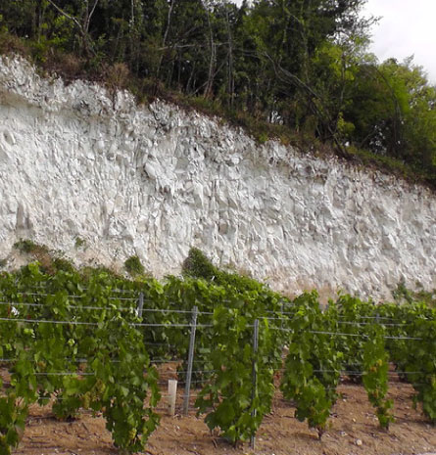

Slide 21
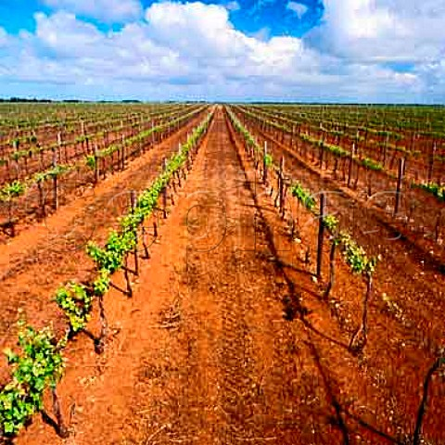

Slide 22
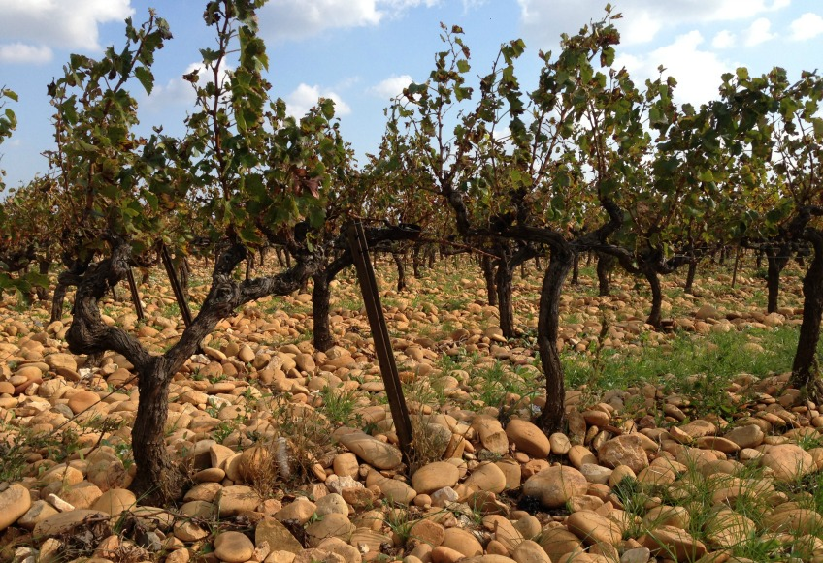

Slide 23
Factors Affecting the Taste of Wine
Grape Variety
Viticulture
Soil
Physical Location
Climate
Vinification
Luck of the Year

Slide 24
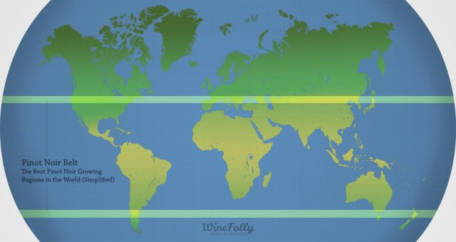
Image credit: https://winefolly.com/tutorial/pinot-noir-regions/
Notes:
Temperate Zones
(both maritime and continental)
OLD WORLD:
France, Italy, Spain, Germany, Portugal, Switzerland, Austria, Hungary, Greece
NEW WORLD:
US, California, Chile, Argentina, Uruguay, South Africa, Australia, New Zealand

Slide 25
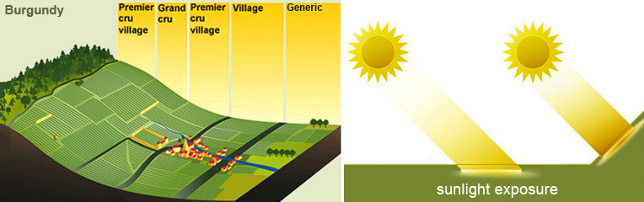

Slide 26
Factors Affecting the Taste of Wine
Grape Variety
Viticulture
Soil
Physical Location
Climate
Vinification
Luck of the Year

Slide 27
Climate
Maritime
Continental
Mediterranean

Slide 28
Common Regulations & Laws
Appellations
Grape Variety
Minimum Alcohol
Maximum Yield
Methods of Viticulture
Methods of Vinification
Notes:
Appellations: regions: zones: states:

Slide 29
Short List of Problems
Grape Vines Face
Phylloxera
Glassy Winged Sharpshooter

Slide 30
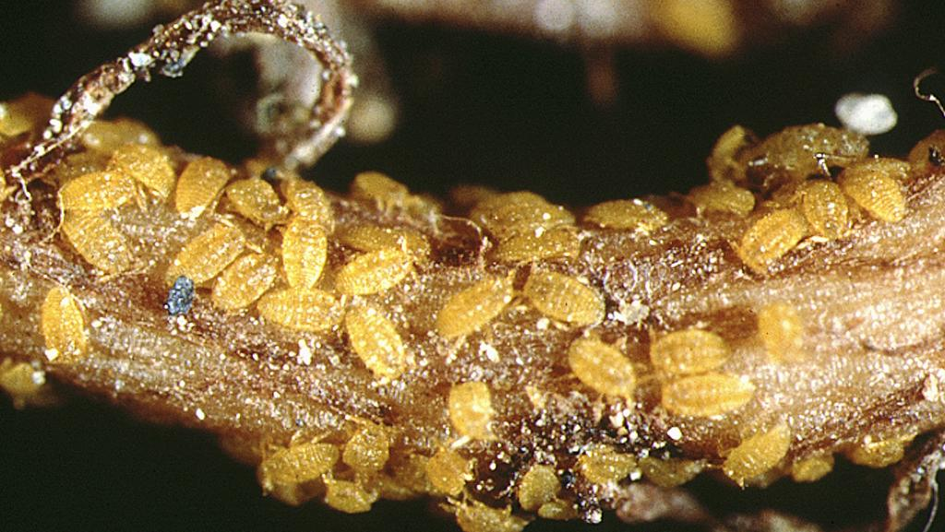
What is Phylloxera?

Slide 31
What is Phylloxera?
Grape Louse that feeds on the roots of vitis vinifera and injects its waste into the roots
Thought to be Resistant to Rootstock AxR1
Did it Destroyed Wine Industry?
  70% of French Vineyards in 1860’s-1870’s
  New Zealand in 1970’s
  Napa Valley in 1983
  West Coast of US by 1995
Various vitis labrusca root stocks now used

Slide 32
Terms to Know
Viticulture
Wine Maker, Vitner, Vineyard Manager, Grape Grower
Parts of a Grape Vine
Annual cycle of a grape vine
Brix and Beaume
Climate: Maritime, Continental, Mediterranean
Vineyard Management Terms: Conventional, Sustainable, Organic, Biodynamic
Vintage
Phylloxera
Appellation
Yield
Vitis vinifera/labrusca
Grafting
Root stock/bud wood
Vitis Vinifiera
Vitis Labrusca
Botrytis Cinerea (Noble Rot)
Notes:
Botrytis Cinerea: Noble rot, mold growth that punctures the skin, water drains out
Must: the juice and liquidy pulp produced by crushing or pressing grapes before fermentation
Chaptalization: adding cane or beet sugar to wine must before or during fermentation in the effort to increase the sugar and hence alc.
Brix: a way to measure sugar
Carbonic Maceration: uncrushed grapes placed in a closed tank weight crushes grapes, heat from Fermentation creates fermentation in uncrushed grapes, light “juicy” wine
Barrique = 60 Gallons, 9 liters just over 6 cases

