Slide 1
Wines of the Southern Hemisphere:
Australia, New Zealand & South Africa
New York City College of Technology, CUNY
Spring 2019
Prof. Karen Goodlad, CSW

Slide 2
Class Schedule
Return and Review Quiz
Review of Retail Shop Assignment
Lecture Objectives, New Zealand, Australia & South Africa
  Identify fermented beverages
  Discuss wine making methods using industry terminology
  Explain the factors that affect the taste of fermented beverages
  Identify geographical regions of NZ, AU, & SA

Slide 3
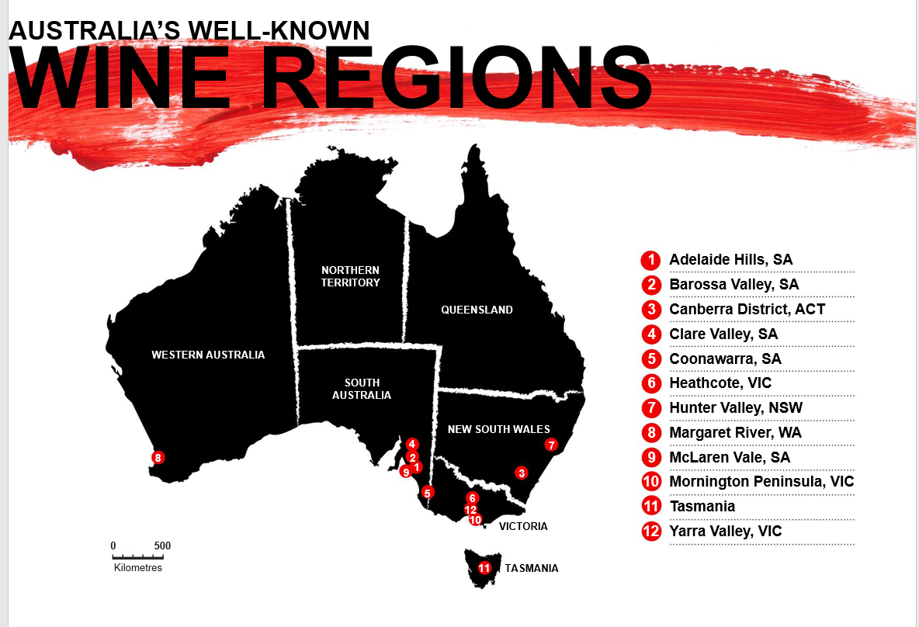

Slide 4
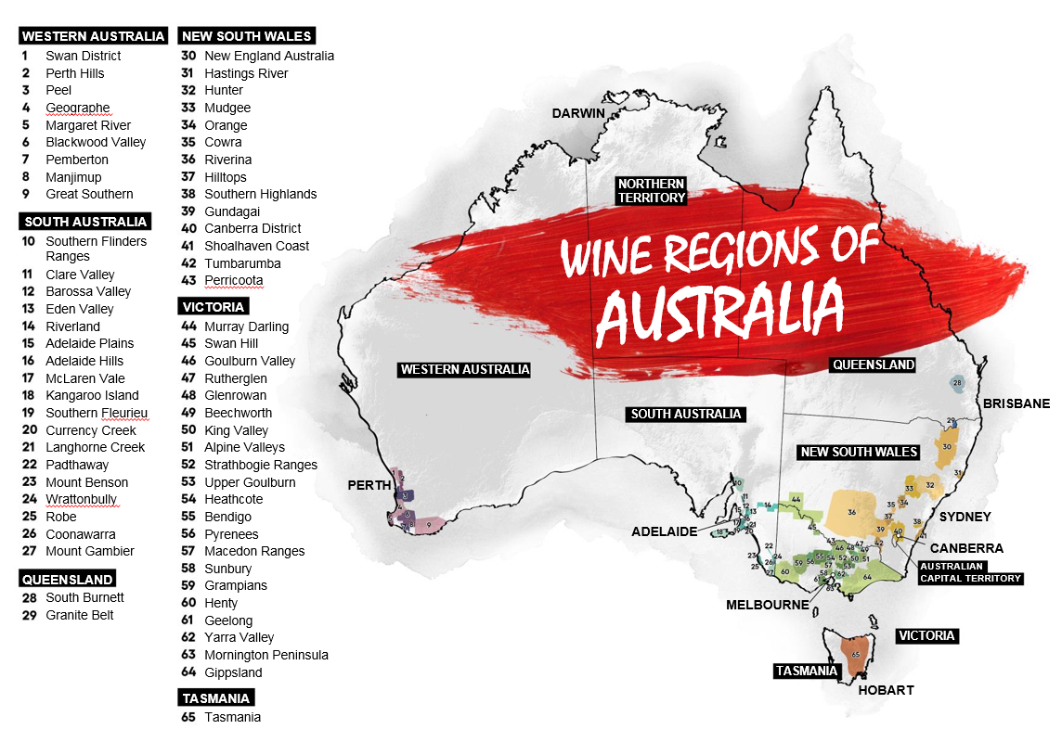

Slide 5
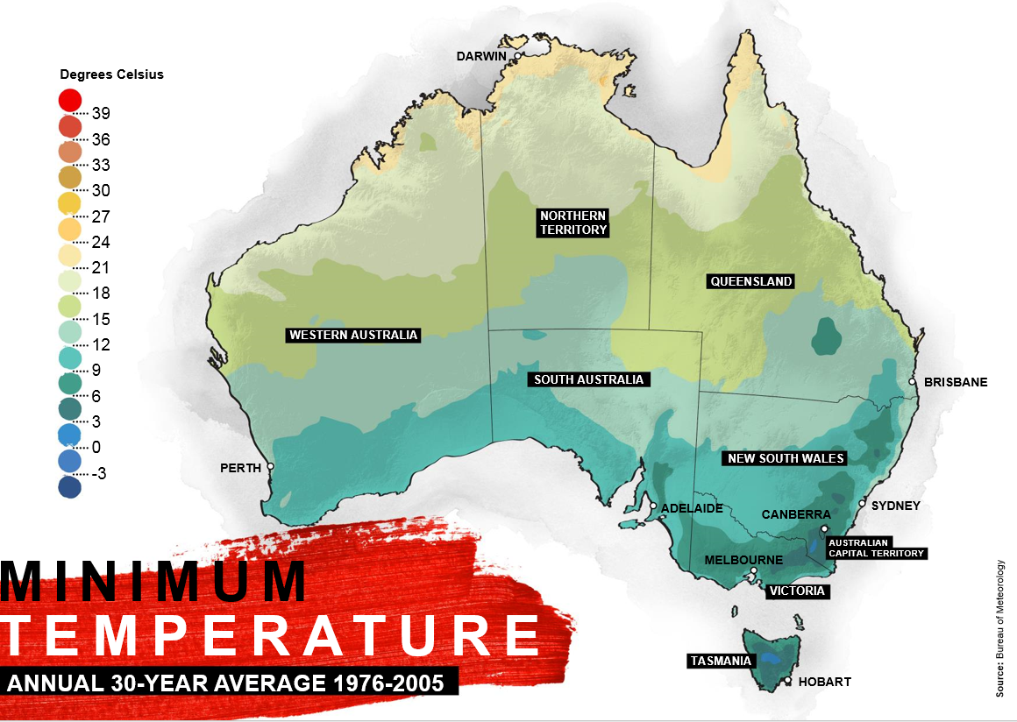
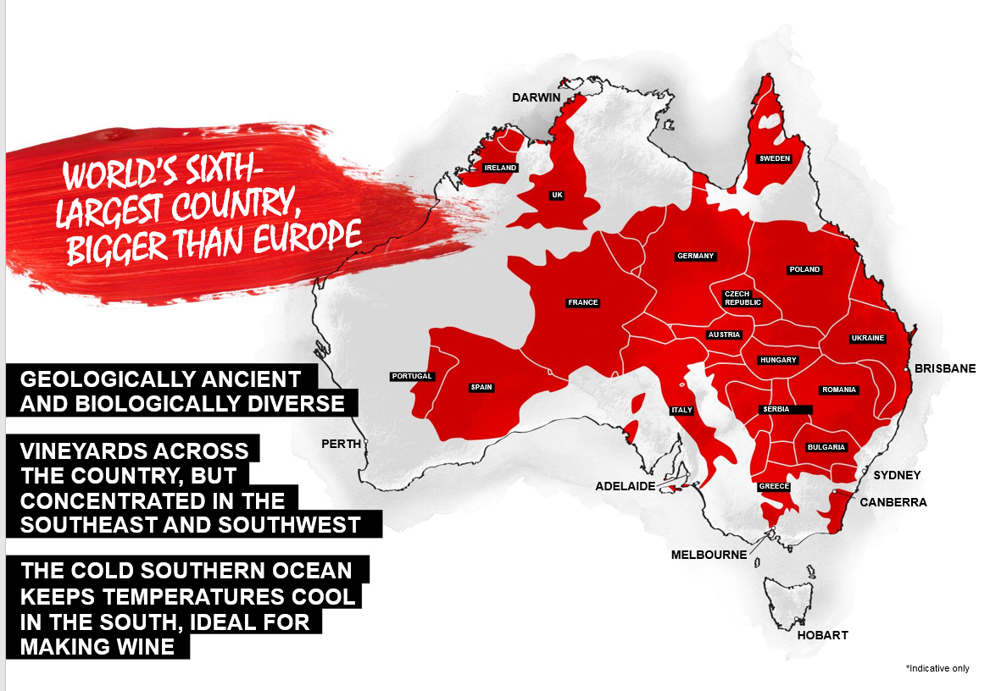

Slide 6
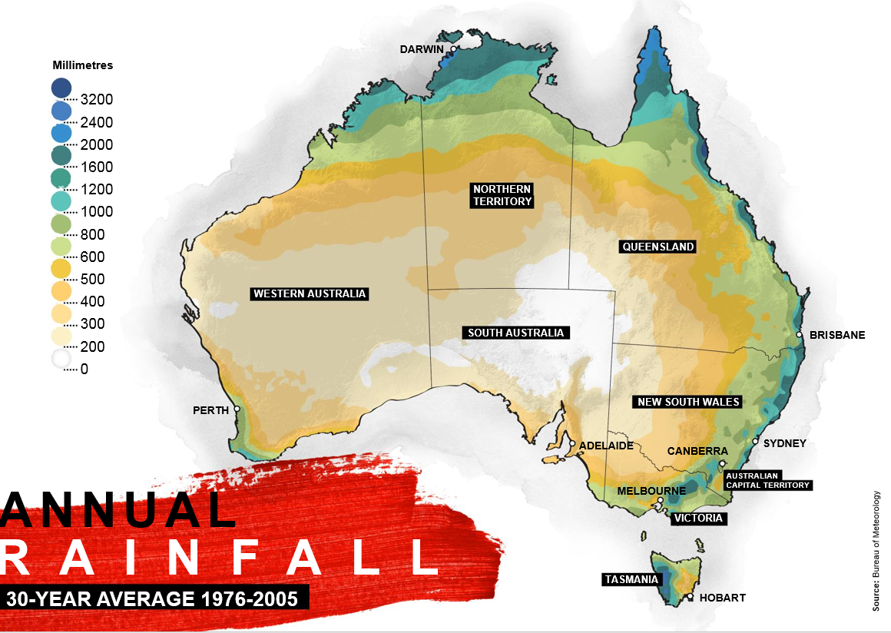

Slide 7
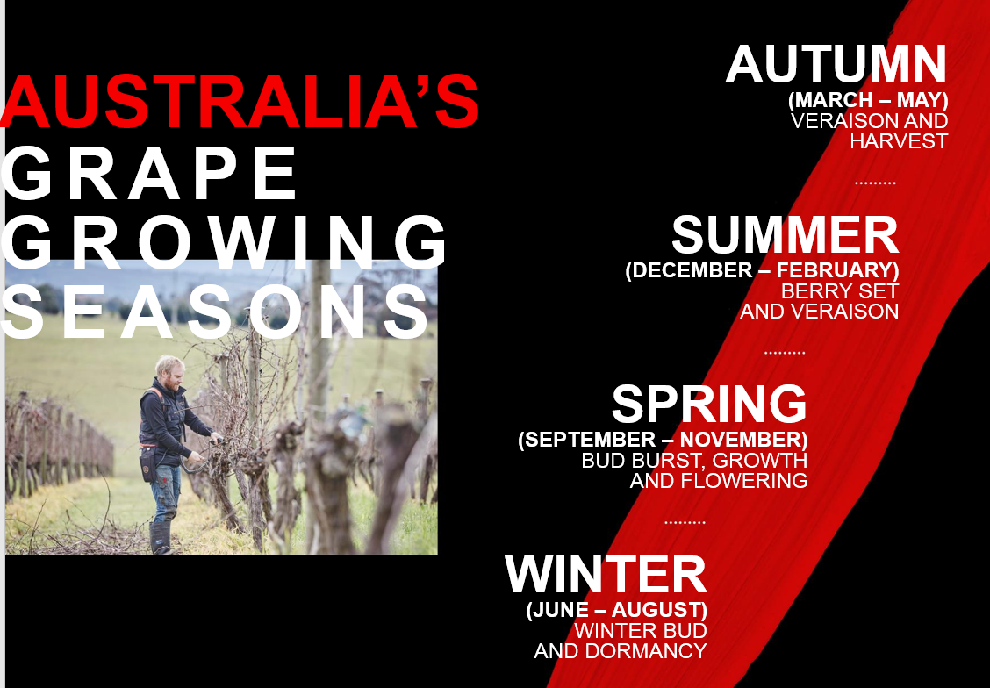
Wines of Australia: An Overview
Harvest is March/April
Chaptalization is illegal/acids can be added
Use of technology in both the vineyard and the winery are common
Corporate Giants: Southcorp, BRL Hardy, Orland Wyndham, Beringer Blass, McGuigan Simeon
Learn about Australian wine from Jancis Robinson: https://www.youtube.com/watch?v=U5srEWQ9VW4

Slide 8
Wine of Australia: Wine Laws
Geographic indication
“Super-Area” Southeastern Australia
85% of grape varietal on label, region specific
85% of blend, list in order
Generic labels are not permitted
95% vintage
Show Reserve, must win an award from a competition
“Wood-Matured” aged in new or young casks
Wine must come from place name (geographical indication)
Can not use other geographical information
  Ex: Bordeaux, Champagne, Napa
Notes:
Similar to AVA
Geographic indication controversy regarding defined areas
The importance eow wine shows is that wines show a particular style

Slide 9
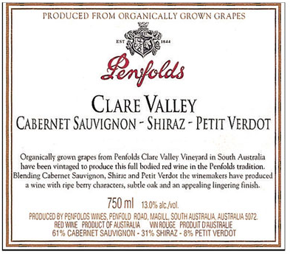

Slide 10
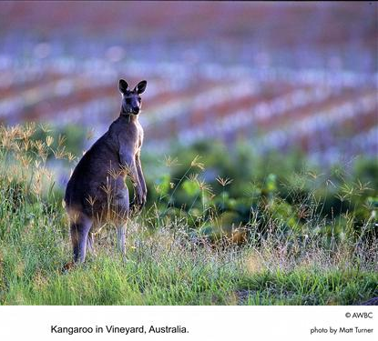
Australia: Dominant Grape Varieties
Shiraz (Syrah of Rhone Valley)
Chardonnay
Cabernet Sauvignon
Notes:
Varietal First mindset
Chard 15%
Shiraz 18% really the syrah grape
Cab. Sauv 15%

Slide 11
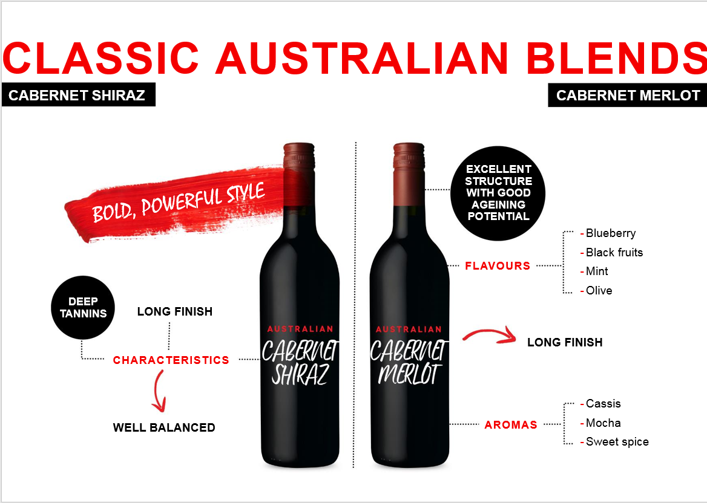

Slide 12
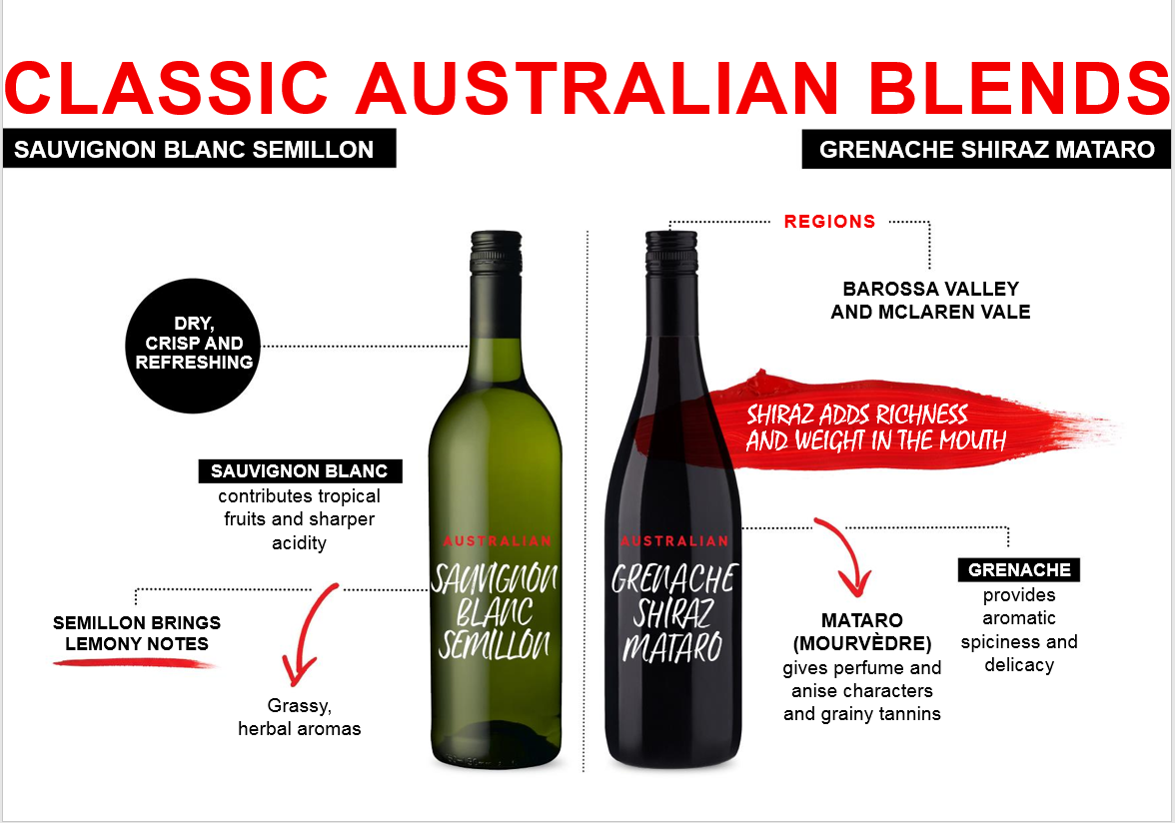

Slide 13
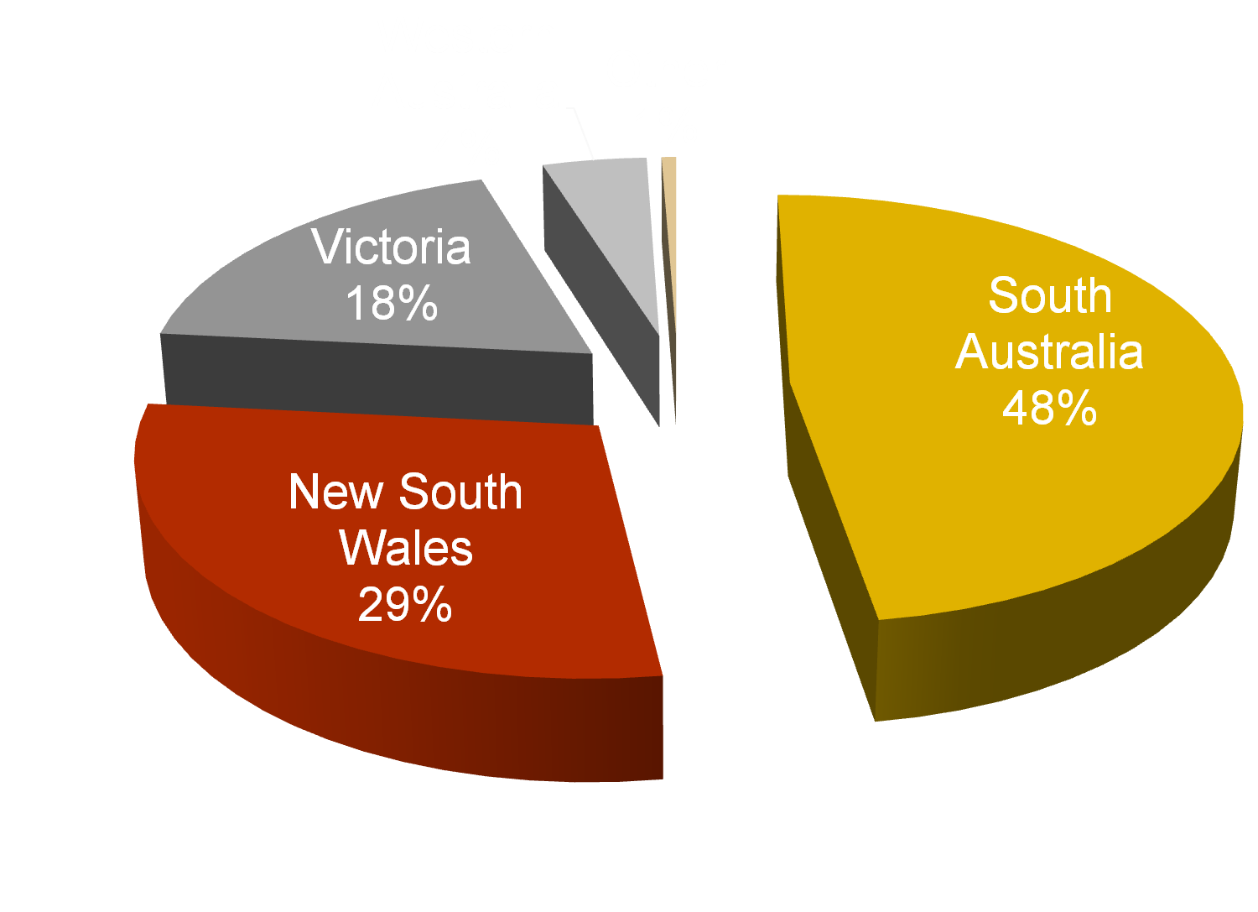
Winegrape Production by State, 2010
Source: Wines of Australia
Notes:
Source: http://www.wineaustralia.com/australia/LinkClick.aspx?fileticket=0xGfZTMjDjA%3d&tabid=5419
Murray River and Murrumbidgee provide irrigation for Victoria and New South Wales
South Australia, No phylloxera
Victoria gets water from melting snow of The Great Dividing Range

Slide 14
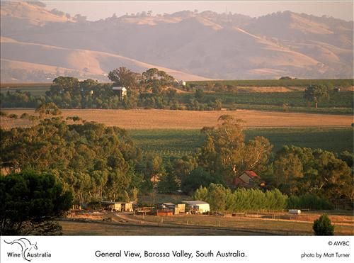
South Australia: Barossa Valley
Link To Information: https://www.wineaustralia.com/discover-australian-wine/south-australia-wines/barossa
~50% of the wine in South Australia comes from Barossa Valley
Continental Climate: Hot and Dry with some cooling conditions from ocean breezes
Topography: Flat Lands, Some Hill Plantings
Grape Variety: Shiraz & Chardonnay dominate then Semillon & Riesling
Soil: Varies with Limestone, Clay or Sand

Slide 15
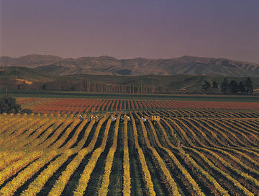
Wines of New Zealand
History:
  Little Wine Consumption
  Early 1900’s Prohibition + Phylloxera
  Restaurants Could Not Sell Wine Until the Late ’70s
Today:
  High Quality Wine/Intense Competition
  33rd Largest Wine Producer/Export 20%
  Labels are Regulated
    Represent 85% of Regions, Varietal and Vintage
Notes:
Videos http://www.nzwine.com/media-centre/video/

Slide 16
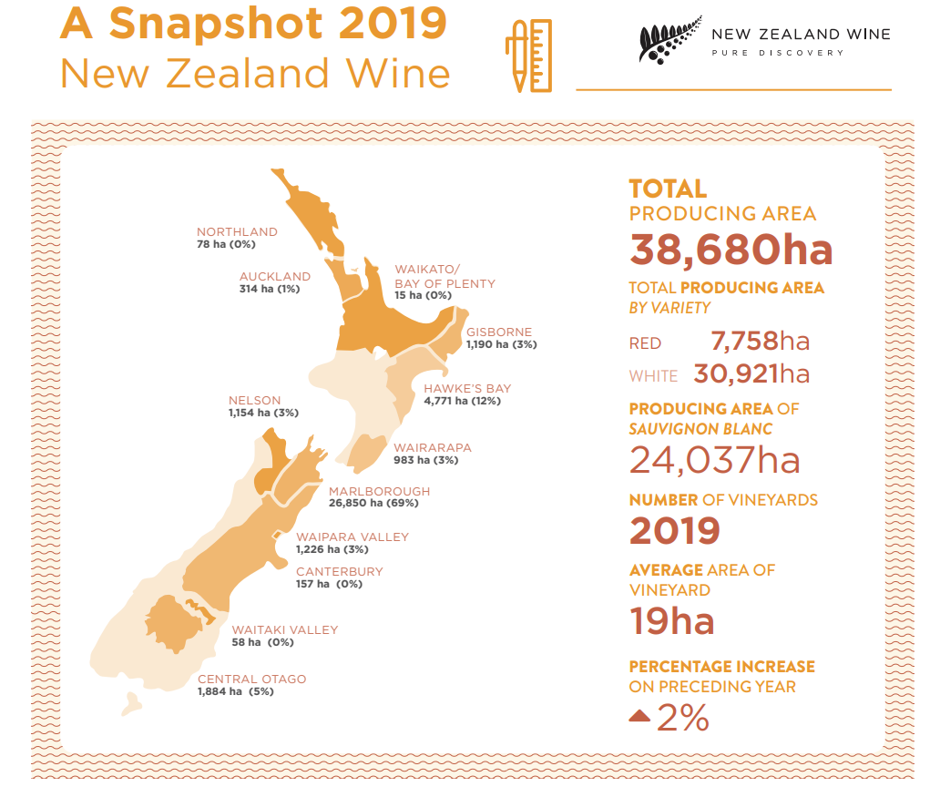
https://www.nzwine.com/media/12951/vineyard-register-2019_online.pdf

Slide 17
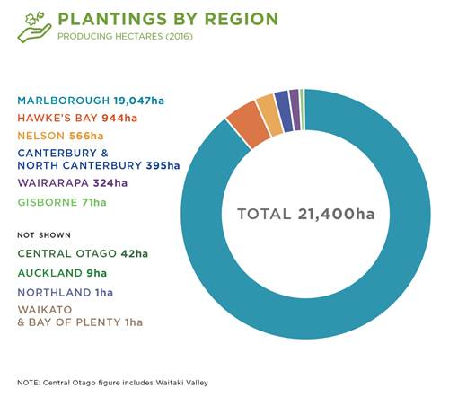
Varietal plantings of Sauvignon Blanc in New Zealand
Source: https://www.nzwine.com/en/our-winestyles/sauvignon-blanc/
Notes:
Climate is a major factor in defining regional styles.
Northern: warmer, milder growing conditions result in riper and richer styles, with melon, nectarine and other stonefruit flavours.
Southern: longer, cooler growing conditions that promote stronger, more vibrant fruit flavours and higher acidity levels.
The resulting wines are more pungent, and crisper, with passionfruit and other tropical fruit flavours, red pepper (capsicum) and gooseberry characters.

Slide 18
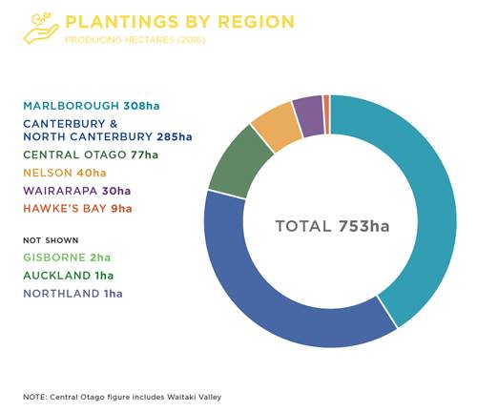
Regional plantings of Riesling in New Zealand

Slide 19
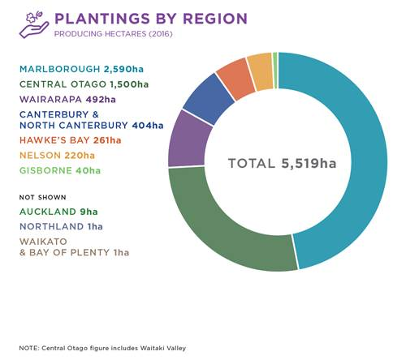
Regional plantings of Pinot Noir in New Zealand

Slide 21
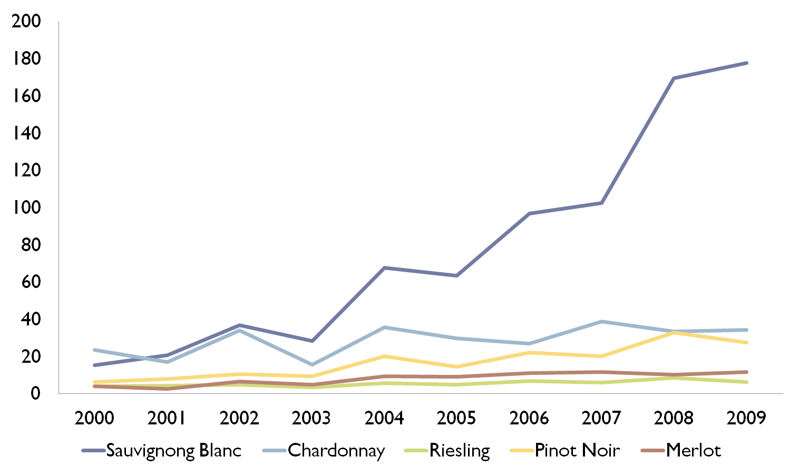
New Zealand Grape Varieties 2000-2009
Source: Wine of NZ Annual Report 2012
The First Sauvignon Banc: in NZ: https://grapecollective.com/articles/fun-facts-about-new-zealand-wine

Slide 22
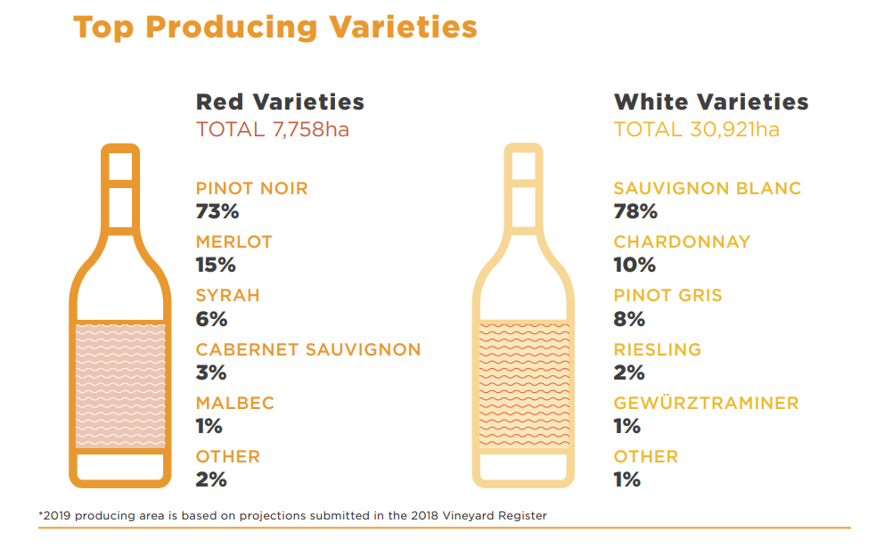
https://www.nzwine.com/media/12951/vineyard-register-2019_online.pdf

Slide 23
Marlborough, Plenty of Wine “Grows” There
66.4% of Total Wine Grape Acreage
First Planted in 1973
Topography
  Planted mostly on plains
  Protected, Kaikoura Range (Cold Southerly Winds)
  Protected, North Island (North Easterly Winds)

Slide 24
Marlborough Climate
Plenty of sunshine, moderate temperatures and strong diurnal variation are the keys to Marlborough’s piercing fruit intensity, strong varietal expression, and acid retention over long ripening periods.
The eastern coastal aspect bestows cooling sea breezes and protective mountains, providing relief from extreme rain and wind. Long Indian summers occasionally dice with drought but more often allow a wide range of styles to flourish.

Slide 25
Marlborough Soil
Ones of the keys to Marlborough’s success is its ancient, glacial, free-draining soil. The extensive braided river systems deposited a threaded legacy of stony sandy loam over very deep, stony gravels. Rapaura is stoniest; the lower Wairau has more loam and thus higher water retention. Clay is prevalent in the southern valleys, assisting Pinot Noir. While the Awatere is more fragmented, with gravelly silt-loams and wind-blown loess.

Slide 26
Central Otago Climate
This is the world’s southernmost wine region and the country’s highest. In this semi-continental climate, frosts are accepted and planned for but site selection is key. High sunshine hours and short, hot summers provide an idyllic, at times brutal, landscape for vines. The dry autumns and overall low humidity are significant assets, helping to coax both amazing purity and complexity.
From: https://www.nzwine.com/en/our-regions/central-otago/

Slide 27
Central Otago Soil
Central Otago soils comprise of moderately old, windblown loess (silt) formed over successive ice ages by glaciers grinding schist rock into a fine flour. Layers of loess, at various depths, are interspersed with river gravels and sandy soils formed by water erosion. Soils are free draining, even when heavy in texture.
Low rainfall keeps reduced leaching, maintaining a good level of minerality present, but low levels of organic matter. The result is soil low in vigour and high in mineral richness, where irrigation can be employed to control vine stress and optimise fruit quality.
All of these attributes have combined to result in Central Otago standing on the world stage as a unique winegrowing terroir, from which premium quality boutique wines are made.
From: https://www.nzwine.com/en/our-regions/central-otago/

