Slide 1

NYC Parks
NYC Department of Parks & Recreation:
Vision and Mission
Our vision is to create and sustain thriving parks and public spaces for New Yorkers.
Our mission is to plan resilient and sustainable parks, public spaces, and recreational amenities, build a park system for present and future generations, and care for parks and public spaces.

Slide 2
NYC Parks
timeline
Bowling Green
1733
Orchard Beach 1936
Fort Washington Park
1847-97
Prospect Park
1865-95
Fresh Kills 2008-
1736-1803
City Hall Park
1856-76
Central Park
1903
Seward Park
(first playground)
1939
Flushing Meadows Corona
2009-19 High Line

Slide 3
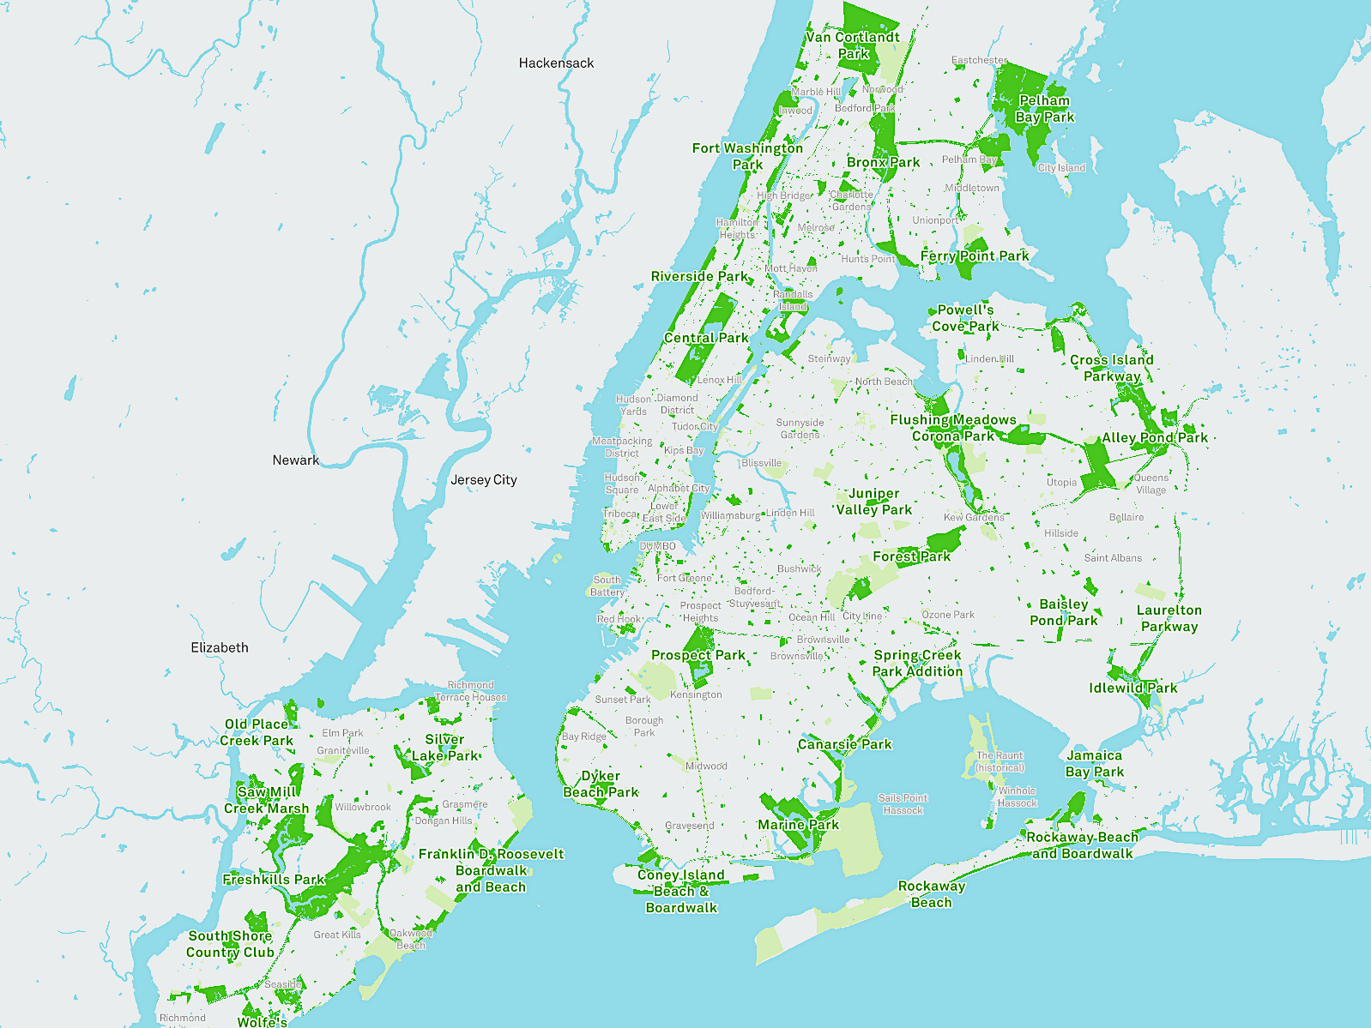
NYC Parks

Slide 4
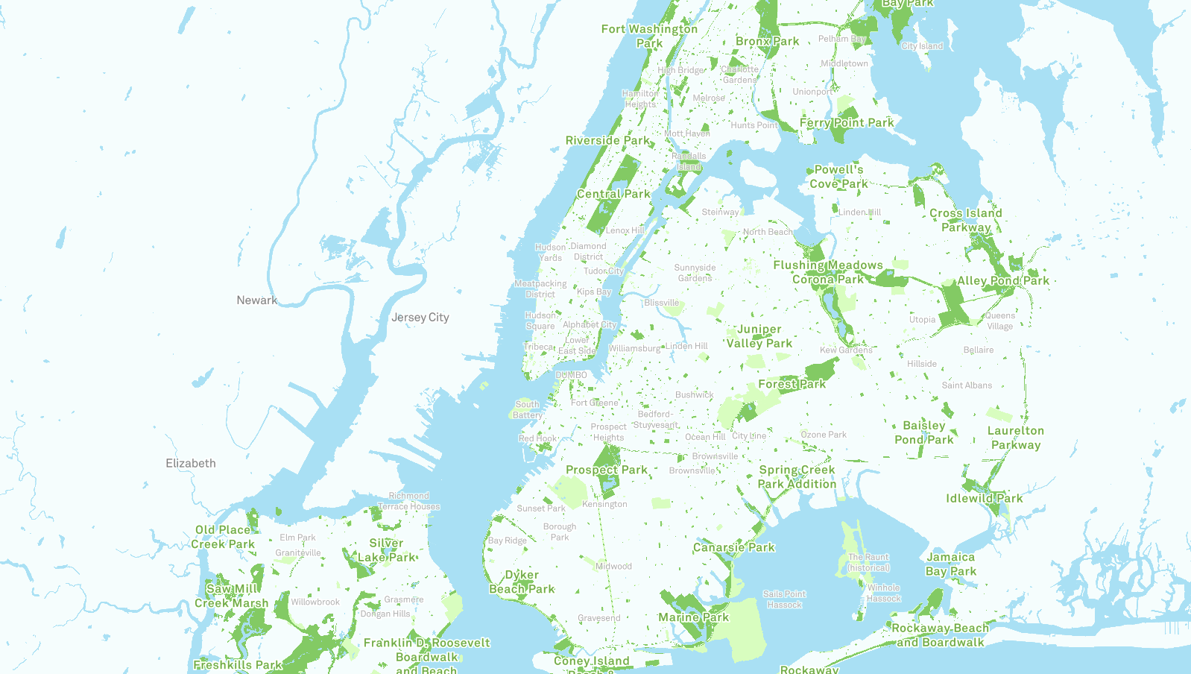
NYC Dept. of Parks & Recreation
More than 30,000 acres of land — 14 percent of NYC.
More than 5,000 individual properties ranging from Coney Island Beach and Central Park to community gardens and Greenstreets.
More than 800 athletic fields and nearly 1,000 playgrounds, 1,800 basketball courts, 550 tennis courts, 65 public pools, 51 recreational facilities, 15 nature centers, 14 golf courses, and 14 miles of beaches.

Slide 5
NYC Dept. of Parks & Recreation
Care for 1,200 monuments and 23 historic house museums.
Look after 600K street trees, and 2m more in parks.
New York City's principal provider of recreational and athletic facilities and programs.
Home to free concerts, world-class sports events, and cultural festivals.

Slide 6
Notes:
https://www.youtube.com/watch?v=9GeyoMJKWSQ

Slide 7
Central Park Conservancy Mission
The mission of the Central Park Conservancy is to restore, manage, and enhance Central Park in partnership with the public.
The Central Park Conservancy aspires to build a great organization that sets the standard for and spreads the principles of world-class park management – emphasizing environmental excellence – to improve the quality of open space for the enjoyment of all. The Conservancy is committed to sustaining this operating model to provide a legacy for future generations of park users.

Slide 8
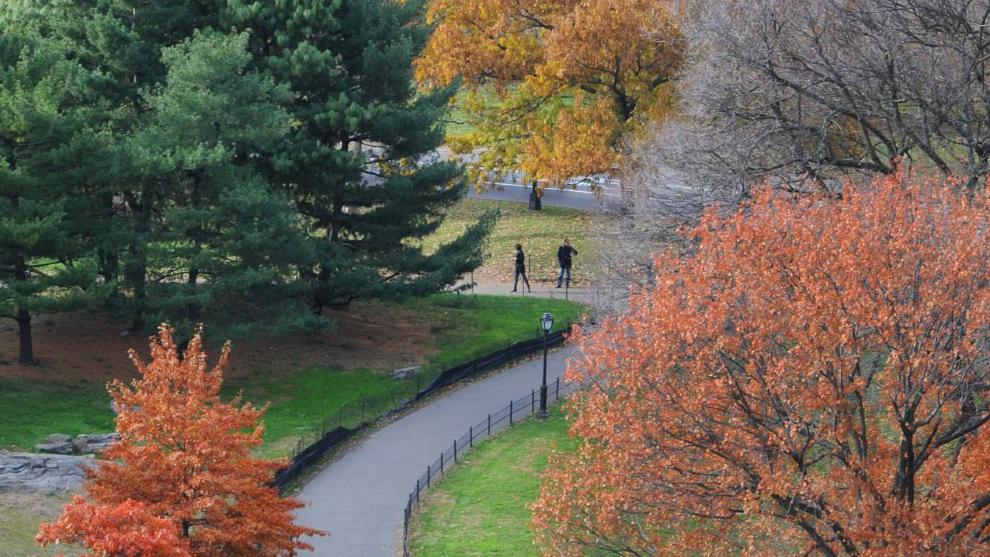
Central Park: At a Glance
Designed by Frederick Law Olmsted and Calvert Vaux, first opened to the public in 1858.
Comprised of 843 acres, including 150 acres of water, 250 acres of lawn and 80 acres of woodland.
More than 20,000 trees, 9,000 benches (4,000 of which have been “adopted”), 36 bridges and arches, 30 tennis courts, 26 ball fields, and 21 playgrounds .

Slide 9
Central Park: At a Glance
There were nearly 42 million visits to Central Park in 2014 – an average of nearly 115,000 people per day.
Since 1908, more than 300 feature films have been filmed in the Park, including two winners of the Oscar for Best Picture.

Slide 10
Central Park as a venue and a magnet for visitors
  Visits to Central Park in 2014 are estimated to have totaled 41.8m, an average of nearly 115,000 visits per day.
  Visits to the Park by people from outside NYC metropolitan area are estimated at 13.7m, including 8.3m by people visiting New York from outside the U.S.

Slide 11
Central Park as a venue and a magnet for visitors
  Conservancy estimates that in 2014, local spending by visitors from outside the metropolitan area who came to New York to attend or participate in special events in Central Park (excluding the New York City Marathon), along with incremental spending by other visitors to the Park from outside the area, directly and indirectly accounted for 1,871 FTE jobs in New York City, with $87.5 million in earnings and $203.8 million in City-wide economic output.

Slide 12
Central Park as a venue and a magnet for visitors
  Many hotels and museums surround Central Park.
  As of 2014, we estimate that 58 hotels in the Central Park area employed approximately 15,445 workers – about 35% of all hotel workers in Manhattan – with earnings totaling approximately $995m.
  In 2014, attendance at 43 museums in Central Park area totaled approx. 19.6m. These museums employed more than 6,500 people in full- and part-time jobs, accounting for nearly 60% of all museum employment in NYC.

Slide 13
Resource for community residents
Central Park provides a wide range of opportunities for both active and passive recreation, cultural and entertainment activities and other benefits for NYC residents.
In 2014, New York City residents are estimated to have visited the Park approximately 27 million times. According to a 2009 survey of Park users, walking is the most common activity in which visitors to the Park engage.

Slide 14
Resource for community residents
The opportunities for physical activity that the Park provides are estimated to have reduced health care costs in New York City and associated losses of labor productivity by approximately $53 million annually.
Central Park is also a leading venue for the development of “social capital,” through the Conservancy’s volunteer programs; participation in team sports or other forms
of group recreation; and major fund-raising events for a variety of charitable causes.

Slide 15
Impact on City revenues
Central Park conservancy estimates that in fiscal year 2014, New York City tax and fee revenues attributable to the operations of the Conservancy and other Central Park-based enterprises, to spending by out-of-town visitors to the Park, and to the increase in property values associated with proximity to the Park, totaled more than $1.045 billion.

Slide 16
NYC Dept. of Parks and Recreation Budget 2019
Notes:
The Agency's Parks Opportunity Program (POP) is an innovative transitional employment program which provides intensive skills training, adult education, employment counseling, job placement assistance, as well as paid work experience to Public Assistance recipients.

