Slide 1

Brand Image
By: Bria Hill

Slide 2

Brand Identity
Dedication
Curiosity
Progression
(MotivatingAfrica.com, 2019)

Slide 3
The importance of growing and maintaining a growth mindset was instilled in me at the beginning of my retail career. Following this model has given many rewards including three promotions all in less than three years. One’s mission now is to embrace the expansion of my network and knowledge of the overall business rather than solely my role in the matter. Also, to become the best leader possible through hard work, dedication, and applying concepts one has learned while pursuing a degree and applying them to both the personal and professional realms of life. This includes helping one’s team to achieve any and all established goals as well as maintaining positive professional and personal relationships.
Mission Statement

Slide 4

Objectives
Brainstorm
Embrace
Remain
Maximize
Build
(Pxhere.com, 2019)

Slide 5
PERSONAL GOALS
    Wake up early daily
    Reserve time daily to plan out days accordingly
    Commit to working out three days per week on a consistent basis
    Drink 1 gallon of water daily (7 refills of reusable water bottle; keep track)
    Double amount in saving account by next birthday
    Limit outside dining budget to $75 per week (including Starbucks)
    Read one non curricular based book per month
"Success isn't always about greatness. It's about consistency"
(Dwayne Johnson, 2012)

Slide 6
PROFESSIONAL GOALS
    Master conisitency
    Create universal training plan so that new hires onboarding are exposed to differenct areas of the business
    Create a list consisting of 5 of my best associates to invest in and create their growth plans
    Reach out to two external leaders to gain insight on their processes and procedures to success
    Complete all (required or non-required) management trainings
    Plan to become fluent in all AOR’s of the business one year from today
"Love challenges, be intrigued by mistakes, enjoy effort, and keep on learning"
(Carol Dweck, 2012)

Slide 7
Bibliography
C. (2017, March). [Digital image]. Retrieved from https://pxhere.com/en/photo/1095458
Dweck, C. S. (2012). Mindset: How you can fulfil your potential. London: Robinson.
Johnson, D. (2012, June 08). Success isn't always about 'greatness". It's about consistency..." Retrieved
from https://twitter.com/therock/status/211054285432160257?lang=en
  Personal Values & Why they Matter.(n.d.).Retrieved from https://www.motivatingafrica.com/personal-development/personal-values-and-why-they-
  matter/

Slide 8
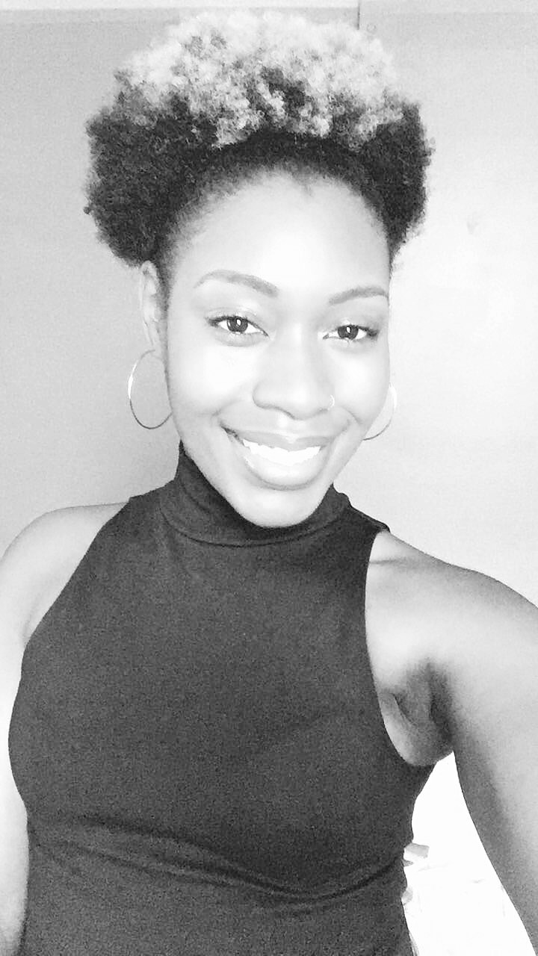
Thank You

