Slide 1
Contexts of Development
Chapter 14

Slide 2
What is Family?
The definition of family changes across time and across culture.
Traditional Family
Traditional family has been defined as two or more people who are related by blood, marriage, and—occasionally—adoption (Murdock, 1949).
Historically, the most standard version of the traditional family has been the two-parent family.
Another traditional form of family is the joint family, in which three or more generations of blood relatives live in a single household or compound.
Modern Family
Modern families—especially those in industrialized societies—exist in many forms, including:
  the single parent family
  foster families
  same-sex couples
  childfree families
  many other variations from traditional norms.
Common to each of these family forms is commitment, caring, and close emotional ties (Benokraitis, 2015).
Factors such as divorce and re-marriage have changed the definition of family.
¹
"Child, Family, and Community" by Rebecca Laff and Wendy Ruiz, College of the Canyons is licensed under CC BY 4.0 / A derivative from the original work.

Slide 3
What is Family?
Family systems theory - Each person has a role to play in their family, and each role comes with certain rules and expectations. The goal for the family is stability: rules and expectations that work for all. When the role of one member of the family changes, so do the rules and expectations; thus, causing each member to adjust their own role and expectations to compensate for the change.
Gender has been one factor by which family roles have long been assigned. Traditional roles have historically placed housekeeping and childrearing squarely as part of women’s responsibilities. Men, by contrast, have been seen as protectors and as providers of resources including money. However, families are now crossing these traditional roles with women working outside the home and men contributing more to domestic and childrearing responsibilities.
Parental roles have an impact on the ambitions of their children. Croft and her colleagues (2014) examined the beliefs of more than 300 children. When fathers endorsed more equal sharing of household duties and when mothers were more workplace oriented, daughters were more likely to have ambitions toward working outside the home and working in less gender-stereotyped professions. ²
Video: Family Systems Theory – EDUC 111, provides a brief overview of Bowen’s Family Systems Theory.
2. ""Child, Family, and Community" by Rebecca Laff and Wendy Ruiz, College of the Canyons is licensed under CC BY 4.0 / A derivative from the original work

Slide 4
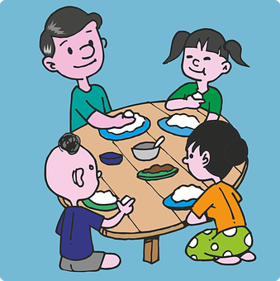
Contexts of Development - Family Atmosphere
Family Atmosphere
One of the ways to assess the quality of family life is to consider the tasks of families:
1. Providing food, clothing and shelter
2. Encouraging learning
3. Developing self-esteem
4. Nurturing friendships with peers
5. Providing harmony and stability
A good home environment is one in which the child’s physical, cognitive, emotional, and social needs are adequately met.
Sometimes families emphasize certain needs over other needs.
Parents should consider how it feels to live in the household. Is it stressful and conflict-ridden? Is it a place where family members enjoy being? 3
One function of the family is the provision of food and shelter. ⁴
3. Child Growth and Development: An Open Educational Resources Publication by College of the Canyons by Jennifer Paris, Antoinette Ricardo, and Dawn Richmond is licensed under CC BY 4.0
4. Image retrieved from Pixabay.com is licensed under CC0.

Slide 5

The Family Stress Model
The Family Stress Model
Family relationships are significantly affected by conditions outside the home.
For example, financial difficulties are associated with parents’ depressed moods, which in turn lead to marital problems and poor parenting that contributes to poorer child adjustment .
Within the home, parental marital difficulty or divorce affects more than half the children growing up today in the United States.
Difficulties outside the home can negatively affect the family.
Video: Robert Waldinger: What Makes a Good Life? Lessons from the Longest Study on Happiness. Dr, Waldinger discusses the data collected from the Harvard Study of Adult Development which tracked the lives of 724 men over the span of 75 years to answer the question, “What keeps us happy and healthy as we go through life?”
5. Child Growth and Development: An Open Educational Resources Publication by College of the Canyons by Jennifer Paris, Antoinette Ricardo, and Dawn Richmond is licensed under CC BY 4.0

Slide 6



Different Family Types
Singlehood Families : These families contains a person who is not married or in a common law relationship. He or she may share a relationship with a partner but lead a single lifestyle. Couples that are childless are often overlooked in the discussion of families.
⁶
Single-Parent Families: These families are defined as one parent who has most of the day-to-day responsibilities in the raising of the child or children, who is not living with a spouse or partner, or who is not married. Single parent by choice families refer to a family that a single person builds by choice. These families can be built with the use of assisted reproductive technology and donor gametes (sperm and/or egg) or embryos, surrogacy, foster or kinship care, and adoption. ⁷
Two-Parent Families :The nuclear family is often referred to as the traditional family structure. It includes two married parents and children.
Two-parent families also include families of cohabitating couples (not married) and same-sex families
6. Images retrieved from pixabay.com are licensed under CC0.
7. Child Growth and Development: An Open Educational Resources Publication by College of the Canyons by Jennifer Paris, Antoinette Ricardo, and Dawn Richmond is licensed under CC BY 4.0

Slide 7



Different Family Types Cont’d
Families by Choice: These families are relatively newly recognized and describe families not recognized by the legal system. It may include adopted children, live-in partners, kin of each member of the household, and close friends.
⁸
Blended Families: These
families are described as having mixed parents: one or both parents remarried and bringing children of the former family into the new family.
Extended Families: These families include three generations: grandparents, parents, and children. This is the most common type of family worldwide. ⁹
¹⁰
8. Image retrieved from wikipedia.org is licensed under Creative Commons Attribution-ShareAlike License;
9 ..Child Growth and Development: An Open Educational Resources Publication by College of the Canyons by Jennifer Paris, Antoinette Ricardo, and Dawn Richmond is licensed under CC BY 4.0
10. Images retrieved from pixabay.com are licensed under CC0. (Please note this excludes the Brady Bunch image)

Slide 8
Divorce
While the assumption has been that divorce has a strong, negative impact on the child and that single-parent families are deficient in some way, 75-80 percent of children and adults who experience divorce suffer no long-term effects (Hetherington & Kelly, 2002). Nevertheless, divorce, remarriage and life in stepfamilies can have a variety of short-term and long-term consequences.
Short-term consequences
Grief over losses suffered
Reduced Standard of Living.
Adjusting to Transitions
Long-Term Consequences
Economic/Occupational Status
Improved Relationships with the Custodial Parent
Greater emotional independence in sons
Feeling more anxious in their own love relationships
Adjustment of the custodial parent.
Video: Effects of Family Separation on a Child, discusses both the short-term and long-term effects of separation and divorce.
11.Child Growth and Development: An Open Educational Resources Publication by College of the Canyons by Jennifer Paris, Antoinette Ricardo, and Dawn Richmond is licensed under CC BY 4.0

Slide 9
Socialization: Parenting Styles
Parenting style captures two important elements of parenting: parental responsiveness and parental demandingness (Maccoby & Martin, 1983).
Parental responsiveness (also referred to as parental warmth or supportiveness) refers to "the extent to which parents intentionally foster individuality, self-regulation, and self-assertion by being attuned, supportive, and acquiescent to children's special needs and demands" (Baumrind, 1991, p. 62).
Parental demandingness (also referred to as behavioral control) refers to "the claims parents make on children to become integrated into the family whole, by their maturity demands, supervision, disciplinary efforts and willingness to confront the child who disobeys" (Baumrind, 1991, pp. 61- 62).
¹²
12. "Child, Family, and Community" by Rebecca Laff and Wendy Ruiz, College of the Canyons is licensed under CC BY 4.0 / A derivative from the original work

Slide 10
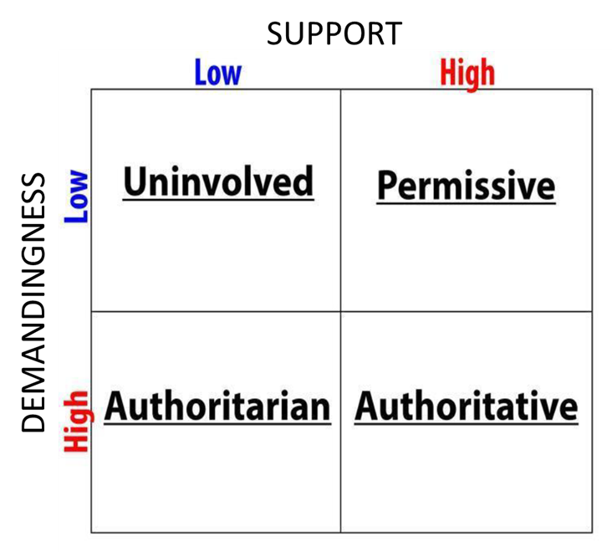
Parenting Styles: Baumrind’s Four Parenting Styles
Baumrind’s Four Parenting Styles. ¹³
Parenting Styles
Indulgent parents (also referred to as "permissive" or "nondirective") "are more responsive than they are demanding. They are nontraditional and lenient, do not require mature behavior, allow considerable self-regulation, and avoid confrontation" (Baumrind, 1991, p. 62). Indulgent parents may be further divided into two types: democratic parents, who, though lenient, are more conscientious, engaged, and committed to the child, and nondirective parents.
Authoritarian parents are highly demanding and directive, but not responsive. "They are obedience- and status-oriented and expect their orders to be obeyed without explanation" (Baumrind, 1991, p. 62). These parents provide well-ordered and structured environments with clearly stated rules. Authoritarian parents can be divided into two types: nonauthoritarian-directive, who are directive, but not intrusive or autocratic in their use of power, and authoritarian-directive, who are highly intrusive.
Authoritative parents are both demanding and responsive. "They monitor and impart clear standards for their children's conduct. They are assertive, but not intrusive and restrictive. Their disciplinary methods are supportive, rather than punitive. They want their children to be assertive as well as socially responsible, and self-regulated as well as cooperative" (Baumrind, 1991, p. 62).
Uninvolved parents are low in both responsiveness and demandingness. In extreme cases, this parenting style might encompass both rejecting-neglecting and neglectful parents, although most parents of this type fall within the normal range.
Video: Baumrind’s Parenting Styles (Intro Psych Tutorial #181), discusses each of Baumrind’s parenting styles and possible causes for each style.
13. Image retrieved from "Child, Family, and Community" by Rebecca Laff and Wendy Ruiz, College of the Canyons is licensed under CC BY 4.0 / A derivative from the original work
14. "Child, Family, and Community" by Rebecca Laff and Wendy Ruiz, College of the Canyons is licensed under CC BY 4.0 / A derivative from the original work
¹⁴

Slide 11
Parenting Styles: Consequences for Children
Parenting style has been found to predict child well-being in the domains of social competence, academic performance, psychosocial development, and problem behavior. Research in the United States, based on parent interviews, child reports, and parent observations consistently finds:
Children and adolescents whose parents are authoritative are more socially and academically competent than those whose parents are non-authoritative (Baumrind, 1991; Weiss & Schwarz, 1996; Miller et al., 1993).
Children and adolescents whose parents are uninvolved perform most poorly in all domains.
In general, parental responsiveness predicts social competence and psychosocial functioning, while parental demandingness is associated with academic competence and behavioral control.
Children and adolescents from authoritarian families (high in demandingness, but low in responsiveness) tend to perform moderately well in school and tend not to have problem behavior, but they have poorer social skills, lower self-esteem, and higher levels of depression.
Children and adolescents from indulgent homes (high in responsiveness, low in demandingness) are more likely to have problem behavior and perform less well in school, but they have higher self-esteem, better social skills, and lower levels of depression.
¹⁵
15. "Child, Family, and Community" by Rebecca Laff and Wendy Ruiz, College of the Canyons is licensed under CC BY 4.0 / A derivative from the original work

Slide 12
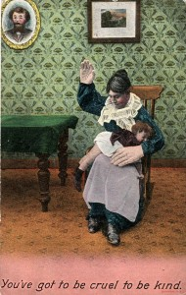
Consequences of Spanking
How effective is spanking and are there any negative consequences?
Studies have shown that physical punishment, including spanking, hitting and other means of causing pain, can lead to increased aggression, antisocial behavior, physical injury and mental health problems for children.
In a longitudinal study that followed more than 1500 families from 20 U.S. cities, parents’ reports of spanking were assessed at ages three and five (MacKenzie, Nicklas, Waldfogel, & Brooks-Gunn, 2013). This study revealed the negative cognitive effects of spanking in addition to the increase in aggressive behavior.
Internationally, physical discipline is increasingly being viewed as a violation of children’s human rights. ¹⁶
¹⁷
Physical punishment can have negative side effects.
Video: Parenting Panel: To Spank or Not to Spank – Steve Harvey: While you have read about the negative impact that spanking may have on a child, why would some parents continue to spank? Unlike any of the videos you have viewed, this video does not discuss scientific research, but rather looks at two groups of parents; one who spank their children and one who do not.
16. "Lifespan Development: A Psychological Perspective 2nd Edition by Martha Lally and Suzanne Valentine-French is licensed under CC BY-NC-SA 3.0
17. Introduction to Sociology – 2nd Canadian Edition by William Little is licensed under CC BY 4.0.

Slide 13
Effective Discipline Methods
Using positive reinforcement to change behavior is almost always more effective than using punishment.
Positive punishment is more likely to create only temporary changes in behavior¹⁸
Shaping : Reinforcing Successive Approximations of a Target Behavior
1. Reinforce any response that resembles the desired behavior.
2. Then reinforce the response that more closely resembles the desired behavior. You will no longer reinforce the previously reinforced response.
3. Next, begin to reinforce the response that even more closely resembles the desired behavior.
4. Continue to reinforce closer and closer approximations of the desired behavior.
5. Finally, only reinforce the desired terminal behavior.
Other Alternatives that are Advocated by Child Development Specialists
1. Praising and modeling appropriate behavior
2. Providing time-outs for inappropriate behavior
3. Giving choices.
4. Helping the child identify emotions and learning to calm down
5. Ignoring small annoyances (e.g., using extinction for an undesirable behavior that has been inadvertently reinforced, such as discontinuing attention when a child has a tantrum)
6. Using negative punishment, such as withdrawing privileges for undesirable behavior (e.g., teenager loses car privilege for coming home intoxicated)
Using a Differential Reinforcement Procedure* *Video: Differential Reinforcement Explained, defines and provides examples of the different types of differential reinforcement. While these procedures are effective for children with various neurodevelopmental disorders, they are also very effective for children who are neurotypically developing.
Video: Managing Your Toddler’s Behavior, provides tips on how to manage a toddler's behavior before they act-out.
¹⁹
18. Introduction to Psychology by University of Minnesota is licensed under a Creative Commons Attribution-NonCommercial-ShareAlike 4.0 International License,
19. Lifespan Development: A Psychological Perspective 2nd Edition by Martha Lally and Suzanne Valentine-French is licensed under CC BY-NC-SA 3.0 (modified by Marie Parnes)

Slide 14
Media: Influences on Development
According to the Kaiser Family Foundation, kids ages 8-18 now spend, on average, 7.5 hours in front of a screen for entertainment each day, 4.5 of which are spent watching TV.
Over a year, that adds up to 114 full days watching a screen for fun. That’s just the time they spend in front of a screen for entertainment. It doesn’t include the time they spend on the computer at school for educational purposes or at home for homework.
²¹
Age Range in Years | Amount of Screen Time *
8-10 | 6 hours a day
11-14 | 9 hours a day
15-18 | 7.5 hours a day
* Includes all entertainment media
20. Screen Time vs Lean Time was retrieved from the CDC – public domain

Slide 15
The Influences of Excessive Screen Time
Cognitive Influences
For 12-21-month-olds, co-viewing television with parents led to an overall reduction in the quality and quantity of parent-infant interactions when the TV was on.
When the same group of children were tested at 6-9 years of age, the results indicated that parent-infant co-viewing had a direct negative association with children’s executive function skills, academic achievement, and language during middle childhood. The more children co-viewed with their parents during infancy, the more likely they were to exhibit poorer working memory, academic performance, and language skills during middle childhood. ²¹
Physical Influences
Screen time increase children’s risk for obesity because sitting and watching a screen is time that is not spent being physically active. TV commercials and other screen ads can lead to unhealthy food choices because the foods aimed at kids are high in sugar, salt, or fats. Children eat more when they are watching TV, especially if they see ads for food.²²
Increased media use is associated with shorter and poorer quality sleep, which is also a significant risk factor for obesity.
Behavioral Influences
Studies have reported that young children who have two or more hours per day using mobile devices show more externalizing behaviors (aggression, tantrums) and inattention (Tamana, et al., 2019) and a higher risk of behavioral problems (Wu, 2017)
Children learn some behavior by observation. Some studies suggest that violent television shows, movies, and video games may also have antisocial effects. However, many children who watch violent media do not become violent.
Repeated exposure to violent acts may lead to desensitization.²³
21. Hanson, Katherine, "THE INFLUENCE OF EARLY MEDIA EXPOSURE ON CHILDREN’S DEVELOPMENT AND LEARNING" (2017). Doctoral Dissertations. 1011. https://scholarworks.umass.edu/dissertations_2/1011. Part of the Developmental Psychology Commons
22Effect of Media Use on Adolescent Body Weight.by Eun Me Cha, MPH, PhD; Deanna M. Hoelscher, PhD Nalini Ranjit, PhD, Baojiang Chen, PhD; Kelley Pettee Gabriel, MS, PhD, Steven Kelder, MPH, PhD, ; Debra L. Saxton, MS was retrieved from the CDC – public domain
23. . Hanson, Katherine, "THE INFLUENCE OF EARLY MEDIA EXPOSURE ON CHILDREN’S DEVELOPMENT AND LEARNING" (2017). Doctoral Dissertations. 1011. https://scholarworks.umass.edu/dissertations_2/1011. Part of the Developmental Psychology Commons

Slide 16
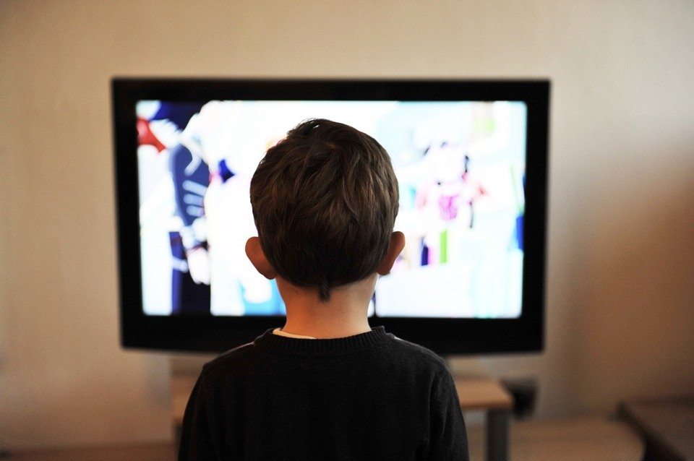
Media and Self-Understanding
Young children begin developing social understanding very early in life.
Movies, music videos, the internet, and advertisers can all create cultural images of what is desirable or undesirable and can influence a child’s self-concept. ²⁴
When children internalize and compare themselves to these cultural images, it can affect their self-esteem, which is defined as an evaluation of one’s identity.
  If there is a discrepancy between how children view themselves and what they consider to be their ideal selves, their self-esteem can be negatively affected. ²⁵
When children internalize and compare themselves to cultural images, it can affect their self-esteem. ²⁶
24. Child Growth and Development: An Open Educational Resources Publication by College of the Canyons by Jennifer Paris, Antoinette Ricardo, and Dawn Richmond is licensed under CC BY 4.0 (modified by Marie Parnes)
25. Child Growth and Development: An Open Educational Resources Publication by College of the Canyons by Jennifer Paris, Antoinette Ricardo, and Dawn Richmond is licensed under CC BY 4.0 (modified by Marie Parnes)
26. Image from Pixabay.com is licensed under CC0.

Slide 17
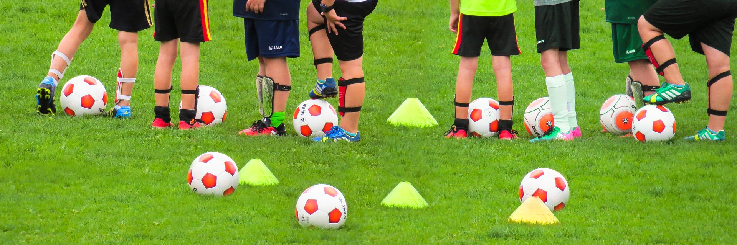
Structured Activities: Recess, Physical Education & Organized Sports
Recess and Physical Education:
Recess is a time for free play and Physical Education (PE) is a structured program that teaches skills, rules, and games.
They’re a big part of physical fitness for school age children and are the key component in introducing children to sports.
After years of schools cutting back on recess and PE programs, there has been a turn around, prompted by concerns over childhood obesity and the related health issues.
Organized Sports: Pros and Cons :
Middle childhood is a great time to introduce children to organized sports,.
However, the emphasis on competition and athletic skill can be counterproductive and lead children to grow tired of the sport and want to quit.
Adult involvement in children’s activities may shift the focus away from the children .
Sports are important for children. Children’s participation in sports has been linked to:
  Higher levels of satisfaction with family and overall quality of life in children
  Improved physical and emotional development
  Better academic performance
Gender, poverty, location, ethnicity, and disability can limit opportunities to engage in sports. Girls were more likely to have never participated in any type of sport.
²⁷
Video: Why Recess and Physical Education are Making a Comeback, discusses not only the importance of recess, but how recess may help the development of cognitive abilities.
²⁸
27. Child Growth and Development: An Open Educational Resources Publication by College of the Canyons by Jennifer Paris, Antoinette Ricardo, and Dawn Richmond is licensed under CC BY 4.0 (modified by Marie Parnes)
28. Image by Pixabay is licensed by CC0.
²⁸

Slide 18
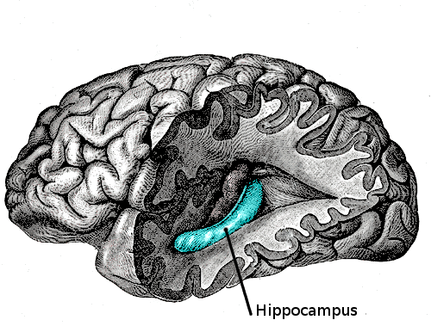
The Effects of Stress on Children
Children experience different types of stressors.
Normal, everyday stress can provide an opportunity for young children to build coping skills and poses little risk to development.
Children who experience toxic stress or who live in extremely stressful situations of abuse over long periods of time can suffer long-lasting effects. High levels of the stress hormone cortisol can reduce the size of the hippocampus and affect the child's memory abilities. Stress hormones can also reduce immunity to disease. The brain exposed to long periods of severe stress can develop a low threshold making the child hypersensitive to stress in the future.
The toxic stress that young children endure can have a significant impact on their later lives. Positive experiences strengthen biological systems while adverse experiences can increase mortality and morbidity. ²⁹
High levels of cortisol can reduce the size of the hippocampus and affect a child’s memory abilities. ³⁰
Video: Toxic Stress Derails Healthy Development, discusses how suffering from extreme stress during childhood can have long-term consequences for learning, behavior, and both physical and mental health.
29. Lifespan Development by Lumen Learning: Childhood Stress and Development is licensed under CC BY 4.0.
30. Image retrieved from wikipedia.org is licensed under Creative Commons Attribution-ShareAlike License

Slide 19
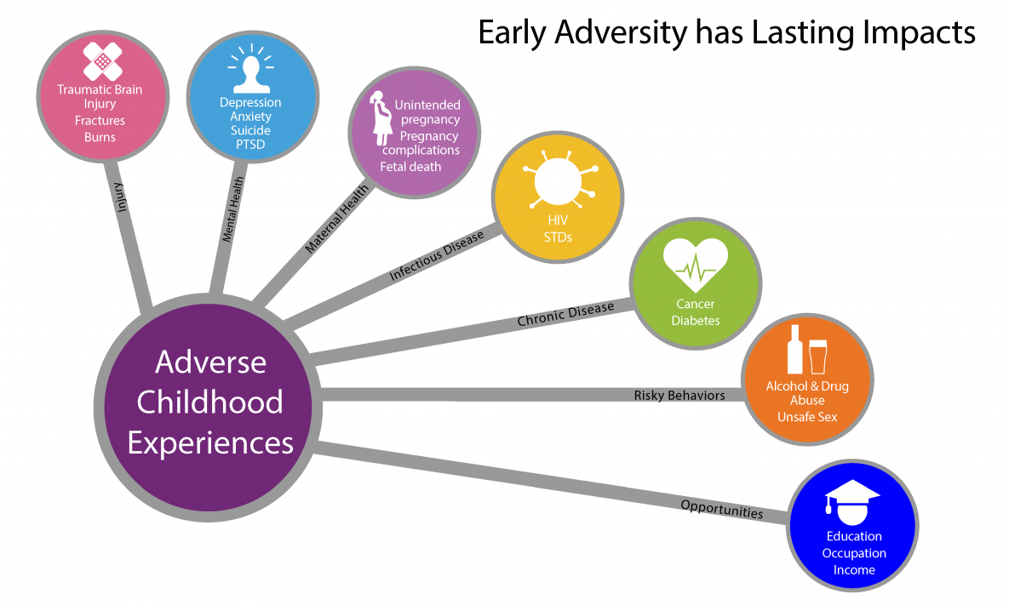
Adverse Childhood Experiences (ACEs)
³²
All types of abuse, neglect, and other potentially traumatic experiences that occur before the age of 18 are referred to as adverse childhood experiences (ACEs) (CDC, 2019).
ACEs have been linked to risky behaviors, chronic health conditions, low life potential and early death, and as the number of ACEs increases, so does the risk.³¹
Video: We Can Prevent ACEs, discusses how to prevent ACE’s by using strategies to create safe, stable, nurturing environments for children.
32. Psychology - What is Stress? by Openstax is licensed under CC-BY-4. 0 (modified by Marie Parnes)
33. Image retrieved from Lifespan Development: A Psychological Perspective 2nd Edition by Martha Lally and Suzanne Valentine-French is licensed under CC BY-NC-SA 3.0

Slide 20
Resiliency
Being able to overcome challenges and successfully adapt is resiliency. Even young children can exhibit strong resilience to harsh circumstances. However, we can’t “make” children resilient, but we can explore those qualities and skills that help them develop key elements of resiliency.³⁴
Factors that Contribute to Childhood Resilience
³⁵
Cognitive Development/Problem-solving Skills
As children mature, the problems they solve get more complex. Solving problems engages our prefrontal cortex which is involved in executive function.
During times of stress and trauma, the prefrontal cortex is typically shut down so that our body can respond to the threats it is facing.
Helping children engage in problem-solving activities, will allow them to gain a sense of self-efficacy and mastery as well as re-engaging the parts of their brain that may have been offline.
Self-Regulation
Self-regulation is the ability to control oneself in a variety of ways. It involves working memory, the ability to focus on a goal, tolerance for frustration, and controlling and expressing one’s emotions appropriately and in context.
Self-regulation is key for academic and social success and plays a significant role in mental health outcomes.
Relationships with Caring Adults
Disrupted attachment relationships can be devastating for young children because they are still developing an internal working model of what relationships look like and because they rely so intensively on their caregivers to get their basic needs met.
By developing relationships with caring adults,, children learn about healthy relationships
Video 1: InBrief: What is Resilience?
Video 2: InBrief: The Science of Resilience
Video 3: In Brief: How Resilience is Built
34. Child Growth and Development: An Open Educational Resources Publication by College of the Canyons by Jennifer Paris, Antoinette Ricardo, and Dawn Richmond is licensed under CC BY 4.0
35. Childhood Resilience retrieved from SAMSA HHS.gov – public domain.

Slide 21
Chronic Health Conditions in Childhood
Asthma is a chronic disease that affects your airways. The inside walls of your airways become sore and swollen.
In the United States, nearly 9 million children have asthma. Children have smaller airways than adults, which makes asthma especially serious for them.
Children with asthma may experience wheezing, coughing, chest tightness, and trouble breathing, especially early in the morning or at night.³⁶
Diabetes- Until recently, the common type of diabetes in children and teens was Type 1. It was called juvenile diabetes. With Type 1 diabetes, the pancreas does not make insulin, a hormone that helps glucose, or sugar, get into your cells to give them energy. Without insulin, too much sugar stays in the blood.
Younger people are also getting Type 2 diabetes. Type 2 diabetes used to be called adult-onset diabetes. But now it is becoming more common in children and teens, due to more obesity. With Type 2 diabetes, the body does not make or use insulin well.
Children have a higher risk of type 2 diabetes if they are overweight or obese, have a family history of diabetes, or are not active. Children who are African American, Hispanic, Native American/Alaska Native, Asian American, or Pacific Islander also have a higher risk.
To lower the risk of type 2 diabetes in children:
    Have them maintain a healthy weight
    Be sure they are physically active
    Have them eat smaller portions of healthy foods
    Limit time with the TV, computer, and video
Children and teens with type 1 diabetes may need to take insulin. Type 2 diabetes may be controlled with diet and exercise. If not, patients will need to take oral diabetes medicines or insulin.
³⁸
³⁷
Video: Obesity and Diabetes on the Rise in Children, discusses the obesity epidemic and how it has led to a large increase in Type 1 and Type 2 diabetes.
36. Child Growth and Development: An Open Educational Resources Publication by College of the Canyons by Jennifer Paris, Antoinette Ricardo, and Dawn Richmond is licensed under CC BY 4.0
37. Asthma Triggers by 7Mike5000 retrieved from Wikipedia Commons is licensed under CC SA-3.0
38. Diabetes in Children and Teens retrieved from MedlinePlus U.S. National Library of Medicine – Public domain

