Slide 1
Social Cognition and Peer Relationships
Chapter 13

Slide 2
Social Cognition – Theory of Mind
Theory of mind refers to the ability to think about other people’s thoughts. This mental mind reading helps humans to understand and predict the reactions of others, thus playing a crucial role in social development.
  Infants and toddlers have a relatively simple theory of mind and are aware of some basic characteristics:
    What people are looking at is a sign of what they are paying attention to.
    People act intentionally and are goal directed.
      Shared Intentionality: Coordinated collaborative interactions that make possible the sharing of mental states with others. For example: Babies as young as 14 months who witness an adult struggling to reach for an object will interrupt their play to crawl over and hand the object to the adult
    People have positive and negative feelings in response to things around them.
      For example, when toddlers overhear adults disagreeing, they use that information to guide their own behavior. (Video: Toddlers Regulate their Behavior to Avoid Making Adults Angry)
    People have different perceptions, goals, and feelings. ¹
From: Committee on the Science of Children Birth to Age 8: Deepening and Broadening the Foundation for Success; Board on Children, Youth, and Families; Institute of Medicine; National Research Council; Allen LR, Kelly BB, editors. Transforming the Workforce for Children Birth Through Age 8: A Unifying Foundation. Washington (DC): National Academies Press (US); 2015 Jul 23. 4, Child Development and Early Learning. Licensed under Public Domain.

Slide 3
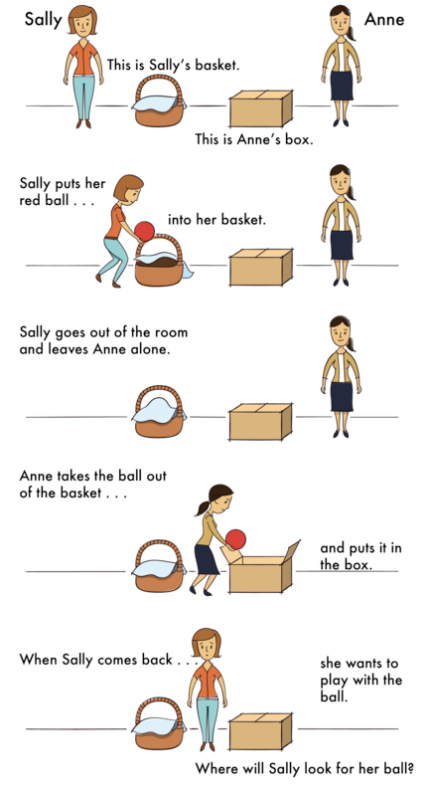
Social Cognition – Theory of Mind and the False Belief Task
One common method for determining if a child has attained an understanding of false beliefs is the false belief task (Wimmer & Perner, 1983).
  There are several iterations of the false belief task. One of the more common is the one illustrated to the right called, “The Sally-Anne Task/Test.”
To be successful on tasks of this type, the child must separate what he or she “knows” to be true from what someone else might “think” is true. The child must also understand that what guides people’s actions and responses are what they believe rather than what is reality. Prior to age four children are rarely successful at solving such a task (Wellman, Cross & Watson, 2001).
²
Video: The “False Belief” Test: Theory of Mind, shows Gopnick’s work with younger and older children using a “Snoopy” version of the False Belief Task.
2. Text and Image from Malle, B. (2020). Theory of mind. In R. Biswas-Diener & E. Diener (Eds), Noba textbook series: Psychology. Champaign, IL: DEF publishers. Retrieved from http://noba.to/a8wpytg3 is licensed under CC BY NC SA 4.0

Slide 4
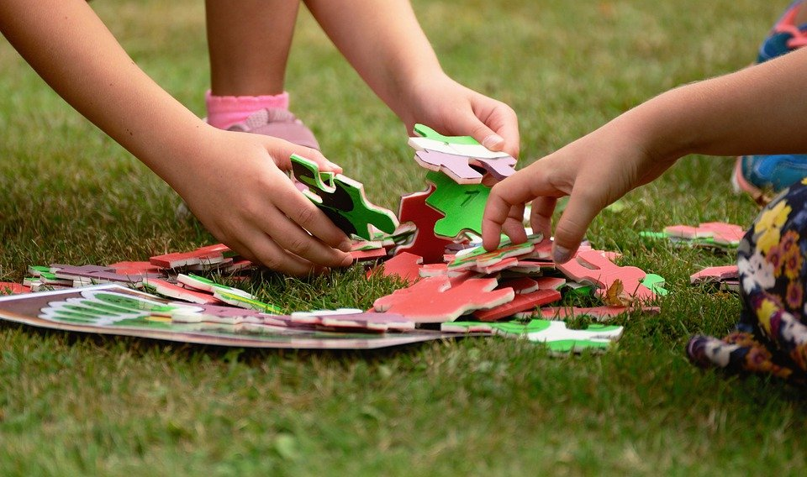
Theory of Mind in Social Life
In social situations, children rely on theory of mind to infer what others are thinking and feeling.
Some examples of social interactions are:
Teaching another person new actions or rules by considering what the learner knows or doesn’t know and how one might best make him understand.
Learning the words of a language by monitoring what other people attend to and are trying to do when they use certain words.
Figuring out our social standing by trying to guess what others think and feel about us.
Sharing experiences by telling a friend how much we liked a movie or by showing her something beautiful.
Collaborating on a task by signaling to one another that we share a goal and understand and trust the other’s intention to pursue this joint goal. ³
Children form an alliance to complete the puzzle ⁶
3. Malle, B. (2020). Theory of mind. In R. Biswas-Diener & E. Diener (Eds), Noba textbook series: Psychology. Champaign, IL: DEF publishers. Retrieved from http://noba.to/a8wpytg3 is licensed under CC BY NC SA 4.0
4. Image retrieved from pixabay.com is licensed under CC0.

Slide 5
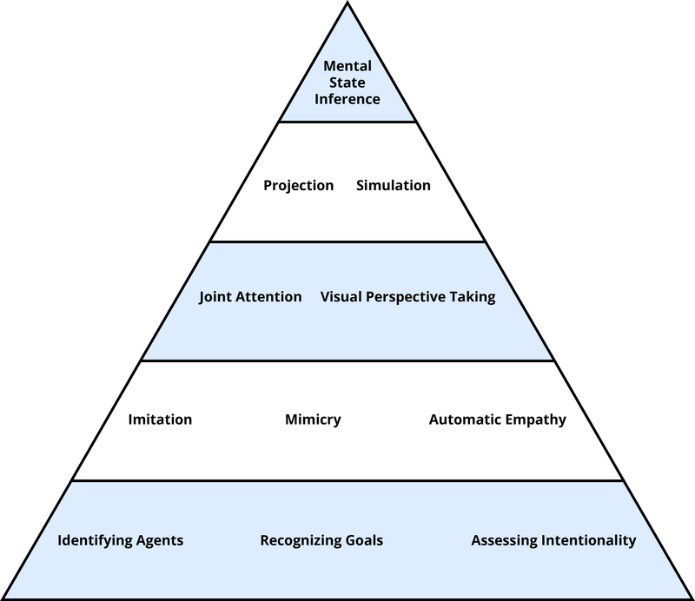
The Mental Processes Underlying the Theory of Mind
What underlies people’s capacity to recognize and understand mental states is a whole host of tools for many different but related tasks in the social world (Malle, 2008).
⁵
The figure to the right shows some of the most important tools, organized in a way that reflects the complexity of involved processes: from simple and automatic on the bottom to complex and deliberate on the top.
This organization also reflects development—from tools that infants master within the first 6–12 months to tools they need to acquire over the next 3–5 years.
5. Text and image from Malle, B. (2020). Theory of mind. In R. Biswas-Diener & E. Diener (Eds), Noba textbook series: Psychology. Champaign, IL: DEF publishers. Retrieved from http://noba.to/a8wpytg3 is licensed under CC BY NC SA 4.0

Slide 6
The Mental Processes Underlying the Theory of Mind Cont’d
Major Tools of the Theory of Mind
Agents, Goals, and Intentionality The agent category allows humans to identify those moving objects in the world that can act on their own. Features that even very young children take to be indicators of being an agent include being self-propelled, having eyes, and reacting systematically to the interaction partner’s behavior, such as following gaze or imitating (Johnson, 2000; Premack, 1990). Recognizing goals builds on this agent category, because agents are characteristically directed toward goal objects, which means they seek out, track, and often physically contact said objects. Through learning to recognize the many ways by which agents pursue goals, humans learn to pick out behaviors that are intentional.
Imitation, Synchrony, and Empathy Imitation and empathy aid the understanding of mind from childhood on (Meltzoff & Decety, 2003). A subtle, automatic form of imitation is called mimicry, and when people mutually mimic each other, they can reach a state of synchrony. Automatic empathy builds on imitation and synchrony.
Joint Attention, Visual Perspective Taking Humans are capable of actively engaging in joint attention. Shared engagement is critical for children to learn the meaning of objects and the words that refer to them. Another important capacity of engagement is visual perspective taking. When we overcome our egocentric perspective, we imaginatively adopt the other person’s spatial viewpoint and determine how the world looks from their perspective.
Projection, Simulation (and the Specter of Egocentrism) One tool to understand the other’s thoughts or feelings is simulation—using one’s own mental states as a model for others’ mental states. An even simpler form of such modeling is the assumption that the other thinks, feels, wants what we do—which has been called the “like-me” assumption (Meltzoff, 2007) or the inclination toward social projection (Krueger, 2007). In a sense, this is an absence of perspective taking, because we assume that the other’s perspective equals our own. ⁶
Explicit Mental State Inference The ability to truly take another person’s perspective requires that we separate what we want, feel, and know from what the other person is likely to want, feel, and know. To do so humans make use of a variety of information, such as stored knowledge; such as general knowledge and agent-specific knowledge. They also critically rely on perceived facts of the concrete situation. This capacity of integrating multiple lines of information into a mental-state inference develops steadily within the first few years of life. ⁷
6. Malle, B. (2020). Theory of mind. In R. Biswas-Diener & E. Diener (Eds), Noba textbook series: Psychology. Champaign, IL: DEF publishers. Retrieved from http://noba.to/a8wpytg3 is licensed under CC BY NC SA 4.0
7. Malle, B. (2020). Theory of mind. In R. Biswas-Diener & E. Diener (Eds), Noba textbook series: Psychology. Champaign, IL: DEF publishers. Retrieved from http://noba.to/a8wpytg3 is licensed under CC BY NC SA 4.0 (modified by Maria Pagano)

Slide 7
Theory of Mind and Autism
Another way of appreciating the enormous impact that theory of mind has on social interactions is to study what happens when the capacity is severely limited, as in the case of autism spectrum disorder (ASD) (Tager-Flusberg, 2007)
Baron-Cohen, Leslie and Frith (1985) reported that children with autism, who suffer from severe impairment in social interaction and communication, do not pass the false belief test.
  The most consistent finding is that before the verbal mental age of 11 years, children with ASD do not pass various versions of the false belief test.
Criticisms of Baron-Cohen’s findings
  The false-belief task is cognitively demanding, and children must remember the sequence of the events presented, correctly understand the experimenter’s question, and the ASD child must inhibit their initial response to the actual location of the object
Most researchers agree that while high functioning individuals with ASD who have attained a verbal mental age of 11 can pass false-belief tasks, researchers also find that these same individuals fail to correctly infer complex mental states from situations where they are presented photographs of eyes or are asked to interpret cartoon animations.
⁸
⁹
Video 1: Baron Cohen – Sally Ann Test: This brief video shows a child who is approximately 8 or 9 years old and who has autism taking the Sally-Anne Test.
Video 2: Psychology – Autism – Simon Baron-Cohen: In this video Simon Baron-Cohen discusses work with children who have autism, the Sally-Anne test, the autism spectrum, the meaning of mindblindness, and the talents that some individuals with autism exhibit.
Video 3 “Labeling and Identifying Emotions”: Video Lesson – Applied Behavior Analysis – FirstPath Autism: This video shows a counselor working with an autistic child and helping the child recognize emotions across different situations using touch, talk, and self reflection.
8. Lifespan Development: A Psychological Perspective 2nd Edition by Martha Lally and Suzanne Valentine-French is licensed under CC BY-NC-SA 3.0
9. Senju A. Spontaneous theory of mind and its absence in autism spectrum disorders. Neuroscientist. 2012 Apr;18(2):108-13. doi: 10.1177/1073858410397208. Epub 2011 May 23. PMID: 21609942; PMCID: PMC3796729. Licensed under Public domain.

Slide 8

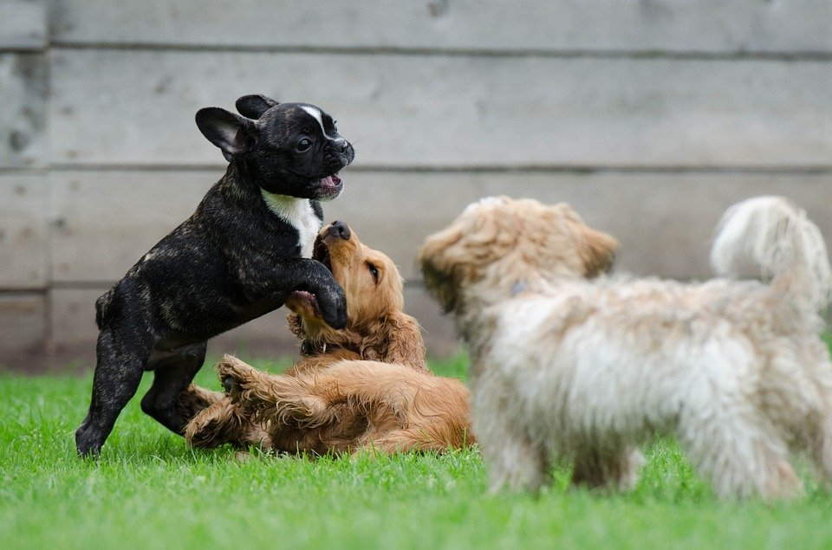

Play: What is Play and Why is Play Important?
What is play?
Play is a spontaneous, voluntary, pleasurable and flexible activity involving a combination of body, object, symbol use and relationships. In contrast to games, play behavior is more disorganized, and is typically done for its own sake.
All mammals—from mice to humans—engage in some sort of play. ¹⁰
Play can help children learn the skills needed for social interactions. Play can also help young children master their emotions, and to make their own decisions. It also teaches flexibility, motivation, and confidence. Evidence suggests that play can help boost brain function, increase fitness, improve coordination and teach cooperation. (Play: Synthesis. In: Tremblay RE, Boivin M, Peters RDeV, eds. Smith PK, topic ed. Encyclopedia on Early Childhood Development [online]. http://www.child-encyclopedia.com/play/synthesis. Updated June 2013. Accessed July 29, 2020. Used with permission.)
The increase of commercial toys and technological developments by the toy industry has fostered more sedentary and less healthy play behaviors in children.
Playing and talking to babies and children are vital for their language development. Children who talk with their parents tend to acquire a vocabulary that will later help them in school. ¹¹
All mammals engage in some sort of play. ¹³
10. Child and Adolescent Psychology Lumen Learning licensed under CC BY 4.0
11. Images retrieved from Pixabay.com are licensed under CC0.

Slide 9
Types of Play
Preschoolers Engage in Different Types of Play
Social - Social play is usually the first form of play observed in young children. Social play is characterized by playful interactions with parents (up to age 2) and/or other children (from two years onwards).
Parallel - Parallel play occurs when children between 2 to 3 years old commonly play next to each other without much interaction
Object - Creating a play environment where children are encouraged to pick up, explore and manipulate objects results in endless learning opportunities. You don’t need to buy lots of toys the simplest materials are best for open-ended play. ¹²
Sociodramatic- As their cognitive skills develop, including their ability to imagine, imitate and understand other’s beliefs and intents, children start to engage in sociodramatic play. While interacting with same-age peers, children develops narrative thinking, problem-solving skills (e.g., when negotiating roles), and a general understanding of the building blocks of story
Locomotor - Locomotor play typically includes running and climbing, and even play fighting especially amongst boys aged three to six. In contrast to the popular belief, play fighting lacks intent to harm either emotionally or physically even though it can look like real fighting. ¹³
Video: Early Years Foundation Stage: Children Play at Being Travel Agents: The children in this video are displaying several of the types of play as they pretend to plan a trip to Japan. Can you identify the different types of play that are demonstrated by the children?
12. Play: Synthesis. In: Tremblay RE, Boivin M, Peters RDeV, eds. Smith PK, topic ed. Encyclopedia on Early Childhood Development [online]. http://www.child-encyclopedia.com/play/synthesis. Updated June 2013. Accessed July 29, 2020. Used with permission.
13. The material on this page is from http://galileo.org/earlylearning an Early Learning website and a joint venture of the Government of Alberta and Galileo Educational Network. For copyright information, visit http://creativecommons.org/licenses/by-nc-sa/3.0/

Slide 10
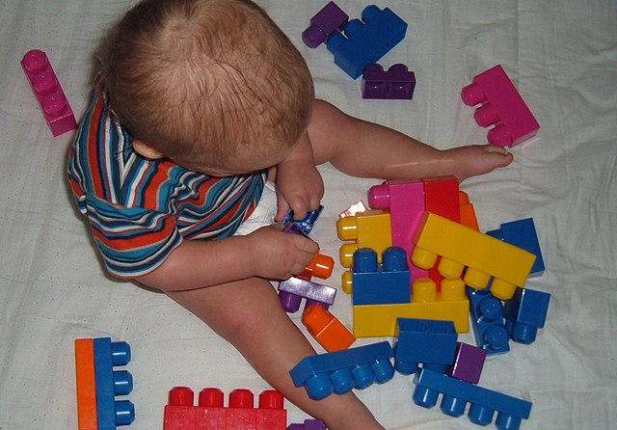
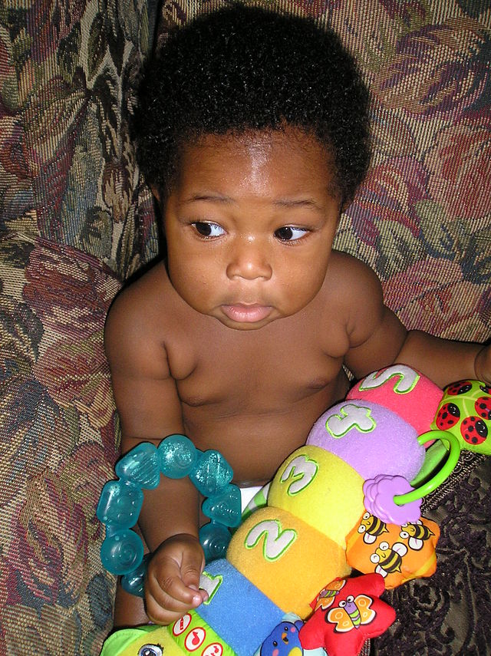
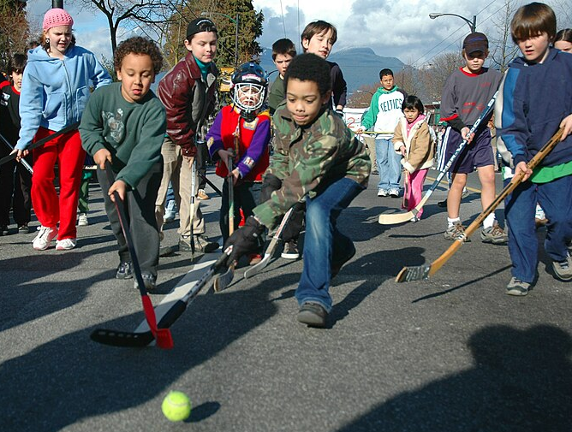
Play: Stimulating and Fostering Children’s Learning
¹⁵
Researchers suggest providing toys that enhance children’s:
motor coordination (e.g., challenging forms of climbing structure)
creativity (e.g., building blocks, paint, clay, play dough)
mathematic skills (e.g., board games “Chutes and Ladders” - estimation, counting and numeral identification)
language and reading skills (e.g., plastic letters, rhyming games, making shopping lists, bedtime story books, toys for pretending)
literacy skills (e.g., literacy-rich environments, such as a “real restaurant” with tables, menus, name-tags, pencils and notepads, are effective to increase children’s potential in early literacy development) ¹⁴
¹⁶
¹⁷
14. Play: Synthesis. In: Tremblay RE, Boivin M, Peters RDeV, eds. Smith PK, topic ed. Encyclopedia on Early Childhood Development [online]. http://www.child-encyclopedia.com/play/synthesis. Updated June 2013. Accessed July 29, 2020. Used with permission.
15. Image from Wikimedia: Child Playing with Blocks. No author provided, MHV assumed based on copyright claims. Licensed under Public domain.
16. Image from Wikimedia: Child Development Play. By Mary Asomah. Licensed under GNU Free Documentation License
17. Image from Wikimedia: Children Playing Road Hockey in Vancouver. Originally posted to Flickr. Licensed under CC BY SA 2.0.

Slide 11
Theories of Play - Piaget
Piaget saw play as a way of children developing their intellectual abilities (Dyer & Moneta, 2006). Piaget created the following four stages of play that correspond with his stages of cognitive development.
Stage | Description
Functional Play (Occurs during the Sensorimotor Stage) | Exploring, inspecting, and learning through repetitive physical activity.
Symbolic Play (Occurs during the Pre-Operational Stage) | The ability to use objects, actions, or ideas to represent other objects, actions, or ideas and may include taking on roles.
Constructive Play (Occurs during the Concrete Operational Stage) | Involves experimenting with objects to build things; learning things that were previously unknown with hands on manipulation of materials.
Games with Rules (Occurs during the Formal Operational Stage) | Imposes rules that must be followed by everyone that is playing; the logic and order involved forms the foundation for developing game playing strategy ¹⁸
18. Child Growth and Development: An Open Educational Resources Publication by College of the Canyons by Jennifer Paris, Antoinette Ricardo, and Dawn Richmond is licensed under CC BY 4.0

Slide 12
Theories of Play – Parten’s Stage Theory
Parten (1932) observed two to five-year-old children and noted six types of play:
Three labeled as non-social play (unoccupied, solitary, and onlooker) and three categorized as social play (parallel, associative, and cooperative).
Younger children engage in non-social play more than those older; by age five associative and cooperative play are the most common forms of play (Dyer & Moneta, 2006). ¹⁹
CATEGORY | DESCRIPTION
Unoccupied Play | Children’s behavior seems more random and without a specific goal. This is the least common form of play.
Solitary Play | Children play by themselves, do not interact with others, nor are they engaging in similar activities as the children around them.
Onlooker Play | Children are observing other children playing. They may comment on the activities and even make suggestions but will not directly join the play.
Parallel Play | Children play alongside each other, using similar toys, but do not directly act with each other.
Associative Play | Children will interact with each other and share toys but are not working toward a common goal.
Cooperative Play | Children are interacting to achieve a common goal. Children may take on different tasks to reach that goal. ²⁰
¹⁸
Video: Stages of Play (Mildred Parten’s Play, provides a brief summary of Parten's stages of play development.
19. Children’s Development by Ana R. Leon is licensed under CC BY 4.0
20. Children’s Development by Ana R. Leon is licensed under CC BY 4.0

Slide 13
Peer Relationships
Peer relationships are particularly important for children and can influence the growth of personality and self-concept.
In peer relationships, children learn how to initiate and maintain social interactions with other children. They learn skills for managing conflict, such as turn-taking, compromise, and bargaining. Play also involves the mutual, sometimes complex, coordination of goals, actions, and understanding.
Peer relationships require developing very different social and emotional skills than those that emerge in parent-child relationships.
However, peer relationships can be challenging as well as supportive. Peer rejection may lead to behavioral problems later in life. On the other hand, being accepted by other children is an important source of affirmation and self-esteem.
With increasing age, children confront the challenges of bullying, peer victimization, and managing conformity pressures. Social comparison with peers is an important means by which children evaluate their skills, knowledge, and personal qualities, but it may cause them to feel that they do not measure up well against others.
Also, with the approach of adolescence, peer relationships become focused on psychological intimacy, involving personal disclosure, vulnerability, and loyalty (or its betrayal)
21. Children’s Development by Ana R. Leon is licensed under CC BY 4.0

Slide 14
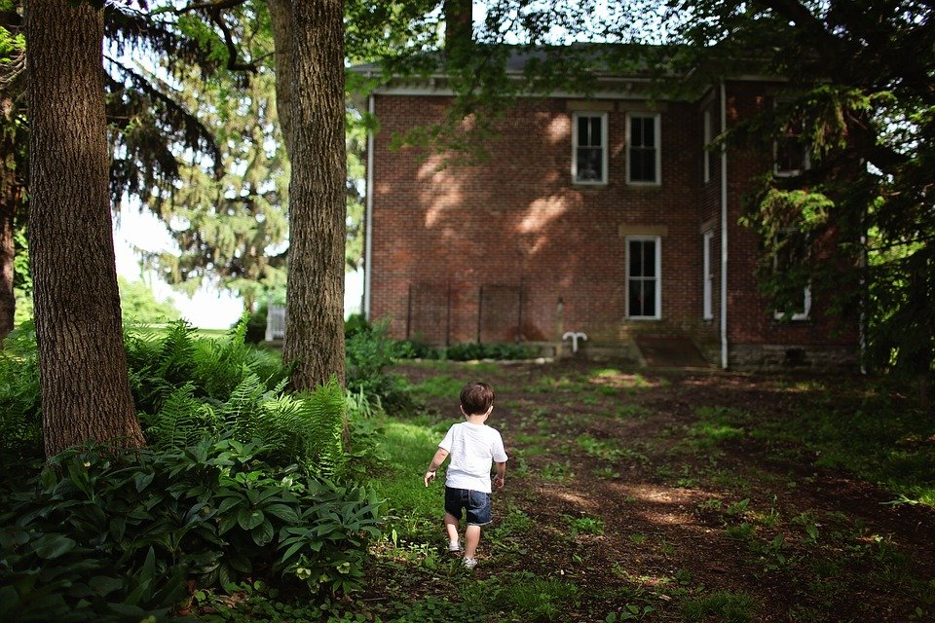
Imaginary Companions
May consist of invisible characters that the child refers to in conversation or plays with for an extended period of time and/or objects that the child personifies, such as a stuffed toy or doll, or characters the child impersonates every day.
Estimates of the number of children who have imaginary companions varies from as little as 6% to as high as 65%, depending on what is included in the definition (Gleason, Sebanc, & Hartup, 2000).
Imaginary companions often change over time.
Contrary to the assumption that children with imaginary companions are compensating for poor social skills, several studies have found that these children are very sociable
Young children view their relationship with their imaginary companion to be as supportive and nurturing as with their real friends. Gleason has suggested that this might suggest that children form a schema of what is a friend and use this same schema in their interactions with both types of friends
Some studies define imaginary companions as invisible characters that the child refers to in conversation or plays with for an extended period of time. ²³
Video: Marjorie Taylor – Imaginary Companions and the Children Who Create Them. Dr. Taylor, a developmental psychologist discusses her research on children who have imaginary friends.
22 Lifespan Development: A Psychological Perspective 2nd Edition by Martha Lally and Suzanne Valentine-French is licensed under CC BY-NC-SA 3.0.
23 Image retrieved from Pixabay.com is licensed under CC0.

Slide 15
Sociometric Peer Status
Sociometric assessment – used to measure attraction between members of a group, such as a classroom of students. In sociometric research, children are asked to mention the three children they like to play with the most, and those they do not like to play with. The number of times a child is nominated for each of the two categories (like, do not like) is tabulated. ²⁴
CATEGORY | DESCRIPTION
Popular Children | Receive many votes in the “like” category, and very few in the “do not like” category.
Rejected Children | Receive more unfavorable votes, and few favorable ones.
Controversial Children | Mentioned frequently in each category, with several children liking them and several children placing them in the do not like category.
Neglected Children | Rarely mentioned in either category.
Average Children | Have a few positive votes with very few negative votes.
Popular- Prosocial Children | Are nice and have good social skills; tend to do well in school and are cooperative and friendly.
Popular-Antisocial Children | May gain popularity by acting tough or spreading rumors about others.
Rejected -Withdrawn Children | Are shy and withdrawn and are easy targets for bullies because they are unlikely to retaliate when belittled.
Rejected-Aggressive Children | Are ostracized because they are aggressive, loud, and confrontational. They may be acting out of a feeling of insecurity. ²⁵
Video: PSY241 – 15.1 Sociometric Status: While this video use a different type of question, it still gets the point across about how children are placed in the differing categories. Note that while the table above gives a description of the different types of popular and rejected children, the video only touches on the breakdown.
24. Lifespan Development: A Psychological Perspective 2nd Edition by Martha Lally and Suzanne Valentine-French is licensed under CC BY-NC-SA 3.0
25. Child Growth and Development: An Open Educational Resources Publication by College of the Canyons by Jennifer Paris, Antoinette Ricardo, and Dawn Richmond is licensed under CC BY 4.0

Slide 16
Long Term Outcomes of Popularity
Childhood popularity researcher Mitch Prinstein has found that:
Likability in childhood leads to positive outcomes throughout one’s life (as cited in Reid, 2017).
Adults who were accepted in childhood have stronger marriages and work relationships, earn more money, and have better health outcomes than those who were unpopular.
Those who were unpopular as children, experienced greater anxiety, depression, substance use, obesity, physical health problems and suicide.
A significant consequence of unpopularity was that children were denied opportunities to build their social skills and negotiate complex interactions, thus contributing to their continued unpopularity.
Further, biological effects can occur due to unpopularity, as social rejection can activate genes that lead to an inflammatory response. ²⁶
26. Lifespan Development: A Psychological Perspective 2nd Edition by Martha Lally and Suzanne Valentine-French is licensed under CC BY-NC-SA 3.0

Slide 17
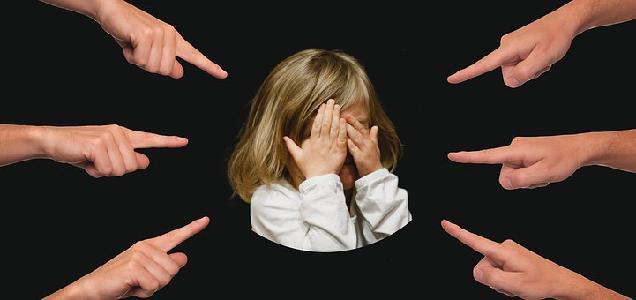
Bullying
Bullying is defined as unwanted, aggressive behavior among school aged children that involves a real or perceived power imbalance. Further, the aggressive behavior happens more than once or has the potential to be repeated.
To be considered bullying, the behavior must be:
aggressive and include an imbalance of Power: Kids who bully use their power—such as physical strength, access to embarrassing information, or popularity—to control or harm others.
Repetition occurs when bullying behaviors happen more than once or have the potential to happen more than once. ²⁷
²⁸
27. United States Department of Health and Human Services. Public Domain: No Known Copyright
28. Image retrieved fron Pixabay is licensed under CC0.

Slide 18
Bullying
Among students who reported being bullied, female students reported being bullied online or by text at a rate three times that of males (21 percent vs. 7 percent).
Seventeen percent of White students who reported being bullied were bullied online or by text, compared with 12 percent of students of races other than White.
A higher percentage of high school students reported being bullied online or by text (19 percent) than the percentage of middle school students (12 percent).
Students Ages 12 Through 18 Who Reported Being Bullied at School
(Data are from School Year 2016-2017 and were reported in November 2019)
The data used in this report come from the 2017 School Crime Supplement (SCS), a nationally representative sample survey of students ages 12 through 18 enrolled in public or private school for all or part of the school year (not homeschooled for all of the school year).
29. Text and table from Data Point. U.S. Department of Education: Electronic Bullying: Online and by Text. Published November 2019. Public Domain

Slide 19
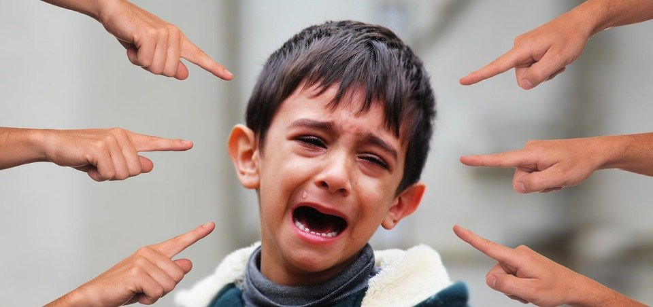
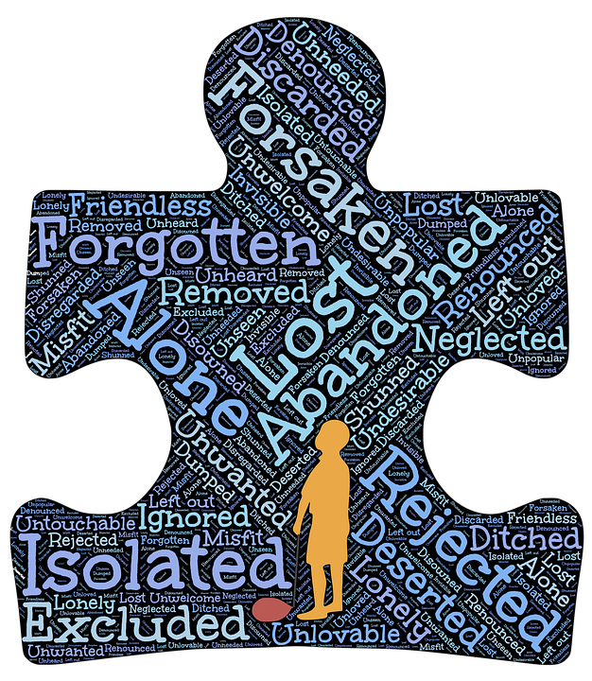
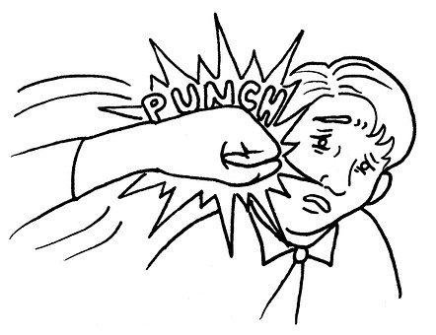
Types of Bullying: Verbal, Social and Physical
Verbal bullying: saying or writing mean things.
Verbal bullying includes:
Teasing
Name-calling
Inappropriate sexual comments
Taunting
Threatening to cause harm
Social bullying: sometimes referred to as relational bullying, involves hurting someone’s reputation or relationships. Social bullying includes:
Leaving someone out on purpose
Telling other children not to be friends with someone
Spreading rumors about someone
Embarrassing someone in public
Physical bullying: hurting a person’s body or possessions. Physical bullying includes:
Hitting, kicking, or pinching
Spitting
Tripping or pushing
Taking or breaking someone’s things
Making mean or rude hand gestures ³⁰
³¹
30. U.S. Department of Justice, Bureau of Justice Statistics, School Crime Supplement (SCS) to the National Crime Victimization Survey, 2017 National Center for Education Statistics NCES. Public Domain.
31. Images retrieved from Pixabay.com is licensed under CC0.

Slide 20


Types of Bullying: Cyberbullying
Cyberbullying is bullying that takes place over digital devices like cell phones, computers, and tablets Cyberbullying includes sending, posting, or sharing negative, harmful, false, or mean content about someone else. It can include sharing personal or private information about someone else causing embarrassment or humiliation. Some cyberbullying crosses the line into unlawful or criminal behavior.
³⁴
The most common places where cyberbullying occurs are:
Social Media, such as Facebook, Instagram, Snapchat, and Tik Tok
Text messaging and messaging apps on mobile or tablet devices
Instant messaging, direct messaging, and online chatting over the internet
Online forums, chat rooms, and message boards, such as Reddit
Email
Online gaming communities ³²
Online chatting is one place for cyberbullying.
Children who are cyberbullied are more likely to:
experience in-person bullying
be unwilling to attend school
receive poor grades
use alcohol and drugs
skip school
have lower self-esteem
have more health problems ³³
Kids who are cyberbullied are more likely to use alcohol and drugs.
32. U.S. Department of Health and Human Services: stopbullying.gov
33. U.S. Department of Health and Human Services: stopbullying.gov
34. Images retrieved from Pixabay.com are licensed under CC0.

Slide 21
Children Who Are at Risk of Being Bullied
No single factor puts a child at risk of being bullied or bullying others. Bullying can happen anywhere—cities, suburbs, or rural towns. Depending on the environment, some groups—such as lesbian, gay, bisexual, transgender or questioning (LGBTQ+) youth, youth with disabilities, and socially isolated youth—may be at an increased risk of being bullied.
Generally, children who are bullied have one or more of the following risk factors:
Are perceived as different from their peers, such as being overweight or underweight, wearing glasses or different clothing, being new to a school, or being unable to afford what kids consider “cool”
Are perceived as weak or unable to defend themselves
Are depressed, anxious, or have low self esteem
Are less popular than others and have few friends
Do not get along well with others, seen as annoying or provoking, or antagonize others for attention
Gay, lesbian, bisexual, and transgender teens.
However, even if a child has these risk factors, it doesn’t mean that they will be bullied.
³⁵
35 United States Department of Health and Human Services. Public Domain: No Known Copyright.

Slide 22
Signs of Bullying
Look for changes in the child. However, be aware that not all children who are bullied exhibit warning signs. Some signs that may point to a bullying problem are:
Unexplainable injuries
Lost or destroyed clothing, books, electronics, or jewelry
Frequent headaches or stomach aches, feeling sick or faking illness
Changes in eating habits, like suddenly skipping meals or binge eating. Kids may come home from school hungry because they did not eat lunch.
Difficulty sleeping or frequent nightmares
Many of the warning signs that cyberbullying is occurring happen around a child’s use of their device. Some of the warning signs that a child may be involved in cyberbullying are:
Noticeable increases or decreases in device use, including texting.
A child exhibits emotional responses (laughter, anger, upset) to what is happening on their device.
A child hides their screen or device when others are near and avoids discussion about what they are doing on their device.
Social media accounts are shut down or new ones appear.
A child starts to avoid social situations, even those that were enjoyed in the past.
A child becomes withdrawn or depressed or loses interest in people and activities.
³⁶
³⁷
36. From stopbullying.gov a federal government website managed by the U.S. Department of Health and Human Services. Licensed under public domain.
37. From stopbullying.gov a federal government website managed by the U.S. Department of Health and Human Services. Licensed under public domain.
Video: Is it Cyberbullying?, describes cyberbullying and what to do if you believe you are being cyberbullied.

Slide 23

How to Prevent Bullying: Evidence Based Programs/Curricula: BP-PBIS
Bully Prevention in Positive Behavioral Interventions and Supports (BP-PBIS) is designed:
  to define and teach the concept of “being respectful” to all students in a school
  to teach all students a three-step response (stop, walk, talk), that minimizes potential social reinforcement when they encounter disrespectful behavior
    Indicating through words and gesture to stop
    walk away if the problem continues
    talk to an adult if the issue is still not resolved
  to precorrect the three-step response prior to entering activities likely to include problematic behavior
  to teach an appropriate reply when the three-step response is used
  to train staff on a universal strategy for responding when students report incidents of problem behavior.
³⁹
³⁸
³⁴
Video: STOP WALK TALK IN EGUSD_2022, discusses how schools are implementing BP-PBIS programs. This video also discusses the difference between bullying and peer conflict, and how STOP, WALK, TALK is being used to stop “hate motivated behavior”.
38. Ross SW, Horner RH. Bully prevention in positive behavior support. J Appl Behav Anal. 2009 Winter;42(4):747-59. doi: 10.1901/jaba.2009.42-747. PMID: 20514181; PMCID: PMC2791686. Licensed under public domain.
39. Image from Wikimedia Commons by, User: Gabbys0102. Licensed under CC BY SA 3.0

