Slide 1
The Development of Self and Moral Development
Chapter 12

Slide 2
Development of Self Concept
Theories of Self Based on interaction
Self-concept refers to beliefs about general personal identity including personal attributes, such as one’s age, physical characteristics, behaviors, and competencies.
We aren’t born with a self-concept. It develops through interaction with others that are those close to us like parents, siblings, or peers.¹
Charles Horton Cooley used the metaphor of a mirror or looking-glass when describing this process.
Our self-concept develops when we look at how those around us respond to us, how we look, what we say, and what we do. We then use their reactions to make self-judgments
George Herbert Mead also focused on social interaction as important for developing a sense of self.
He divided the self into two parts: the “I” or the spontaneous part of the self that is creative and internally motivated, and the “me” or the part of the self that takes into account what other people think.
The key to living well is to find ways to give expression to the “I” with the approval of the “me”. The I is inborn. But the me develops through social interaction and a process called “taking the role of the other.” ²
Video 1: Khan Academy: Charles Cooley – Looking Glass Self, discusses several dimensions of Cooley’s Theory of Self
Video 2: Khan Academy: George Herbert Mead: The “I” and “Me” Self, briefly compares Cooley and Mead’s ideas and then goes on to discusses several dimensions of Cooley’s theory.
Lifespan Development: A Psychological Perspective 2nd Edition by Martha Lally and Suzanne Valentine-French is licensed under CC BY-NC-SA 3.0
Lecture Transcript Module 5 Early Childhood Lifespan Development by Lumen Learning is licensed under CC BY 4.0 (modified by Maria Pagano)

Slide 3
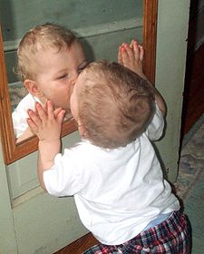
Development of Self Concept: Mirror Self-Recognition Test
When does one’s self concept begin? Beulah Amsterdam (1972) investigated this question by placing a smudge of rouge surreptitiously on the nose of an infant, Amsterdam asked the child’s mother to point to a mirror and ask the child, “Who’s that?”³
Amsterdam found that children could be placed into one of three categories based on the age of the child:
6-12 months: The child appeared to believe their refection was another child and, in some cases, tried to play with the “other” child.
13-24 months: Some infants in this group were a bit weary of the “other” child and withdrew, while some occasionally smiled.
20 months and older: Infants pointed or rubbed to the rouge on their nose, leading Amsterdam to believe that this group had achieved self-concept.
The development of language also provides insight into the developing self-concept. For example, between the ages of 15- and 18-months children will begin to use words such as “mine” and “my” indicating that they understand their relationship to a person or thing.⁵
⁴
Video: The Rouge Test: Self-Recognition, shows children taking part in the “Mirror Self-Recognition Task,” and discusses the results
3. Lecture Transcript Module 5 Early Childhood Lifespan Development by Lumen Learning is licensed under CC BY 4.0 (modified by Maria Pagano)
Image retrieved from wikipedia is licensed under Creative Commons Attribution-ShareAlike License
. Lecture Transcript Module 5 Early Childhood Lifespan Development by Lumen Learning is licensed under CC BY 4.0 (modified by Maria Pagano)

Slide 4
Development of Self Concept in Preschoolers and School Aged Children
Preschoolers Self Concept
By the age of three or four, children begin to view themselves as separate and unique individuals capable of independent thoughts and actions. For example, in striving to become autonomous a 4-year-old may insist on dressing themselves. When describing themselves, preschoolers limit their descriptions to concrete expressions such as their physical attributes, age, and sex.
School Age Children’s Self Concept
The period of middle childhood is a time where the child becomes less egocentric and more able to think about themselves in complex ways. According to Erikson, during this time children are very busy or industrious. They are constantly doing, planning, playing, getting together with friends, achieving. They have a more realistic sense of self than do those in early childhood, and they better understand their strengths and weaknesses. This is a time when they are gaining a sense of how they measure up when compared with friends. They will either get a sense of confidence for future challenges or a sense of inferiority.
Video: Self Concept.Mov, shows examples of how two preschool and five middle-school children perceive themselves.
⁶
6. Children’s Development by Ana R. Leon is licensed under CC BY 4.0 (modified by Maria Pagano)

Slide 5


Development of Self Concept: Self-Esteem and Self-Efficacy
Self-Esteem
Self-Esteem is defined as an evaluation of one’s identity. Internalizing others’ appraisals and creating social comparison affect children’s self-esteem. If there is a discrepancy between how children view themselves and what they consider to be their ideal selves, their self-esteem can be negatively affected. ¹⁴
Self-Efficacy
Self-efficacy is the belief that you are capable of carrying out a specific task or of reaching a specific goal (Bandura, 1977, 1986, 1997).
Large discrepancies between self-efficacy and ability can create motivational problems. If a student believes that he or she can solve mathematical problems, then the student is more likely to attempt the mathematics homework that the teacher assigns. However, If a student believes that he or she is incapable of math, then the student is less likely to attempt the math homework regardless of the student's actual ability in math.
It is possible to have either too much or too little self-efficacy, and according to Bandura (1997) the optimum level seems to be either at, or slightly above, true ability.
If a person’s sense of self-efficacy is very low, he or she can develop learned helplessness, a perception of complete lack of control in mastering a task. Learned Helplessness is similar to depression, a pervasive feeling of apathy and a belief that effort makes no difference and does not lead to success. ¹⁵
Confidence builds self-esteem. (Image generated using Chat GPT Art Generator)
14. Lifespan Development: A Psychological Perspective by Martha Lally and Suzanne Valentine-French is licensed under CC BY-NC-SA 3.0
15. Child Development – Unit 5: Theories (Part II) by Lumen Learning references Educational Psychology by Kelvin Seifert and Rosemary Sutton, licensed under CC BY 4.0
16. Image retrieved from Pexels.com is licensed under CC0.
Learned helplessness can arise from low self-efficacy. ¹⁶

Slide 6
Theories of Gender Development
The development of gender and gender identity is a multifaceted interaction of different developmental processes.
Young children learn about gender from parents, peers, and others in society, and develop their own conceptions of the attributes associated with maleness or femaleness (called gender schemas).
There are several psychological theories that partially explain how children form their own gender roles after they learn to differentiate based on gender. ¹⁹
Video: A Class That Turned Around Kids’ Assumptions of Gender Roles. Gender schemas can be pretty powerful and even change the way that we look at the world. Watch the look of surprise on these children’s faces.
19. Child Growth and Development: An Open Educational Resources Publication by College of the Canyons by Jennifer Paris, Antoinette Ricardo, and Dawn Richmond is licensed under CC BY 4.0
¹²

Slide 7
Theories of Gender Development
Psychoanalytic Theories of Gender Development (Freud and Chodorow) Freud: Believed that masculinity and femininity are learned as a resolution to the phallic stage, when the child learns to model their own behavior after the same-sexed parent. Chodorow: Mothering promotes gender stereotypic behavior when mothers push their sons away too soon while keeping girls dependent.
Social Learning Theory Gender role socialization is a result of the ways in which parents, teachers, friends, schools, religious institutions, media and others send messages about what is acceptable or desirable behavior as males or females. This socialization begins early.
²⁰
²¹
Video 1: Psychodynamic Explanation of Gender Development: This first third of this video reviews Freud’s theory with a focus on the Oedipal stage, and the last third of the video concentrates on criticisms of Freud’s theory. The middle-third, which discusses the psychodynamic explanation of gender development begins a timestamp 3:27 and ends at timestamp 6:02
Video 2: Social Learning Theory Applied to Gender Development. The description of social learning theory and how it describes gender development begins at timestamp 0:57 and ends at timestamp 3:12. The video continues by discussing research that has been done in this area (ends at timestamp 6:02), the influence of culture and media on gender roles (ends at timestamp 10:48) and ends with a discussion of criticisms of social learning theory.
20. Children’s Development by Ana R. Leon is licensed under CC BY 4.0
21. Children’s Development by Ana R. Leon is licensed under CC BY 4.0

Slide 8
Theories of Gender Development
Cognitive Theory The Cognitive-Developmental Approach emphasizes the role of cognitions in the process of gender development. Lawrence Kohlberg proposed that gender developed in stages. Stage 1. Gender Identity/Labeling: Approximately age 2 to 3. The child recognizes that they are a girl or a boy and will also recognize and label others and label others as a girl or a boy. However, that label of “girl” or “boy” is based solely on that other child’s outward appearance. Therefore, a child at this stage who sees a child with long hair would label that child as a girl even if it were a boy. Stage 2. Gender Stability: Approximately age 3-5. Children recognize that their own gender is stable over time. That is a boy will grow into a man and a girl will grow into a woman. However, this same child is still unsure about others. For example, a child in this stage would believe that a girl who plays with trucks would grow up to be a man. So, while the child in this stage understands gender from their own perspective, they do not understand gender from another’s perspective. Stage 3. Gender Constancy: By the age of 5 or 6 children understand that gender is consistent across all situations, so just because a boy may play with a doll, he will remain a boy.²²
Gender Schema Theory Argues that children are active learners who socialize themselves. Children actively organize others’ behavior, activities, and attributes into gender categories (i.e., schemas) which guide what children notice and remember later. By only remembering schema-consistent information, gender schemas strengthen more and more over time.²³
Video 1: Kohlberg’s Theory of Gender Development, discusses and provides examples for each of Kohlberg’s stages of gender development.
Video 2: Gender Constancy, first shows a child in the stage of gender stability and then a child in the stage of gender constancy answering questions about gender.
Video 3. Gender Schema Theory, first reviews what a schema is and then discusses the development of gender schemas. The last section of the video beginning at timestamp 4:42 discusses what can be done in the classroom and is not required but suggested.
22. From Lumen Learning Introduction to Communication. Cited as Survey of Communication Study. Authored by: Scott T Paynton and Linda K Hahn. Provided by: Humboldt State University. Located at: https://en.wikibooks.org/wiki/Survey_of_Communication_Study/Preface. Licensed under CC BY SA 4.0.
23. Children’s Development by Ana R. Leon is licensed under CC BY 4.0

Slide 9
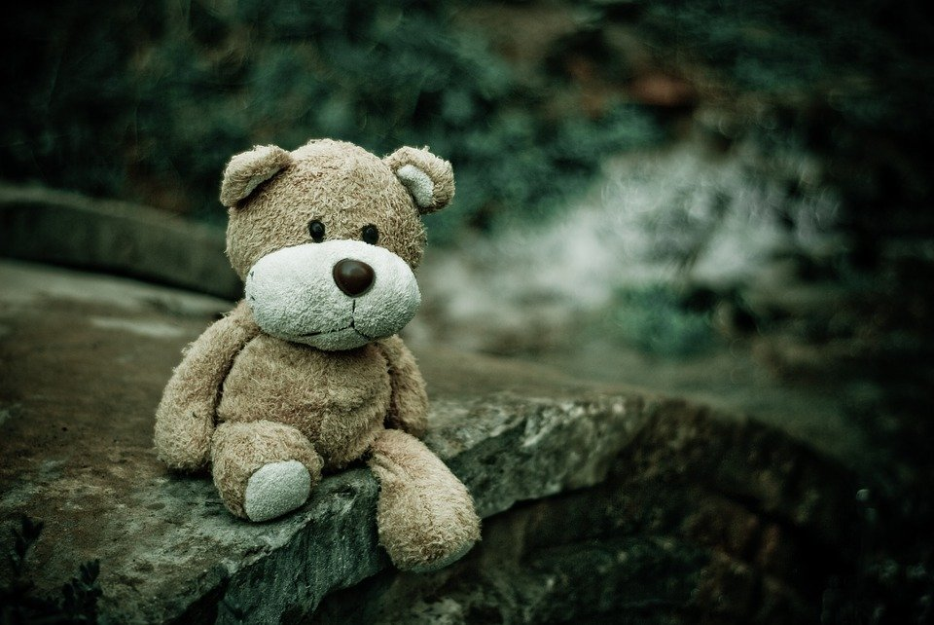
Gender Socialization & How Much Does Gender Matter for Children?
Gender Socialization
A meta-analysis of research from the United States and Canada found that parents most frequently treated sons and daughters differently by encouraging gender-stereotypical activities (Lytton & Romney, 1991). Fathers, more than mothers, are particularly likely to encourage gender-stereotypical play, especially in sons. Parents also talk to their children differently based on stereotypes. Parents are also much more likely to discuss emotions with their daughters than their sons. Children do a large degree of socializing themselves. By age 3, children play in gender-segregated play groups and expect a high degree of conformity. Children who are perceived as gender atypical (i.e., do not conform to gender stereotypes) are more likely to be bullied and rejected than their more gender-conforming peers. Many societies, have seen a rapid change in perceptions of gender roles, media portrayals of gender, and legal trends relating to gender. ²⁴
How Much Does Gender Matter for Children?
Starting at birth, children learn the social meanings of gender from adults and their culture. Gender roles and expectations are portrayed in children’s toys, books, commercials, video games, movies, television shows and music (Khorr, 2017). When children make choices regarding their gender identification, expression, and behavior that may be contrary to gender stereotypes, it is important that they feel supported by the caring adults in order to feel valued, resilient, and develop a secure sense of self (American Academy of Pediatricians, 2015). ²⁵
24. Children’s Development by Ana R. Leon is licensed under CC BY 4.0
25. Lifespan Development: A Psychological Perspective 2nd Edition by Martha Lally and Suzanne Valentine-French is licensed under CC BY-NC-SA 3.0
26 Image retrieved from pixabay.com is licensed under CC0.
Example of a gender-neutral toy. ²⁶

Slide 10

Moral Development
Morality is a system of beliefs about what is right and good compared to what is wrong or bad.
Moral development is the process whereby children develop an understanding of the proper attitudes and behaviors toward other people in society based on social and cultural norms, rules, and laws. ²⁷
Moral beliefs are related to, but not identical with, moral behavior: it is possible to know the right thing to do, but not actually do it. It is also not the same as knowledge of social conventions, which are the customs needed for the smooth operation of society.
When it comes to schooling and teaching, moral choices are woven into almost every aspect of classroom life.
Moral themes about fairness or justice, on the one hand, and about consideration or care on the other contribute to how students develop beliefs about right or wrong.
A morality of justice is about human rights—that is, about respect for fairness, impartiality, equality, and individuals’ independence.
A morality of care is about human responsibilities—more specifically, about caring for others, showing consideration for individuals’ needs, and interdependence among individuals. Students and teachers need both forms of morality.
Rules and laws shape children’s moral development.
27. Children’s Development by Ana R. Leon is licensed under CC BY 4.0 (modified by Maria Pagano)
28. Educational Psychology by Kelvin Seifert and Rosemary Sutton is licensed under CC BY 4.0 . However, the link for the text is broken. Text with citation can be found at OER Services

Slide 11
Piaget’s Theory of Moral Development
Piaget based his theory of moral development on the patterns of reasoning used by children of different ages about moral decisions. These moral decisions were based on short stories or “vignettes” told to the children, who were then asked questions about who was naughtier.
Example vignettes
1a. A little boy called John is in his room. He is called to dinner. He goes into the dining room. But behind the door there was a chair, and on the chair, there was a tray with fifteen cups on it. John could not have known that there was all this behind the door. He goes in, the door knocks against the tray, bang go the fifteen cups and they all get broken!
1b. Once there was a little boy whose name was Henry. One day when his mother was out, he tried to get some jam out of the cupboard. He climbed up on to a chair and stretched out his arm. But the jam was too high, and he couldn't reach it and have any. But while he was trying to get it he knocked over a cup. The cup fell down and broke. ²⁹
Based on Piaget’s interviews:
Infants and children (up until the age of 2) were premoral and had no conscious awareness of rules or morality.
Children younger than 7, tend to view the child who broke more cups as being naughtier than the child who broke fewer cups.
However, by 8 years of age, the child begins to understand that one’s intentions are an important factor when judging morality.
Piaget’s (1965) two main types of moral thinking
Heteronomous morality (moral realism) (4 to 7 years)
Younger children reason about morality in way that was subject to the control of others such as parents, teachers, and even God. These authority figures have the ability to impose punishment. This type of thinking is also egocentric, because the child cannot see the situation from different points of view; so intent is meaningless in the younger child’s determination of who is naughtier. Another aspect to heteronomous thinking is immanent justice or the idea that automatic punishments come to someone based on their prior bad behavior or deed.
2. Autonomous morality (moral relativism) (Begins by age 7 or 8)
The child moves away from being egocentric and consequently begins to understand the broader perspective of another as well as their intentions. The child also understands that rules are arbitrary constructs that are created for reasons of fairness, and that following these rules is beneficial to them when interacting with others. ³⁰
29. Piaget, J. (1965). The Moral Judgment of the Child. Glencoe, Illinois. Public domain.
30. Piaget, J. (1965). The Moral Judgment of the Child. Glencoe, Illinois. Public domain.

Slide 12
Kohlberg’s Theory of Moral Development
In order to study moral development, Kohlberg explored this area, by reading the following moral dilemma to boys of different age groups:
A woman was on her deathbed. There was one drug that doctors thought might save her. It was a form of radium that a druggist in the same town had recently discovered. The drug was expensive to make, but the druggist was charging ten times what the drug cost him to produce. He paid $200 for the radium and charged $2,000 for a small dose of the drug. The sick woman's husband, Heinz, went to everyone he knew to borrow the money, but he could only get together about $1,000 which is half of what it cost. He told the druggist that his wife was dying and asked him to sell it cheaper or let him pay later. But the druggist said: “No, I discovered the drug and I'm going to make money from it.” So Heinz got desperate and broke into the man's laboratory to steal the drug for his wife. Should Heinz have broken into the laboratory to steal the drug for his wife? Why or why not?
What is important in terms of the answer is not whether you replied, “Yes, I would steal the drug,” or “No, I would not steal the drug,” but rather your rationale for the answer.
Based on participants’ responses, Kohlberg developed a three level (preconventional, conventional and postconventional), six stage (two stages for each level) theory of moral development whereby individuals experience the stages universally and in sequence as they form beliefs about justice. ³¹
Video: Kohlberg’s 6 Stages of Moral Development, provides examples for each level and each stage of Kohlberg's theory.
31 Child and Adolescent Psychology Lumen Learning licensed under CC BY 4.0 (modified by Maria Pagano).

Slide 13
Kohlberg’s Stages of Moral Development
Age | Moral Level | Description
Young children prior to Age 9 | Preconventional | Stage 1: Focus is on self-interest and punishment is avoided. The man shouldn’t steal the drug, as he may get caught and go to jail. Stage 2: Rewards are sought. The man should steal the drug because he does not want to lose his wife who takes care of him.
Older children, adolescents, and most adults | Conventional | Stage 3: Focus is on how situational outcomes impact others and wanting to please and be accepted. The man should steal the drug because that is what good husbands do. Stage 4: People make decisions based on laws or formalized rules. The man should obey the law; stealing is a crime.
Rare in adolescents and few adults | Postconventional | Stage 5: Individuals employ abstract reasoning to justify behaviors and make it clear that while they do not generally favor breaking the law, laws are social contracts that we agree to until we can change them by democratic means. The man should steal the drug because laws can be unjust, and one should consider the whole situation. Moral rights must be protected. Stage 6: Moral behavior is based on self-chosen ethical principles that should look to settle disputes through the principles of justice that require each of us to impartially consider and respect the rights of all who are involved. Finding an answer to this question is not easy, and for this reason Kohlberg dropped this stage from his scoring.
³²
Lifespan Development: A Psychological Perspective 2nd Edition by Martha Lally and Suzanne Valentine-French is licensed under CC BY-NC-SA 3.0 (modified by Maria Pagano)

Slide 14
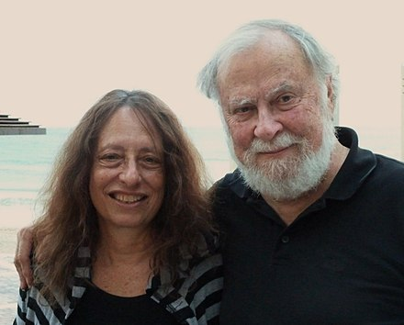
Carol Gilligan and the Morality of Care
Carol Gilligan ideas center on a morality of care, or system of beliefs about human responsibilities, care, and consideration for others. Gilligan proposed three moral positions that represent different extents of ethical care.
Moral Position | Definition of What is Morally Good
Position 1: Survival orientation | Action that considers one’s personal needs only
Position 2: Conventional care | Action that considers others’ needs or preferences, but not one’s own
Position 3: Integrated care | Action that attempts to coordinate one’s own personal needs with those of others. ³⁴
Video: Carol Gilligan’s Theory of Moral Development discusses Gilligan’s theory and provides examples of her stages using the moral vignette of the “Moles and the Porcupine,”.
Carol and James Gilligan ³⁵
Educational Psychology was retrieved from Open Textbooks for Hong Kong and is licensed under CC BY-SA 4.0
Image was retrieved from wikiwand.com and is licensed under CC BY-SA 4.0

Slide 15
Moral Development - Social Domain Theory
Social domain theory – Considers moral development in terms of the individual’s interactions with their environment, and views moral reasoning as one of three separate domains of knowledge.
Three Domains of Knowledge (Turiel 1983):
  The moral - how individuals should treat one another
  The societal - conventions designed to foster the functioning of social groups which can vary from culture to culture
  The personal - matters of individual choice that do not affect others
Each of these domains is independent and develops in early childhood. ³⁶
Research has found that children as young as four years of age can assess not only their own moral behavior, but the behavior of others.
  For Example: Young children have been shown to understand the difference between situations that are moral in nature (i.e., taking something that is not yours is always wrong) versus situations that are social in nature (i.e., It’s not polite to cut in front of the line), versus situations that are personal in nature (i.e., I don’t like loud discussion, but if someone else does then that’s their choice). ³⁷
Video: Social Domain Theory: Begin at timestamp 1:15. This video begins by explaining the three domains of knowledge, and then discusses research in the area beginning at timestamp 5:12, which ends at 8:03. If you would like to continue, please do, but you are only responsible for viewing up to timestamp 8:03.
36. Turiel, E. (1983). The development of social knowledge: Morality and convention (Cambridge studies in social and emotional development). New York City, New York: Cambridge University Press.
37. Lourenco, O. (2014). Domain theory: A critical review. New Ideas in Psychology, 32, 1-17. Retrieved fromhttps://www.researchgate.net/publication/259130460_Domain_theory_A_critical_review

Slide 16
Are We Born Moral? Helpers and Hinderers
Hamlin, Wynn, and Bloom (2007) tested 10-month-old infants by first habituating them to a scene where a red circle or “climber” repeatedly attempts to climb a hill but is not successful. On the third attempt the “climber” was either assisted by a yellow triangle, “helper” who pushed the “climber” from behind or was pushed down by a blue, “hinderer” square.
During the test phase infants were given the opportunity to reach for or touch either the yellow triangle “helper,” or blue square “hinderer.”
Fourteen of the 16 10-month-olds chose the yellow triangle helper, leading Hamlin, Wynn and Bloom to conclude that the babies preferred those who performed positive social acts over those who performed negative social acts, and that this preference formed the basis for later moral cognition.⁴⁰
Red circle is “helped” by yellow triangle
Red circle is “hindered” by a blue square
Video, “Can Babies Tell Right from Wrong?” discusses and demonstrates the “helper” and “hinderer” research of Hamlin, Wynn, and Bloom, not only as described on this slide and in your text, but also using different scenarios.
40. Text and Image retrieved from Hamlin, J.K. (2015) Front. Psychol., 29 January 2015 | https://doi.org/10.3389/fpsyg.2014.01563. Licensed under Creative Commons Attribution License (CC BY 4.0).

