Slide 1
Emotional Development and Attachment
Chapter 11

Slide 2

Emotional Development: Emotional Development in Infants
An emotion is a subjective state of
being that we often describe as our feelings.
Emotional expression refers to the way one displays
an emotion and includes nonverbal and verbal behaviors (Gross, 1999). ¹
Happy
²
Emotions are Broken Down into Two General Categories
Basic Emotions / Primary Emotions | Appear first interest, happiness, anger, fear, surprise, sadness and disgust
Self-Conscious Emotions / Secondary Emotions | Appear as children start to develop a self-concept, and require social instruction on when to feel such emotions envy, pride, shame, guilt, doubt, and embarrassment
³
Psychology 2e, Emotion and Motivation from Open Stax is licensed under CC BY 4.0 (modified by Marie Parnes)
Image from pixabay.com is licensed under CC0.
Child Growth and Development: An Open Educational Resources Publication by College of the Canyons by Jennifer Paris, Antoinette Ricardo, and Dawn Richmond is licensed under CC BY 4.0 (modified by Marie Parnes)

Slide 3
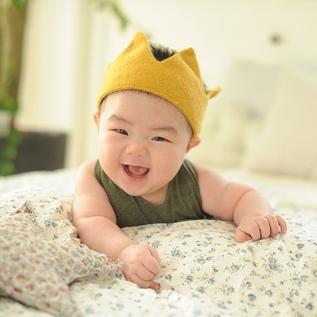
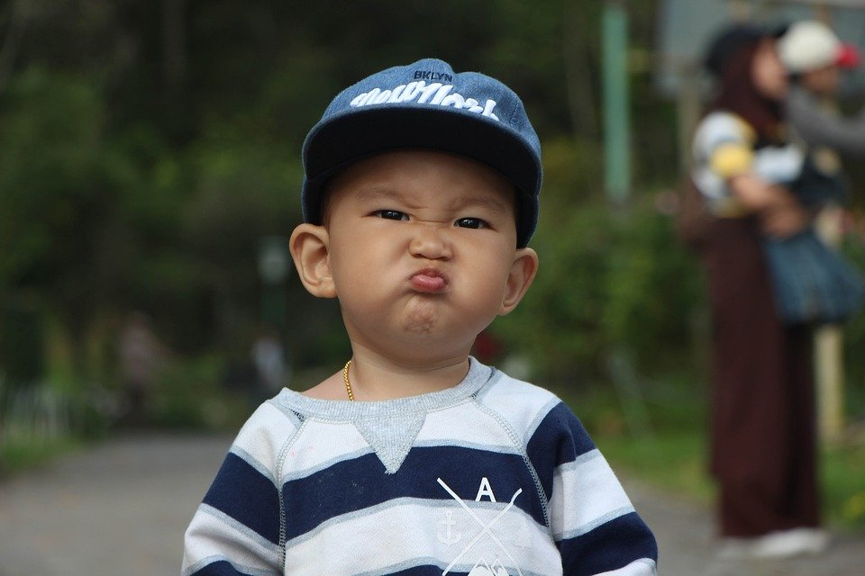
Emotional Development: Emotional Development in Infants
At birth - Infants exhibit two emotional responses: attraction and withdrawal. They show attraction to pleasant situations that bring comfort, stimulation, and pleasure, and they withdraw from unpleasant stimulation such as bitter flavors or physical discomfort.
At around two months - Infants exhibit social engagement in the form of social smiling as they respond with smiles to those who engage their positive attention (Lavelli & Fogel, 2005). ⁴
Between 2 to 3 months -Pleasure is expressed as laughter.
Between 6 and 8 months - Displeasure becomes more specific as fear, sadness, or anger.
  Anger is often the reaction to being prevented from obtaining a goal, such as a toy being removed (Braungart-Rieker, Hill-Soderlund, & Karrass, 2010).
  Sadness is typically the response when infants are deprived of a caregiver (Papousek, 2007).
  Fear is often associated with the presence of a stranger, known as stranger wariness, or the departure of significant others known as separation anxiety. Both appear sometime between 6 and 15 months after object permanence has been acquired. Further, there is some indication that infants may experience jealousy as young as 6 months of age (Hart & Carrington, 2002).⁶
⁵
⁷
4. Lifespan Development: A Psychological Perspective 2nd Edition by Martha Lally and Suzanne Valentine-French is licensed under CC BY-NC-SA 3.0
5. Image: CC0 Public Domain
6. Child Growth and Development: An Open Educational Resources Publication by College of the Canyons by Jennifer Paris, Antoinette Ricardo, and Dawn Richmond is licensed under CC BY 4.0 (modified by Marie Parnes)
7. Image from pixabay.com is licensed under CC0.

Slide 4
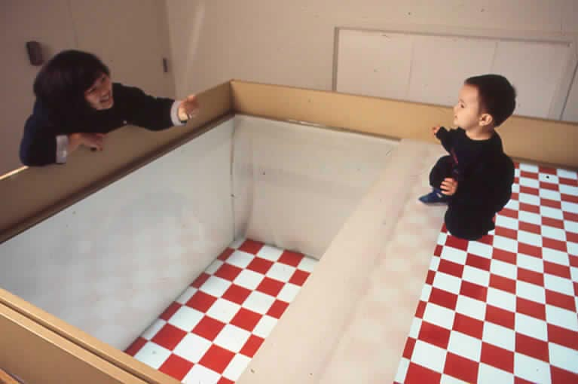
Emotional Development in Infants: Social influences and the Development of Emotions
Facial expressions of emotion are important regulators of social interaction. This concept has been investigated under the concept of social referencing; that is, the process whereby infants seek out information from others to clarify a situation and then use that information to act (Klinnert, Campos, & Sorce, 1983).
Visual Cliff Research and Social Referencing
Campos and colleagues placed mothers on the far end of the “cliff” from the infant. Mothers first smiled to the infants and placed a toy on top of the safety glass to attract them; infants invariably began crawling to their mothers. When the infants were in the center of the table, however, the mother then posed an expression of fear, sadness, anger, interest, or joy. The results were clearly different for the different faces; no infant crossed the table when the mother showed fear; only 6% did when the mother posed anger, 33% crossed when the mother posed sadness, and approximately 75% of the infants crossed when the mother posed joy or interest. ⁸
This mother is encouraging her child to crawl across the visual cliff. The child hesitates to move forward as they see the transparent surface.⁹
Video: “An Experiment by Joseph Campos: The Visual Cliff” demonstrates and discusses social referencing using the visual cliff.
8. Child Growth and Development: An Open Educational Resources Publication by College of the Canyons by Jennifer Paris, Antoinette Ricardo, and Dawn Richmond is licensed under CC BY 4.0 (modified by Marie Parnes)
9 Image by Lockman, Fears, and Lewis (2018), Photograph of mother and child on visual cliff. Published in Oxford Research Encyclopedias. Licensing under APA guidelines for use.

Slide 5
Emotional Development in Childhood
Social influences and the Development of Emotions: Empathy
Emotional contagion - an emotional expression of a person leads another person to experience a similar emotional state (Bruder et al., 2012; Peters and Kashima, 2015).
    A component of emotional contagion, emotional mimicry, is defined as the imitation of the facial, verbal, or postural expressions of others (Hatfield et al., 1993; Hess and Fischer, 2013). For example, newborn babies will cry when they hear others crying. ¹⁰
During childhood, the development of empathy, he ability to identify with the feelings of another person is a crucial part of emotional and social development in childhood and helps in the development of prosocial (socially positive) and altruistic (helpful, beneficent, or unselfish) behavior.
    Altruistic behavior occurs when a person does something in order to benefit another person without expecting anything in return. Empathy helps a child develop positive peer relationships; it is affected by a child's temperament, as well as by parenting style. Children raised in loving homes with affectionate parents are more likely to develop a sense of empathy and altruism, whereas those raised in harsh or neglectful homes tend to be more aggressive and less kind to others.
Empathy begins to increase in adolescence and is an important component of social problem solving and conflict avoidance. Levels of cognitive empathy begin rising in girls around 13 years old, and around 15 years old in boys (Van der Graaff et al., 2013). ¹¹
Video: Mirror Neurons, discusses the affects that mirror neurons, in part have, in how people relate to each other.
10. Socioemotional Development in Childhood Boundless Psychology. Curation and Revision. Provided by: Boundless.com licensed by CC BY-SA 4.0
11. Psychology2e from Openstax licensed under CC BY 4.0

Slide 6
Emotional Development: Temperament
Temperament is the innate characteristics of the infant, including mood, activity level, and emotional reactivity, noticeable soon after birth. A caregiver's ability to work well and accurately read the child will enjoy a goodness-of-fit, meaning their styles match and communication and interaction can flow. Parenting is bidirectional; not only do parents affect their children, but children influence their parents.
In a 1956 landmark study, Chess and Thomas (1996) evaluated 141 children’s temperament based on parental interviews. Referred to as the New York Longitudinal Study, infants were assessed on 9 dimensions of temperament :
Activity level, rhythmicity (regularity of biological functions), approach/withdrawal (how children deal with new things), adaptability to situations intensity of reactions threshold of responsiveness (how intense a stimulus has to be for the child to react) quality of mood distractibility attention span persistence.
Based on the infants’ behavioral profiles, they were categorized into three general types of temperament:
Easy Child (40%) who is able to quickly adapt to routine and new situations, remains calm, is easy to soothe, and usually is in a positive mood. Difficult Child (10%) who reacts negatively to new situations, has trouble adapting to routine, is usually negative in mood, and cries frequently. Slow-to-Warm-Up Child (15%) has a low activity level, adjusts slowly to new situations and is often negative in mood.
Video: Navigating Your Child’s Temperament, discusses Thomas and Chess’s three types of temperament and Goodness of Fit.
12. Lifespan Development: A Psychological Perspective 2nd Edition by Martha Lally and Suzanne Valentine-French is licensed under CC BY-NC-SA 3.0
¹²

Slide 7

Emotional Development
Temperament and Personality
Temperament may be one of the things about us that stays the same throughout development.
In contrast, personality, defined as an individual’s consistent pattern of feeling, thinking, and behaving, is the result of the continuous interplay between biological disposition and experience.
  Personality also develops from temperament in other ways (Thompson, Winer, & Goodvin, 2010). As children mature biologically, temperamental characteristics emerge and change over time.
  Personality is made up of many other features besides temperament. Children’s developing self-concept, their motivations to achieve or to socialize, their values and goals, their coping styles, their sense of responsibility and conscientiousness, and many other qualities are encompassed into personality.
  These qualities are influenced by biological dispositions, the child’s experiences with others, particularly in close relationships.¹³
Image retrieved from Wikimedia Commons licensed under Creative Commons Attribution-Share Alike 4.0
13. Lifespan Development: A Psychological Perspective 2nd Edition by Martha Lally and Suzanne Valentine-French is licensed under CC BY-NC-SA 3.0

Slide 8
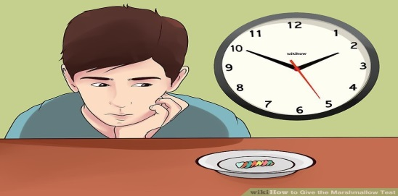
Emotional Development: Emotional Regulation and Self Control
Emotional self-regulation refers to strategies we use to control our emotional states so that we can attain goals (Thompson & Goodvin, 2007).
Young infants have very limited capacity to adjust their emotional states and depend on their caregivers to help soothe themselves.
By 4 to 6 months, babies can begin to shift their attention away from upsetting stimuli (Rothbart et al, 2006).
Older infants and toddlers can more effectively communicate their need for help and can crawl or walk toward or away from various situations (Cole, Armstrong, & Pemberton, 2010). This aids in their ability to self-regulate. ¹⁴
Walter Mischel’s “Marshmallow Test.”
Mischel designed a study to assess self-regulation in
young children. In the marshmallow study, Mischel and his colleagues placed a preschool child in a room with one marshmallow on the table. The child was told that they could either eat the marshmallow now or wait until the researcher returned to the room and then they could have two marshmallows (Mischel, Ebbesen & Raskoff, 1972).
Children differ in their degree of self-control. The children who had more self-control in preschool (the ones who waited for the bigger reward) were more successful in high school. They had higher SAT scores, had positive peer relationships, and were less likely to have substance abuse issues.(Mischel, Shoda, & Rodriguez, 1989; Mischel et al., 2010).
Those children who had poor self-control in preschool (the ones who grabbed the one marshmallow) were not as successful in high school, and they were found to have academic and behavioral problems. ¹⁶
Can this child delay gratification for a larger reward? ¹⁵
Lifespan Development: A Psychological Perspective 2nd Edition by Martha Lally and Suzanne Valentine-French is licensed under CC BY-NC-SA 3.0
Marshmallow Test Image retrieved from wiki How licensed under CC BY-NC-SA 3.0
Psychology2e from Openstax licensed under CC BY 4.0
Video: The Marshmallow Test (Stanford University + Truth) by Practical Psychology, demonstrates Mishel's marshmallow test and how the results hold up today.

Slide 9
Emotional Intelligence
Emotional intelligence: The concept of emotional intelligence was introduced in the 60s and rose in popularity with the release of Daniel Goleman’s 1995 book Emotional Intelligence – Why it can matter more than IQ. ¹⁷
Emotional Intelligence (EI) can be generally defined as how we perceive, communicate, regulate, and understand our own emotions, as well as the emotions of others.
A higher EI level appears to be an important predictive factor of health-related outcomes, such as improved wellbeing and social interactions during development (Andrei et al., 2014), as well as fewer somatic complaints (e.g., Jellesma et al., 2011).
A number of studies on EI through childhood have been conducted within educational settings; showing that EI can be important for positive adaptation within the classroom, with particular implications for social-emotional competences and for consequent adaptive behaviors with peers (Frederickson et al., 2012).
High EI scores were positively associated with multiple peer ratings for prosocial behavior (Mavroveli et al., 2009).
Data from self-report surveys revealed that a high EI is negatively related to bullying (Mavroveli and Sánchez-Ruiz, 2011), victimization attitude (Kokkinos and Kipritsi, 2012) and behavioral problems in general (Poulou, 2014).
EI may moderate the relationship between intelligence and scholastic performance (Agnoli et al., 2012).
Overall, high EI (especially in the ability to regulate emotions) is associated with several positive outcomes for children. ¹⁸
17. Emotional Intelligence by Lyndsay T Wilson retrieved from Explorable is licensed under CC BY 4.0
18. The Relationship Between Trait Emotional Intelligence, Cognition, and Emotional Awareness: An Interpretative Model by Sergio Agnoli, Giacomo Mancini, Federica Andrei and Elena Trombini retrieved from Frontiers in Psychology is licensed under CC BY-4.0. (modified by Marie Parnes)

Slide 10
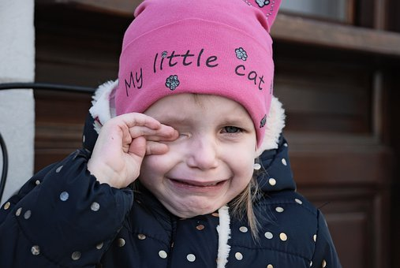
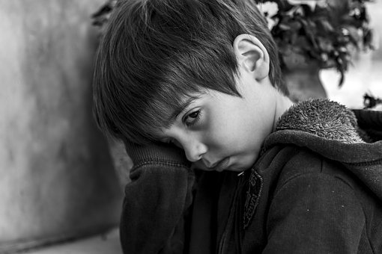
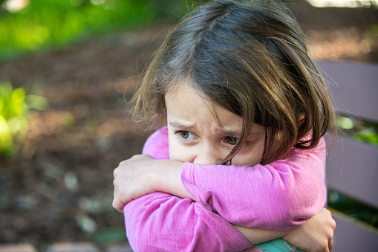
Emotional Disorders
Many children have fears and worries and may feel sad and hopeless from time to time. Strong fears may appear at different times during development. Although some fears and worries are typical in children, persistent or extreme forms of fear and sadness could be due to anxiety or depression. ¹⁹
Mental health disorders are diagnosed by a qualified professional using the Diagnostic and Statistical Manual of Mental Disorders, 5th Edition (DSM-5). This is a manual that is used as a standard across the profession for diagnosing and treating mental disorders. ²⁰
²¹
19. https://www.cdc.gov/childrensmentalhealth/features/anxiety-depression-children.html
20. Child Growth and Development: An Open Educational Resources Publication by College of the Canyons by Jennifer Paris, Antoinette Ricardo, and Dawn Richmond is licensed under CC BY 4.0 (modified by Marie Parnes)
21. Images retrieved from Pixabay.com are licensed under CC0.

Slide 11
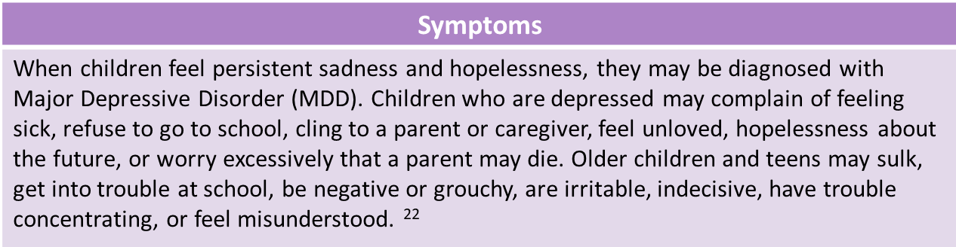
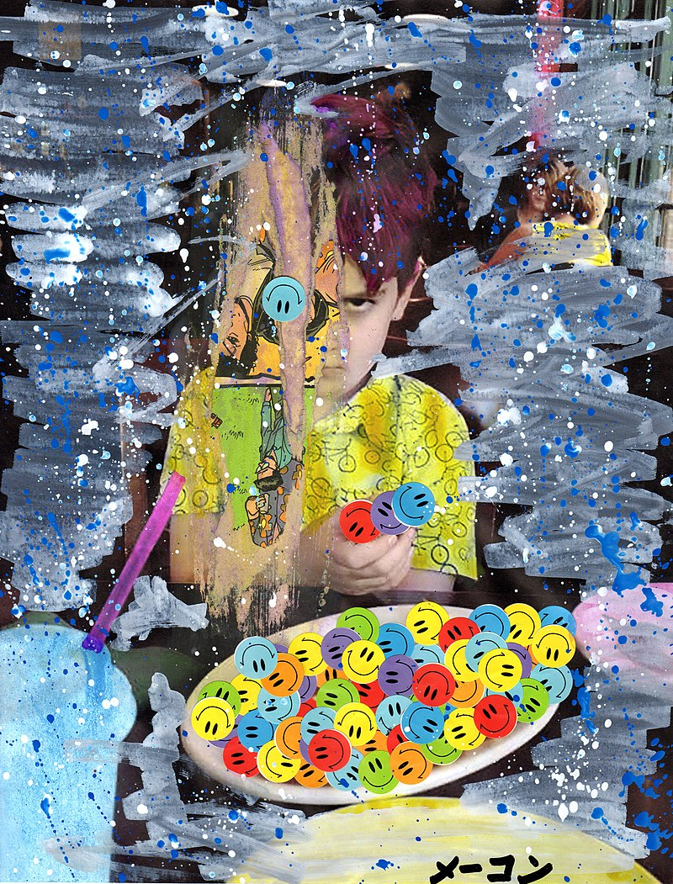
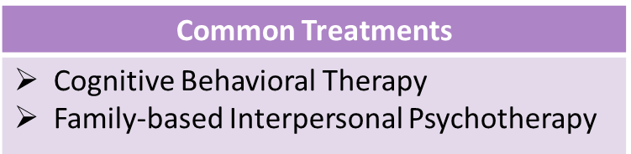
Emotional Disorders: Depression
While antidepressants may be prescribed by medical professionals in certain situations, they can pose serious risks for children, teens and young adults. ²³
24
Video: Treatment for Depression – Child Mind Institute, discusses both Cognitive Behavioral Therapy and Interpersonal Therapy for treating childhood depression but also discusses other types of therapy and includes an in-depth discussion of medical treatments.
22. Child Growth and Development: An Open Educational Resources Publication by College of the Canyons by Jennifer Paris, Antoinette Ricardo, and Dawn Richmond is licensed under CC BY 4.0 (modified by Marie Parnes)
23. Depression Basics from NIMH.NIH.gov is public domainhttps://childmind.org/article/what-behavioral-therapies-work-on-childhood-and-adolescent-depression/
24. Artwork: Aldo Addresses the Unwanted Plate of Happy by Marc-Anthony Macon from Wikimedia Commons. Licensed under CC BY SA 2.0.

Slide 12
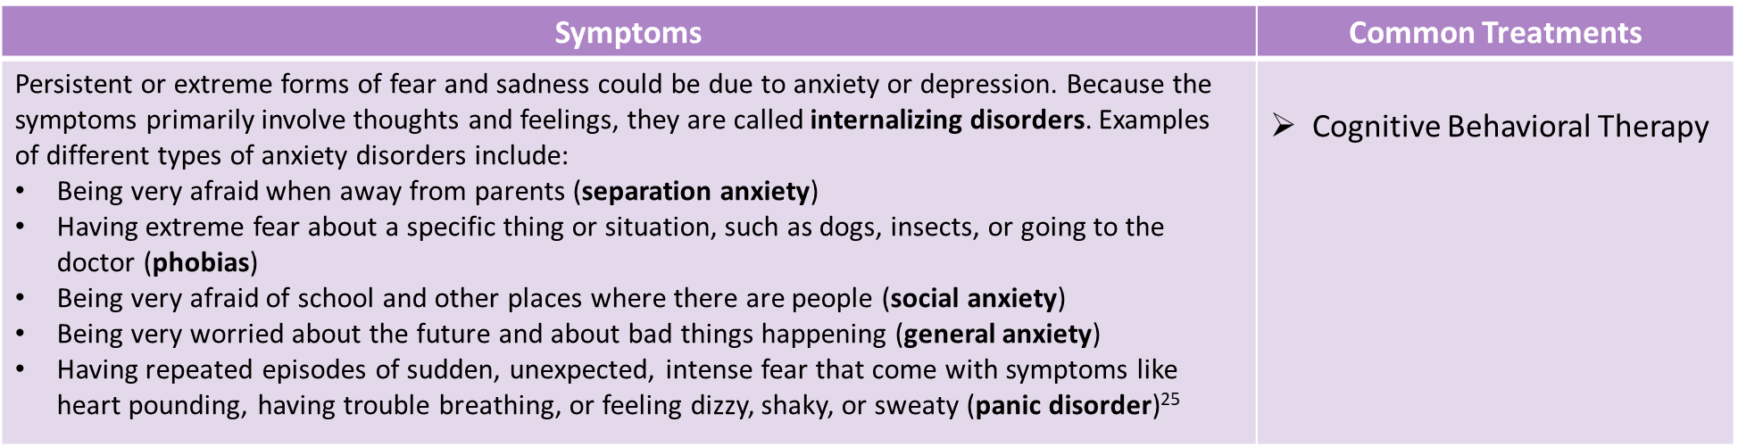
Emotional Disorders: Anxiety
25. Anxiety and Depression in Children retrieved from CDC.Gov – public domain.

Slide 13
Disruptive, Impulse Control, and Conduct Disorders: Conduct Disorder (CD) : Description and Symptoms
Description and Symptoms
Description: Conduct disorder (CD) is a repetitive and persistent pattern of behavior in which the basic rights of others, or major age-appropriate norms, are violated. These behaviors are often referred to as "antisocial behaviors." It is often seen as the precursor to antisocial personality disorder, which is not diagnosed until the individual is 18 years old. Children diagnosed with CD often presents with a lack of empathy, or the ability to recognize the feelings of others. Symptoms: Four categories of behavior that could be present in the child’s behavior: (3 or more of the 15 which comprise the 4 categories must be manifest within the past 12 months with at least one criterion present in the past 6 months. Aggression to people and animals Destruction of Property Deceitfulness or theft Serious violation of rules Onset Type: Childhood - At least 1 symptom prior to the age of 10 Adolescent - No symptoms prior to the age of 10 Unspecified - Criteria for diagnosis are met, but there is not enough information to determine whether the onset of the first symptoms was before or after the age of 10. Spectrum: Mild – Few if any conduct problems in excess of those to make the diagnosis are present. Moderate – The number of conduct problems and the effect on others is between mild and severe Severe – Exhibits behaviors in excess of those required to meet the diagnosis
26
Video: More Than Just Naughty Kids: Getting to Know Conduct Disorder, discusses what Conduct Disorder is, and what may cause Conduct Disorder. However, the video does not discuss Multi-Systematic Treatment
26. From PsychDB and adapted by Maria Pagano. No author name is provided. Licensed under Fair Use

Slide 14
Disruptive, Impulse Control, and Conduct Disorders: Conduct Disorder: Treatment
Treatment of Conduct Disorder
Multi-Systemic Therapy (MST), an intensive, integrative treatment that emphasizes how an individual's conduct problems fit within a broader context. MST therapy must include: Integration of empirically based treatment to acknowledge a large variety of risk factors that may be influencing the behavior such as Screening, Brief Intervention, and Referral to Treatment (SBIRT), which quickly assesses the severity of substance abuse and identifies the appropriate level of treatment. Rewards for positive changes in behavior and environment to ultimately empower caregivers Any thorough quality assurance mechanisms that focus on completing objectives set in treatment.
9 Core Principles of MST
1. The client exists within a series of systems
2. Practitioners use existing positive systems to help client create change
3. Interventions should include increased responsibility of family members
4. MST is present-focused and action-oriented
5. Each interventions targets a specific behavior
6. MST interventions should match the developmental age of the child for which they are created
7. Family members are needed to enact interventions
8. Evaluation of interventions occur from multiple perspectives
9. Each intervention is made to be used long term and in multiple settings
27
Video: Multisystemic Therapy (MST), shows how MST is used. Parents are interviewed and therapists are shown creating a therapeutic plan for the children involved in the therapy.
27. All text (adapted) and table from Wikipedia: Multisystemic Therapy. Licensed under CC BY SA 3.0.

Slide 15
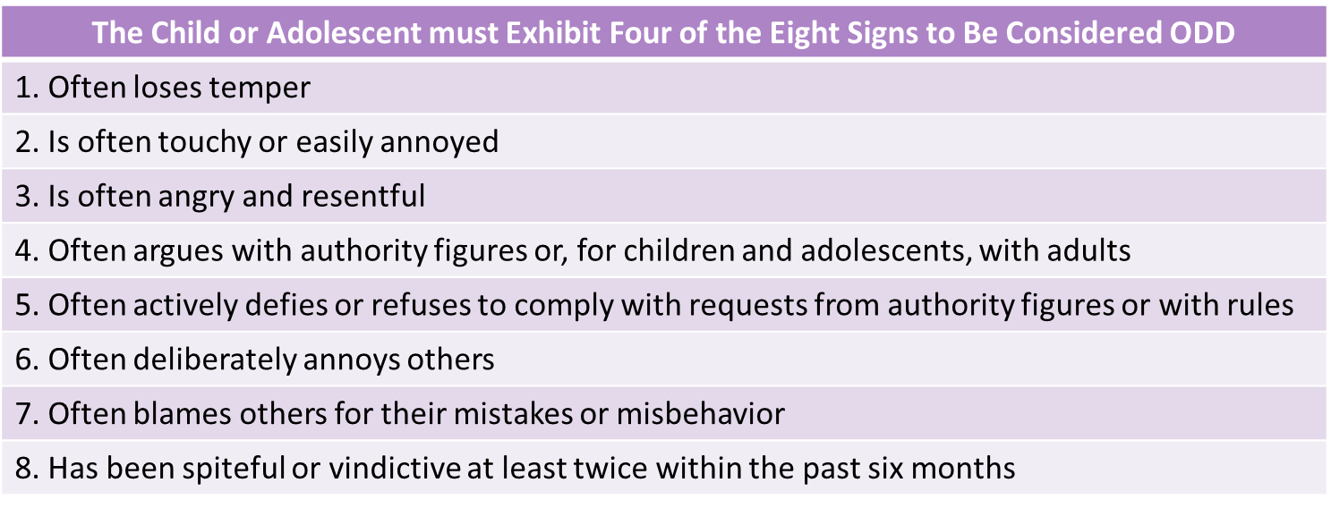
Disruptive, Impulse Control, and Conduct Disorders: Oppositional Defiant Disorder (ODD)
Description of ODD | Treatment
Listed in the DSM-5 under Disruptive, impulse-control, and conduct disorders and defined as "a pattern of angry/irritable mood, argumentative/defiant behavior, or vindictiveness". Children with oppositional defiant disorder are not aggressive toward people or animals, do not destroy property, and do not show a pattern of theft or deceit. For a child or adolescent to qualify for a diagnosis of ODD, behaviors must cause considerable distress for the family or interfere significantly with academic or social functioning. ODD can be greatly amplified by the presence of other disorders such as ADHD, depression, or substance use disorders. | Parent management training Individual psychotherapy, Family therapy Cognitive behavioral therapy Social skills training Preventative Programs
27
Video 1: What is Oppositional Defiant Disorder?, provides an overview of ODD and some of the therapies used to treat ODD.
Video 2: Tips for Managing Oppositional Defiant Disorder, many of which are taught in therapy.
²⁷
27. All text from Wikipedia: Oppositional Defiant Disorder. Licensed under CC BY SA 3.0.

Slide 16
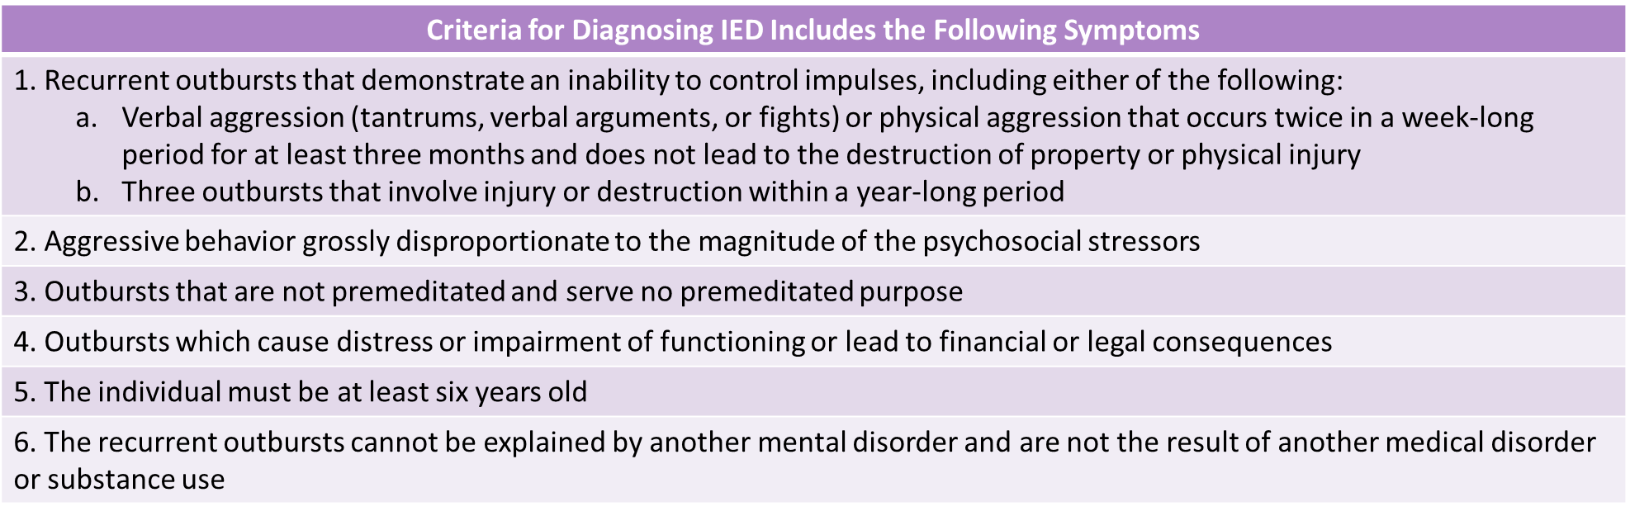
Disruptive, Impulse-Control, and Conduct Disorders: Intermittent Explosive Disorder (IED)
Description of IED | Treatment
IED is a behavioral disorder characterized by explosive outbursts of anger, often to the point of rage, that are disproportionate to the situation at hand (e.g., impulsive screaming triggered by relatively inconsequential events). Impulsive aggression is unpremeditated and is defined by a disproportionate reaction to any provocation, real or perceived. | Cognitive behavioral therapy Individual therapy Family Psychotropic medication (though the pharmaceutical options have shown limited success)
28
Video: What is Intermittent Explosive Disorder? Dr. Jeff Gardere describes IED along with discussing it’s causes, symptoms and treatments.
28. From Wikipedia: Intermittent Explosive Disorder. Licensed under CC BY SA 3.0

Slide 17
Attachment: What is Attachment and Overview of Theories of Attachment
What is Attachment?
Attachment is a deep and enduring emotional bond that connects one person to another across time and space (Ainsworth, 1973; Bowlby, 1969). Attachment behavior towards the child includes responding sensitively and appropriately to the child’s needs Attachment is characterized by specific behaviors in children, such as seeking proximity to the attachment figure when upset or threatened (Bowlby, 1969). Such behavior appears universal across cultures.
Attachment Theories
Behaviorist Theories of Attachment (e.g., Dollard & Miller, 1950) suggest that attachment is a set of learned behaviors. They learn to associate the feeder, with the comfort of being fed. Through the process of classical conditioning, come to find contact with the primary care giver comforting and thereby form an attachment. Certain behaviors (e.g., crying, smiling) bring desirable responses from others (e.g., attention, comfort), and are strengthened through operant conditioning.
The Evolutionary Theory of Attachment (e.g., Bowlby, Harlow, Lorenz) suggests that children come into the world biologically pre-programmed to form attachments with others, because this will help them to survive. The infant produces innate ‘social releaser’ behaviors such as crying and smiling that stimulate innate caregiving responses from adults. The determinant of attachment is not food, but care and responsiveness. Bowlby suggested that a child would initially form only one primary attachment (monotropy) and that the attachment figure acted as a secure base. The attachment relationship acts as a prototype for all future social relationships.²⁹
29. Attachment Theory by McLeod, S. A. was retrieved from Simply Psychology licensed under CC NY-NC-ND 3.0 (modified by Marie Parnes)

Slide 18
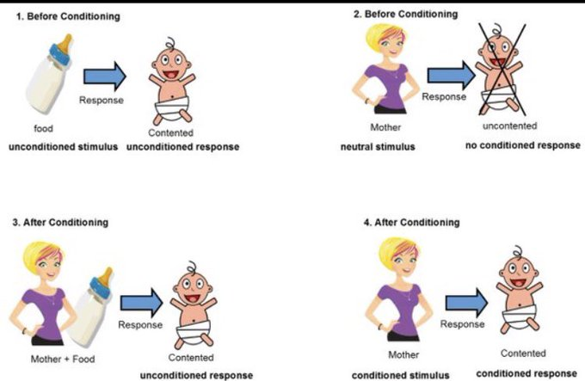
Attachment: Behavioral Theories of Attachment: Classical Conditioning
Video: A Level Psychology – Classical Conditioning, reviews Pavlovian or Classical Conditioning in the first half, and then applies classical conditioning to attachment in the second half of the video (the second half begins at timestamp 2:05).
30. Image from Twitter: Attachment: Classical Conditioning and Learning. #Psychology #AQAPsychology#Classical Conditioning. Licensing: AQA website allows educational use.

Slide 19
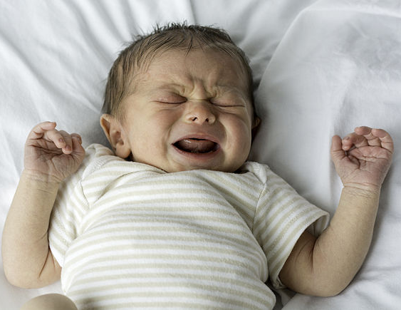
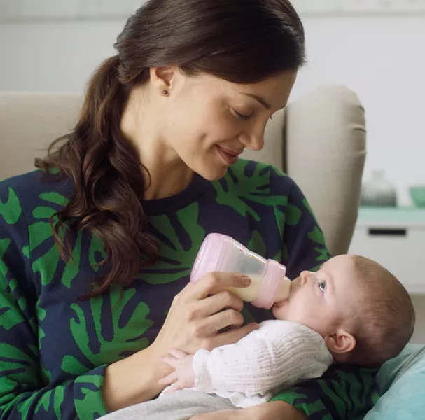
Attachment: Behavioral Theories of Attachment: Operant Conditioning
According to Dollard and Miller (1950), during operant conditioning, a behavior must be reinforced in order to be maintained. This requires multiple responses to find the one that is best suited to satisfy the drives. Infants cry when they are hungry, causing their mother to provide food (the food is a positive reinforcer), an example of a primary reinforcement. At the same time, the infant may feel the comfort and connection with their mother, causing a secondary reinforcement.
Behavior: Baby cries because the baby is hungry
Consequence: Mom feeds baby and crying stops (primary reinforcer), and at the same time the infant may feel comfort and attachment (secondary reinforcer).
31. Image of Baby Crying (left) by Evan-Amos from Wikimedia is licensed under Public Domain.
32. Image of baby being bottle fed (right) from MAM. No licensing information provided.

Slide 20
Attachment: Bowlby’s 4 Stages of Attachment
Bowlby's 4 Stages of Attachment
Stage | Age | Characteristics
Pre-Attachment | Newborn to 6 weeks | No attachment to any specific individual. The infant does not show any preference for a particular individual and will not fuss when picked up by a stranger.
Attachment in the Making | 6 Weeks to 6-8 Months | The infant begins to show preferences for caregivers, predominantly for the primary caregiver over strangers. The primary caregiver can typically soothe the baby more easily than others.
Clear-Cut Attachment | 6-8 Months to 18-24 Months | A clear attachment has been formed between the primary caregiver and infant, and when separated the infant will become upset (separation anxiety)
Formation of Reciprocal Relationships | 24 Months and Older | As the child begins to develop mental representations of others this leads to the formation of multiple attachments with other who often interact with the infant
Video: Four Stages of Attachment (John Bowlby) – Attachment – Psychology Revision Tool, discusses each stage of Bowlby’s Theory and the infant preference for humans over objects.

Slide 21
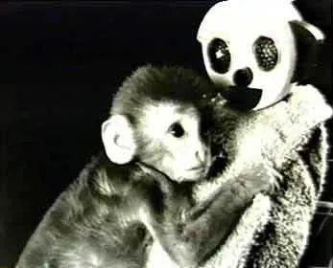

Attachment: Harlow’s Work with Rhesus Monkeys
Harry Harlow (1958) studied the mechanisms by which attachment developed using newborn rhesus monkeys .
In contrast to the behavioral theory of attachment, which suggested that an infant would form an attachment with the caregiver that provides food, Harlow wanted to show that attachment develops as a result of the mother providing “tactile comfort,” suggesting that infants have an innate (biological) need to touch and cling to something for emotional comfort.
³³
³⁴
Video: Harlow’s Studies on Dependency in Monkeys, shows three different experiments conducted by Harlow. Keep in mind the third experiment when reading about Ainsworth’s Strange Situation.
33. Harry Harlow Monkey Love Experiments by McLeod, S. A. was retrieved from Simply Psychology licensed under CC NY-NC-ND 3.0 (modified by Marie Parnes)
34. Image retrieved from wikipedia public domain CC0

Slide 22
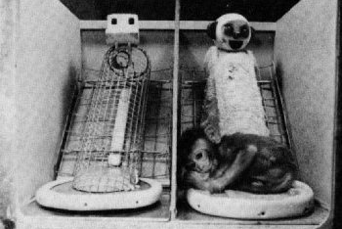
Attachment: Harlow’s Findings
Experiment | Results
Infant monkeys reared with surrogate mothers - Eight monkeys were separated from their mothers immediately after birth and placed in cages with access to two surrogate mothers, one made of wire, and one covered in soft terry toweling cloth. Four of the monkeys could get milk from the wire mother and four from the cloth mother. The animals were studied for 165 days. | Both groups of monkeys spent more time with the cloth mother (even though if she had no milk). The infant would only go to the wire mother when hungry. Once fed it would return to the cloth mother for most of the day. If a frightening object was placed in the cage the infant took refuge with the cloth mother (its safe base). And the infant would explore more when the cloth mother was present. Harlow concluded that: The sensitive response and security of the caregiver is what is important (as opposed to the provision of food).
³⁵
³⁶
35. Harry Harlow Monkey Love Experiments by McLeod, S. A. was retrieved from Simply Psychology licensed under CC NY-NC-ND 3.0 (modified by Marie Parnes)
36.. Image sretrieved from wikipedia public domain CC0

Slide 23
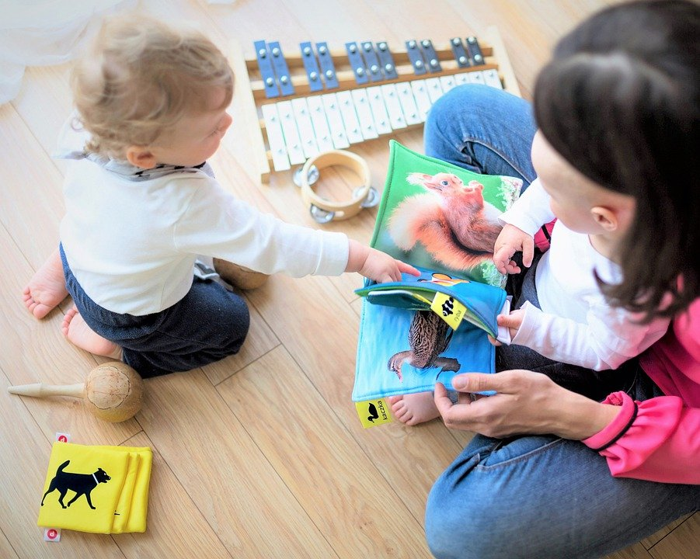
Attachment: Ainsworth’s Strange Situation
Developmental psychologist Mary Ainsworth and her colleagues created a laboratory test that measured an infant’s attachment to his or her parent. The test is called The Strange Situation because it is conducted in a context that is unfamiliar to the child and therefore likely to heighten the child’s need for his or her parent (Ainsworth, 1979).
During the procedure, the parent and the infant are first left alone, while the infant explores the room full of toys. Then a strange adult enters the room and talks for a minute to the parent, after which the parent leaves the room. The stranger stays with the infant for a few minutes, and then the parent again enters, and the stranger leaves the room.
During the entire session, a video camera records the child’s behaviors, which are later coded by the research team. The investigators were especially interested in how the child responded to the caregiver leaving and returning to the room, referred to as the “reunion.”
On the basis of their behaviors, the children are categorized into one of four groups where each group reflects a different kind of attachment relationship with the caregiver. One style is secure and the other three styles are referred to as insecure. ³⁷
Mother and Baby alone ³⁸
Video: The Strange Situation – Mary Ainsworth, discusses how the assessment is conducted and shows a child who is securely attached.
37. Child Growth and Development: An Open Educational Resources Publication by College of the Canyons by Jennifer Paris, Antoinette Ricardo, and Dawn Richmond is licensed under CC BY 4.0
38. Image from Pixabay.com is licensed under are licensed under CC0.

Slide 24
Attachment: Ainsworth’s Attachment Styles
On the basis of their behaviors, the children are categorized into one of four groups. The first style is secure and the other three styles (on the next slide) are referred to as insecure.
Attachment Style
Secure Attachment Style (approximately 65% of children) Children who explore freely while the caregiver is present and may engage with the stranger. Will typically play with the toys and from time to time will show the caregiver the toy so as to engage in play. Reunion: The child may be upset when the caregiver departs but is also happy to see the caregiver upon their return. The child is easily calmed by the caregiver.
Some cultural differences in attachment styles have been found (Rothbaum, Weisz, Pott, Miyake, & Morelli, 2010). These differences reflect cultural variation rather than true insecurity (van Ijzendoorn and Sagi, 1999). ³⁹
39. All text on this page from Child Growth and Development: An Open Educational Resources Publication by College of the Canyons by Jennifer Paris, Antoinette Ricardo, and Dawn Richmond is licensed under CC BY 4.0

Slide 25
Attachment: Ainsworth’s Attachment Styles Cont’d
Attachment Style
Ambivalent or Resistant Attachment Style (approximately 20% of children) These children are wary about the situation in general, particularly the stranger, and stay close or even cling to the caregiver rather than exploring the toys. When the caregiver leaves, the child becomes extremely distressed and is ambivalent or resistant when the caregiver returns. Reunion: The child may rush to the caregiver, but then fails to be comforted when picked up. The child may still be angry and even resist attempts to be soothed.
Avoidant Attachment Style (approximately 10-15% of children) These children will avoid or ignore the caregiver and show little emotion when the mother departs or returns. The child may run away from the mother when she approaches. The child will not explore very much, regardless of who is there, and the stranger will not be treated much differently from the mother.
Disorganized/Disoriented Attachment Style (approximately 5-10% of children) seems to have an inconsistent way of coping with the stress of the strange situation. The child may cry during the separation, but avoid the mother when she returns, or the child may approach the mother but then freeze or fall to the floor. ⁴⁰
Video: Secure, Insecure, Avoidant, Ambivalent Attachment in Mothers’ Babies. The first part of the video shows a securely attached child. Examples of insecure attachments begin at timestamp 1:49
40. Child Growth and Development: An Open Educational Resources Publication by College of the Canyons by Jennifer Paris, Antoinette Ricardo, and Dawn Richmond is licensed under CC BY 4.0

Slide 26
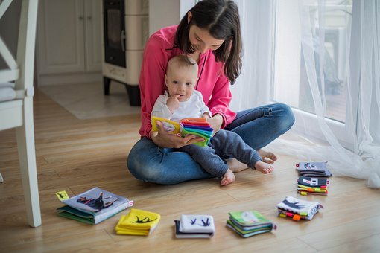
Attachment: Sensitive Responsiveness
One of the key determinants of attachment patterns is the history of sensitive and responsive interactions between the caregiver and the child, which help the child learn to regulate their emotions, give the child confidence to explore the environment, and provide the child with a safe haven during stressful circumstances.
Evidence for the role of sensitive caregiving in shaping attachment patterns comes from studies like the one from Grossmann, Grossmann, Spangler, Suess, and Unzner (1985), that looked at parent–child interactions in the homes of 54 families, up to three times during the child’s first year of life. At 12 months of age, infants and their mothers participated in the strange situation. Grossmann and her colleagues found that children who were classified as secure in the strange situation at 12 months of age were more likely than children classified as insecure to have mothers who provided responsive care to their children in the home environment.
Van den Boom (1994) developed an intervention that was designed to enhance maternal sensitive responsiveness. When the infants were 9 months of age, the mothers in the intervention group were rated as more responsive and attentive in their interaction with their infants compared to mothers in the control group. In addition, their infants were rated as more sociable, self-soothing, and more likely to explore the environment. At 12 months of age, children in the intervention group were more likely to be classified as secure than insecure in the strange situation.⁴¹
42
41. Attachment Through the Life Course by R. Chris Fraley retrieved from NOBA licensed under CC BY-BC-SA 4.0
42. Image retrieved from Pixabay.com

Slide 27
Attachment: Patterns and Adaptation
Attachment Patterns and Child Outcomes
Attachment researchers have studied the association between children’s attachment patterns and their adaptation over time.
Researchers have found that children who are classified as secure in the strange situation are more likely to have high functioning relationships with peers, to be evaluated favorably by teachers, and to persist with more diligence in challenging tasks.
In contrast, insecure-avoidant children are more likely to be construed as “bullies” or to have a difficult time building and maintaining friendships (Weinfield, Sroufe, Egeland, & Carlson, 2008).⁴³
Attachment in Adolescence
Research on attachment in adolescence find that teens who are still securely attached to their parents have less emotional problems (Rawatlal, Kliewer & Pillay, 2015), are less likely to engage in drug abuse and other criminal behaviors (Meeus, Branje & Overbeek, 2004), and have more positive peer relationships (Shomaker & Furman, 2009).⁴⁴
43. Attachment Through the Life Course by R. Chris Fraley retrieved from NOBA licensed under CC BY-BC-SA 4.0
44. Lifespan Development: A Psychological Perspective 2nd Edition by Martha Lally and Suzanne Valentine-French is licensed under CC BY-NC-SA 3.0

Slide 28
Attachment Disorders: Reactive Attachment Disorder: Description
Reactive Attachment Disorder
The Diagnostic and Statistical Manual 5th Edition (DSM-5) classifies reactive attachment disorder as a trauma- and stressor-related condition of early childhood caused by social neglect and maltreatment. Affected children have difficulty forming emotional attachments to others, show a decreased ability to experience positive emotion, cannot seek or accept physical or emotional closeness, and may react violently when held, cuddled, or comforted. Affected children are unpredictable, difficult to console, and difficult to discipline. Moods fluctuate erratically, and children may seem to live in a “flight, fight, or freeze” mode. Changes in routine, attempts to control, or unsolicited invitations to comfort may elicit rage, violence, or self-injurious behavior, which interferes with the acquisition of cognitive, academic and social skills. Moreover, it can interfere with language acquisition and cause behavioral dysfunction. The genesis of reactive attachment disorder is always trauma; specifically, the severe emotional neglect commonly found in institutional settings, such as overcrowded orphanages, foster care, or in homes with mentally or physically ill parents. Infants who do not develop a predictable, nurturing bond with a trusted care stop seeking comfort when hurt, avoid physical and emotional closeness, and eventually become emotionally bereft.⁴⁵
Video: Reactive Attachment Disorder, Causes, Signs, Symptoms, Diagnosis and Treatment.
45. Reactive Attachment Disorder by Elizabeth E. Ellis; Musa Yilanli; Abdolreza Saadabadi. retrieved from StatPearls Publishing NCBI.NLM.NIH.gov. Licensed under CC BY NC ND 4.0

Slide 29
Attachment Disorders: Reactive Attachment Disorder: Treatment and Prognosis
Treatment / Management
RAD requires a multi-pronged treatment incorporating parent education and trauma-focused therapy.
Parent education focuses on developing positive, non-punitive behavior management strategies, ways of responding to nonverbal communication, anticipation and coping strategies for when triggers arise.
Parent-child psychotherapy can facilitate bonding and healthy attachment.
Empathy and compassion are key elements to building trust. Developing a nurturing parent-child relationship is the cornerstone to overcoming the damage caused by severe neglect and abuse.
Prognosis
Even with intervention, injured children encounter difficulties in every aspect of their lives. The traumatic situations which lead to the attachment disorder create a constant state of stress.
Early identification and treatment has been shown to improve outcomes; however, parent education and support is key.
Parents adopting children from state custody or from overseas orphanages should receive education on the impact of social deprivation and connected with service agencies or providers specializing in attachment disorders. ⁴⁴
45. Reactive Attachment Disorder by Elizabeth E. Ellis; Musa Yilanli; Abdolreza Saadabadi. retrieved from StatPearls Publishing NCBI.NLM.NIH.gov. Licensed under CC BY NC ND 4.0

