Slide 1
Language Development
Chapter 10

Slide 2
What is Language?
Language is a system of communication that uses symbols in a regular way to create meaning. (Lifespan Development: A Psychological Perspective 2nd Edition by Martha Lally and Suzanne Valentine-French is licensed under CC BY-NC-SA 3.0 (modified by Marie Parnes))
Language involves both the ability to comprehend spoken and written words and to create communication in real time when we speak or write.
Most languages are oral, generated through speaking.
Human language is unique because it has the qualities of
  Generativity - Human language can communicate an infinite number of ideas.
  Recursion – We can put words, phrases, and sentences inside of themselves without limits. For example, we can say the sentence “Mark likes anchovies.” But we can also put that sentence inside of a sentence: “Carol thinks that Mark likes anchovies.”
  Displacement - Human language has displacement. This means that through the power of language, we can refer to things that aren’t present spatially or temporally.
Modality-independent—that is, it is possible to use the features of
displacement, generativity, and recursion across multiple modes.
The different forms of language:
Speaking is the auditory form of language
Writing and sign language are visual forms.
Braille is a tactile form. ²
Human Language Development Boundless Psychology Curation and Revision provided by: Boundless.com licensed by CC BY-SA 4.0
Communicating in sign language ³
Image retrieved from Linguistics for Teachers of English by Carol Russell , Kansas State University, Open Textbook Library licensed under CC BY-NC-SA 4.0
Video: Noam Chomsky – The Structure of Language: A very young Noam Chomsky discusses the structure of language. While watching the video, make note of how he discusses the properties above which make human language unique.

Slide 3
Origins of Language
It is difficult to find direct evidence for when people first began to speak.
It is also likely that there was an intermediate period during which our communication systems were comparable to those of other primates.
Proto-Indo-European
Proto Indo-European (PIE) is the name for the common ancestor of the Indo-European language family. A language family is a group of languages descended from a common language. The Indo-European language family contains 445 current languages, and all of them are thought to have descended from PIE.
Not all languages that have ever been spoken are still commonly used. For example, Latin, which was spoken in the Roman Empire, is now considered a dead language, or a language that has no native speakers
Human Language Development Boundless Psychology. Curation and Revision provided by: Boundless.com licensed by CC BY-SA 4.0
Video: The Sound of the Proto-Indo-European Language (Numbers, Words, & Story): You can browse through this video to listen to someone speaking the Proto-Indo-European language. As you browse the video, notice how similar some of the numbers and words are to English and the Romance Languages (Spanish, French and Italian).

Slide 4
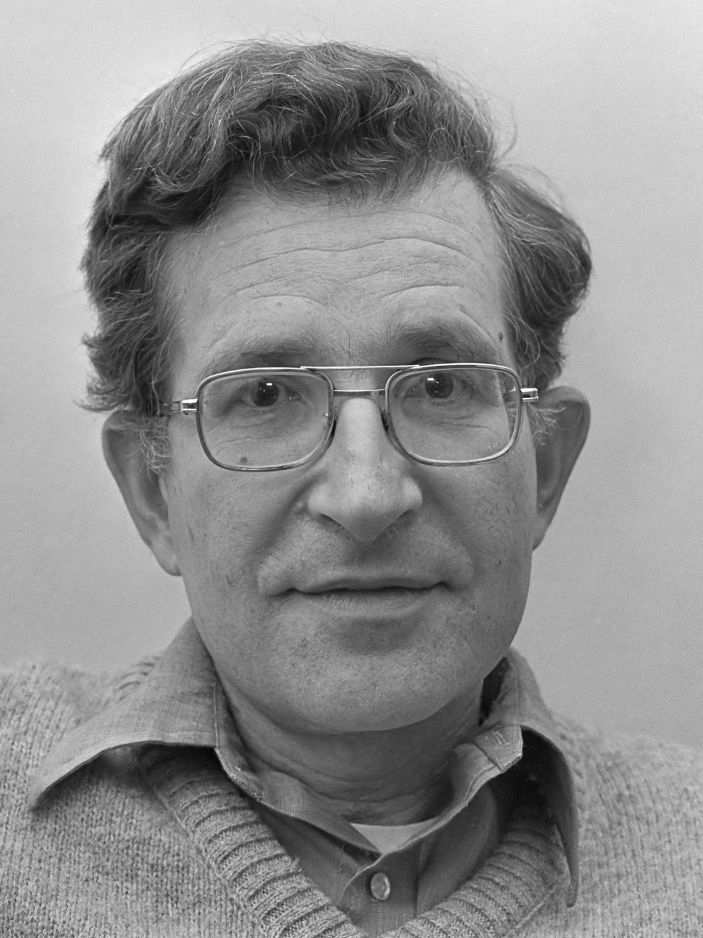
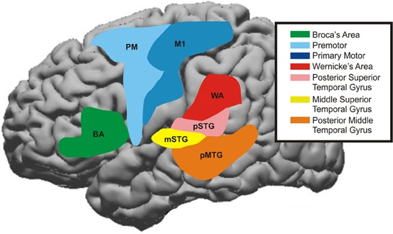
Theories of Language Development: Nativist Theory
Noam Chomsky believes that the brains contain a language acquisition device (LAD) that includes a universal grammar which is hard-wired into the brain and underlies all human language.
Children are born with a knowledge of general rules of syntax that determine how sentences are constructed; infants just need some exposure.
However, Evans and Levinson (2009) surveyed the world’s languages and found that none of the presumed underlying features of the language acquisition device were entirely universal. (Lifespan Development: A Psychological Perspective 2nd Edition by Martha Lally and Suzanne Valentine-French is licensed under CC BY-NC-SA 3.0 (modified by Marie Parnes))
While not an LAD, there are several brain structures which are involved with different aspects of language.
Between infancy and puberty, there is a critical period, a time in which learning can easily occur, for language.
Children who are not exposed to language early in their lives will likely never grasp the grammatical and communication nuances of language.( Lifespan Development: A Psychological Perspective 2nd Edition by Martha Lally and Suzanne Valentine-French is licensed under CC BY-NC-SA 3.0 (modified by Marie Parnes) )
Noam Chomsky: Image retrieved from wikimedia commons and is licensed under CreativeCommons CC0 1.0 Universal Public Domain
Image retrieved from Human Language Development Boundless Psychology. Curation and Revision provided by: Boundless.com licensed by CC BY-SA 4.0
Video: Universal Grammar (Intro Psych Tutorial #84) discusses both the LAD and Universal Grammar.

Slide 5
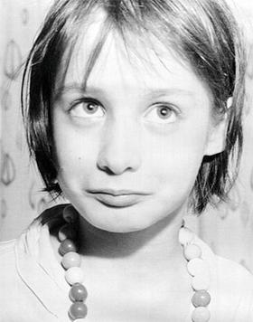
Theories of Language Development: Critical Period
The critical period hypothesis of language development states that there is an ideal timeframe of brain development to acquire language, after which further language acquisition becomes much more difficult if not impossible.
The critical period hypothesis is derived from the concept of a critical period in the biological sciences, which refers to a set period in which an organism must acquire a skill or ability or said organism will not be able to acquire it later in life. (Critical Period Hypothesis from Wikipedia is licensed under CC BY SA 3.0)
Genie (born 1957) is the pseudonym of an American feral child who was a victim of severe abuse, neglect, and social isolation. The extent of her isolation prevented her from being exposed to any significant amount of speech, and as a result she did not acquire language during her childhood.
Linguists saw Genie as providing an opportunity to gain further insight into the processes controlling language acquisition skills and to test the critical period hypothesis of language development. (Genie: Feral Child from Wikipedia is licensed under CC BY-NC-SA 3.0
The first publicly released picture of Genie, taken in 1970, just after authorities took control of her care at the age of 13 from Wikipedia is licensed under CC BY-NC-SA 3.0
Video 1.: Genie Wiley – TLC Documentary 2003: This 12:26 video tells the full story of how Genie came to be found and researchers who worked with her.
Video 2: Genie Wiley Speaking: A 2:37compilation of videos of Genie Wiley speaking.

Slide 6
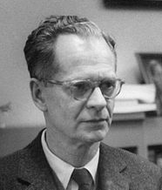
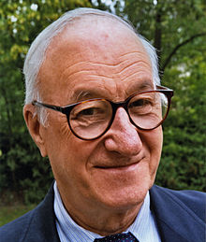
Theories of Language Development: Learning Theory
Learning Theory
Language occurs through the principles of learning, including association and reinforcement, and observation and imitation of others. (Skinner, 1953, Bandura, 1977).
Children modify their language through imitation and reinforcement, such as parental praise and being understood. For example, when a two-year-old child asks for juice, he might say, “me juice,” to which his mother might respond by giving him a cup of apple juice.
Other researchers believe that language cannot be entirely learned because children learn words too fast for them to be learned through reinforcement.⁸ However, the results of generalized imitation research (e.g., Poulson et al, 1991) indicate that only some words need to be reinforced. Words that were not reinforced still increased in their frequency.
9. B.F Skinner Image retrieved from wikipedia is licensed under Creative Commons Attribution-ShareAlike License
10. Albert Bandura Image retrieved from wikipedia is licensed under Creative Commons Attribution-ShareAlike License
Video: Language Acquisition – Skinner vs. Chomsky(Intro Psych Tutorial #82) discusses the differences between Skinner’s behavioral theory of language development and Chomsky’s nativist theory of development. Discussion begins at timestamp 0.52.
8. Lifespan Development: A Psychological Perspective 2nd Edition by Martha Lally and Suzanne Valentine-French is licensed under CC BY-NC-SA 3.0 (modified by Marie Parnes)

Slide 7

Theories of Language Development: Social Pragmatics
Language is not only a cognitive skill, but also a social one.
Children use several pre-linguistic skills (such as pointing and other gestures) to communicate not only their own needs, but what others may need.
Research by Gross, Behne, Carpenter & Tomasello, 2010) showed that toddlers as young as 18-months-old can make linguistic repairs when another person does not understand them.
Children are using language not only as a means of achieving some material goal, but to make themselves understood in the mind of another person. ¹¹
Image retrieved from pexels.com is licensed under CC0
Lifespan Development: A Psychological Perspective 2nd Edition by Martha Lally and Suzanne Valentine-French is licensed under CC BY-NC-SA 3.0 (modified by Marie Parnes)

Slide 8
Theories of Language Development: Statistical Learning
Statistical learning acquisition claims that infants' language-learning is based on pattern perception rather than an innate biological grammar.
Several statistical elements such as frequency of words, frequent frames, phonotactic patterns and other regularities provide information on language structure and meaning for facilitation of language acquisition.
Some research points to the possibility that the difficulty of learning a second language may be caused by the structural patterns and language cues that one has already picked up from acquisition of first language. In that sense, the knowledge of and skills to process the first language from statistical acquisition may act as a complicating factor when one tries to learn a new language with different sentence structures, grammatical rules, and speech patterns.
Statistical Language Acquisition from Wikipedia is licensed under CC BY SA 3.0.
Video: The Linguistic Genius of Babies: In this Ted talk, Dr. Patricia Kuhl discusses her research on how infants learn one language over another. Dr. Kuhl’s findings indicate that infants are taking statistics on the sounds they need to know.

Slide 9
Language and Cognition: Jean Piaget & Lev Vygotsky
Jean Piaget's theory of language development suggests that children use both assimilation and accommodation to learn language.
Assimilation is the process of changing one's environment to place information into an already existing schema (or idea).
Accommodation is the process of changing one's schema to adapt to the new environment.
Piaget believed children first create mental structures within the mind (schemas) and from these schemas, language development happens.
Consequently, language was simply a part of cognition.
Lev Vygotsky's theory of language development focused on social learning and the zone of proximal development (ZPD).
The ZPD is a level of development obtained when children engage in social interactions with others; it is the distance between a child's potential to learn and the actual learning that takes place.
Vygotsky's theory also demonstrated that Piaget underestimated the importance of social interactions in the development of language.
Video: Khan Academy: Theories of Language and Cognition: Processing the Environment discusses Piaget’s theory, Vygotsky’s theory, and the Safir-Whorf theory (you will learn more about this theory in a later slide).
Human Language Development Boundless Psychology. Curation and Revision provided by: Boundless.com licensed by CC BY-SA 4.0

Slide 10
Language and Cognition: Saphir-Worf Hypothesis and Cognitive Behavioral Theory
Theory | Description
Sapir-Whorf Hypothesis Video: Linguistic Relativity: Does Your Language Change How You See the World?, discusses research which supports certain aspects of the Sapir-Whorf Hypothesis. | Language and thought (or "cognition") tend to interact, a theory known overall as linguistic relativity. What one thinks becomes what one communicates, and what one communicates can lead to new thoughts.
Cognitive Behavioral Theory | Cognitive-behavioral theory claims that what people think impacts what they say and do. Problems with our internal dialogue, known as cognitive distortions, can lead to negative behaviors or serious emotional problems. For example, thinking you are going to fail a test may lead you to not study.
Human Language Development Boundless Psychology. Curation and Revision provided by: Boundless.com licensed by CC BY-SA 4.0
¹⁶

Slide 11
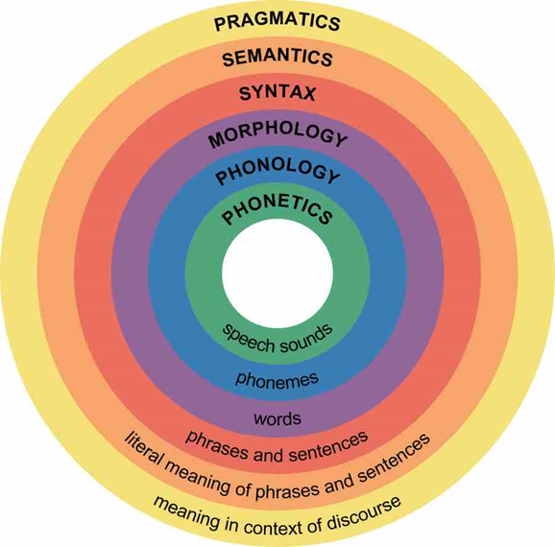
Components of Language
Phonemes and Phonology: A phoneme is the smallest unit of sound that makes a meaningful difference in a language and the study of phonemes is Phonology. The word “bit” has three phonemes. Different languages contain different numbers of phonemes. Infants are born able to detect all phonemes, but by 10 months of age a child’s ability to recognize phonemes becomes very similar to that of the adult speakers of the native language.
Morphemes and Morphology: Morphology is the study of words and other meaningful units of language like suffixes and prefixes. A morpheme is a string of one or more phonemes that makes up the smallest units of meaning in a language. Some morphemes are prefixes and suffixes used to modify other words. For example, the syllable “re-” as in “rewrite” or “repay” means “to do again,” and the suffix “-est” as in “happiest” or “coolest” means “to the maximum.”
Syntax: Syntax is the study of sentences and phrases, or how people put words into the right order so that they can communicate meaningfully. All languages have underlying rules of syntax, which, along with morphological rules, make up every language’s grammar. An example of syntax coming into play in language is “Eugene walked the dog” versus “The dog walked Eugene.” In order for the sentence to convey the intended meaning, the words must be in a certain order.
Semantics: Semantics is about the meaning of sentences. Someone who studies semantics is interested how words denote real-world objects or concepts.
Pragmatics: Pragmatics is how we communicate effectively and appropriately with others. Examples of pragmatics include turn-taking, staying on topic, volume and tone of voice, and appropriate eye contact.
Contextual information:, Contextual information is the information surrounding language to help us interpret it. Examples of contextual information include our knowledge and nonverbal expressions, such as facial expressions, postures, and gestures.
Lifespan Development: A Psychological Perspective 2nd Edition by Martha Lally and Suzanne Valentine-French is licensed under CC BY-NC-SA 3.0 (modified by Marie Parnes)
Major levels of Linguistic Structure from Image retrieved from Human Language Development Boundless Psychology. Curation and Revision provided by: Boundless.com licensed by CC BY-SA 4.0
17. 18.

Slide 12

Developmental Course of Language: Infancy through Toddlerhood: Pre-linguistic Speech
Newborns communicate their thoughts and needs with body posture (being relaxed or still), gestures, cries, and facial expressions.
Intentional Vocalizations: In terms of producing spoken language, babies begin to coo almost immediately. Cooing is a one-syllable combination of a consonant and a vowel sound (e.g., coo or ba). Cooing serves as practice for vocalization, as well as the infant hears the sound of his or her own voice and tries to repeat sounds that are entertaining.
At about four to six months of age, infants begin making even more elaborate vocalizations that include the sounds required for any language. Eventually, these sounds will no longer be used as the infant grows more accustomed to a particular language.
At about 7 months, infants begin babbling, engaging in intentional vocalizations that lack specific meaning and comprise a consonant-vowel repeated sequence, such as ma-ma-ma, da-da-da. (Video: Communicative Babbling shows examples of babbling and how to promote babbling. The video also briefly discusses gesturing.)
At around 9 months, infants will begin to use gesturing: Children communicate information through gesturing long before they speak. Deaf babies also use gestures to communicate wants, reactions, and feelings. (Video: Sounds and Gestures: Building Blocks for Your Child’s First Words: Discusses both babbling and gestures (gestures begin at timestamp 0.33, however this video is quite brief. Only 1.57)
Image from Pexels.com is licensed under the Creative Commons Zero (CC0) license ("CC0 Content").
Lifespan Development: A Psychological Perspective 2nd Edition by Martha Lally and Suzanne Valentine-French is licensed under CC BY-NC-SA 3.0

Slide 13
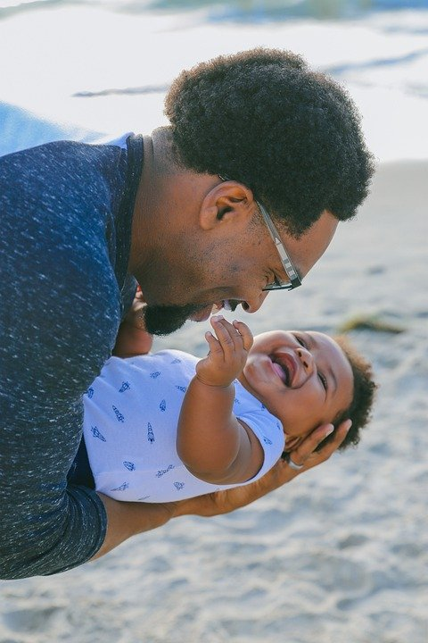
Developmental Course of Language: Infancy through Toddlerhood: Infant Directed Speech (Motherese)
Infant-Directed Speech
Adults tend to use “baby talk” or that sing-song type of intonation and exaggeration used when talking to children. This is a universal tendency called infant-directed speech (sometimes called motherese or parentese).
Infant-directed speech involves exaggerating the vowel and consonant sounds, using a high-pitched voice, and delivering the phrase with great facial expression (Clark, 2009).
Why is this done? Infants are frequently more attuned to the tone of voice of the person speaking than to the content of the words themselves and are aware of the target of speech.
Lifespan Development: A Psychological Perspective 2nd Edition by Martha Lally and Suzanne Valentine-French is licensed under CC BY-NC-SA 3.0
Image retrieved from Pixabay.comis licensed under CC0.
Video: Better Brains for Babies – Infant Directed Speech. This very brief video shows an adult using infant-directed speech.
²³

Slide 14
Developmental Course of Language: Infancy through Toddlerhood
At around 10 months of age, the infant can understand more words (receptive language) than they can produce (expressive language).
One of the first words that children understand is their own name, (usually by about 6 months), followed by commonly used words like “bottle,” “mama,” and “doggie” by 10 to 12 months (Mandel, Jusczyk, & Pisoni, 1995).
Infants shake their head “no” around 6–9 months, and they respond to verbal requests to do things like “wave bye-bye” or “blow a kiss” around 9–12 months.
Children use the cues that parents provide, to help them learn language. Children learn that people are usually referring to things that they are looking at when they are speaking (Baldwin, 1993), and that that the speaker’s emotional expressions are related to the content of their speech.
Children begin using their first words at about 12 or 13 months of age and may use partial words to convey thoughts at even younger ages. These one-word expressions are referred to as holophrastic speech. For example, the child may say “ju” or “juice” to express that the child wants juice.
Video: Conversation with a 19-Month-Old. See if you can pick out the holophrases being used this child. In addition to the video, the site also contains millstones of language development for children between 15 and 18 months of age.
Lifespan Development: A Psychological Perspective 2nd Edition by Martha Lally and Suzanne Valentine-French is licensed under CC BY-NC-SA 3.0

Slide 15
Developmental Course of Language: Infancy through Toddlerhood
Language errors
The early utterances of children contain many errors, for example, confusing /b/ and /d/, or /c/ and /z/. The words are often simplified because they are not yet able to make the more complex sounds of the real language Children may say “keekee” for kitty, “nana” for banana, and “vesketti” for spaghetti because it is easier.
Underextension: When a child who learns that a word stands for an object may initially think that the word can be used for only that particular object. For example, only the family’s Irish Setter is a “doggie.”
Overextension: When a child may think that a label applies to all objects that are similar to the original object. For example, all animals become “doggies.”
Two-word sentences and telegraphic (text message) speech
By toddlerhood, children have a vocabulary of about 50-200 words and begin putting those words together such as “baby bye-bye” or “doggie pretty.” Telegraphic speech/text message speech occurs when unnecessary words are not used. “Give baby ball” is used rather than “Give the baby the ball.”
First words and cultural influences
If the child is using English, first words tend to be nouns. The child labels objects such as cup, ball, or other items that they regularly interact with. In a verb-friendly language, however, children may learn more verbs.
Video: AcqOfLang1: Underextension and Overextension discusses the underextension and overextension of words by children first learning language.
Lifespan Development: A Psychological Perspective 2nd Edition by Martha Lally and Suzanne Valentine-French is licensed under CC BY-NC-SA 3.0

Slide 16
Developmental Course of Language: Middle Childhood
Milestone | Description
Vocabulary | By fifth grade, a child's vocabulary has grown to 40,000 words. It grows at a rate that exceeds that of those in early childhood. Children can associate new words with those already known, and there is a more sophisticated understanding of word meanings. Mapping refers to the question of how infants attach language, objects, concepts, and actions, to the things that they experience in the world. Many theories have been proposed to explain this process, such as fast mapping, constraints and semantic & syntactic boot-strapping. Video 1. AcqOfLang1:Fastmapping, discusses the concept of fastmapping in relation to language development Video 2. AcqOfLang1: Whole Object and Mutual Exclusivity Assumptions discusses the constraints of whole object and mutual exclusivity. Video 3. AcqOfLang1: Syntactic Bootstrapping Hypothesis.
New Understanding | Children are also able to think of objects in less literal ways. For example, if asked for the first word that comes to mind when one hears the word "pizza", the younger child is likely to say "eat" or some word that describes what is done with a pizza. However, the older child is more likely to place pizza in the appropriate category and say "food".
Grammar | Children have internalized the rules and exceptions for that language’s grammar
Context | Contextual information—the information surrounding language—is used for interpretation. Context includes tone of voice, body language, and the words being used. For example, the word “awesome,” when said with a big smile, means the person is excited about a situation. “Awesome,” said with crossed arms, rolled eyes, and a sarcastic tone, means the person is not thrilled with the situation. Child Growth and Development: An Open Educational Resources Publication by College of the Canyons by Jennifer Paris, Antoinette Ricardo, and Dawn Richmond is licensed under CC BY 4.0
Metalinguistic awareness | An essential aspect to language development is focused on children being aware of language and the components of language. Metalinguistics retrieved from Psychology wiki at wikia.org is licensed under CC BY-SA 3.0 (modified by Marie Parnes)

Slide 17
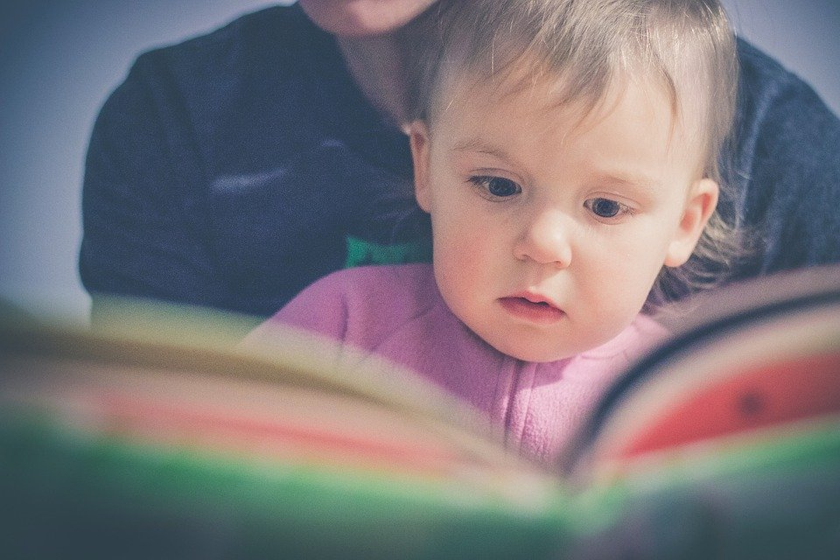
Literacy
Emergent Literacy
A term that is used to explain a child's knowledge of reading and writing skills before they learn how to read and write words.
Components of Emergent Literacy
Print motivation: Being interested in and enjoying books.
Vocabulary: Knowing the names of things.
Print awareness: Noticing print, knowing how to handle a book, and knowing how to follow words on a page.
Narrative skills: Being able to describe things and events and to tell stories.
Letter knowledge: Understanding letters are different from each other, knowing their names and sounds, and recognizing letters everywhere.
Phonological awareness: Being able to hear and play with the smaller sounds in words.
Image retrieved from Pixabay.com is licensed under CC0.
Text from Emergent Literacies retrieved from Psychology wiki at wikia.org is licensed under CC BY-SA 3.0
²⁹
Video 1: Rx for Success Dialogic Reading. Dialogic reading, or shared reading, is having a conversation with your child about a book. Instead of reading a book to your child, let them tell a story about a picture in the book. Examples of dialogic reading are provided.
Video2: REACH Workshop Series: Emergent Writing, discusses the interaction between emergent writing and emergent reading. The video also provides examples of emergent writing exercises that can be done with children.

Slide 18
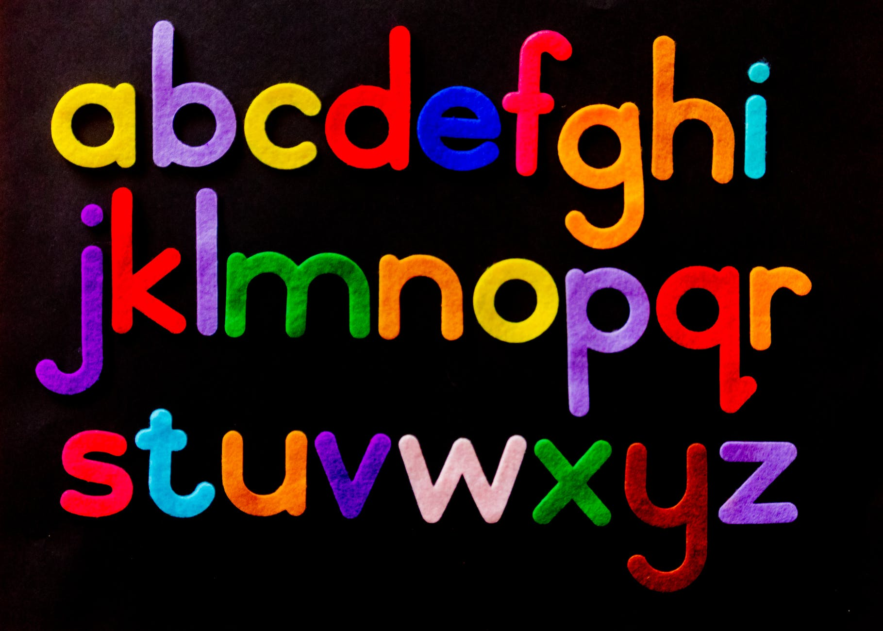
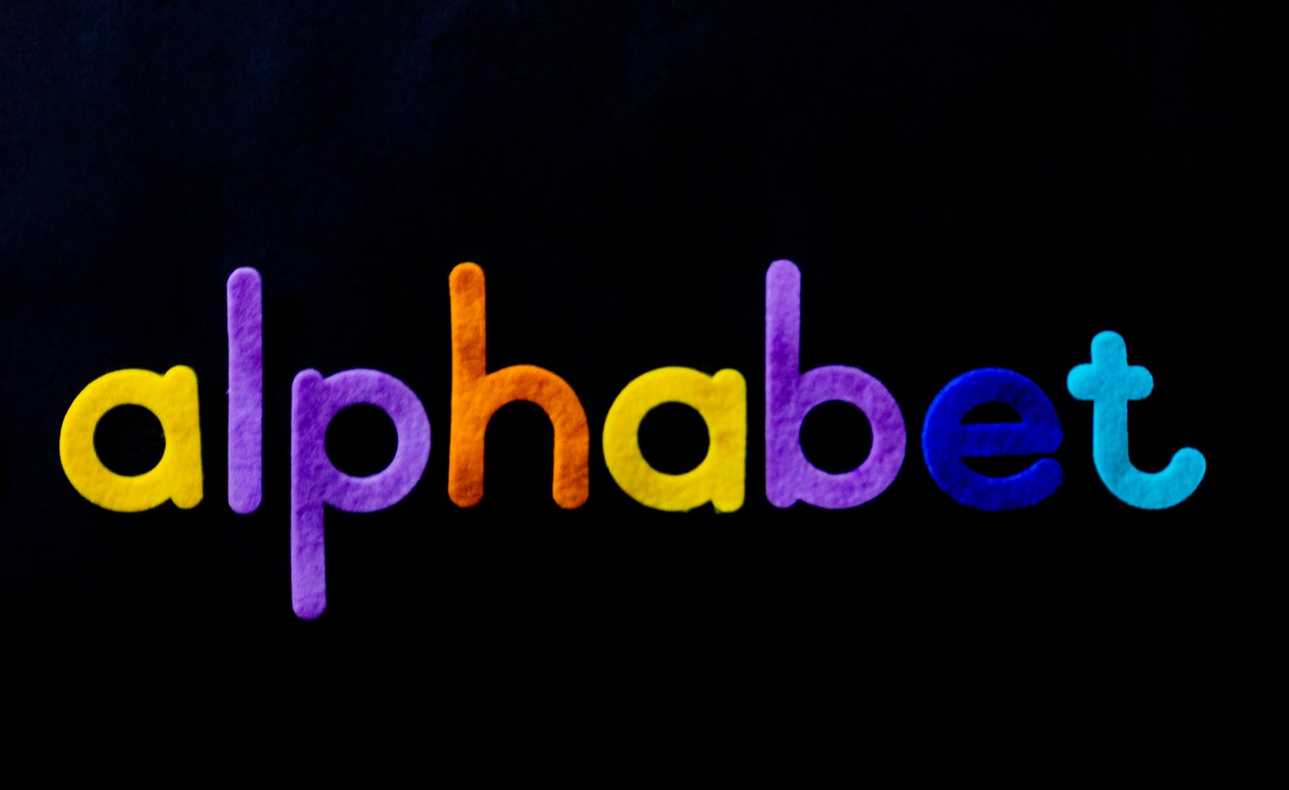
Literacy: Reading
How to Teach Reading: Two Approaches
Phonemic awareness, awareness of the component sounds within words, is a crucial skill in learning to read.
  To measure phonemic awareness, researchers ask children to decide whether two words rhyme, to decide whether the words start with the same sound, to identify the component sounds within words, and to indicate what would be left if a given sound were removed from a word.
Kindergartners’ performance on these tasks is the strongest predictor of reading achievement in third and fourth grade.
Teaching these skills to randomly chosen 4- and 5-year-olds results in their being better readers years later (National Reading Panel, 2000).
A huge milestone in middle childhood is learning to read and write.
Approach | Methodology
Phonics-based | Teaches reading by making sure children can understand letter-sound correspondences (how letters sound), automatically recognize familiar words, and decode unfamiliar words. This ability to break the code of reading allows children to read words they have never heard spoken before.
Whole-language | Attempts to teach reading as naturally as possible. As the sounds of words don’t have meaning, the focus is on reading words and sentences in context (such as real books), rather than learning the sounds and phonemes that make up words. ³²
³¹
Text from Child Growth and Development: An Open Educational Resources Publication by College of the Canyons by Jennifer Paris, Antoinette Ricardo, and Dawn Richmond is licensed under CC BY 4.0
Images retrieved from Pixabay are licensed under CC0.
Above text from Child Growth and Development: An Open Educational Resources Publication by College of the Canyons by Jennifer Paris, Antoinette Ricardo, and Dawn Richmond is licensed under CC BY 4.0
Video: Reading Wars: Phonics vs. Whole Word, discusses recent research that has consequences regarding both the phonics-based approach and the whole language approach. If you are pressed for time begin at timestamp 0.55 and end at timestamp 5.55. Note: Like other debates in development, this debate also depends on different situations and circumstances.

Slide 19

Literacy: Writing
Handwriting is a complex task that involves both visual–motor and cognitive skills.
During the school age period, children learn to associate movements with the mental image of the letters, and to write from dictation, and become able to control their movements proactively (Meulenbroek and Van Galen, 1988).
Practicing that ability during the school period allows the process of handwriting to become more and more automatic (Feder and Majnemer, 2007).
The acquisition of handwriting also affects more advanced literacy skills, such as the ability to produce written texts.
The role of general dynamic coordination in the handwriting skills of children by Andrea Scordella, Sergio Di Sano, Tiziana Aureli, Paola Cerratti, Vittore Verratti, Giorgio Fanò-Illic and Tiziana Pietrangelo retrieved from Frontiers in Psychology licensed under CC-BY 4.0. (modified by Marie Parnes) .
Image from pixabay.com is licensed under CC0.
³⁴

Slide 20
Speech and Language Disorders
Disorder | Description
Aphasia | A loss of the ability to produce or understand language is referred to as aphasia. When brain areas specific to language processing and production areas are damaged or injured, capabilities for speaking or understanding can be lost.
Articulation Disorder | An articulation disorder refers to the inability to correctly produce speech sounds (phonemes) because of imprecise placement, timing, pressure, speed, or flow of movement of the lips, tongue, or throat (NIDCD, 2016). Sounds can be substituted, left off, added or changed. These errors may make it hard for people to understand the speaker. They can range from problems with specific sounds, such as lisping to severe impairment in the phonological system.
Fluency Disorders | Fluency disorders affect the rate of speech. Speech may be labored and slow, or too fast for listeners to follow. The most common fluency disorder is stuttering. Stuttering is a speech disorder in which sounds, syllables, or words are repeated or last longer than normal. These problems cause a break in the flow of speech, which is called dysfluency (Medline Plus, 2016b).
Voice Disorders | Disorders of the voice involve problems with pitch, loudness, and quality of the voice (American Speech-Language and Hearing Association, 2016). It only becomes a disorder when problems with the voice make the child unintelligible.
Child Growth and Development: An Open Educational Resources Publication by College of the Canyons by Jennifer Paris, Antoinette Ricardo, and Dawn Richmond is licensed under CC BY 4.0
Video 1. Articulation Disorder (What is an Articulation Disorder and What Causes Articulation Disorders?
Video 2. Signs Your Child May Have a Stuttering or Fluency Disorder, explains common signs of stuttering and when to seek speech therapy.
Video 3. Speech Therapy for Children with Voice Disorders, interviews a speech pathologist who specializes in children’s voice disorders. The video is a bit long (27:28), so if you are pressed for time begin at timestamp 3:34 and end at timestamp 8:51

Slide 21
Fluency Disorders | Fluency disorders affect the rate of speech. Speech may be labored and slow, or too fast for listeners to follow. The most common fluency disorder is stuttering. Stuttering is a speech disorder in which sounds, syllables, or words are repeated or last longer than normal. These problems cause a break in the flow of speech, which is called dysfluency (Medline Plus, 2016b).
Voice Disorders | Disorders of the voice involve problems with pitch, loudness, and quality of the voice (American Speech-Language and Hearing Association, 2016). It only becomes a disorder when problems with the voice make the child unintelligible. ⁴¹

Slide 22
Bilingualism
Hola * Hello * Bonjour * Nǐn hǎo * Konnichiwa * Zdravstvuyte * Asalaam alaikum * Shalom * Salve * Yassas
The majority of children around the world are Bilingual, meaning that they understand and use two languages (Meyers-Sutton, 2005).
Children who are dual language learners are one of the fastest growing populations in the United States (Hammer et al., 2014).
Dual language learners may hear the same number of words and phrases (quantity) overall, as do monolingual children, but it is split between two languages (Hoff, 2018). They will show higher expressive and receptive skills in the language they come to hear the most.
Bilingual children have advantages in executive functioning, such as the ability to screen out irrelevant information (inhibitory control), as well as advantages in verbal and non-verbal working memory.
Bilingual children demonstrate greater efficiency in the word-learning process.
Lifespan Development: A Psychological Perspective 2nd Edition by Martha Lally and Suzanne Valentine-French is licensed under CC BY-NC-SA 3.0
Video: Igniting Bilingual Learning, discusses the work being done at I-LABS by researchers like Patricia Kuhl and concluded that given the right science-based approach, babies can start developing bilingual skills with just one hour of play per day, in the context of early education centers.

