Slide 1
Intelligence and Measurement
Chapter 9

Slide 2

Classifying Intelligence: One vs. Many
General Intelligence Theories
General Intelligence Theory
Charles Spearman: Spearman’s Two-Factor Theory, attempted to show that all cognitive performance can be explained by two variables: one general ability (g) and the many specific abilities (s) it gave rise to. However, further analysis showed that g alone was enough to explain the correlations between different tests. ¹
General Intelligence Theory
Raymond Cattel: Cattell expanded on Spearman’s theory of a unified g and explored the difference between two independent but correlated factors of general intelligence: crystallized and fluid, which he called Gc and Gf. ²
Video: Fluid and Crystallized Intelligences
General Ability
the single factor that underlies performance in all cognitive domains
Specific Abilities
the abilities specific to certain areas of intelligence, such as verbal fluency.
Fluid Intelligence
the ability to see complex relationships and solve problems
Crystallized intelligence
acquired knowledge and the ability to retrieve it
³
1 Spearman and the theory of general intelligence by Lyndsay T Wilson was retrieved from Explorable.com is licensed under CC BY 4.0
2. Introduction to Psychology – Thinking and Intelligence by Lumen Learning is licensed under CC BY 4.0 (modified by Marie Parnes)
^{3.} Introduction to Psychology – Thinking and Intelligence by Lumen Learning is licensed under CC BY 4.0 (modified by Marie Parnes)
Video: Spearman’s Two Factor Theory

Slide 3
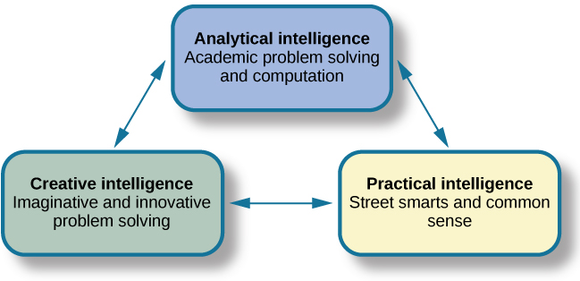
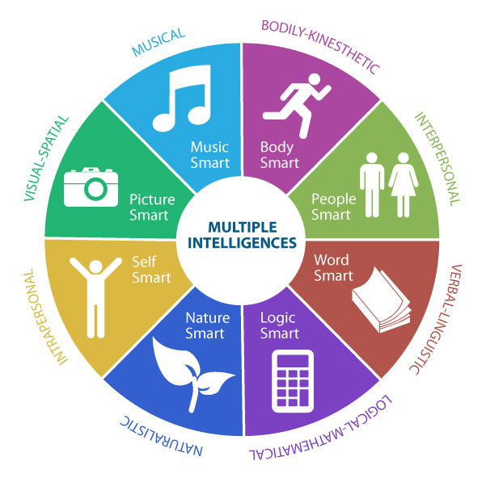
Classifying Intelligence: Multiple Intelligence Theories
Multiple Intelligence Theory
Robert Sternberg: Sternberg has proposed a Triarchic (three-part) theory of intelligence that proposes that people may display more or less analytical intelligence, creative intelligence, and practical intelligence. ³
Multiple Intelligence Theory
Howard Gardner: Gardner argued that it would be evolutionarily functional for different people to have different talents and skills and proposed that there are eight intelligences that can be differentiated from each other. A potential ninth intelligence; that is, existential still needs empirical support.⁴
⁶
⁵
Video: Theories of Intelligence: Gardner & Sternberg. If pressed for time begin at timestamp 2:17
3. Lifespan Development: A Psychological Perspective 2nd Edition by Martha Lally and Suzanne Valentine-French is licensed under CC BY-NC-SA 3.0 (modified by Marie Parnes)
4. Lifespan Development: A Psychological Perspective 2nd Edition by Martha Lally and Suzanne Valentine-French is licensed under CC BY-NC-SA 3.0 (modified by Marie Parnes)
5. Image retrieved from Psychology 2e, Thinking and Intelligence from Openstax is licensed under CC BY 4.0
6. Sajaganesandip, CC BY-SA 4.0 <https://creativecommons.org/licenses/by-sa/4.0>, via Wikimedia Commons

Slide 4
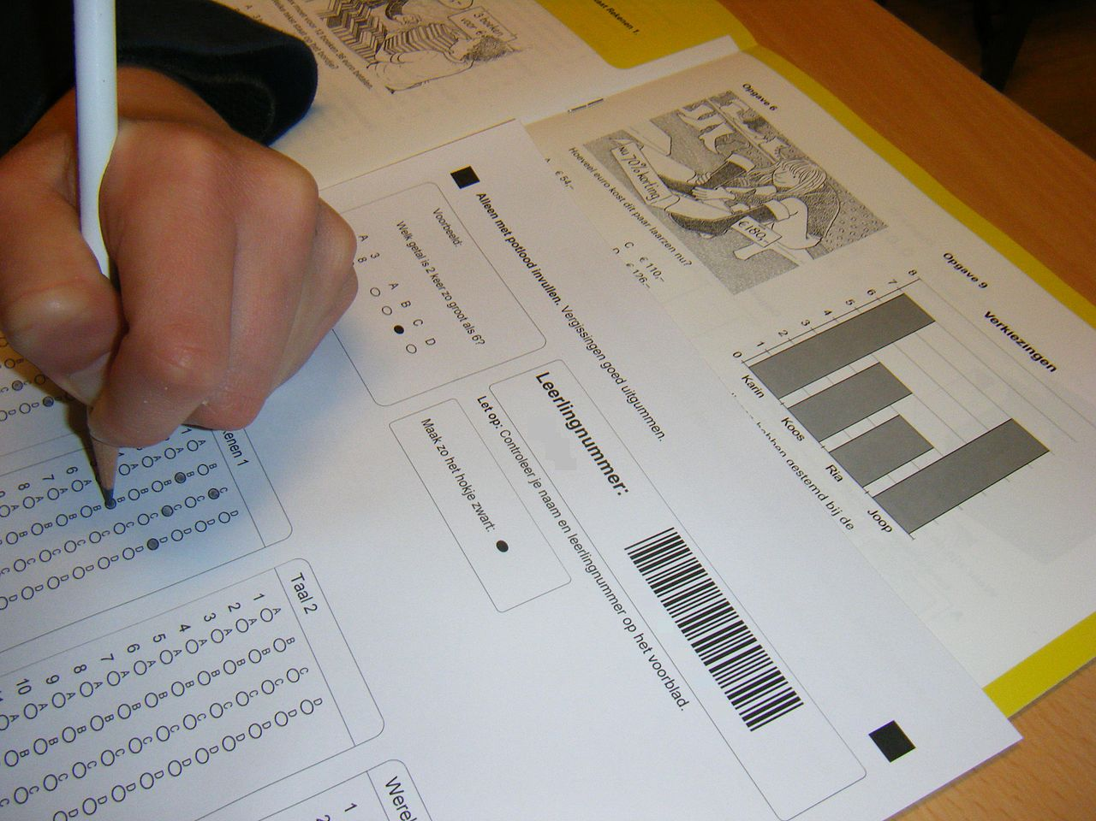
Measuring Intelligence: Standardization and the Intelligence Quotient
The goal of most intelligence tests is to measure “g”, the general intelligence factor.
Good intelligence tests are reliable, meaning that they are consistent over time.
Good intelligence tests demonstrate validity, meaning that they actually measure intelligence rather than something else.
Intelligence changes with age; understanding intelligence requires that we know the norms or standards in a given population of people at a given age. The standardization of a test involves giving it to a large number of people at different ages and computing the average score on the test at each age level. They are designed in such a way that the manner of administration, scoring, and interpretation of results is consistent.
Intelligence tests should be standardized on a regular basis. The Flynn effect refers to the observation that scores on intelligence tests worldwide have increased substantially over the past decades (Flynn, 1999).
Standardization allows us calculate a person’s mental age, which is the age at which a person is performing intellectually. If we compare the mental age of a person to the person’s chronological age, the result is the Intelligence Quotient (IQ), a measure of intelligence that is adjusted for age. A simple way to calculate IQ is by using following formula: IQ = mental age ÷ chronological age × 100.
However, most modern intelligence tests are based on the relative position of a person’s score among people of the same age, rather than on the basis of this formula⁷
Image retrieved from Wikipedia and licensed under CC BY SA 3.0
Video: Brains vs. bias: Crash Course Psychology #24: Discusses standardization, reliability, and validity begins at timestamp 1:58 and ends at timestamp 4:40.
Text above from Child Growth and Development: An Open Educational Resources Publication by College of the Canyons by Jennifer Paris, Antoinette Ricardo, and Dawn Richmond is licensed under CC BY 4.0

Slide 5
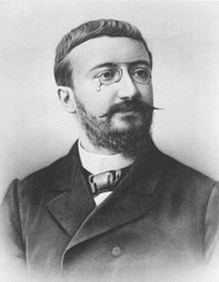
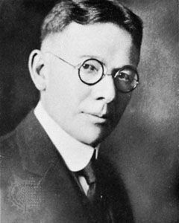
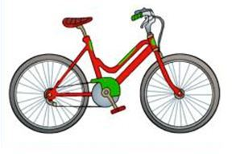
Intelligence Tests: From the Binet-Simon to the Stanford-Binet
Stanford-Binet
In the early 1900s, the Ministry of Education in France tasked psychologist Alfred Binet and Theodore Simon with devising a way to identify children who were struggling with ordinary class and needed extra attention. They developed the Binet-Simon scale and made many subsequent adjustments. Lewis Terman standardized the Binet-Simon test for the more diverse American population in 1916, where it flourished as a new tool in a rapidly changing political environment, becoming the Stanford-Binet test.⁹
Alfred Binet⁸
Lewis Terman¹¹
Sample practice question on the Stanford-Binet V. The child is asked to identify the picture. A bike or bicycle would be the correct answer. ¹⁰
Video: Stanford Binet: Discusses the Stanford Binet and the intelligence quotient. You can end at timestamp 4:00 if you like, or continue.
8.Image of Alfred Binet is public domain. 9. Binet and the First IQ Test by Lyndsay T Wilson was retrieved from Explorable.com is licensed under CC BY 4.0 10. Image retrieved from NYC Gifted and Talented Program and Testing Blog - public domain. 11. Image from Wikipedia an is public domain.

Slide 6
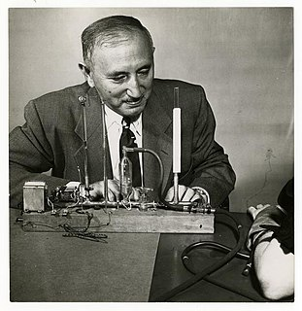
Intelligence Tests: Wechsler Scales
Wechsler Scales
The Wechsler Adult lntelligence Scale Fourth Edition (WAIS) is the most widely used intelligence test for adults aged 16 years to 90 years and 11 months. Wechsler Primary and Preschool Scale of Intelligence-Fourth Edition (WPPSI-IV) is an individually administered intelligence test designed for children aged 2 years and 6 months to 7 years and 7 months. ¹² Wechsler Intelligence Scale for Children-Fifth Edition (WISC-V) is designed for children aged 6 years to 16 years and 11 months.¹³
David Wechsler ¹¹
Video: What is the WPPSI Test (Wechsler Preschool and Primary Scale of Intelligence)? Provides examples from the test.
Video: What is the WISC Test (Wechsler Intelligence Scale for Children)? Provides examples from the test.
Lifespan Development: A Psychological Perspective 2nd Edition by Martha Lally and Suzanne Valentine-French is licensed under CC BY-NC-SA 3.0 (modified by Marie Parnes)
Wechsler Intelligence Scale for Children is retrieved from retrieved from Wikipedia and is licensed under Creative Commons Attribution-ShareAlike License
Image retrieved from Wikipedia and is licensed under Creative Commons Attribution-ShareAlike License

Slide 7
Extremes of Intelligence: Intellectual Disability and Giftedness
IQ is distributed in the population in the form of a normal distribution (or bell curve), which is the pattern of scores usually observed in a variable that clusters around its average.
The bulk of the scores fall toward the middle, with fewer scores falling at the extremes.
The normal distribution of intelligence shows that on IQ tests, the majority of people cluster around the average (in this case, where IQ = 100), and fewer have extremely high or extremely low intelligence.
The standard deviation of an IQ test is about 15. This means that about 2% of people score above an IQ of 130, often considered the threshold for giftedness, and about the same percentage score below an IQ of 70, often being considered the threshold for an intellectual disability.
The normal distribution of IQ scores in the general population shows that most people have about average intelligence, while very few have extremely high or extremely low intelligence. ¹⁴
Video: Normal Distribution – Intro to Psychology: Discusses the normal distribution, and standard deviation in terms of I. Q.
14. Lifespan Development: A Psychological Perspective 2nd Edition by Martha Lally and Suzanne Valentine-French is licensed under CC BY-NC-SA 3.0 .

Slide 8
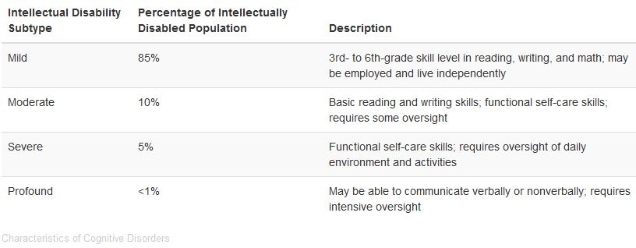
Extremes of Intelligence: Intellectual Disability
Intellectual Disability (or Intellectual Developmental Disorder)
The diagnosis of Intellectual Disability is based on a low IQ score and deficiencies in adaptive functioning.
The severity of the disability is based on adaptive functioning, or how well the person handles everyday life tasks.¹⁵
There are four subtypes of Intellectual Disability: mild, moderate, severe, and profound. The Diagnostic and Statistical Manual of Psychological Disorders lists criteria for each subgroup (APA, 2013) ¹⁶
Four Subtypes of Intellectual Disability ¹⁷
Video: Intellectual Disability-Mental Retardation-Signs, Causes, levels of ID describes intellectual disabilities and discusses the signs and symptoms of intellectual disability and its onset.
15 Lifespan Development: A Psychological Perspective 2nd Edition by Martha Lally and Suzanne Valentine-French is licensed under CC BY-NC-SA 3.0 . (Modified by Marie Parnes)
16. Measures of Intelligence by Openstax is licensed under CC-BY-4.0
17 . Measures of Intelligence by Openstax is licensed under CC-BY-4.0

Slide 9

Intellectual Disability: Down Syndrome
Down Syndrome
One cause of intellectual developmental disorder is Down syndrome, a chromosomal disorder caused by the presence of all or part of an extra 21st chromosome. The prevalence rises sharply in those born to older mothers. People with Down syndrome typically exhibit a distinctive pattern of physical features, including a flat nose, upwardly slanted eyes, a protruding tongue, and a short neck.¹⁸
Video: Down Syndrome, Causes, Signs and Symptoms, Diagnosis and Treatment.
Some physical features of Down Syndrome ¹⁹
18. Lifespan Development: A Psychological Perspective 2nd Edition by Martha Lally and Suzanne Valentine-French is licensed under CC BY-NC-SA 3.0 . (modified by Marie Parnes)
19. Image from Pexels.com licensed under CC0

Slide 10
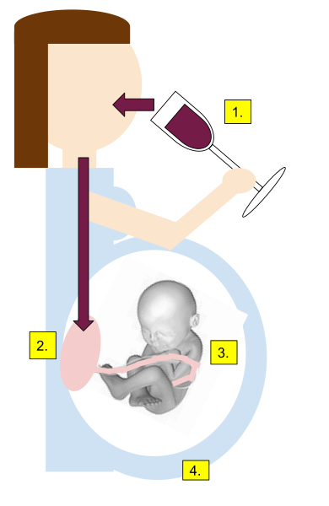
Intellectual Disability: Fetal Alcohol Syndrome
Fetal Alcohol Syndrome
This spectrum of disorders (FASD) is a group of conditions that can occur in a person whose mother ingested alcohol during pregnancy. Fetal alcohol syndrome (FAS) is the most severe disorder on this spectrum, and it is the leading cause of intellectual disability. Alcohol crosses the barrier of the placenta and damages the developing brain of the fetus. Alcohol exposure presents a risk of fetal brain damage at any point during a pregnancy, since brain development is ongoing throughout pregnancy. ²⁰
1. Alcohol consumed 2. Alcohol crosses into the placenta. 3. Alcohol Metabolizes. 4. FAEE (biomarker) detected in meconium. Alcohol particularly affects the heart and brain and interferes with the fetus receiving sufficient oxygen and nourishment. ²¹
20. Intellectual Disabilities Boundless Psychology. Curation and Revision. Provided by: Boundless.com licensed by CC BY-SA 4.0 and 21 Image from wikimedia commons was contributed by Grace Martin wikipedia commoms is licensed under CC BY-SA 4.0

Slide 11

Giftedness
Refers to children who have an IQ of 130 or higher (Lally & Valentine-French, 2015).
Lewis Terman and his colleagues (Terman & Oden, 1959) selected about 1,500 high school students who scored in the top 1% on the Stanford-Binet and similar IQ tests (i.e., who had IQs of about 135 or higher), and tracked them for more than seven decades (the children became known as the “termites” and are still being studied today).
This study found that these students were not unhealthy or poorly adjusted, but rather were above average in physical health and were taller and heavier than individuals in the general population. The students also had above average social relationships and were less likely to divorce than the average person (Seagoe, 1975).
Many of these students went on to achieve high levels of education and entered prestigious professions, including medicine, law, and science.
Another study of young adolescents who had even higher IQs found that these students ended up attending graduate school at a rate more than 50 times higher than that in the general population (Lubinski & Benbow, 2006).²²
Terman’s research dispelled the negative stereotypes about gifted children; for example, that they are socially eccentric.
Image retrieved from: https://en.wikipedia.org/wiki/Lewis_Terman
Creative Commons Attribution-ShareAlike License 3.0;
22. Lifespan Development: A Psychological Perspective 2nd Edition by Martha Lally and Suzanne Valentine-French is licensed under CC BY-NC-SA 3.0 .

Slide 12
Gifted Programs
Benefits of Gifted Programs
Gifted children often learn faster than their peers, and work more independently; they may become bored in a traditional classroom setting.
Gifted programs keep the child engaged in learning.
Some programs even offer gifted children college-level credit for advanced placement classes (with a passing grade on an assessment test). ²³
Way to Implement Gifted Programs
Allow a gifted child to skip grades.
Keep the child in the regular classroom but provide additional assignments and opportunities for enrichment
The child participates in a pull-out program and leaves the classroom during certain times or days for advanced classes. ²⁴
Disadvantages of Gifted Programs
By labeling some children as "gifted" and others as "not gifted," schools can create a self-fulfilling prophecy where those who are not accepted into the program do not perform as well as those who are accepted.
Students who are not identified as gifted are denied the benefits of enriched education. Some programs involve activities like field trips, talks from scholars, or cultural experiences, like visits to museums. These enrichment activities would benefit all children, not just the gifted. ²⁶
Lifespan Development: A Psychological Perspective 2nd Edition by Martha Lally and Suzanne Valentine-French is licensed under CC BY-NC-SA 3.0
The Intellectually Gifted Boundless Psychology. Curation and Revision. Provided by: Boundless.com licensed by CC BY-SA 4.0.
Image from pexels.com licensed under CC0
26. The Intellectually Gifted Boundless Psychology. Curation and Revision. Provided by: Boundless.com licensed by CC BY-SA 4.0

Slide 13
Learning Disabilities
A Learning Disability (or LD) is a specific impairment of academic learning that interferes with a specific aspect of schoolwork and that reduces a student's academic performance significantly. The student may be delayed in reading, writing, listening, speaking, or doing mathematics, but not in all of these at once.
Learning Disability | Description
Dyslexia | One of the most commonly diagnosed disabilities. Refers to children with reading difficulties. The child may reverse letters, have difficulty reading from left to right, or may have problems associating letters with sounds.
Dysgraphia | Refers to a writing disability that is often associated with dyslexia. Children may struggle with sounding out words and writing them phonetically or may have difficulty spelling irregular words. There may experience trouble forming letters when using a pen or pencil. ²⁷
Video 1: What is Dyslexia? A brief (4:34) TED-Ed talk that explains dyslexia.
Video 2: Supporting Students with Dysgraphia discusses what dysgraphia is and how to help children with dysgraphia.
27. Lifespan Development: A Psychological Perspective 2nd Edition by Martha Lally and Suzanne Valentine-French is licensed under CC BY-NC-SA 3.0 .

Slide 14
Learning Disabilities: Continued
Learning Disability | Description
Dyscalculia | Children with average intelligence who exhibit poor academic performance in mathematics.
Dyspraxia / Developmental Coordination Disorder DCD | Children with average intellectual ability who struggle with everyday tasks that require coordination.
Auditory Processing Disorder (APD) | Children with a processing deficit in the auditory modality
Visual Processing Disorder (VPD) | Children who have difficulty processing or interpreting visual information. Children with visual processing issues may have difficulty telling the difference between two shapes or finding a specific piece of information on a page. ²⁸
Video 1. Dyscalculia: Numberphile: A cognitive neuropsychologist discusses dyscalculia and his research on dyscalculia. I know that this video is bit longer than usual, but I think you will find it quite interesting.
Video 2. Dyspraxia: James’ Story – NHS: Meet James and his Mom, who describes her son's symptoms and the methods used to improve his condition.
Video 3. Central Auditory Processing Disorder (CAPD): Discusses CAPD, its effects, and what can be done to help people with CAPD.
Video 4. Visual Discrimination: Explanation and Discussion.
28. Child Growth and Development: An Open Educational Resources Publication by College of the Canyons by Jennifer Paris, Antoinette Ricardo, and Dawn Richmond is licensed under CC BY 4.0 (MODIFIED BY Marie Parnes)

Slide 15
Children with Disabilities: Legislation
Legislation | Description
Rehabilitation Act of 1973, Section 504 | This law, the first of its kind, required that individuals with disabilities be accommodated in any program or activity that receives Federal funding (PL 93-112, 1973).
Americans with Disabilities Act of 1990 (or ADA) | This legislation also prohibited discrimination on the basis of disability, just as Section 504 of the Rehabilitation Act had done (PL 101-336, 1990). Although the ADA also applies to all people (not just to students), its provisions are more specific and “stronger” than those of Section 504. In particular, ADA extends to all employment and jobs, not just those receiving Federal funding. It also specifically requires accommodations to be made in public facilities such as with buses, restrooms, and telephones.
Individuals with Disabilities Education Act (or IDEA) | As its name implied, this legislation was more focused on education than either Section 504 or ADA. It was first passed in 1975, reauthorized in 2004 (PL 108-446, 2004), and most recently amended in 2015 through Public Law 114-95, as Every Student Succeeds Act (United States Department of Education, 2017). In its current form, the law guarantees the following rights related to education for anyone with a disability from birth to age 21.). ²⁹
29. Lifespan Development: A Psychological Perspective 2nd Edition by Martha Lally and Suzanne Valentine-French is licensed under CC BY-NC-SA 3.0 .

Slide 16
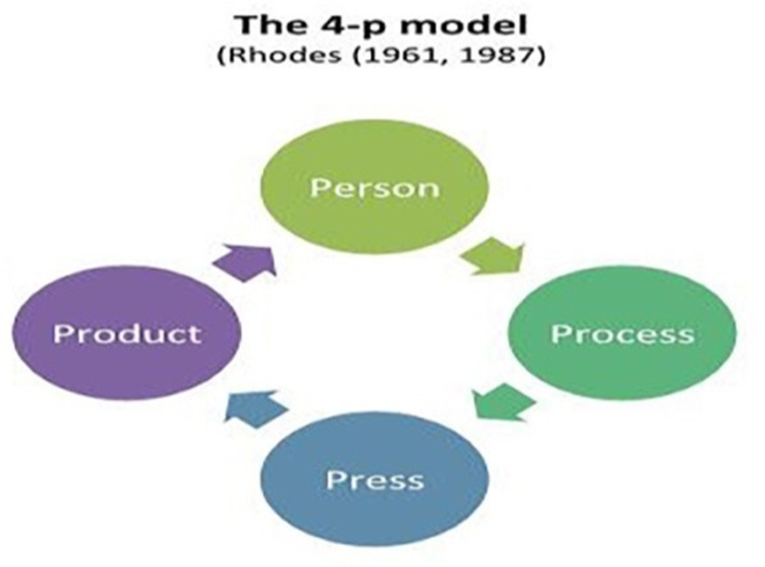
Creativity and Intelligence: Two Models of Creativity
Big “C”/Little “c” Model
Creativity Type | Description
Capital or Big “C” | Major productions of importance that bring into existence something new, and which receives validation.
Pro-”C” | The effortful progression beyond little “c” and mini “c”, not reaching Big-”C” status
Little or Small “c” | Refers to ideas or products that are new to the person, but only to the person
Mini “c” | Defined as the novel and personally meaningful interpretation of experiences, actions, and event
Video: Big C, Pro-c, Little-c & Mini-c Creatives- Dr. Tim Patson. Dr. Patson is one of Australia’s leading researchers in creativity, and in this video, he discusses Big C, Pro-c, Little-c and Mini-c.
Video: 4 P’s of Creativity: Reviews Rhode’s model of creativity.
Places creativity at the interplay of four distinct strands, i.e., process (the different stages of a creative activity), person (the characteristics of individuals), press (the qualities of the environment where creativity happens), and product (the tangible or intangible outcomes of the creative process). Rhodes’ classification has become a major framework for the holistic exploration of creativity. ³⁰
30. Image retrieved from On the Edge Between Digital and Physical: Materials to Enhance Creativity in Children. An Application to Atypical Development by Michela Ponticorvo, Luigia Simona Sica, Angelo Rega, & Orazio Miglino retrieved from Frontiers in Psychology licensed under CC-BY license.

Slide 17
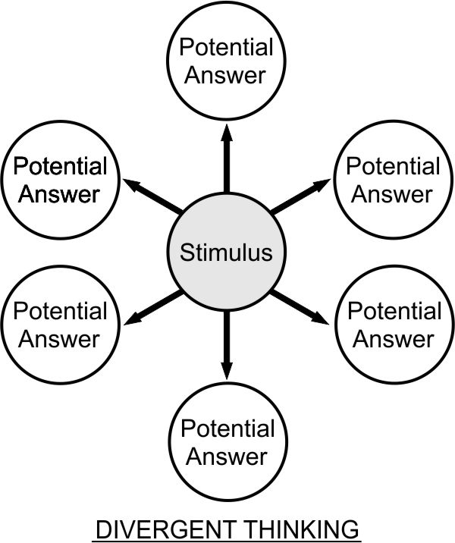
Measures of Creativity
The core of creativity is divergent thinking (DT), which is the ability of an individual to generate as many answers as possible to a problem. DT Standardized tests based on DT tasks have been developed to evaluate people’s creativity (Sayed and Mohamed, 2013)
Previous studies indicate that tests of DT are reliable and valid predictors of certain creative performance criteria, although they do not guarantee actual creative achievement However, they are effective measurements to assess creative ability.
The Torrance Test of Creative Thinking (TTCT) is one of the most well-constructed tests to assess creativity and it is widely given to elementary students to assess their creativity. ³¹
By Aishwarya.gudadhe - Own work, from Wikimedia is licensed under CC BY-SA 4.0,
Activities which promote divergent thinking include:
creating lists of questions,
setting aside time for thinking and meditation
Brainstorming
subject mapping
bubble mapping
keeping a journal
role-playing games,
creating artwork
free writing
Wikipedia licensed under the Creative Commons Attribution-ShareAlike License 3.0;
Video: The Torrance Test of Creative Thinking. The actual TTCT is discussed beginning at timestamp 2:55 and ending at timestamp 6:55 for this 12:35 video. Note: a list of task types for the TTCT can be found on the following slide.
31. Divergent Thinking and Intelligence: An Empirical Study of the Threshold Hypothesis with Chinese Children by Baoguo Shi, Lijing Wang, Jiahui Yang, Mengpin Zhang and Li Xu retrieved from Frontiers in Psychology licensed under CC-BY license. (modified by Marie Parnes)

Slide 18
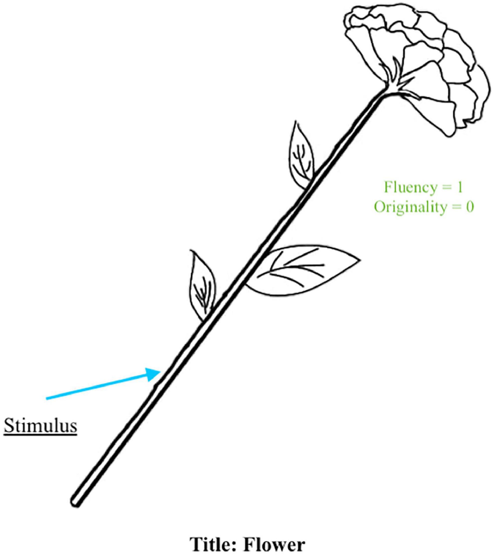
Measures of Creativity: Torrance Test of Creative Thinking (TTCT)
Task Type | Specific Tasks per Type
Verbal tasks using verbal stimuli | Unusual Uses Impossibilities Consequences Task Just Suppose Task Situations Task Common Problems Task Improvement Mother- Hubbard Problem Imaginative Stories Task Cow jumping Problems
Verbal tasks using nonverbal stimuli | Ask and Guess Task Product Improvement Task Unusual Uses Task
Non-verbal tasks | Incomplete figures task Picture construction task or shapes task Circles and squares Task Creative design task
Example of a response where the stimulus is identifiable and used as part of the idea (i.e., flower).
Alabbasi, A. M., Paek, S. H., Kim, D., & Cramond, B. (2022). What do educators need to know about the Torrance Tests of Creative Thinking: A comprehensive review. Frontiers in Psychology, 13. https://doi.org/10.3389/fpsyg.2022.1000385 Creative Commons Attribution License (CC BY).
³²
32. Retrieved from Wikipedia and is licensed under Creative Commons Attribution-ShareAlike License

Slide 19

Creativity From a Developmental Point of View
Children tend to exhibit a natural disposition toward creativity and expression
Fluency (the ability to generate multiple ideas) and flexibility develop across adolescence.
In children with atypical developmental, creative activities can offer support. For example, arts and crafts can enhance spatial awareness, hand-eye coordination, and motor skills.
If not stimulated, creativity can diminish. For instance, creativity diminishes by 40% between the ages of five and seven. This is due to the beginning of formal schooling with its educational rules which may inhibit commitment to creative thinking and behaviors. ³³
Image retrieved from Pexels.com Licensed under the Creative Commons Zero (CC0)
Video: These Top Six Creative Activities for Preschoolers are Absolute Fun discusses why creative is so important for preschoolers and ideas on how to improve their child’s creative development.
33. On the Edge Between Digital and Physical: Materials to Enhance Creativity in Children. An Application to Atypical Development by Michela Ponticorvo, Luigia Simona Sica, Angelo Rega, & Orazio Miglino retrieved from Frontiers in Psychology licensed under CC-BY license. (modified by Marie Parnes)

Slide 20
Relationship between Intelligence and Creativity
According to the threshold hypothesis theory, the relationship between creativity and intelligence may vary at different levels of intelligence.
Below an IQ level of 120, a correlation between IQ and creativity is observed, whereas no correlation is observed at IQ levels above 120.(Guilford and Christensen, 1973) However, the results of other research yielded inconsistent results.
Results of research utilizing children of different age groups indicate that different IQ thresholds exist within different age groups.
Welter et al.(2016) contends that the association between intelligence and creativity is not straightforward and is dependent on a combination of factors. Overall, the evidence suggests that intelligence is necessary for creativity but not sufficient. ³⁴
Video: James Kaufman – Creativity and Intelligence. Dr. James Kaufman discusses not only the Threshold Hypothesis Theory in this short video, but other theories that try to explain if a relationship between intelligence and creativity does exist.
34. Divergent Thinking and Intelligence: An Empirical Study of the Threshold Hypothesis with Chinese Children by Baoguo Shi, Lijing Wang, Jiahui Yang, Mengpin Zhang and Li Xu retrieved from Frontiers in Psychology licensed under CC-BY license. (modified by Marie Parnes)

Slide 21
The School Experience: Testing in Schools
Children's academic performance is often measured with the use of standardized tests.
Achievement Tests
Used to measure what a child has already learned. Achievement tests are often used as measures of teaching effectiveness within a school setting. Examples: Terra Nova Achievement Tests (K-12) Regents Exams (High School – five required in NY to receive diploma)
Aptitude Tests
Designed to measure a student’s ability to learn or to determine if a person has potential in a particular program. These are often used at the beginning of a course of study or as part of college entrance requirements. Examples: The Scholastic Aptitude Test (SAT) and Preliminary Scholastic Aptitude Test (PSAT), MCAT (Medical College Admission Test), LSAT (Law School Admission Test), and the GRE (Graduate Record Examination). Intelligence tests are also a form of aptitude test, which designed to measure a person’s ability to learn. ³⁵
In 2001, President Bush signed into effect Public Law 107-110, better known as the No Child Left Behind Act mandating that schools administer achievement tests to students and publish those results so that parents have an idea of their children's performance. On December 12, 2015, President Obama signed into law the Every Student Succeeds Act (ESSA). This law is state driven and focuses on expanding educational opportunities and improving student outcomes, including in the areas of high school graduation, drop-out rates, and college attendance. ³⁶
35. Child Growth and Development: An Open Educational Resources Publication by College of the Canyons by Jennifer Paris, Antoinette Ricardo, and Dawn Richmond is licensed under CC BY 4.0 (MODIFIED BY Marie Parnes)
36. Child Growth and Development: An Open Educational Resources Publication by College of the Canyons by Jennifer Paris, Antoinette Ricardo, and Dawn Richmond is licensed under CC BY 4.0

Slide 22
The School Experience
The school experience can be viewed from three standpoints.
Standpoints | Description
Teacher-Parent Relationship | Parents vary in their level of involvement with their children's schools. Teachers devise a variety of techniques to keep parents in touch with daily and overall progress.
Student Perspective | The majority of the day (298 minutes) takes place in the student state in which the student focuses on a task or tries to stay focused on a task, is passive, compliant, and often frustrated. The street corner state the state in which friends talk and play; about 66 minutes a day take place in this state. The home state occurs when parents or siblings visit the school. Children in this state may enjoy special privileges such as going home early or being exempt from certain school rules in the mother’s presence. The sanctity state is a time in which the child is contemplative, quiet, or prayerful and is a very brief part of the day.
Cultural Influence | Part of the hidden curriculum that includes ideas of patriotism, gender roles, the ranking of occupations and classes, competition, and other values.
³⁷
37. Psyc 200 Lifespan Psychology. Authored by: Laura Overstreet. Located at: http://opencourselibrary.org/econ-201/. License: CC BY 3.0: Attribution (modified by Marie Parnes)

