Slide 1
Theories of Cognitive Development
Chapter 7: Piaget & Vygotsky

Slide 2

What is Cognitive Development?
Cognition is the mental processes used in acquiring knowledge and comprehension.
Cognition is not simply intelligence, but intelligence is a part of cognition.
Cognition includes all higher order thinking including the use of logic, problem solving, judging, and remembering.
Cognitive development focuses on the changes that occur in how we think and learn as we grow.
Children do not just know less than adults do, there are differences in the very way that they think about and understand their experiences.
Cognitive processes build on each other and are used in existing knowledge and to generate new knowledge.
Image from Wikimedia Commons. Licensed under CC BY SA 3.0
Video: What is Cognition? Explained in 2 Min. The information up to timestamp 1:35 explains cognition.

Slide 3
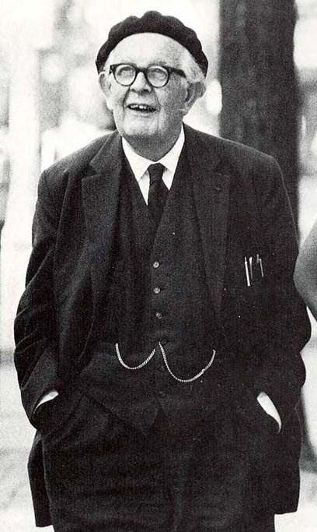
Who is Jean Piaget?
Jean Piaget was born in 1896 in Neuchatel, Switzerland and died in 1980 in Geneva Switzerland
At the age of 11, he wrote a paper on the albino sparrow, which was published, and which began his famous career.
After graduating high school, he attended the University of Zurich, where he became interested in psychoanalysis.
In 1920 he was employed by at the Binet Institute where his job was to develop French versions on English intelligence tests.
He was quite curious about the reasons “why” children gave wrong answers to questions and hypothesized that these wrong answers provided insight into the way a child thinks and reasons.
He married in 1923 and had three children who became the focus of his research, Jacqueline, Lucienne, and Laurent.
Image from Lumen Learning, Introduction to Psychology, Module 9 Lifespan Development. Licensed under CC BY 4.0
Video: Jean Piaget Biography: The Theory on Child Development. If you’re interested in knowing more about Piaget, this video provides a bit more detail. However, there is no audio to accompany the video, so you will have to read the text provided.

Slide 4
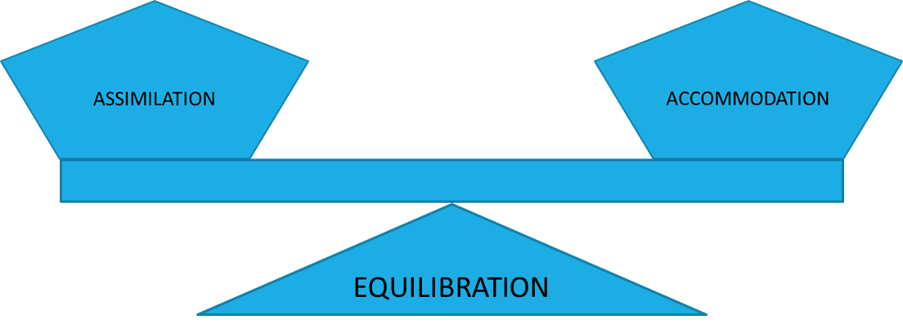
Schemata (plural of scheme), Assimilation, Accommodation, and Equilibration
From birth children develop schemata, or mental models that are used to help us categorize and interpret information.
  Initially, schemata are very basic, such as sucking and grasping.
Through the process of assimilation and accommodation we learn new information and adjust our schemata.
  Assimilation: New information is taken in and easily fits within an existing scheme
  Accommodation: New information is taken in and changes are made to a scheme
Equilibration, or balance occurs when most new information can easily be assimilated. However, if assimilation fails, then disequilibration results. Since disequilibration is uncomfortable and frustrating, the organism will move to accommodate the new challenge.
  If accommodation is successful, the organism returns to equilibration
  If the organism cannot assimilate or accommodate the new information, then no learning will take place.
Video: Schemas, Assimilation and Accommodation: Jean Piaget's Epistemological Concepts provides examples of each concept
A Balance Creates Equilibrium
An Imbalance creates Disequilibrium

Slide 5
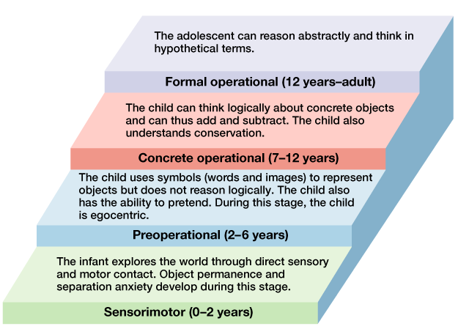
Piaget’s Theory: The Basics
Cognitive development proceeds from the interplay of assimilation and accommodation.
  The to-and-fro of these two processes leads not only to short-term learning, but also to long-term developmental change.
After observing children closely, Piaget proposed that cognition developed through distinct stages from birth through the end of adolescence.
  By stages he meant a sequence of thinking patterns with four key features:
    They always happen in the same order.
    No stage is ever skipped.
    Each stage is a significant transformation of the stage before it.
    Each later stage incorporated the earlier stages into itself.
Piaget proposed four major stages of cognitive development:
  (1) sensorimotor intelligence
  (2) preoperational thinking
  (3) concrete operational thinking
  (4) formal operational thinking.
Each stage is correlated with an age period of childhood, but only approximately.
Image from Boundless.com. Piaget’s Stages of Cognitive Development. Licensed under CC BY 4.0
Text from Lumen Learning Educational Psychology Chapter 3: Student Development. Licensed under CC BY 4.0
Video: Khan Academy: Piaget’s Stages of Cognitive Development provides an overview of Piaget’s stages and the abilities developed during each stage.

Slide 6
Piaget’s Theory Stage 1: Sensorimotor Thinking
The sensorimotor stage lasts from birth to about 2 years old and consists of six substages. This period is a time when infants “think” by means of their senses and motor actions.
Sub-Stage | Age | Description
1 Simple Reflexes | Birth-6 weeks | “Coordination of sensation and action through reflexive behaviors”. Three primary reflexes are described by Piaget: sucking of objects in the mouth, following moving or interesting objects with the eyes, and closing of the hand when an object contacts the palm (palmar grasp). Over the first six weeks of life, these reflexes begin to become voluntary actions. For example, the palmar reflex becomes intentional grasping.
2 First habits and primary circular reactions phase | 6 weeks-4 months | “Coordination of sensation and two types of schema: habits (reflex) and primary circular reactions (reproduction of an event that initially occurred by chance). The focus is still on the infant’s body”. As an example of this type of reaction, an infant might repeat the motion of passing their hand before their face.
3 Secondary circular reactions phase | 4–8 months | Development of habits. “Infants become more object-oriented, moving beyond self-preoccupation; repeat actions that bring interesting or pleasurable results”. This stage is associated primarily with the development of coordination between vision and prehension. Three new abilities occur at this stage: intentional grasping for a desired object, secondary circular reactions, and differentiations between ends and means. At this stage, infants will intentionally grasp the air in the direction of a desired object, often to the amusement of friends and family. Secondary circular reactions, or the repetition of an action involving an external object begin; for example, moving a switch to turn on a light repeatedly. The differentiation between means and ends also occurs. This is perhaps one of the most important stages of a child’s growth as it signifies the dawn of logic.
4 Coordination of secondary circular reactions stages | 8–12 months | “Coordination of vision and touch—hand-eye coordination; coordination of schemas and intentionality“.This stage is associated primarily with the development of logic and the coordination between means and ends. This is an extremely important stage of development, holding what Piaget calls the “first proper intelligence“. Also, this stage marks the beginning of goal orientation, the deliberate planning of steps to meet an objective.
5 Tertiary circular reactions, novelty, and curiosity | 12–18 months | “Infants become intrigued by the many properties of objects and by the many things they can make happen to objects; they experiment with new behavior”. This stage is associated primarily with the discovery of new means to meet goals. Piaget describes the child at this juncture as the “young scientist,” conducting pseudo-experiments to discover new methods of meeting challenges.
6 Internalization of Schemas | 18–24 months | “Infants develop the ability to use primitive symbols and form enduring mental representations”. This stage is associated primarily with the beginnings of insight, or true creativity. This marks the passage into the preoperational stage.
Text from Lumen Learning, Education, Society, & the K-12 Learner. Part II: Educational Psychology. Licensed under CC BY 4.0
Video: Sensorimotor Stage – 6 Substages provides an overview and examples of the 6 substages of sensorimotor development. I strongly suggest you follow this slide while watching the video. Note the hyperlinks within the text if you need help with certain concepts.

Slide 7

Piaget’s Theory Stage 1 (Birth to 2 Years) : Sensorimotor Thinking
During the sensorimotor stage, the development of object permanence takes place over six sub-stages. These sub-stages (discussed in detail on the next slide) occur as a result of development that occurs during the six substages during the sensorimotor stage.
During the sensorimotor period, object permanence, the child’s understanding that objects continue to exist even though the object cannot be seen, develops.
  At the end of the sensorimotor stage children have developed mental representation of objects.
Video, Object Permanence in Babies demonstrates lack of object permanence in a child who is approximately six months old. While the video runs for 4:04, you will quickly get the idea, and therefore do not need to view the entire video unless you would like to.
The A-Not B Error
Complete object Permanence does not happen overnight, but develops gradually, (typically by 12 months). So, while a 9-month-old may search for an object that is covered by a cloth, if that child watches someone cover the object with a cloth in a different location, the child will only search for the object in the location where they last saw the saw the object.
Video: Clip 5 A not B Error shows a 9-month-old boy who has attained a basic understanding of object permanence but cannot yet overcome the A-not-B error.
Peek-a-boo is so much fun, because the person disappears and re-appears.
Text and image from Wikipedia. Object Permanence. Licensed under CC BY SA 3.0. Text edited by Maria Pagano

Slide 8
Piaget’s Theory Stage 1: Sensorimotor Thinking: Six Substages of Object Permanence
Stage 1: 0–1 months: Reflex Schema Stage – Babies learn how the body can move and work and reflexive responses are the way an infant understands the world. No attempt to locate objects that have disappeared.
Stage 2: 1–4 months: Primary circular reactions – Babies notice objects and will continue to look where an object was, but for only a few moments. However, no attempt to locate objects that have disappeared occurs.
Stage 3: 4–8 months: Secondary circular reactions – Babies will reach for an object that is partially hidden, or that has dropped from view.. If an object is completely hidden, the infant makes no attempt to retrieve it.
Stage 4: 8–12 months: Coordination of secondary circular reactions –The very earliest understanding of object permanence emerges, as the child is now able to retrieve an object when its concealment is observed. However, since the development of object permanence is not complete, infants at this stage are prone to the A-not-B error.
12–18 months: Tertiary circular reaction – The child gains means-end knowledge and can solve new problems. The child is now able to retrieve an object when it is hidden several times within their view but cannot locate it when it is outside their perceptual field (invisible displacement of the object)
18–24 months: Invention of new means through mental combination – The child fully understands object permanence, will overcome the mistakes of the A-not-B error and can comprehend invisible displacement of objects.
Text from Wikipedia. Object Permanence. Licensed under CC BY SA 3.0. Text edited by Maria Pagano

Slide 9
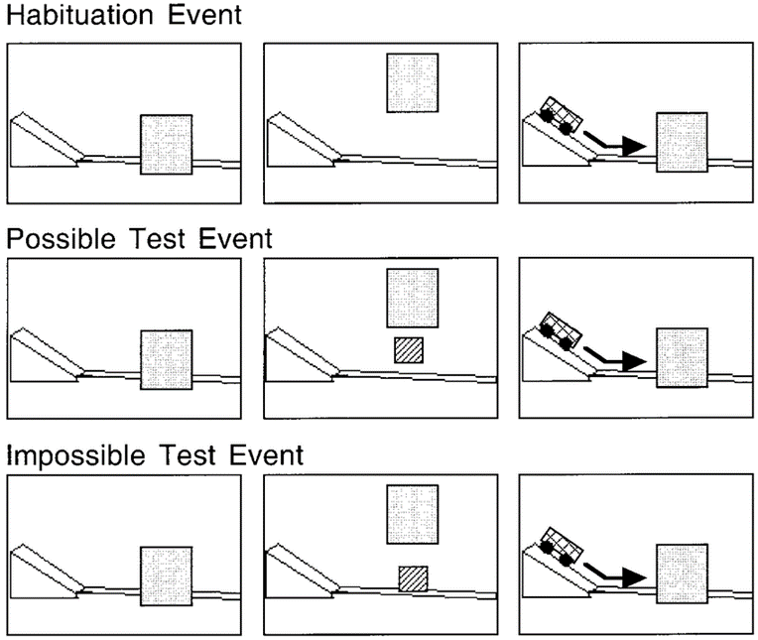
Violation of Expectation (VOE): VOE Studies and Object Permanence
VOE studies suggest that by 2.5 months, infants can represent hidden objects and consequently conclude that young infants’ cognitive abilities may be richer and more continuous with those of adults than was traditionally believed by researchers like Piaget.
Typical VOE Experiment
Prior to the test trials, infants usually receive habituation or familiarization trials to acquaint them with various aspects of the test events.
Infants are then shown two test events, one consistent (“possible” event) and one inconsistent (“impossible” event)
With appropriate controls, evidence that infants look reliably longer at the unexpected than at the expected event is taken to indicate that they
    (1) possess the expectation under investigation
    (2) detect the violation in the unexpected event
    (3) are surprised by this violation. The term surprise is used here simply as a short-hand descriptor, to denote a state of heightened attention or interest caused by an expectation violation.
Text from NIH National Library of Medicine, National Center for Biotechnology Information by Wang, Baillargeon, and Bruekner. Licensed under Public Domain. Edited by Maria Pagano
One of the Object Permanence Tasks Designed by Baillargeon and Discussed in the Video. Image from ResearchGate by Markman, Arthur & Dietrich, Eric. (1998). Used for Educational Purposes
Video: Object Concept: VOE Ramp Study Baillargeon demonstrates a VOE experiment where a truck appears to “magically” go through a solid box

Slide 10
Piaget’s Theory Stage 2 (2 to 7 Years): Preoperational Thinking: The Basics
Children begin to use symbols to represent words, images, and ideas (language use), and begin to engage in pretend play and symbolic play (pretending a sheet draped over two chairs is a fort).
Children are egocentric, or unable to take the perspective of others. A child at this stage thinks that everyone sees, thinks, and feels just as they do.
  Between 3 and 5 years old, children come to understand that people have thoughts, feelings, and beliefs that might be different from their own.
Children begin to use language in the preoperational stage but cannot understand adult logic. A preoperational child’s thinking is syncretic and animistic.
  Syncretism refers to the tendency to think that if two events occur simultaneously, one caused the other. For example: A child believes that by putting on their bathing suit they can change the season to summertime.
  Animism: The belief that inanimate objects have lifelike qualities. For example, putting one’s dolly to bed because the doll is tired and needs a nap.
Children lack conservation, or the ability to understand that even though the appearance of something has changed it is still equal in amount, area, and mass if nothing else has been removed or added.
  The inability to conserve is cause by:
    Centration: Focusing on only one aspect of a situation or problem at a time
    A lack of Reversibility: Reversibility is the ability to reverse mental operations.
Video Piaget’s Preoperational Stage.mov, provides a basic overview of how children think during the preoperational stage.

Slide 11
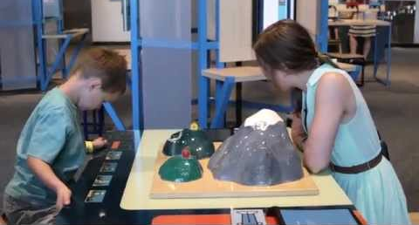
Piaget’s Theory Stage 2: Preoperational Thinking: Egocentric Thought and Speech
Piaget developed the Three-Mountain Task to determine the level of egocentrism displayed by children. Children view a 3-dimensional mountain scene from one viewpoint and are asked what another person at a different viewpoint would see in the same scene.
Video: Piaget's Mountains Task demonstrates how Piaget tested for egocentrism using the Three Mountain Task.
Text and Image from Lumen Learning, Introduction to Psychology, Module 9 Lifespan Development. Licensed under CC BY 4.0

Slide 12
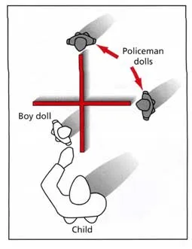
Piaget’s Theory Stage 2: Criticisms of the Three Mountain Task
Martin Hughes (1975) argued that the three-mountain task did not make sense to children and was complicated by the fact that children had to match the doll’s view with a photograph.
The Police Doll Task (Hughes, 1975)
Showed children a model of two intersecting walls with a “boy” doll and a “policeman” doll .
He then placed the policeman doll in various positions and asked the child to hide the boy doll from the policeman.
Hughes then brought in a second policeman doll and placed both dolls at the end of the two walls as shown in the image (where?).
The child was then asked to hide the boy from both policemen. In order to do this, the child had to consider two different points of view (the policemen and the doll).
His results showed that children between the ages of three and half and five and half correctly positioned the doll 90% of the time.
Video: Policeman Task: Shows a preoperational aged child taking the Police Doll Task.
Image from Simply Psychology. McLeod, S. A. (2018). Preoperational stage. Licensed under CC BY NC ND 3.0

Slide 13
Piaget’s Theory Stage 2: Preoperational Thinking: Animism
Animism
The belief that inanimate objects (such as toys and teddy bears) have human feelings and intentions. By animism Piaget (1929) meant that for the preoperational child the world of nature is alive, conscious and has a purpose.
Piaget identified four stages of animism:
Up to the ages of 4 or 5 years, the child believes that almost everything is alive and has a purpose.
During the second stage (5-7 years), only objects that move have a purpose.
In the next stage, (7-9 years), only objects that move spontaneously are thought to be alive.
In the last stage (9-12 years), the child understands that only plants and animals are alive.
Text from Simply Psychology. McLeod, S. A. (2018). Preoperational stage. Licensed under CC BY NC ND 3.0

Slide 14
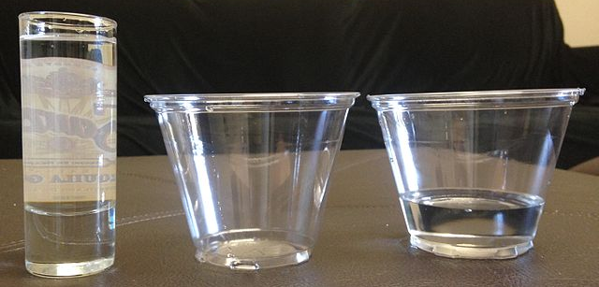
Piaget’s Theory Stage 2: Preoperational Thinking: Conservation Errors
Preoperational children have not yet mastered the concept of conservation and reversibility.
Fails to Conserve: Centration
If a child is first shown two glasses of water each equal in width and height (like the two short wide glasses shown to the right) that contain the same amount of liquid and you then pour the water from one of the short wide glasses into a container that is taller in height and shorter width (like the tall, thin glass in the image), the child will think that the amount of water has changed, and that the tall thin glass contains more water. The child centers on the height of the glass.
Fails to Conserve: Lack of Reversibility
Even if unsure, the child could pour the water from the tall thin glass back into the short wide glass, but this solution does not come to them because they lack the ability to reverse the operation.
Image from Wikimedia Commons by Waterlily 16 is licensed under CC BY SA 3.0
BEGIN HERE
Video: Piaget’s Liquid Conservation Task, shows several children of different ages taking the part in a conservation of liquid task.

Slide 15
Piaget’s Theory Stage 2: Preoperational Thinking: Classification Errors
Classification begins as the ability to sort items in some sort of order, for example color or shape. Classification then develops to include the understanding of how categories relate to one another and how to use categorical information to solve problems.
The logic of classifying object into superordinate and subordinate categories is tested using a Class Inclusion Problem:
  Class inclusion problems look at the child’s understanding of how categories relate to one another.
For Example: First the child is asked, “Are there more red flowers or blue flowers?” The preoperational child will correctly answer that there are more red flowers.
  However, when the preoperational child is asked, are there more red flowers or are there more flowers, the typical preoperational child will incorrectly respond that there are more “red flowers.”
Image from Quizlet. Used for Educational Purposes Only

Slide 16
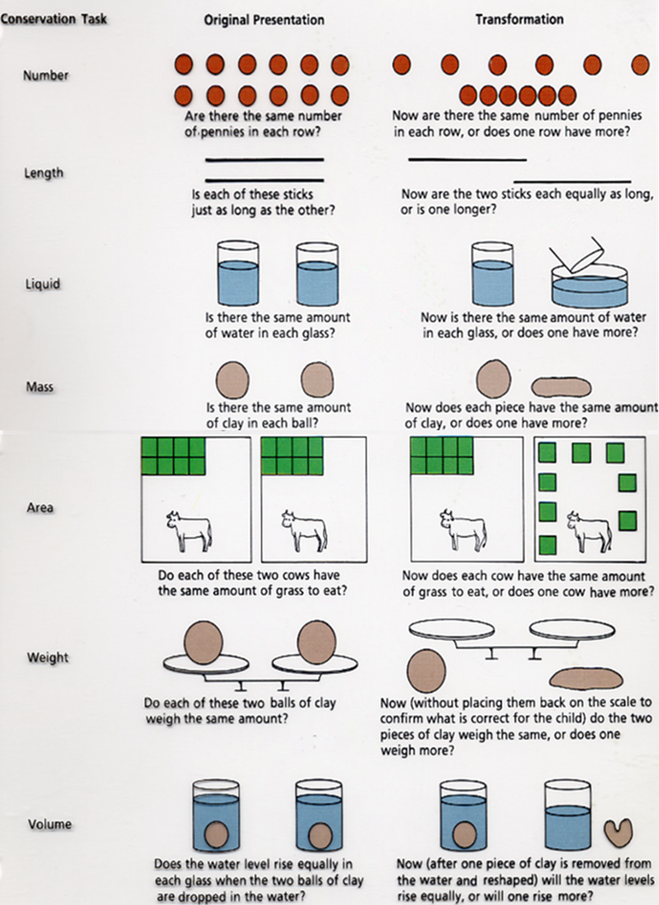


Piaget’s Theory Stage 3: Concrete Operational Thinking
From ages 7 to 11 children continue to master logic but do so in concrete ways. In other words, the use of logic is dependent on the context in which the problem is posed. Therefore, the child is capable of logic in some situations, but cannot transfer that logic to all situations. Piaget referred to this inability to generalize abilities as horizontal decalage.
  Horizontal Decalage: The ability to perform one task or operation does not lead to the ability to generalize that that knowledge to another task or operation that is conceptually the same as the original task.
  Think back to the conservation of liquid task. While most children can conserve liquid by age seven and decenter on only one aspect of the container, that same 7-year-old will not be able to apply that same ability to conservation of weight.
Video: A Typical Child on Piaget’s Conservation Tasks, which shows a 4-and-a-half-year-old child attempting conservation of number, length, continuous liquid (you’ve seen this before), mass and area.
Image from homepages.gac.edu. No licensing or copyright provided by author

Slide 17
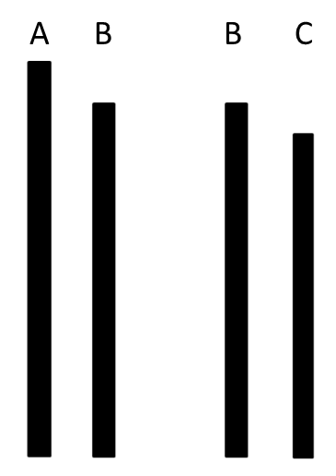
Piaget’s Theory Stage 3: Concrete Operational Thinking: Horizontal Decalage
While the concrete operational child can solve the logic problem given below when provided with the image illustrating an example of the question, that same concrete operational child cannot solve a problem given abstractly. That is when simply asked only the question, if A is greater than B and, B is greater than C, then…
If A is greater than B and, B is greater than C, then…what is the next logical conclusion?
The answer to the above question is A, is greater than C

Slide 18
Piaget’s Theory Stage 4: Formal Operational Thinking
The formal operational stage begins at approximately 12 years of age.
At this stage adolescents can manipulate ideas in their head, without the benefit of concrete material.
At this stage adolescents can:
  Use hypothetico-deductive reasoning to generate hypotheses about the world and approach problems in a systematic and organized way.
  Reason abstractly and think about hypothetical and abstract concepts in a way that younger children cannot, such as questions like the one on the previous slide.
Testing Formal Operations:
  Third Eye Task – One of the simplest tests of formal operations
    Children were asked where they would put an extra eye, if they were able to have a third one, and why. Schaffer (1988) reported that when asked this question, 9-year-olds all suggested that the third eye should be on the forehead. However, 11-year-olds were more inventive, for example suggesting that a third eye placed on the hand would be useful for seeing round corners.
    The balance scale task requires the child to use their understanding of distance and weight to predict whether the arms of a balance will either fall right, left or balance. (Go to the Human Development Video Activity which takes you through typical balance scale problems and shows the answers given by children of different ages as well as the rationale for their answers.)
While most individuals attain some degree of formal operational thinking, most adults do not regularly demonstrate formal operational thought.

Slide 19
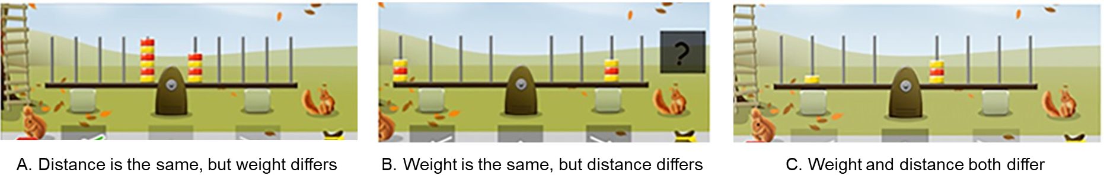
Siegler’s Balance Scale Problem
Siegler (2016) viewed development as more of a continuum, rather than stages and differentiated between a series of rules that children might use to solve balance-scale items.
Rule 1: Only considers the number of blocks and disregards the distance
Rule 2: Does include the distance, but only when the number of blocks is equal on both sides
Rule 3: The child knows that both the number of blocks and the distance should be considered, but does not know how to properly apply the rule and so will guess when both the weight and distance are in conflict as in “C,” above
Rule 4: Can take both the weight and distance into account and will come to the correct answer
Video: Cognitive Psychology – Session 3 explains Siegler’s balance scale task. Begin at timestamp 11:46 and end at timestamp 18:18.
Image from Hofman, A. D., Visser, I., Jansen, B. R., & van der Maas, H. L. (2015). The Balance-Scale Task Revisited: A Comparison of Statistical Models for Rule-Based and Information-Integration Theories of Proportional Reasoning. PloS one, 10(10), e0136449. From U.S. National Library of Medicine National Institutes of Health. Public Domain.

Slide 20

Vygotsky’s Theory: The Basics
Egocentric speech does not “die out” as the child matures as theorized by Piaget, but rather becomes inner speech or thought.
Vygotsky’s believed that culture and social interaction within that culture plays a central role in cognitive development, and unlike Piaget believed that learning impacts development rather than development driving learning.
Learning takes place within the Zone of Proximal Development (ZPD), which contains cognitive structures that can only mature with the help of a more experienced other.
Vygotsky Teaching: Image from Soviet Psychology Archive. Image is Public Domain.

Slide 21
Vygotsky’s Theory: From Social Speech to Inner Speech (Thoughts)
Social or External Speech (18 months to 3 years):
  This type of speech is merely for communication purposes. The child uses this type of speech to express simple thoughts like “I want a cookie.” At this point, thought and language are separate systems and one does not affect the other.
Private or Egocentric Speech: (From about age 3 to 7):
  Speech for oneself that stems from the child’s social interactions with others that is used for interpersonal communication by the child (the child talking to him or herself) and is believed to enhance the development of self-regulation by the child. Typically, this type of speech is not understood by others who hear it.
Inner Speech or Thought:
  According to Vygotsky, “ Inner speech is not the interior aspect of external speech – it is a function in itself.” Consequently, “ While in external speech thought is embodied in words, in inner speech words die as they bring forth thought.”¹ This type of speech allows us to direct our thinking and behavior and enables us to engage in all forms of higher mental functions like “counting in your head.”
Video: CTET CDP Vygotsky – Types of Speech – Public External Speech, Private Speech & Silent Inner Speech discusses the three different types of speech proposed by Vygotsky and provides examples.
¹ Lev Vygotsky, Thought, and Language, 1934. MIT Press, 1962

Slide 22

Vygotsky’s Theory: The Zone of Proximal Development
The Zone of Proximal Development (ZPD) is the area between what a child can do on his own versus what the child can do with the help of a skilled partner.
The Zone of Proximal Development
What the Child Can do Without the Help of Another
Those skills too difficult to master alone but can be done accomplished with help of a more knowledgeable other (MKO) or expert.
What the Child Cannot do even with the Help of an MKO.
This area is where scaffolding is used by the more knowledgeable other to effect learning
Scaffolding: Adjusting the support offered to fit the child’s current level of performance.
Video: Vygotsky and Scaffolding explains the ZPD and Scaffolding.
Text from : Children’s Development by Ana R. Leon is licensed under CC BY 4.0 (modified by Maria Pagano)

Slide 23

Vygotsky’s Theory: Scaffolding
Scaffolding is effective when:
  The task is broken down into manageable steps.
  Direction is provided to keep the child focused.
  The child’s interest in the task is motivated by the teacher.
  Factors that cause frustration are reduced.
  The expectations of the activity are defined and modeled.
  Using open-ended questions like, “What do you think will happen if we…?
Image from Family: 9 Ideas for Better Scaffolding in Early Years (2021) by Ruby Veazy. No licensing information provided on blog. This blog also contains some interesting reading and is very short.
Video: Charlie demonstrates Vygotsky 0001, Watch how Charlie’s Mom demonstrates the use of scaffolding to teach Charlie how to count. As you watch the video, see if you can find examples of the above concepts being used.

Slide 24
Vygotsky vs. Piaget
 | Vygotsky’s Sociocultural View | Piaget’s Cognitive Developmental View
Learning is… | social and children work with others to build knowledge. | Solitary, and children learn through their own explorations.
Development is driven by… | input from others and MKO’s | movement to the next stage of development
Context | Development is different depending on social and cultural context. | Development is universal and stages are the same regardless of cultural context.
Stages? | No. Development is continuous. | Yes. Development is discontinuous.
Relationship of Learning and Development | Learning precedes development. | Development precedes learning.
Role of Language | Language drives thought. | Thought drives language.
Speech | Social speech becomes inner speech which leads to the development of inner speech. | Egocentric speech dies out and becomes social speech.
Video: Differences of Piaget and Vygotsky highlights the major differences between Vygotsky’s theory and Piaget’s theory.
Table Vygotsky vs. Piaget posted on Quora by Jane Jack and adapted by Maria Pagano. No licensing information provided.

