Slide 1
Brain and Body Development
Chapter 6

Slide 2
Newborn Reflexes
Reflex | Approximate Age When Disappears | Description
Sucking | Does not disappear but changes with age | Occurs when the roof of the baby’s mouth is touched or stroked, the baby will begin to suck. This reflex develops around the 32nd week of pregnancy.
Rooting | 4 months | Starts when the corner of the baby’s mouth is stroked. The baby will then turn their head, open their mouth, and root in the direction of the stroking
Moro | 2 months | Sometime called the startle reflex. In response to a loud sound, the baby will lift its arms and legs, curl them back toward the body, and throw their head back.
Stepping | 2 months | When held upright and feet touch a solid surface, the baby appears to take steps
Babinski | 8-9 months | The baby's toes will fan out when the sole of their foot is stroked.
Grasping | 9-12 months | Stroking the palm of the baby’s hand will cause the baby to close their fingers and grasp.
Crawling Reflex | Few weeks to months after birth | When placed on their stomach a baby will pull their legs under their body and kick out in a crawling motion.
Tonic Neck Reflex | 5-7 months | Also known as the fencing reflex. Turning a baby’s head to the right, will cause the baby’s right arm to stretch out and the left arm to bend in at the elbow. Turning a baby’s head to the left, will cause the baby’s left arm to stretch out and the right arm to bend in at the elbow.
Video: “Newborn Reflexes Assessment (Infant) Nursing Pediatric NCLEX Review” shows each of the reflexes on the left and includes two other newborn reflexes (Tonic Neck Response and Crawling Reflex) that are not in the textbook.
The video explains and demonstrates each reflex and notes when or if the reflex disappears.

Slide 3
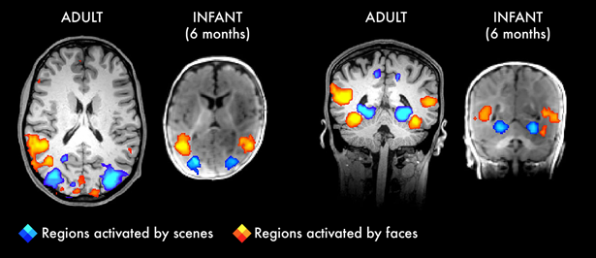
Newborn Brain Development: Neuronal Development
Most of the brain’s 100 to 200 billion neurons are present at birth, but they are not fully mature.
Each neural pathway forms thousands of new connections during infancy and toddlerhood (called blooming).
  By age 2, a single neuron might have thousands of dendrites.
  Neural pathways that are not used will be eliminated through a process called pruning.
    Pruning makes those neural pathways that are used form stronger connections.
    It is thought that pruning causes the brain to function more efficiently, allowing for mastery of more complex skills.
    Pruning continues through childhood and into adolescence in various areas of the brain.
Neural pathway development (blooming) and pruning is primarily found in the cortex (the thin outer covering of the brain involved in voluntary activity and thinking).
Video: Experiences Build Brain Architecture from The Center on the Developing Child at Harvard University discusses the importance of neuronal blooming.
The image on the right shows the cerebrum and corresponding activated areas when adults and 6-month-olds view pictures of scenes (blue areas) or faces (yellow/orange areas).
The image on the right shows the occipital lobe area and corresponding activated areas when adults and 6-month-olds view pictures of scenes or faces.
Note that while there is a bit more activation in the adult brain, the areas of activation are basically the same indicating that both adults and infants are processing this information in the same areas of the brain.
Text and Image from Lumen Learning, Lifespan Development, Module 4: Infancy, Physical Growth and Brain Development Licensed under CC BY 4.0

Slide 4
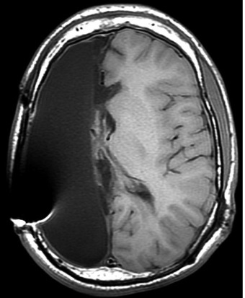
Newborn Brain Development: Neuroplasticity
Neuroplasticity refers to the brain’s ability to change and reorganize neural pathways to enhance its adaptability to environmental change and compensate for injury.
  The brain is especially “plastic” during infancy and childhood periods, because new neural connections are continuously being formed (remember, blooming).
  Many aspects of brain function remain plastic even into adulthood, however as we age, we have different degrees of neuroplasticity at different points in the lifespan. Consequently, the brain is far more plastic when we are younger than when we are older.
Video: “Brain Plasticity - The Story of Jody” looks at the question, “Can we live with half of our brain removed?,” and can brain plasticity (neuroplasticity) make up for that missing half of the brain?
Perpendicular view of brain following a hemispherectomy from National Library of Medicine National Center for Biotechnology Information. “Hemispherectomy in the Treatment of Seizures: A Review,” (2014) by Sean M. Lew. Public Domain.
Video: Hemispherectomy: Jody: Newschannel 2: 1997 briefly follows Jody as an adult.
Video: I Only Have Half a Brain - BBC Stories briefly follows Jody as an adult.

Slide 5
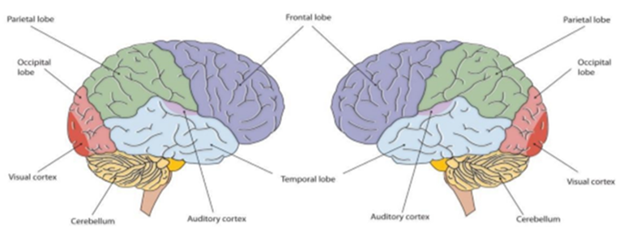
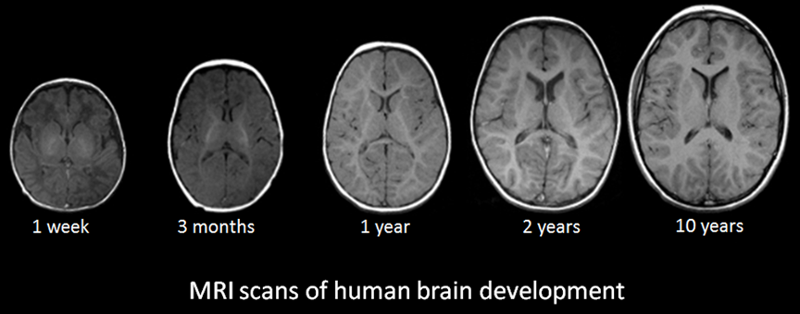
Newborn Brain Development: Hemispheric Growth
The newborn brain is approximately 33% of adult size at birth
By 3 moths of age the infant’s brain is already 55% of adult size
The brain is about 75 % its adult weight by three years of age
By age 6, the brain is 95% its adult weight.
  Two major brain spurts occur during middle/late childhood:
    Between 6 and 8 significant improvements in fine motor skills and eye-hand coordination can be found
    Between 10 and 12 years, the frontal lobes become more developed and improvements in logic, planning and memory are evident.
Although the brain grows rapidly during infancy, specific brain regions do not mature at the same rate.
    Primary motor areas develop earlier than primary sensory areas
    The prefrontal cortex develops primarily during adolescence and is not fully complete until around the age of 25
Video “How Baby Brains Develop” focuses more on brain development but does briefly discuss neuronal development.
Image “MRI Scans of Human Brain Development” is public domain
Above text and Image of Brain from Lifespan Development: A Psychological Perspective 2nd Edition by Martha Lally and Suzanne Valentine-French is licensed under CC BY-NC-SA 3.0

Slide 6
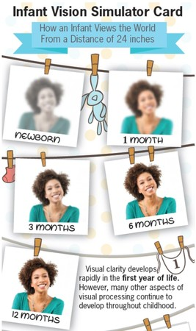
Development of the Sensory Systems: Vision
Vision is one of the most poorly developed senses at birth
Typically, a newborn cannot see further than 8 to 10 inches away from their faces.
  At 8-weeks old, visual acuity is 20/300
  At 3-months-old visual acuity is 20/200
Infant visual acuity is poor because the fovea, which contains the highest concentration of cones does not fully develop until 15 months.
Infants can see color, but the colors need to be high in contrast
Newborns prefer and orient to face-like stimuli more than other patterned stimuli
Text fromLifespan Development: A Psychological Perspective 2nd Edition by Martha Lally and Suzanne Valentine-French is licensed under CC BY-NC-SA 3.0
Image from Ohio Optometric Association, Worthington, Ohio 43085. Terms of use not restricted

Slide 7
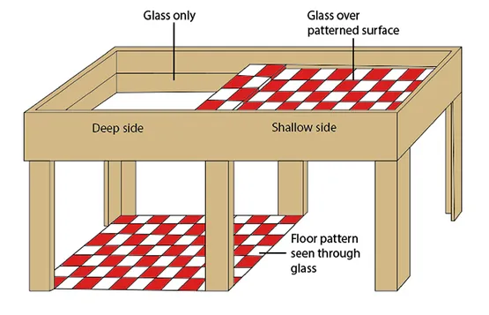
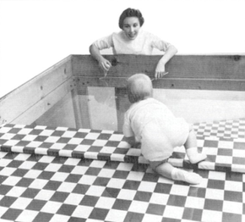
Development of the Sensory Systems: Binocular Vision and The Visual Cliff
Binocular Vision compares the input from both eyes to create the perception of depth, or stereopsis. By about the third month of development infants have binocular abilities, however binocular vision continues to develop through the 6th month.
Text from Lumen Learning, Boundless Psychology: Sensation and Perception. Licensed under CC BY SA 4.0.
Image from Russel, J. (2020, July 27). Visual cliff experiment. Simply Psychology. Licensed Under CC BY NC ND 3.0
Image from Wikipedia, Visual Cliff. Licensed under CC BY SA 3.0.
The image on the left is an illustration of the “visual cliff,” and the image on the right is from Gibson’s original work, “The Visual Cliff.”
Video: Gibson – Visual Cliff Experiments (Affordances) shows examples of the seminal work conducted by Gibson and Walk (1960), which tested infant depth perception development.

Slide 8
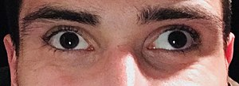
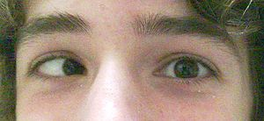
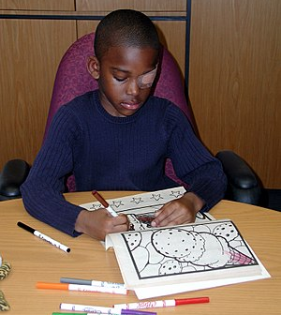
Development of the Sensory Systems: Vision Problems
Strabismus: A condition in which the eyes do not properly align with each other when looking at an object
Text from Wikipedia, Strabismus. Licensed under CC BY SA 3.0
A person with exotropia, an outward eye turn
A person with esotropia, an inward eye turn
Exotropia Image from Wikipedia, Strabismus. Licensed under CC BY SA 3.0
Esotropia Image from Wikipedia, Esotropia. Licensed under CC BY SA 3.0
Amblyopia (Lazy Eye): A disorder of sight in which the brain fails to process inputs from one eye and over time favors the other eye. It results in decreased vision in an eye that otherwise typically appears normal. Amblyopia is the most common cause of decreased vision in a single eye among children and younger adults.
A child wearing an adhesive eyepatch to correct amblyopia
Text and image to the right from Wikipedia, Amblyopia. Licensed under CC BY SA 3.0
Video: What is Amblyopia? While this video focuses on amblyopia, it also discusses strabismus. Please remember that while strabismus and amblyopia are different, strabismus can lead to amblyopia.

Slide 9
Development of the Sensory Systems: Vision Problems
Nearsightedness, also known as myopia, is an eye condition that causes blurry distance vision
  Large studies have identified more than 200 genes involved in nearsightedness, and additional studies are underway.
  Environmental and lifestyle factors also play an important part in nearsightedness. Much of the recent increase in the frequency of nearsightedness worldwide is likely related to spending less time outdoors and doing more "near work," such as reading, studying, and working on computers and handheld devices.
Farsightedness, also known as hyperopia, is an eye condition that causes blurry near vision.
  Few genes associated with the condition have been identified, and none of the identified genes appears to play a major role in the development of farsightedness.
  It is possible that environmental factors also contribute to a person's risk of being farsighted, but these have not been well-studied.
Astigmatism, Blurred vision caused by an abnormally curved cornea.
  Astigmatism is very common, but the cause of astigmatism is unknown. Frequently, astigmatism occurs together with nearsightedness and farsightedness.
Nearsightedness text Source: MedlinePlus, National Library of Medicine. Public domain.
Farsightedness text Source: MedlinePlus, National Library of Medicine. Public domain.
Astigmatism text Source: MedlinePlus, National Library of Medicine. Public domain.
Video: What is Myopia, Hyperopia, and Astigmatism? This video provides examples along with explanations for myopia, hyperopia, and astigmatism

Slide 10
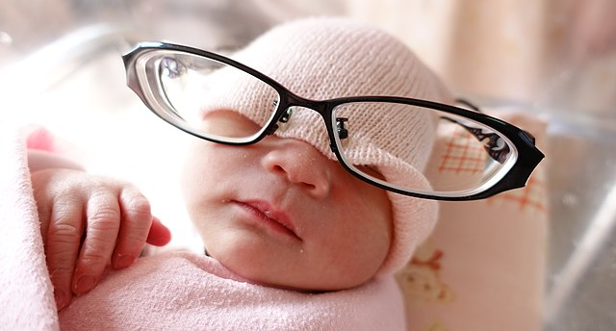
Development of the Sensory Systems: Vision Screening
All babies should have their eyes checked before being released from the hospital. (blink response to light, pupil response), ability to follow a target.
By 6 months of age infants should have eye alignment (cover and uncover test), eye focus, and eye health examined.
Between the ages of 3 and 4, children are old enough for the chart “type” eye tests that adults can take, however instead of using letters, images and symbols are used.
Video: Two-month Well Baby Check Up. This video show a 2-month-old getting a complete check-up; however, the first 5 minutes of the video shows the eye exam portion of the check-up.
Image from Wikimedia by Xiaoanan licensed under CC BY SA 4.0

Slide 11
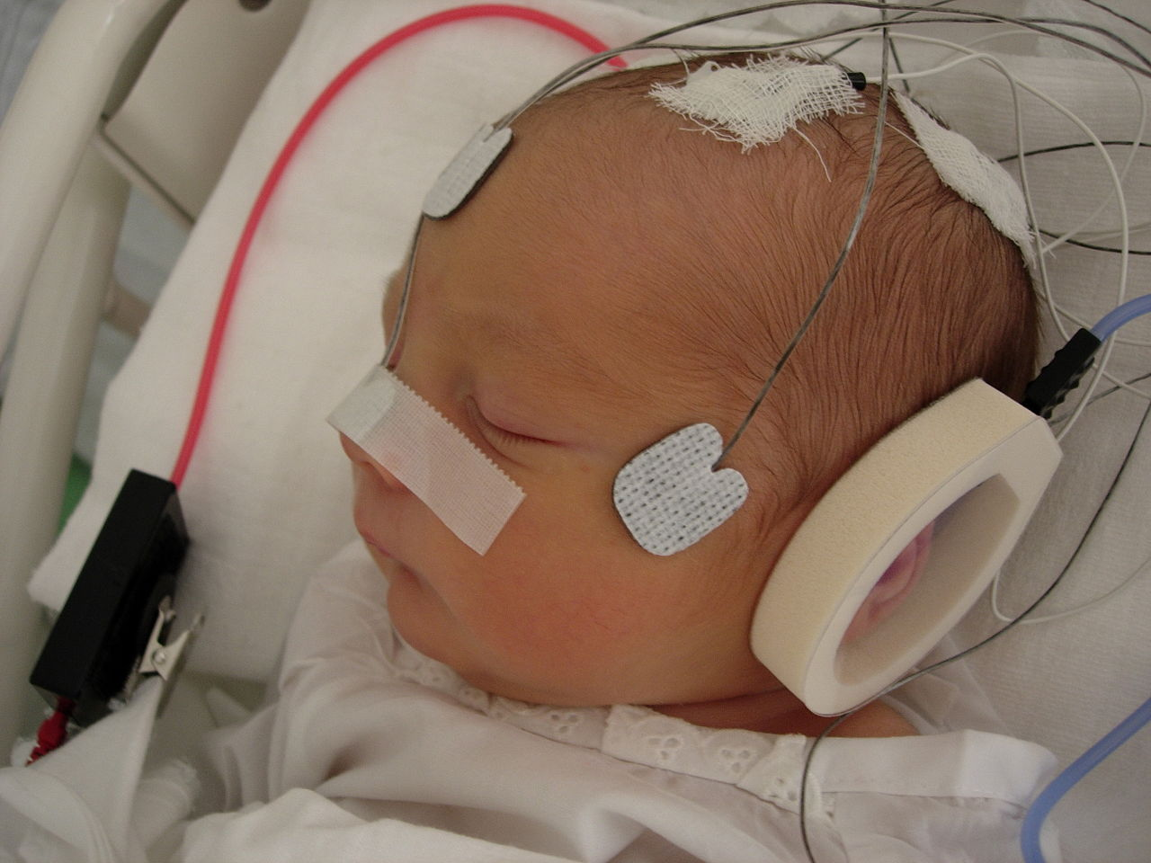
Development of the Sensory Systems: Hearing
Unlike the visual system the auditory system is functional several weeks before birth
By the age of 6 months, infants can respond to a broad range of sounds
Newborns prefer the voices of their own mothers to voices of unfamiliar females when speaking the same material and will register in utero specific information heard from their mother’s voice.
Infants distinguish between very similar sounds as early as one month of age and can distinguish between familiar and non-familiar voices.
Infants are sensitive to higher frequency sounds.
Between 6- and 9-months old infants show a preference for listening to their native language and the ability to distinguish sounds that are not heard diminishes.
A newborn infant detecting the beat in music. Source: Wikimedia, by Gabor Stefanics. Licensed under CC BY SA 3.0.
Video: How a Baby’s Hearing Changes as They Grow. This video not only discusses the physical development of hearing, but also looks at the role sound exposure plays in building the baby’s auditory system.
Text from Lifespan Development: A Psychological Perspective 2nd Edition by Martha Lally and Suzanne Valentine-French is licensed under CC BY-NC-SA 3.0

Slide 12
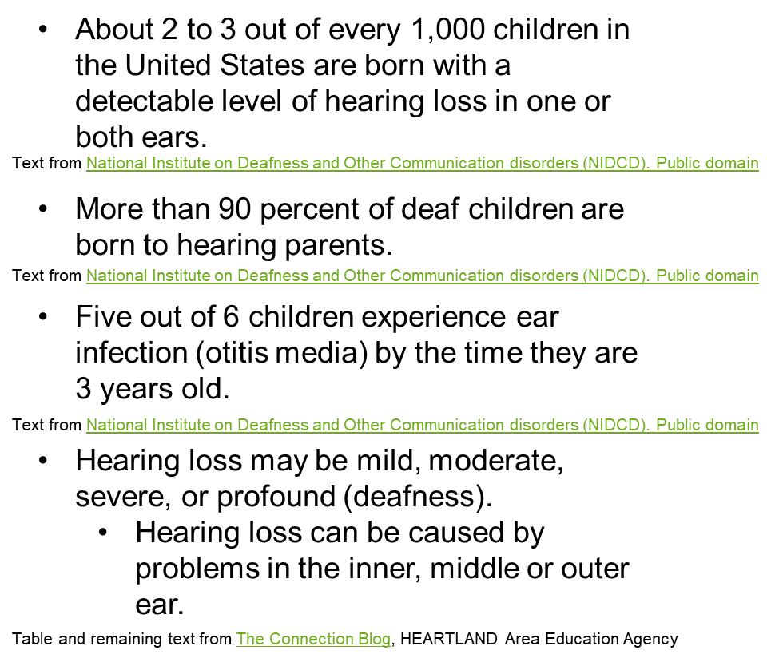
Development of the Sensory Systems: Hearing Loss
Part of the Ear | Possible Causes
Middle or Outer Ear | Birth defects Ear wax buildup
 | Fluid buildup behind the eardrum
 | Injury or rupture of the eardrum
 | Objects stuck in the ear canal
 | Infections to the eardrum
Inner Ear | Exposure to toxins or medicines while in womb or after birth Genetic Disorders Infections passed by Mom (measles or herpes Meningitis (inflammation of the membranes that surround and protect the brain and spinal cord. Problems with inner ear structure Tumors
Video: Infant Hearing Loss discusses how to detect hearing loss and what can be done if hearing loss is detected.

Slide 13
Development of the Sensory Systems: Cortical Deafness
Cortical deafness (central hearing loss) is a type of sensorineural hearing loss resulting from damage to the auditory nerve (the brain pathways that lead to the nerve), but there is no apparent damage to the structures of the ear. This disorder is rare in infants and children.
Symptoms of cortical deafness in infants and children include:
  A newborn baby may not startle when there is a loud noise nearby.
  Older infants, who should respond to familiar voices, may show no reaction when spoken to.
  Children should be using single words by 15 months, and simple 2-word sentences by age 2. If they do not reach these milestones, the cause may be hearing loss.
Text from The Connection Blog, HEARTLAND Area Education Agency

Slide 14
Development of the Sensory Systems: Screening for Hearing Loss
Two common hearing tests are used to screen newborns:
  Auditory Brainstem Response (ABR): Electrodes are used to determine if the cochlea is operating properly and sending signals to the brain.
    Video: Audiology: ABR Testing demonstrates how infants are tested using ABR
  Otoacoustic Emissions Test (OAE): Microphones are placed in the baby’s ear which detect sound. These sounds should echo in the ear canal. However, if no echo is measured, this is a sign of hearing loss.
    Video: Introducing Otoacoustic Emission (OAE) As a Newborn Screening Tool- Interacoustics Academy demonstrates the use of the OAE. This video also demonstrates ABR, which begins at timestamp 2:34 (later in the video).

Slide 15
Development of the Sensory Systems: Hearing Loss Treatment
Hearing Aids: Make sound louder and can be used for differing degrees of hearing loss in infants as young as one month.
Cochlear Implants: A small electronic device that consists of an external portion that sits behind the ear and a second portion that is surgically placed under the skin. Unlike a hearing aid, which amplifies sound, the cochlear implant stimulates the auditory nerve which sends signals that the brain recognizes as sound.
Assistive Listening Devices (ALD’s): Any device that helps amplify the sounds you want to hear, especially where there’s a lot of background noise. ALD’s can be used with a hearing aid or cochlear implant to help a wearer hear certain sounds.
Augmentative and Alternative Communication (AAC) Devices: Help people with communication disorders to express themselves. These devices can range from a simple picture boards to a computer program that synthesizes speech from text.
From National Institute on Deafness and Other Communication Disorders (NIDCD). Public domain
Text from U.S. Department of Health & Human Services, National Institutes of Health, National Institute on Deafness and Other Communication Disorders (NIDCD), Cochlear Implants. Public domain
From U. S Department of Health and human Services, National Institutes of Health, National Institute on Deafness and Other Communication Disorders. NICD Fact Sheet: Assistive Devices for People with Hearing, Voice, Speech, or Language Disorders. Public domain
From U. S Department of Health and human Services, National Institutes of Health, National Institute on Deafness and Other Communication Disorders. NICD Fact Sheet: Assistive Devices for People with Hearing, Voice, Speech, or Language Disorders. Public domain
Video:1 Hearing Services for Children- Boys Town National Research Hospital (scroll down a bit when you get to the site), discusses and demonstrates hearing tests and hearing aids for infants and children.
Video 2: The Road to Hearing for Baby Aida discusses how baby Aida, born deaf is fitted with cochlear implants.

Slide 16
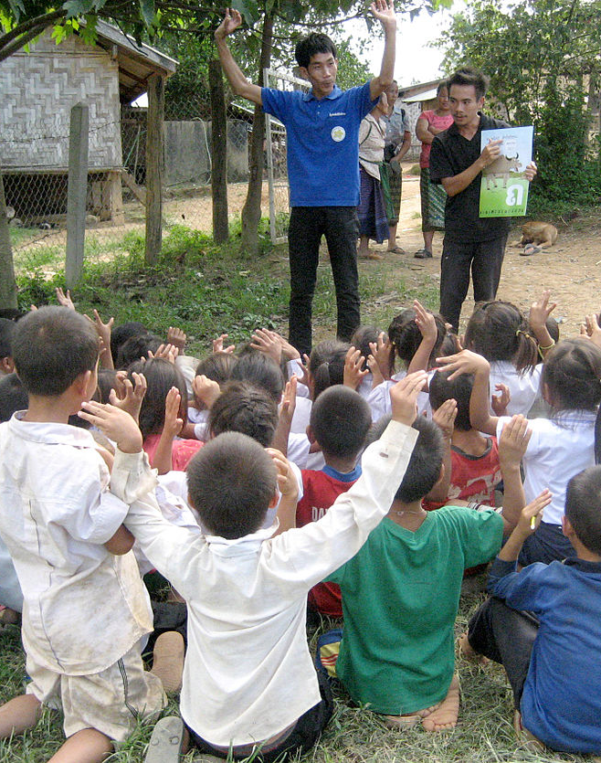
Development of the Sensory Systems: Learning to Communicate
Auditory-oral and auditory-verbal options combine natural hearing ability and hearing devices, such as hearing aids and cochlear implants, with other strategies to help children develop speech and English-language skills. Auditory-oral options use visual cues such as lipreading and sign language, while auditory-verbal options work to strengthen listening skills.
Signed English is a system that uses signs to represent words or phrases in English. Signed English is designed to enhance the use of both spoken and written English.
American Sign Language (ASL) is a language used by some children who are deaf and their families and communities. ASL has its own grammar and has no written form.
Combined options use portions of the various methods listed above. For example, some deaf children who use auditory-oral options also learn sign language. Children who use ASL also learn to read and write in English. Combined options can expose children who are deaf or hard-of-hearing to many ways to communicate with others.
Text below and Image above from Wikipedia. Licensed under CC BY SA 3.0
Video: Communication Options for Children Who are Deaf or Hard of Hearing, explains in more detail most of the above ways to communicate. The portion of the video applicable to this page ends at timestamp 7:50. There is also a video on hearing aids that follows.
Young students learn some words of Lao sign language from Suliphone, a deaf artist. This was one of several activities at a school, book party sponsored by Big Brother Mouse, a literacy project in Laos where Suliphone works.
Text from U. S Department of Health and human Services, National Institutes of Health, National Institute on Deafness and Other Communication Disorders. Your Baby’s Hearing Screening. Public domain.

Slide 17
Development of the Sensory Systems: Touch and Pain
Newborns are comforted by touch and being swaddled.
While no benefits for normal full-term infants have been clearly demonstrated using massage, there is evidence that premature babies who are massaged have improved weight gain and leave the NICU quicker.
However, massaging your child gently may,
  Help the infant relax and sleep
  Reduce crying
  Encourage bonding
Newborns can feel pain.
  Repeated exposure to pain can result in emotional problems and lead to stress.
  Holding or swaddling the infant during a procedure or even breastfeeding during a procedure helps reduce the potential trauma of the situation.
Text from U. S. Department of Health and Human Services, National Institutes of Health. National Center for Complementary and Integrative Health. Massage Therapy: What You Need to Know. Public domain.
Video 1: Step-by-step Guide to Massaging Your Baby provides simple instructions for how to an infant massage.
Video 2: From the Minds of Babes: New Frontiers in Pediatric Pain discusses how up until the 1980’s many believed that infants, especially newborns did not process and feel pain like children and adults.

Slide 18
Development of the Sensory Systems: Taste
Foods that are sweet appear to be innately preferred by most or all herbivores and omnivores.
A sensitivity to and preference for salty tasting substances also appears to have an innate component that develops at around 4 months.
  By 2 years of age, children’s preferences for salty foods are even greater than they are for adults.
Flavor senses are well developed at birth and continue to change throughout childhood and adolescence.
Foods that are bitter will often trigger a negative response in newborns and infants.
Genetic variation in the ability to taste bitter compounds may have important implications as a marker for dietary patterns and chronic health in children.
  Few children have a higher liking for bitter taste and consume bitter foods.
  Those children who are unable to taste bitter tend to consume more dietary fat and are prone to obesity.
Video: The Taste of Babies: Sweet & Bitter/Breast & Bottle discusses research on taste differentiation in babies.
Text from U.S. National Library of Medicine. Beauchamp, G. K., & Mennella, J. A. (2011). Flavor Perception in Human Infants: Development and Functional Significance. Public domain.

Slide 19
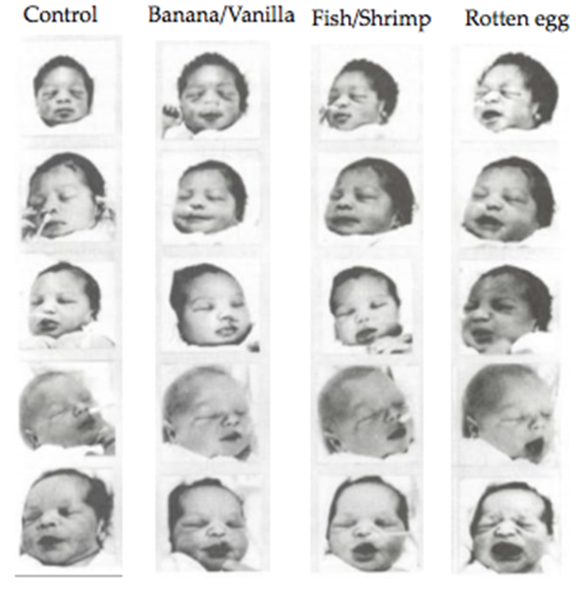
Development of the Sensory Systems: Smell
At 6 days old infants will preferentially turn their heads to the smell of their own mother’s breast pad over that of another baby’s mom indicating that at birth infants have a memory for olfaction.
The image on the right is from Jacob Steiner’s seminal work which showed that the smells which are pleasing to most adults, and smells which are aversive to most adults are also pleasing or aversive in the same way to newborns. For example, notice the unpleasant look on the faces of the newborns when given the smell of rotten eggs.
Video: Using a Babies Sense of Smell to Make them Less Anxious with Strangers: Discusses research that demonstrates having babies hold their Mom’s t-shirt made them less anxious. Note: The discussion of this study ends at timestamp 2:19
Image from Steiner, Jacob E. (1977) Human Facial Expressions in Response to Taste and Smell Stimulation. Advances in Child Development and Behavior Volume 134, pages 257-295
Odor preferences measured using facial expressions of 3 to 8-hour-old infants in response to some food related odors.

Slide 20
Physical Development: Overall Physical Growth
The average newborn weighs approximately 7.5 pounds (healthy birth weight is between 5 lbs. 8 oz. and 8 lbs.).
  Over the first few days of life, infants typically lose about 5% of they body weight.
By 4 months the infant doubles in weight and by one year has tripled the birth weight.
The average length of a newborn is 19.5 inches, increasing to 29.5 inches by 12 months and 34.4 inches by 2 years old
At birth, the head makes up about 25 percent of a person’s length, and by adulthood, the head comprises about 15 percent of a person’s length.
Growth is influenced by two major trends:
  Cephalocaudal Development: Development from head to toe (for example, infants will be able to control their head movements before torso movements)
  Proximodistal Development: From the midline outward (for example, infants will have control over the whole hand before individual fingers.
Two hormones that are very important to the growth process:
  Human Growth Hormone (HGH): Influence all growth except that of the Central Nervous System (CNS) (the brain and the spinal cord.)
  Thyroid Stimulating Hormone: The hormone that influences growth in the CNS
Text from Child Growth and Development: An Open Educational Resources Publication by College of the Canyons by Jennifer Paris, Antoinette Ricardo, and Dawn Richmond is licensed under CC BY 4.0

Slide 21
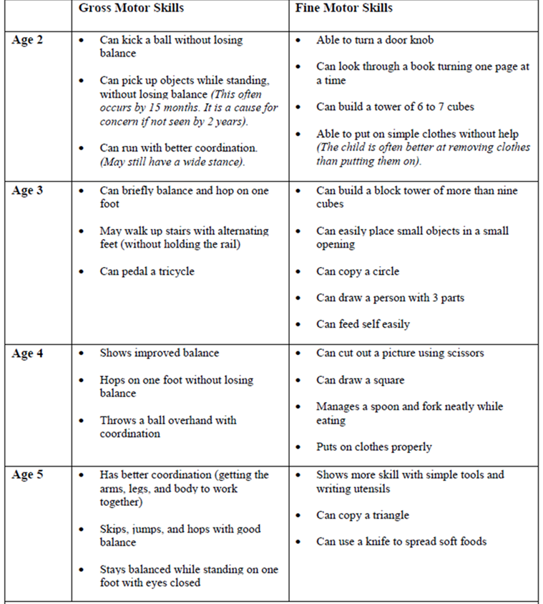
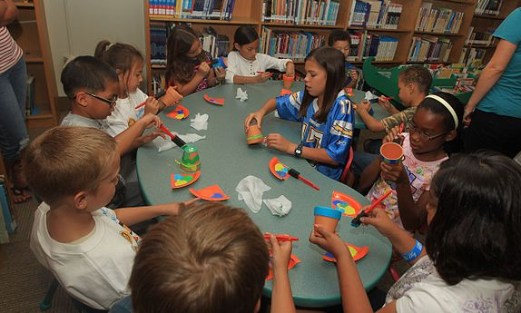
Motor Development: Gross and Fine Motor Skills
Two basic forms of motor skills are:
  Gross motor: skills that involve the large muscle groups of the body—for example, the legs and arms.
  Fine motor: skills that involve small movements, mostly of the hands and fingers, but also of the lips and tongue.
Children Playing at the Lifelong Learning Library by Lance Cpl. Ali Azimi from Wikimedia is licensed under Public Domain
Video: EYFS – Physical Development – Fine Motor Skills: While this video is subtitled, “Fine Motor Skills,” can we really separate gross and fine motor skills? This is discussed in the video.
Chart Courtesy of MedlinePlus from the National Library of Medicine (NLM). Public domain.

Slide 22
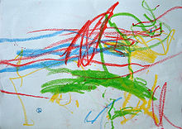
Physical Development: Children’s Art
Transformation of Children’s Artwork
Scribbling | From 2 to 4 years | Begins with about 20 different scribbles (random scribbling). By age 3 begin to use basic structure of scribbles to create shapes (controlled scribbling). By age 4 creating images that are recognizable. Provides a chance to move their arms freely and is imaginative. Will choose their favorite colors to scribble.
Pre-Schematic | From 3 to 7 years | Produces first representative symbols. Begins to draw lines, and simplistic shapes like circles and squares.
Schematic | From 6 to 11 years | Consistent and repeated symbols are used for objects like the “scarecrow” drawings of people and drawings of houses will al look the same.
Transitional | From 9 to 12 years | Colors become more realistic, and artwork looks more from an adult perspective. Gender roles are defined using clothing, and accessories.
Realism | 12 years and older | The child becomes more self-critical of his or her drawings and
One-year-old’s scribble from Wikipedia. Licensed under CC BY SA 3.0
Video: Development of Drawing in Young Children compares the work of three researchers and what they observed in the drawings of children.
Text from Lifespan Development: A Psychological Perspective 2nd Edition by Martha Lally and Suzanne Valentine-French is licensed under CC BY-NC-SA 3.0 (modified by Maria Pagano)

Slide 23
Physical Development: Sports
According to the National Alliance for Youth Sports (NAYS), approximately 65% of children worldwide are involved in sports activities.
  55% of American children are involved in sports
Research conducted by Felfe, Lechner, and Steinmayr (2016) revealed that when compared to children who were physically inactive, children who participated in sports
  had lower resting heart rates
  did better in school
  had parents who rated their health as significantly better than those parents whose children did not participate in sports
  were less hyperactive
  had fewer peer, emotional, behavioral or conduct problems
  expressed less antisocial behavior
  In the United States 8 million, 3rd to 12th grade girls and 13 million boys play sports.
    Gender equality for children was better in rural and suburban areas than in urban areas.
    Social class contributes to differences in gender participation
      Half of low-income parents agreed that their schools and communities were not meeting the needs of girls.
Above text adapted from Felfe, C., Lechner, M., & Steinmayr, A. (2016). Sports and Child Development. PloS one, 11(5), e0151729. From U.S National Library of Medicine, national Institutes of Health. Public domain
From Wikipedia, Gender in Youth Sports. Licensed under CC BY SA 3.0

Slide 24
Physical Development: Childhood Obesity
The measurement for determining excess weight is the Body Mass Index (BMI) which expresses the relationship of height to weight. According to the Centers for Disease Control and Prevention (CDC), children whose BMI is at or above the 85th percentile for their age are considered overweight, while children who are at or above the 95th percentile are considered obese.
Excess weight and obesity in children is associated with a variety of medical and cognitive conditions including high blood pressure, insulin resistance, inflammation, depression, and lower academic achievement.
  Being overweight has also been linked to impaired brain functioning, which includes deficits in executive functioning, working memory, mental flexibility, and decision making.
  Children who ate more saturated fats performed worse on relational memory tasks, while eating a diet high in omega-3 fatty acids promoted relational memory skills.
  A growing concern is the lack of recognition from parents that children are overweight or obese. Katz (2015) referred to this as “oblivobesity.”
Children who are overweight tend to be rejected, ridiculed, teased and bullied by others.
Behavioral interventions, including training children to overcome impulsive eating behaviors, are being researched to help overweight children.
Video: Obesity in Children: Discusses the rise of childhood obesity since 1988
Lifespan Development: A Psychological Perspective 2nd Edition by Martha Lally and Suzanne Valentine-French is licensed under CC BY-NC-SA 3.0

Slide 25
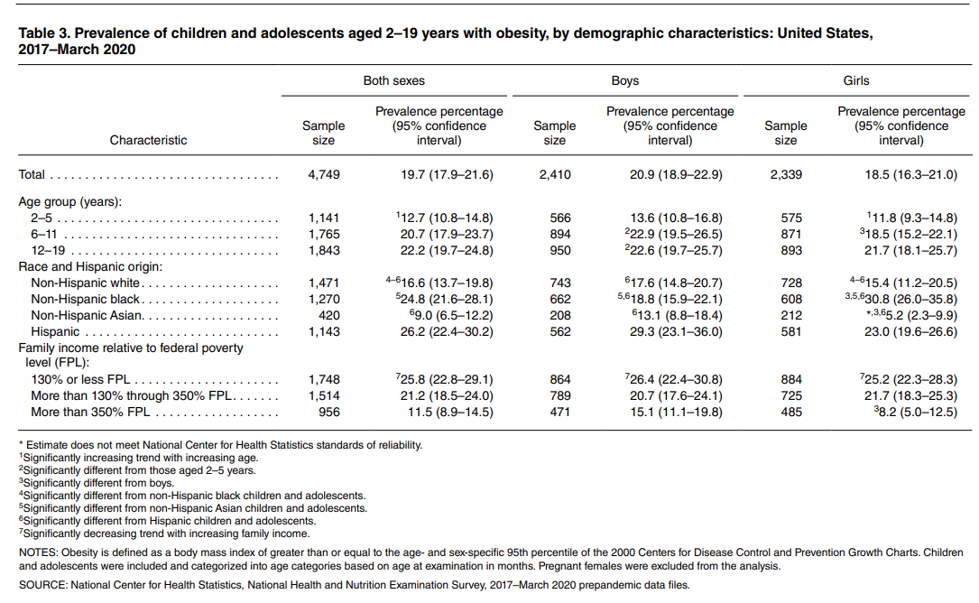
Physical Development: Childhood and Adolescent Obesity Statistics in the United States
Childhood obesity is a serious problem in the United States, putting children and adolescents at risk for poor health. According to the CDC: (data are for years 2017 to 2020 and for children and adolescents aged 2-19 years)
The prevalence of obesity was 19.7% and affected about 14.7 million children and adolescents.
  Obesity prevalence was 12.7% among 2- to 5-year-olds, 20.7% among 6- to 11-year-olds, and 22.2% among 12- to 19-year-olds.
Childhood obesity is also more common among certain populations.
  Obesity prevalence was 26.2% among Hispanic children, 24.8% among non-Hispanic Black children, 16.6% among non-Hispanic White children, and 9.0% among non-Hispanic Asian children.
FPL is defined as A measure of income issued every year by the Department of Health and Human Services (HHS). The FPL is based on family size and income, and the higher the percentage, the more income a family has, and the lower the percentage the less income a family has.
Text and Table from U.S. Centers for Disease Control and Prevention . Public domain

