Slide 1
Prenatal Development
Chapter 4

Slide 2
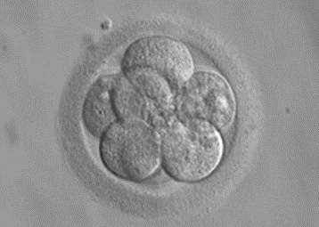
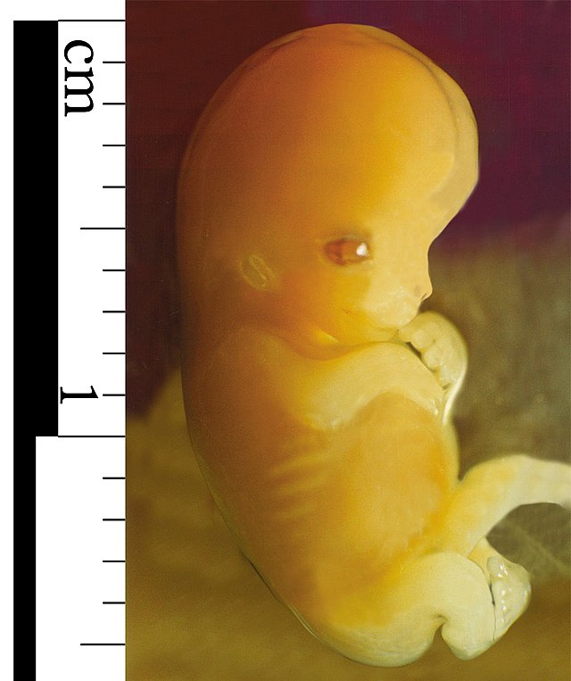
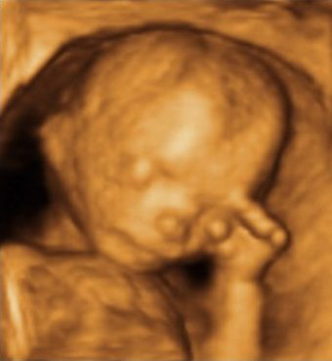
The Three Stages of Prenatal Development
What is Prenatal Development? – The development of an organism before birth that begins at conception and ends with the birth of the newborn.
  The three stages of prenatal development:
    The Germinal Stage that begins at fertilization and ends at week 2 of prenatal development. (note: the germinal stage is often called the Zygote Stage)
    The Embryonic Stage begins at the start of week 3 and ends at week 8 of prenatal development.
    The Fetal stage begins at the start of week 9 and ends with the birth of the newborn (somewhere between week 38 and week 40)
Video: Stages of Prenatal Development (you need to scroll down a little to find the video), provides a brief overview of the three stages of prenatal development.
Germinal Stage
Conception to 2 weeks
Embryonic Stage
3 to 8 weeks
Fetal Stage
3 to 8 weeks
Eight-cell zygote, at three days
Image of zygote from Wikipedia. Licensed under CC BY SA 3.0
Image of embryo from Wikimedia Commons. Licensed under CC BY SA 3.0
Echography of 12-week-old fetus
Image of fetus from Wikimedia Commons. Licensed under CC BY SA 3.0
Embryo 7 Weeks after Conception

Slide 3
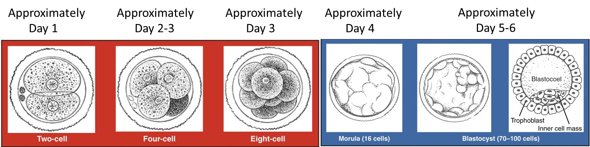
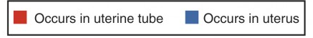
The Three Stages of Prenatal Development: The Germinal Stage (Fertilization to 2 weeks)
  Fertilization occurs when a sperm and an oocyte (egg) combine and their nuclei fuse.
  This new single cell called a zygote, contains all the genetic material needed to form a human, with half the genetic information coming from mom and half coming from dad.
Video: Fertilization (Conception) while quite good, has the words “Sample Use Only” on the screen (which can be a little annoying).
Image from OpenStax CNX Anatomy & Physiology licensed under CC BY 4.0

Slide 4
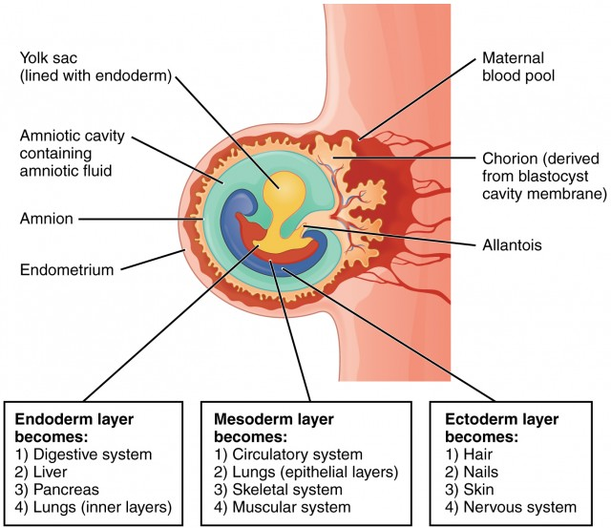
The Three Stages of Prenatal Development: Embryonic Period (Week 3 to 8)
Beginning around the third week, the blastocyst implants in the uterine wall. This begins the embryonic period which will end at the start of week 9.
  During this time cells continue to differentiate, and embryogenesis begins.
    Embryogenesis is the process of cell differentiation which begins when the blastocyst divides into three different cell layers, the endoderm layer, the mesoderm layer, and the ectoderm layer.
Video: Embryo Forms: Weeks 4 to 8 of Pregnancy While this video was created for expecting parents, it still provides an excellent presentation of development during the embryonic period.
In the third week, embryonic cells of the ectoderm, mesoderm, and endoderm begin to migrate and differentiate into the cell lineages that will give rise to mature organs and organ systems in the infant.
Image and text explanation from OpenStax CNX Anatomy & Physiology licensed under CC BY 4.0

Slide 5
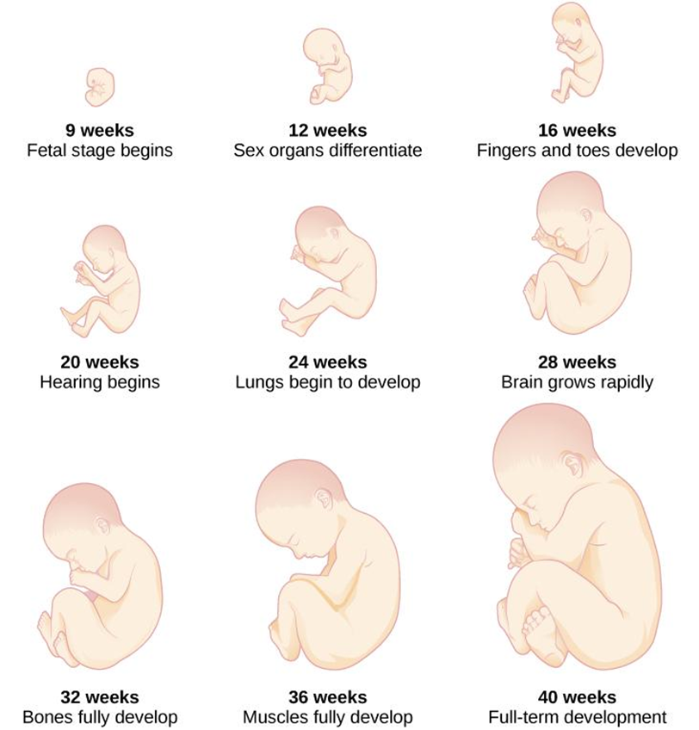
The Three Stages of Prenatal Development: Fetal Period (Week 8 until Birth)
Week 9
Nipples and hair follicles form.
All baby's essential organs have begun to grow.
Week 10
Your baby's eyelids are more developed and begin to close.
The outer ears begin to take shape.
Baby's facial features become more distinct.
Weeks 11 - 14
Your baby's eyelids close and will not reopen until about the 28th week.
Nails appear on the fingers and toes.
Genitals appear.
Tooth buds appear for the baby teeth.
Weeks 15 - 18
At this stage, baby's skin is almost transparent.
Fine hair called lanugo develops on baby's head.
The liver and pancreas produce secretions.
Your little one now makes sucking motions.
Weeks 19 - 21
Your baby can hear..
The mother may feel a fluttering in the lower abdomen. This is called quickening, when mom can feel baby's first movements.
By the end of this time, baby can swallow.
Week 22
Meconium, baby's first bowel movement, is made in the intestinal tract.
Eyebrows and lashes appear.
Baby's heartbeat can be heard with a stethoscope.
Weeks 23 - 25
Bone marrow begins to make blood cells.
The lower airways of the baby's lungs develop.
Your baby begins to store fat.
Week 26
Your baby may startle in response to loud noises.
Footprints and fingerprints are forming.
Air sacs form in baby's lungs, but lungs still aren't ready to work outside the womb.
Weeks 27 - 30
Your baby's eyelids can open and close.
The respiratory system, while immature, produces the substance that helps air sacs fill with air.
Weeks 31 - 34
Rhythmic breathing occurs, but baby's lungs are not fully mature.
Baby's bones are fully developed but are still soft.
Weeks 35 - 37
Baby weighs about 5 1/2 pounds.
Your baby keeps gaining weight, but probably won't get much longer.
Baby has definite sleeping patterns.
Muscles and bones are fully developed.
Week 38 - 40
Head hair is now coarse and thicker.
In your 40th week of pregnancy, it's been 38 weeks since conception, and your baby could be born any day now.
Image by CNX Psychology is licensed under CC BY 4.0
Video: Prenatal Development: What Babies Learn in the Womb highlights some of the major developmental milestones of each stage of prenatal development. The fetal stage begins at timestamp 2:04.

Slide 6
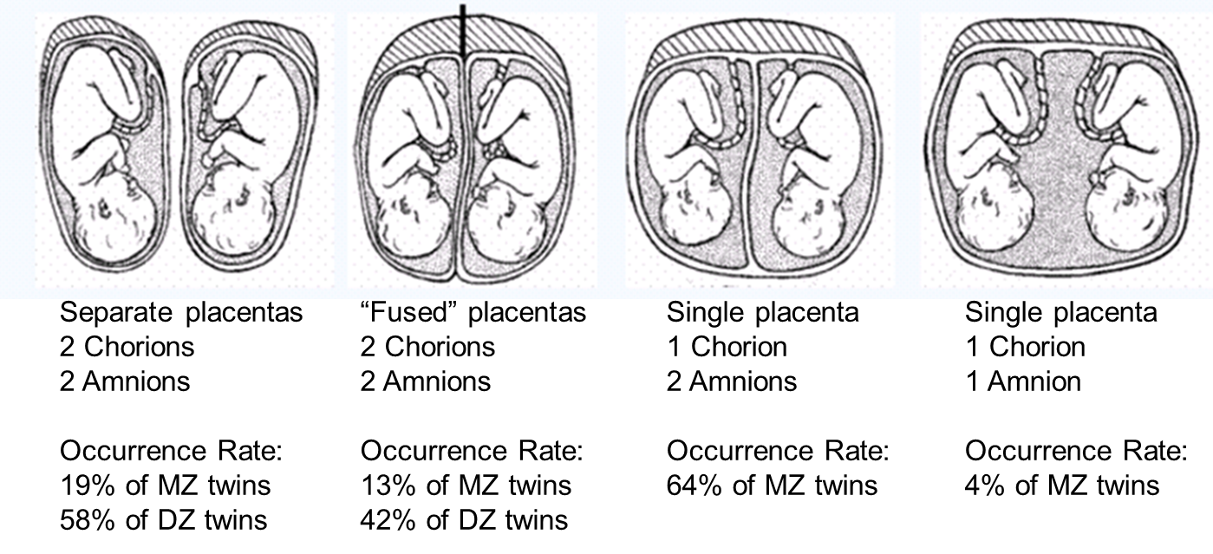
Monozygotic and Dizygotic Twins
Monozygotic (Identical) Twins: Occur when a single fertilized ovum splits in two.
  Share the same genotype, and often the same phenotype.
Dizygotic (Fraternal) Twins: Occurs when two separate ovum are fertilized.
  Will have a different genotype and phenotype.
Video: Monochorionic (1 chorion) vs Dichorionic (2 chorions) Twin Pregnancy discusses how the two different types of twinning occur, and the different types of chorion, amnion, and placenta development occur.
Image and accompanying text from Twins Research Australia, which is a national resource supported by a Centre of Research Excellence Grant from the national Health and Medical Research Council and housed within the University of Melbourne. The image and link are no longer available on the page and no copyright information can be found.

Slide 7
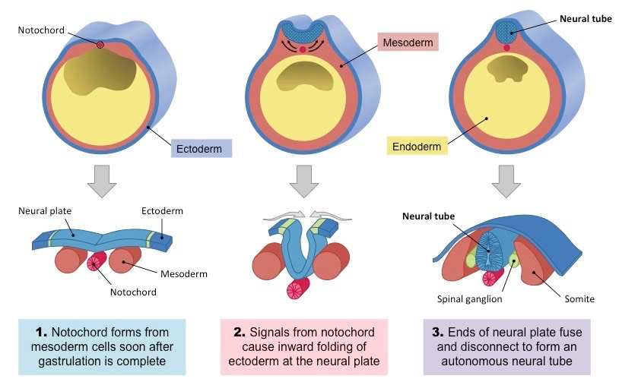
Prenatal Brain Development: Neurulation
All tissues are derived from three initial germ layers (ectoderm, mesoderm, endoderm) formed via gastrulation.
In chordates, a flexible notochord will develop during gastrulation and lead to the subsequent formation of a neural tube
The formation of a neural tube in embryonic chordates occurs via the process of neurulation
Cells located in the outer germ layer (ectoderm) differentiate to form a neural plate
The neural plate then bends dorsally, folding inwards to form a groove flanked by a neural crest
The inward folded groove closes off and separates from the neural crest to form the neural tube
The neural tube will elongate as the embryo develops and form the central nervous system (brain and spinal cord)
The cells of the neural crest will differentiate to form the components of the peripheral nervous system
Videos: If you need just a bit more help in understanding neurulation, then the first 3 minutes of this 6-minute video, Step 1: Neuroscience: Development of the CNS is for you (the remainder of the video discusses neural tube defects. However, for a bit more help, the video,, Neurulation – Neural Tube formation – Third Week Embryology should do the trick. Like the first video, the second half of the second video also discusses neural tube defects.
Image and text adapted from Cornell, B. 2016 from BioNinja which is a free source

Slide 8
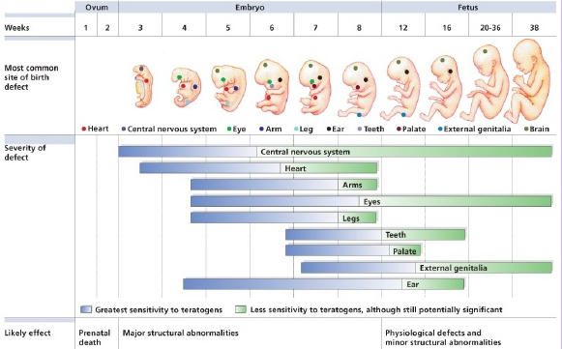
Teratogens
Teratogens: Any environmental substance that can produce physical defects in the human embryo or fetus.
The timing and amount of exposure, the number of teratogens exposed to, and genetic make-up will affect both the type and amount of damage.
There are 4 categories of teratogens:
  Physical Teratogens
  Metabolic Conditions
  Infections
  Drugs and Chemicals
Text from The Embryo Project Encyclopedia by Chanapa Tantibanchachai. Licensed under CC BY-NC-SA 3.0
Video: Harmful Teratogens – Intro to Psychology
Image from ETE 210 Human Development by Katherine Diener. No licensing information provided.

Slide 9
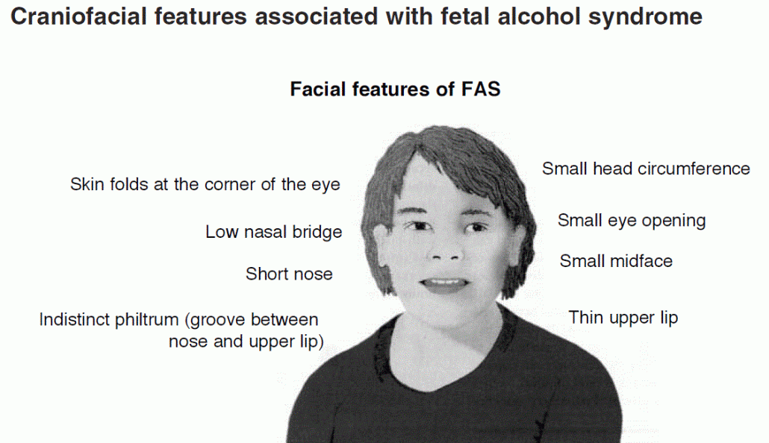
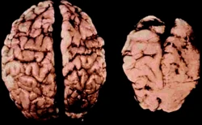
Teratogens: Fetal Alcohol Spectrum Disorders
Fetal Alcohol Spectrum Disorder (FASD) describes a continuum of permanent birth defects caused by maternal consumption of alcohol during pregnancy, which includes, but is not limited to Fetal Alcohol Syndrome (FAS).
The physical features of FASD can vary widely within one individual exposed to prenatal alcohol, however newborns with FASD typically exhibit the following:
  Growth deficiency
  Craniofacial abnormalities
  Central Nervous System Damage
Video: Fetal Alcohol Disorders are More Common than You Think from PBS News Hour looks at the rise in FASD across the United States.
Text and image of FAS brain from wikia.org Psychology Wiki Fetal Alcohol Spectrum Disorder. Licensed under CC BY SA 3.0
Image “Craniofacial Features Associate with Fetal Alcohol Syndrome” from Alcohol-Related Birth Defects, The Past, Present and Future by Kenneth R. Warren Ph.D and Laurie L. Foudin, Ph.D. Found at National Institute on Alcohol Abuse and Alcoholism.
The brains of two six-week-old infants. The left brain is normal, while the right brain is of an infant with FAS. The photograph is from the clinic of Dr. Sterling Clarren of the University of Washington.

Slide 10
Maternal Factors That Effect The Outcome of a Pregnancy
Age of Mom:
  Woman over the age of 35 are likely to have an increased risk of diabetes, miscarriages, premature birth, and having a child with a genetic disorder or birth defect.
  Teenage mothers are at higher risk for anemia and high blood pressure, especially if the mom is under the age of 15. Infants born to teenage moms have a higher risk for being premature and low birthweight.
Gestational Diabetes: Approximately 7% of pregnant women will develop diabetes. If untreated, gestational diabetes can cause premature birth, stillbirth, jaundice, and low blood sugar.
High Blood Pressure: Can lead to premature birth, low birth weight, and placental abruption.
Rh Disease: Can lead to jaundice, anemia, heart failure, brain damage and death.
Weight Gain or Loss:
  Women who gain too little weight risk giving birth to a child who is low-birth weight.
  Women who gain too much weight could have a premature infant or an overweight infant.
Stress: Can lead to premature birth, or low birthweight.
Depression: Can lead to premature birth, low birthweight, less newborn activity and attentiveness. Women taking antidepressants during pregnancy risk giving birth to a child with birth defects.

Slide 11
Paternal Factors That Effect The Outcome of a Pregnancy
Research looking at the influence of what paternal factors might influence prenatal development have found:
  If paternal educational was high school or less there was a significantly greater risk of preterm birth.
  Increased paternal age was related to low birthweight births.
  Obese fathers were at greater risk of having children born with low birthweight, even when the mother was not obese.
When Dad was absent or was not involved with the pregnancy:
  Infants' birthweight was lower.
  Infant mortality rates during the first year of life were nearly 4 times higher.
  More maternal complications like anemia and high blood pressure were found.

Slide 12
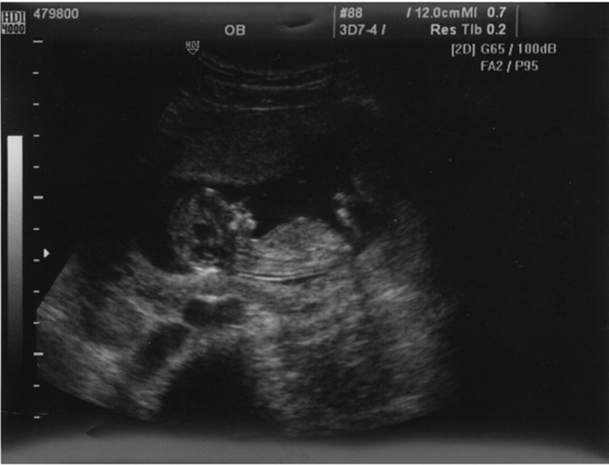
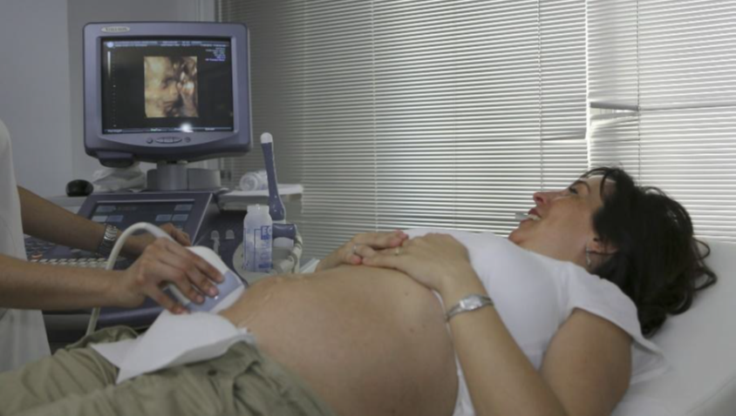
Prenatal Assessment: Ultrasound
Ultrasound: Sound waves that are converted to a two-dimensional image and can be used to examine the fetus for defects or other problems.
Image by MedicalPrudens is licensed under CC0 1.0
Video: When and Why Pregnancy Ultrasound are Done Narrated by Dr. Charlene Emmanuel an OB-GYN at New York-Presbyterian Hospital
Ultrasound image of 12-week-old fetus. (credit: Margaret W. Carruthers, Flickr) from College Physics Open Stax. Licensed under CC BY 4.0.

Slide 13
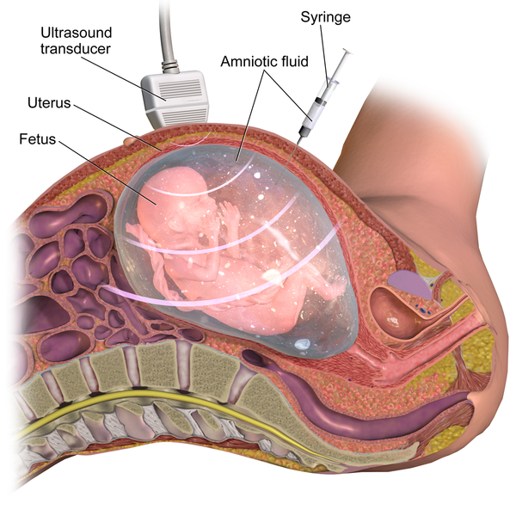
Prenatal Assessment: Amniocentesis
Amniocentesis is a medical procedure used in the prenatal diagnosis of chromosomal abnormalities, fetal infections and sex determination.
During an ultrasound a small amount of amniotic fluid, which contains fetal tissues, is sampled from the amniotic sac and the fetal DNA is then examined for genetic abnormalities.
The most common reason to have an amniocentesis performed is to determine whether a fetus has certain genetic disorders or a chromosomal abnormality.
An amniocentesis is performed when a woman is between 15- and 20-weeks gestation. Women who choose to have this test are primarily those at increased risk for genetic and chromosomal problems, in part because the test is invasive and carries a small risk of miscarriage.
Video: Amniocentesis (Amniotic Fluid Test). This 3D medical animation show an amniocentesis procedure.
Text and image from Wikipedia. Licensed under CC BY SA 3.0. Text Modified by Maria Pagano

Slide 14
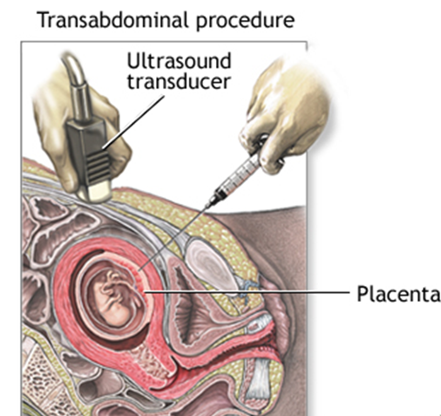
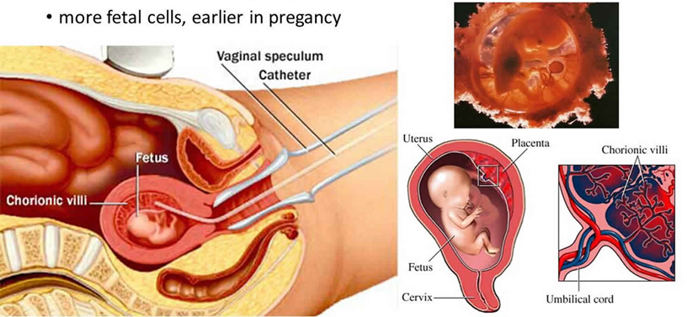
Prenatal Assessment: Chorionic Villus Sampling (CVS)
Chorionic Villus Sampling (CVS), can be done through the through the belly (transabdominal) and is like an amniocentesis, or via the cervix (transcervical). However, miscarriage rates are slightly higher when the test is done transcervically.
Transcervical Procedure
The transabdominal procedure is performed by inserting a needle through the abdomen and uterus and into the placenta
The transcervical procedure is performed by inserting a thin plastic tube through the vagina and cervix to reach the placenta where sample villi are collected. The transcervical procedure collects more fetal cells than the transabdominal procedure and can be done earlier in the pregnancy
Text: Courtesy of MedlinePlus from the National Library of Medicine
Transcervical procedure image courtesy of Health JADE as fair use
Transabdominal procedure image courtesy of MedlinePlus from the National Library of Medicine
Video Amniocentesis vs Chorionic Villus Sampling Note: At timestamp 5:22 the video goes over examples in the form of test questions,

Slide 15
Complications of Pregnancy: Minor and Major Complications
Minor Complications | Major Complications
Nausea | Spontaneous Abortion: Typically occurs due to chromosomal abnormalities and before the 12th week of pregnancy.
Heartburn | Ectopic Pregnancy: The zygote becomes attached to the fallopian tube before reaching the uterus.
Gas | Hyperemesis Gravidarum: Severe nausea, vomiting and weight loss While there is no known cause, risk factors include first pregnancy, multiple pregnancy, prior family history of HG, trophoblastic disorder, and a history of eating disorder
Constipation and Hemorrhoids | Preeclampsia: High Blood Pressure The most common complication of pregnancy. Occurs most frequently in first pregnancies, and is more common in women who are obese, diabetic, or are carrying twins.
Backache | Maternal Mortality: According to the Centers for Disease Control (2019) about 700 American women die from complications related to pregnancy. Contributing factors include, bleeding, infections, and heart-related problems.
Leg Cramps
Shortness of Breath
Varicose Veins
Video: The Most Common Pregnancy Complications – Causes, Symptoms and Treatments.
Text from Lifespan Development: A Psychological Perspective by Martha Lally and Suzanne Valentine-French is licensed under CC BY-NC-SA 3.0 Modified by Maria Pagano for Table presentation.

Slide 16
Infertility: Causes
Infertility: When a couple has failed to conceive a child after one year (6 months if the woman is 35 or older) of trying.
Female factors (approximately 1/3 of cases) involved in infertility include:
  Failure to ovulate
  Pelvic Inflammatory Disease (an infection of a woman’s reproductive organs)
  Polycystic Ovary Syndrome (a hormonal imbalance that effects the development and/or release of the ovum)
  Fibroids (abnormal growths that develop in or on a woman’s uterus)
Male factors (approximately 1/3 of cases) involved in infertility include:
  Lack of sperm production
  Low sperm production which can be caused by several factors including:
    Heavy alcohol use
    Drugs
    Environmental toxins like pesticides and lead
    Radiation treatment and chemotherapy for cancer
Both male and female factors or unknown (approximately 1/3 of the cases).
Video: Infertility in Men and Women: Causes, Diagnosis, and Treatment – Infertility Treatment for Women. While this video has no narration it is produced by an accredited hospital and discusses the symptoms, causes, and treatment options for both male and female infertility.

Slide 17
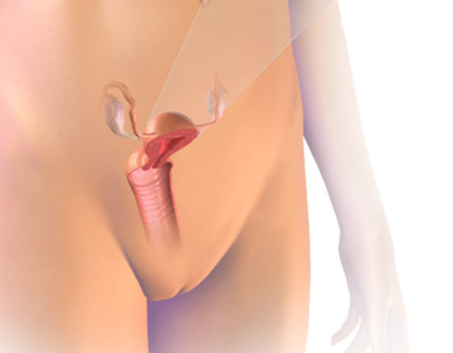
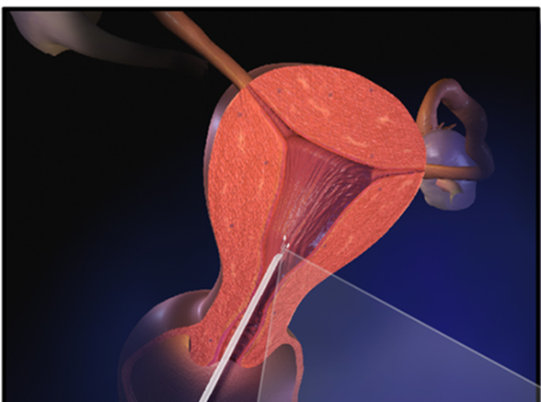
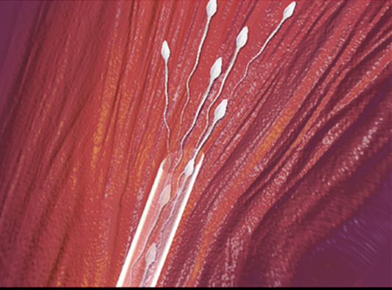
Infertility: Options for Building Families: Intrauterine Insemination
Intrauterine Insemination (IUI): Sperm is collected and placed directly into the uterus when the woman is determined to be ovulating.
Woman is determined to be ovulating
(B) Sperm are inserted into the uterus
(C) Once released sperm will travel to the fallopian tubes and if successful fertilization will occur.
Video: Intrauterine Insemination – IUI explains how the process of IUI is done.
Image from Wikipedia. License CC BY SA 3.0. Reformatted by Maria Pagano

Slide 18
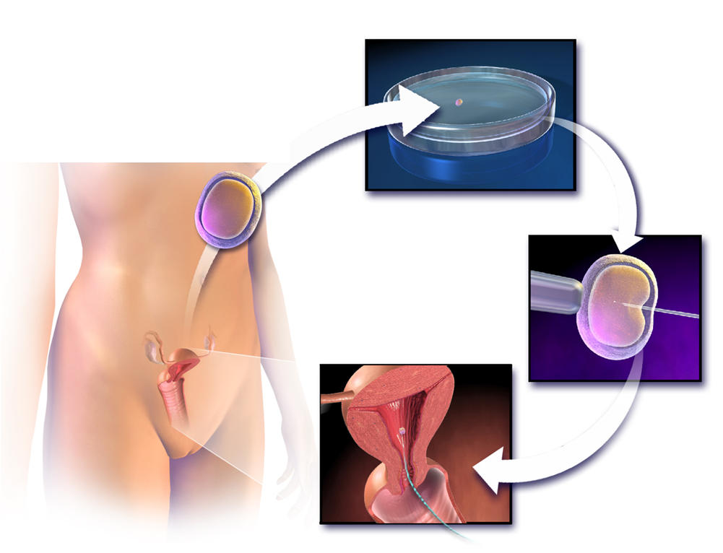
Infertility: Options for Building Families: In Vitro Fertilization
In Vitro Fertilization: Eggs are collected from ovaries and fertilization of those eggs by sperm is done in a lab. Once the fertilized eggs have reached the embryonic stage, the embryos are implanted into the woman’s uterus.
Video 1: How Does In Vitro Fertilization (IVF) Work?
Video 2: IUI vs IVF: What’s the Difference? This 2-minute video discusses the differences between IUI and IVF and also discusses the success rates for each.
Image from Wikipedia. License CC BY SA 3.0.

