Slide 1
Conception and Heredity
Chapter 3

Slide 2
Heredity: The Human Genome Project
Prior to the completion of the human genome project in 2003, scientists were expecting to find 100,000 or more genes in the human genome.
  It turned out we only have around 24,000 genes. This is a few more than a chimpanzee or a mouse, but nothing spectacular.
  About 98% of the DNA in your genes is the same as in chimpanzees, making humans as closely related to a chimp as horses are to zebras.
Surprisingly, scientists discovered that large parts of our genome is made up of DNA that doesn’t code for genes.
Genes are scattered in clusters throughout our chromosomes, separated by long stretches of DNA that doesn’t provide the code for any proteins.
  About half of your genome is made of this non-coding DNA which seemed useless and so was given the name called “junk” DNA.
    However, scientists have now discovered that much of this non-coding DNA plays an important role in coding for genetic switches that regulate when and where genes are switched on and off in your body.

Slide 3
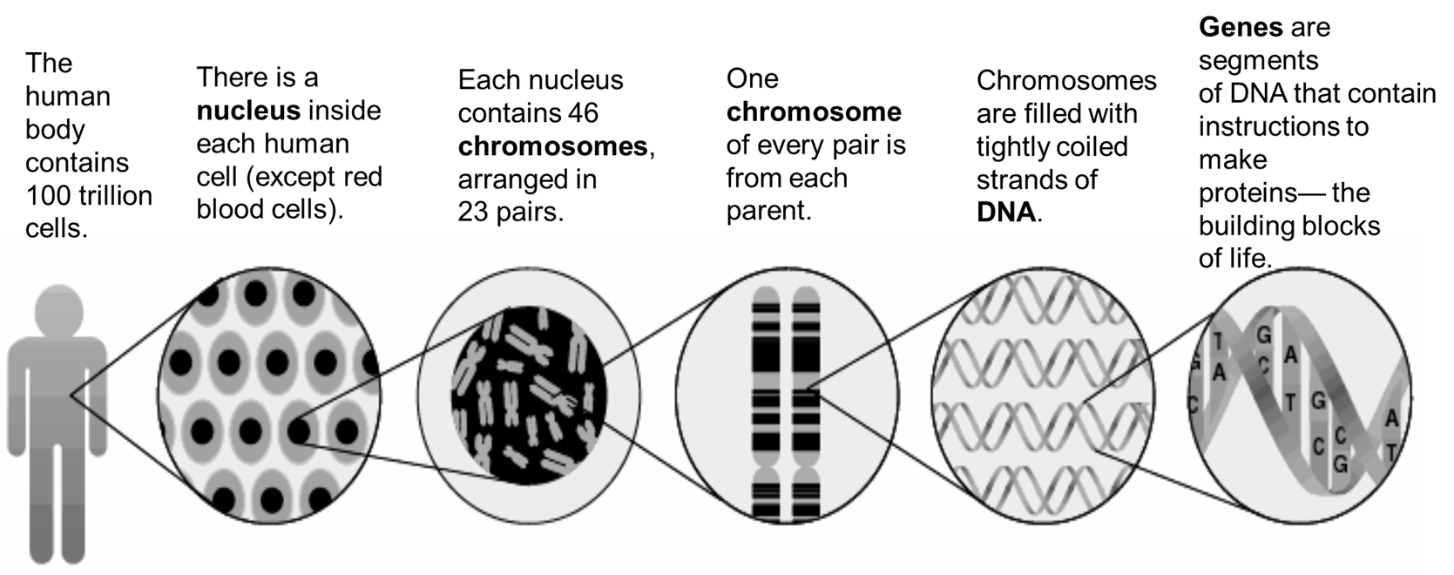
Heredity: From Cell to Genes
Video: What is DNA? In addition to a two-minute video on DNA, this site also contains a brief reading which provides more information on DNA
Image found at: https://content.csbs.utah.edu/~isabella/geneticmaterial.slide . No licensing information found at link

Slide 4
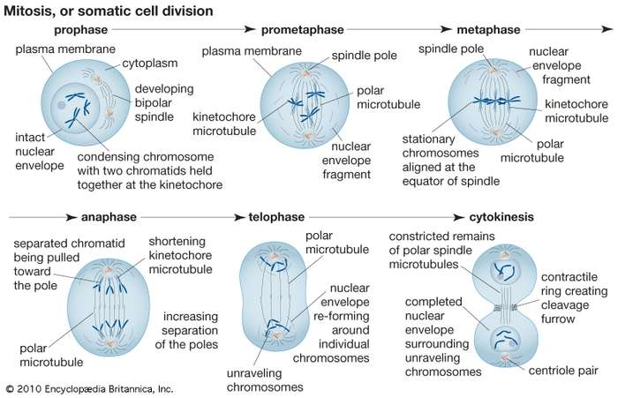
Genes and Chromosomes: Mitosis
Mitosis is defined as the cell’s nucleus making an exact copy of all the chromosomes and splitting into two new cells.
While the YouTube video Mitosis: Splitting Up is Complicated – Crash Course Biology #12 is very good at explaining mitosis, it’s missing the prometaphase but don’t worry because the prometaphase is just an extension in some ways of what happens in the prophase.
Image from Encyclopedia Britannica. Used under permissions given for educational purposes.

Slide 5
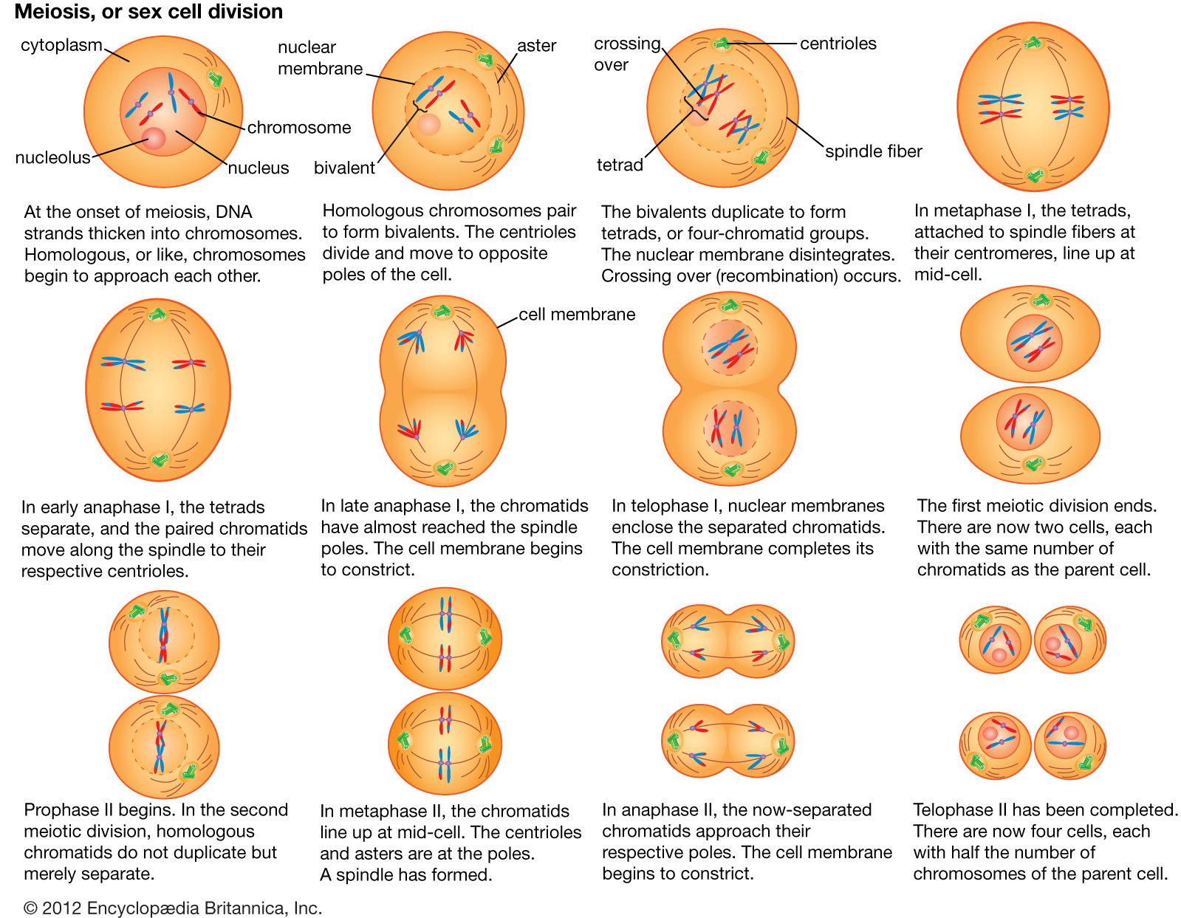
Genes and Chromosomes: Meiosis
Video: When watching the YouTube video Phases of Meiosis try to follow along with the image on the right. Pause the video where needed so that you might get a better understanding of the process.
Image from Encyclopedia Britannica. Used under permissions given for educational purposes.

Slide 6
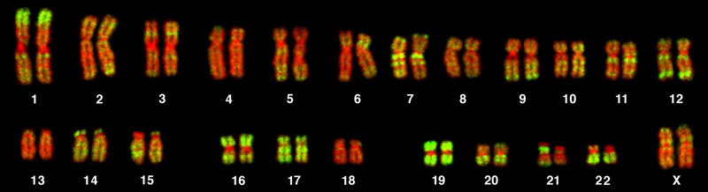
Chromosomes
Each human cell contains a full complement of DNA stored in 23 pairs of chromosomes.
The karyotype above is from a human female (note the two X chromosomes at the 23rd position)
  A karyotype is a picture of the number and appearance of chromosomes.
  A karyotype matches the chromosomes based on size from largest to smallest.
  The first 22 pairs of chromosomes are referred to as autosomes or body chromosomes.
  The 23rd pairing are not autosomes, but rather sex chromosomes.
Video: Reading Karyotypes: In addition to discussing how to read a karyotype this video also discusses chromosomal disorders
Image from Lumen Learning Biology for Majors I. Licensed under CC BY 4.0.

Slide 7
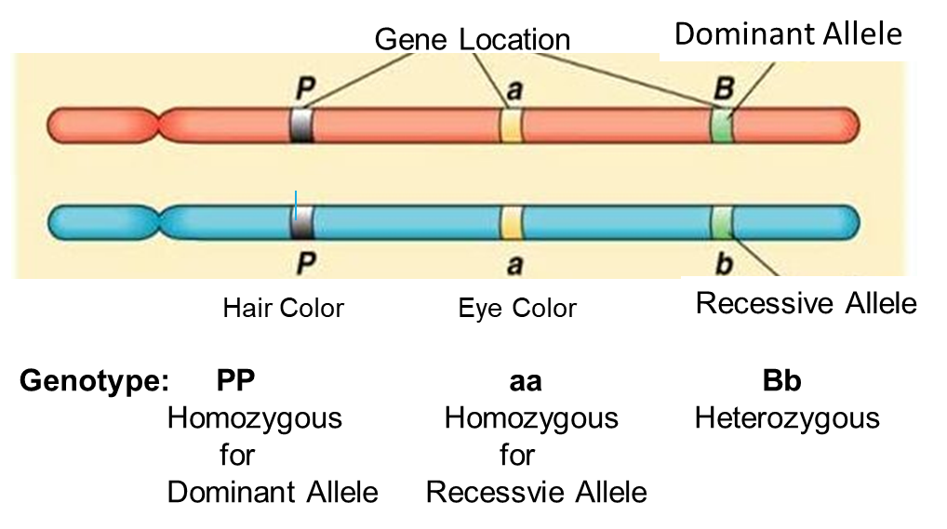
Heredity: Alleles
An allele is a specific location on a pair of genes that controls for the same characteristic.
Genes code for the proteins that express and control all biochemical and physical features of an organism.
  The two alleles a person has inherited for a particular gene are referred to as one’s genotype.
  The observable characteristics of an individual’s genes is referred to as one’s phenotype
A dominant trait is an inherited characteristic that can be observed in offspring if it is contributed from a parent through a dominant allele
A recessive trait will only be expressed if the offspring has two copies of the recessive allele that codes for the trait.
In the example shown above, the genotype for hair is homozygous for the dominant allele and consequently this individual might have what color hair? This same individual is homozygous for the recessive allele that determines eye color. What color eyes might this person have? The final pairing which is not given a trait. Let’s say that this is the allele for dimples, and that dimples is a dominant trait. Would this individual have dimples or not?
Video: Dominant vs Recessive Alleles. This video show you how to distinguish dominant and recessive alleles
Video: Genes vs Alleles. This video further explains the difference between an allele and a gene.

Slide 8
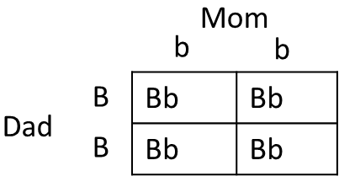
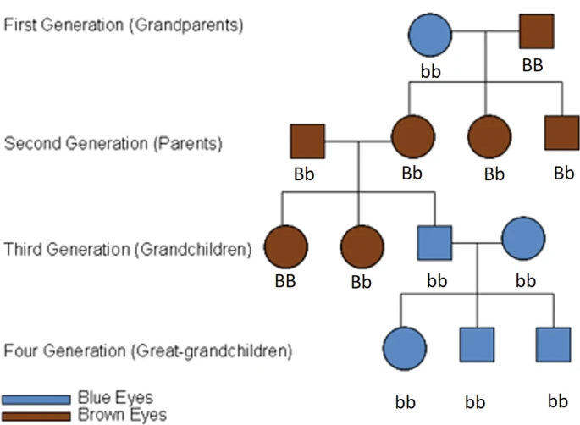
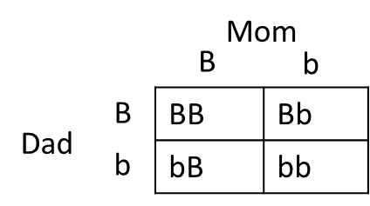

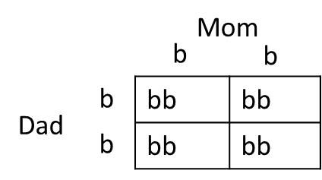
Mendelian Heredity
Grandparent’s
offspring
Parent’s
offspring
Grandchildren’s
offspring
The Punnett Squares above corresponds to the generational pairings illustrated on the left and shows the probability of inheriting either brown or blue eyes.
Video: Khan Academy-An Introduction to Mendelian Genetics: This video reviews the information found on the previous slide, and introduces the concept of Mendelian genetics along with how to create a Punnett Square
Simple Four-Generation Mendelian Pedigree of Brown and Blue Eyes from Mackey, D.A. What colour are your eyes? Teaching the genetics of eye colour & colour vision. Edridge Green Lecture RCOphth Annual Congress Glasgow May 2019. Eye 36, 704–715 (2022). https://doi.org/10.1038/s41433-021-01749-x Used as permitted for educational purposes.

Slide 9
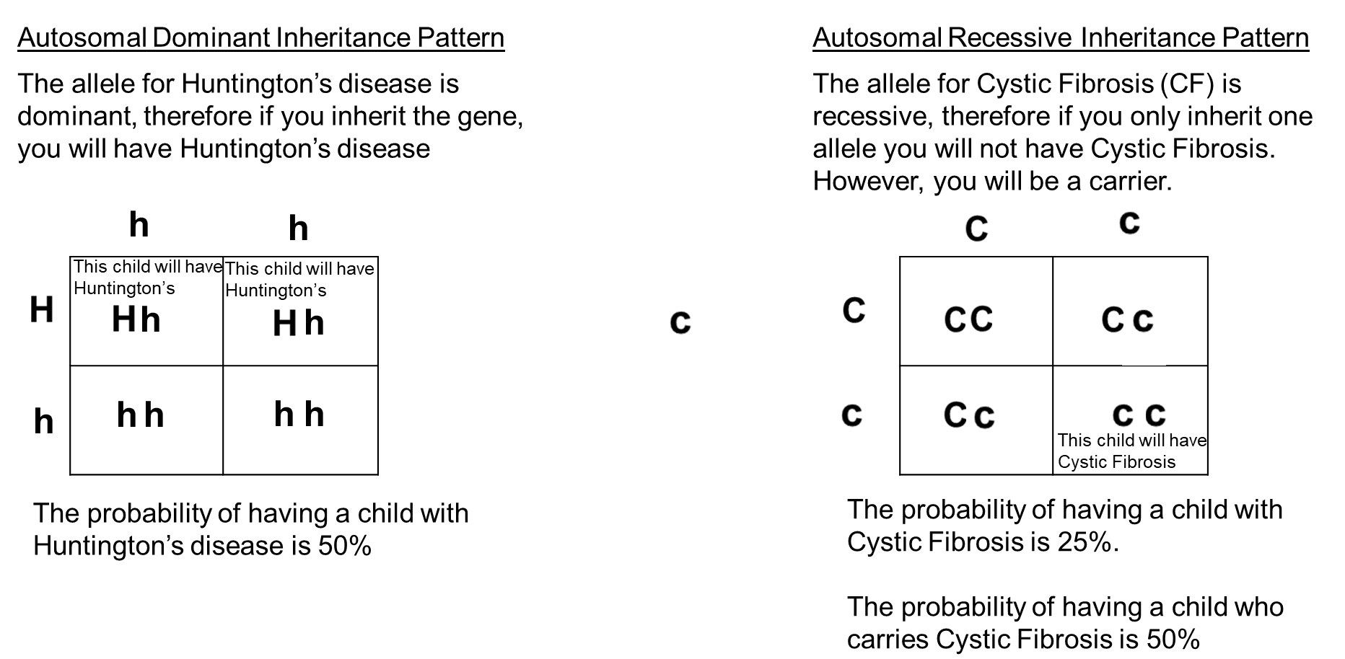
Autosomal Dominant and Autosomal Recessive Inheritance Patterns

Slide 10
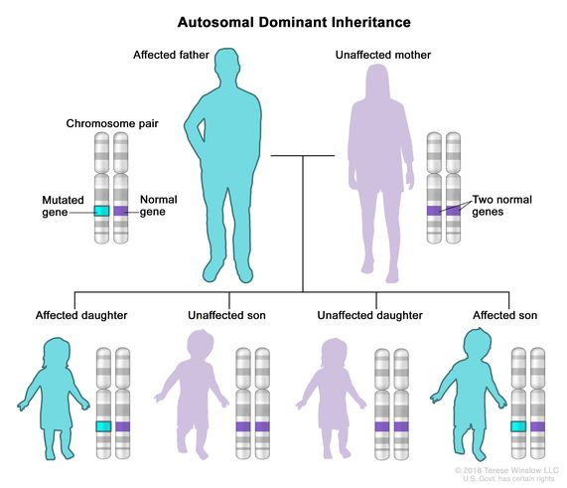
Autosomal Dominant Inheritance Patterns
Autosomal Dominant Inheritance- a way a genetic trait or condition can be passed down from parent to child. One copy of a mutated (changed) gene from one parent can cause the genetic condition.
A child who has a parent with the mutated gene has a 50% chance of inheriting that mutated gene.
Men and women are equally likely to have these mutations and sons and daughters are equally likely to inherit them.
Examples of autosomal dominant inheritance disorders include:
  Huntington’s Disease and Marfan Syndrome
Video: Understanding Autosomal Dominant and Autosomal Recessive Inheritance, provides an explanation of how children inherit autosomal recessive conditions like cystic fibrosis and autosomal dominant conditions like Huntington's disease. Before you look at the video, you might want to take a look at the next slide which explains autosomal recessive inheritance patterns.
Image and text from NIH National Cancer Institute Dictionary is licensed under public domain and is copyright-free

Slide 11
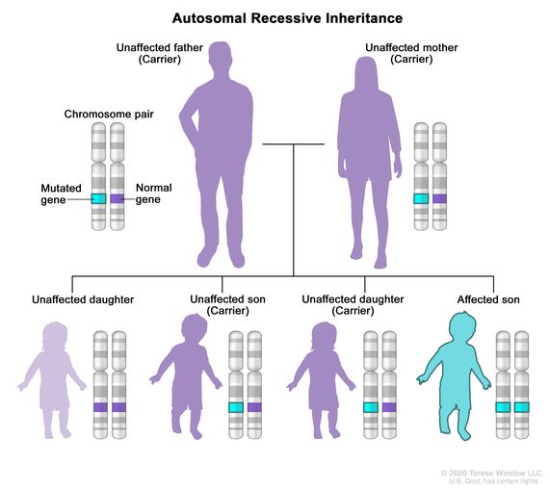
Autosomal Recessive Inheritance Patterns
Autosomal recessive inheritance is a way a genetic trait or condition can be passed down from parent to child. In autosomal recessive inheritance, a genetic condition occurs when one variant is present on both alleles (copies) of a given gene.
Parents of a child with an autosomal recessive condition usually do not have the condition.
Unaffected parents are called carriers because they each carry one copy of the mutated gene and can pass it to their children.
Examples of autosomal recessive inheritance disorders include:
  Cystic fibrosis and Sickle cell disease
Video: Please see the video on the previous slide for an explanation of how children inherit autosomal recessive conditions like cystic fibrosis and autosomal dominant conditions like Huntington's disease.
Image and text from NIH National Cancer Institute Dictionary is licensed under public domain and is copyright-free

Slide 12
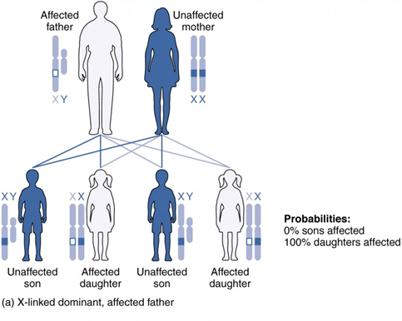

Sex-Linked Disorders: X-Linked Dominant Inheritance
X-linked dominant inheritance refers to genetic conditions associated with mutations in genes on the X chromosome. A single copy of the mutation is enough to cause the disease in both males (who have one X chromosome) and females (who have two X chromosomes). In some conditions, the absence of a functional gene results in the death of affected males.
Video: Pedigree Analysis-Part2: Sex-linked Inheritance Patterns, discusses both X-linked dominant and recessive inheritance. My advice is to watch the first half of video on X-linked dominant inheritance and then pause the video and go to the next slide where X-linked recessive inheritance is discussed.
In males (who only have one X chromosome), a mutation in the copy of the gene on the single X chromosome causes the condition.
Fathers cannot pass X-linked dominant conditions to their sons, but all daughters of affected fathers will be affected with the condition and can pass it on to their children. (Image (a))
Fragile X syndrome is an example of an X-linked dominant disorder
(a) If Mom is affected, then only 50% of her daughters and 50% of her sons will be affected.
(b) If Dad is affected, then all his daughters will be affected.
HOWEVER
If Dad is affected, then none of his sons will be affected, because the sons inherit Dad’s Y chromosome
Image from Anatomy &Physiology by OpenStax is licensed under CC BY 4.0
Text from NIH National Cancer Institute Dictionary is licensed under public domain and is copyright-free

Slide 13
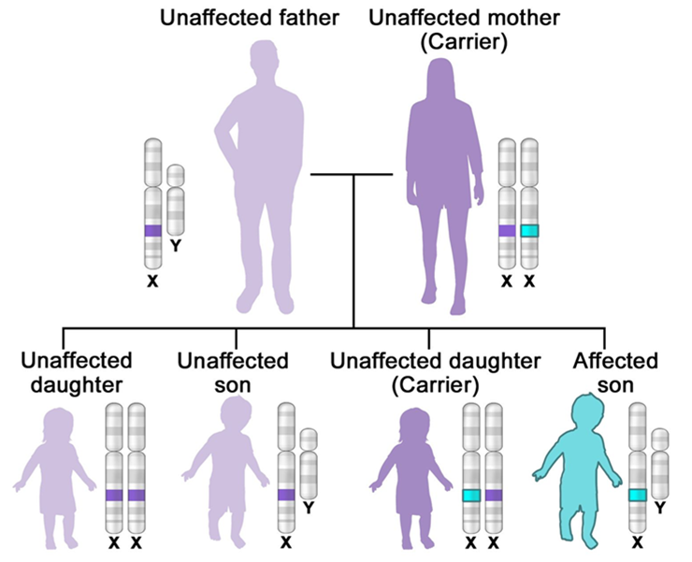
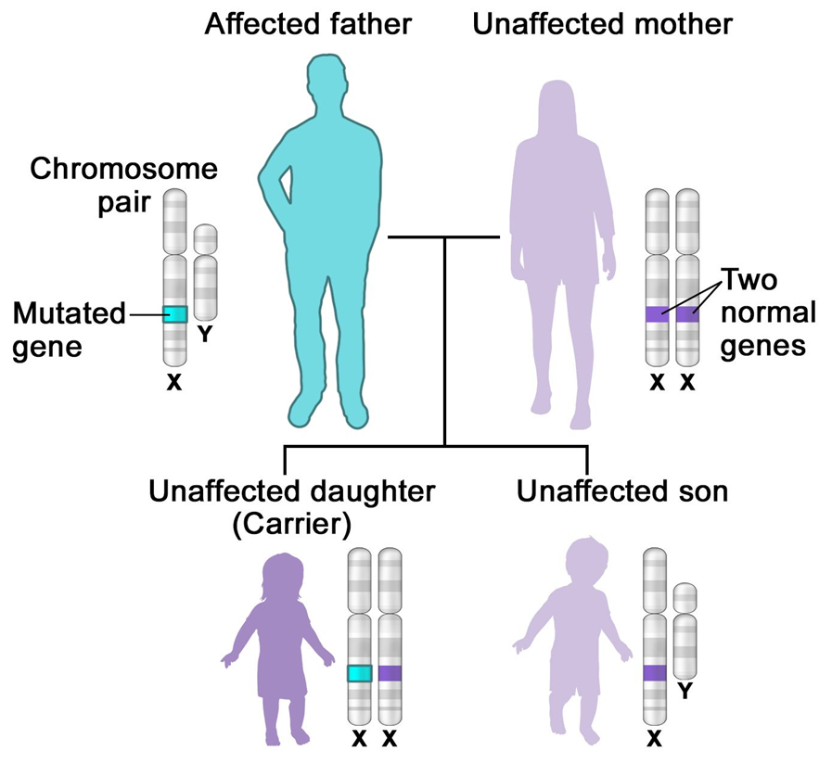
Sex-Linked Disorders: X-Linked Recessive Inheritance
X-linked recessive inheritance refers to genetic conditions associated with mutations in genes on the X chromosome. A male carrying such a mutation will be affected, because he carries only one X chromosome. A female carrying a mutation in one gene, with a normal gene on the other X chromosome, is generally unaffected. For a female to have the condition, she must have the mutation on both X chromosomes. Hemophilia is an example of an X-linked recessive disorder
Video: See the previous slide for video link which discusses both X-linked dominant and recessive inheritance.
If only the father or the mother has the mutated X-linked gene, the daughters are usually not affected and are called carriers because one of their X chromosomes has the mutation but the other one is normal. Sons will be affected if they inherit the mutated X-linked gene from their mother. Fathers cannot pass X-linked recessive conditions to their sons.
In males (who only have one X chromosome), a mutation in the copy of the gene on the single X chromosome causes the condition.
Image and text from NIH National Cancer Institute Dictionary is licensed under public domain and is copyright-free

Slide 14
Other Inheritance Patterns
Disorder | Description and Example
Incomplete Dominance | Occurs when the dominant allele does not completely mask the recessive allele. For example, when red (dominant) and white roses (recessive) are crossbred the result will be pink roses. The pink roses will be heterozygous for red and white.
Codominance | Characterized by the equal, distinct, and simultaneous expression of both parent’s alleles. For example, the blood type AB is codominant blood types.
Lethal Alleles | Causes the death of the organism that inherits the alleles. Examples of recessive trait lethal alleles are Cystic Fibrosis and Tay-Sachs. Dominant lethal allele disorders are rare because individuals with this disorder usually die before they can pass on the gene. Huntington’s disease is an example of a dominant lethal allele
Mutations | Mutations are any alteration of the DNA base sequence. Mutations can occur during DNA replication or can result from exposure to toxic chemicals during pregnancy. Several different types of mutations can occur, such as deletion which results in changes to the number of DNA base pairs, or insertion where changes to the base pairs are added to the DNA.
Video 1: Codominance and Incomplete Dominance – Biomolecules – MCAT – Khan Academy, explains codominance and incomplete dominance and provides examples.
Video 2. Mutations, explains both gene and chromosome mutations and the significance of these changes.

Slide 15
Chromosomal Disorders
Maternal age appears to be linked with chromosomal abnormalities.
  Women over the age of 35 are at greater risk of giving birth to a child with a chromosomal abnormality.
Trisomy: The affected individual has three chromosomes on a pairing of chromosomes instead of two. Instead of having 46 chromosomes, the individual will have 47.
  Down’s Syndrome or Trisomy 21 is the most common of these types of genetic disorders.
  Other forms of autosomal disorders included
    Trisomy 13 (Patau’s Syndrome) – Associated with severe intellectual disability and physical abnormalities throughout the body, like weak muscle tone, cleft palate, and extra fingers or toes.
    Trisomy 18 (Edward’s syndrome) – Associated with abnormalities throughout the body like, a small jaw and mouth, abnormally shaped head, and clenched hands.
  Forms of sex-linked trisomy’s include:
    Klinefelter Syndrome (XXY) – Caused when an extra X chromosome is present in the sex chromosomes of a male. Males may have low testosterone, reduced muscle mass, and reduced or no sperm production.
Monosomy: The affected individual has only one chromosome present in a pairing instead of two.
  Turner’s Syndrome (XO) – A condition that only affects only females and is caused when all or part of one X chromosome is missing. Individuals with this disorder typically suffer from infertility, and heart defects.
Video: Down Syndrome – Ability Awareness PSA Video, shows one of the National Down Syndrome Society’s (NDSS) ambassadors, who has Down Syndrome discussing the work done by the NDSS to make people more aware of the disorder.

Slide 16
Behavioral Genetics
Behavioral geneticists study the effects of heredity on behavior.
There are three types of genotype environment correlations:
  Passive Genotype Environment – The child inherits genes that correlate with the environment provided by the family. If athletics runs in a family, the environment provided to the child will support his/her athletic development.
  Evocative Genotype Environment – Refers to how the social environment reacts to individuals based on their inherited characteristics. If someone is outgoing and his/her social interaction with others supports that behavior, the behavior will be supported.
  Active Genotype Environment (niche-picking) – Occurs when an individual seeks out environments that support their genetic characteristics. Children who are musically inclined actively seek out music instruction and opportunities that support their ability.
Video: Gene Environment Interactions and Correlations Video. Begin the video at timestamp 3:44. This video is more of a podcast lecture, and the slides are a bit blurry, however the lecture and the accompanying text does a very good job at explaining each of the three different types of genotype environment correlations.

