Slide 1
Research Methods
Chapter 2

Slide 2
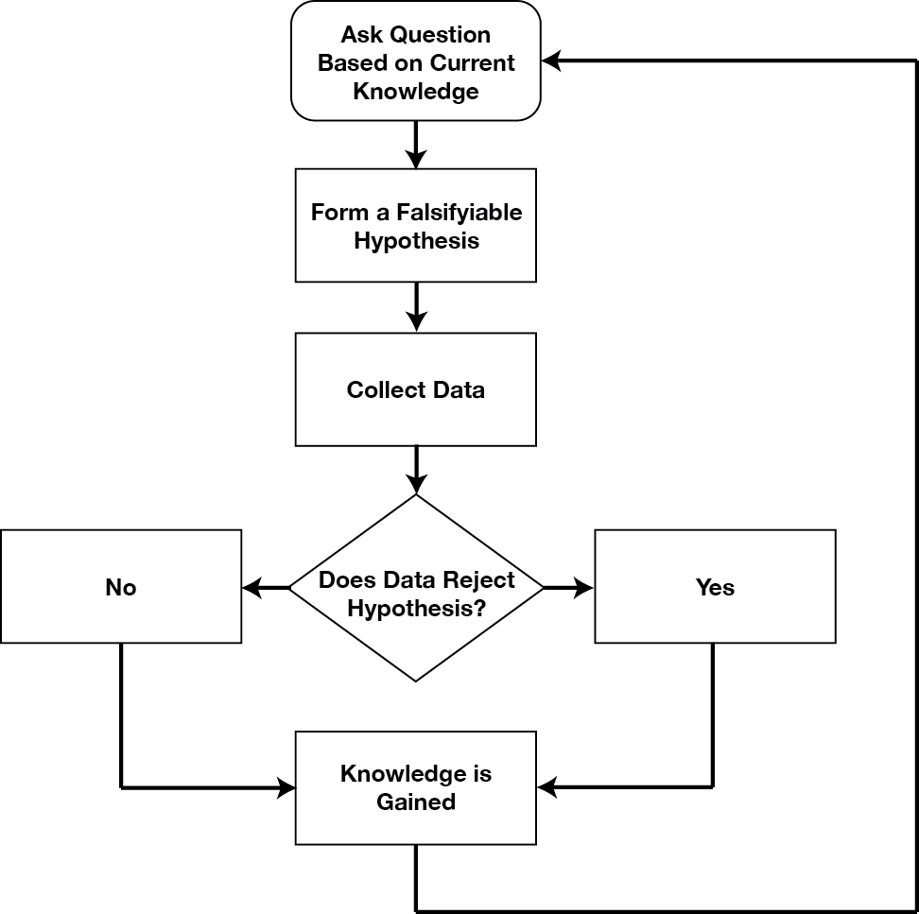
Knowing What We Know: The Scientific Method
The scientific method is a way of acquiring knowledge empirically that involves careful observations and skepticism about what is observed.
While the procedures may vary across and between fields of inquiry, the underlying processes of the scientific method are frequently the same.
Video: The Scientific Method: Steps, Examples, Tips, and Exercise
Image from Wikimedia Commons is authored by Keith Chan and licensed under CC BY SA 4.0 International.

Slide 3
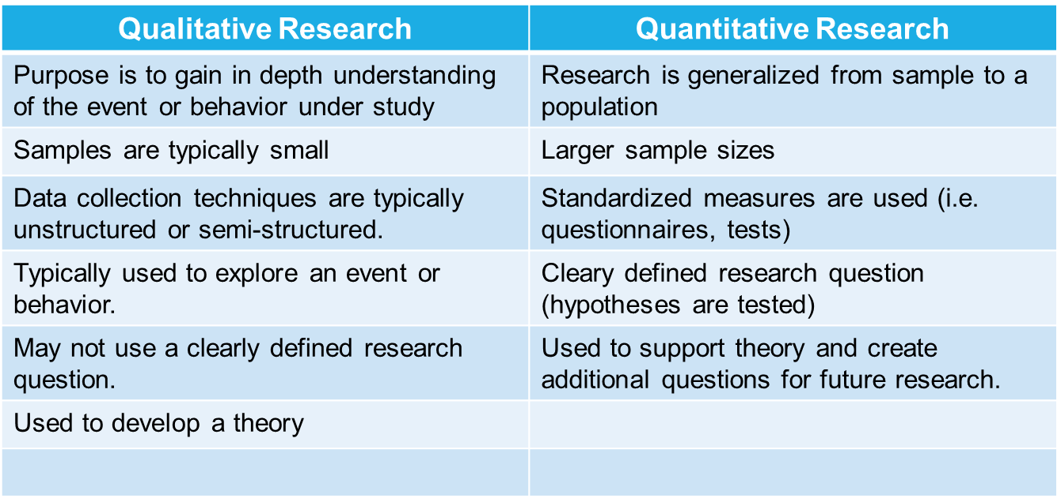
Quantitative Versus Qualitative Research Methods
Research can be divided into two basic categories
  Qualitative research:
    Explores question of the “how” and “why”
    Typically conducted using interviews, focus groups, and other face-to-face strategies to gather information.
  Quantitative research
  Investigates data and the relationship between data that can be represented by numbers.
Piaget’s work began as qualitative (he observed the behavior of his three children) and eventually moved to quantitative investigations where his theory was tested.
Summary of Qualitative and Quantitative Designs
Video: The Differences between Qualitative and Quantitative Research discusses qualitative and quantitative research. The video also discusses the mixed method approach which uses both qualitative and quantitative research.
Text from Lumen Learning Research Methods in Psychology and is taken from Research Methods in Psychology. Authored by: Paul C. Price, Rajiv S. Jhangiani, and I-Chant A. Chiang. Licensed under CC BY NC SA 4.0

Slide 4
Research Methods: Descriptive Research
Descriptive Research Methods describe a behavior or situation of interest, such as how often something might occur and under what conditions. Descriptive methods cannot determine cause and effect relationships. Examples include the following:
  Case Studies: In-depth investigations of a single person, group or event.
    (McLeod, S. A. (2019, August 03). Case study method. Simply Psychology is licensed under CC BY NC 3.0.)
  Observations: Involve watching and/or recording the actions of participants.
    (Children’s Development by Ana R. Leon is licensed under CC BY 4.0)
  Surveys/Questionnaires: Typically involve asking a standard set of questions either over the phone, through the mail, or over email.
    (Lifespan Development by Lumen Learning is licensed under CC BY 4.0)
  Interviews: Like survey and questionnaire method, but instead of using phone interview, the mail, or email, the individual meets face-to-face with the researcher.
    (Lifespan Development: A Psychological Perspective 2nd Edition by Martha Lally and Suzanne Valentine-French is licensed under CC BY-NC-SA 3.0 )
  Psychophysiological Assessment: measures of heart rate, hormone levels, or brain activity.
    (Lifespan Development: A Psychological Perspective 2nd Edition by Martha Lally and Suzanne Valentine-French is licensed under CC BY-NC-SA 3.0 )
  Secondary/Content Analysis or Archival: Analyzing information that has already been collected or examining document or media.
    (Lifespan Development: A Psychological Perspective 2nd Edition by Martha Lally and Suzanne Valentine-French is licensed under CC BY-NC-SA 3.0 )
Video: Psychology Crash Course #5: The Descriptive Method. This video is useful for taking notes and describes cross-sectional and longitudinal research designs as well as descriptive designs.

Slide 5
Research Methods: Correlational Designs
Correlational research involves the measurement of two or more variables and an assessment of the relationship between or among those variables.
The correlation coefficient is a statistical measure of the direction and strength of the relationship between two variables that ranges from -1.00 to +1.00.
  Positive Correlation: As one variable either increases or decreases in strength, so does the other variable. +1.00 indicates a perfect positive correlation. The closer you are to 1, the stronger your correlation
  Negative Correlation: As one variable increases in strength, the other variable decreases in strength, or vice-versa. -1.00 indicates a perfect negative correlation. The closer you are to -1, the stronger your correlation.
  Which is the stronger correlation? +.75 or -.75? Both are equal in strength since both correlation coefficients are equal to .75. Remember that the “+” or “-” sign only tells you about the direction of the relationship and not the strength of the relationship.
  Zero correlation indicates no relationship. The closer your correlation coefficient is to zero, the weaker the correlation.
  Causality cannot be inferred between variables in correlations due to possible third variable effects.
CORRELATION IS NOT CAUSEATION
Video: Research Design – Correlational Studies: provides additional help in understanding scatterplots.

Slide 6
Research Methods: Correlational Designs
As one variable increases, so does the other variable. Example: As height goes up, so does weight.
As one variable increases, the other variable decreases. Example: As television viewing goes up, exam grades go down.
POSITIVE CORRELATION
NEGATIVE CORRELATION
As one variable decreases, the other variable increases. Example: As television viewing goes down, exam grades go up.
As one variable decreases, so does the other variable. Example: As height goes down, so does weight.

Slide 7
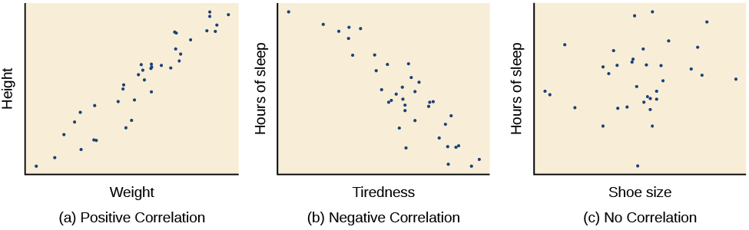
Research Methods: Correlational Designs: Scatter Plots
Scatterplots are a graphical view of the strength and direction of correlations. The stronger the correlation, the closer the data points are to a straight line.
In the examples below, we see that there is:
  (a) a strong, almost perfect positive correlation between weight and height.
  (b) a strong, almost perfect negative correlation between tiredness and hours of sleep.
  (c) no correlation between shoe size and hours of sleep.
Video: Statistics – Making a Scatter Plot shows how to create a scatterplot by hand
Text and image from Open Stax Introduction to Psychology and is licensed under CC BY 4.0. Text slightly modified by Maria Pagano

Slide 8
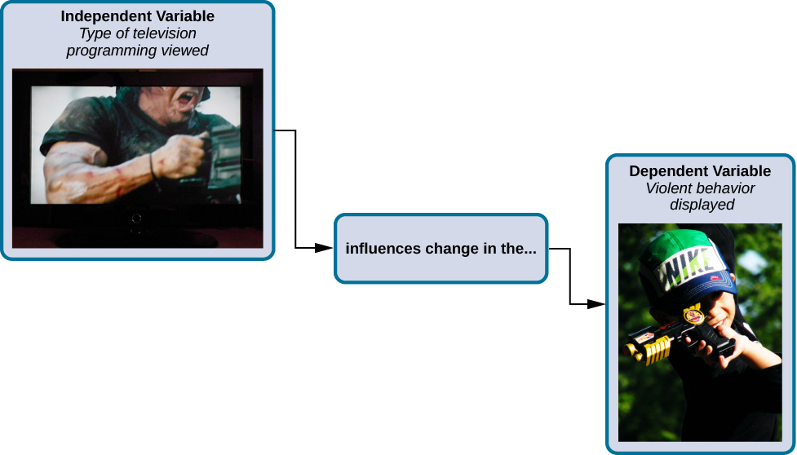
Research Methods: Experimental Designs
Experimental designs are the only way to test if there is a cause-and-effect relationship between two variables.
  Experiments are designed to test hypotheses, or a specific statement about the relationship between variables.
  Good experiments randomly assign participants to a minimum of two groups:
    The experimental group: Receives the experimental treatment or variable being tested
    The control group: Does not receive the experimental treatment or variable being tested.
  Researchers need to operationally define the variables used in the experiment.
  The variable used in experimental designs are referred to as:
    The independent variable- The variable that is manipulated or altered by the researcher.
    The dependent variable- The variable that is measured.
In an experiment, participants are randomly assigned to a minimum of two different groups, where manipulations of the independent variable are expected to result in changes in the dependent variable for the experimental group.
Video: Experimental Design: Variables, Groups, and Random Assignment This video goes into detail and further explains of all the information found on this slide as well as random assignment.
Text and image from Open Stax Introduction to Psychology and is licensed under CC BY 4.0. Text modified by Maria Pagano

Slide 9
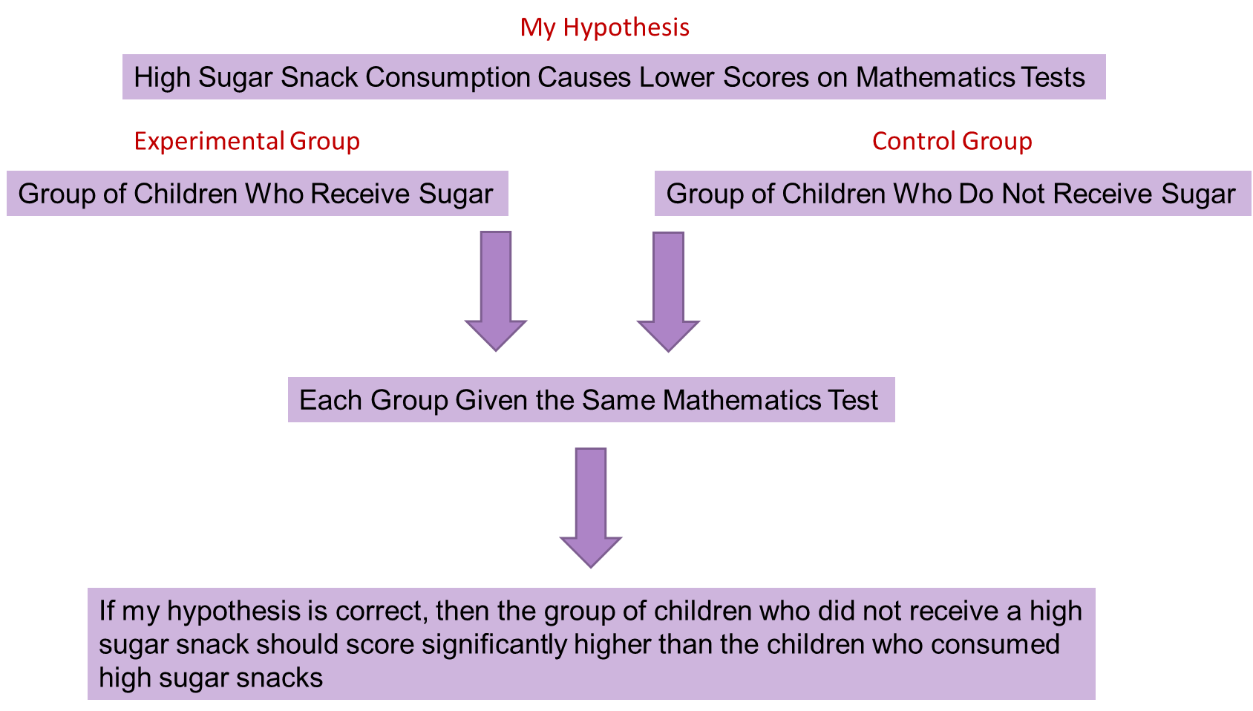
Research Methods: Experimental Designs: Hypotheses
Hypothesis: A prediction which is based in theoretical ideas or observations and can be tested using experimental methods.
Your hypothesis should be a question that you can test, or what’s referred to as a ”testable” hypothesis.
  In other words, you need to be able to measure both "what you do" and "what will happen.“ For example:
    Let’s say that I have observed that children who consume high sugar content snacks seem to do poorer on their mathematics tests than children who do not high sugar snacks. If I wanted to run a study, I could hypothesize that if I manipulate the amount of sugar in a child’s diet, then those children who receive more than an average day’s worth of sugar should do worse on a mathematics test than those who had did not receive more sugar.

Slide 10
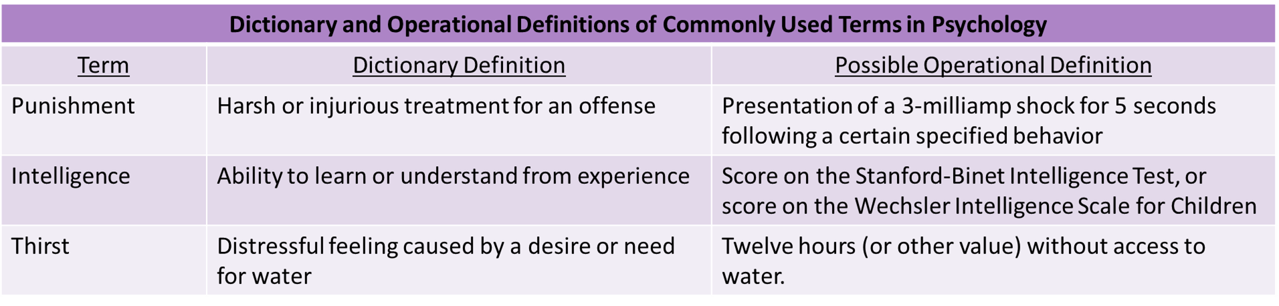
Research Methods: Experimental Designs: Operational Definitions
Operational definitions define variables in a way in which the variable can be measured. When developing an operational definition, you should keep in mind the following:
  The operational definition should describe the behavior in an observable manner.
  The operational definition should describe the behavior in measurable terms
  The operational definition should be clear, concise, and contain all the information needed so that someone trying to replicate your work can easily do so.
In our example from the previous page, we could operationally define our mathematics test by detailing things like, how many questions the test contained, what types of questions were given on the exam (addition and subtraction), how long did student have to take the exam, and whether the children were allowed to use calculators.
Video: For basic help with operational definitions, go to Operational Definition or if you feel you need even more help, then go to Theories and Operational Definitions
Table adapted from University of Central Arkansas Chapter 5 Measurement: Operational Definitions. No licensing information given.

Slide 11
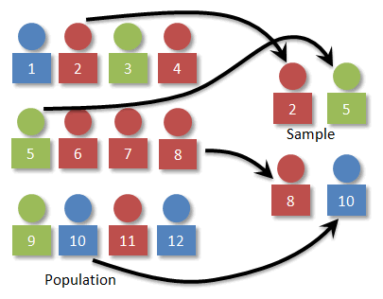
Research Methods: Experimental Designs: Random Sampling and Random Assignment
A random sample is a subset of a larger population in which every member of the population has an equal chance of being selected.
  Random samples are preferred because if the sample is large enough, we can be reasonably sure that the participating individuals are representative of the larger population.
    This means that the percentages of characteristics in the sample—sex, ethnicity, socioeconomic level, and any other characteristics that might affect the results—are close to those percentages in the larger population.
  In our example of sugar intake, let’s say we decide our population of interest is fourth graders. However, all fourth graders is a very large population, so instead we might say our population of interest is all fourth graders in a particular city.
    If we randomly selected our sample then we would ensure that every member of the population has an equal change of being selected regardless of income bracket, race, ethnicity, religion and so on.
  Once our sample has been randomly selected, our next step is to randomly assign our sample of students to either a control group or an experimental group. With random assignment, all participants have an equal chance of being assigned to either group.
Image from Statistics by D. Kernler and is licensed under CC BY NC SA 3.0
Video: 5.4 Random Sampling vs Random Assignment, discusses how random sampling leads to random assignment.
Text from Lumen Learning Introduction to Psychology and is licensed under CC By 4.0 (Modified by Maria Pagano)

Slide 12
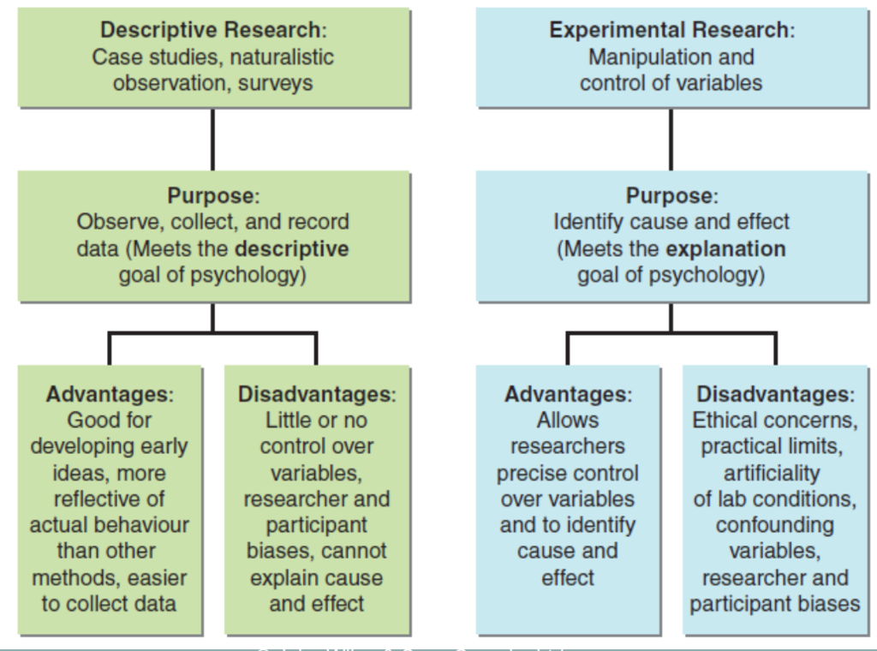
Research Methods: Advantages and Disadvantages of Descriptive and Experimental Research
Table from Quizlet, which allows use if non-commercial

Slide 13
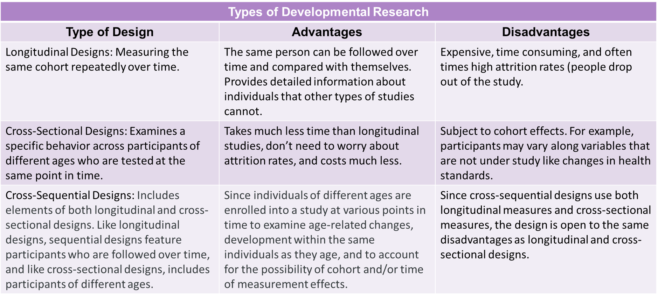
Developmental Research Designs: Longitudinal, Cross-Sectional, and Cross Sequential Designs
Video: Developmental Research Designs discusses Cross-Sectional, Longitudinal, and Cross-Sequential Designs. Note: The video refers to Cross-Sequential Designs as Longitudinal-Sequential Designs, however they are the same thing.
Text from Research Methods in Developmental Psychology. Authored by: Angela Lukowski and Helen Milojevich. Provided by University of California, Irvine.The Noba Project. Licensed under CC BY NC SA.

Slide 14
Developmental Research Designs: Preferential Looking and Habituation
Types of Developmental Research
Type of Design | Description of Design
Preferential Looking Video: Visual Acuity Testing, Part 1: History of Preferential Looking and Early Testing. | Developed by Robert L. Fantz in 1961 and used to determine if infants preferred to look at one object over another. Fantz found that infants preferred faces and face-like patter over non-face-like patterns. This design is also used to evaluate infant visual acuity and has been adapted in the study of audition.
Habituation: The process of presenting a stimulus repeatedly until the infant becomes bored or dishabituated with the stimulus. | Fixed Trial Habituation: “The simplest habituation protocols which involve administering a set of discrete, repetitive stimulus presentations to an infant; each trial has a fixed duration, and a fixed intertrial interval. For example, one might present 8 trials of a checkerboard to an infant, each lasting 10 s with a 10 s intertrial interval (Colombo et al., 1997).”
 | Infant Controlled Procedure: Like the fixed trial design infants are administered repetitive stimulus presentations, but the the trial is not considered to start until the has looked at the stimulus and is terminated when the infant looks. In addition, the trials continue until the infant has reduced his/her looking to some criterion that is established by the researcher.
Video: Infant Habituation. Demonstrates and discusses Fixed Trial Habituation
Video: Habituation: Studying Infants Before They Can Talk. Provides an example of how the Infant Controlled procedure is done.
Text from Infant Visual Habituation by John Colombo and D. Wayne Mitchell Source: U.S. National Library of Medicine. Public domain.

Slide 15
Conducting Ethical Developmental Research
Researchers who work with infants and children must follow the ethical guidelines set forth by of the American Psychological Association and the Society for Research in Child Development. Some of the more important ethical standards include:
  Nonharmful Procedures: Any procedure that could harm the infant or child either physically or psychologically should be avoided.
  Informed Consent: The purposes, procedures, and all known risks and benefits of their studies to the potential participants must be explained. When working with minors, researchers must obtain informed consent from both the children (somethings called assent) and their parent or guardians.
  Risks versus Benefits: Studies should be conducted only when the potential benefits outweigh any known risks.
  Unforeseen Consequences: If a research procedure results in any negative consequences for a child, the researcher must do whatever is necessary to correct the situation. Also, if during the study the researcher collects information that could have bearing on the child’s well-being, the researcher must discuss this with the child’s parents.
  Confidentiality: Researchers must keep all information obtained from participants confidential.
  Debriefing: The researcher must fully explain the purpose of the research.

