Slide 1
Introduction To Infant and Child Development
Chapter 1

Slide 2
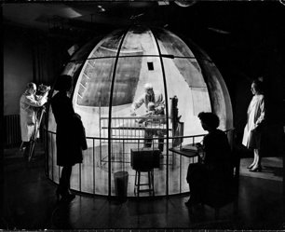
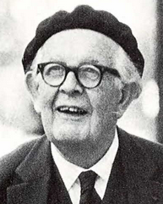
Why Study Infant and Child Development from a Psychological Perspective?
Two Key Goals Involved in the Study of Infant and Child Development Focus On:
Describing Change- Arnold Gesell was the first to film infants and children and to use these films to categorize “norms” of development such as the average age a child will begin to crawl or walk.
In 1926 Gesell began to use the "movie camera" to film his infant participants through a one-way mirror. During his years of study, he filmed approximately 12,000 children of various ages at differing stages of development. From these observations Gesell concluded that most children go through similar and predictable maturational changes as they age. The image on the left is referred to as Gesell’s Dome. It’s the environment he used to film and observe his infant participants. (Image from Time Magazine Archives and is public domain)
Explaining Change- Theories provide us with explanations for how and why we change over time. Unlike Gesell, who described change, Jean Piaget (right) was interested in the process of qualitative change and studied how children and adolescents gradually became able to think logically and scientifically. (Adapted from Lumen Learning Educational Psychology)
Video: Life Begins (Arnold Gesell, 1939) is an interesting old-school film on the development of various milestones. Look at the section on Early Locomotion, which begins at 11:22 (and ends at 21:08).
Image of Piaget by Unidentified (Ensian published by University of Michigan) - 1968 Michiganensian, p. 91, Public Domain, https://commons.wikimedia.org/w/index.php?curid=53878611

Slide 3
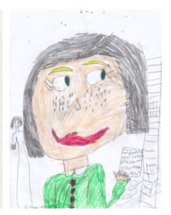

Domains of Child Development
Development is multidimensional and as we grow, we change across three general domains:
The Physical (For example, the body and the brain)
The Cognitive (For example, thinking and reasoning)
The Social/Emotional (For example, understanding the feelings of others)
Please note that while discussed separately, these domains do overlap and effect each other
The two drawing above demonstrate the progression in both drawing skill and visual processing during early childhood. The drawing on the left is done by a 2-year-old, and the drawing on the right is by a 7-year-old. (The image and the text are from Lumen Learning and is licensed under CC BY 4.0.

Slide 4

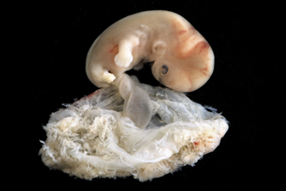

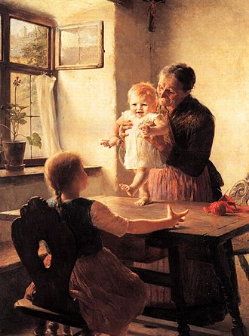

Periods of Child Development
The First 5 Stages of the Lifespan
(1) Prenatal Development (conception through birth)
(4) Middle Childhood (6 to 11 years)
"Embryo @ 6 - 7 weeks" by lunar caustic is licensed under CC BY 2.0
(3) Early Childhood (3 to 5 years)
Image from Pixabay is licensed under CC0 1.0
This above photo is a work of an employee of the Executive Office of the President of the United States, taken or made as part of that person's official duties. As a work of the U.S. federal government, it is in the public domain. (President Obama Talks with Third and Fourth Grade Students)
(2) Infancy and Toddlerhood (birth through two years)
Lewsley, Joanne (February 2019). "Developmental milestones: walking"
(5) Adolescence (12 to adulthood)
"Brazil - For adolescent girls in Brazil, ‘One Win Leads to Another’" by UN Women Gallery is licensed under CC BY-NC-ND 2.0

Slide 5
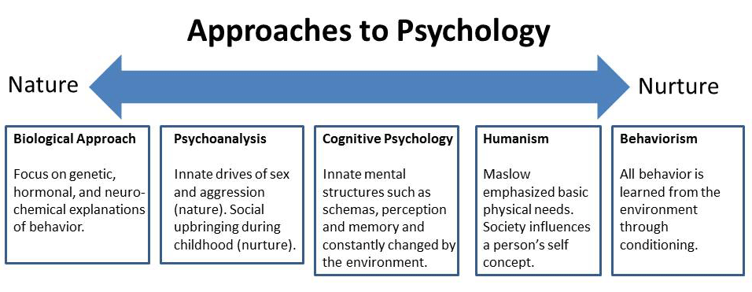
General Theoretical Questions That Surround the Study of Development: The Nature/Nurture Debate
The nature versus nurture debate involves the extent to which particular aspects of behavior are a product of either inherited (i.e., genetic) or acquired (i.e., learned) influences.
Nature is what we think of as pre-wiring and is influenced by genetic inheritance and other biological factors.
Nurture is generally taken as the influence of external factors after conception, e.g., the product of exposure, life experiences and learning on an individual.
Instead of defending extreme nativist or nurturist views, most psychological researchers are now interested in investigating how nature and nurture interact in a host of qualitatively different ways.
Video: Nature vs Nurture (Psychology Debate Explained) #Alevel, reviews the nature/nurture debate and how thinking has changed over this discussion.
Text and image from: McLeod, S. A. (2018, December 20). Nature vs nurture in psychology. Simply Psychology. https://www.simplypsychology.org/naturevsnurture.html is licensed under CC BY NC ND 3.0

Slide 6
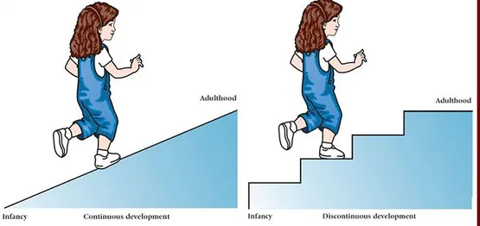
General Theoretical Questions That Surround the Study of Development: Continuity Versus Discontinuity
Continuous or normative development is typically viewed as a continual and cumulative process. The continuity view says that change is gradual. Children become more skillful in thinking, talking or acting much the same way as they get taller. (Vygotsky and Information Processing Theories).
The discontinuity view sees development as more abrupt-a succession of changes that produce different behaviors in different age-specific life periods called stages. Biological changes provide the potential for these changes. (Piaget, Freud, Erikson, Kohlberg).
Video: Lifespan Development: Continuity vs Discontinuity (begin at timestamp 0:50), reviews the quantitative and qualitative changes across development and provides examples.
Text and image from: McLeod, S. A. (2017, Jan 14). Developmental psychology. Simply Psychology. https://www.simplypsychology.org/developmental-psychology.html is licensed under CC BY NC ND 3.0

Slide 7
General Theoretical Questions That Surround the Study of Development
Active versus Passive Development
Do children play the role of an active explorer in their development as is purported by cognitive theorists like Piaget and Vygotsky, or does the child passively receive information from the environment as the Learning Theorist contend?
Those theories who view children as active agents of their own development not only view the child as one who selectively and spontaneously involve themselves with their environment, but as on who can alter their environment to meet their needs. For example, the development of social skills and friendships.
Those theories that portray children as passive recipients of information view the child as one who does not spontaneously act on the environment, but rather as someone who reacts to stimuli from the environment, for example the behavioral theories of Watson and Skinner. Consequently, these developmentalists view development as the accumulation of learned associations. For example, physical growth and changes in infant reflexes.

Slide 8
General Theoretical Questions That Surround the Study of Development: Stability versus Change
Are you the same person you've always been? How similar are you to how you were as a child?
Stability versus change theories of development study whether an individual’s traits change or remain the same as they age.
  Stability theorists argue that stabilization of a particular trait or characteristic occurs early and persists throughout the lifespan.
  Change theorists argue that major attributes are potentially changeable throughout life.
  Some theorists believe it is a combination of both
  There are several layers to consider when approaching the question of stability versus change:
    What causes stabilization of an attribute?
    Are there critical periods for stabilization of certain attributes?
    Do some attributes stabilize early in development while other attributes stabilize later?
    Once an attribute stabilizes, is it impossible to change?
    Is the process of stabilization the same for everyone?

Slide 9
Does Investment in Early Childhood Development Lay the Foundation for a Prosperous and Sustainable Society?: How Physical, Cognitive, and Social Emotional Interact in Early Brain Development
Emotional and physical health, social skills and cognitive capacities that emerge in the early years are all important and excessive or prolonged stress can be toxic to the developing brain.
The basic architecture of the brain is constructed through an ongoing process that begins before birth and continues into adulthood.
In the first few years of life, 700 new neural connections called synapses are formed every second (blooming) and the interactive influences of genes and experience help shape the developing brain.
After this period of rapid proliferation, these connections are reduced through a process called pruning, so that brain circuits become more efficient.
The brain is most flexible or plastic early in life to accommodate a wide range of environments and interactions, but as the brain becomes more specialized , it also becomes less capable of reorganizing and adapting to new or unexpected changes.
Emotional and physical health, social skills and cognitive capacities that emerge in the early years are all important prerequisites for success in school and later in the workplace in community and numerous scientific studies support the conclusion that providing supportive, responsive relationships as early in life as possible can prevent or reverse the damaging effects of toxic stress.
This slide was created using information from the following and can be found in the textbook on page 6.
Investment in Early Childhood Development Lays the Foundation for a Prosperous and Sustainable Society by Jack P. Shonkoff, MD, Julius B. Richmond FAMRI Professor of Child Health and Development is found at Importance of early childhood development. In: Tremblay RE, Boivin M, Peters RDeV, eds. Encyclopedia on Early Childhood Development [online]. http://www.child-encyclopedia.com/sites/default/files/dossiers-complets/en/importance-of-early-childhood-development.pdf. Updated March 2011. Accessed August 1, 2020. This article is used with permission by Encyclopedia of Early Childhood Development.

Slide 10
Does Investment in Early Childhood Development Lay the Foundation for a Prosperous and Sustainable Society?
How Physical, Cognitive, and Social Emotional Interact in Early Brain Development
The image on the right shows both the difference in neuronal density from birth through age 14, but also shows the proliferation of synaptic connections that develop from birth to six years of age (blooming), and the subsequent pruning which occurs so that the brain circuits can become more efficient.
Video: Experiences Build Brain Architecture, discusses the importance of the development of neural networks.
Image from Rethinking the Brain: New Insights into Early Development by Rima Shore, ERIC Institute of Education Science, ED.gov licensed under Fair Use

Slide 11
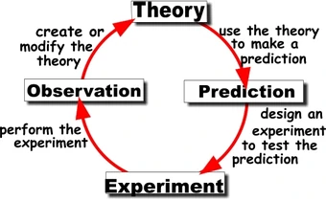
Theories of Development: What is a Theory?
Scientific theory, is a well-confirmed type of explanation that is made in a way consistent with the scientific method and can be described in such a way that scientific tests should be able to provide empirical support for the theory, or empirical contradiction ("falsify") of it. Scientific theories are reliable, rigorous, and comprehensive.
Scientific theories are distinguished from hypotheses, which are individual empirically testable conjectures, and from scientific laws, which are descriptive accounts of the way nature behaves under certain conditions.
Theories guide the enterprise of finding facts rather than of reaching goals. Consequently, research adds additional information to the theory, but the story is never really completed.
Image from Wikia.org is licensed under CC BY SA 3.0
Video: Fact vs. Theory vs. Hypothesis vs. Law…EXPLAINED!
Text from Wikipedia is licensed under CC BY SA 3.0 (modified by Maria Pagano)

Slide 12
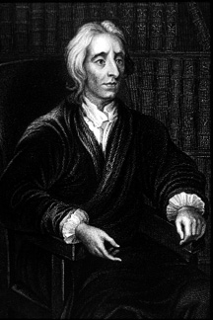
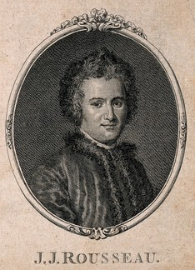
Theories of Development: Historical Theories of Development
Image of John Locke is public domain.
Image of Jean-Jacques Rousseau is licensed under CC BY 4.0
John Locke (1632-1704): Refuted innate knowledge and proposed that children are shaped by their social environments
Jean-Jacques Rousseau (1712-1778): Children developed according to a natural plan which unfolded in different stages.

Slide 13
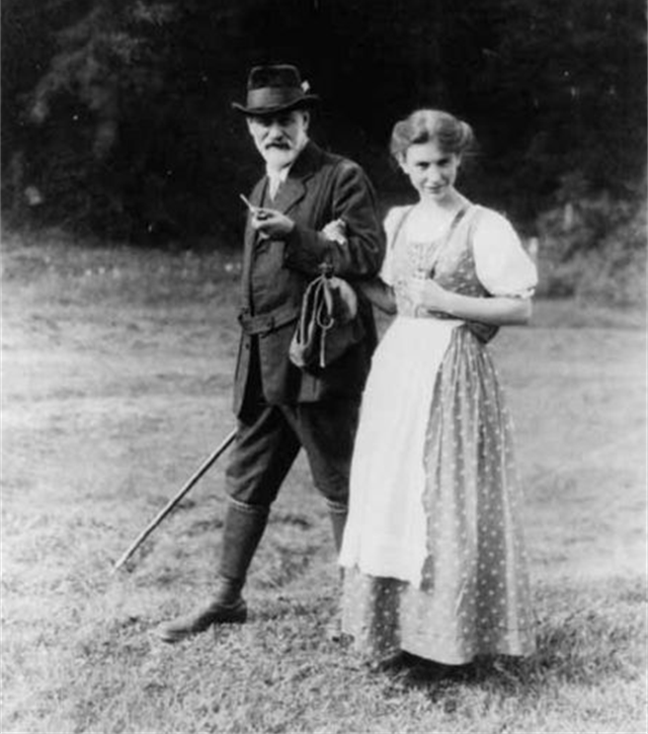
Theories of Development: Contemporary Theories of Development: Freud and Psychodynamic Theory
Trained as a medical doctor in Vienna
Believed that mental process, motivations and desires were unconscious yet influenced our conscious behavior.
Proposed a theory of mind that included:
  Conscious mind or what we are aware of
  Pre-conscious mind or those experiences and thoughts that can be easily retrieved into the conscious mind
  Unconscious mind or those thoughts, motivations and memories that cannot be easily accessed through conscious awareness.
Video 1: Sigmund Freud: Biography of Freud’s Theories, Life and Death, is a brief video introducing Freud and his ideas.
Video 2:
Image of Freud and his daughter Anna in the Dolomite Alps, Italy
Is from Library of Congress Prints and Photographs Division Washington, D.C

Slide 14
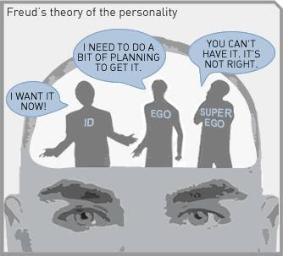
Theories of Development: Contemporary Theories of Development: Freud and Psychodynamic Theory
Freud’s Theory of Self Includes the Following Three Components:
  Id:
    Operates on the pleasure principle (wants immediate gratification) and works to satisfy basic urges, needs, and desires.
      At birth, the id serves am important role because it ensures that an infant’s needs are met. For example, when an infant is hungry or needs changing it will cry until his or her needs are met.
  Ego:
    Develops by the first year of life and operates under the reality principle.
      For example, if a child wants a toy that another child is playing with, the child’s initial instinct would be to take it. However, parents and society exert pressure on the child to wait for his or her turn.
    The role of the ego is to satisfy the id in socially acceptable ways, and to release tension that is created by unmet id impulses.
  Super-Ego: The superego develops during the Phallic Stage around the age of 5 or 6. This part of personality includes one’s conscience (our understanding of right and wrong) and the ego ideal (the person we aspire to be).
Image from Id ego super ego. WikiMedia. Licensed under CC BY 4.0.
Video: Id, Ego, Superego, provides a quick review of the id, ego, and superego.

Slide 15
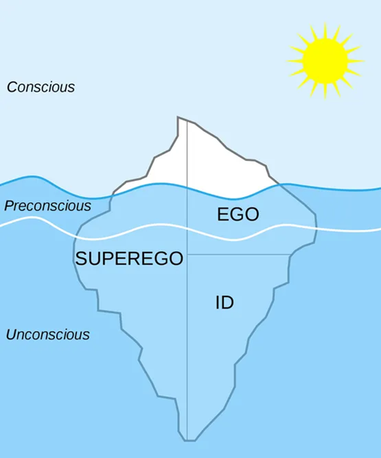
Theories of Development: Contemporary Theories of Development: Freud and Psychodynamic Theory
The id is the inherited, fully unconscious part of the self.
The ego resides mainly in the conscious part of self. However, a small part of the ego can be found both at the preconscious and unconscious levels
Like the ego, the super-ego can be found at all three levels of consciousness. However, unlike the ego, the superego resides predominately at the unconscious level.
Video: The Conscious, Preconscious and Unconscious Mind: Freud’s Topographical Approach, discusses each level of consciousness and provides examples.
Image from McLeod, S. A. (2019, September 25). Id, ego and superego. Simply Psychology. Licensed under CC BY NC ND 3.0

Slide 16
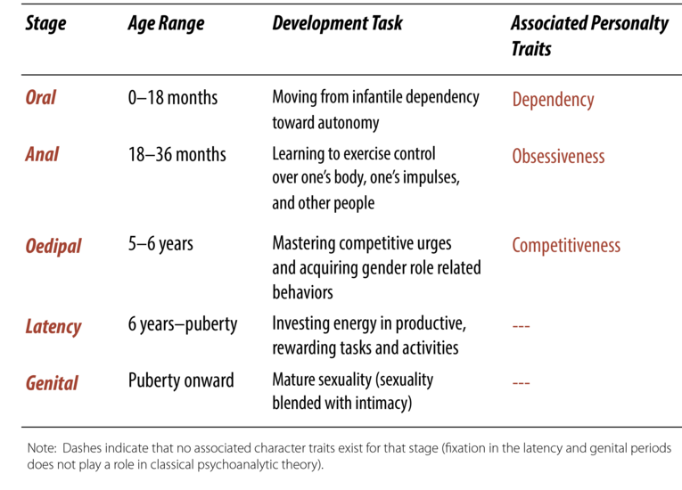
Theories of Development: Contemporary Theories of Development: Freud’s Psychosexual Stage Model
Freud argued that early in life we progress through a sequence of developmental stages, each with its own unique challenge and its own mode of sexual gratification.
  Frustration or over gratification during a particular stage resulted in “fixation” at that stage, and to the development of an oral, anal, or Oedipal personality style.
Consistent with the developmental challenges that the child confronts during each stage:
  Oral fixation is hypothesized to result in a dependent personality
  Anal fixation results in a lifelong preoccupation with control
  Oedipal fixation leads to an aggressive, competitive personality orientation.
The table below illustrates the basic organization of Freud’s psychosexual stage model, and the three personality styles that result.
Video: Freud’s 5 Stages of Development, provides explanations and examples of Freud’s theory.
Table and Text from Bornstein, R. (2020). The psychodynamic perspective. In R. Biswas-Diener & E. Diener (Eds), Noba textbook series: Psychology. Champaign, IL: DEF publishers. Licensed under CC BY NC SA 4.0

Slide 17
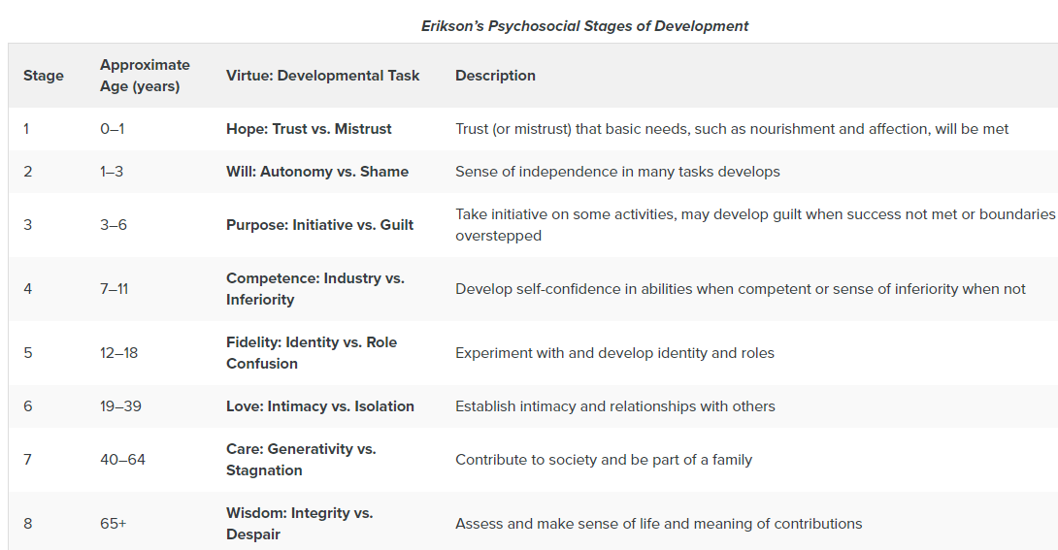
Theories of Development: Contemporary Theories of Development: Erikson and Psychosocial Theory
Erikson’s Theory states that:
  The ego has greater importance in guiding our actions than does the id.
  We make conscious choices in life, and these choices focus on meeting certain social and cultural needs rather than purely biological ones.
  We develop through an unfolding of our personality in predetermined stages (also called epigenetic principles)
  Our environment and surrounding culture influence how we progress through these stages.
Video: 8 Stages of Development by Erik Erikson, provides more details and examples of the stages listed above.
Table and text found at Lumen Learning Lifespan Development. Erikson's Stages of Development. Provided by: Boundless. And is licensed under CC BY SA 4.0

Slide 18
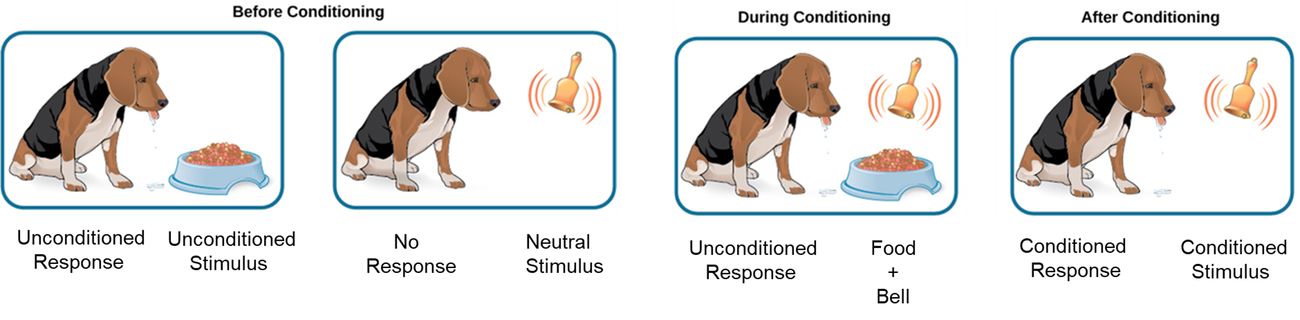
Theories of Development: Contemporary Theories of Development: Pavlov and Classical Conditioning
Discovered by Russian physiologist Ivan Pavlov, classical conditioning is a type of unconscious learning.
Before Conditioning:
  An unconditioned stimulus (food) produces an unconditioned response (salivation), and a neutral stimulus (bell) does not produce a response.
During Conditioning:
  The unconditioned stimulus (food) is presented repeatedly just after the presentation of the neutral stimulus (bell).
After Conditioning:
  The neutral stimulus alone produces a conditioned response (salivation), thus becoming a conditioned stimulus.
Video: Review of Pavlovian Conditioning (Scroll down the page to find the video on classical conditioning)
Image (edited by M. Pagano) and text from OpenStax College and is licensed under CC BY 4.0

Slide 19
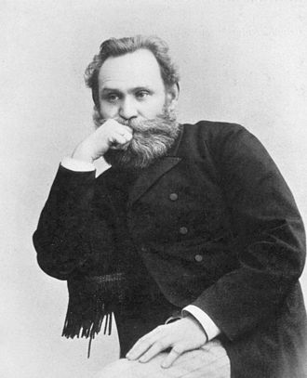
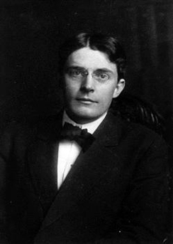
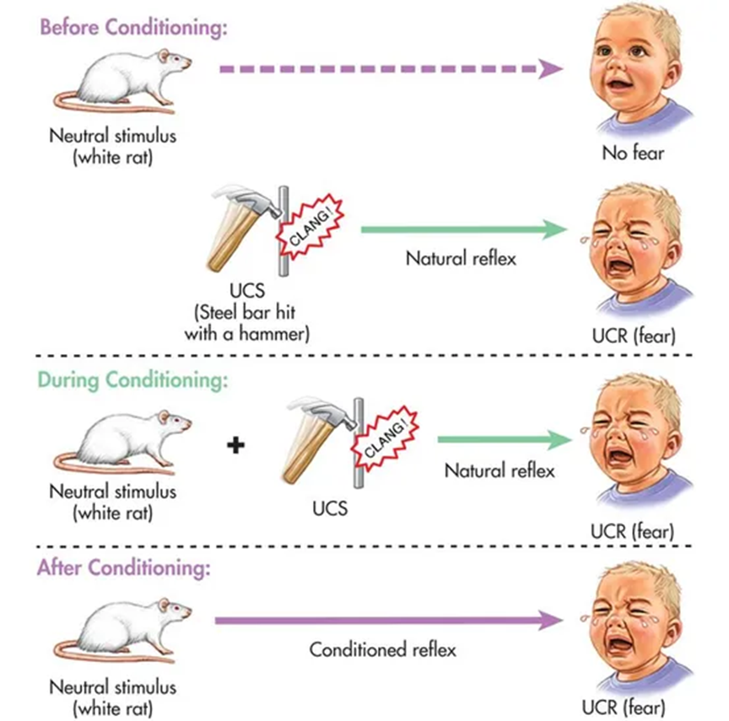
Theories of Development: Contemporary Theories of Development: Watson and Classical Conditioning
Image of Pavlov from Wikipedia. Licensed under CC BY SA 3.0
Image of Watson from “History of Psychology” Authored by Open Stax. Licensed under CC BY 4.0
Watson added to the work conducted by Pavlov using human participants instead of dogs.
He is recognized as a major influence in the shift of psychology from the mind to observable behavior.
Video: Watson’s Theory of Behaviourism. Describes Watson’s theory, explains the “Little Albert study, and shows the results of Watson’s attempts to use behaviorism to raise his own children.
Classical Conditioning Chart from Child Growth and Development: An Open Educational Resources Publication by College of the Canyons by Jennifer Paris, Antoinette Ricardo, and Dawn Richmond is licensed under CC BY 4.0

Slide 20
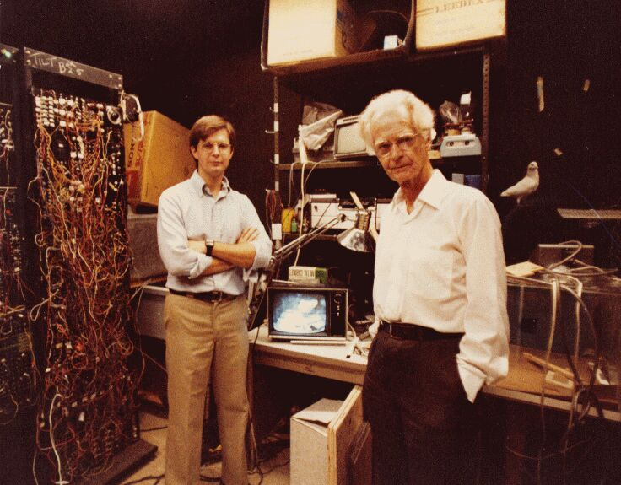
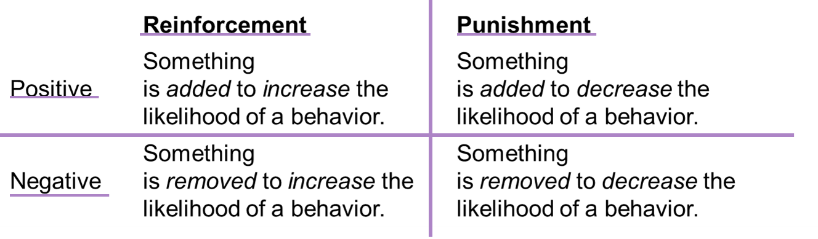
Theories of Development: Contemporary Theories of Development: Skinner and Operant Conditioning
Positive and Negative Reinforcement and Punishment
Table from Operant Conditioning Authored by Open Stax and licensed under CC BY 4.0
B.F. Skinner and Robert Epstein photographed in the Harvard Pigeon Laboratory in the 1980s.
Image from Wikimedia Commons by Biglicks12 is licensed under CC BY SA 4.0
YouTube Video: Interview with Skinner as He Discusses Conditioning Pigeons.
YouTube Video: Ted Ed Talk: The Difference between Classical and Operant Conditioning.

Slide 21
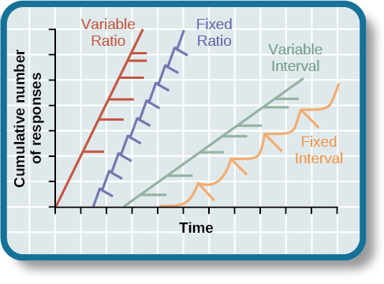
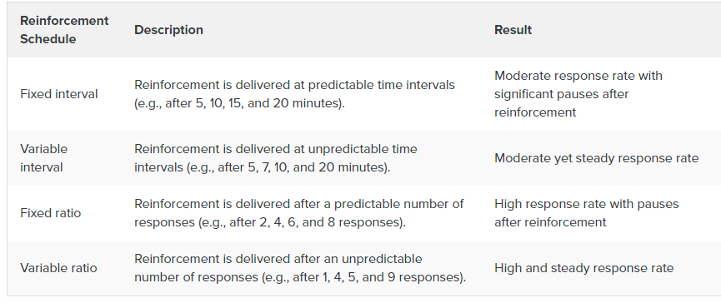
Theories of Development: Contemporary Theories of Development: Skinner and Schedules of Reinforcement
Video: Schedules of Reinforcement ,provides both explanations and examples for Schedules of Reinforcement
The four reinforcement schedules yield different response patterns.
  The variable ratio schedule is unpredictable and yields high and steady response rates, with little if any pause after reinforcement.
  A fixed ratio schedule is predictable and produces a high response rate, with a short pause after reinforcement.
  The variable interval schedule is unpredictable and produces a moderate, steady response rate.
  The fixed interval schedule yields a scallop-shaped response pattern, reflecting a significant pause after reinforcement.
Image, Table and Text from Operant Conditioning Authored by Open Stax and licensed under CC BY 4.0

Slide 22
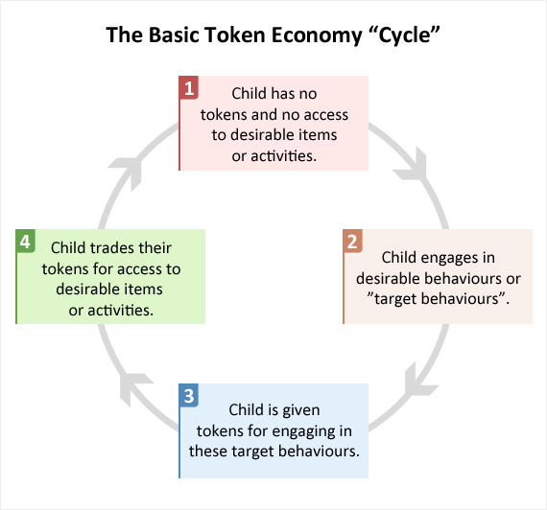
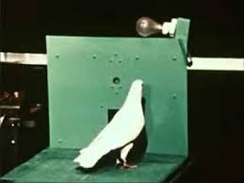
Theories of Development: Contemporary Theories of Development: Application of Operant Conditioning: Token Economy and Shaping
Video, “What is a Token Economy” shows a Mom discussing how she uses Token Economies to get her children to perform the positive behaviors.
Shaping, or method of successive approximations is the term used by Skinner to explain how learning can be achieved by rewarding a behavior at each successive step until the desired behavior is obtained.
Image from KNILT by Dr. Jianwei Zhang is licensed under CC BY NC 4.0
Token economies are based on operant conditioning principles and involve rewarding desirable behaviors with “tokens” that can be exchanged for items or privileges. Undesirable behaviors can be punished by taking away tokens.
The image above is taken from the following Video, B.F. Skinner Foundation – Pidgeon Turn and shows Skinner shaping the pecking behavior of a pigeon.

Slide 23
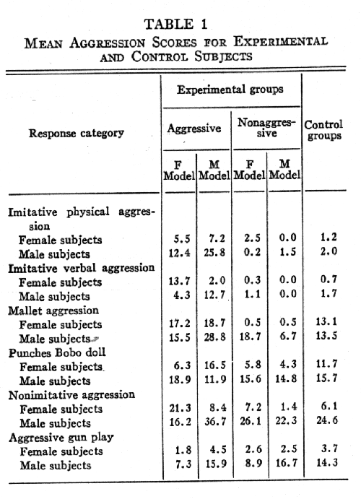

Theories of Development: Contemporary Theories of Development: Bandura and Social Learning Theory
Unlike Watson and Skinner, Bandura proposed that internal mental processes played an important role in human learning and human behavior. He called his theory a social cognitive learning theory because not only did learning occur from watching others being rewarded and punished for performing a behavior, but he also believed that this information was processed by the individual who watched the behavior being performed.
The table to the right provides the descriptive statistics from Bandura’s original study found at Bandura, Ross, and Ross, 1961. Public Domain.
Note the difference in behavior when the child is a male or female and when the model is a female or a male.
Video: Albert Bandura Bobo Doll Experiment. Bandura narrates his research and shows film clips from his original study.
Image from M(EYE) OBJECTIVE by Dorothea Lange Wordpress Blog no copyright or license found

Slide 24
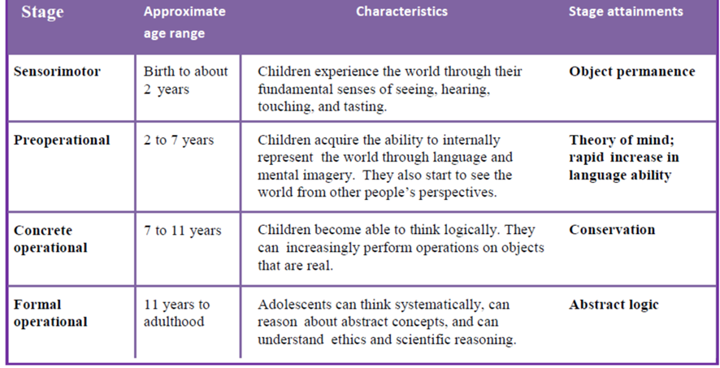
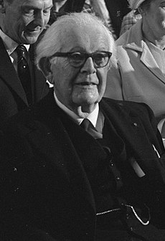
Theories of Development: Contemporary Theories of Development: Piaget and Cognitive Theory
According to Piaget:
A schema is mental template that a child develops to understand the world.
For learning to occur, schemas much change.
  Assimilation: Interpreting new information withing the framework of one’s existing knowledge.
  Accommodation: making changes to one’s knowledge in order to understand something that doesn’t fit into a pre-existing scheme
In order to develop cognitively, organisms need to balance accommodation with assimilation
Video: Schemas, Assimilation and Accommodation: Jean Piaget's Epistemological Concepts, provides an introduction to the concepts, schemas, assimilation, and accommodation.
Table from Lifespan Development: A Psychological Perspective 2nd Edition by Martha Lally and Suzanne Valentine-French is licensed under CC BY-NC-SA 3.0
Image of Piaget at the Royal Tropical Institute in Amsterdam (1972) as he is about to receive the Erasmus Prize is from Wikimedia Commons, and is licensed under CC0 1.0 Universal

Slide 25

Theories of Development: Contemporary Theories of Development: Vygotsky and Cognitive Theory
For Vygotsky, interaction with the more knowledgeable member of one’s family and community leads to the acquisition of thought processes like cognition.
Image of Vygotsky on the opening pages of Thought and Speech (1934) from Wikimedia Commons is licensed under CC BY SA 4.0 International
Video: Vygotsky's theory of Cognitive Development in Social Relationships
No new learning occurs because the task is too easy
No new learning occurs because the task is too difficult
What the Child Can do Without Assistance from Another
Skills too difficult for the child to do on his or her own but can be accomplished with the guidance from a knowledgeable other.
What the Child Can Not do. Even with the Assistance of Another
ZONE OF PROXIMAL DEVELOPMENT
New Learning Occurs
The Zone of Proximal Development: The area between the child’s independent abilities and what the child can do with help from those more knowledgeable.

Slide 26
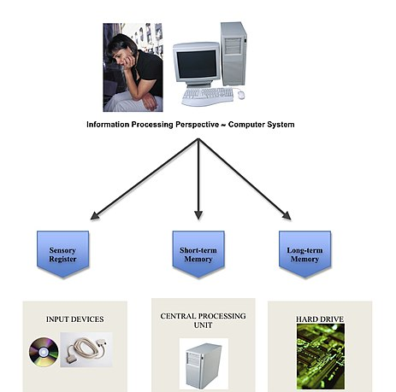
Theories of Development: Contemporary Theories of Development: Information Processing
Information Processing Theory: Breaks down the way we understand and use information into steps, such as acquiring information, storing it, and retrieving it, much in the same way a computer uses information.
  The more complex mental skills of adults are built from the primitive abilities of children.
Video: Information Processing Theory. Reviews the basic components of Information Processing Theory
Image from Wikimedia Commons and posted by Psych11-spain.
Image is cited as public domain.

Slide 27
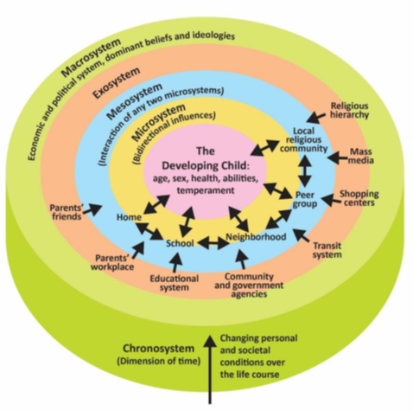
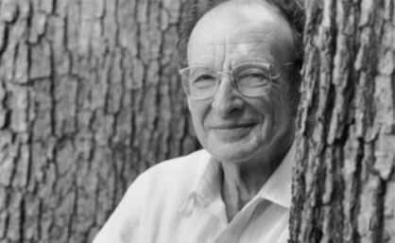
Theories of Development: Contemporary Theories of Development: Bronfenbrenner’s Ecological Systems Model
Bronfenbrenner’s Ecological Systems Model offers a framework for psychologists to better understand how the interaction between the individual, their community, and society can influence development.
Image from “Child Growth and Development” by Jean Zaar, M.S. and is licensed under CC BY-SA 4.0.
Video: Bronfenbrenner’s Ecological Systems: 5 Forces Impacting Our Lives, explains and provides examples of Ecological Systems Theory.
Image by Ian Joslin can be found on ResearcGate.net and is licensed under CC BY SA 4.0

Slide 28
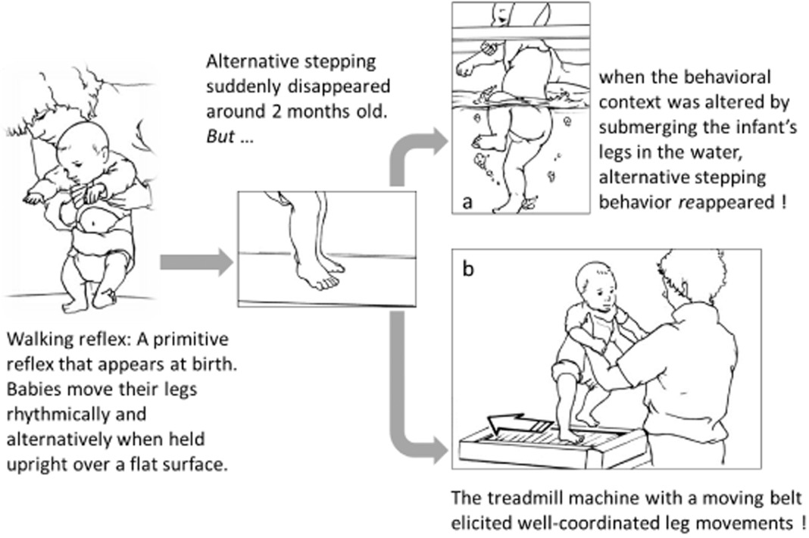
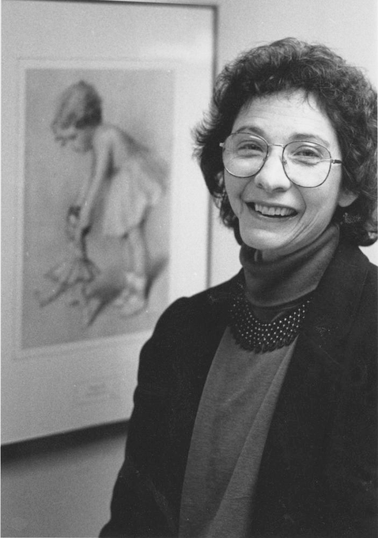
Theories of Development: Contemporary Theories of Development: Thelen and Dynamic Systems Theory
According to Thelen, “ Development can only be understood as the multiple, mutual, and continuous interactions of all the levels of developing system, from the molecular to the cultural.” (Thelen, E., & Smith, L. B. (1994) A dynamic systems approach to the development of cognition and action. Cambridge, MA: MIT Press)
Thelen’s research showed that:
  Developmental processes are nonlinear (unlike the theories proposed by Freud, Piaget, and Vygotsky.
  Variability in development serves a functional purpose.
The image to the right shows the disappearance of a newborn baby's stepping behavior and its reappearance in altered behavioral contexts. (From Wiley Online Library. Maruyama, Dineva, Spencer, & Schoner, (2014). Japanese Psychological Research, Volume:68, pages 386-401, first published October 7, 2014.)
Image from Twitter posted by the Indiana University Archives
Video: Motor Development – Baby Body Sense (Esther Thelen). This video also includes a general discussion of motor development and the work of Eugene Goldfield. The discussion of Thelen’s work begins at timestamp 3:17

