Slide 1


Introduction to Food & Beverage Management
Culinary Math:
Costing

Slide 2
Metric
1000 ml = 1 l
1000 g = 1 kg
1 l ≅ 34 fl. oz. ≅ 1 qt
1 kg = 2.2 lb.
1 oz ≅ 28 g

Slide 3
Costing
    To determine cost:
    determine how much you need
    determine the units in which the ingredient is sold (pounds, gallons, liters, bushels, etc.)
    translate your ingredient into those units
    multiply by unit cost

Slide 4
Costing
    To determine cost:
    how much you need
    quantity in which
    item is sold
× unit price = cost

Slide 5
Introduction to Costing
• AP cost: as purchased cost

Slide 6
Introduction to Costing
• if a pound of Parmesan costs you $12 dollars a pound and you use ½ ounce per portion, what is your cost per portion?

Slide 7
Introduction to Costing
• ½ ounce = 1/32 lb = .03125 lb
.0315 X $12 = $0.375 /portion

Slide 8
Introduction to Costing
If a recipe for lasagna uses 3 ounces Parmesan and serves 8 people what is the cost of Parmesan per portion?

Slide 9
Introduction to Costing
3 oz = 3/16 lb = .1875 lb
.1875 × $12 = $2.25/recipe
2.25 ÷ 8 = $0.28125/portion

Slide 10
Costing Biscuits
Ingredients
Quantity
unit
sold
quantity in
units sold
$ cost/
unit
Extension $
Bread Flour | 1 lb. 4 oz. | lb.
Pastry Flour | 1 lb. 4 oz. | lb.
Salt | .75 oz. | lb.
Sugar | 2 oz. | lb.
Baking Powder | 2.5 oz. | lb.
Shortening | 14 oz. | lb.
Milk | 1 pt. 10 fl. oz. | qt.

Slide 11
Costing Biscuits
Ingredients
Quantity
unit
sold
quantity in
units sold
$ cost/
unit
Extension $
Bread Flour | 1 lb. 4 oz. | lb. | 1.25
Pastry Flour | 1 lb. 4 oz. | lb. | 1.25
Salt | .75 oz. | lb.
Sugar | 2 oz. | lb.
Baking Powder | 2.5 oz. | lb.
Shortening | 14 oz. | lb.
Milk | 1 pt. 10 fl. oz. | qt.

Slide 12
Costing Biscuits
Ingredients
Quantity
unit
sold
quantity in
units sold
$ cost/
unit
Extension $
Bread Flour | 1 lb. 4 oz. | lb. | 1.25
Pastry Flour | 1 lb. 4 oz. | lb. | 1.25
Salt | .75 oz. | lb. | .047
Sugar | 2 oz. | lb.
Baking Powder | 2.5 oz. | lb.
Shortening | 14 oz. | lb.
Milk | 1 pt. 10 fl. oz. | qt.

Slide 13
Costing Biscuits
Ingredients
Quantity
unit
sold
quantity in
units sold
$ cost/
unit
Extension $
Bread Flour | 1 lb. 4 oz. | lb. | 1.25
Pastry Flour | 1 lb. 4 oz. | lb. | 1.25
Salt | .75 oz. | lb. | .047
Sugar | 2 oz. | lb. | .125
Baking Powder | 2.5 oz. | lb.
Shortening | 14 oz. | lb.
Milk | 1 pt. 10 fl. oz. | qt.

Slide 14
Costing Biscuits
Ingredients
Quantity
unit
sold
quantity in
units sold
$ cost/
unit
Extension $
Bread Flour | 1 lb. 4 oz. | lb. | 1.25
Pastry Flour | 1 lb. 4 oz. | lb. | 1.25
Salt | .75 oz. | lb. | .047
Sugar | 2 oz. | lb. | .125
Baking Powder | 2.5 oz. | lb. | .156
Shortening | 14 oz. | lb.
Milk | 1 pt. 10 fl. oz. | qt.

Slide 15
Costing Biscuits
Ingredients
Quantity
unit
sold
quantity in
units sold
$ cost/
unit
Extension $
Bread Flour | 1 lb. 4 oz. | lb. | 1.25
Pastry Flour | 1 lb. 4 oz. | lb. | 1.25
Salt | .75 oz. | lb. | .047
Sugar | 2 oz. | lb. | .125
Baking Powder | 2.5 oz. | lb. | .156
Shortening | 14 oz. | lb. | .875
Milk | 1 pt. 10 fl. oz. | qt.

Slide 16
Costing Biscuits
Ingredients
Quantity
unit
sold
quantity in
units sold
$ cost/
unit
Extension $
Bread Flour | 1 lb. 4 oz. | lb. | 1.25
Pastry Flour | 1 lb. 4 oz. | lb. | 1.25
Salt | .75 oz. | lb. | .047
Sugar | 2 oz. | lb. | .125
Baking Powder | 2.5 oz. | lb. | .156
Shortening | 14 oz. | lb. | .875
Milk | 1 pt. 10 fl. oz. | qt. | .813

Slide 17
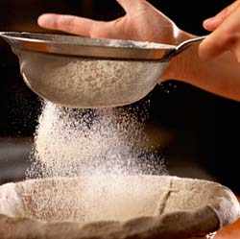
Costing Biscuits
Bread Flour = $0.64 per lb

Slide 18
Costing Biscuits
unit
sold
quantity
units sold
$ cost/
unit
Ingredients
Quantity
Extension $
Bread Flour | 1 lb. 4 oz. | lb. | 1.25 | .64
Pastry Flour | 1 lb. 4 oz. | lb. | 1.25
Salt | .75 oz. | lb. | .047
Sugar | 2 oz. | lb. | .125
Baking Powder | 2.5 oz. | lb. | .156
Shortening | 14 oz. | lb. | .875
Milk | 1 pt. 10 fl. oz. | qt. | .813

Slide 19
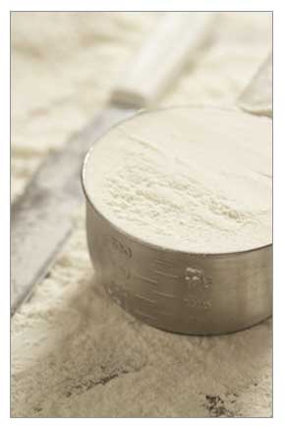
Costing Biscuits
Pastry Flour = $0.54 per lb

Slide 20
Costing Biscuits
unit
sold
quantity
units sold
$ cost/
unit
Ingredients
Quantity
Extension $
Bread Flour | 1 lb. 4 oz. | lb. | 1.25 | .64
Pastry Flour | 1 lb. 4 oz. | lb. | 1.25 | .54
Salt | .75 oz. | lb. | .047
Sugar | 2 oz. | lb. | .125
Baking Powder | 2.5 oz. | lb. | .156
Shortening | 14 oz. | lb. | .875
Milk | 1 pt. 10 fl. oz. | qt. | .813

Slide 21
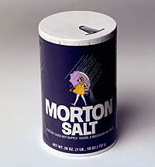
Costing Biscuits
Salt = $0.16 per lb.

Slide 22
Costing Biscuits
unit
sold
quantity
units sold
$ cost/
unit
Ingredients
Quantity
Extension $
Bread Flour | 1 lb. 4 oz. | lb. | 1.25 | .64
Pastry Flour | 1 lb. 4 oz. | lb. | 1.25 | .54
Salt | .75 oz. | lb. | .047 | .16
Sugar | 2 oz. | lb. | .125
Baking Powder | 2.5 oz. | lb. | .156
Shortening | 14 oz. | lb. | .875
Milk | 1 pt. 10 fl. oz. | qt. | .813

Slide 23
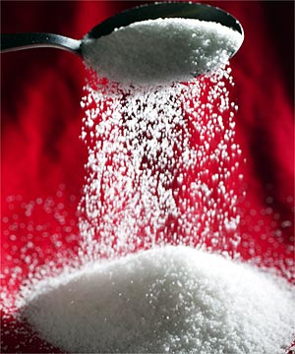
Costing Biscuits
Sugar = $0.64 per lb.

Slide 24
Costing Biscuits
unit
sold
quantity
units sold
$ cost/
unit
Ingredients
Quantity
Extension $
Bread Flour | 1 lb. 4 oz. | lb. | 1.25 | .64
Pastry Flour | 1 lb. 4 oz. | lb. | 1.25 | .54
Salt | .75 oz. | lb. | .047 | .16
Sugar | 2 oz. | lb. | .125 | .64
Baking Powder | 2.5 oz. | lb. | .156
Shortening | 14 oz. | lb. | .875
Milk | 1 pt. 10 fl. oz. | qt. | .813

Slide 25
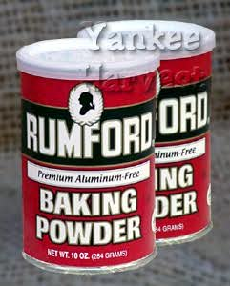
Costing Biscuits
Baking Powder = $0.80 per lb
How much do oz. of shortening cost?

Slide 26
Costing Biscuits
unit
sold
quantity
units sold
$ cost/
unit
Ingredients
Quantity
Extension $
Bread Flour | 1 lb. 4 oz. | lb. | 1.25 | .64
Pastry Flour | 1 lb. 4 oz. | lb. | 1.25 | .54
Salt | .75 oz. | lb. | .047 | .16
Sugar | 2 oz. | lb. | .125 | .64
Baking Powder | 2.5 oz. | lb. | .156 | .80
Shortening | 14 oz. | lb. | .875
Milk | 1 pt. 10 fl. oz. | qt. | .813

Slide 27
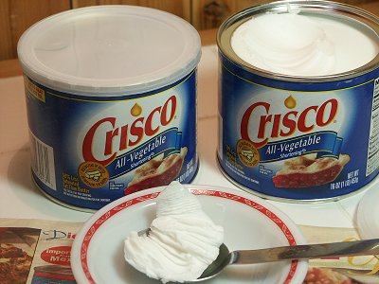
Costing Biscuits
Shortening is = $1.75 per lb

Slide 28
Costing Biscuits
unit
sold
quantity
units sold
$ cost/
unit
Ingredients
Quantity
Extension $
Bread Flour | 1 lb. 4 oz. | lb. | 1.25 | .64
Pastry Flour | 1 lb. 4 oz. | lb. | 1.25 | .54
Salt | .75 oz. | lb. | .047 | .16
Sugar | 2 oz. | lb. | .125 | .64
Baking Powder | 2.5 oz. | lb. | .156 | .80
Shortening | 14 oz. | lb. | .875 | 1.75
Milk | 1 pt. 10 fl. oz. | qt. | .813

Slide 29
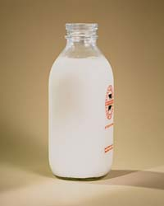
Costing Biscuits
Milk is = $1.89 per qt
What does 26 oz of Milk cost?

Slide 30
Costing Biscuits
unit
sold
quantity
units sold
$ cost/
unit
Ingredients
Quantity
Extension $
Bread Flour | 1 lb. 4 oz. | lb. | 1.25 | .64
Pastry Flour | 1 lb. 4 oz. | lb. | 1.25 | .54
Salt | .75 oz. | lb. | .047 | .16
Sugar | 2 oz. | lb. | .125 | .64
Baking Powder | 2.5 oz. | lb. | .156 | .80
Shortening | 14 oz. | lb. | .875 | 1.75
Milk | 1 pt. 10 fl. oz. | qt. | .813 | 1.89

Slide 31
Costing Biscuits
always round up
to nearest ¢
unit
sold
quantity
units sold
$ cost/
unit
Ingredients
Quantity
Extension $
Bread Flour | 1 lb. 4 oz. | lb. | 1.25 | .64 | .80
Pastry Flour | 1 lb. 4 oz. | lb. | 1.25 | .54
Salt | .75 oz. | lb. | .047 | .16
Sugar | 2 oz. | lb. | .125 | .64
Baking Powder | 2.5 oz. | lb. | .156 | .80
Shortening | 14 oz. | lb. | .875 | 1.75
Milk | 1 pt. 10 fl. oz. | qt. | .813 | 1.89

Slide 32
Costing Biscuits
unit
sold
quantity
units sold
$ cost/
unit
Ingredients
Quantity
Extension $
Bread Flour | 1 lb. 4 oz. | lb. | 1.25 | .64 | .80
Pastry Flour | 1 lb. 4 oz. | lb. | 1.25 | .54 | .68
Salt | .75 oz. | lb. | .047 | .16
Sugar | 2 oz. | lb. | .125 | .64
Baking Powder | 2.5 oz. | lb. | .156 | .80
Shortening | 14 oz. | lb. | .875 | 1.75
Milk | 1 pt. 10 fl. oz. | qt. | .813 | 1.89

Slide 33
Costing Biscuits
unit
sold
quantity
units sold
$ cost/
unit
Ingredients
Quantity
Extension $
Bread Flour | 1 lb. 4 oz. | lb. | 1.25 | .64 | .80
Pastry Flour | 1 lb. 4 oz. | lb. | 1.25 | .54 | .68
Salt | .75 oz. | lb. | .047 | .16 | .01
Sugar | 2 oz. | lb. | .125 | .64
Baking Powder | 2.5 oz. | lb. | .156 | .80
Shortening | 14 oz. | lb. | .875 | 1.75
Milk | 1 pt. 10 fl. oz. | qt. | .813 | 1.89

Slide 34
Costing Biscuits
unit
sold
quantity
units sold
$ cost/
unit
Ingredients
Quantity
Extension $
Bread Flour | 1 lb. 4 oz. | lb. | 1.25 | .64 | .80
Pastry Flour | 1 lb. 4 oz. | lb. | 1.25 | .54 | .68
Salt | .75 oz. | lb. | .047 | .16 | .01
Sugar | 2 oz. | lb. | .125 | .64 | .08
Baking Powder | 2.5 oz. | lb. | .156 | .80
Shortening | 14 oz. | lb. | .875 | 1.75
Milk | 1 pt. 10 fl. oz. | qt. | .813 | 1.89

Slide 35
Costing Biscuits
unit
sold
quantity
units sold
$ cost/
unit
Ingredients
Quantity
Extension $
Bread Flour | 1 lb. 4 oz. | lb. | 1.25 | .64 | .80
Pastry Flour | 1 lb. 4 oz. | lb. | 1.25 | .54 | .68
Salt | .75 oz. | lb. | .047 | .16 | .01
Sugar | 2 oz. | lb. | .125 | .64 | .08
Baking Powder | 2.5 oz. | lb. | .156 | .80 | .13
Shortening | 14 oz. | lb. | .875 | 1.75
Milk | 1 pt. 10 fl. oz. | qt. | .813 | 1.89

Slide 36
Costing Biscuits
unit
sold
quantity
units sold
$ cost/
unit
Ingredients
Quantity
Extension $
Bread Flour | 1 lb. 4 oz. | lb. | 1.25 | .64 | .80
Pastry Flour | 1 lb. 4 oz. | lb. | 1.25 | .54 | .68
Salt | .75 oz. | lb. | .047 | .16 | .01
Sugar | 2 oz. | lb. | .125 | .64 | .08
Baking Powder | 2.5 oz. | lb. | .156 | .80 | .13
Shortening | 14 oz. | lb. | .875 | 1.75 | 1.54
Milk | 1 pt. 10 fl. oz. | qt. | .813 | 1.89

Slide 37
Costing Biscuits
unit
sold
quantity
units sold
$ cost/
unit
Ingredients
Quantity
Extension $
Bread Flour | 1 lb. 4 oz. | lb. | 1.25 | .64 | .80
Pastry Flour | 1 lb. 4 oz. | lb. | 1.25 | .54 | .68
Salt | .75 oz. | lb. | .047 | .16 | .01
Sugar | 2 oz. | lb. | .125 | .64 | .08
Baking Powder | 2.5 oz. | lb. | .156 | .80 | .13
Shortening | 14 oz. | lb. | .875 | 1.75 | 1.54
Milk | 1 pt. 10 fl. oz. | qt. | .813 | 1.89 | 1.54

Slide 38
Costing Biscuits
    1 batch biscuits costs $ 4.78
    recipe makes 64 biscuits
    what’s the food cost on 1 biscuit?

Slide 39
Costing Biscuits
    1 batch biscuits costs $ 4.78
    recipe makes 64 biscuits
    what’s the food cost on 1 biscuit?
    $4.78 ÷ 64 = $.0747 ≅ $.08

Slide 40
Costing Risotto
    recipe yield: 6 portions
    recipe requires 1 1/2 cups arborio rice
    Arborio rice costs $2.95/lb
    1 cup arborio rice weighs 7 ounces
    what is the cost of rice in 1 portion?

Slide 41
Costing Risotto
ingredients
quantity
standard
weight
total
weight
unit
sold
quantity in
units sold
$ cost/
unit
Extension $
Arborio Rice | 1½ c | 1c = 7oz. |  | lb. |  | 2.95

Slide 42
Costing Risotto
ingredients
quantity
standard
weight
total
weight
unit
sold
quantity in
units sold
$ cost/
unit
Extension $
Arborio Rice | 1½ c | 1c = 7oz. | 10.5 oz. | lb. |  | 2.95

Slide 43
Costing Risotto
ingredients
quantity
standard
weight
total
weight
unit
sold
quantity in
units sold
$ cost/
unit
Extension $
Arborio Rice | 1½ c | 1c = 7oz. | 10.5 oz. | lb. | .66 | 2.95

Slide 44
Costing Risotto
ingredients
quantity
standard
weight
total
weight
unit
sold
quantity in
units sold
$ cost/
unit
Extension $
Arborio Rice | 1½ c | 1c = 7oz. | 10.5 oz. | lb. | .66 | 2.95 | 1.94

Slide 45
Costing Risotto
    yield 6 portions • 1 1/2 cups arborio rice
    Arborio rice $2.95/lb • 1 c. weighs 7 oz. 7 oz. × 1.5 (c.) = 10.5 oz.
    .66 lb × $2.95 = $1.94
    what is the cost of rice in 1 portion?
    $1.94 ÷ 6 = $.33

