Slide 1
Algorithms
Chapter 3
With Question/Answer Animations

Slide 2
Greedy Algorithms
Optimization problems minimize or maximize some parameter over all possible inputs.
Among the many optimization problems we will study are:
  Finding a route between two cities with the smallest total mileage.
  Determining how to encode messages using the fewest possible bits.
  Finding the fiber links between network nodes using the least amount of fiber.
Optimization problems can often be solved using a greedy algorithm, which makes the “best” choice at each step. Making the “best choice” at each step does not necessarily produce an optimal solution to the overall problem, but in many instances, it does.
After specifying what the “best choice” at each step is, we try to prove that this approach always produces an optimal solution, or find a counterexample to show that it does not.
The greedy approach to solving problems is an example of an algorithmic paradigm, which is a general approach for designing an algorithm. We return to algorithmic paradigms in Section 3.3.

Slide 3
Greedy Algorithms: Making Change
Example: Design a greedy algorithm for making change (in U.S. money) of n cents with the following coins: quarters (25 cents), dimes (10 cents), nickels (5 cents), and pennies (1 cent) , using the least total number of coins.
Idea: At each step choose the coin with the largest possible value that does not exceed the amount of change left.
  If n = 67 cents, first choose a quarter leaving 67−25 = 42 cents. Then choose another quarter leaving 42 −25 = 17 cents
  Then choose 1 dime, leaving 17 − 10 = 7 cents.
  Choose 1 nickel, leaving 7 – 5 – 2 cents.
  Choose a penny, leaving one cent. Choose another penny leaving 0 cents.

Slide 4
Greedy Change-Making Algorithm
Solution: Greedy change-making algorithm for n cents. The algorithm works with any coin denominations c₁, c₂, …,c_{r} .
  For the example of U.S. currency, we may have quarters, dimes, nickels and pennies, with c₁ = 25, c₂ = 10, c₃ = 5, and c₄ = 1.
procedure change(c₁, c₂, …, c_{r}: values of coins, where c₁> c₂> … > c_{r} ; n: a positive integer)
for i := 1 to r
d_{i} := 0 [d_{i} counts the coins of denomination c_{i}]
while n ≥ c_{i}
d_{i} := d_{i} + 1 [add a coin of denomination c_{i}]
n = n - c_{i}
[d_{i} counts the coins c_{i}]

Slide 5
Proving Optimality for U.S. Coins
Show that the change making algorithm for U.S. coins is optimal.
Lemma 1: If n is a positive integer, then n cents in change using quarters, dimes, nickels, and pennies, using the fewest coins possible has at most 2 dimes, 1 nickel, 4 pennies, and cannot have 2 dimes and a nickel. The total amount of change in dimes, nickels, and pennies must not exceed 24 cents.
Proof: By contradiction
  If we had 3 dimes, we could replace them with a quarter and a nickel.
  If we had 2 nickels, we could replace them with 1 dime.
  If we had 5 pennies, we could replace them with a nickel.
  If we had 2 dimes and 1 nickel, we could replace them with a quarter.
  The allowable combinations, have a maximum value of 24 cents; 2 dimes and 4 pennies.

Slide 6
Proving Optimality for U.S. Coins
Theorem: The greedy change-making algorithm for U.S. coins produces change using the fewest coins possible.
Proof: By contradiction.
  Assume there is a positive integer n such that change can be made for n cents using quarters, dimes, nickels, and pennies, with a fewer total number of coins than given by the algorithm.
  Then, q̍ ≤ q where q̍ is the number of quarters used in this optimal way and q is the number of quarters in the greedy algorithm’s solution. But this is not possible by Lemma 1, since the value of the coins other than quarters can not be greater than 24 cents.
  Similarly, by Lemma 1, the two algorithms must have the same number of dimes, nickels, and quarters.

Slide 7
Greedy Change-Making Algorithm
Optimality depends on the denominations available.
For U.S. coins, optimality still holds if we add half dollar coins (50 cents) and dollar coins (100 cents).
But if we allow only quarters (25 cents), dimes (10 cents), and pennies (1 cent), the algorithm no longer produces the minimum number of coins.
  Consider the example of 31 cents. The optimal number of coins is 4, i.e., 3 dimes and 1 penny. What does the algorithm output?

Slide 8
Halting Problem
Example: Can we develop a procedure that takes as input a computer program along with its input and determines whether the program will eventually halt with that input.
Solution: Proof by contradiction.
Assume that there is such a procedure and call it H(P,I). The procedure H(P,I) takes as input a program P and the input I to P.
  H outputs “halt” if it is the case that P will stop when run with input I.
  Otherwise, H outputs “loops forever.”

Slide 9
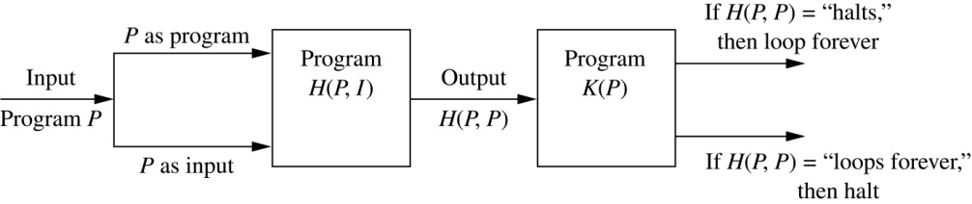
Halting Problem
Since a program is a string of characters, we can call H(P,P). Construct a procedure K(P), which works as follows.
  If H(P,P) outputs “loops forever” then K(P) halts.
  If H(P,P) outputs “halt” then K(P) goes into an infinite loop printing “ha” on each iteration.

Slide 10
Halting Problem
Now we call K with K as input, i.e. K(K).
  If the output of H(K,K) is “loops forever” then K(K) halts. A Contradiction.
  If the output of H(K,K) is “halts” then K(K) loops forever. A Contradiction.
Therefore, there can not be a procedure that can decide whether or not an arbitrary program halts. The halting problem is unsolvable.

Slide 11
The Growth of Functions
Section 3.2

Slide 12
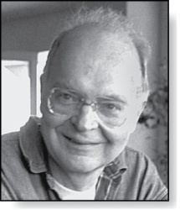
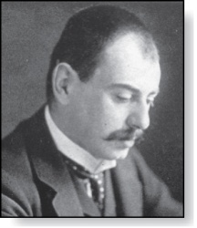
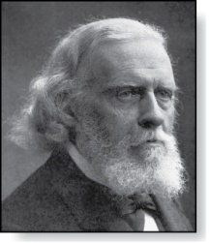
Section Summary
Donald E. Knuth
(Born 1938)
Big-O Notation
Big-O Estimates for Important Functions
Big-Omega and Big-Theta Notation
Edmund Landau
(1877-1938)
Paul Gustav Heinrich Bachmann
(1837-1920)

Slide 13
The Growth of Functions
In both computer science and in mathematics, there are many times when we care about how fast a function grows.
In computer science, we want to understand how quickly an algorithm can solve a problem as the size of the input grows.
  We can compare the efficiency of two different algorithms for solving the same problem.
  We can also determine whether it is practical to use a particular algorithm as the input grows.
  We’ll study these questions in Section 3.3.
Two of the areas of mathematics where questions about the growth of functions are studied are:
  number theory (covered in Chapter 4)
  combinatorics (covered in Chapters 6 and 8)

Slide 14
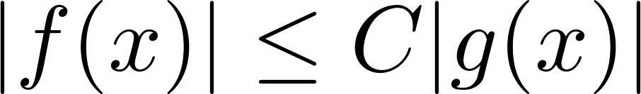
Big-O Notation
Definition: Let f and g be functions from the set of integers or the set of real numbers to the set of real numbers. We say that f(x) is O(g(x)) if there are constants C and k such that
whenever x > k. (illustration on next slide)
This is read as “f(x) is big-O of g(x)” or “g asymptotically dominates f.”
The constants C and k are called witnesses to the relationship f(x) is O(g(x)). Only one pair of witnesses is needed.

Slide 15
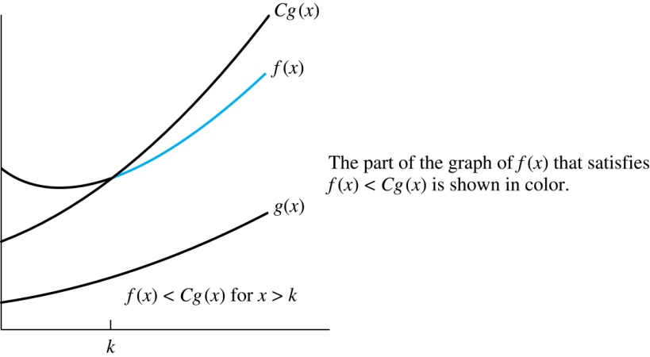
Illustration of Big-O Notation
f(x) is O(g(x)

Slide 16

Some Important Points about Big-O Notation
If one pair of witnesses is found, then there are infinitely many pairs. We can always make the k or the C larger and still maintain the inequality .
  Any pair C ̍ and k̍ where C < C̍ and k < k ̍ is also a pair of witnesses since whenever x > k̍ > k.
You may see “ f(x) = O(g(x))” instead of “ f(x) is O(g(x)).”
  But this is an abuse of the equals sign since the meaning is that there is an inequality relating the values of f and g, for sufficiently large values of x.
  It is ok to write f(x) ∊ O(g(x)), because O(g(x)) represents the set of functions that are O(g(x)).
Usually, we will drop the absolute value sign since we will always deal with functions that take on positive values.

Slide 17
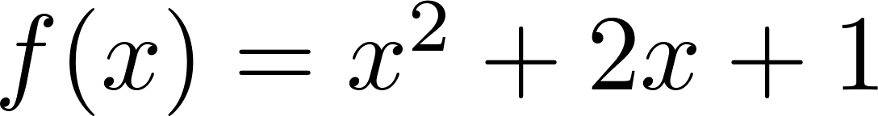
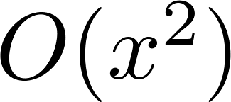
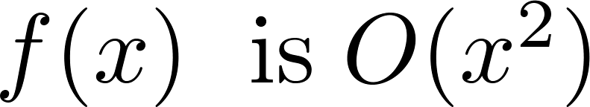
Using the Definition of Big-O Notation
Example: Show that is .
Solution: Since when x > 1, x < x² and 1 < x²
  Can take C = 4 and k = 1 as witnesses to show that
(see graph on next slide)
Alternatively, when x > 2, we have 2x ≤ x² and 1 < x². Hence, when x > 2.
  Can take C = 3 and k = 2 as witnesses instead.

Slide 18
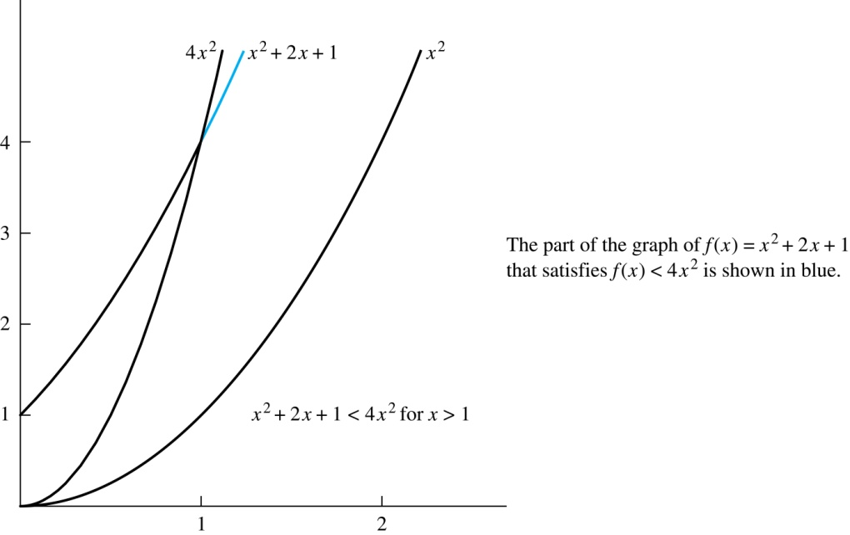
Illustration of Big-O Notation
is

Slide 19
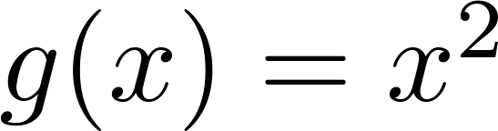
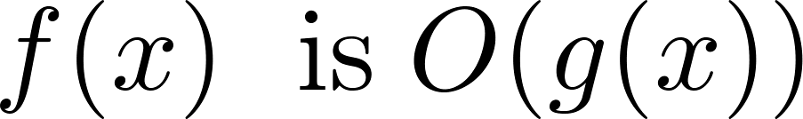

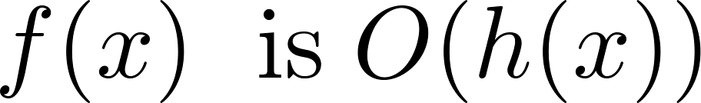
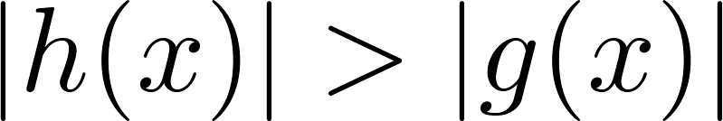
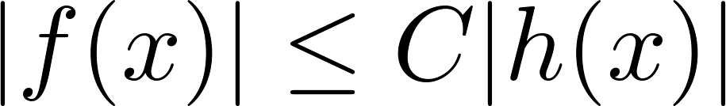
Big-O Notation
Both and
are such that and .
We say that the two functions are of the same order. (More on this later)
If and h(x) is larger than g(x) for all positive real numbers, then .
Note that if for x > k and if
for all x, then if x > k. Hence, .
For many applications, the goal is to select the function g(x) in O(g(x)) as small as possible (up to multiplication by a constant, of course).

Slide 20
Using the Definition of Big-O Notation
Example: Show that 7x² is O(x³).
Solution: When x > 7, 7x² < x³. Take C =1 and k = 7 as witnesses to establish that 7x² is O(x³).
(Would C = 7 and k = 1 work?)
Example: Show that n² is not O(n).
Solution: Suppose there are constants C and k for which n² ≤ Cn, whenever n > k. Then (by dividing both sides of n² ≤ Cn) by n, then n ≤ C must hold for all n > k. A contradiction!

Slide 21

Big-O Estimates for Polynomials
Example: Let
where are real numbers with a_{n} ≠0.
Then f(x) is O(x^{n}).
Proof: |f(x)| = |a_{n}x^{n} + a_{n-1} x^{n-1} + ∙∙∙ + a₁x¹ + a₁|
≤ |a_{n}|x^{n} + |a_{n-1}| x^{n-1} + ∙∙∙ + |a₁|x¹ + |a₁|
= x^{n} (|a_{n}| + |a_{n-1}| /x + ∙∙∙ + |a₁|/x^{n-1} + |a₁|/ x^{n})
≤ x^{n} (|a_{n}| + |a_{n-1}| + ∙∙∙ + |a₁|+ |a₁|)
Take C = |a_{n}| + |a_{n-1}| + ∙∙∙ + |a₁|+ |a₁| and k = 1. Then f(x) is O(x^{n}).
The leading term a_{n}x^{n} of a polynomial dominates its growth.
Uses triangle inequality, an exercise in Section 1.8.
Assuming x > 1

Slide 22
Big-O Estimates for some Important Functions
Example: Use big-O notation to estimate the sum of the first n positive integers.
Solution:
Example: Use big-O notation to estimate the factorial function
Solution:
Continued →

Slide 23
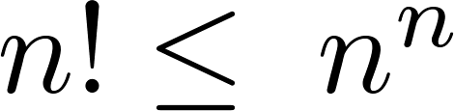
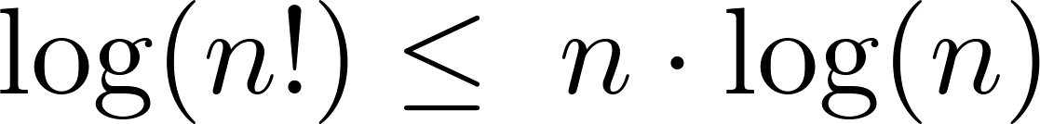
Big-O Estimates for some Important Functions
Example: Use big-O notation to estimate log n!
Solution: Given that (previous slide)
then .
Hence, log(n!) is O(n∙log(n)) taking C = 1 and k = 1.

Slide 24
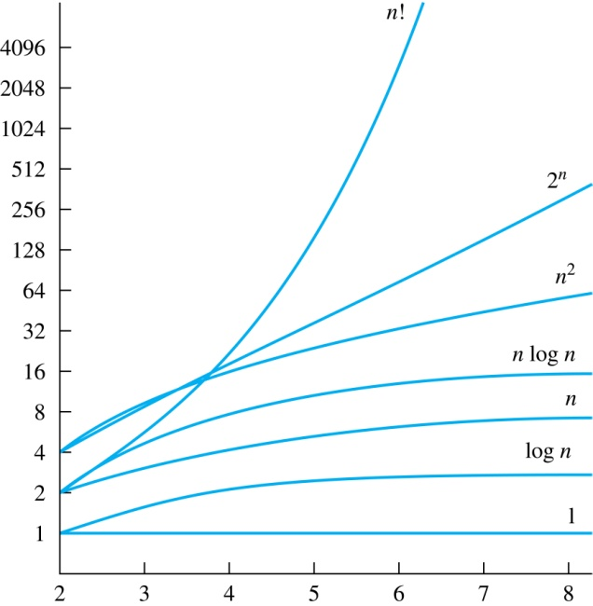
Display of Growth of Functions
Note the difference in behavior of functions as n gets larger

Slide 25
Useful Big-O Estimates Involving Logarithms, Powers, and Exponents
If d > c > 1, then
n^{c} is O(n^{d}), but n^{d} is not O(n^{c}).
If b > 1 and c and d are positive, then
(log_{b} n)^{c} is O(n^{d}), but n^{d} is not O((log_{b} n)^{c}).
If b > 1 and d is positive, then
n^{d} is O(b^{n}), but b^{n} is not O(n^{d}).
If c > b > 1, then
b^{n} is O(c^{n}), but c^{n} is not O(b^{n}).

Slide 26
Combinations of Functions
If f₁ (x) is O(g₁(x)) and f₂ (x) is O(g₂(x)) then
( f₁ + f₂ )(x) is O(max(|g₁(x) |,|g₂(x) |)).
  See next slide for proof
If f₁ (x) and f₂ (x) are both O(g(x)) then
( f₁ + f₂ )(x) is O(g(x)).
  See text for argument
If f₁ (x) is O(g₁(x)) and f₂ (x) is O(g₂(x)) then
( f₁ f₂ )(x) is O(g₁(x)g₂(x)).
  See text for argument

Slide 27
Combinations of Functions
If f₁ (x) is O(g₁(x)) and f₂ (x) is O(g₂(x)) then
( f₁ + f₂ )(x) is O(max(|g₁(x) |,|g₂(x) |)).
  By the definition of big-O notation, there are constants C₁,C₂ ,k₁,k₂ such that | f₁ (x) ≤ C₁|g₁(x) | when x > k₁ and f₂ (x) ≤ C₂|g₂(x) | when x > k₂ .
  |( f₁ + f₂ )(x)| = |f₁(x) + f₂(x)|
≤ |f₁ (x)| + |f₂ (x)| by the triangle inequality |a + b| ≤ |a| + |b|
  |f₁ (x)| + |f₂ (x)| ≤ C₁|g₁(x) | + C₂|g₂(x) |
≤ C₁|g(x) | + C₂|g(x) | where g(x) = max(|g₁(x)|,|g₂(x)|)
= (C₁ + C₂) |g(x)|
= C|g(x)| where C = C₁ + C₂
  Therefore |( f₁ + f₂ )(x)| ≤ C|g(x)| whenever x > k, where k = max(k₁,k₂).

Slide 28
Ordering Functions by Order of Growth
Put the functions below in order so that each function is big-O of the next function on the list.
f₁(n) = (1.5)^{n}
f₂(n) = 8n³+17n² +111
f₃(n) = (log n )²
f₄(n) = 2^{n}
f₅(n) = log (log n)
f₆(n) = n² (log n)³
f₇(n) = 2^{n} (n² +1)
f₈(n) = n³+ n(log n)²
f₉(n) = 10000
f₁₀(n) = n!
We solve this exercise by successively finding the function that grows slowest among all those left on the list.
f₉(n) = 10000 (constant, does not increase with n)
f₅(n) = log (log n) (grows slowest of all the others)
f₃(n) = (log n )² (grows next slowest)
f₆(n) = n² (log n)³ (next largest, (log n)³ factor smaller than any power of n)
f₂(n) = 8n³+17n² +111 (tied with the one below)
f₈(n) = n³+ n(log n)² (tied with the one above)
f₁(n) = (1.5)^{n} (next largest, an exponential function)
f₄(n) = 2^{n} (grows faster than one above since 2 > 1.5)
f₇(n) = 2^{n} (n² +1) (grows faster than above because of the n² +1 factor)
f₁₀(n) = 3^{n} ( n! grows faster than c^{n} for every c)

Slide 29
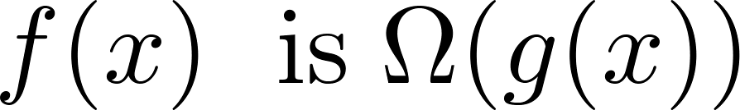
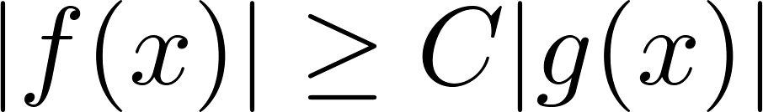
Big-Omega Notation
Definition: Let f and g be functions from the set of integers or the set of real numbers to the set of real numbers. We say that
if there are constants C and k such that
when x > k.
We say that “f(x) is big-Omega of g(x).”
Big-O gives an upper bound on the growth of a function, while Big-Omega gives a lower bound. Big-Omega tells us that a function grows at least as fast as another.
f(x) is Ω(g(x)) if and only if g(x) is O(f(x)). This follows from the definitions. See the text for details.
Ω is the upper case version of the lower case Greek letter ω.

Slide 30
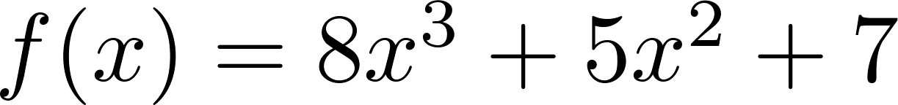
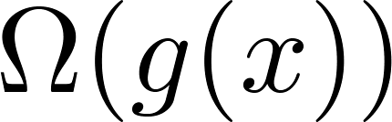
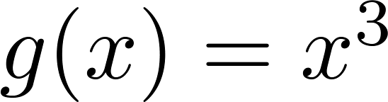
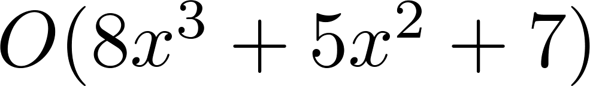
Big-Omega Notation
Example: Show that is
where .
Solution: for all positive real numbers x.
  Is it also the case that is ?

Slide 31
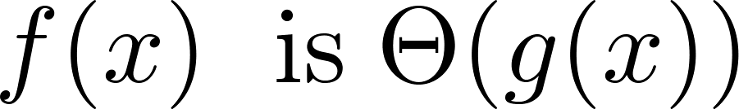
Big-Theta Notation
Θ is the upper case version of the lower case Greek letter θ.
Definition: Let f and g be functions from the set of integers or the set of real numbers to the set of real numbers. The function if
and .
We say that “f is big-Theta of g(x)” and also that “f(x) is of order g(x)” and also that “f(x) and g(x) are of the same order.”
if and only if there exists constants C₁ , C₂ and k such that C₁g(x) < f(x) < C₂ g(x) if x > k. This follows from the definitions of big-O and big-Omega.

Slide 32
Big Theta Notation
Example: Show that the sum of the first n positive integers is Θ(n²).
Solution: Let f(n) = 1 + 2 + ∙∙∙ + n.
  We have already shown that f(n) is O(n²).
  To show that f(n) is Ω(n²), we need a positive constant C such that f(n) > Cn² for sufficiently large n. Summing only the terms greater than n/2 we obtain the inequality
  1 + 2 + ∙∙∙ + n ≥ ⌈ n/2⌉ + (⌈ n/2⌉ + 1) + ∙∙∙ + n
  ≥ ⌈ n/2⌉ + ⌈ n/2⌉ + ∙∙∙ + ⌈ n/2⌉
  = (n − ⌈ n/2⌉ + 1 ) ⌈ n/2⌉
  ≥ (n/2)(n/2) = n²/4
  Taking C = ¼, f(n) > Cn² for all positive integers n. Hence, f(n) is Ω(n²), and we can conclude that f(n) is Θ(n²).

Slide 33
Big-Theta Notation
Example: Sh0w that f(x) = 3x² + 8x log x is Θ(x²).
Solution:
    3x² + 8x log x ≤ 11x² for x > 1, since 0 ≤ 8x log x ≤ 8x² .
      Hence, 3x² + 8x log x is O(x²).
    x² is clearly O(3x² + 8x log x)
    Hence, 3x² + 8x log x is Θ(x²).

Slide 34
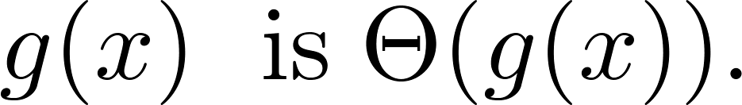
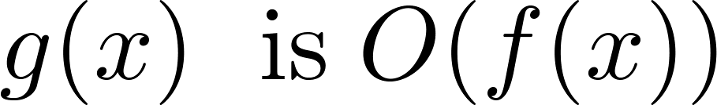
Big-Theta Notation
When it must also be the case that
Note that if and only if it is the case that and .
Sometimes writers are careless and write as if big-O notation has the same meaning as big-Theta.

Slide 35
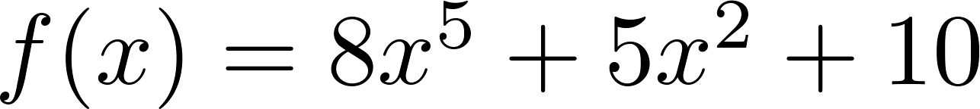
Big-Theta Estimates for Polynomials
Theorem: Let
where are real numbers with a_{n} ≠0.
Then f(x) is of order x^{n} (or Θ(x^{n})).
(The proof is an exercise.)
Example:
The polynomial is order of x⁵ (or Θ(x⁵)).
The polynomial is order of x¹⁹⁹ (or Θ(x¹⁹⁹) ).

