Slide 1
Introduction to Proofs
Section 1.7

Slide 2
Section Summary
Mathematical Proofs
Forms of Theorems
Direct Proofs
Indirect Proofs
  Proof of the Contrapositive
  Proof by Contradiction

Slide 3
Proofs of Mathematical Statements
A proof is a valid argument that establishes the truth of a statement.
In math, CS, and other disciplines, informal proofs which are generally shorter, are generally used.
  More than one rule of inference are often used in a step.
  Steps may be skipped.
  The rules of inference used are not explicitly stated.
  Easier for to understand and to explain to people.
  But it is also easier to introduce errors.
Proofs have many practical applications:
  verification that computer programs are correct
  establishing that operating systems are secure
  enabling programs to make inferences in artificial intelligence
  showing that system specifications are consistent

Slide 4
Definitions
A theorem is a statement that can be shown to be true using:
  definitions
  other theorems
  axioms (statements which are given as true)
  rules of inference
A lemma is a ‘helping theorem’ or a result which is needed to prove a theorem.
A corollary is a result which follows directly from a theorem.
Less important theorems are sometimes called propositions.
A conjecture is a statement that is being proposed to be true. Once a proof of a conjecture is found, it becomes a theorem. It may turn out to be false.

Slide 5
Forms of Theorems
Many theorems assert that a property holds for all elements in a domain, such as the integers, the real numbers, or some of the discrete structures that we will study in this class.
Often the universal quantifier (needed for a precise statement of a theorem) is omitted by standard mathematical convention.
For example, the statement:
“If x > y, where x and y are positive real numbers, then x² > y² ”
really means
“For all positive real numbers x and y, if x > y, then x² > y² .”

Slide 6
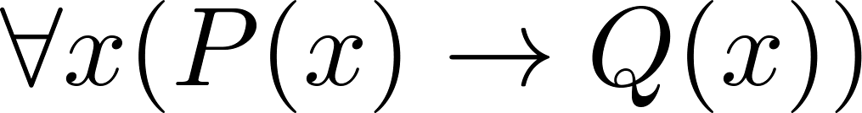
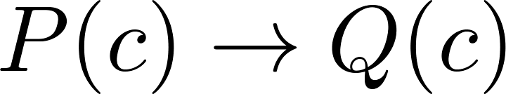

Proving Theorems
Many theorems have the form:
To prove them, we show that where c is an arbitrary element of the domain,
By universal generalization the truth of the original formula follows.
So, we must prove something of the form:

Slide 7
Proving Conditional Statements: p → q
Trivial Proof: If we know q is true, then
p → q is true as well.
“If it is raining then 1=1.”
Vacuous Proof: If we know p is false then
p → q is true as well.
“If I am both rich and poor then 2 + 2 = 5.”
[ Even though these examples seem silly, both trivial and vacuous proofs are often used in mathematical induction, as we will see in Chapter 5) ]

Slide 8
Even and Odd Integers
Definition: The integer n is even if there exists an integer k such that n = 2k, and n is odd if there exists an integer k, such that n = 2k + 1. Note that every integer is either even or odd and no integer is both even and odd.
We will need this basic fact about the integers in some of the example proofs to follow. We will learn more about the integers in Chapter 4.

Slide 9
Proving Conditional Statements: p → q
Direct Proof: Assume that p is true. Use rules of inference, axioms, and logical equivalences to show that q must also be true.
Example: Give a direct proof of the theorem “If n is an odd integer, then n² is odd.”
Solution: Assume that n is odd. Then n = 2k + 1 for an integer k. Squaring both sides of the equation, we get:
n² = (2k + 1)² = 4k² + 4k +1 = 2(2k² + 2k) + 1= 2r + 1,
where r = 2k² + 2k , an integer.
We have proved that if n is an odd integer, then n² is an odd integer.
( marks the end of the proof. Sometimes QED is used instead. )

Slide 10
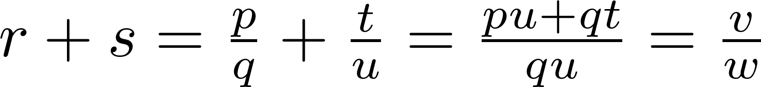
Proving Conditional Statements: p → q
Definition: The real number r is rational if there exist integers p and q where q≠0 such that r = p/q
Example: Prove that the sum of two rational numbers is rational.
Solution: Assume r and s are two rational numbers. Then there must be integers p, q and also t, u such that
Thus the sum is rational.
where v = pu + qt
w = qu ≠ 0

Slide 11
Proving Conditional Statements: p → q
  Proof by Contraposition: Assume ¬q and show ¬p is true also. This is sometimes called an indirect proof method. If we give a direct proof of ¬q → ¬p then we have a proof of p → q.
    Why does this work?
Example: Prove that if n is an integer and 3n + 2 is odd, then n is odd.
Solution: Assume n is even. So, n = 2k for some integer k. Thus
3n + 2 = 3(2k) + 2 =6k +2 = 2(3k + 1) = 2j for j = 3k +1
Therefore 3n + 2 is even. Since we have shown ¬q → ¬p , p → q must hold as well. If n is an integer and 3n + 2 is odd (not even) , then n is odd (not even).

Slide 12
Proving Conditional Statements: p → q
Example: Prove that for an integer n, if n² is odd, then n is odd.
Solution: Use proof by contraposition. Assume n is even (i.e., not odd). Therefore, there exists an integer k such that n = 2k. Hence,
n² = 4k² = 2 (2k²)
and n² is even(i.e., not odd).
We have shown that if n is an even integer, then n² is even. Therefore by contraposition, for an integer n, if n² is odd, then n is odd.

Slide 13
Proving Conditional Statements: p → q
Proof by Contradiction: (AKA reductio ad absurdum).
To prove p, assume ¬p and derive a contradiction such as p ∧ ¬p. (an indirect form of proof). Since we have shown that ¬p →F is true , it follows that the contrapositive T→p also holds.
Example: Prove that if you pick 22 days from the calendar, at least 4 must fall on the same day of the week.
Solution: Assume that no more than 3 of the 22 days fall on the same day of the week. Because there are 7 days of the week, we could only have picked 21 days. This contradicts the assumption that we have picked 22 days.

Slide 14
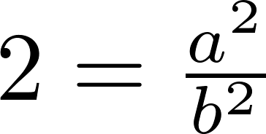
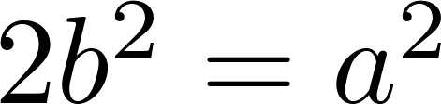
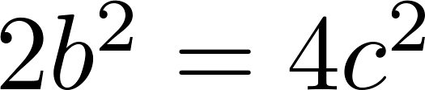
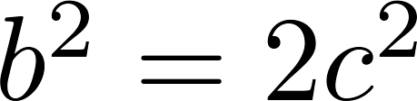
Proof by Contradiction
A preview of Chapter 4.
Example: Use a proof by contradiction to give a proof that √2 is irrational.
Solution: Suppose √2 is rational. Then there exists integers a and b with √2 = a/b, where b≠ 0 and a and b have no common factors (see Chapter 4). Then
Therefore a² must be even. If a² is even then a must be even (an exercise). Since a is even, a = 2c for some integer c. Thus,
Therefore b² is even. Again then b must be even as well.
But then 2 must divide both a and b. This contradicts our assumption that a and b have no common factors. We have proved by contradiction that our initial assumption must be false and therefore √2 is irrational .

Slide 15
Proof by Contradiction
A preview of Chapter 4.
Example: Prove that there is no largest prime number.
Solution: Assume that there is a largest prime number. Call it p_{n}. Hence, we can list all the primes 2,3,.., p_{n}. Form
None of the prime numbers on the list divides r. Therefore, by a theorem in Chapter 4, either r is prime or there is a smaller prime that divides r. This contradicts the assumption that there is a largest prime. Therefore, there is no largest prime.

Slide 16
Theorems that are Biconditional Statements
To prove a theorem that is a biconditional statement, that is, a statement of the form p ↔ q, we show that p → q and q →p are both true.
Example: Prove the theorem: “If n is an integer, then n is odd if and only if n² is odd.”
Solution: We have already shown (previous slides) that both p →q and q →p. Therefore we can conclude p ↔ q.
Sometimes iff is used as an abbreviation for “if an only if,” as in
“If n is an integer, then n is odd iif n² is odd.”

