Slide 1
Propositional Equivalences
Section 1.3

Slide 2
Section Summary
Tautologies, Contradictions, and Contingencies.
Logical Equivalence
  Important Logical Equivalences
  Showing Logical Equivalence
Propositional Satisfiability
  Sudoku Example

Slide 3
Tautologies, Contradictions, and Contingencies
A tautology is a proposition which is always true.
  Example: p ∨¬p
A contradiction is a proposition which is always false.
  Example: p ∧¬p
A contingency is a proposition which is neither a tautology nor a contradiction, such as p
P | ¬p | p ∨¬p | p ∧¬p
T | F | T | F
F | T | T | F

Slide 4
Logically Equivalent
Two compound propositions p and q are logically equivalent if p↔q is a tautology.
We write this as p⇔q or as p≡q where p and q are compound propositions.
Two compound propositions p and q are equivalent if and only if the columns in a truth table giving their truth values agree.
This truth table show ¬p ∨ q is equivalent to p → q.
p | q | ¬p | ¬p ∨ q | p→ q
T | T | F | T | T
T | F | F | F | F
F | T | T | T | T
F | F | T | T | T

Slide 5
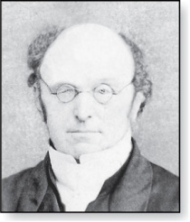
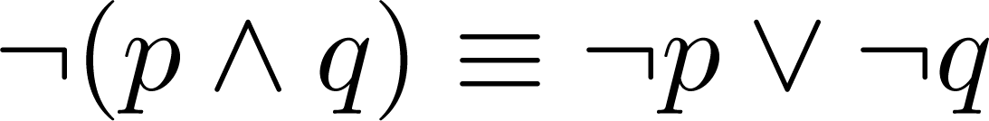
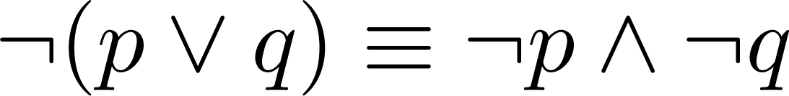
De Morgan’s Laws
Augustus De Morgan
1806-1871
This truth table shows that De Morgan’s Second Law holds.
p | q | ¬p | ¬q | (p∨q) | ¬(p∨q) | ¬p∧¬q
T | T | F | F | T | F | F
T | F | F | T | T | F | F
F | T | T | F | T | F | F
F | F | T | T | F | T | T

Slide 6
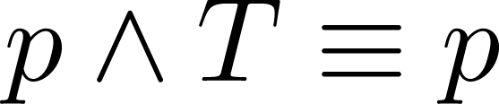
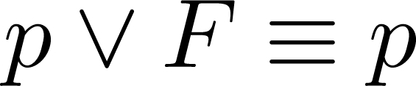
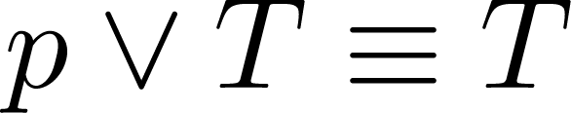
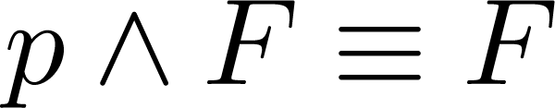
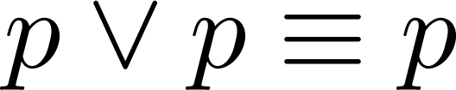
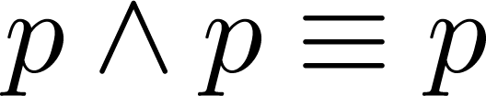
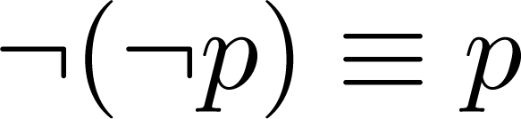
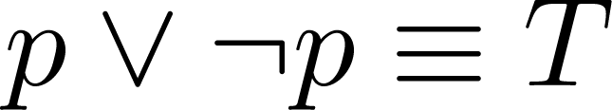
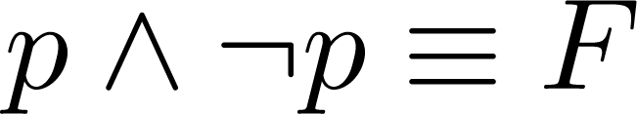
Key Logical Equivalences
Identity Laws: ,
Domination Laws: ,
Idempotent laws: ,
Double Negation Law:
Negation Laws: ,

Slide 7
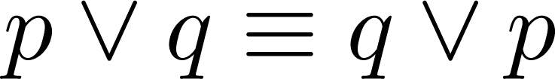
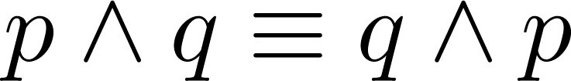
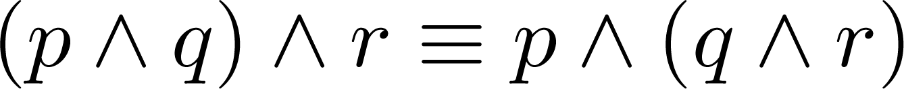
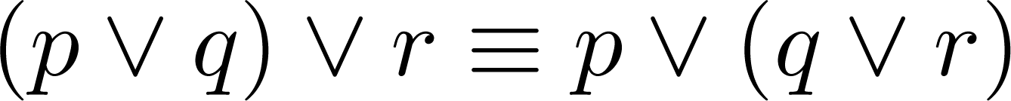
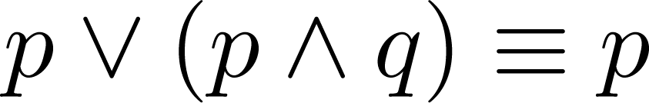
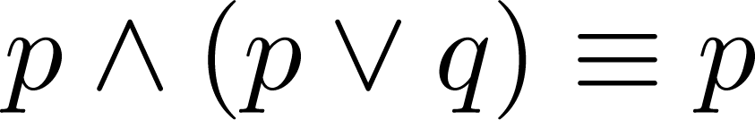
Key Logical Equivalences (cont)
Commutative Laws: ,
Associative Laws:
Distributive Laws:
Absorption Laws:

Slide 8
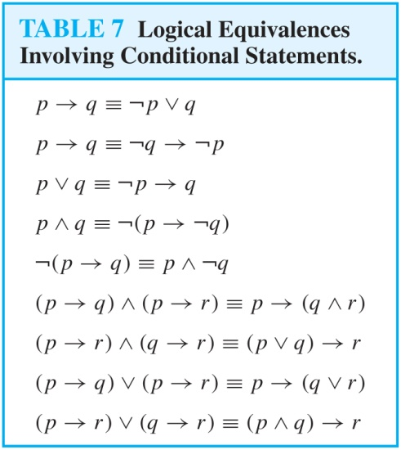
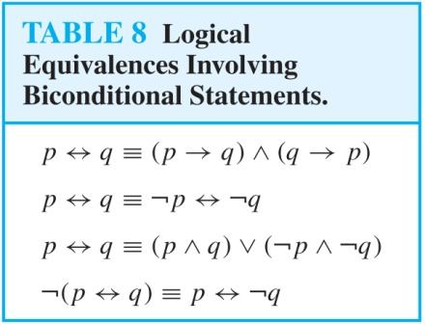
More Logical Equivalences

Slide 9



Constructing New Logical Equivalences
We can show that two expressions are logically equivalent by developing a series of logically equivalent statements.
To prove that we produce a series of equivalences beginning with A and ending with B.
Keep in mind that whenever a proposition (represented by a propositional variable) occurs in the equivalences listed earlier, it may be replaced by an arbitrarily complex compound proposition.

Slide 10
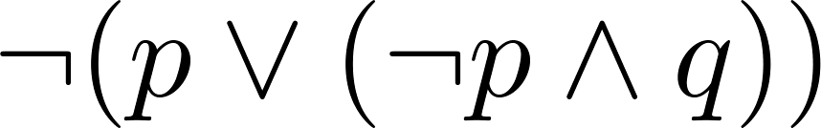
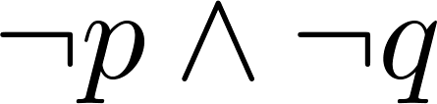
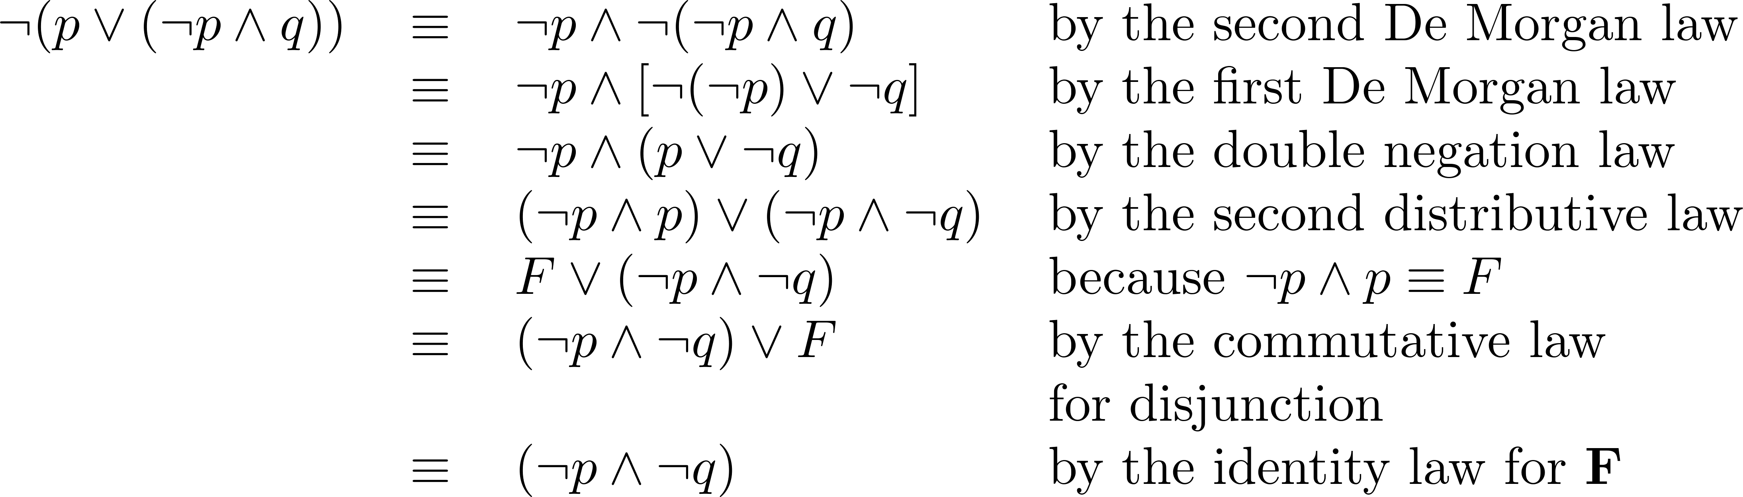
Equivalence Proofs
Example: Show that
is logically equivalent to
Solution:

Slide 11
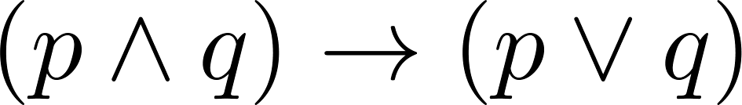
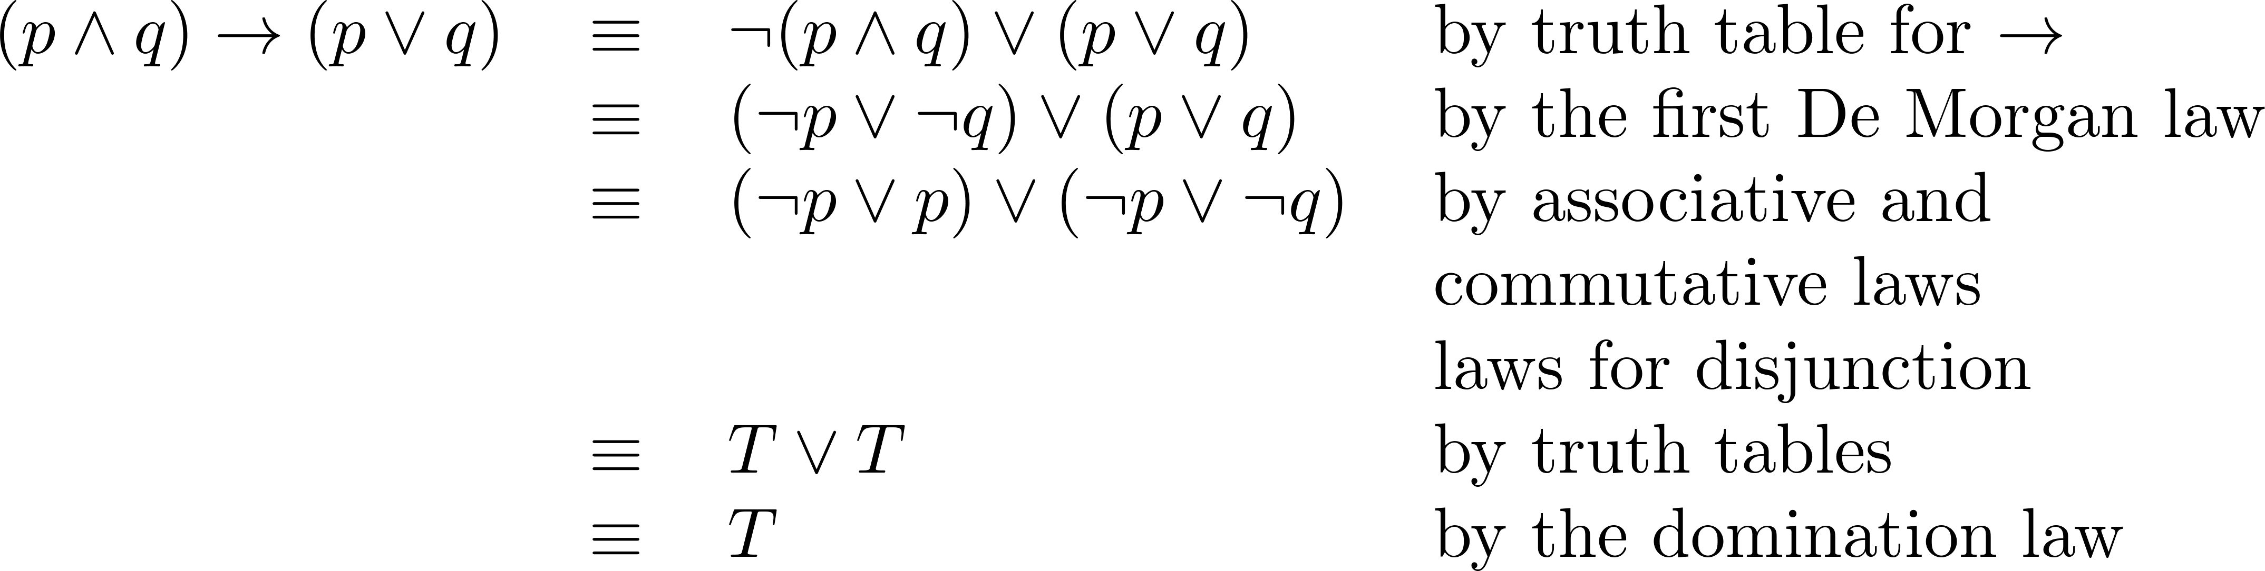
Equivalence Proofs
Example: Show that
is a tautology.
Solution:

Slide 12
Propositional Satisfiability
A compound proposition is satisfiable if there is an assignment of truth values to its variables that make it true. When no such assignments exist, the compound proposition is unsatisfiable.
A compound proposition is unsatisfiable if and only if its negation is a tautology.

Slide 13
Questions on Propositional Satisfiability
Example: Determine the satisfiability of the following compound propositions:
Solution: Satisfiable. Assign T to p, q, and r.
Solution: Not satisfiable. Check each possible assignment of truth values to the propositional variables and none will make the proposition true.

Slide 14
Notation
Needed for the next example.

Slide 15
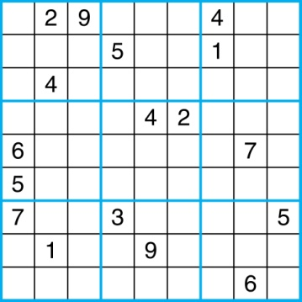
Sudoku
A Sudoku puzzle is represented by a 9×9 grid made up of nine 3×3 subgrids, known as blocks. Some of the 81 cells of the puzzle are assigned one of the numbers 1,2, …, 9.
The puzzle is solved by assigning numbers to each blank cell so that every row, column and block contains each of the nine possible numbers.
Example

Slide 16
Encoding as a Satisfiability Problem
Let p(i,j,n) denote the proposition that is true when the number n is in the cell in the ith row and the jth column.
There are 9×9 × 9 = 729 such propositions.
In the sample puzzle p(5,1,6) is true, but p(5,j,6) is false for j = 2,3,…9

Slide 17
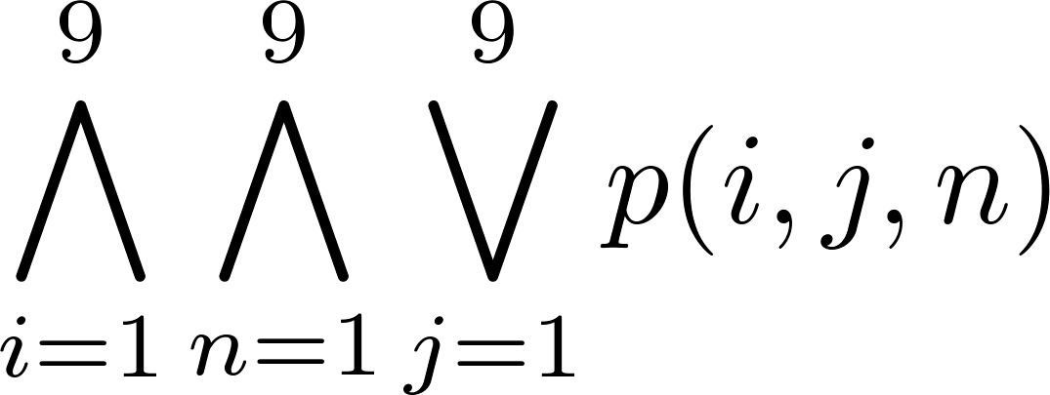
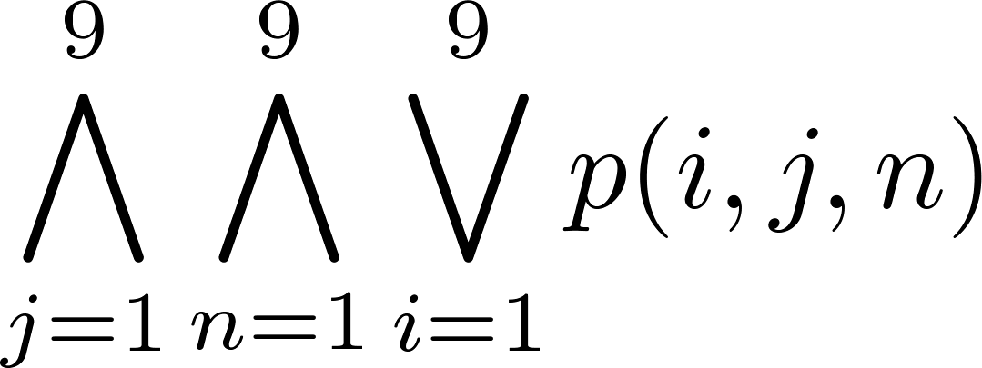
Encoding (cont)
For each cell with a given value, assert p(d,j,n), when the cell in row i and column j has the given value.
Assert that every row contains every number.
Assert that every column contains every number.

Slide 18
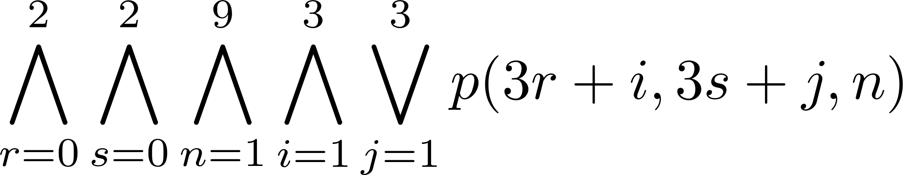
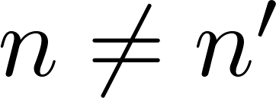
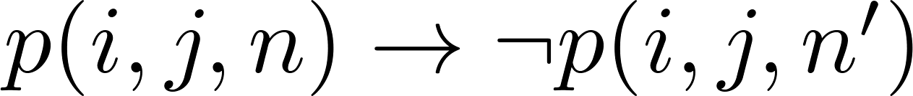
Encoding (cont)
Assert that each of the 3 x 3 blocks contain every number.
(this is tricky - ideas from chapter 4 help)
Assert that no cell contains more than one number. Take the conjunction over all values of n, n’, i, and j, where each variable ranges from 1 to 9 and ,
of

Slide 19
Solving Satisfiability Problems
To solve a Sudoku puzzle, we need to find an assignment of truth values to the 729 variables of the form p(i,j,n) that makes the conjunction of the assertions true. Those variables that are assigned T yield a solution to the puzzle.
A truth table can always be used to determine the satisfiability of a compound proposition. But this is too complex even for modern computers for large problems.
There has been much work on developing efficient methods for solving satisfiability problems as many practical problems can be translated into satisfiability problems.

