Slide 1

ENG 1121
English Composition 2
Do you have questions about MLA in-text citation or formatting Works Cited pages?
Read on!
Notes:
Materials:
Roster
Cards
Ask for Research Papers and Works Cited pages. Check their names on the grading sheet.

Slide 2
Review of MLA In-text Citations
The four most common citations are
Author and page number
Title and page number
Page number only
Secondhand quotations
Take out your Research Papers and review your in-text citations.
If you have Rules of Thumb handy, go to page 140—all this information is there!
Notes:
RI
5 min
Review the four most common citations, say you’ll be talking about them in depth in a moment

Slide 3
Author and Page Number
If you didn’t mention the author by name when you mentioned his or her work, be sure to put both his or her last name and the page number in parenthesis immediately after the information:
Pizza chains began with Pizza Hut in 1958 (Levine 54).
If your citation comes at the end of a sentence, the period goes outside the last parenthesis.
The exception is a long quote that you indent in your paper:
Montagu argues that it is both unnatural and harmful for American males not to cry:
To be human is to weep. The human species is the only one in the whole world of animate nature that sheds tears. The trained inability of any human being to weep is a lessening of his capacity to be human – a defect that usually goes deeper than the mere inability to cry…. It is very sad. (248)
Notes:
RI
3 min

Slide 4
Title and Page Number
Often articles have no author listed. If this is the case, give the first distinctive words of the title followed by the page number:
The actual fat content of a frozen pizza may be more than the package claims (“A Meal” 19).
Note that you put the name of the article, not the source.
Notes:
RI
3 min

Slide 5
Page Number Only
Put only the page number if you have already mentioned the author’s name:
Ed Levine notes that “The appeal of pizza crosses all ethnic, racial and class lines” (10).
When possible, use this method of citation. Mentioning the author’s name makes the paper more cohesive and readable.
Notes:
RI
3 min

Slide 6
No Page Number Available
For most electronic sources, no page number is given. The best option is to mention the author or title in your sentence.
Hanna Miller reports that 93% of Americans eat pizza at least once a month.
If a parenthetical citation works better, include the author, if given—otherwise the title.
Ninety-three percent of Americans eat pizza at least once a month (Miller).
Sometimes electronic sources use section numbers; treat them like page numbers.
Notes:
RI
3 min

Slide 7
Secondhand Quotations
When you quote someone who has been quoted in a source, use qtd. in (quoted in):
Patrick Doyle, Domino’s executive vice-president for international operations, says that pizza “plays incredibly well with really every cultural and regional and demographic group” (qtd. in Crossette 2).
In this example Doyle said it, although you found it in Crossette. Note that Doyle won’t be listed in your Works Cited; Crossette will be.
Notes:
RI
3 min

Slide 8

Need help?
There are other ways to cite sources. Check out Rules of Thumb, pp. 142-143 for those “Special Cases.”
If you don’t have Rules of Thumb, you can also go to Purdue OWL:
https://owl.purdue.edu/owl/research_and_citation/mla_style/mla_formatting_and_style_guide/mla_in_text_citations_the_basics.html

Slide 9
Works Cited Page: MLA 8th Edition
List only those sources that you actually referred to in your paper.
Alphabetize your list of sources by the authors’ last names. If no author is listed, alphabetize by the first main word in the title.
If you are using sources from the Internet, check this page to be sure you’re formatting your sources correctly: https://owl.english.purdue.edu/owl/resource/747/08/
Pay special attention to order, spacing, and punctuation.
Notes:
ECRI
5 min
Discuss the points to consider

Slide 10
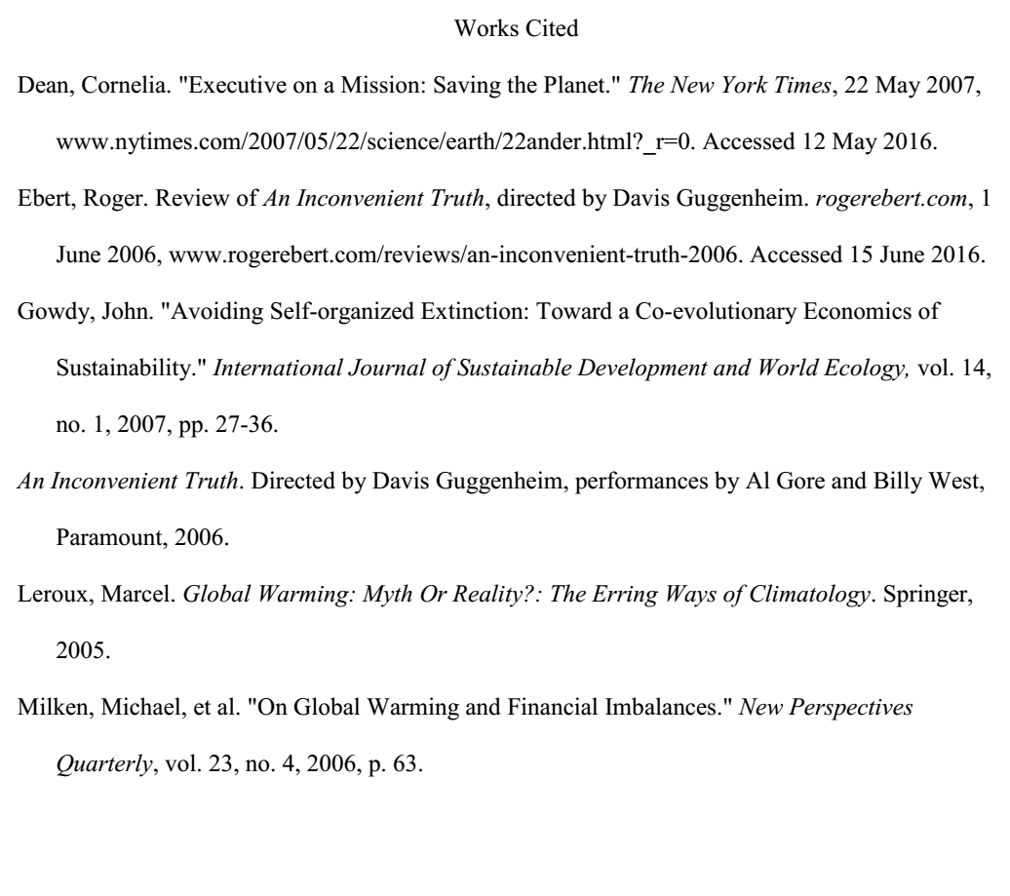
Center Works Cited title.
Use 1” margins, 12 point Times New Roman font.
Alphabetize by last name or title (if there’s no author).
Cite the URL without the http://.
Double space throughout!
Indicate page numbers (if available).
Create a hanging indent of second and subsequent lines.
If there’s more than one author, list the first author and write “et al.”
Notes:
RI
10 min
Ask students to identify the types of sources listed on slide (web, print, movie, book, article, etc.)

