Slide 1
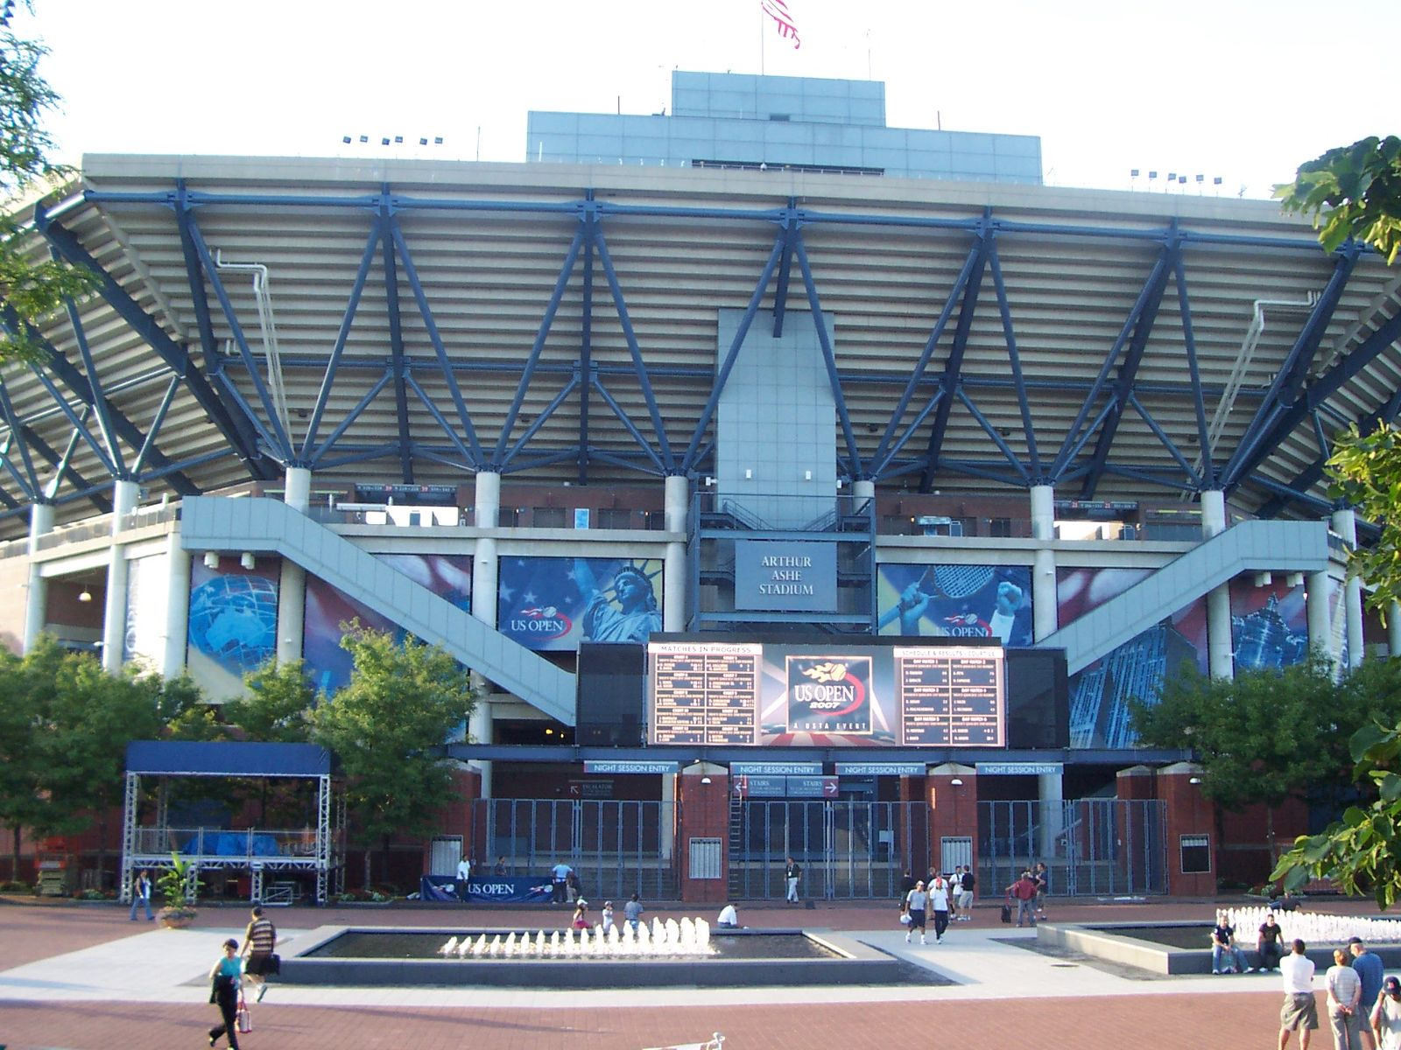
ARTHURASHE STADIUM
Address: 124-02 Roosevelt Ave, Flushing, NY 11368
Eileen, Nickay & Arian
Parks Recreation HMGT4988
Professor. Krondl
May 17, 2019
Source: www.6sqft.com

Slide 2

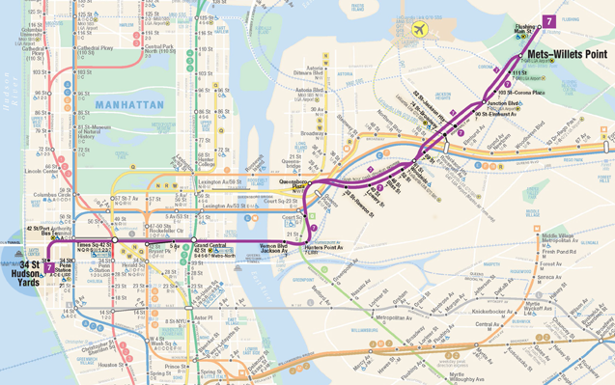

TRANSPORTATION
7 Train to Mets-Willets Point
LIRR-#6473|Penn Station
Q23 to 108 Street/51 Avenue
Q58 to Corona Av/51 Av
http://web.mta.info/capital/no7_alt.html

Slide 3
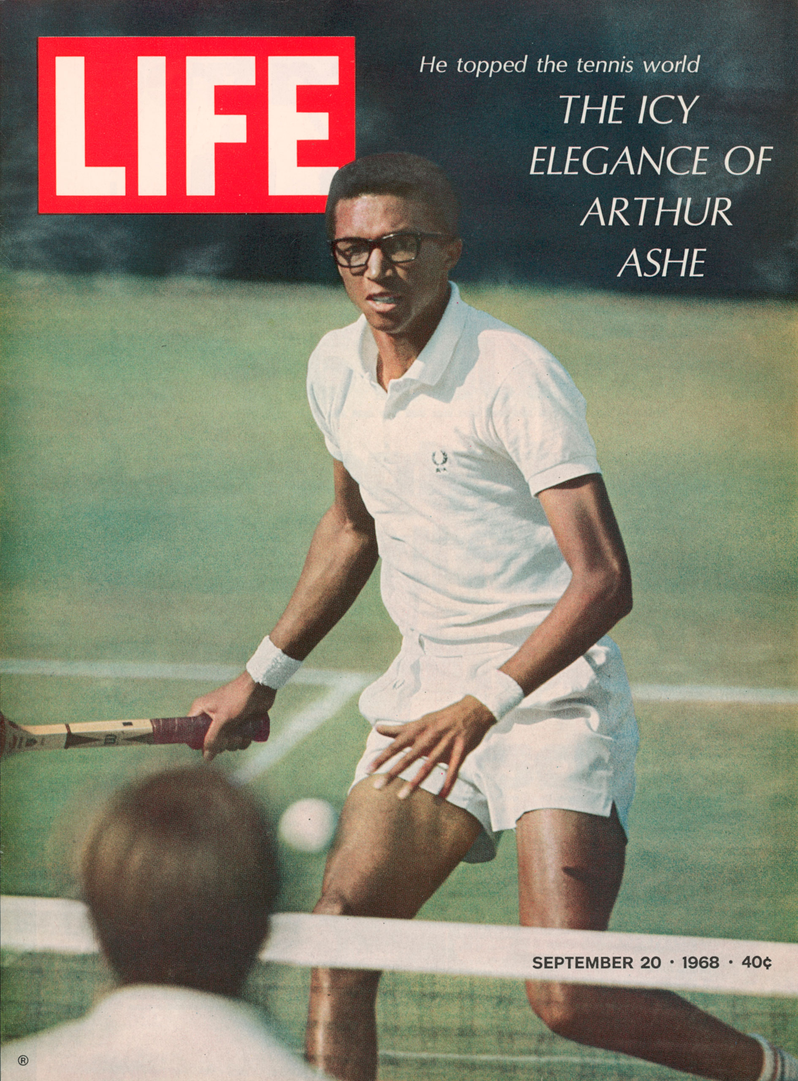
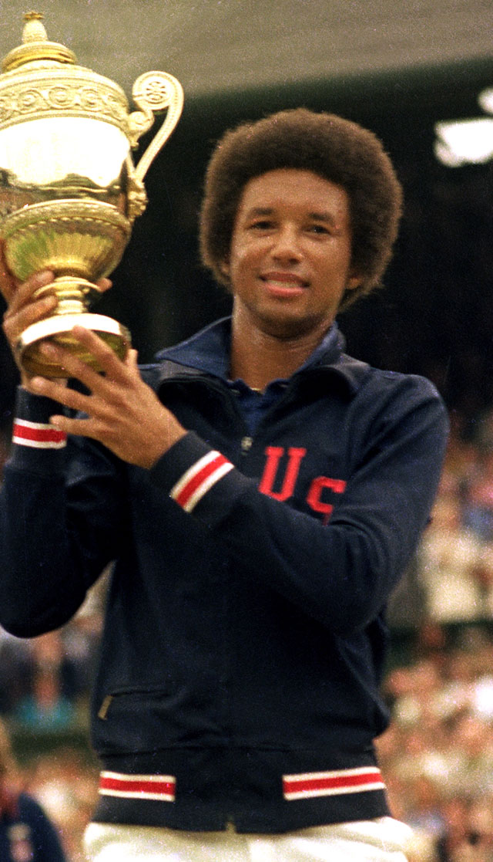


HISTORY
Opened in 1997
USTA
U.S. Open
Arthur Robert Ashe Jr. (1943-1993)
Source: www.britannica.com

Slide 4
MISSION
To Innovate, Promote and Grow the Game of Tennis.
VISION
Leadership at every level – inspire innovation and create opportunities in tennis.
VALUE PROPOSITION
To be your trusted resource for tennis.
Source: www.usta.com

Slide 5

DEMOGRAPHICS
Adults Ages: 12-65 & Over
Children Gender: Female & Male
Teenagers Income: Middle-high class
Seniors

Slide 6
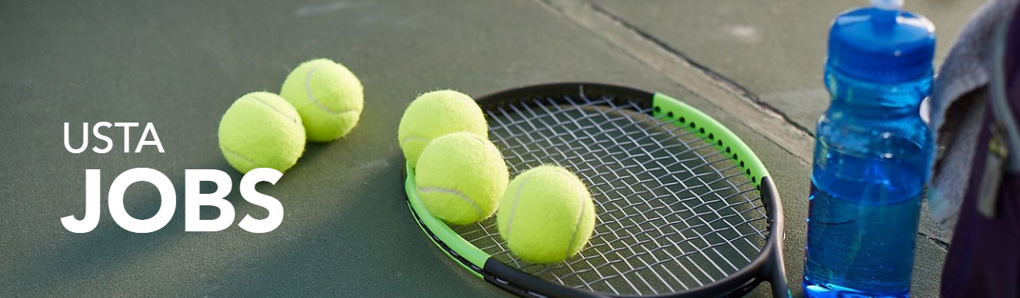
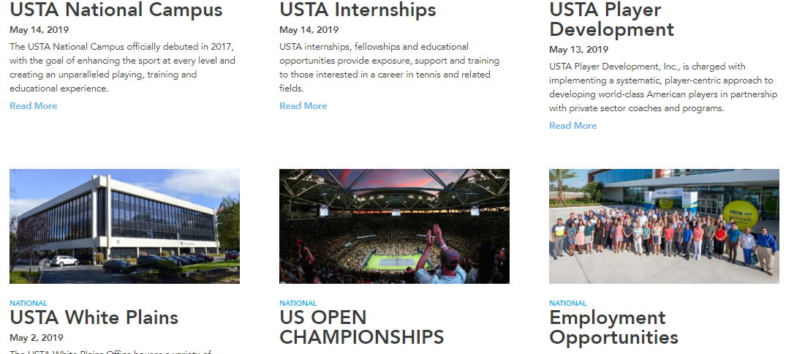


Slide 7

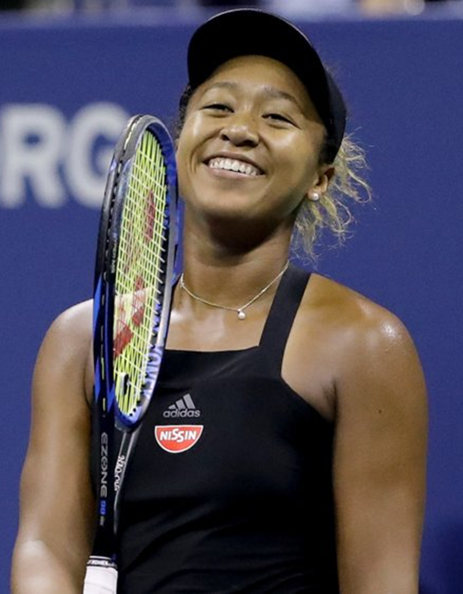
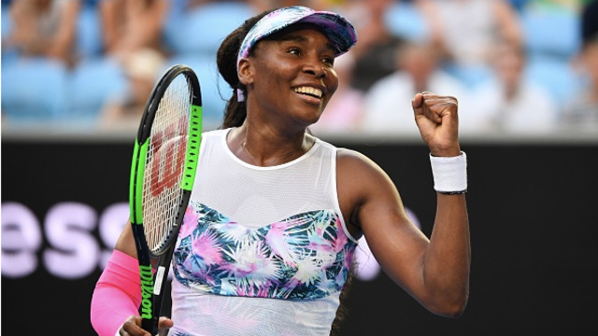
MARKETING
Popular Events:
U.S. Open
U.S. Open Series
Pro Circuit
Davis Cup
FED Cup
International Team Events

Slide 8


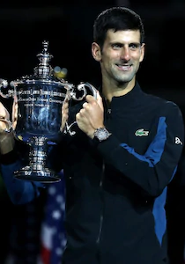
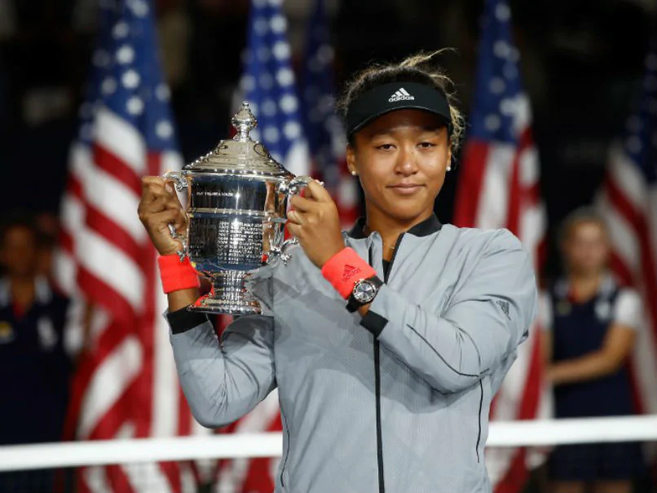


Slide 9
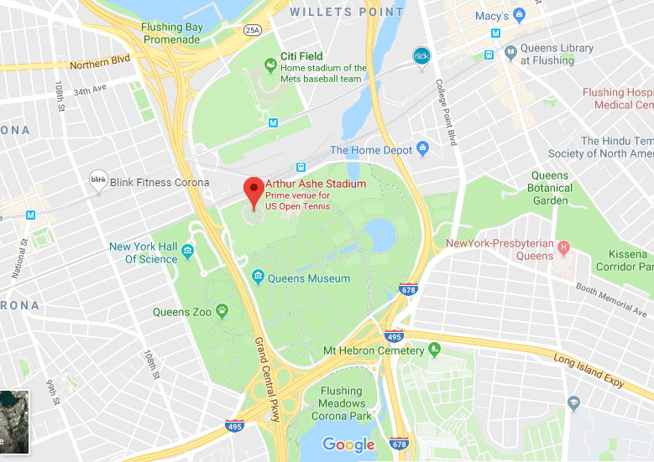
MAP

Slide 10
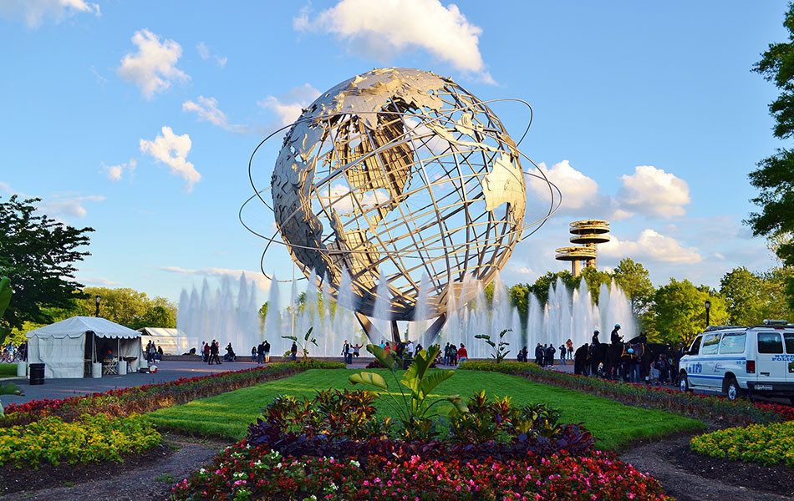
FLUSHING MEADOWS CORONA PARK
Facilities: Sites:
Barbecuing Areas Queens Zoo
Baseball Fields New York State Pavilion
Basket Courts Unisphere
Bicycling & Greenways Queens Museum
Bathrooms Queens Botanic Garden
Dog-friendly Areas Flushing Bay Promenade
Fitness Equipment Citi Field
Football Fields New York Hall of Science
Golf Courses
Handball Courts
Playgrounds
Source: www.bucketlist127.com

Slide 11
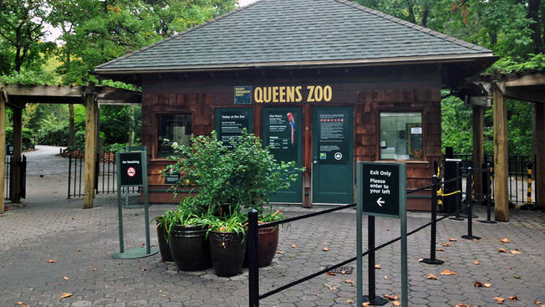
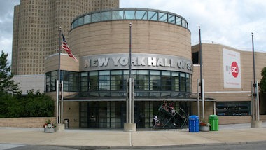
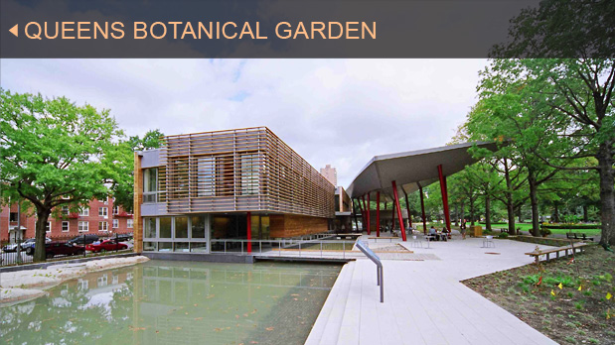
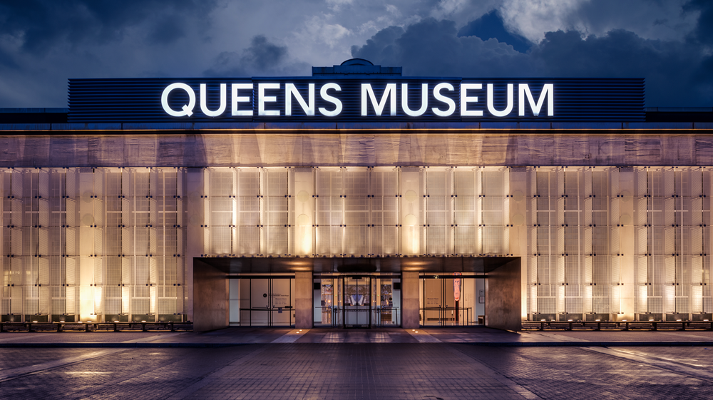

Slide 12

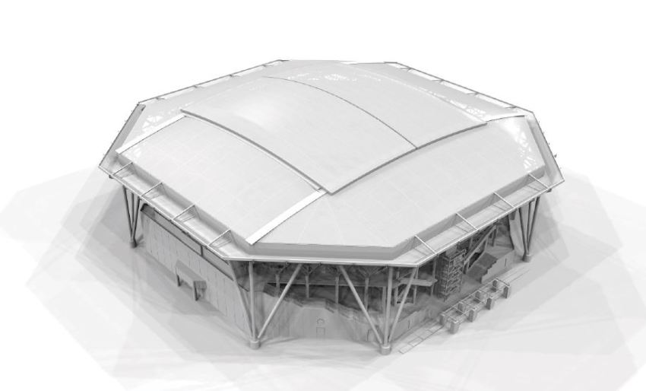
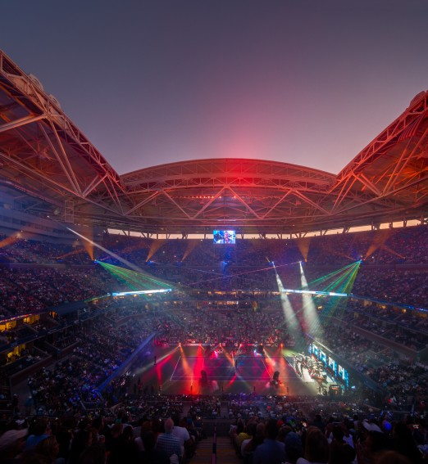
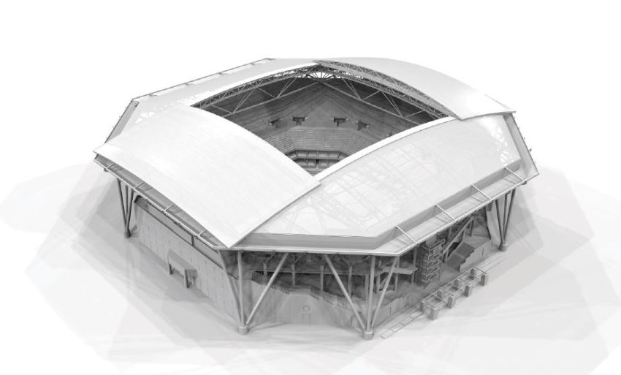
INFRASTRUCTURE

Slide 13
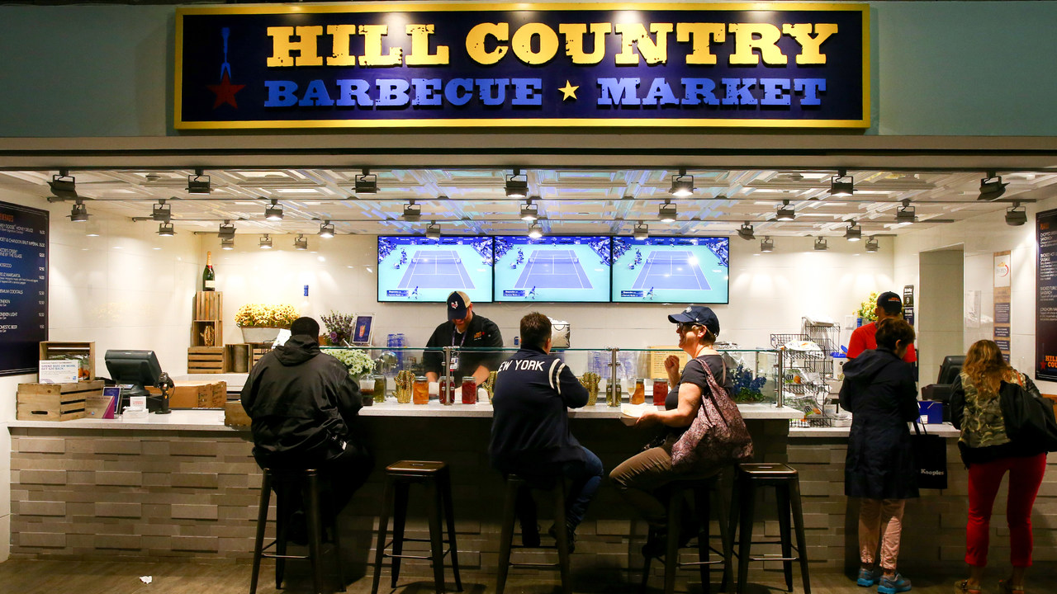
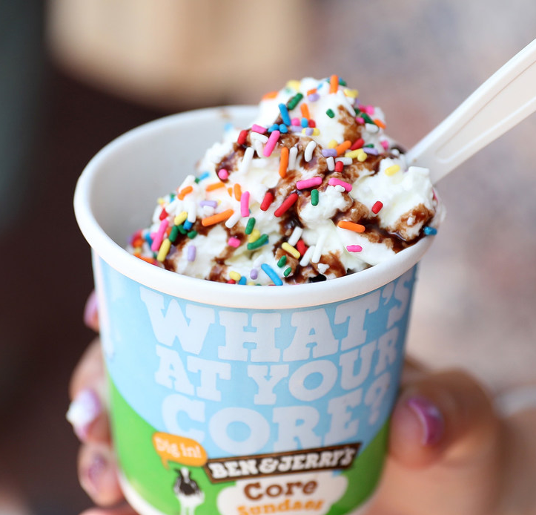
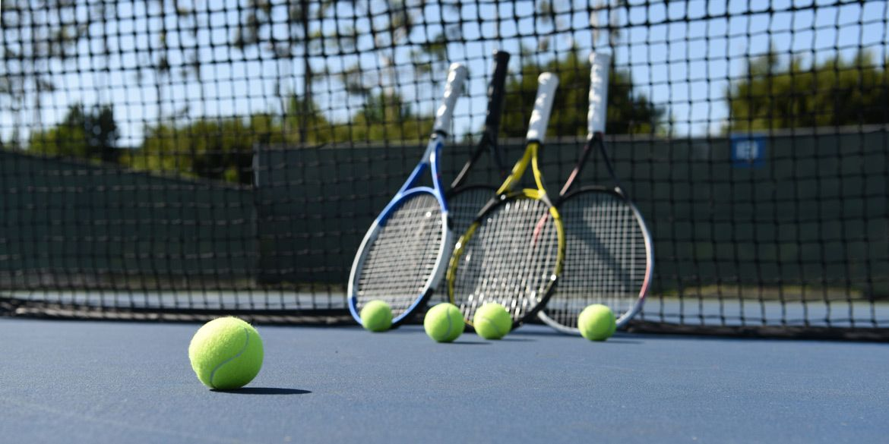
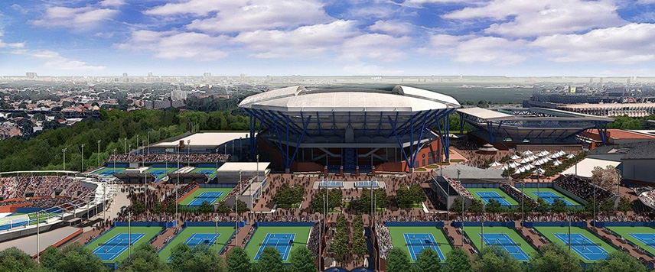
FACILITIES
THINGS
TO
DO

Slide 14
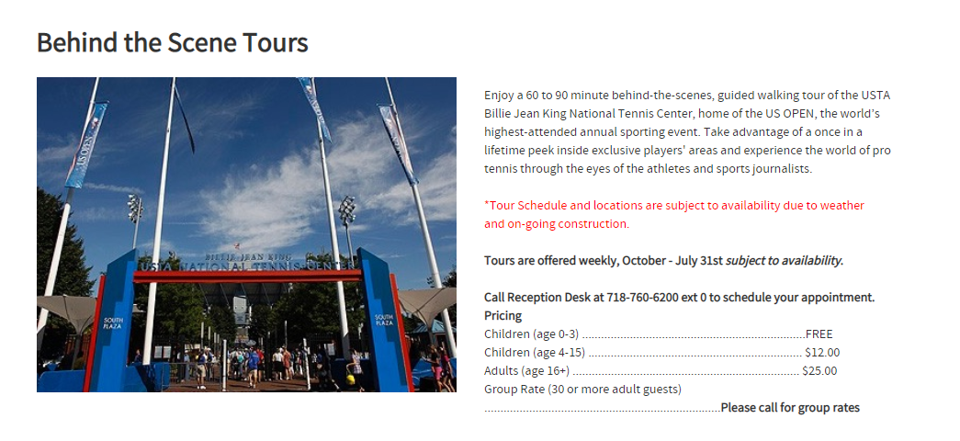
TOUR
Source: ustanew2.gotennissource.com

Slide 15
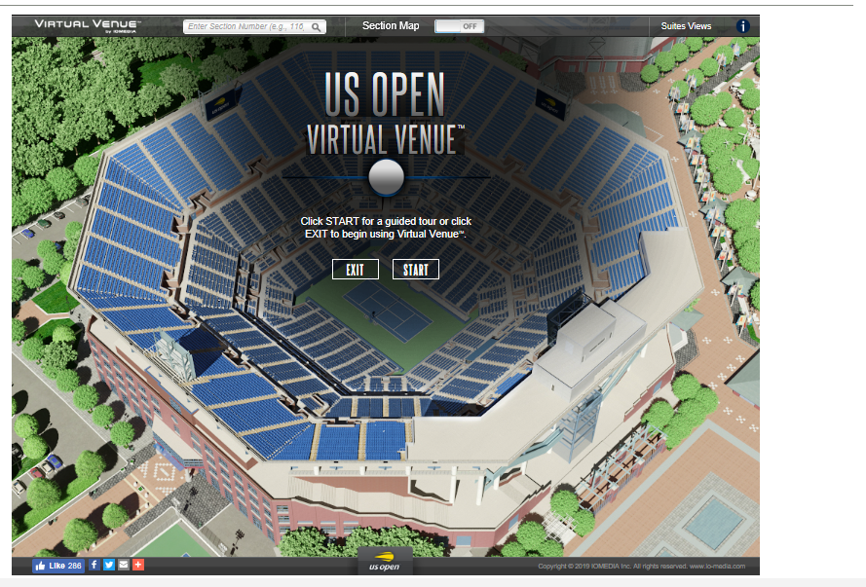
CONT.

Slide 16
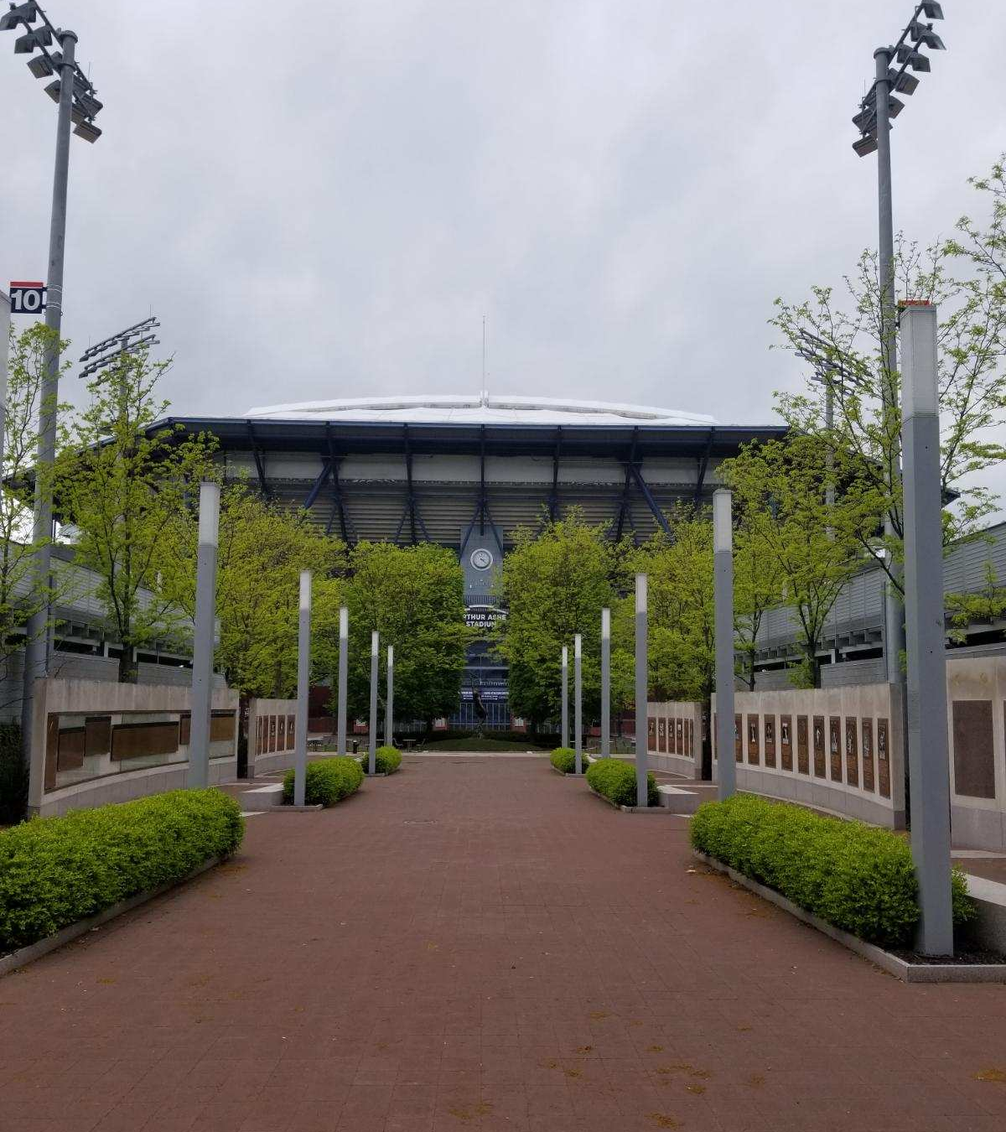
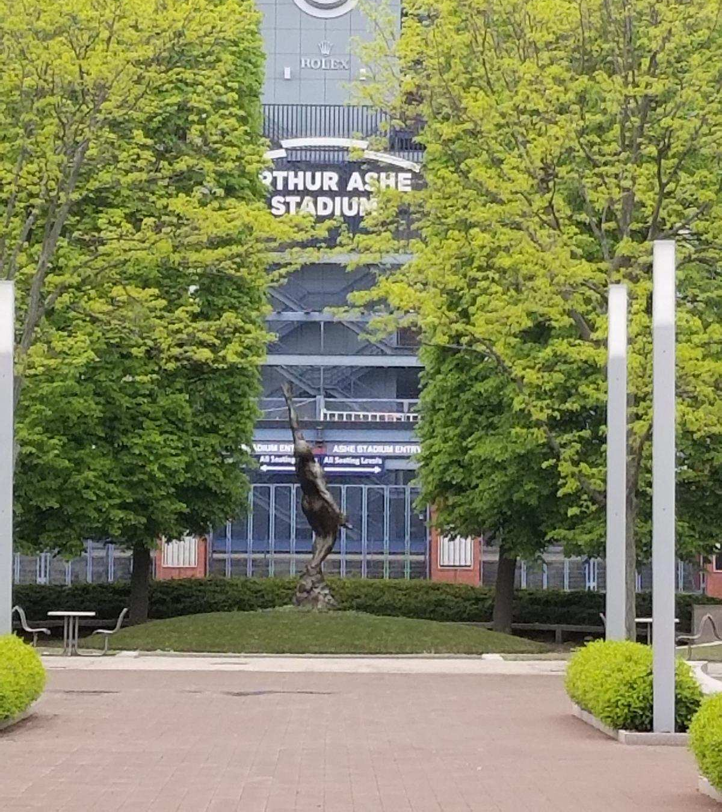

Slide 17
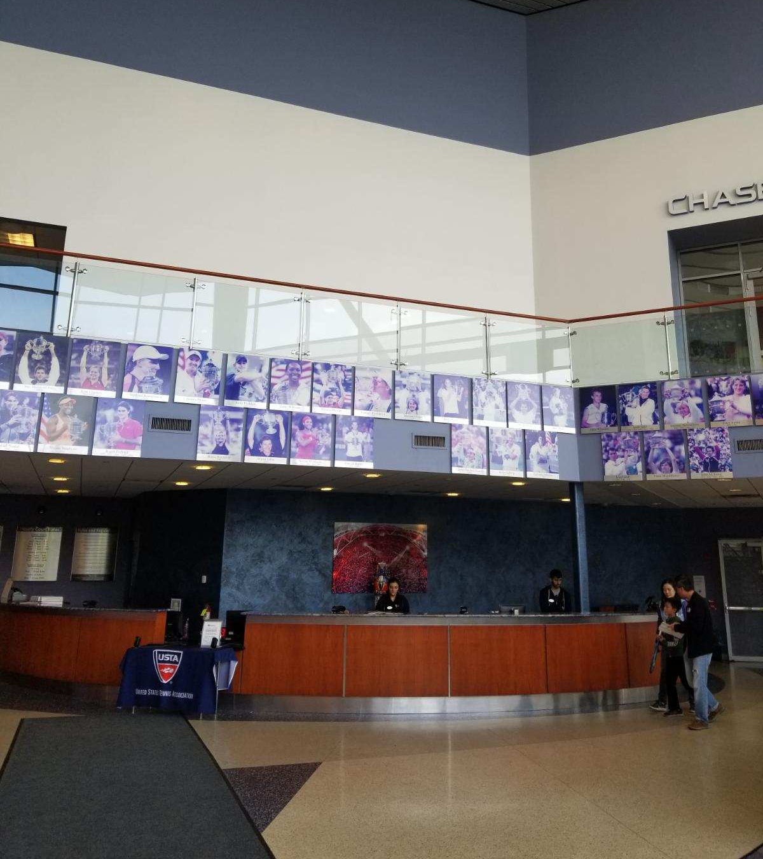
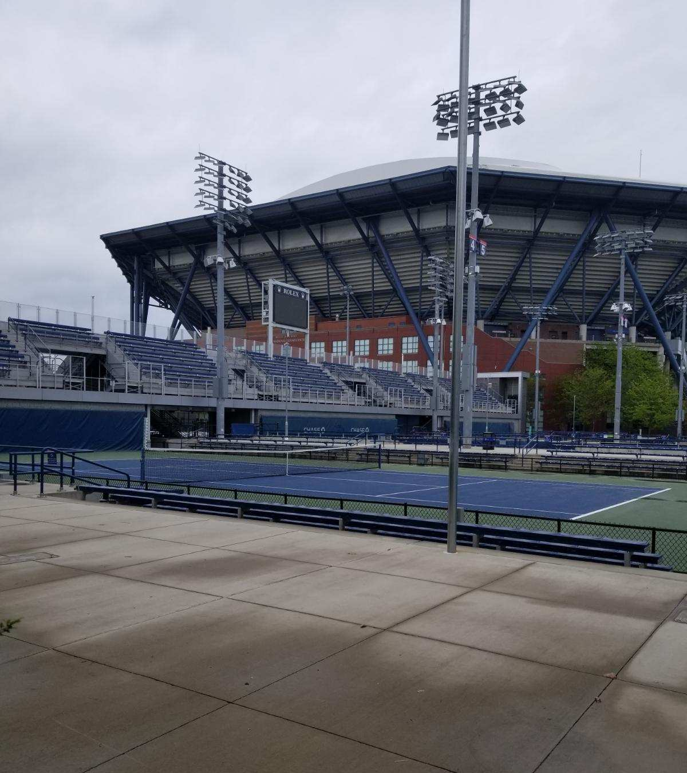

Slide 18


STAY CONNECTED
Facebook
USTA National Tennis Center
@USTANTC
Twitter
@USTANTC

Slide 19
REFERENCES
Arthur Ashe Stadium New York City.com : Profile. Retrieved from https://www.nyc.com/arts__attractions/arthur_ashe_stadium.1139025/
Britannica, T. E. (2019, February 02). Arthur Ashe. Retrieved from https://www.britannica.com/biography/Arthur-Ashe
Flushing Meadows Corona Park. Retrieved from https://www.nycgovparks.org/parks/flushing-meadows-corona-park/highlights/12014
Flushing Meadows Corona Park. Retrieved from https://www.nycgovparks.org/parks/flushing-meadows-corona-park
How to get to Arthur Ashe Stadium in Queens by Subway, Bus or Train. Retrieved from https://moovitapp.com/index/en/public_transit-Arthur_Ashe_Stadium-NYCNJ-site_23160703-121
Schulz, D. (2017, August 28). A History of the US Open in New York: From the West Side Tennis Club to Arthur Ashe Stadium. Retrieved from https://www.6sqft.com/a-history-of-the-us-open-in-new-york-from-the-west-side-tennis-club-to-arthur-ashe-stadium/
Krause, K. M., Art, L. O., & Weigold, S. Arthur Ashe Tennis Stadium by Nishanth Gopinathan. Retrieved from https://fineartamerica.com/featured/arthur-ashe-tennis-stadium-nishanth-gopinathan.html
Visit Flushing Meadows Corona Park. Retrieved from https://www.bucketlist127.com/goal/visit-flushing-meadows-corona-park

Slide 20
“Behind the Scenes Tour.” Retrieved from https://ustanew2.gotennissource.com/page.lasso?p=ustatours
“Honoring the African-American Experience.” Retrieved from https://www.nycgovparks.org/art-and-antiquities/monuments/black-history-month/soul-in-flight
“Mission and Goals.” Retrieved from https://www.usta.com/en/home/about-usta/who-we-are/midwest/Mission.html
Arthur Ashe Stadium Food. (n.d.). Retrieved from https://www.usopen.org/en_US/visit/arthur_ashe_stadium_food.html

