Slide 1
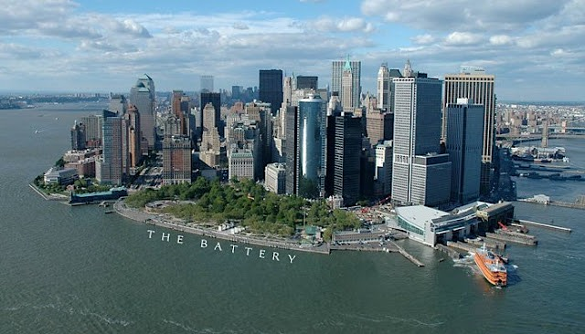
BATTERY PARK
JENNY, STEVEN & DANIELA
PARKS & RECREATION

Slide 2
HISTORY
Battery park has been targeted as the place where the history of New York city begins, and considered the first waterfront park
The parks area was a strategic location for commerce transportation within the piers
During 1788- 1872 the area of battery was being used as a landfill, and during that time every 10 years the area was being enlarge
The park was known as the world first immigrant depot
In 1811 they created a circular fort that was named Castle Clinton for the governor, later they changed the name to Castle Garden
The park was closed during 1940 to 1952 while the Brooklyn battery tunnel and the underpass was being built underneath the area.
In 1944, the Battery Conservancy is a non-profit educational corporation that was created to revitalize the battery and renew the Castle Clinton National Monument
In 1955, due to the construction the park opened up transform and it was expanded two more acres totaling 25 acres
In 1982 the New York State designed the park as part of the Harbor Park, belonging to a group of historic waterfront.

Slide 3
Tourist Guide
The Battery Park is located in Battery Pl, State St and Whitehall St
Subway 4 or 5 to Bowling Green Station or R to Whitehall Street, or BUS M55
Available in Bike, there is an esplanade connected
The parking lot is near the park as well.
The park has memorial and statues over there, like American Merchant Mariners Memorial which is commissioned by the American Merchant Mariner’s Memorial INC
Castle Clinton is very interesting as well, it was built in the 1800s when the New American Government afraid that the Britain Government will return but it was never used against them free to commission every 7:45 am- 5 PM 7 days a week.
The waterfront view is perfect for families and tourist.

Slide 4
Tourist Guide and near attractions
The Statue of Liberty Vista Point also located in here as well
They held a lot walking tour, event as well for kids who interested in planting
The Battery Park has bathrooms for public uses and 4 different eateries, they have Gardens Restaurant, Food Cart, and 2 Snack Bar
The park is designed for locals and tourist in all ages.
While tourist can visit The Bull, Wall Street before they came to the park to relax
. A tourist might want to visit this place because is packed with history and also near a lot of the famous downtown attractions in New York such as the financial district and NMAI.
The park is good for locals near who works near the area as well because after a long and stressful day they can take a broken seat at the park and take some fresh air and relax as well.

Slide 5
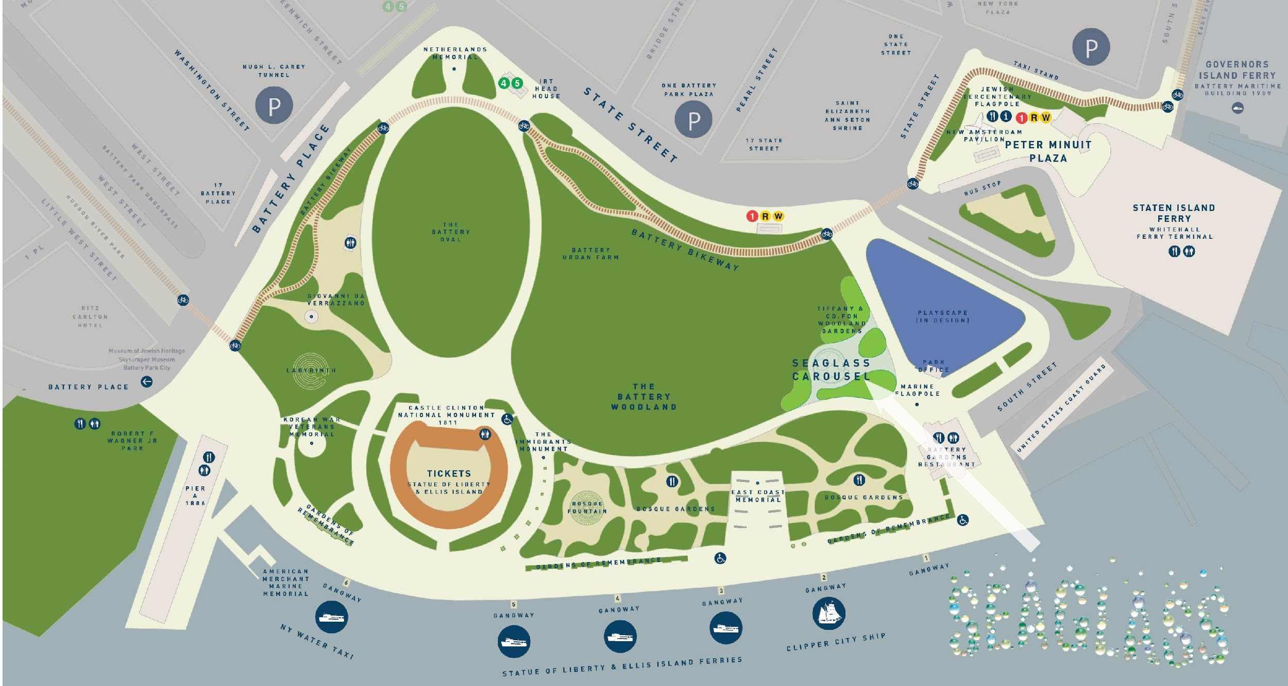
MAP

Slide 6
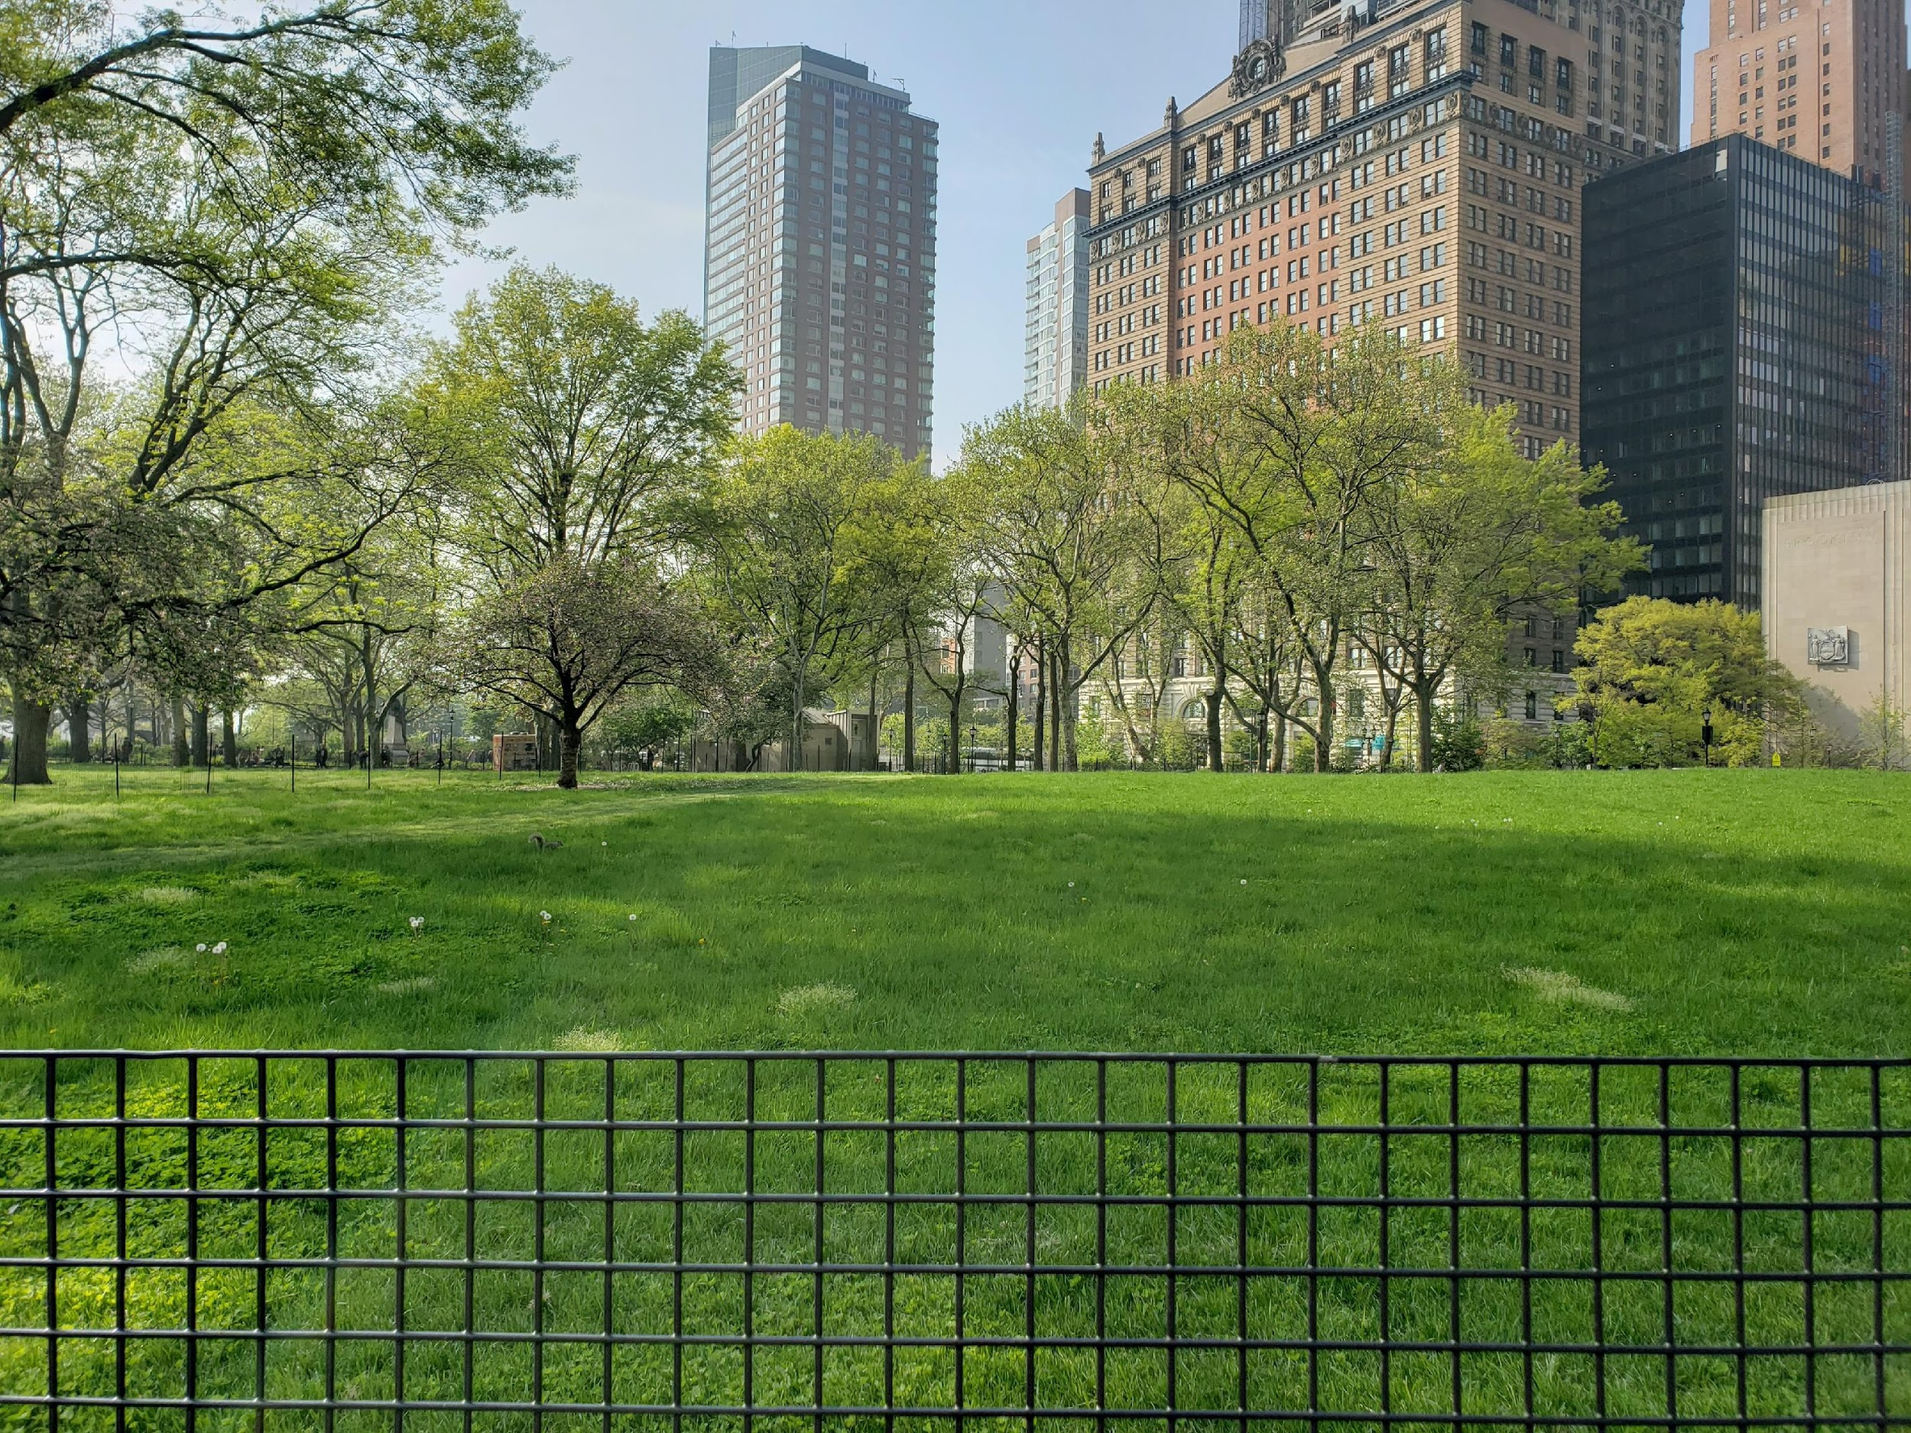
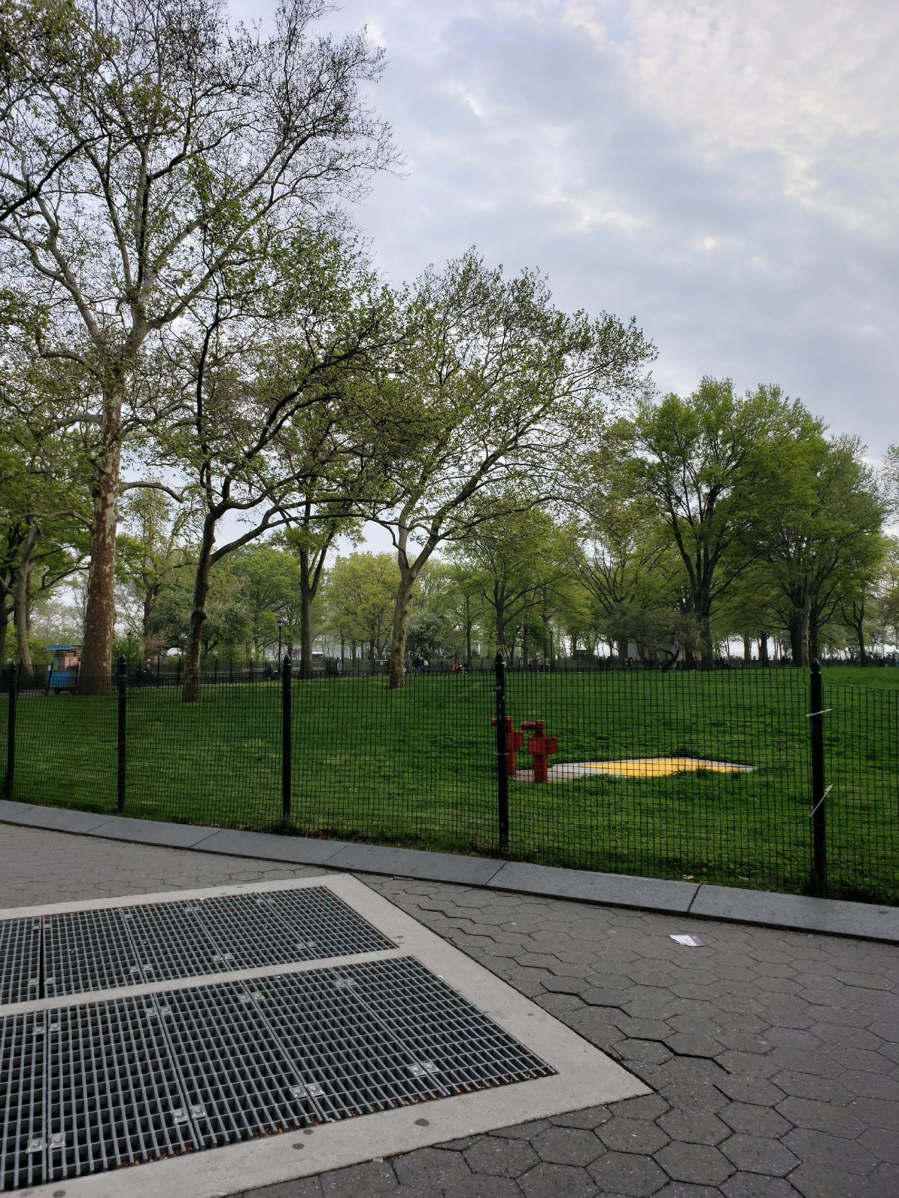
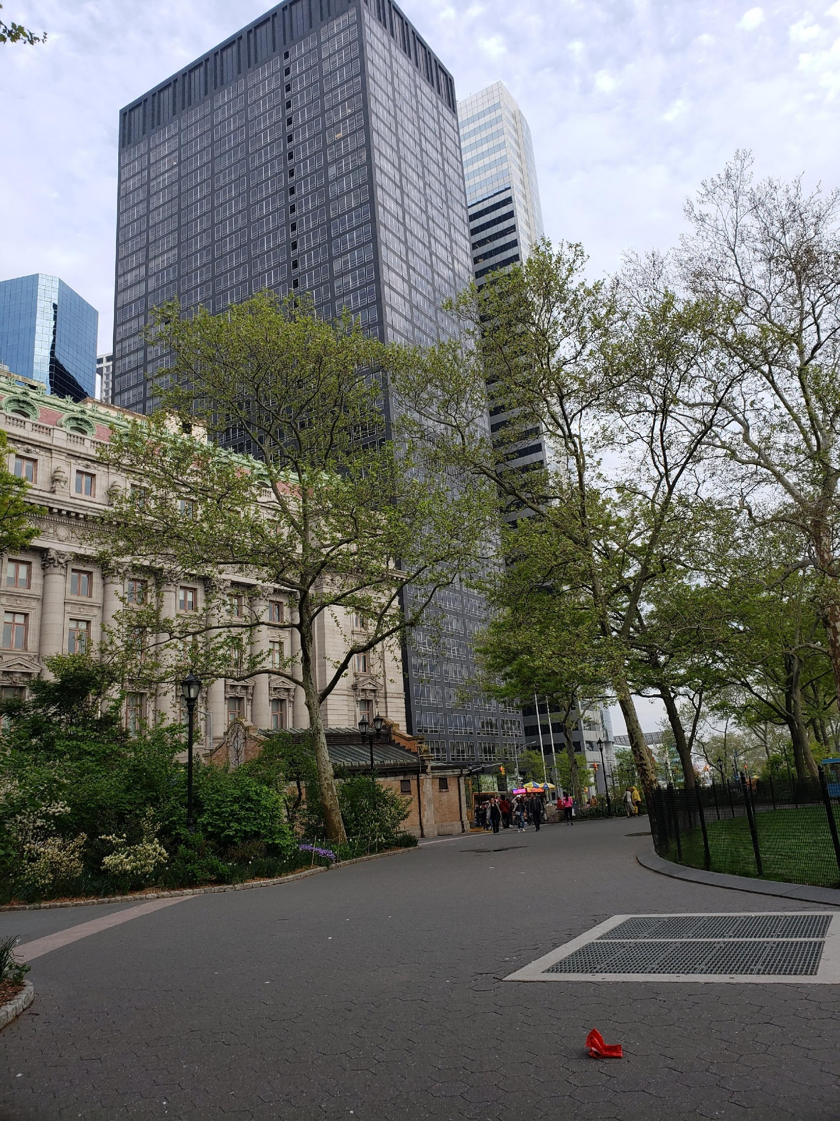

Slide 7
HIGHLIGHTS
On September 11, the battery shoreline serves as a survival route for those fleeing lower Manhattan. The battery garden of remembrance is dedicated within the new upper promenade
The four-acre bosque is opened to the public with a majestic fountain, vast perennial gardens and two food kiosks.
The conservancy creates a battery urban farm to educate students about the urban farming and healthy eating.
The park opens a bikeway that connect Hudson River Park to the East River esplanade
The park has many programs, educational, volunteers, and park program which gives tour and maintain the important landmark and monument of the park
The parks held many events such as walking, workshop, tours, bird walk, concert, sport activities, festival, community field day, dances, plant care day, migration bird walk,
In the Castle Garden they rent it out for receptions, demonstrations, and performances.
The park had Wi-Fi spot for visitors
The battery park has public bathroom, and water fountain through the park

Slide 8
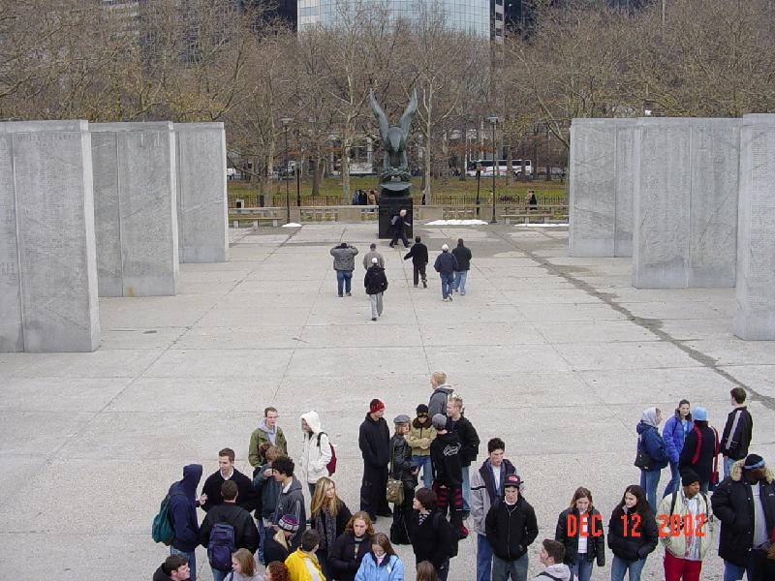
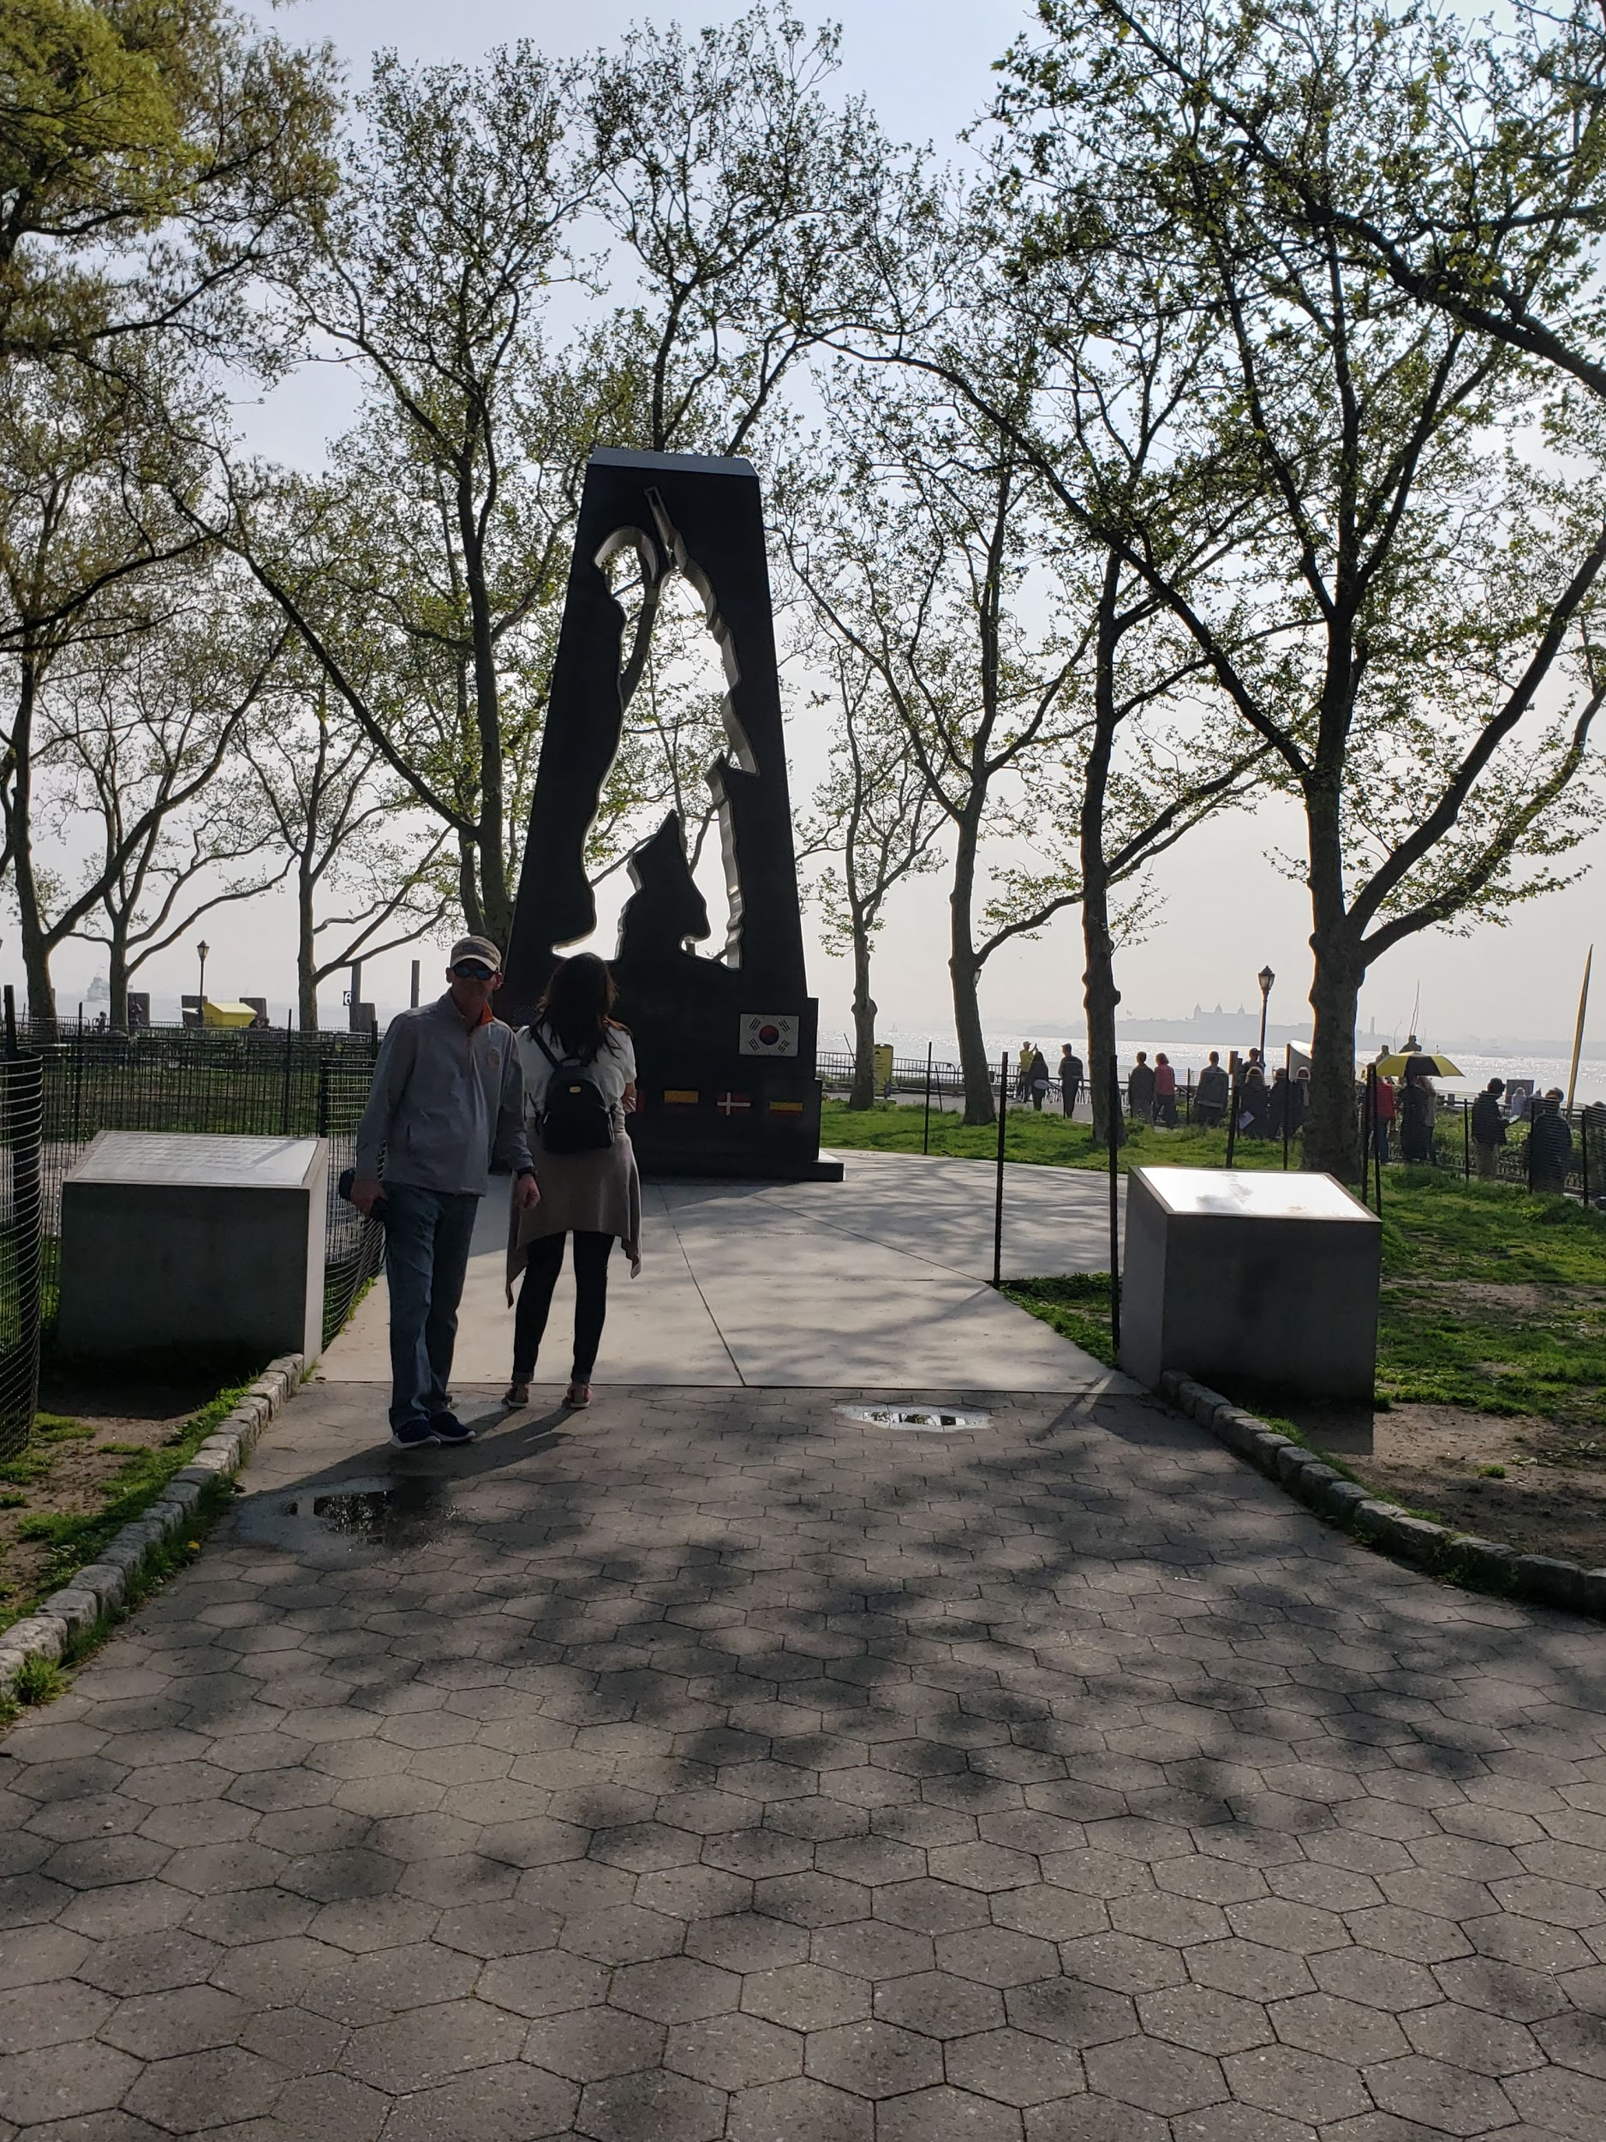
The park contains 21 monuments honoring soldiers, explorers, inventors, and immigrants
The park is also a ferries dock station for visitors to visit the Statue of Liberty and Ellis Island
The park had battery gardens restaurant, battery park food cart, battery park snack bar, and peter minuit snack bar, they also have food cart and trucks around the park and in the park area
The park has four playgrounds in the park with four level and some
of them are wheelchair accessible
Highlights Continuation

Slide 9
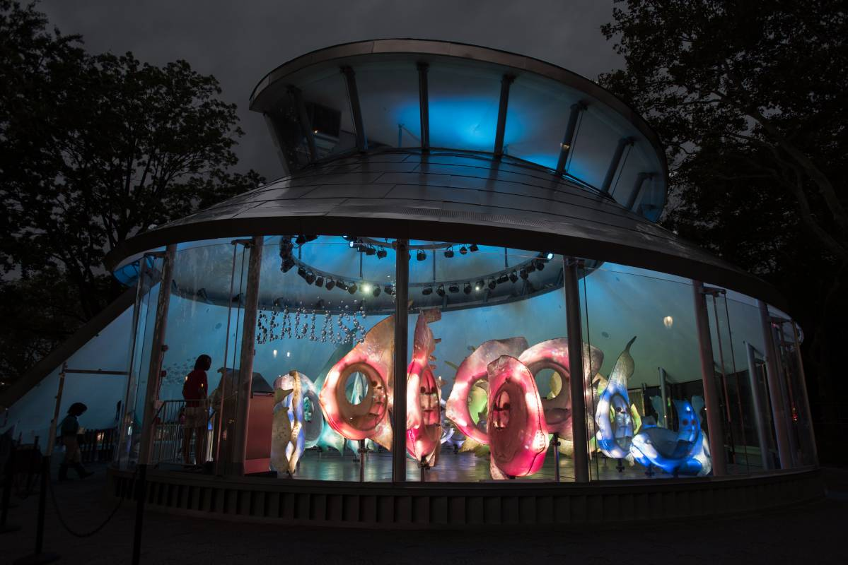
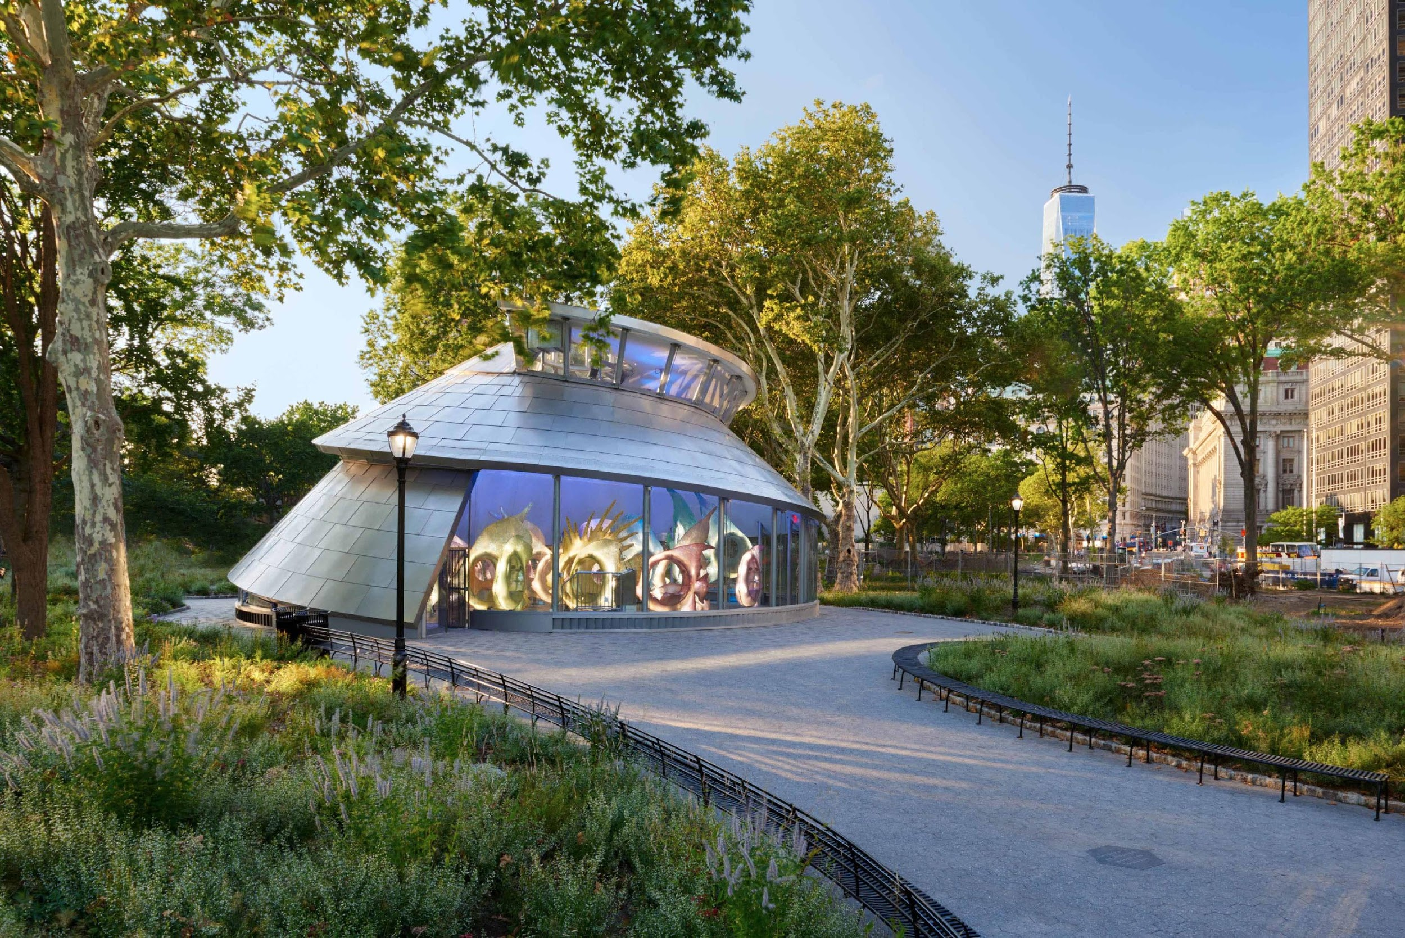
The water features a SeaGlass Carousel with an aquatic themed with a price of $5 per ticket

Slide 10
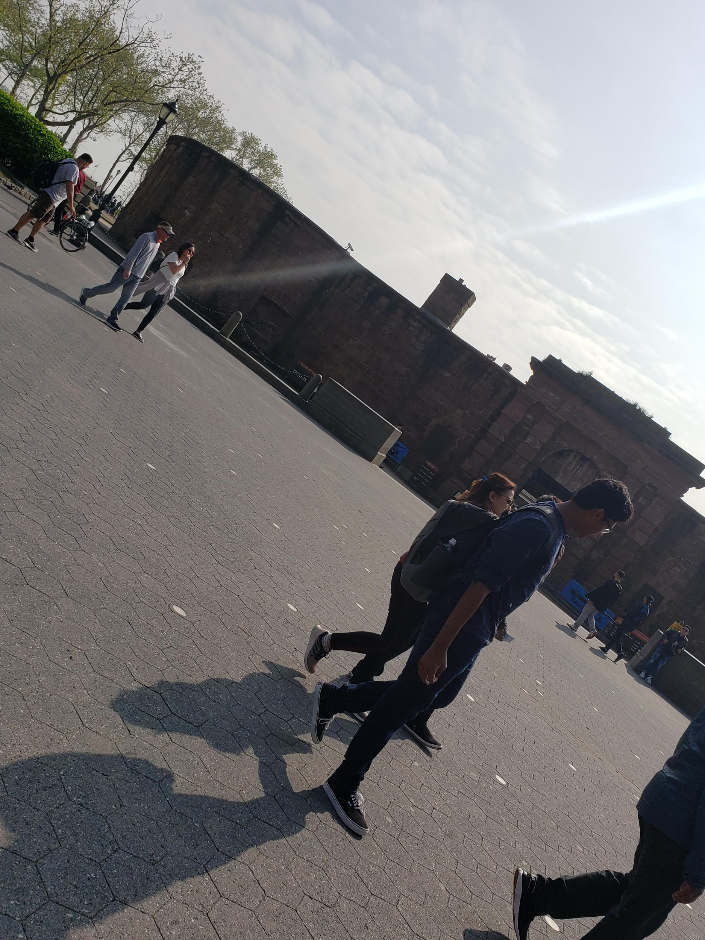
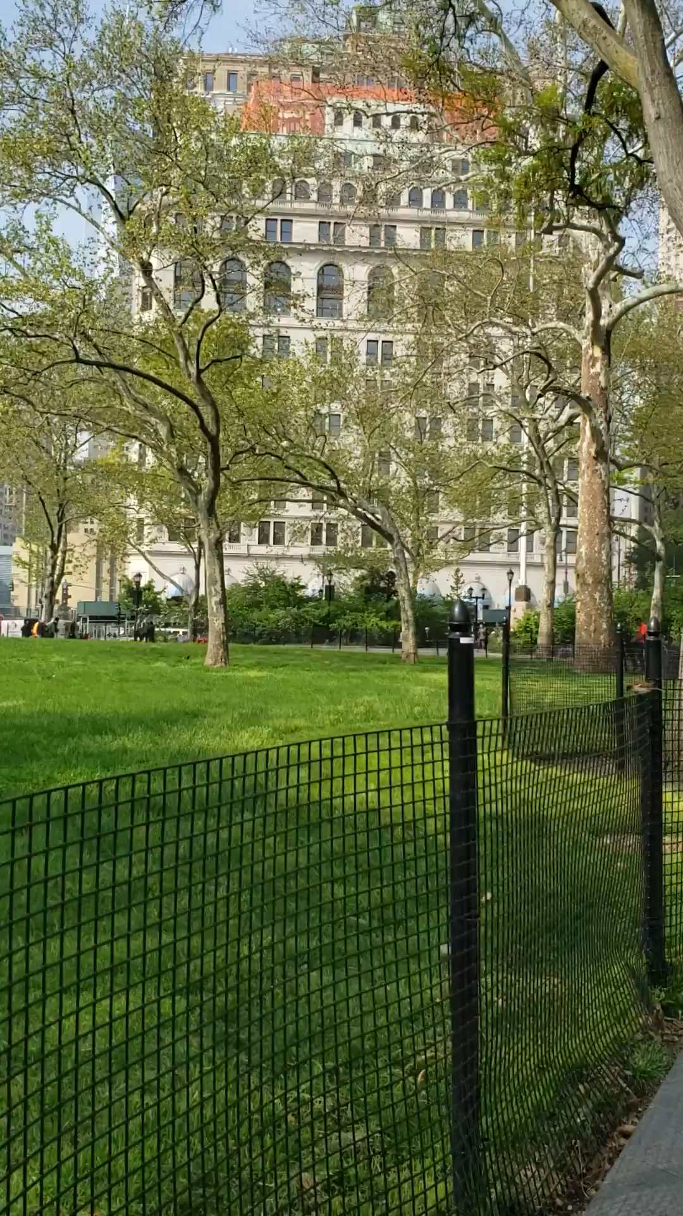
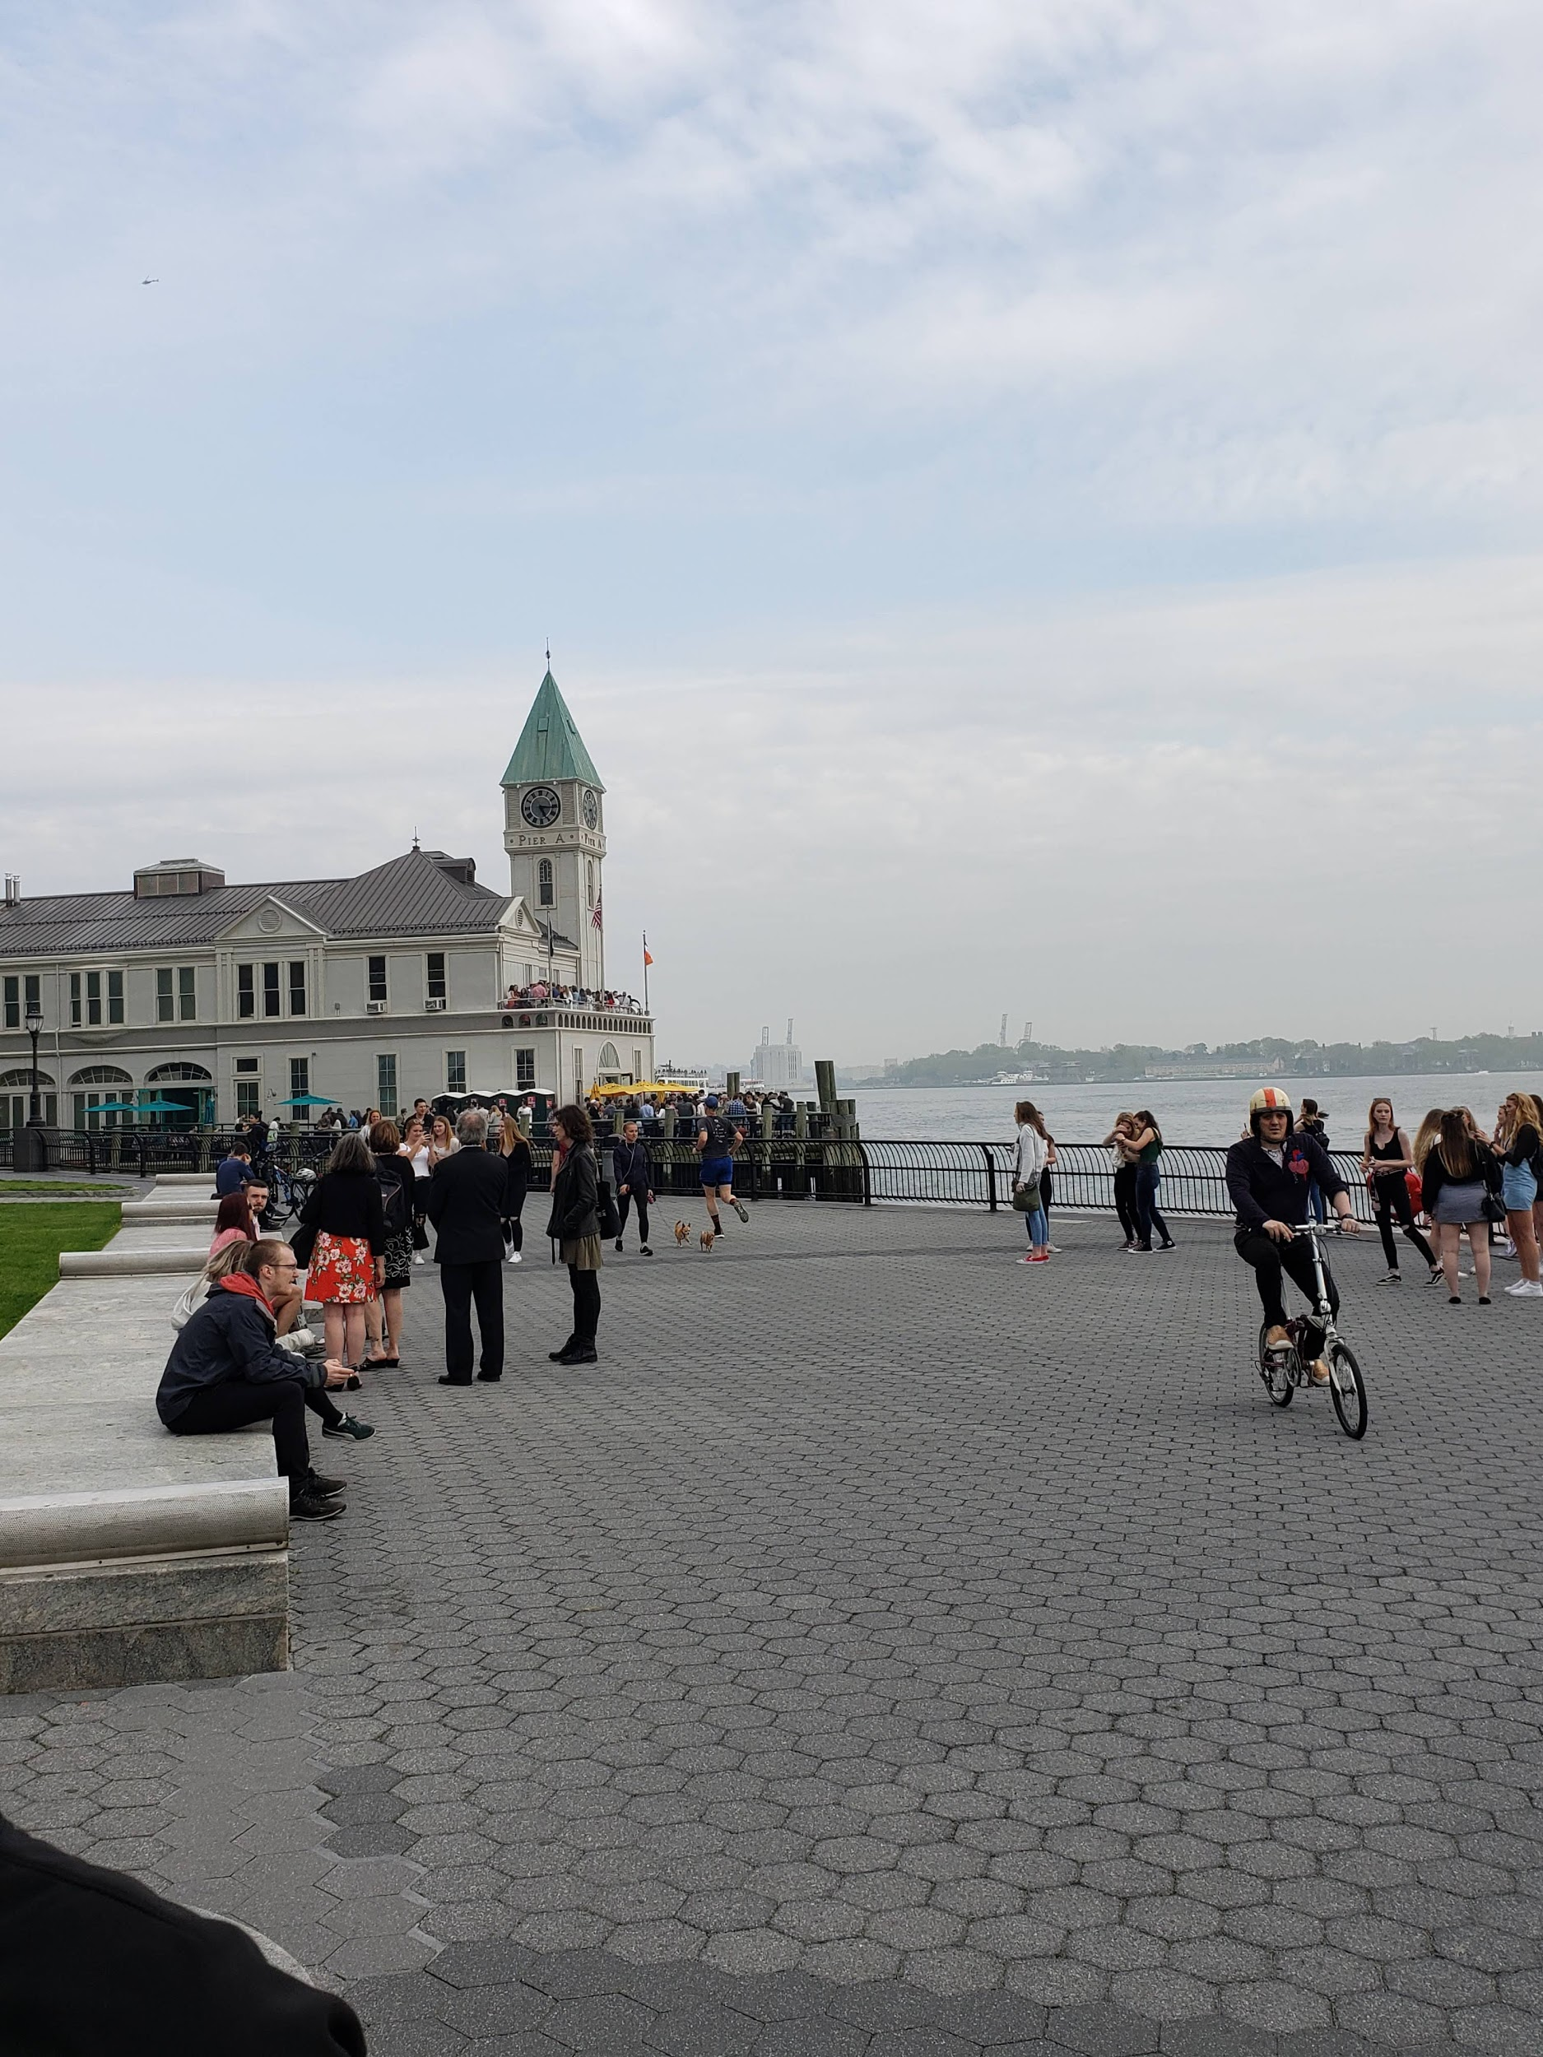
The park manages and host the selling of tickets in the historic exhibit (Castle Clinton) for the Ferries to the Ellis Island and Statue of Liberty

Slide 11
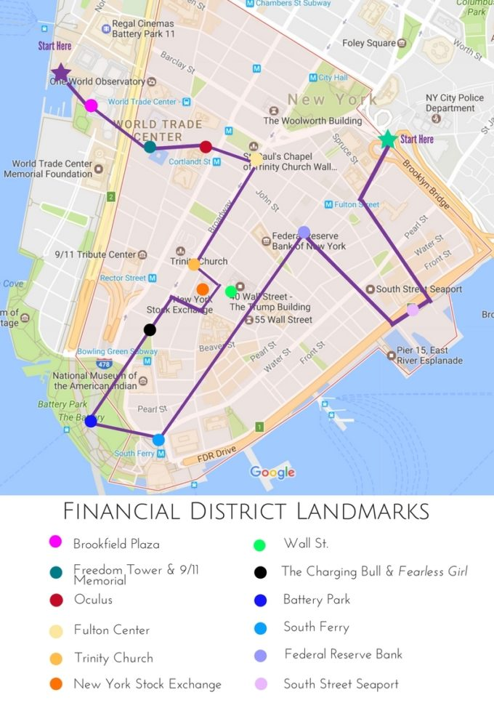

Slide 12
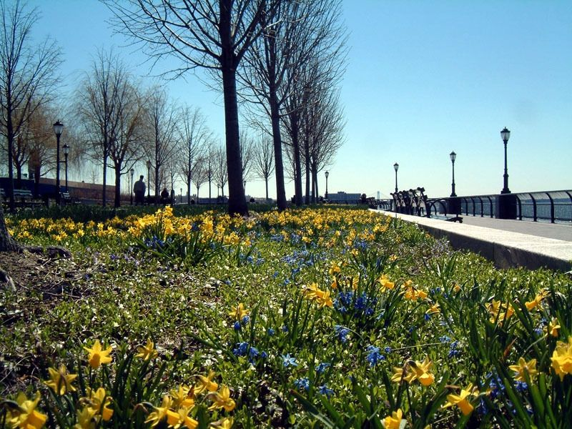

EVENTS- MONTH OF MAY
Tour The Battery- Official Battery Conservancy Tour
Wildflower Tour of The Battery
Spring Migration Bird Walk at The Battery with NYC Audubon

Slide 13
Employee Guide
Park its own and maintain by the Department of parks and Recreation
In 1944, the Battery Conservancy which is a non-profit educational corporation was created to revitalize the battery and renew the Castle Clinton National Monument.
City of New York Department of Parks and Recreations and the National Park Services
Park has many programs, educational, volunteers, and others programs that gives tours and maintain the important landmark and monuments of the park.
Through the National Park Service the government owns and maintain the Castle Clinton
The Park and the castle are major sites in New York State’s Harbor Heritage
Warrie Price, founding President of the Conservancy, serves as the City's Battery Park Administrator and the State's Heritage

Slide 14
Employee Structure
Higher-level start in the board of trustees as 14 employees
Ex-officio trustee with 7 employees
Administration with 5 employees
Operation with 15
680 volunteers from elementary, middle, and high school students
A job that the park is frequently looking is a seasonal and part-time job of the educator. Educators assists with educational teaching programs and general maintenance in the park. For the position of educator its pay $20 an hour, and the job is mostly 24 hours a week.

Slide 15
Profit of the Conservancy
The annual budget of the Battery Conservancy is generated by gifts from the private sector
In recent years, conservancy generated $41 million in private funding and $92 million in city funding
Online shopping store that sell maps, guides, clothings, bags
They have a battery chair program that they located a chair within the park with their name to honor or remember loved one with a one time payment of $2,500
They also have a program of contribute to the battery biodiverse landscapes, and the donor select a species tree they want to donate, donations varies from $25,000 - $5,000
You can also donate to the park the least being $10
They have battery corporate partners support levels and benefits as starting prices for benefactor being $50,00, sponsor being $25,000, patron being $10,000, and partner being $5,000
Event such as the annual celebration of the park as the “America birthplace park”, take place every June 10th and every funding they get is for the park conservatory. It’s more of an event for fundraising for the park

Slide 16
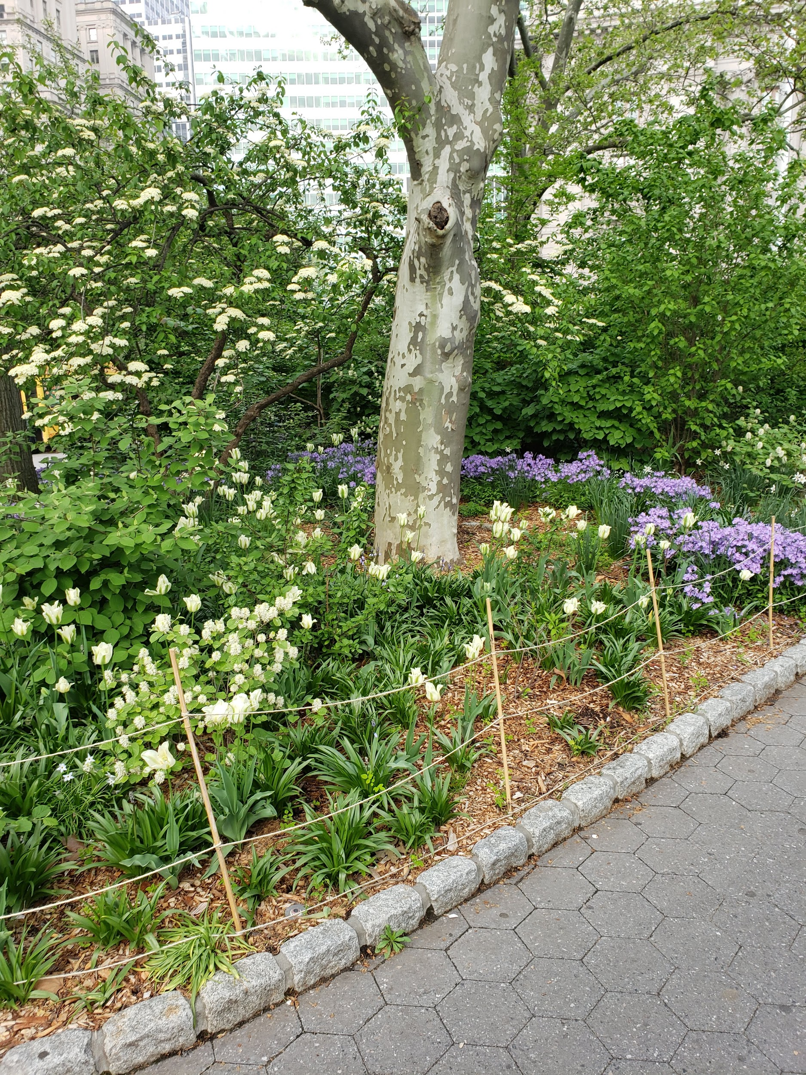
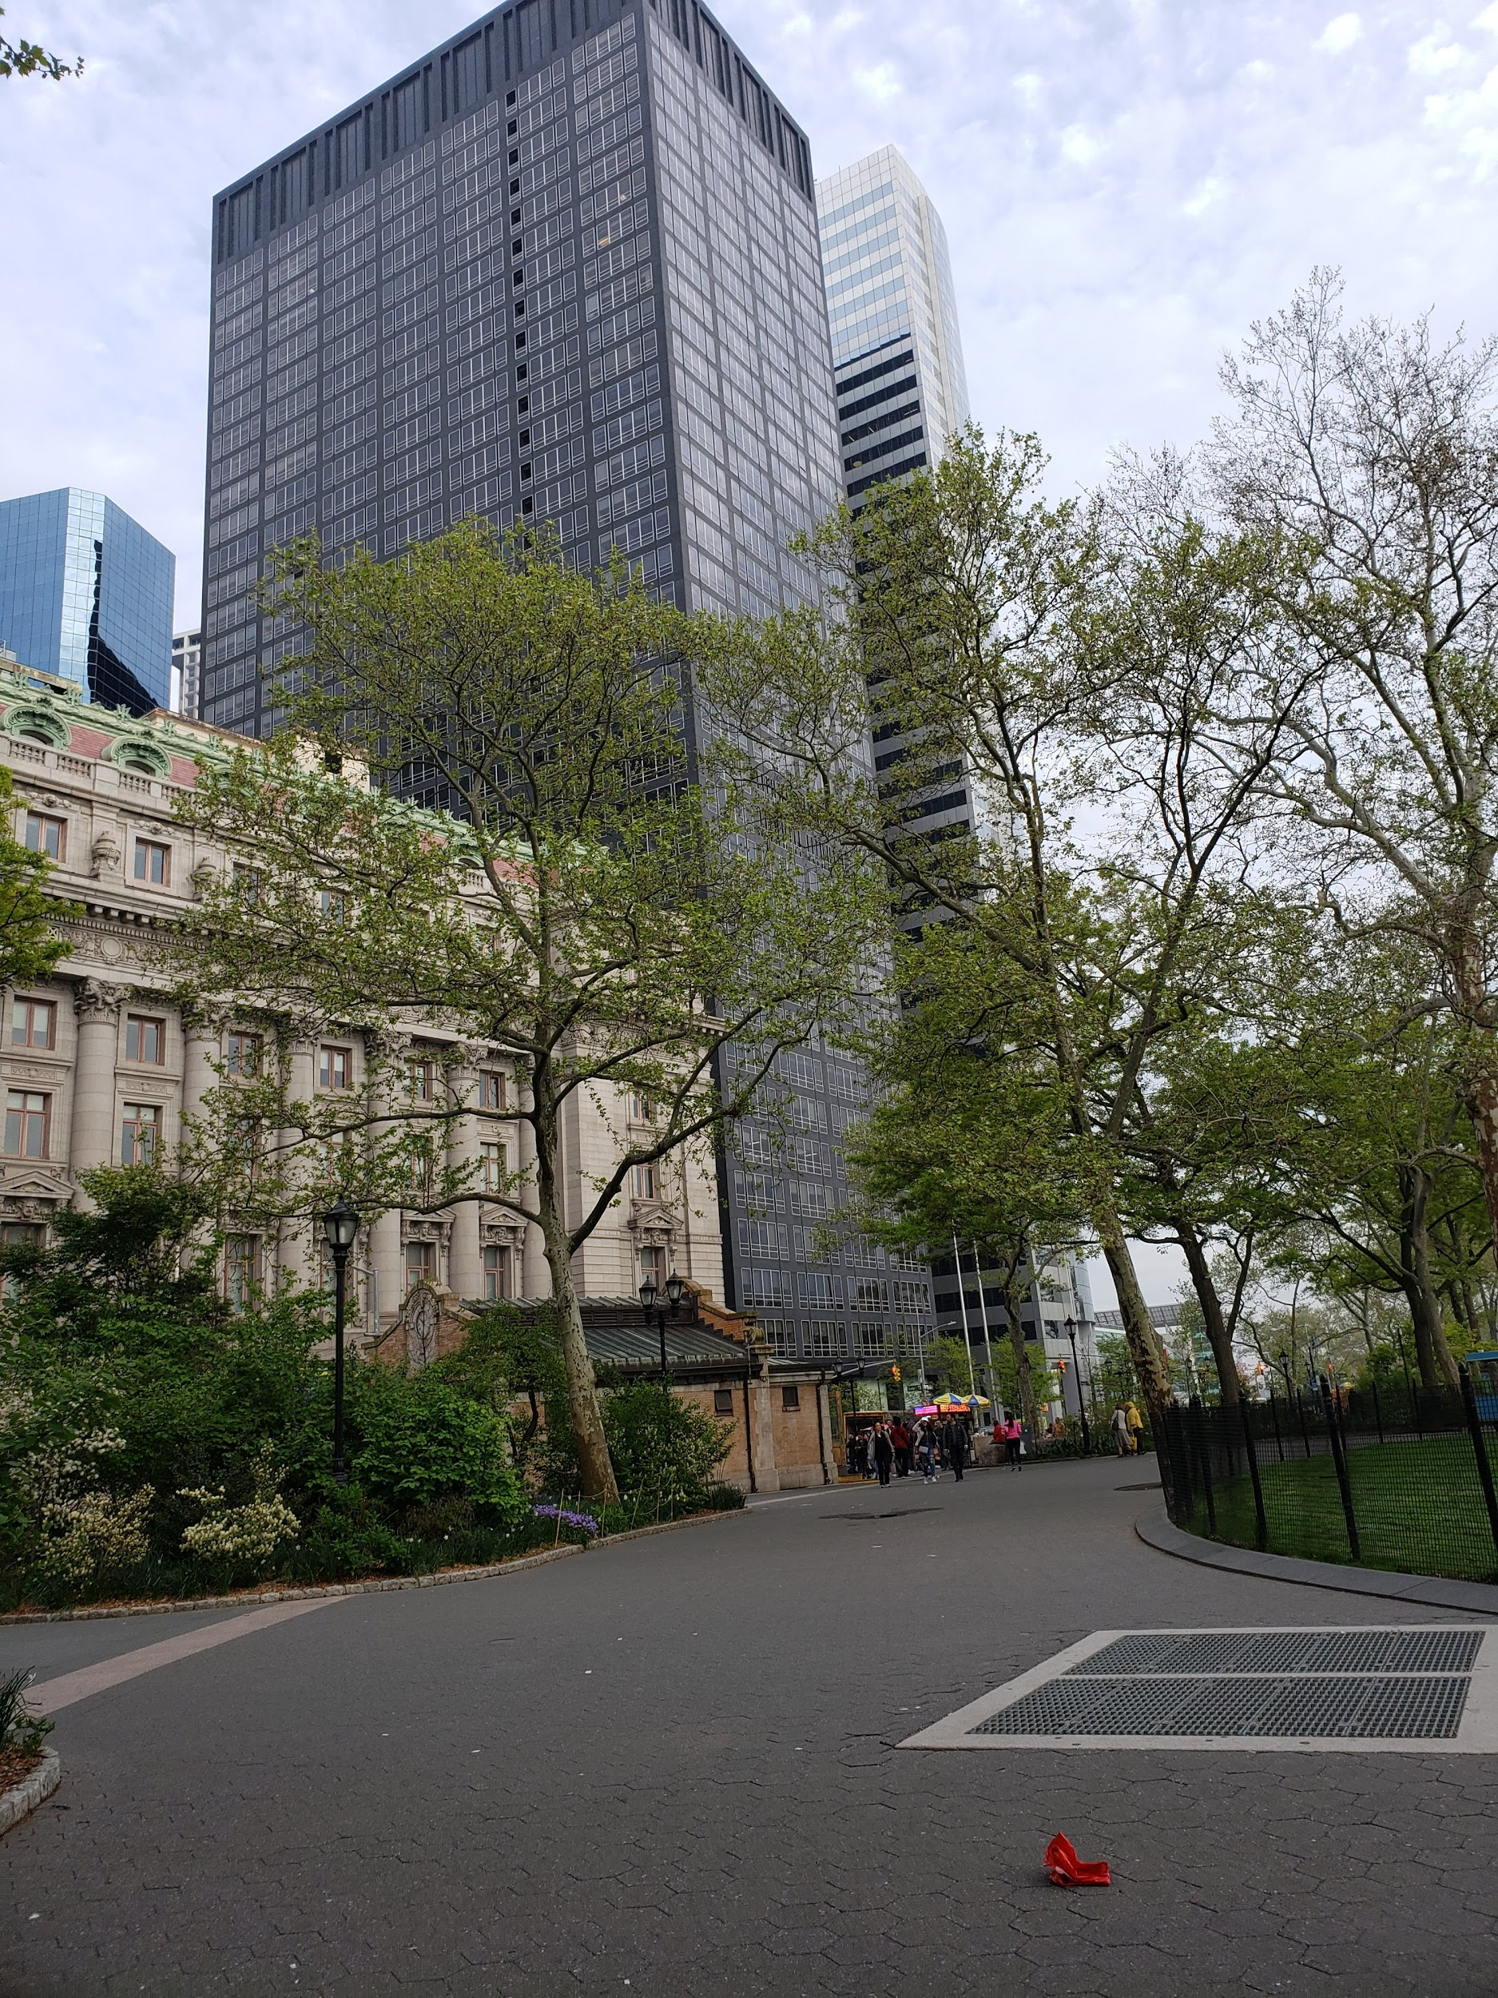
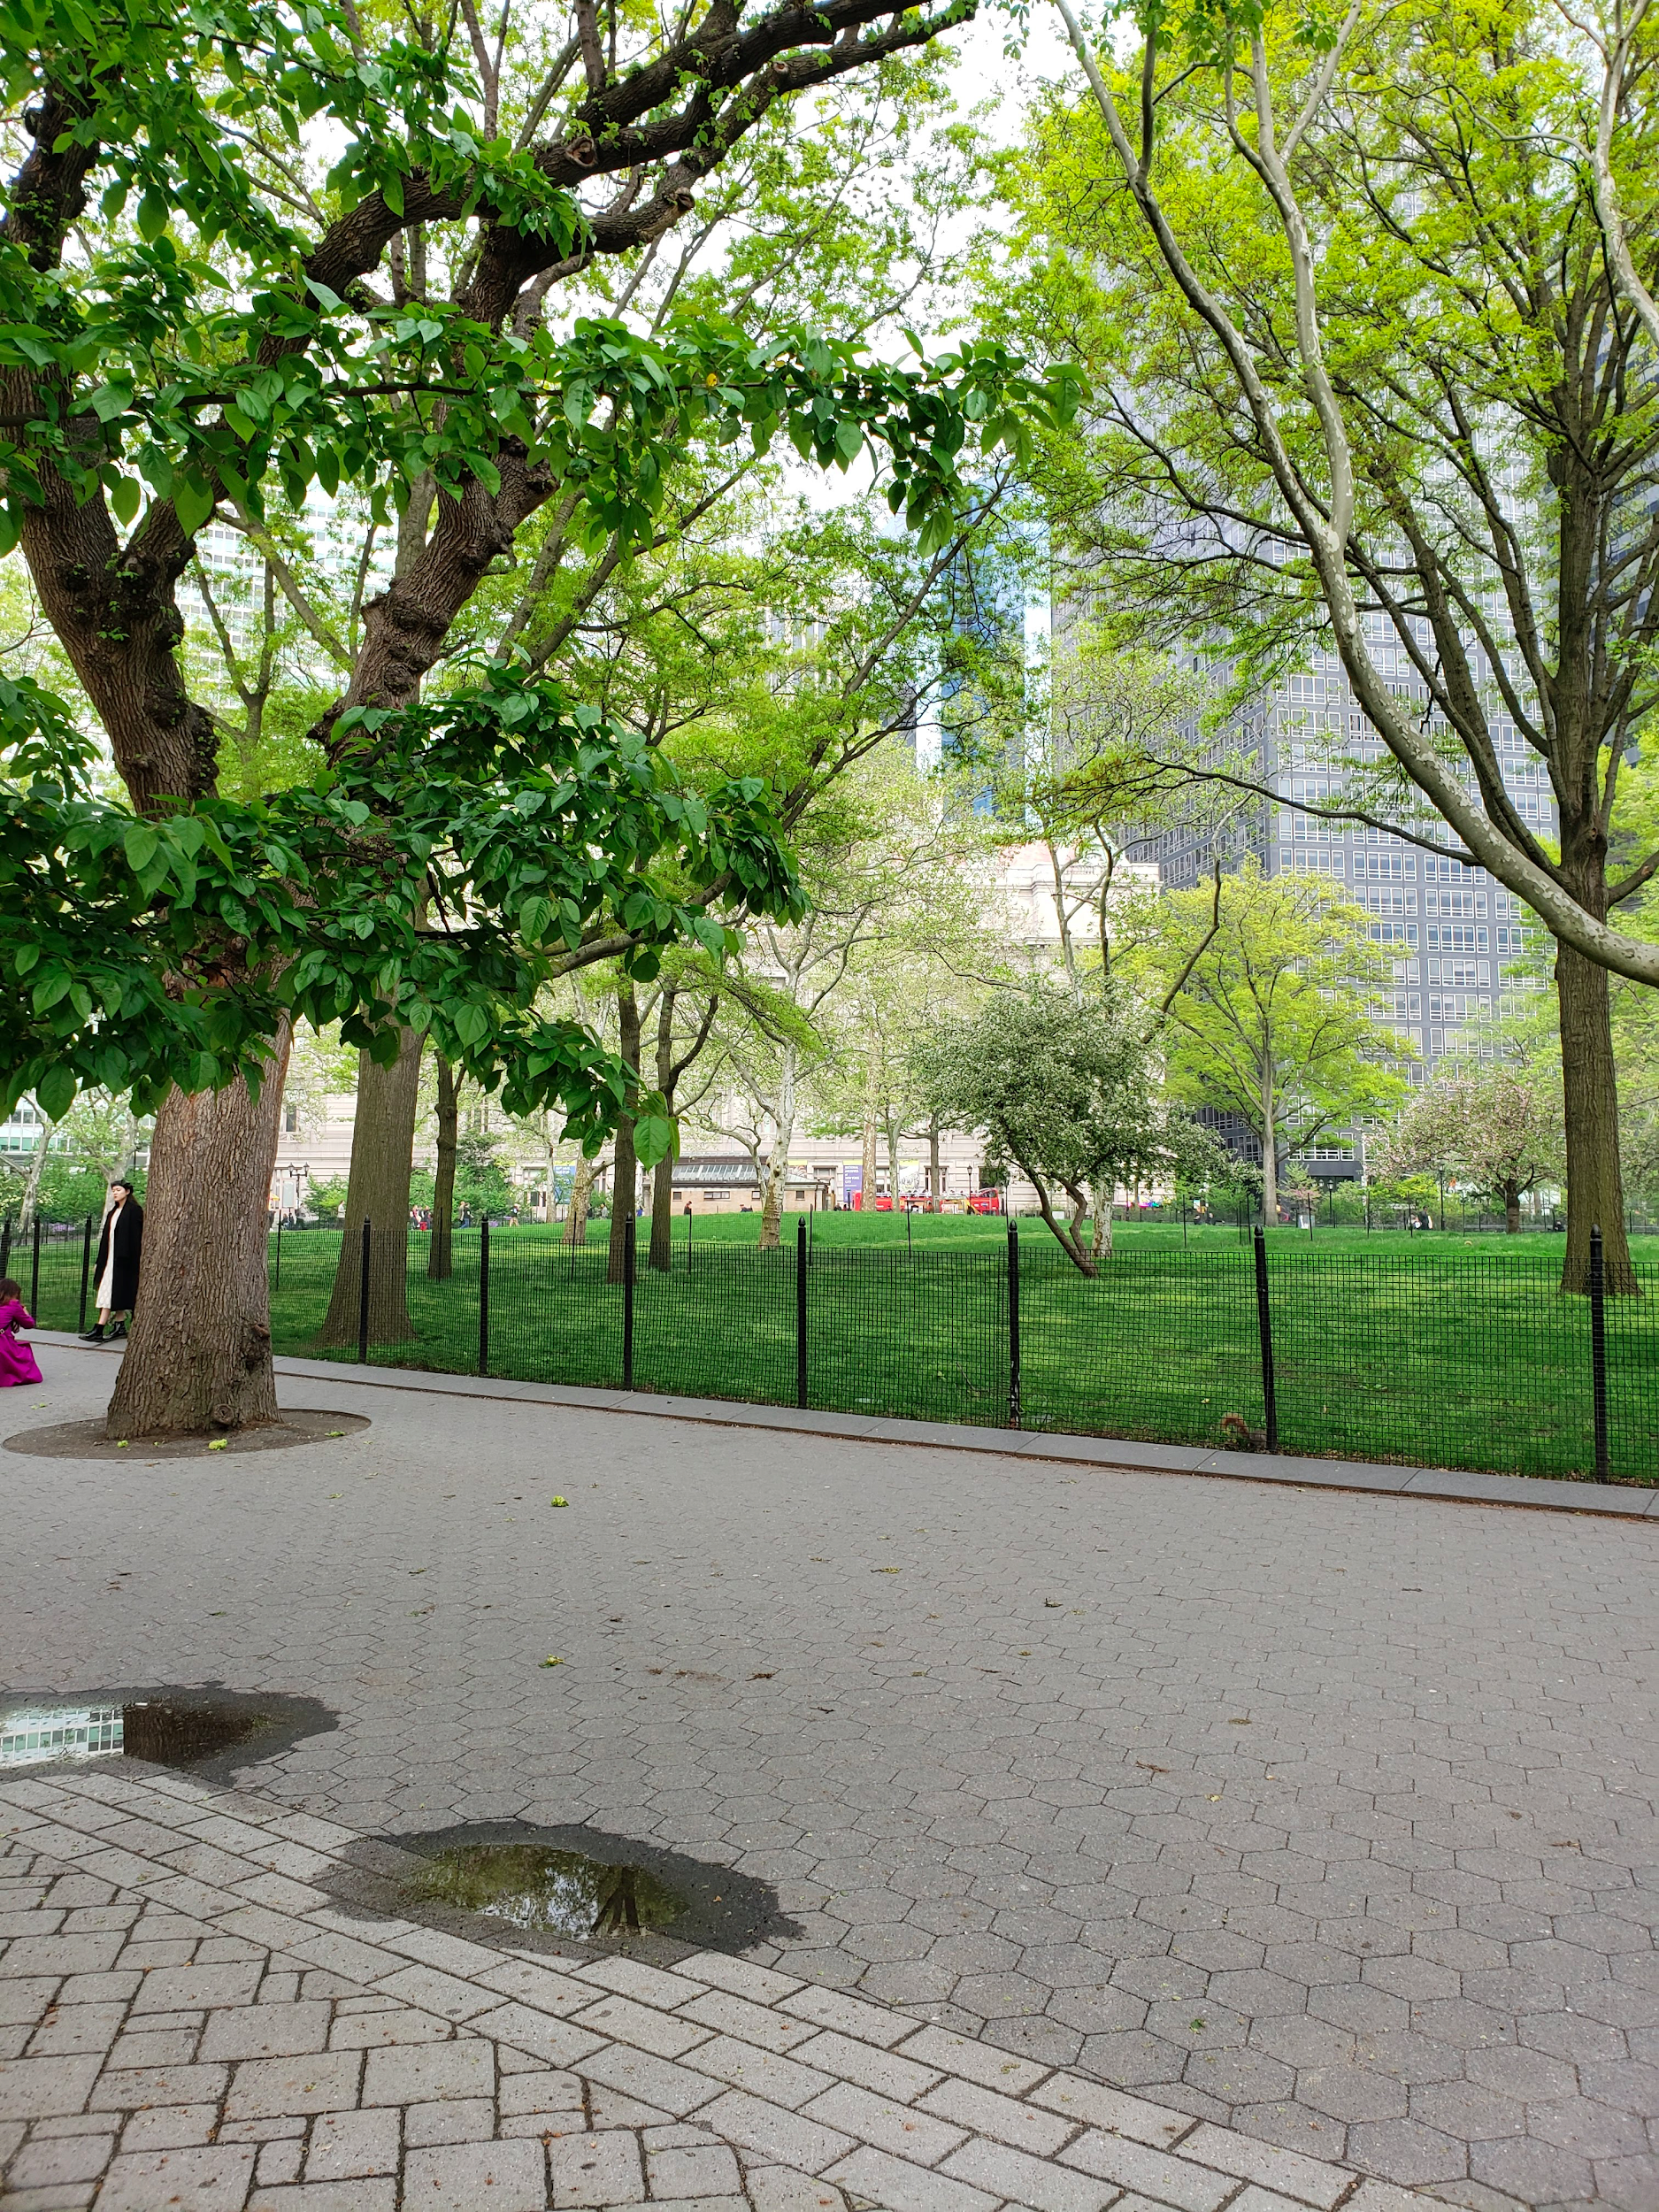
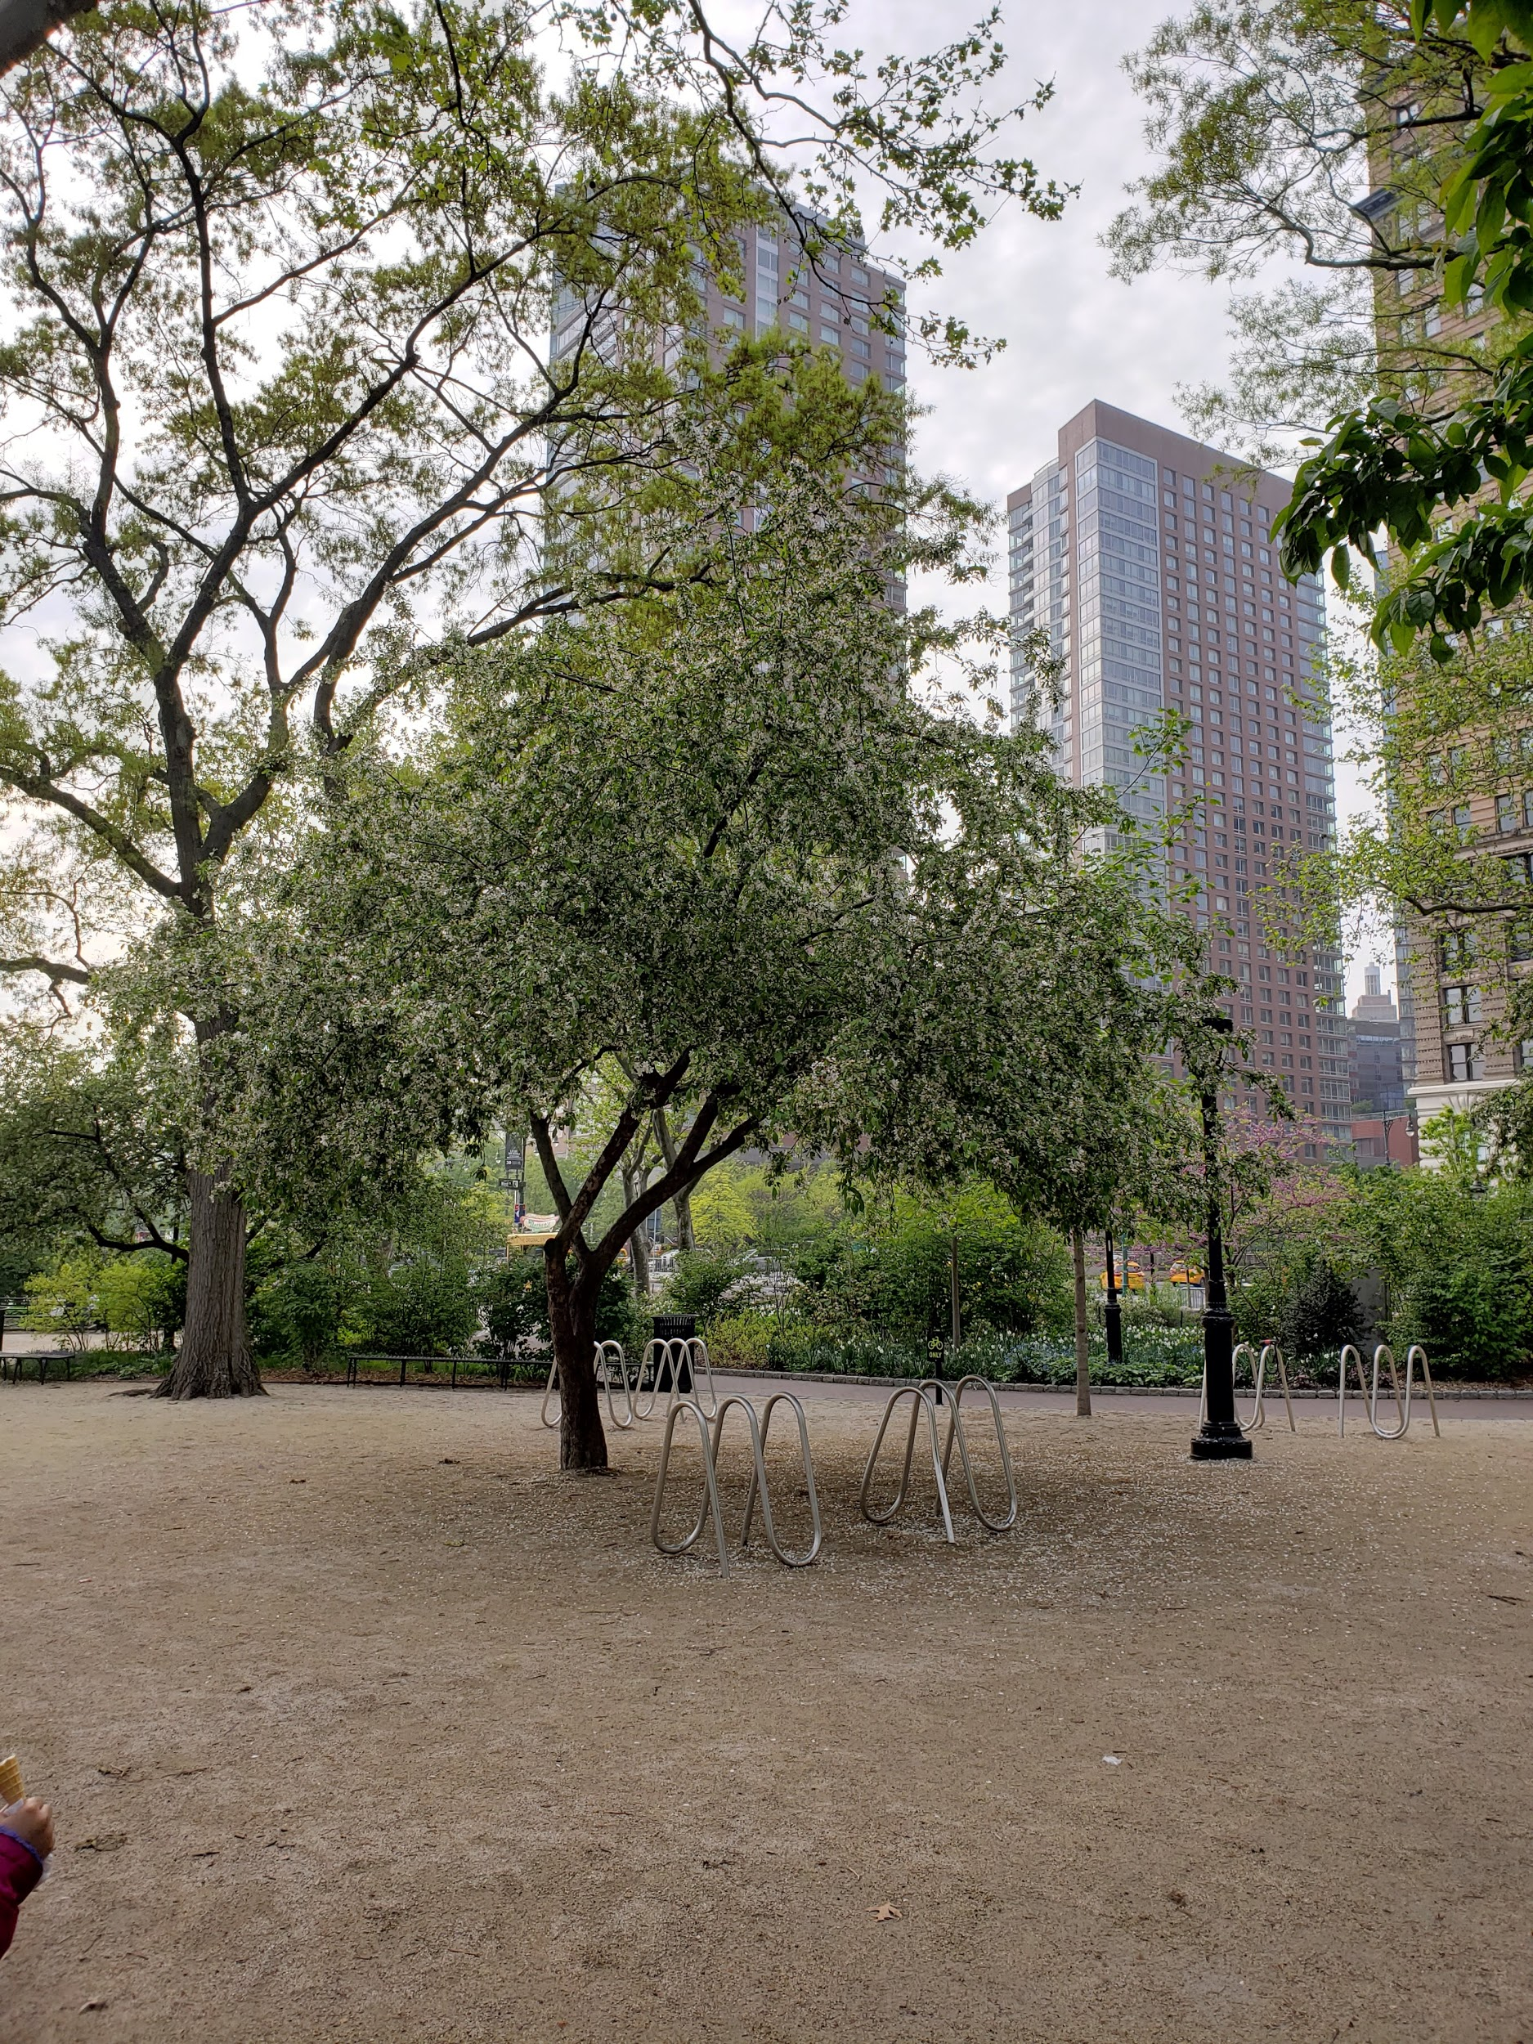

Slide 17
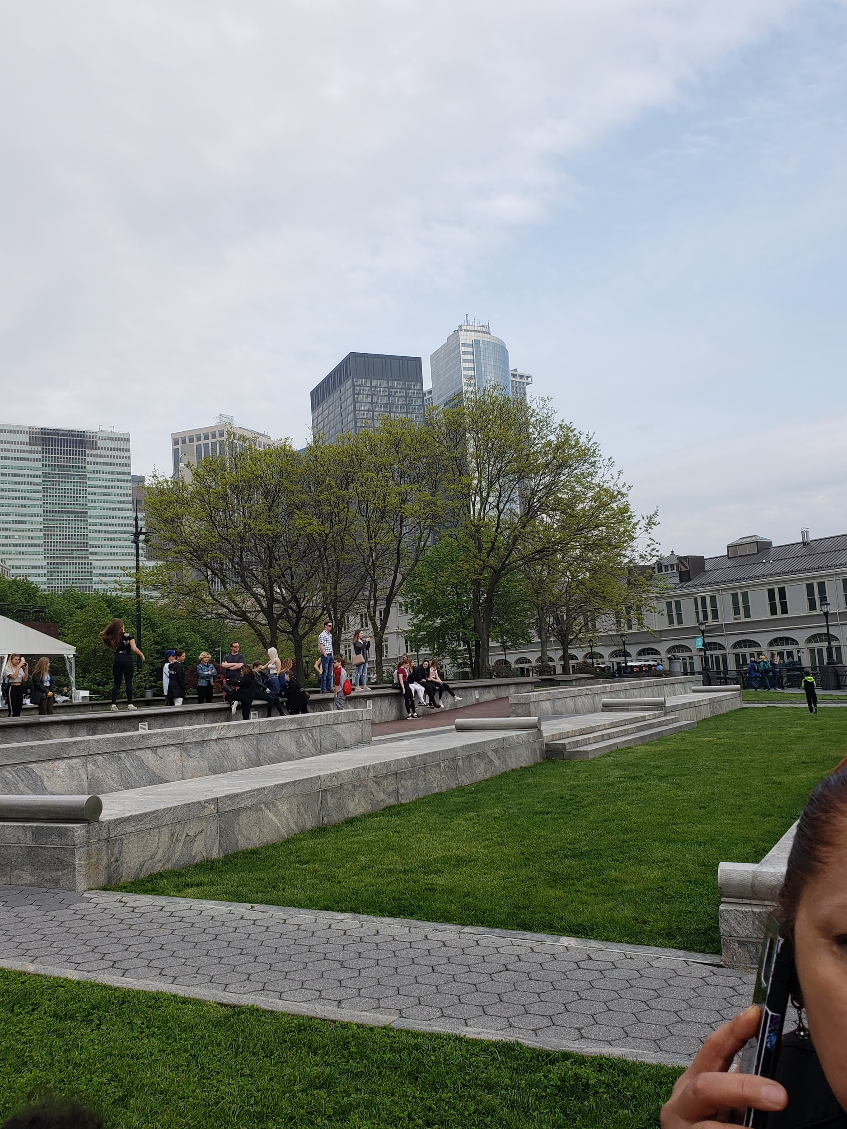
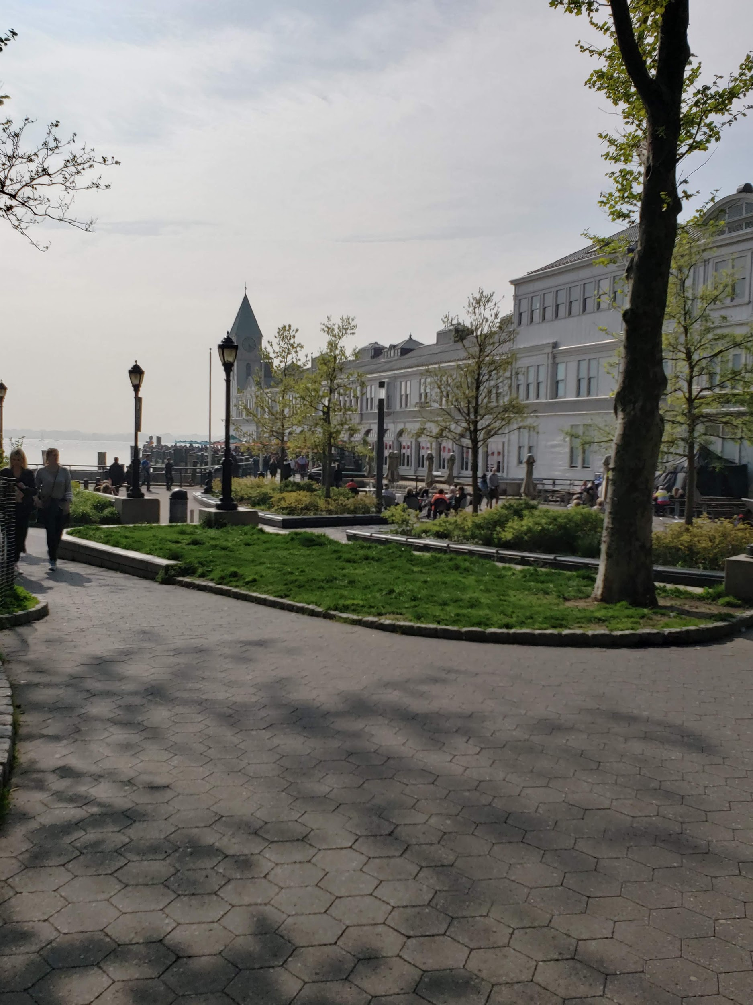
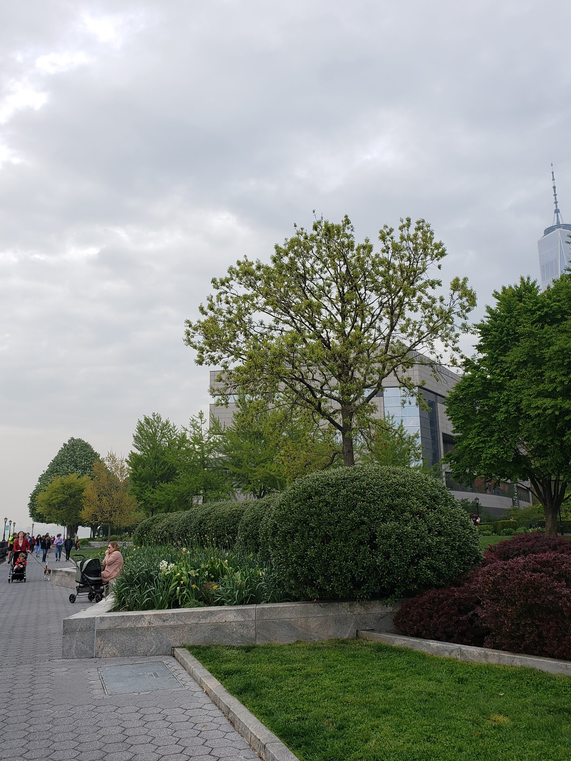
Thank You

