Slide 1
Mission Statement
To discover, interpret, and disseminate—through scientific research and education—knowledge about human cultures, the natural world, and the universe.

Slide 2
AMERICAN MUSEUM OF NATURAL HISTORY TIMELINE
1869 • Zoologist Albert Smith Bickmore is successful in his proposal to create a natural history museum in New York City, winning the support of William E. Dodge, Jr., Theodore Roosevelt, Sr., Joseph Choate, J. Pierpont Morgan. NY Governor Hoffman, signs the Act of Incorporation.
1871 • First exhibits in the Central Park Arsenal.
1872 • The Museum quickly outgrows the Arsenal and secures Manhattan Square (the current location).
1874 • The cornerstone for the Museum's first building at 77th Street is laid by U.S. President Ulysses S. Grant.

Slide 3
American Museum of Natural History, First Annual Report: 1869 (New York: American Museum of
Natural History, 1870), 17.

Slide 4
1877 • The first building opened by U.S. President Rutherford B. Hayes.
1881 • Museum President Morris K. Jesup launches the Museum into a golden age of exploration that lasts from 1880 to 1930. Museum is involved with expeditions that discover the North Pole; explore unmapped areas of Siberia, Outer Mongolia and the great Gobi; and penetrate the densest jungles of the Congo, taking Museum representatives to every continent on the globe.
1895 • President Jesup hires Franz Boas to be the assistant curator in the Department of Ethnology.
The Museum's First Building.

Slide 5
1895 • President Jesup hires Franz Boas to be the assistant curator in the Department of Ethnology.
1896 • The Hall of Northwest Coast Indians opens on the first floor.
1897–1902 • Boas organizes the Jesup North Pacific Expedition. In the entire field of anthropology, nothing of comparable ambition or scope has ever before been attempted. The expedition yields an unparalleled record of the life and culture of the peoples of the North Pacific.
The Jesup Expedition.

Slide 6
9/11 Museum Mission
The National September 11 Memorial Museum serves as the country’s principal institution for examining the implications of the events of 9/11, documenting the impact of those events and exploring the continuing significance of September 11, 2001.
The Museum’s 110,000 square feet of exhibition space is located within the archaeological heart of the World Trade Center site – telling the story of 9/11 through multimedia displays, archives, narratives and a collection of monumental and authentic artifacts. The lives of every victim of the 2001 and 1993 attacks are commemorated as visitors have the opportunity to learn about the lives of the men, women and children who died.
The monumental artifacts of the Museum provide a link to the events of 9/11, while presenting intimate stories of loss, compassion, reckoning and recovery that are central to telling the story of the attacks and the aftermath.

Slide 7
The National September 11 Memorial
• Tribute of remembrance and honor to the 2,977 people killed in attacks of 9/11, 2001 at the World Trade Center site, near Shanksville, Pa., and Pentagon. Also six people killed in the World Trade Center bombing in February 1993.
• The Memorial’s twin reflecting pools are each nearly an acre in size and feature largest manmade waterfalls in North America. The pools sit within the footprints where the Twin Towers once stood.
• Names of every person who died in the 2001 and 1993 attacks are inscribed into bronze panels edging the Memorial pools.

Slide 8
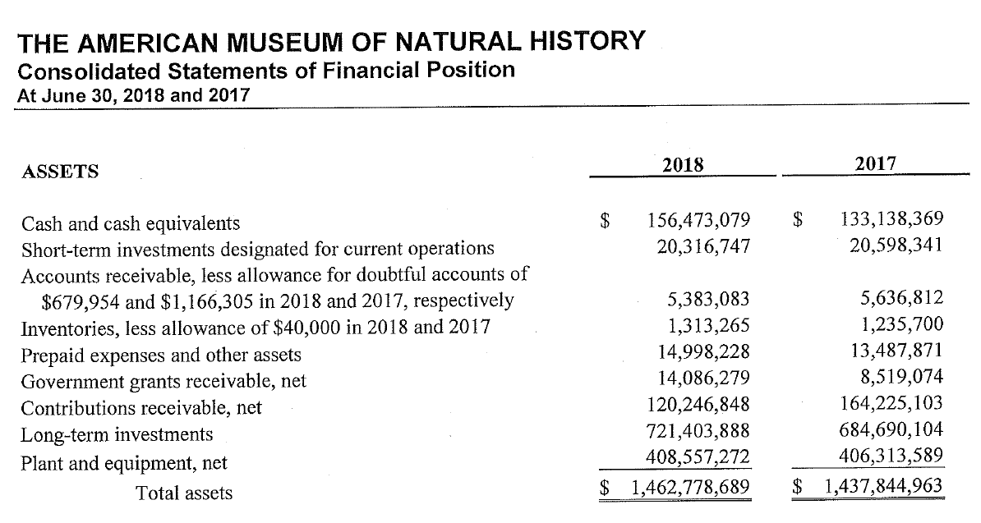

Slide 9
Most visited Smithsonian museums and institutions in the United States in 2018 (in millions)
Most visited Smithsonian museums and institutions in the U.S. 2018
Note: United States; 2018
Further information regarding this statistic can be found on page 8.
Source(s): Smithsonian; ID 258338
4

Slide 10

Number of visits to Smithsonian museums and institutions in the United States from 1970 to 2018 (in millions)
Number of visits to Smithsonian museums and institutions in the U.S. 1970-2018
Note: United States; 1970 to 2018
Further information regarding this statistic can be found on page 8.
Source(s): Smithsonian; ID 258337
2

