Slide 1

Champagne & Sparkling Wine
Prof. Karen Goodlad, HMGT 2402, Wine & Beverage Management

Slide 2
Objectives
--Discuss wine making methods employed to make sparking wine using wine industry terminology
--Explain the factors that affect the taste of sparkling wine
--Identify geographical regions where sparkling wine is produced

Slide 3
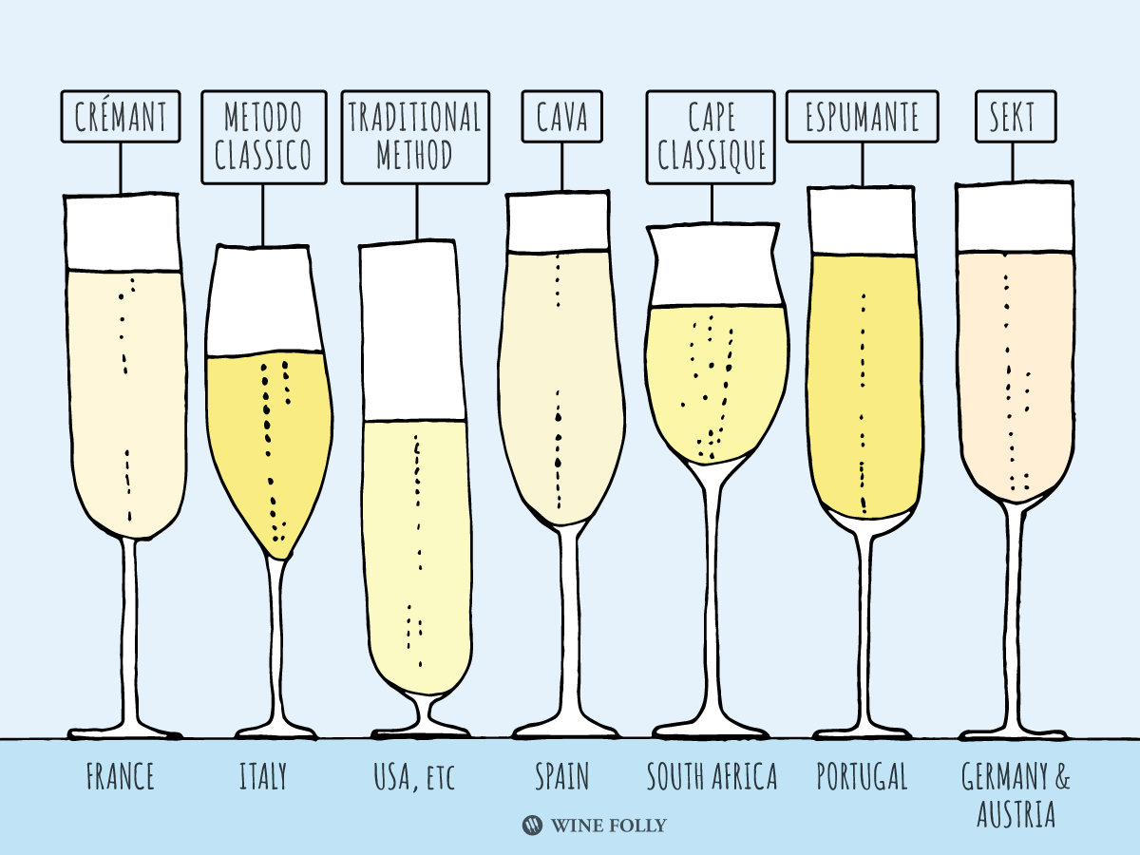

Slide 4
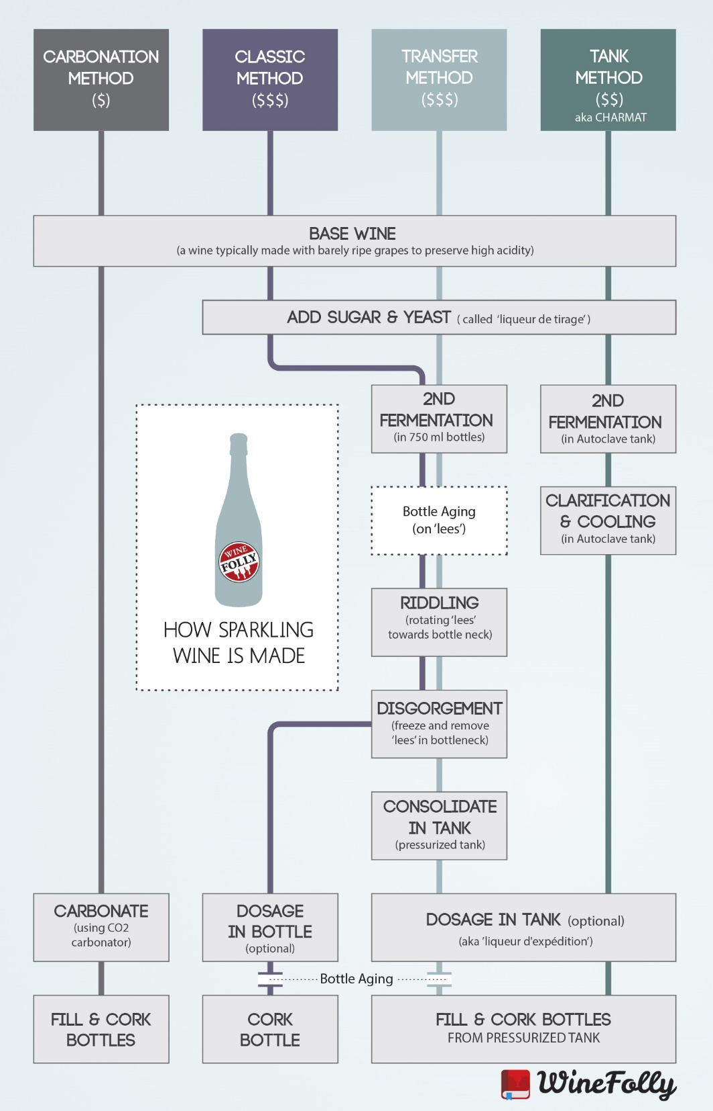

Slide 5
Méthode Champenoise
Harvest
Press
Fermentation
Assamblage/Blending
Liqueur de tirage
  Capped
  Transferred to pupitres/racks
  Sit on Lees (age)
Rémuage/Riddling
Dégorgement/Disgorging
Liqueru d’Expédition/Dosage
Cork/Cage/Seal
Age
Notes:
Blending creates consistent style of the “house”, can be up to 70 different areas, looking forward to aging, can blend reserve stock form previous years
“Bottling liquid”, still wine, sugar, yeasts
Sediment moves down neck, sur point
To disgorge neck is frozen
Dosage = sugar and wine

Slide 6
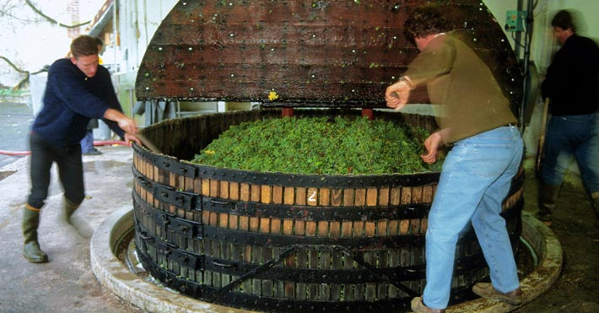
Méthode Champenoise: Press
Notes:
What is of concern here?
Why press 4 times?

Slide 7
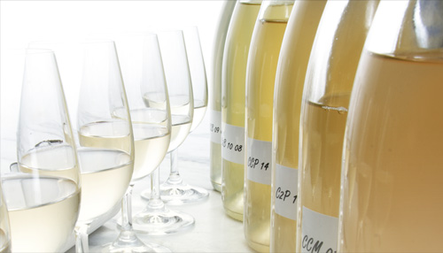
Méthode Champenoise: Assemblage http://www.champagne.us/en/champagne/the-keys-facts-about-champagne-wine/the-blending

Slide 8
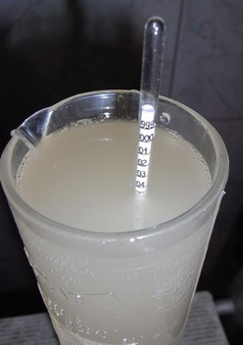
Méthode Champenoise: Liqueur de Tirage
Addition of _______________ and _______________ with the result of _______________

Slide 9
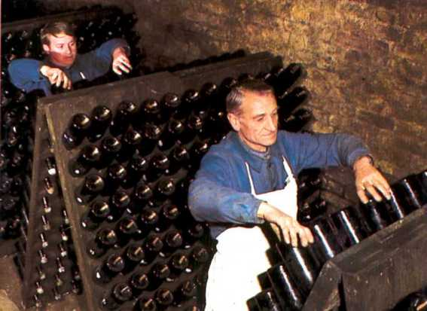
Méthode Champenoise: Remuage/Riddling http://www.champagne.fr/en/from-vine-to-wine/wine-making/maturation-on-lees

Slide 10
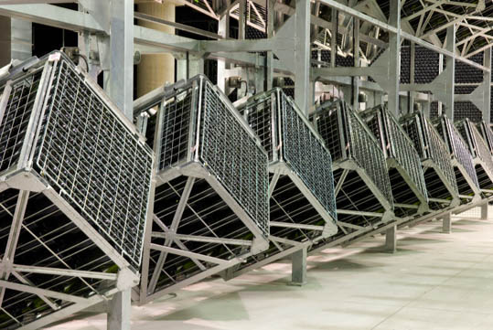
Gyropalettes

Slide 11
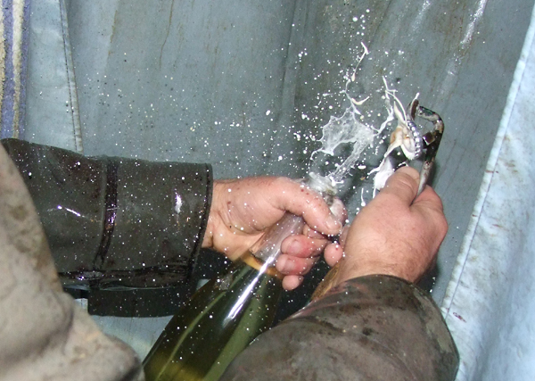
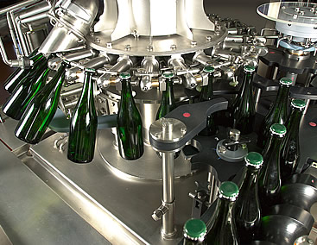
Méthode Champenoise: Dégorgement

Slide 12
Transfer Method
Modified Méthode Champenoise
  Méthode Champegnoise techniques but wine is transferred into a large vat then filtered into individual bottles
Notes:
Sparkling wine made by the transfer process, follows the same procedure as Méthode Champenoise, up to the point of bottling. The secondary fermentation does not take place in the actual bottle sold to the customer. The wine is bottled en tirage. However, immediately following secondary fermentation, the fermentation bottles are emptied under pressure and the wine filtered. This replaces the rémuage, riddling, and dégorgement steps. The transferred wine is then bottled under pressure into a new set of bottles that are shipped to market.
In america it can me identified by The label statement "Fermented in this bottle" means Méthode Champenoise, whereas "Fermented in the bottle"
http://www.winepros.org/wine101/sparkling.htm

Slide 13
Charmat (Tank) Method
Still wine placed in sealed pressurized tank
Sugar and yeast are added
Sparkling wine is filtered and bottled
  Result is light and fruity
  Retains grape characteristics
  Used for inexpensive wine
Notes:
Eugene Charmat, a Frenchman, invented his process in 1907. Instead of individual bottles to produce the secondary fermentation, he invented the glass-lined tank. The wine stays under constant pressure in bulk, through the filtering and bottling process, which takes as little as ninety days from picking to bottling. Charmat is also known as the Bulk Process.
Both the transfer and Charmat process are time and money savers. There are knowledgeable wine critics who contend that the different methods of producing sparking wine can each produce equal quality product given the same fruit to begin with. These critics are in the minority and commercial attempts at high quality Charmat or bulk process sparklers are few and far between.
http://www.winepros.org/wine101/sparkling.htm

Slide 14
Champagne, France
Champagne House (44 houses)
  Long distinguished brands of particular style
  Specialty: blending and producing wine
  Purchase almost all grapes
Growers
  Own an average of 1.5 Hectares (1 hectare: 2.471acres)
  Grow/harvest grapes
Trend: “Grower’s Champagne”
  Single estate grown and bottled, shows terroir
2009 Extension of Region
  40 more villages on perimeter of Champagne

Slide 15
Champagne: Rating System
Comité Interprofessionnel des Vins de Champagne (CIVC)
  Producers, Growers & INAO govern wine production
  Échelle de crus: village rating system, updated 1985
    Soil –climate relationship
    Until 1990 village rating determine price of grapes
Grands Cru (17)
Premier Cru (~32)
Cru
Notes:
All in vineyards in village have same rating
Hectare 10,000 square meters,
More Chardonnay = Lighter style
More Pinots = fuller richer
Aging requirements: NV=15 months, vintage 3 years
Recent vintages (1995, 1996, 1999, 2000, 2002)

Slide 16
Champagne: AOC Laws (CIVC)
Chardonnay, Pinot Noir, Pinot Meunier
Yields in both the vineyard & pressing are limited
Defined pruning, height, spacing & density
Harvest by hand in small baskets
Aging: 15 months for cuvée, 3 years for vintage
Notes:
Chardonnay 27%, Pinot Noir38%, Pinot Meunier 35%

Slide 17
Styles of Champagne
Non Vintage
Blanc de Blancs
Blanc de Noirs
Vintage
Rosé
Cuvée de Prestige
Sugar Content
  Extra Brut
  Brut
  Extra Dry
  Sec
  Demi-Sec
  Doux
Notes:
Extra Brut: 0-6 grams per liter
Brut: 0-15 grams per liter
Extra Dry: 12-20 grams per liter
Sec: 17-35 grams per liter
Demi-Sec: 33-50 grams per liter
Doux: 50+ grams per liter, no longer commercially produced

Slide 18
Types of Producers
NM: Négociant Manipulant
RM: Récoltant Manipulant
CM: Coopérative Manipulant
SR: Société de Récoltants
ND: Négociant Distributeur
MA: Marque d’Acheteur
Notes:
NM: Négociant Manipulant, “House” purchase grapes, do not have vineyards
RM: grower producer
CM: a cooperative of growers that make champagne
SR: 2 or more related growers that come together to produce and market their champagne
ND: distributer of wine
MA: proprietary wine

Slide 19
Champagne: Appellations
Montagne de Reims
Vallée de la Marne
Côte des Blancs
Côte de Sézanne
Côte de Bar
Geography & Climate
  Chalky Soil
  Cold, snow
Notes:
Montagne de Reims: Primarily Pinot noir lone elevation allows cool are to “slip away”
Vallée de la Marne: Primarily Pinot Meunier, easy drinking and fruity style
Côte des Blancs: Primarily Chardonnay, most popular finesse and delicate, mature well
Côte de Sézanne: Chardonnay more fruity than classic style
Côte de Bar: Pinot Noir, most southerly area

Slide 20
Italy, Piedmont
Asti, DOCG, & Moscato d’ Asti, DOCG
  Region: Peimonte, Italy
  Grape: Moscato Bianco
  Predominately made in the Charmat Method
  Spumanti & Frizzante (respectively)
Notes:
https://www.guildsomm.com/public_content/features/articles/b/chris-tanghe/posts/prosecco

Slide 21
Italy, Vento
Prosecco, DOC
  Region: Veneto, Italy
  Grape: Glera
  Charmat Method and Tradtional Method
Prosecco Superiore, DOCG
  established in 2009
  delineates the area between the towns of Valdobbiadene in the west and Conegliano in the east.

Slide 22
Italy, Lombardy
Franciacorta, DOCG
  Chardonnay, Pinot Noir, Pinot Bianco
  Traditional Method

Slide 23
Germany
Sekt: Produced using Charmat method
Riesling, some Pinot Blanc or Pinot Gris

Slide 24
Spain: Cava
Penedès
Méthode Champenoise
Traditional Grape Varietals
  Parellada
  Macabeo
  Xarel-lo
Freixenet, Cordon Negro Brut
  Popular Producer
Cordoniu
  Most Popular Sparkling Wine in the world

Slide 25
North America
Washington State
  Predominately Chardonnay
  Leading Producer: Domaine St. Michele
    Methodé Champagnoise
    323,000 Cases in 2006
California
  Kluge Estate, Mumm, Domaine Chandon, Gloria Ferrer, Soter Vineyards, Laetitia, Roederer Estate, Schramsberg, Domaine Carneros, “J”

Slide 26
Opening a bottle of Sparkling Wine
Le Saberage
  Releasing the cork using a sword
    DO NOT TRY THIS ON YOUR OWN, THIS IS A DIFFICULT TECHNIQUE THAT REQUIRES TRAINING
Traditional Method

Slide 27
Oz Clarke & James May in Champagne
https://youtu.be/qcc_Jnel4s0

Slide 28
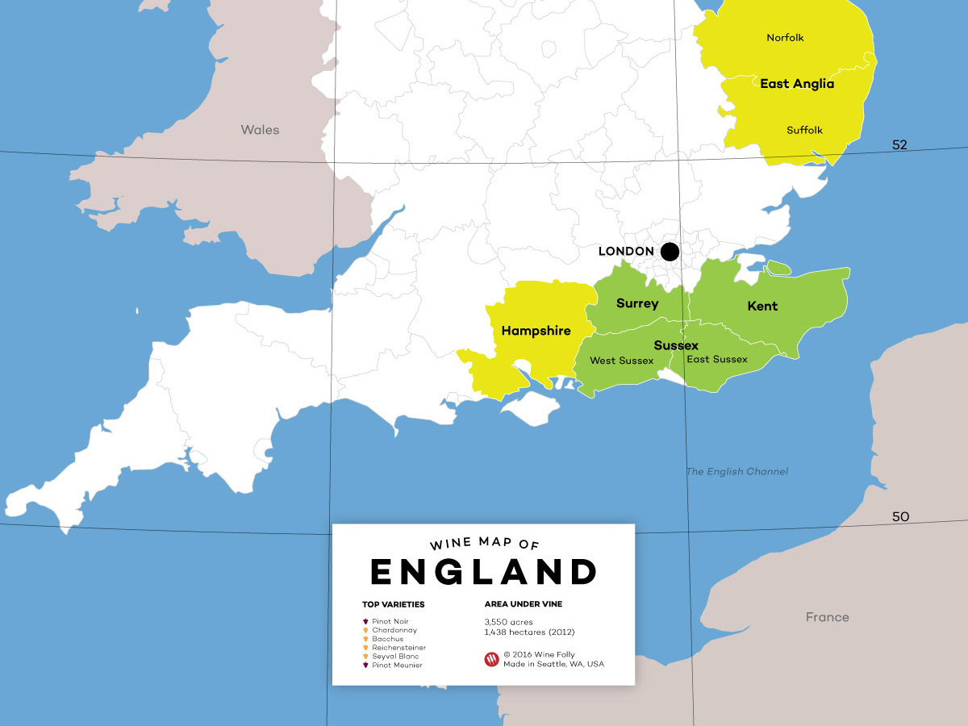

Slide 29
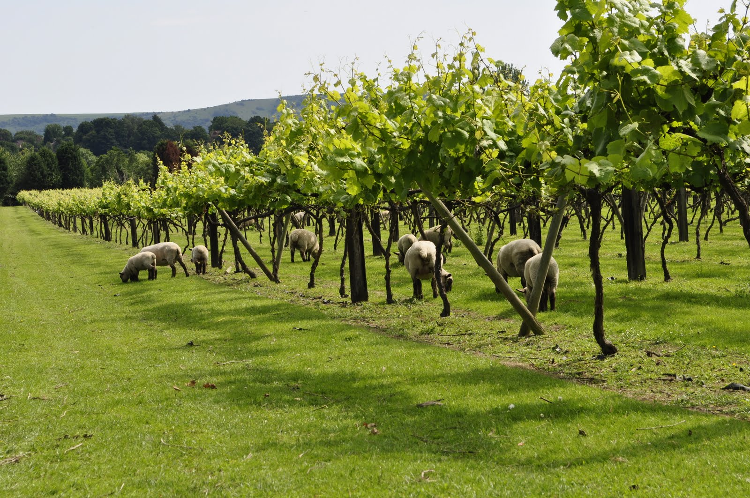
Chalk, Greensand, Clay
Cool coastal influences north of the 51 parallel
Warm September
Grape Varieties: Chardonnay, Pinot Noir, Pinot Meunier, Pinot Blanc, Pinot Gris
https://daily.sevenfifty.com/why-you-should-start-paying-attention-to-english-sparkling-wine/
Photo Credit: http://londoncosmopolitan.blogspot.com/2011/07/west-sussex-wine-trail.html

Slide 30
PDO Quality English Sparkling Wine
Sugar allowed in the production of the cuvee (still wine), not to exceed additional 3% alcohol from naturally occurring sugar
Cuvee can not be less than 9% alcohol, final
Sparkling wine can not be less than 10% and the tirage liqueur may not increase total alcohol by more than 1.5%
De-acidification of cuvee is allowed
Sweetening of cuvee is not permitted
Traditional Method
9 months aging in lees (12-24 is common)
Source: Retrieved from http://www.ukva.org.uk/wp-content/uploads/2017/03/DEFRA-GUIDANCE-PDO-ENGLISH.pdf

Slide 31
Terms to Know
Méthode Champenoise (all related terms)
Champagne Grape Varieties
Charmat Method
Champagne
Prosecco
Cava
Champagne Sugar Content:
  Extra Brut, Brut, Extra Dry, Sec, Demi-Sec, Doux
Vintage
Rosé

