Slide 1

Wines of Italy
HMGT 2402, Wine & Beverage Management
Prof. Karen Goodlad
Spring 2019

Slide 2
What to Expect Today
Quiz (France)
Review Retail Shop Assignment
Session Objectives
  Discuss wine making methods using wine industry terminology
  Explain the factors that affect the taste Italian wines
    Piedmont, Tuscany, Veneto
  Identify geographical regions of Italy

Slide 3
Terms to Know…
Appassimento
Bianco
Classico
Consorzio
Dolce
Frizzante or Frizzantino
Spumante
Metodo Charmat
Metodo classico or tradizionale
Millesimato
Passito or Passita
Recioto
Riserva
Rosato
Rosso
Superiore
Super Tuscan
Tenuta
Uva
Notes:
Classico
- The historic core of a DOC zone.
Consorzio
- Consortium of pr
oducers.
Dolce
Sweet.
Frizzante or Frizzantino
- Fizzy or faintly fizzy
. Metodo Charmat
- Sparkling wine made by the sealed
tank method.
Metodo classico or tradizionale
- Terms for sparkling
wine made by the bottle fermentation method, replacing the
terms champenois or champenoise, which can no longer be
used in Italy.
Millesimato
– Vintage dated sparkling wine.
Passito or Passita
- Partially dried grapes and the strong,
usually sweet wines made from them.
Recioto
-Wine made from partly dried grapes, often sweet
and strong.
Riserva
- Reserve, for DOC or DOCG wine aged a specific
time.
Rosato
- Rosé.
Rosso
- Red
Superior
e
- Denotes DOC wine that meets standar
ds above
the norm (higher alcohol, longer aging, a special subzone),
though conditions vary
.
Tenuta
- Farm or estate.
Uva
- Grape.

Slide 4
Italian Wine Laws
“As market demands increased, so did the need to guarantee and protect the origin of Italian wines.”
--Italian Trade Commission
The Italian Trade Commission is a Great Resource: http://www.italytrade.com/site2005/anglais/images/produits/wines_guide.pdf

Slide 5
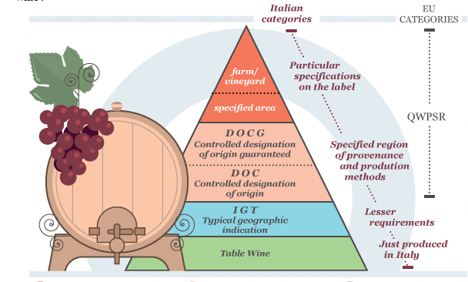
Protected Designation of Origin (PDO)
Source: Made in Italy http://www.italytrade.com/site2005/anglais/pages/appellations/index.php?m=4&article=new&back=y

Slide 6
vino da tavola
Table wine
Industrial alcohol → bulk wines
Label to read only:
  rosso/blanco
  producers name
Notes:
Most Italian wine is consumed in Italy
Comes from any where in Italy
And from any combination of grapes
Producers to know Riinite, Casarsa, Bolla, Cavit and Ecco Domani

Slide 7
Indicazione Geographica Tipica (IGT)
Classified in 1992
  First Application 1996
  ~118 Classified IGTs as of 2016 (same as 2007)
Produced in DOC/DOCG zone, can not list the zone or village on the label
  Lists Region such as Tuscany, Piedmont, Apulia…
Heavily located in Tuscany
What are the results:
Notes:
Introduced in order to bring up level of quality and reputation of Italian Wine
Example: Sassicaia, 1st IGT to become DOC
Cab. Sauv. vine planted in 1968, grown from cuttings of Chateau Lafite-Rothschild vines

Slide 8
Indicazione Geographica Tipica (IGT)
Classified in 1992
  First Application 1996
  ~118 Classified IGTs as of 2016 (same as 2007)
Produced in DOC/DOCG zone, can not list the zone or village on the label
  Lists Region such as Tuscany, Piedmont, Apulia…
Heavily located in Tuscany
What are the results: More R&D, Some Recognizable High Quality Wines, Investment in Non-traditional Grapes, and Vinification Methods. Has had No impact on DOC and DOCG quality.
Notes:
Introduced in order to bring up level of quality and reputation of Italian Wine
Example: Sassicaia, 1st IGT to become DOC
Cab. Sauv. vine planted in 1968, grown from cuttings of Chateau Lafite-Rothschild vines

Slide 9
Denominazione de Origine Controllata (DOC)
Established for 5 Years
Approved grape varieties/ percentage of production
Grown in approved vineyards
Yield per hectare/pruning methods
Total number of gallons of wine produced
Vinification method for some wines
Aging methods/time
Piedmont 1990
  Color/aroma/flavor controlled by tasting commission
Notes:
About 20% of Italy’s wine production (60% of which are red)
Different from France because of aging requirements

Slide 10
Denominazione de Origine Controllata e Grarantita (DOCG)
DOC plus:
  Bottles smaller that 1.25 Gallons/5 liters
  Official numbered tag across the cork’s capsule
To be a DOCG Zone
  5 years as DOC
  “reputation and commercial impact both at home and at an international level”
  Wines of historical importance
  Wines are internationally recognized
  Wines have attracted attention
  Wines contribute to Italy’s financial wealth
Notes:
Started in 1980
Bottles can also be numbered by producer
Wines that fail tasting panel are re named Vino da Tavola

Slide 11
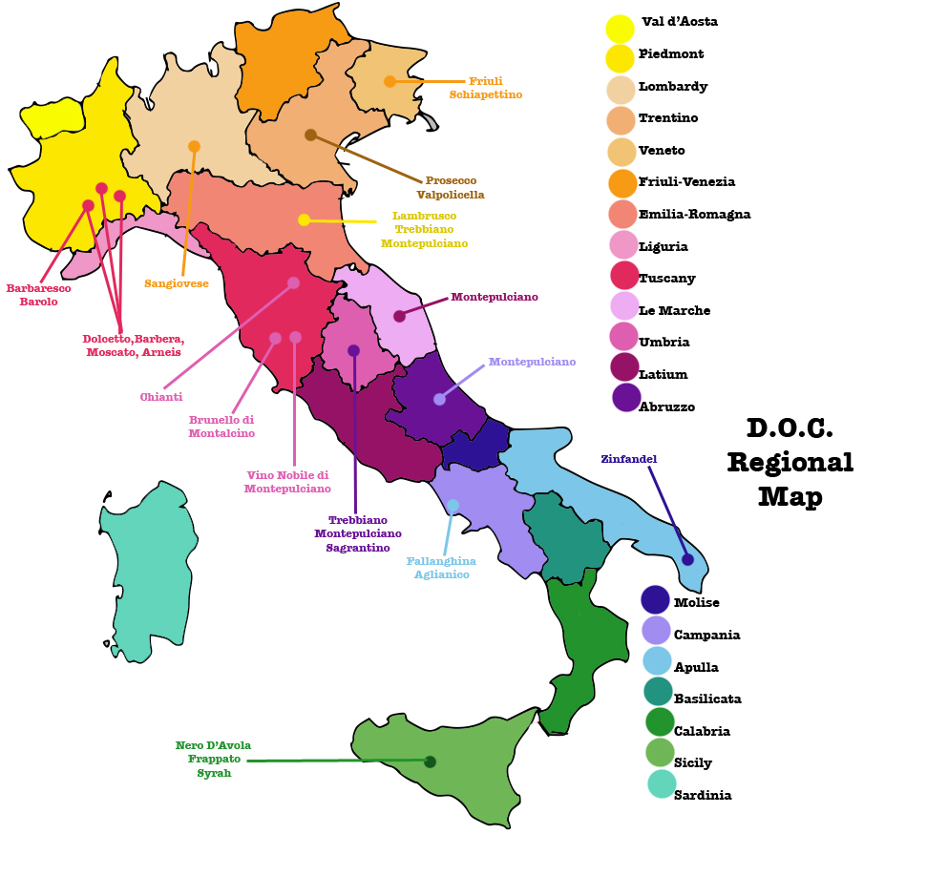
Italy’s Wine Regions
A land of diverse landscape and climate and a vast number of wine grapes.
So much Italian wine is ordinary… SEEK THE EXTRODINARY.

Slide 12
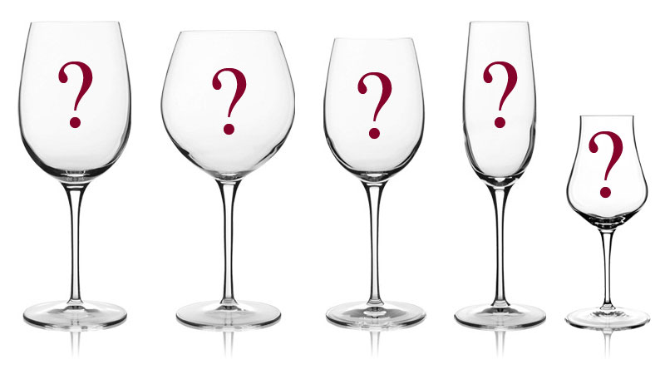
What is in a glass of wine from …?
Piedmont
Tuscany
Veneto

Slide 13
What is in a glass of wine from …?
Appellation
Grape (s)
Climate
Soil
Viticulture
Vinification

Slide 14
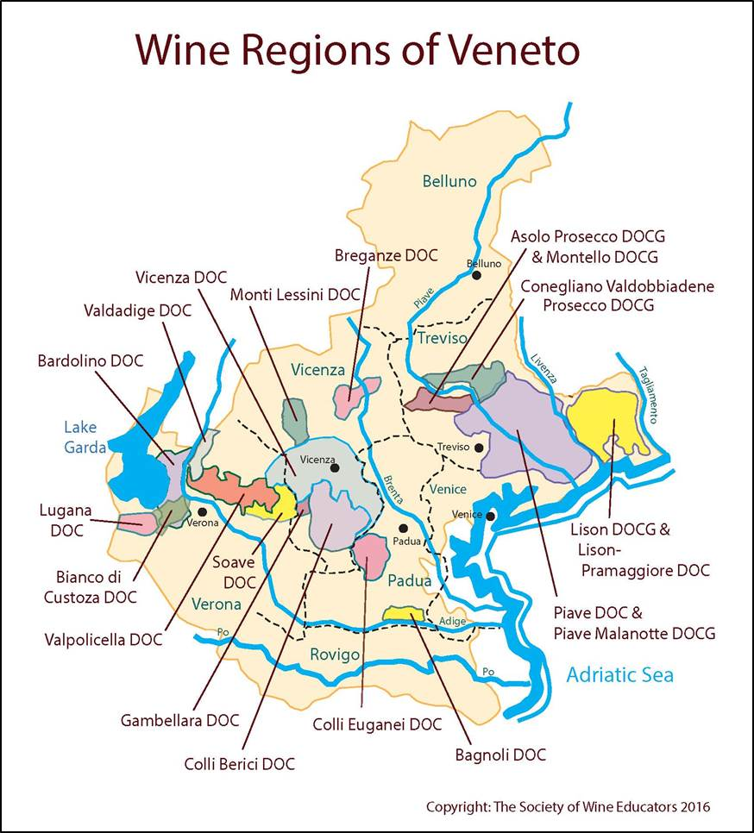
Veneto

Slide 15
Veneto
Wines/Regions to Know
  Prosecco, Soave Superiore, SoaveAmarone, Valpolicella
Grapes to know
  Gargenega, Corvina, Rondinella, Molinara, Glera

Slide 16
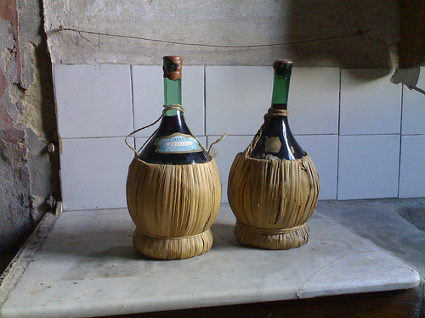
Tuscany, DOCG
Watch and learn: https://vimeo.com/88372900
Chianti
Chianti Classico
  Chianti Classico Riserva
    20% of production, not made every year
Carmignano
Vernaccia di San Gimignano (White)
Brunello di Montalcino
Vino Nobile di Montepulciano
Fiaschi
Old Style Chianti Bottle
Notes:
“Innovation is winning over tradition”, 5.2% production
Chianti
must contain at least 75-90% Sangiovese (can use non traditional grapes like Cabernet Sauv. Merlot…, up to 10% of any other one grape)
Juicy, cherry, raspberry and plummy, great every day pizza wine
DOCG too large to make sure quality is a constant
Fiaschi: Chianti bottles wrapped in straw
Chianti Classico:
Classico is from a small hilly area, the oldest wine growing region in Chianti
100% Sangiovese, lowest yields in Tuscany
Gravel and clay soil
Brunello di Montalcino:
One of Italy’s most prestigious wines
aged in oak for 2 years
High in tannin and thick , hold for20 years then drink
Complex, smoky-spicy, with plummy fruit
Carmingnano
Made form sangiovese, canaiolo, cabernet sauvignon
Vino Nobile do Montepulciano
Prugnolo gentile, clone of sangiovese., makes like chianti classico with more expressive fruit
Boarders the Tyrrhenian Sea
White Grapes: Vernaccia

Slide 17
Chianti Classico and Riserva From Ewing-Mulligan & E. McCarthy Italian Wines for Dummies pg 147-159 Hungry Minds 2001 ISBN 0-7645-5355-0
75–100% Sangiovese,
  up to 10% Canaiolo and up to 20% of any other approved red grape variety such as Cabernet Sauvignon, Merlot or Syrah.
Chianti Classico must have a minimum alcohol level of at least 12% with a minimum of 7 months aging in oak, while Chianti Classico's labeled riserva must be aged at least 24 months at the winery, with a minimum alcohol level of at least 12.5%.^{[4]}
The harvest yields for Chianti Classico are restricted to no more than 7.5 t/ha (3 tonnes per acre). For basic Chianti, the minimum alcohol level is 11.5% with yields restricted to 9 t/ha (4 tonnes per acre).^{[6][11]}
The aging for basic Chianti DOCG is much less stringent with most varieties allowed to be released to the market on 1 March following the vintage year. The sub-zones of Colli Fiorentini, Montespertoli and Rufina must be aged for a further three months and not released until 1 June. All Chianti Classicos must be held back until 1 October in the year following the vintage.^{[1]}

Slide 18
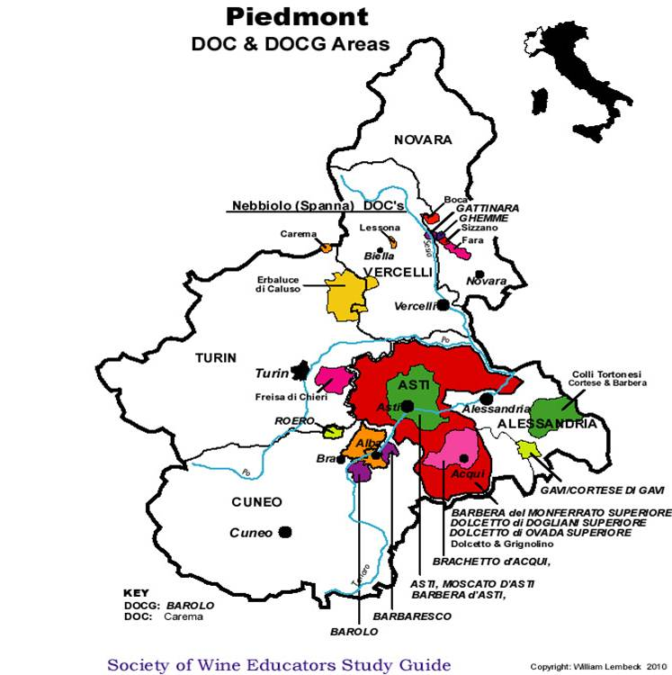

Slide 19
Piedmont
Grapes
  Barbera, Nebbiolo, Moscato, Cortese, Dolcetto
Regions
  Barbera d’ Alba, Nebbiolo d’Alba, Barbaresco, Barolo, Asti, Moscato d’ Asti, Gavi, Dolcetto di Ovada
Styles
  Light red, bold red, light sparkling, full sparkling, light while, spicy white

Slide 20
Piedmont
Watch and Learn: https://vimeo.com/87250296
Barolo vs. Barbaresco
“Patience is a Virtue”
Barolo
Barbaresco
Nebbiolo Grape
Aged Minimum of Three Years in Wood
Riserva: Aged Five Years
Single Vineyards
Cellar: 8-25 years
Wine: Shows Finesse, is Rich & Smokey
Soil of Barolo, various north to south http://video.winespectator.com/play/id/847106654001/name/Barolo%3A+Soils+and+Styles
Nebbiolo Grape
Aged Minimum of Two Years (One in Wood)
Riserva: Aged Four Years
Cellar: 5-20 Years
Wine: Elegant, Feminine, Powerful
Soil more nutrient rich
Notes:
Barolo:
Calcareous Marl
Marbaresco, more nutrient rich Marl= less tannin

Slide 21
Piedmont
Moscato d’ Asti
Asti
Frizzantino: Crushed and kept cold then bottled to complete fermentation
5.5-8% alc.
Smaller Production
Moscato Grape
  Peach Nectar, Great Dessert Style Sparkling Wine
Frizzante: Cuve close, bottle fermented
7.5-9% alc.
Moscato Grape
  Light, Fresh, Grapey, Hints of Peach
  Great Dessert Style Sparkling Wine

Slide 22
Until We Meet Again
Plan the Retail Shop Site Visit
Prepare for Wine of Germany and Eastern Europe

Slide 23
Wine Region: North Eastern Italy
Veneto:
  Recioto do Soave, DOCG
  Important wine from Veneto:
    Valpolicella, 80% Corvina, light red, light style
    Amorone, off-dry, chocolaty and spicy with tobacco “bruise sourness”, can be age worthy
    Bardolio, Grapes: 70% Corvina, +Molinara & Rondinella
    Soave: Grapes: Garganega & Trebbiano, Light, drink young
    Prosecco: Frizzante
Friuli-Venezia Giulia:
  Ramandolo
Trentino-Alto Adige: No DOCG
Notes:
Fresh crisp acidic wines
Mountainous
Veneto: 13% of overall wine production
Amorone: Tops of bunches of grapes, left on mats in the sun to raisinate, ferment most of the sugar to 14-16%alc
Friuli 1.5% of overall production north east corner of Italy, mountainous
Pinot Grigio 1970 11,00 cases produces in 200 2.5 million cases produced
Alto Adige: 2% of overall production many grape varietals from French, German and Italian backgrounds

Slide 24
Wine Regions: Southern Italy & The Islands
Campania: Fiano di Avellino, Greco di Tufo, Taburno, Taurasi
(A)Puglia: No DOCG, Largest Producer of Wine in Italy…14%
Basilicata: No DOCG
Calabria: No DOCG, Better known for olives/olive oils
Sicily: No DOCG, 2nd Largest Wine Production… 13%
Sardinia: Vermentino di Gallura
Notes:
“Land of Wine” by Greeks, oldest history of wine making in Italy
South has a huge production of bulk wine
South is ~36% of Italian wine production (Apulia, 14%, Sicily, 13%)
Less that 10% DOC
Hot, Hot, Hot, coastal and mountain areas are cool for wine growing
Campania: look for Fiano di Avellino for a fun, dry, light white wine
Puglia: Look for Primotivo, a red wine but most of the wine from this region still needs to improve
Basilicata: Poor region, little investment, not much wine to mention, .6% of overall production
Calabria: little interesting wine, 1.6% of production
Sicily, still wine production improving, Marsala, fortified wine, aged in local oak, Secco, Semis Secco, Dolce
Sardinia, Contoversial DOCG because red wines, not white grow better there.

Slide 25
Wine Regions: Central Italy
Emilia-Romagna: Albana di Romagna
Tuscany: see next page, Link to NYTimes
Marche: Rosso Conero, Vernaccia di Serrapetrona (spumante)
Abruzzo: Montepulciano d’Abruzzo
Latium: No DOCG
Molise: No DOCG
Umbria: Montefalco Sagrantino, Torgiano Riserva
Notes:
25 % of total production, 1/3 of italy’s DOC/DOCG

