Slide 1
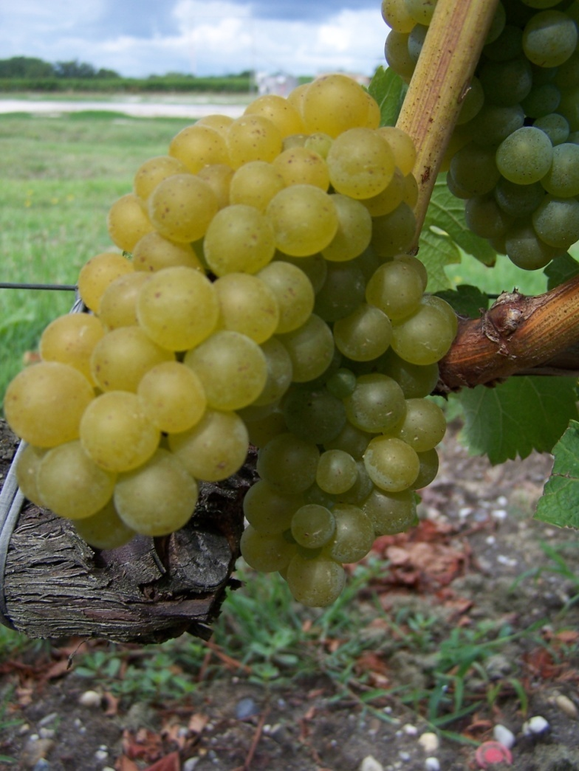

HMGT 2402
Wine & Beverage Management
Prof. Karen Goodlad
Spring 2019
White Wines of France

Slide 2
Overview
Quiz
Lecture Objectives:
  Match appellations with the regions where they’re located and their principal grapes and wine styles
  Discuss wine making methods used to make white wine in various regions of France
  Explain the factors that affect the taste of white wines of France
  Discuss the laws of French wine regions
Tasting

Slide 4
What do EU Wine Regulations Govern?
PDO
PGI
Wine
Read More: https://winefolly.com/review/french-wine-labels-and-terms/

Slide 5
What do EU Wine Regulations Govern?
Grape
Location
Viticulture
Vinification
Read More: https://winefolly.com/review/french-wine-labels-and-terms/

Slide 6
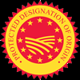
PDO in France AOP
Protected Designation of Origin
“Designation of Origin”
“Its quality and characteristics are essentially or exclusively due to a particular geographical environment with its inherent natural and human factors” (terroir).
“The grapes from which it is produced come exclusively from this geographic area.”
“Its production takes place in this geographical area.”
“It is obtained from vine varieties belonging to Vitis Vinifera”
Notes:
From https://www.guildsomm.com/public_content/features/articles/b/guest_blog/posts/confeusion-a-quick-summary-of-the-eu-wine-reforms
Of the wine-producing regions that have been approved to show a geographic indication, those perceived to be of higher-quality and that have followed more strict regulations during their production are labeled with a designation of origin. These wines are intended to embody the terroir of their respective regions and are referred to as having a Protected Designation of Origin. They must follow far more specific production rules, some of which are outlined below:
“Designation of Origin” means “the name of a region, a specific place, or, in exceptional cases, a country.”
“Its quality and characteristics are essentially or exclusively due to a particular geographical environment with its inherent natural and human factors” (terroir).
“The grapes from which it is produced come exclusively from this geographic area.”
“Its production takes place in this geographical area.”
“It is obtained from vine varieties belonging to Vitis Vinifera” (15)
Traditional Terms
Needless to say, the above proposals caused some ultra-premium winemakers to panic. Imagine you were a producer in the Montalcino area of Italy whose Brunello di Montalcino DOCG would now be hierarchically equal to your Rosso di Montalcino DOC as they would both be produced as sub-denominations of a Montalcino DOP. That would be a pretty alarming change. With this possibility, and many others, in mind, the Commission introduced language allowing for the continued use of “traditional terms.” A traditional term is defined as “a term traditionally used in Member States for designation: 1.) that the product has a protected designation or origin or geographic indication under Community or Member State Law, or 2.) the production or aging method or the quality, color, type of place, or a particular event linked to the history of the product with a protected designation of origin or geographic indication.” (16) Essentially, this definition grandfathers-in nearly any term that was previously used to appellate a wine. So, Spain can still use Denominación de Origen. Germany can still use its Kabinett, Spätelese, Auslese, etc., labels. For a traditional term to be recognized and legal, a region must have paperwork proving its historic origin that is then filed and catalogued “in accordance with [a Regulatory Committee].” (17) A complete list of all the registered traditional terms in the EU can be found at E-Bacchus (http://ec.europa.eu/agriculture/markets/wine/e-bacchus/index.cfm?event=searchPTradTerms&language=EN).

Slide 7
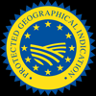
PGI in France, IGP
PGI or Protected Geographic Indication
“Geographic Indication” means “an indication referring to a region, specific place, or a country.”
“It must possess a specific quality, reputation, or other characteristic attributable to that geographic origin.”
“At least 85% of the grapes used for its production must come exclusively from that geographic area or varietal.”
“Its production must take place in that geographic area.”
It must be “obtained from vine varieties belonging to Vitis vinifera or a cross between the Viti vinifera species and other species of the genus Vitis.”
Notes:
From https://www.guildsomm.com/public_content/features/articles/b/guest_blog/posts/confeusion-a-quick-summary-of-the-eu-wine-reforms
PGI or Protected Geographic Indication
The lower level of the geographically-designated quality wines are referred to as having a Protected Geographic Indication. Wines in this classification level have considerably more restrictions than the “Wine” classification level. These restrictions include: (14)
“Geographic Indication” means “an indication referring to a region, specific place, or a country.”
“It must possess a specific quality, reputation, or other characteristic attributable to that geographic origin.”
“At least 85% of the grapes used for its production must come exclusively from that geographic area or varietal.”
“Its production must take place in that geographic area.”
It must be “obtained from vine varieties belonging to Vitis vinifera or a cross between the Viti vinifera species and other species of the genus Vitis.”

Slide 8
Wine in France, Vin
Country of Origin
Grape Variety
Vintage
Notes:
https://www.guildsomm.com/public_content/features/articles/b/guest_blog/posts/confeusion-a-quick-summary-of-the-eu-wine-reforms

Slide 9
France
AOP or AOC, IGP, Vin
Italy
DOCG or DOC, IGT, Vine
Germany
Pradikatswein or Qualitatswein, Landwein, Wein
Spain
Portugal
DO, IGP, Vine de Mesa
DOC, IGP, Vinho de Portugal

Slide 10
Appellation Contrôlée
Appellation Protégée
“Controlled Place-Name of Origin”
High Demand + Constant Supply
= Fraud
1935 – Institut National des Appellations d’Origine des Vins et Eauz-de-Vie (INAO)
2010 EU Laws
  “Protected Naming of Origin”
Notes:
Fraud: 1991 Champagne, 1923 Chateauneuf-du-Pape, Negociants,
1935 – Legally defined appellation boundaries
2010 – changes affected by European Union regulations for foods associated with places

Slide 11
What question do these statements answer?
Tradition of quality & beneficial economic impact
Long history of exporting wines
The French system of appellation laws has been the basis for the appellation laws in other European countries.
Notes:
As far back as the Middle Ages wine was an economically viable commodity

Slide 12
Why do we Study French Wines?

Slide 13
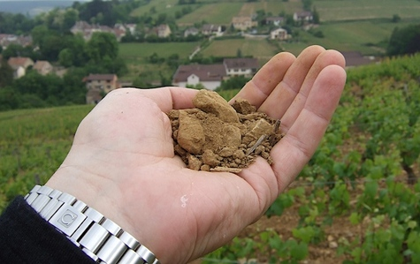
Terroir
Notes:
Climate, soil and viticulture
Climate
Hot to cold climates
Crisp dry whites to full bodied reds
Thousand dollar bottles to every day wines to industrial alcohol

Slide 14
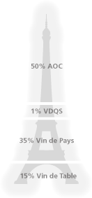
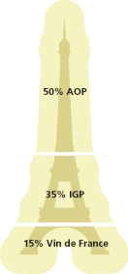
Before the EU Changes
After the EU Changes →
Image Source: Society of Wine Educators

Slide 15
French Wine Labels
Place Name
  Region, District, Village, and/or Vineyard
Export Label
Producer Name
Bottle Size
% alc.
Bottling Information

Slide 16
Loire Valley
North West France
3rd Largest Growing Region
Produce White, Red, Rosé, Sparkling, Sweet & Dry
  Mostly Stainless Steel Fermentation
Cool Climate
  Fresh, Zesty Wine High in Acidity
Soil Types Vary by Region
Appellations Divided By Geographic Location Only
Grand Cru regulations
Notes:
West: fresh dry lean
Central: Sec –dry, demi sec – semi sweet, sweet
East: light and acidic

Slide 17
Loire: Select Appellations & Grapes
Atlantic Region/Western Loire/Nantes
  Muscadet, Muscadet des Coteaux de la Loire, Muscadet Côtes de Grandlieu, Muscadet Sevre et Maine
    Melon de Bourgogne (ranges in style form light to full and ripe)
Middle Loire:
  Anjou: Quarts de Chaume, Savenniéres
    Chenin Blanc, Chardonnay and Sauvignon Blanc (dry, semi sweet and sparkling)
  Saumur
  Touraine: Vouvray
    Sauvignon Blanc and Chenin Blanc (dry, semi sweet and sparkling)
Upper Loire
  Pouilly-Fumé: Sauvignon Blanc
  Sancerre: Sauvignon Blanc
Notes:
Nantes
Cool climate
Maritime influence (Atlantic Ocean, Loire River [longest in France], Loire’s tributaries, marsh land)
Sur lie
Consistent Rainfall Throughout Year
Danger if Spring Frost
Root Stock, planting density controlled, single guyot, 8-12 buds
Muscadet: greatest volume of wine in Loire, paired with seafood
Anjou/Saumur/Touraine
Surrounds city of Tours
Picturesque with rolling hills on historic chateaux
One of coolest climates in Loire
Follows loire and tributaries
Have been known to age for 50+ years, most meant to be drunk upon release
In cool years more sparkling wine is made (high acidity), in Warmer years more sweet (botrytis cinerea)
Vouvray sweetness levels:
Sec (dry) 0-.4% sugar, Demi-Sec (off-dry) .4-1.2%, Moelleux (med. Sweet) 1.2-4.5% sugar, Doux (sweet) more thatn 4.5% sugar
Upper Loire
Micro climates produced by hills and rivers (and deposits or erosion)
75% of grapes are sauvignon blanc
Use single guyot pruning with 7-8 buds
Farmers returning to more natural ways of vineyard management
Sancerre on west of Loire, Pouilly Fume on east side of Loire

Slide 18
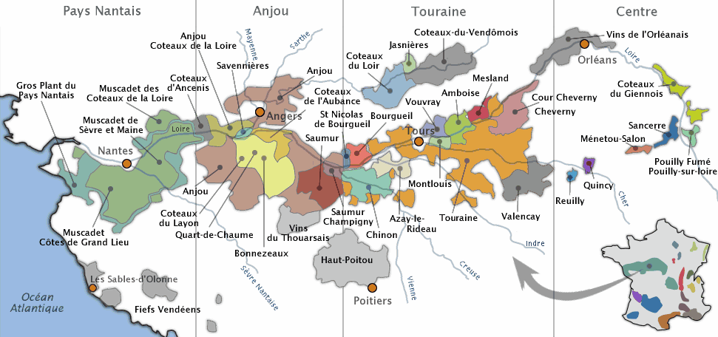
Loire: Sancerre
Sancerre
  Larger Growing Area (4000 acres), Varied soil types, Lean and acidic, Mostly dry wines, some sweet during certain vintages

Slide 19
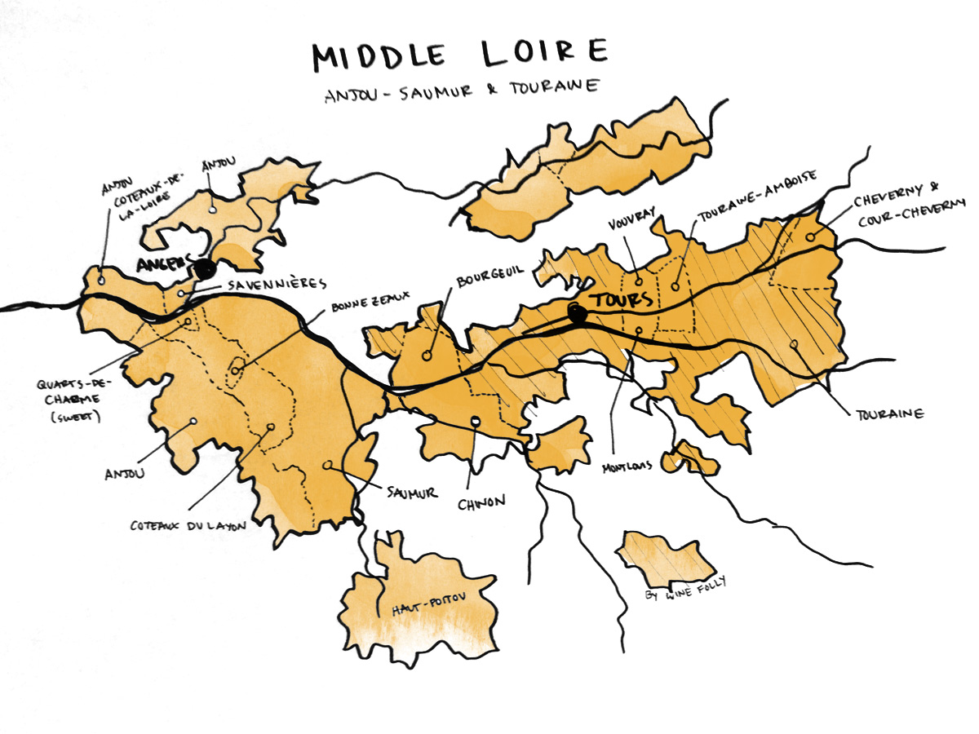

Slide 20
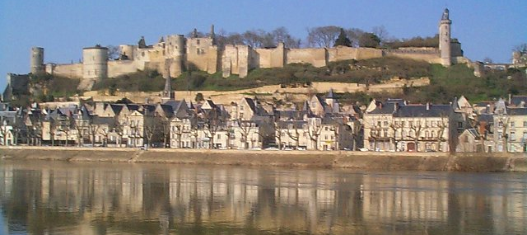
Chinon
Touraine, Loire Valley
Cabernet Franc
Red and Rose
Tuffeau soil: Volcanic clay limestone

Slide 21
Tasting
Sancerre and Chinon

Slide 22
Alsace
West of Germany and the Rhine River
East of Vosges Mountains
Soil: Schist & Limestone
Regulate Minimum Alcohol Level: 8.5%
Only AOC to Label by Varietal
Leading Grape Varietals:
  Riesling, Gewürztraminer, Pinot Gris, Muscat, Sylvaner, Pinot Blanc
Notes:
Long dry growing season
Chaptalization: low sugar levels in dry climates add beet or cane sugar to bring up alcohol level
During a Warm growing seasons: Vendange Tardive: late harvest, Selection de Grains Nobles
botrytis
White Wines Riesling 22.5% Pinot Blanc 21.0% Gewürztraminer 18.0% Pinot Gris 12.6% Sylvaner 11.9%

Slide 23
Alsace Classifications
Wines are Labeled by Grape Names
AOC Alsace Grand Cru
  Single Variety
    Riesling, Gewurztraminer, Muscat, Pinot Gris
  ~5% of production, 51 vineyard sites
AOC Alsace
AOC Crémant d'Alsace
Harvest Dates Determined by Local Wine Board
Notes:
AOC Alsace Grand Cru : followed by the name of the grape variety and by the name of the vineyard where the wine comes from.
AOC Alsace : followed usually by the name of the grape variety such as Gewurztraminer, Sylvaner, Pinot Blanc, Riesling (list of the AOC here)
AOC Crémant d'Alsace
Vendanges tardives: late harvest
Selection de grains noble:

Slide 24
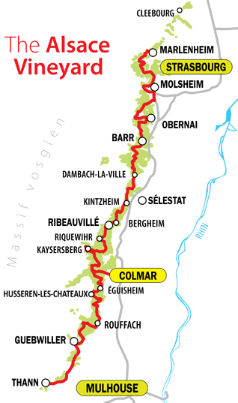
Alsace: Special Features
Vendange Tardive: Late Harvest
Sélection de Grains Nobles “Nobel Grapes”:
  Botrytis
  Riesling, Muscat, Gewürztraminer & Pinot Gris
Edelzwicker “Noble Blend”:
  Riesling, Pinot Blanc, Chasselas, Gewurztraminer, Muscat, Pinot Gris
Crémant d’ Alsace: Sparkling Wine
Notes:
Appellation Alsace Edelzwicker Protégée. Used for a white wine that is a blend of two or more of the eight white varietals that are permitted in Alsace:
Appellation Sélection de Grains Nobles Protégée. The appellation for sweet wines made in the style of Sauternes from grapes that have been affected by botrytis cinerea ("noble rot").
Appellation Vendange Tardive Protégée. Designates late harvest wines, regardless of whether or not they´ve been affected by noble rot.
Appellation Crémant d‘Alsace Protégée. Designates sparkling wines made from Pinot Noir, Pinot Gris, Pinot Blanc, Chardonnay, Auxerrois, or Riesling.

Slide 25
Speak as a Wine Professional
Task 1:
  You are the new assistant sommelier in a French Restaurant, the Director of Food and Beverage asks you to prepare a wine tasting for the service staff (they all have basic and developing wine knowledge).
  You chose to highlight the ___________________________ region in France because ______________
Task 2:
  Create a two minute training presentation for the service staff

Slide 26
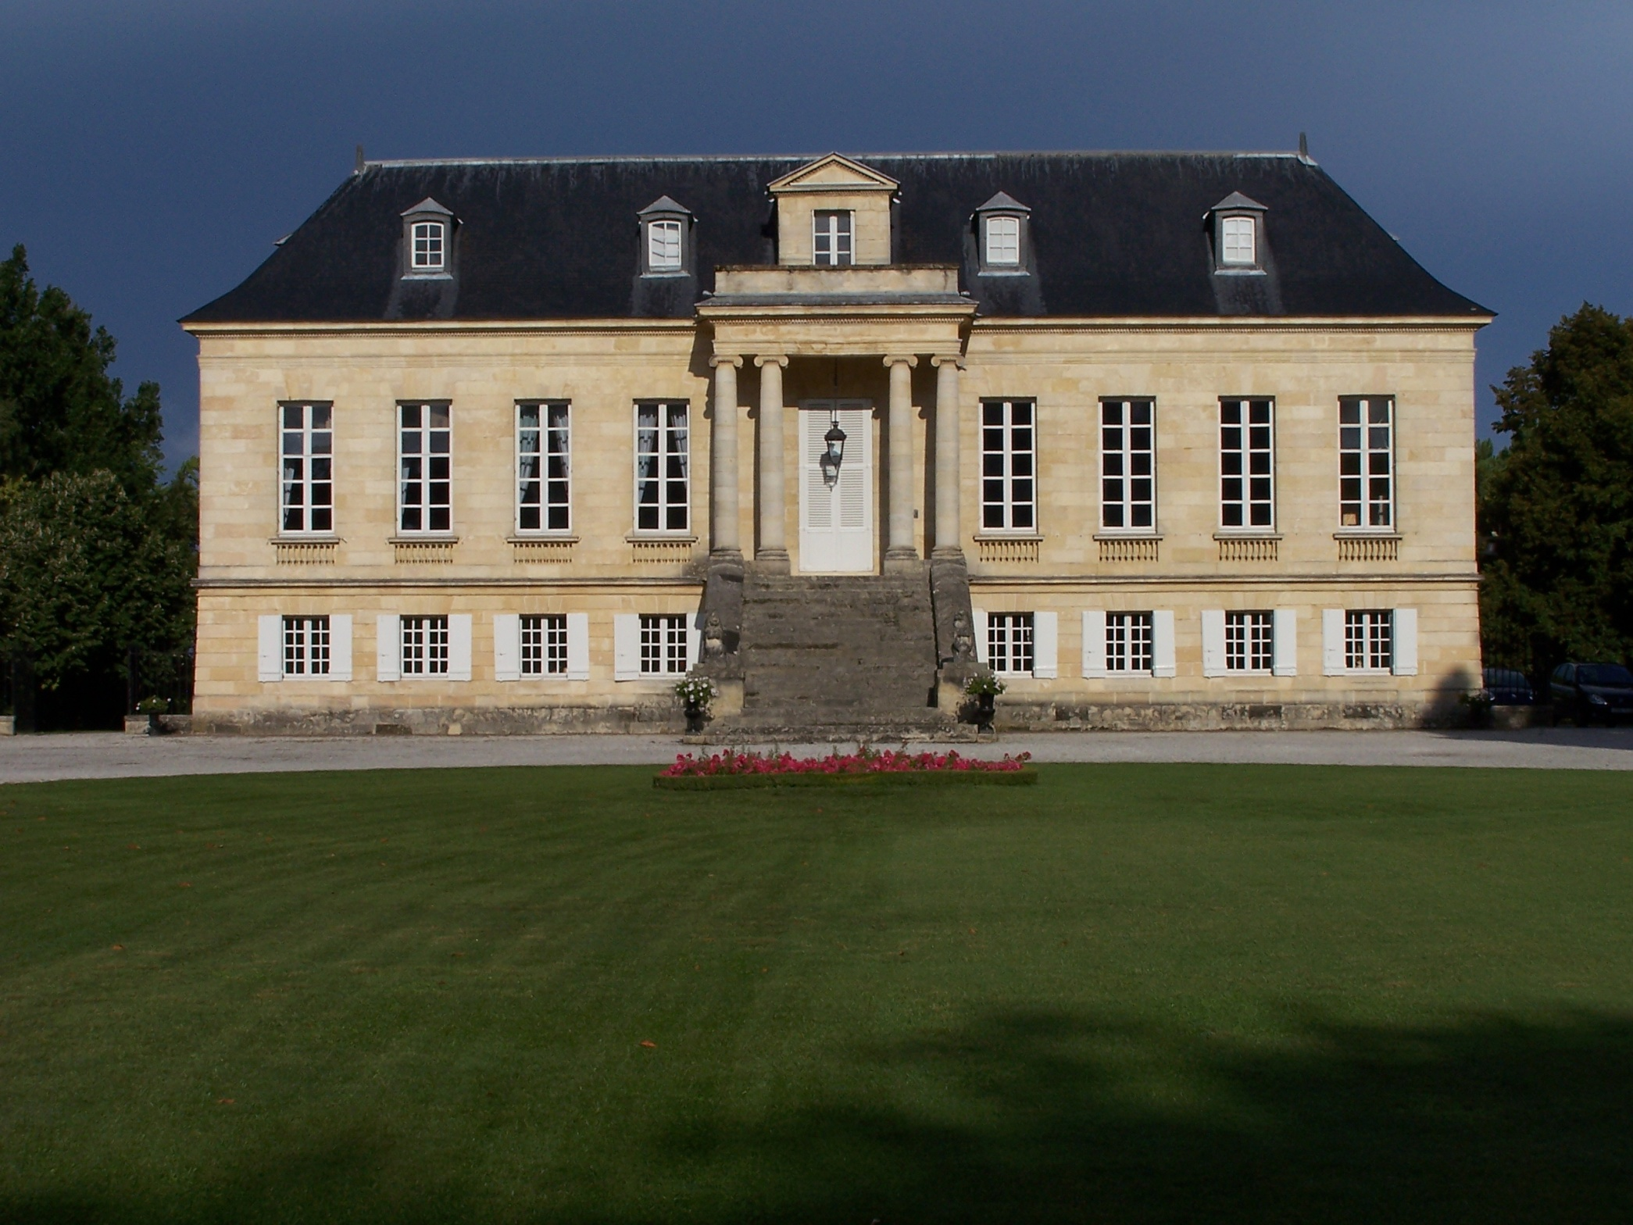
PHOTO

Slide 27
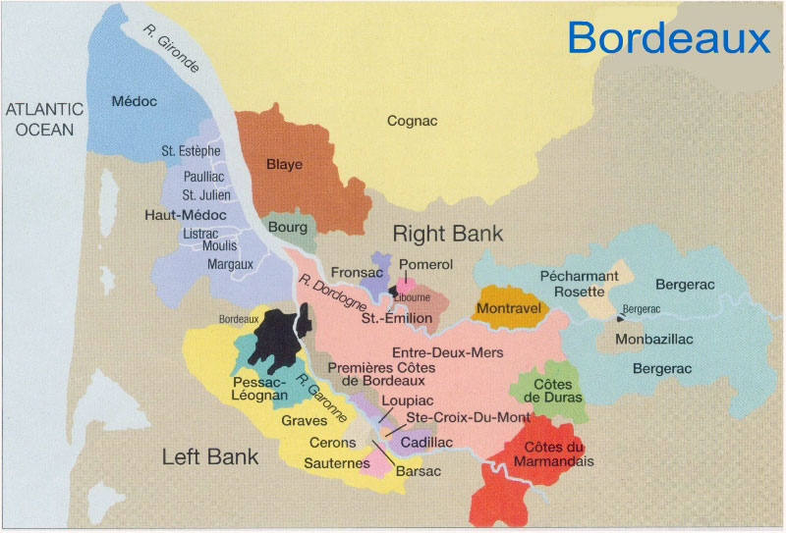
Bordeaux also has a reputation for making quality white wines, particularly in the Left Bank and Entre-Deux-Mers

Slide 28
The famous white wines of Graves are very dry, and are made principally from Sauvignon Blanc and Sémillon grapes.

Slide 29
The Sauternes and Barsac regions are known for their
rich, sweet white wines. Sémillon and Sauvignon Blanc grapes
are the primary varietals.

Slide 30
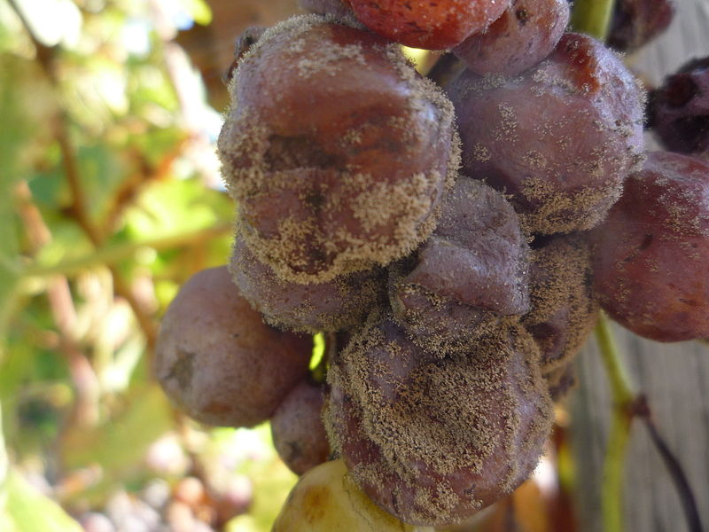
The principal difference is that the sweet wines are made from grapes that are affected by botrytis cinerea ("noble rot"). This is a fungus that dehydrates and shrivels the grapes.

Slide 31
Bordeaux
Among the Largest Wine Growing regions in the World, Mostly Red Wine
  57 Appellations
Maritime Climate
  Gentle, mild, temperate, high percentage of rainfall
  Irrigation is NOT Permitted
Porous Soil
Dominant White Grape Varietals:
  Sauvignon Blanc, Sémillon, Muscadelle
  Wine Producers are Free to Blend as They Want, No Consistency from Year to Year
    Varietals are fermented separately and then blended
Notes:
Semillon: often used for sweet/semi sweet wines, dessert
Sauvignon Blanc, crisp and acidic, dominant grape of Graves
Muscadelle, floral aromas, used for sweet/semi sweet wines
In 1855 Napoleon III asked the Bordeaux Chamber of Commerce to develop a system for classifying their very best red wines. The area’s wine brokers identified 61 of the most expensive red wines and divided them into five categories called crus.

Slide 32
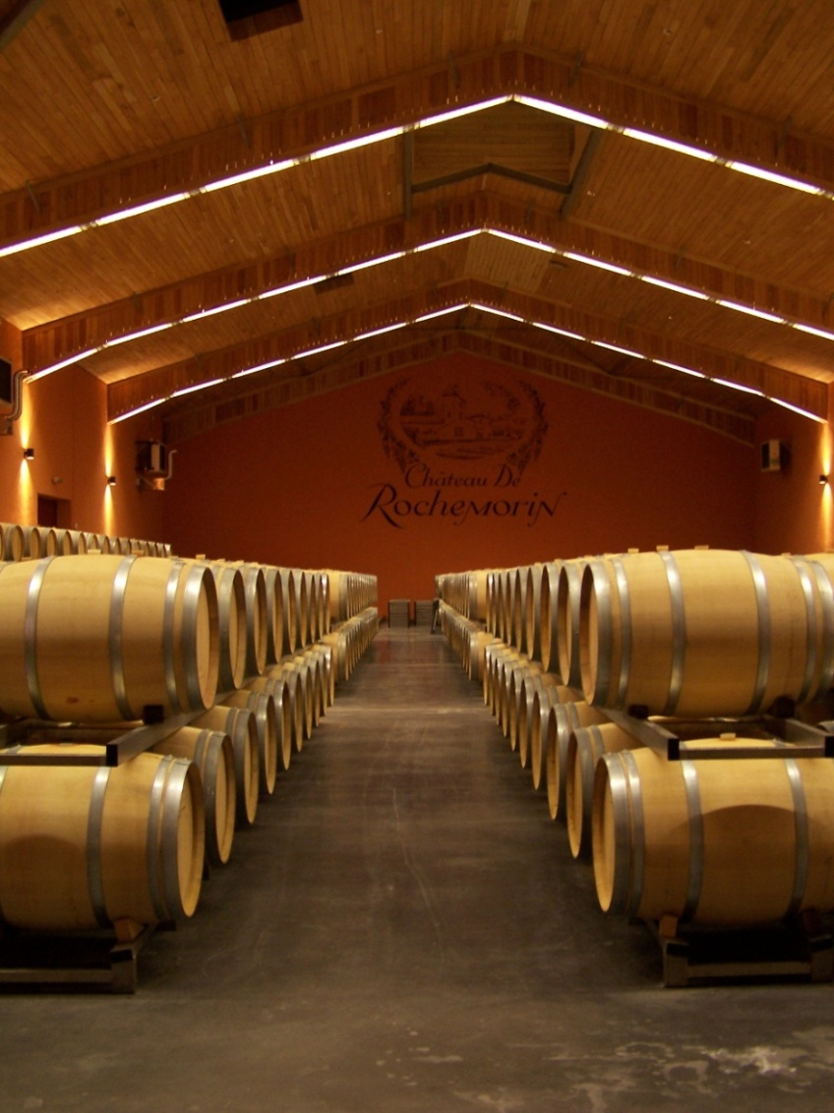
Bordeaux, Sub-appellations
Pessac Léogon
  20% dry white wine, S.B.
  Small valleys, gravel
Graves
  33% dry white wine, Sémillon
  Marl & Limestone
Entre-Deux-Mers
  dry white wine
  Limestone, many rivers
Sauternes & Barsac
  Known as the Finest Sweet Wines
  Botrytis Affected Sémillon & S.B.
  Gran Cru Classification, 26 vineyards

Slide 33
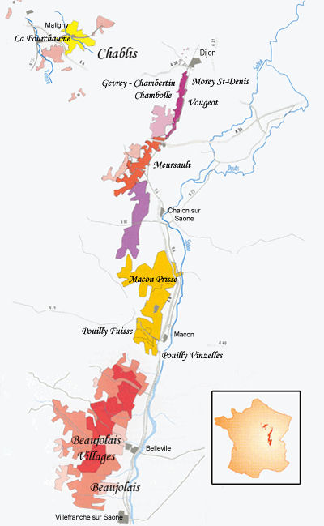
Burgundy
Small Vineyard Parcels
Négociants
Micro Climates
  Soil: Limestone
  Southeast Facing Slopes
Chardonnay Grape Dominates
AOC Quality Ratings:
  Regional, Village, Premier Cru, Grand Cru
Notes:
Regional, high on hill tops (too cool for full ripening), low in valley (lesser quality soils, too cool)
Village, lower yields, higher alc. Levels than reg., designated within growing area
Premier Cru, village and vineyard designation )Chablis will say “Chablis Premier Cru”
Grand Cru (31 Cote d’Or, 7 Chablis) not required to list “Grand Cru” more recently it has been listed (Chablis Grand Cru)

Slide 34
Burgundy, Appellations
Chablis
  Soil: Chalk, Clay, Limestone, Fossil shells
  Climate: Cool, Prone to Frost
  Vinification: Can be Oak Aged or Stainless Steal
Côte Beaune & Côte Beaune-Villages
  Soil: Limestone, Chalk, Marlstone
  Climate: cool at tops of hills (haute)
Côte Chalonnaise (1990)
  Soil: Hilly, limestone & clay
  Table wines rather than imports
Maconnais (Chardonnay and Aligote)
  Soil: marl, plant on east facing slopes
  Climate: Saone river, warmer tan other Burgundy appellations
  Appellation of note: Pouilly-Fuisse
Notes:
Haute Côte Beaune, High on hill tops, cool weather

Slide 35
Rhone
Small amount of White, Mostly Viognier
Beaumes-de-Venise
  Muscat
Condrieu and Château Grillet
  Viognier
St. Joseph
  Roussanne and Marsanne

Slide 36
Until We Meet Again
Complete study guides of France’s regions/appelations
  Burgundy, Loire, Bordeaux, The Rhone Valley, Alsace
Identify regions of France on a map
Next Session is Bordeaux, Burgundy, The Rhone Valley
Read text book about France
Bring in questions for Retail Assignment

