Slide 1
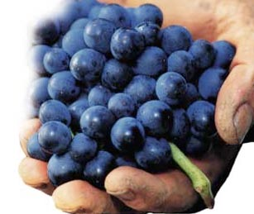

Prof. Karen Goodlad, CSW
Wine & Beverage Management
HMGT 2402
Spring 2019
Viticulture & Vinification

Slide 2
Overview
Attendance
Review of Syllabus
OpenLab
Viticulture
Notes:
Syllabus Speed Dating – Karen Eifler, an education professor at the University of Portland, designed this activity. Two rows of chairs face each other (multiple rows of two can be used in larger classes).
Students sit across from each other, each with a copy of the syllabus that they’ve briefly reviewed. Eifler asks two questions: one about something in the syllabus and one of a more personal nature. The pair has a short period of time to answer both questions. Eifler checks to make sure the syllabus question has been answered correctly.
Then students in one of the rows move down one seat and Eifler asks the new pair two different questions. Not only does this activity get students acquainted with each other, it’s a great way to get them reading the syllabus and finding out for themselves what they need to know about the course. - See more at: http://www.facultyfocus.com/articles/teaching-professor-blog/first-day-of-class-activities-that-create-a-climate-for-learning/#sthash.R0MHLnQw.dpuf

Slide 3
Identify the
Factors Affecting the Taste of Wine

Slide 4


Factors Affecting the Taste of Wine
Grape Variety
Viticulture
Soil
Physical Location
Climate
Vinification
Luck of the Year

Slide 5
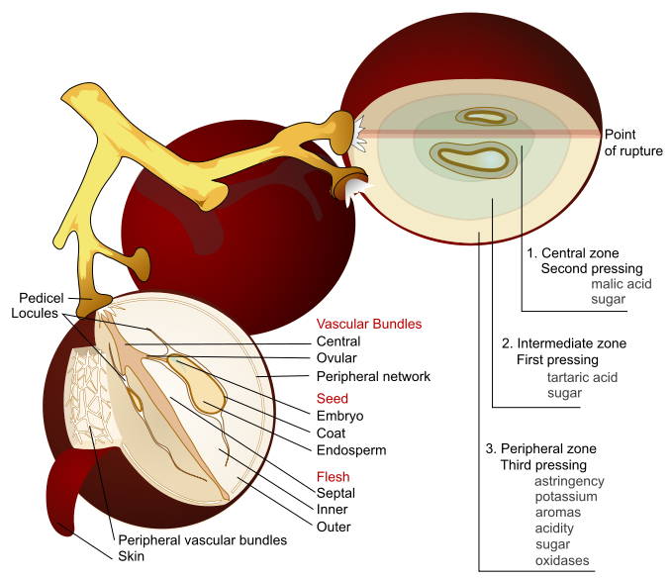
By Mariana Ruiz Villarreal (LadyofHats) - This image was created as part of the Philip Greenspun illustration project., Public Domain, https://commons.wikimedia.org/w/index.php?curid=4546784

Slide 6
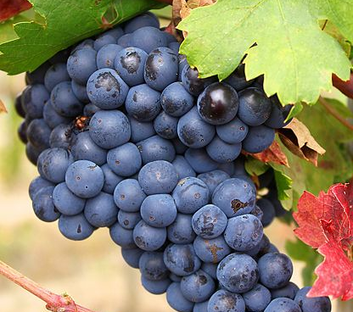
The Genus and Species of Grapes Commonly used for Wine Making
Vitis Vinifera
Vitis Labrusca

Slide 7
Factors Affecting the Taste of Wine
Grape Variety
Viticulture
Soil
Physical Location
Climate
Vinification
Luck of the Year

Slide 8
Viticulture
The science of growing grapes
Vineyard Management
  Physical Structure of the vine
  Life Cycle of The Vine
  Pruning, Trellising, Canopy, Irrigation, Harvest…
  Decisions of Environmental Stewardship
    Conventional, Sustainable, Organic, Biodynamic
      Mike Benziger of Benziger Winery Discusses Organic and Biodynamic Viticulture

Slide 9
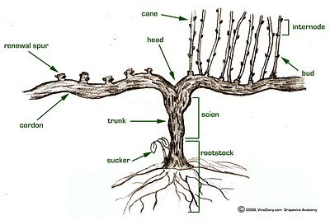
The Grape Vine

Slide 10
Respiration
http://www.viti.com.au/pdf/MVWGG%20Fact%20Sheet%20-%20Grapevine%20Biology.pdf

Slide 11
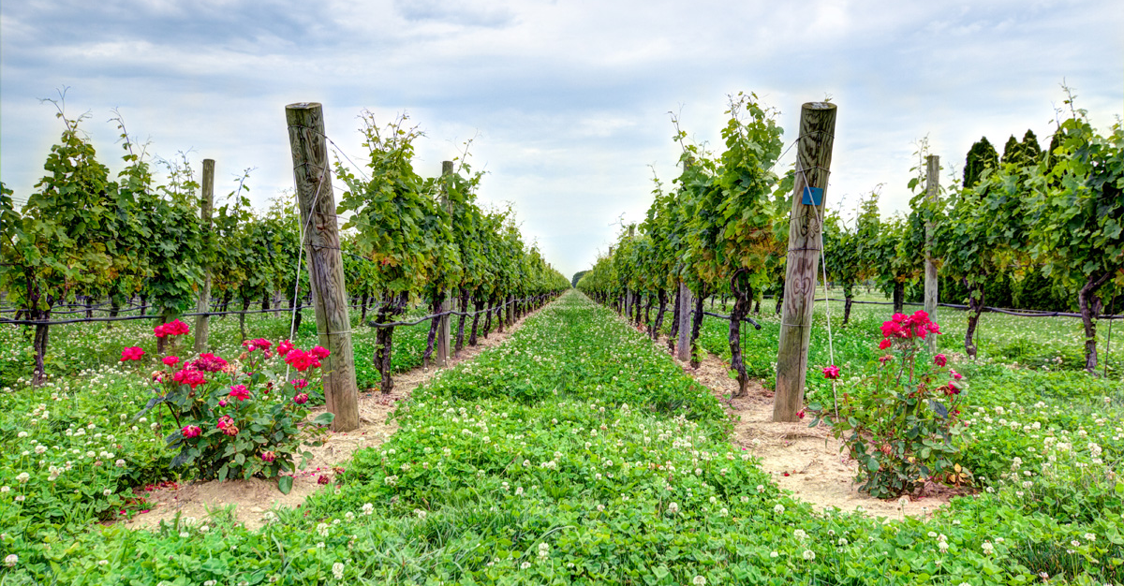
Vineyard Management
Conventional, Organic,
Biodynamic, Sustainable

Slide 12
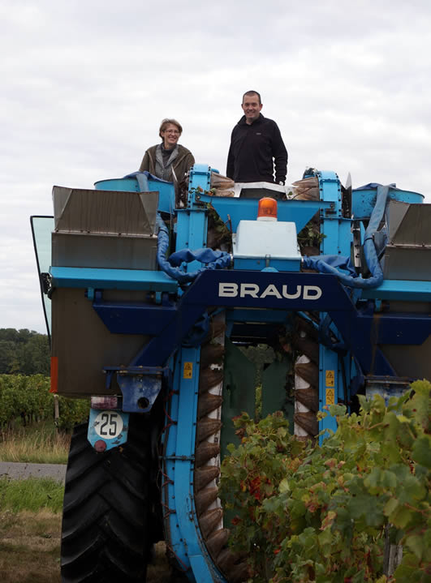
Harvest: Mechanical

Slide 13
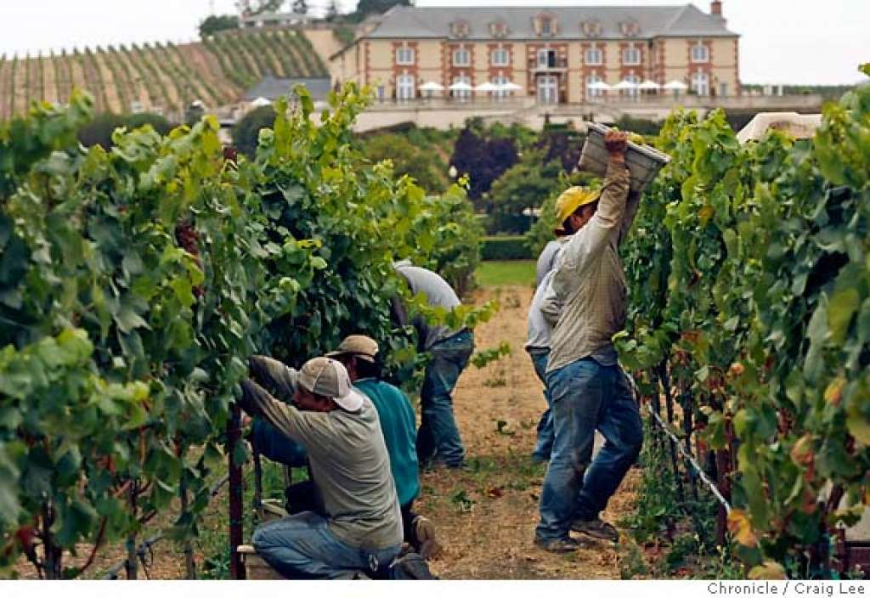
Harvest: Manual

Slide 14
Factors Affecting the Taste of Wine
Grape Variety
Viticulture
Soil
Physical Location
Climate
Vinification
Luck of the Year

Slide 15
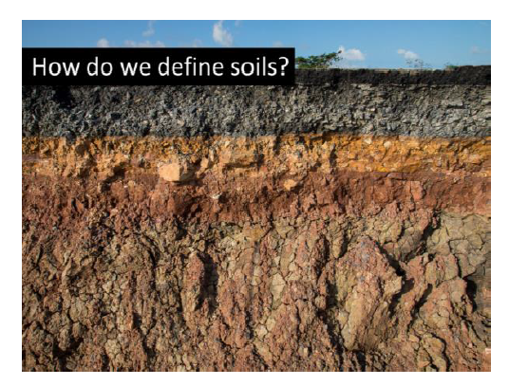
What is important to know about Soil?

Slide 16
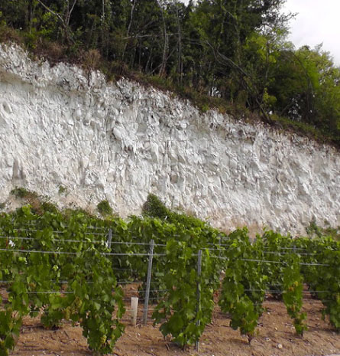

Slide 17
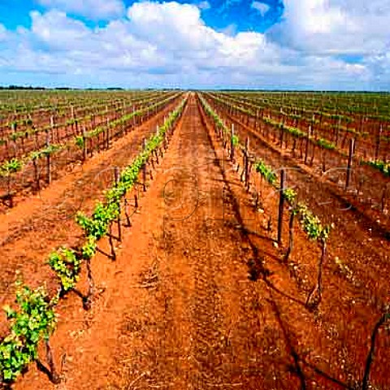

Slide 18
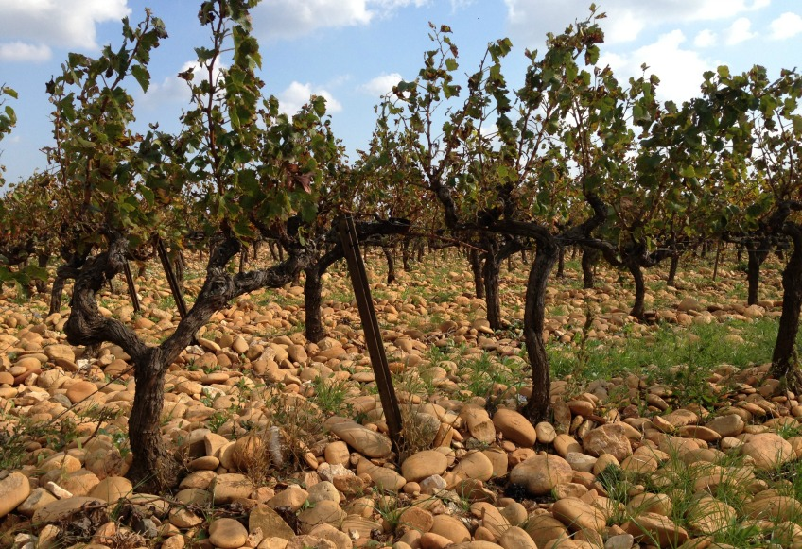

Slide 19
Factors Affecting the Taste of Wine
Grape Variety
Viticulture
Soil
Physical Location
Climate
Vinification
Luck of the Year

Slide 20
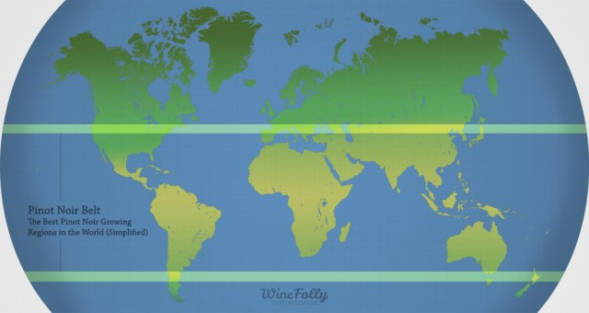
Image credit: https://winefolly.com/tutorial/pinot-noir-regions/
Notes:
Temperate Zones
(both maritime and continental)
OLD WORLD:
France, Italy, Spain, Germany, Portugal, Switzerland, Austria, Hungary, Greece
NEW WORLD:
US, California, Chile, Argentina, Uruguay, South Africa, Australia, New Zealand

Slide 21
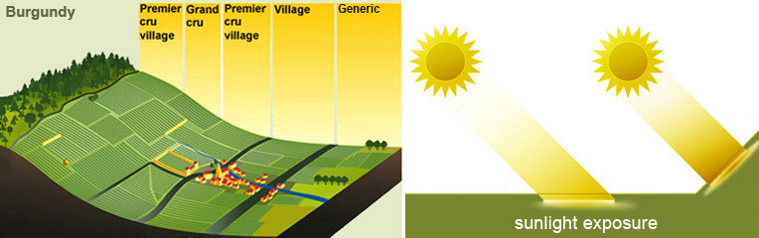

Slide 22
Factors Affecting the Taste of Wine
Grape Variety
Viticulture
Soil
Physical Location
Climate
Vinification
Luck of the Year

Slide 23
Maritime
Continental
Mediterranean

Slide 24
Common Regulations & Laws
Appellations
Grape Variety
Minimum Alcohol
Maximum Yield
Methods of Viticulture
Methods of Vinification
Notes:
Appellations: regions: zones: states:

Slide 25
Short List of Problems
Grape Vines Face
Phylloxera
Glassy Winged Sharpshooter

Slide 26
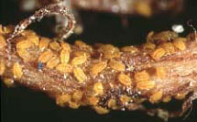
What is Phylloxera?
Grape Louse that feeds on the roots of vitis vinifera and injects its waste into the roots
Thought to be Resistant to Rootstock AxR1
Did it Destroyed Wine Industry????
  70% of French Vineyards in 1860’s-1870’s
  New Zealand in 1970’s
  Napa Valley in 1983
  West Coast of US by 1995
Various vitis labrusca root stocks now used

Slide 27
Terms to Know
Viticulture
Oenology (alt. spelling Enology)
Wine Maker, Vitner, Vineyard Manager, Grape Grower
Botrytis Cinerea (Noble Rot)
Must
Chaptalization
Acidification
Brix and Beaume
Carbonic Maceration
Fining and Filtration
Racking
Malolactic Fermentation
Vintage
Phylloxera
Appellation
Yield
Formula for fermentation
Cap, punching down the cap
Barrique
Vitis vinifera/labrusca
Grafting
Root stock/bud wood
Notes:
Botrytis Cinerea: Noble rot, mold growth that punctures the skin, water drains out
Must: the juice and liquidy pulp produced by crushing or pressing grapes before fermentation
Chaptalization: adding cane or beet sugar to wine must before or during fermentation in the effort to increase the sugar and hence alc.
Brix: a way to measure sugar
Carbonic Maceration: uncrushed grapes placed in a closed tank weight crushes grapes, heat from Fermentation creates fermentation in uncrushed grapes, light “juicy” wine
Barrique = 60 Gallons, 9 liters just over 6 cases

