Slide 1
Wine and Beverage Management
Distilled Beverages
Prof. Karen Goodlad
Fall 2015

Slide 2
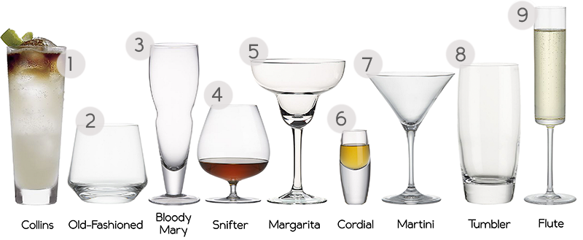
Overview
Attendance
OpenLab, a look into learning opportunities
Lecture
  Introduction to Distilled Beverages

Slide 3
Objectives
Identify distilled beverages
  General Information about process: TASTING
  Distillation: Pot Still and Column Still
  Here are some fun links if you wish to learn more about mixed drinks (we will not cove this information in class or on the exam): Fun videos and cocktail recipes
Discuss how spirits are produced using proper industry terminology
  Know the sugar sources for major categories of spirit production
  Learn about: Production of Vodka, History of Vodka, Production of Gin, History ofGin, Production of Scotch, History of Scotch
  Explain the factors that affect the taste of distilled beverages
  We will not taste during this session but have this available during class: Tasting Notes
Identify geographical regions where distilled beverages are produced
Maps are available here: MAPS. Be familiar with the Cognac region and Scotch Whisky region

Slide 4
Producing Spirits: Distillation
Prepare raw materials for fermentation
Fermentation
Distillation
Post-distillation
  Blending, maturation, flavor, sweetening

Slide 5
Fermentation
  Formula:
  Sugar + Yeast =
  Ethanol + Carbon Dioxide + Heat
  Goal of Fermentation:
  release as many congeners as possible

Slide 6
Distillation
The process of separating alcohol from water and other materials
Water boils: ____________
Alcohol boils: ___________
Pot Still
Continuous “Coffey” Still

Slide 7
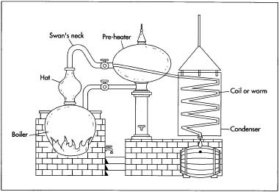
Pot Still

Slide 8
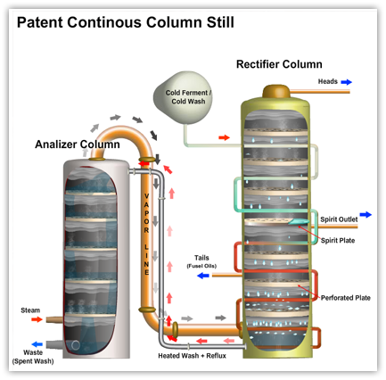
Notes:
While the heated wash is making its way down the analyzer, it meets rising hot steam that is continually pumped into the bottom of the analyzer.
At each successive compartment in this downward flow of wash, the steam, as it moves up, strips off and takes with it more and more alcohol vapor from the descending wash. The wash is mostly water by the time it reaches the bottom of the analyzer to be removed along with condensed steam. At the opposite extreme, the steam at the top of the analyzer is now alcohol rich.
The steam (vapor) now moves back to the rectifier where the process began. The alcohol-rich steam enters the bottom of the rectifier and begins to rise from compartment to compartment. It is this steam that heats the cold wash that is percolating down the wash coil inside the rectifier. As the steam rises, it comes into contact with cooler and cooler parts of the wash coil and is itself cooled in stages, causing condensation and reflux.
A rectifier column may contain dozens of plates, each calibrated at different temperatures to separate out a different congener (remember, congeners vaporize at slightly different temperatures). The distiller strategically chooses where to place the product exit valve so that unwanted congeners condense and remain on a plate below it, or stay in vapor form and rise above it. The desired congeners, instead, condense at a temperature that lands them directly on this "spirit plate" as liquid. So, it is on this spirit plate that the final spirit is formed and then sent out from the rectifier column to a collection vessel. The higher the spirit plate, the higher the alcohol level in the finished spirit. The undesirable heads, since they are more volatile, rise beyond the spirit plate and are removed from the top of the rectifier.
By knowing the volatility of specific congeners (at what temperature it vaporizes or cools) the distiller can calibrate the column still for an extremely precise final result in terms of flavor (congener retention) and alcoholic strength by deciding at which temperature (at what plate-height) to remove the vapor to send to the condenser.
The skilled distiller will also carefully control the rate of flow of the wash and the pressure of the steam, since too quick a distillation produces burnt aromas.
Source: Society of Wine Educators

Slide 9
Benefits of pot stills | Benefits of continuous stills
Greater congener retention | Can be engineered to remove specific congeners with a high degree of precision
Multiple distilling process results in greater array of flavor components | Can operate continuously
Choice of size and shape affects quality of ultimate spirit | Ability of distiller to "fine tune" exact components in final spirit for taste and quality purposes
Appropriate for products produced in relatively small batches | Because of high purity potential, appropriate for "white" spirits
Legally required in some cases, as in Cognac and single malt Scotch Whisky | Can produce spirit at higher level of alcohol than pot stills, and in a single distillation

Slide 10
Types of spirits/raw materials
Grain Based
  Whiskey
Neutral Spirits
  Gin
  Vodka
Fruit and Plant Based
  Brandy
  Rum
  Tequila
Liqueurs
Anise Spirits
Bitters

Slide 11
Grain Based
Whiskey
  Scotch Whisky: Sugar source: _________________
    Peat is _______________ used for ___________________
    Single Malt Scotch
  Irish Whiskey: Sugar source: __________________
  American Whiskey (Bourbon and Tennessee): Sugar source: ___________________
  Pot Still
  Distilled to 190 Proof (80abv)
  Stored in oak barrels
Notes:
Corn, rye, wheat, barley

Slide 12
Neutral Spirits
Vodka
  Sugar source: ___________________
  Continuous “Coffey” Still
  Charcoal Filters used for purifying
Gin
  Sugar source: ___________________
  Combination of Continuous “Coffey” Still & Pot Still
  Flavored with _____________ can also use other botanicals herbs and spices
Notes:
Cereal grains. potatoes

Slide 13
Fruit & Plant Based
Brandy
  Sugar source: ___________________
  Pot Distilled
  Cognac, Armagnac, Calvados, American Brandy
Rum
  Sugar source: ___________________
  Continuous “Coffey” Stills
  Types of Rum
    Clear and Dark
Tequila
  Sugar source: ___________________
  Pot Distilled
  Types of Tequila:
    Blanco/silver, reposado, añejo

Slide 14
Terms to know before we go
Congener
Distillation
Fermentation
List types of spirits, name/base ingredient
Proof vs. ABV
Still (pot and continuous and which is used for each spirit)

Slide 15
Until we meet again…
Read Chapters 16 ,17, 18
Comment on your classmates winery anysis

