Slide 1
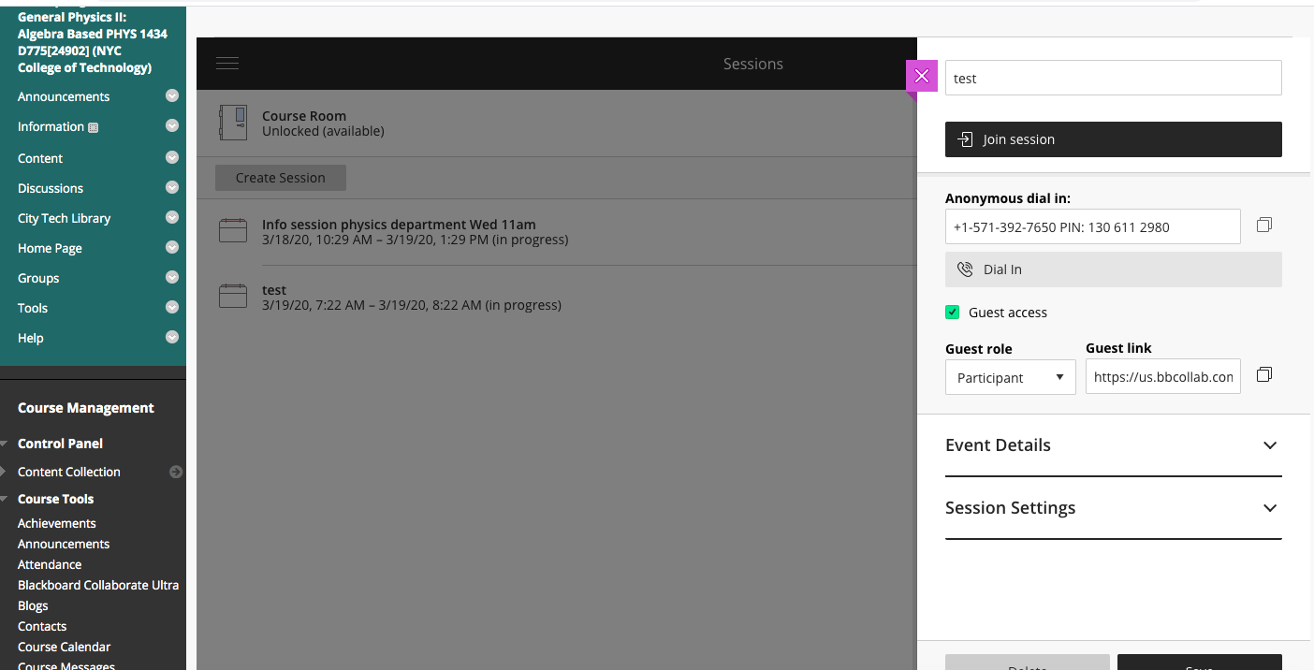
CLICK HERE
To copy the dial-in number and pin. Then with Ctr-V you can paste it to your email
Dial-in number and PIN
Students or guests can join the session by phone using this number and PIN
Guest access link
Students or guests can join the session just by going to this link
CLICK HERE
To copy the link. Then with Ctr-V you can paste it to your email

