Slide 1
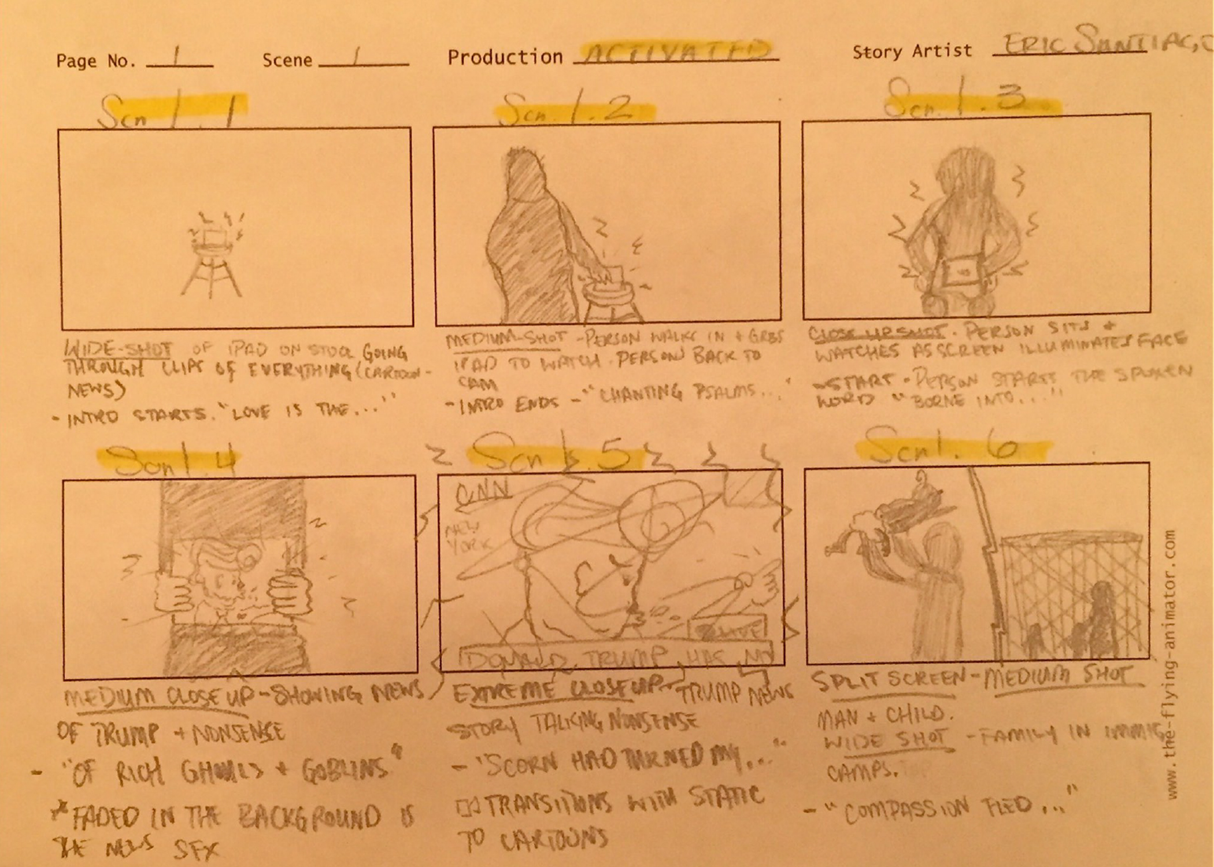
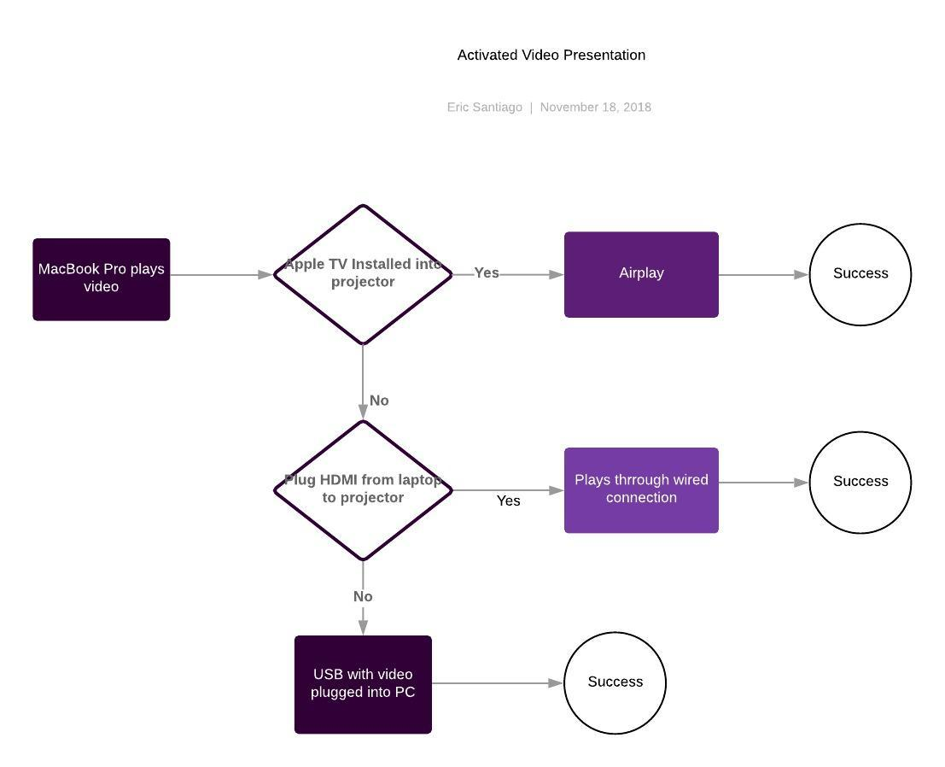
“Activated“
Written and Directed by: Eric Santiago
Department of Entertainment Technology. New York City College of Technology, Brooklyn, NY 11201
Introduction
Growing up in a culture based around instant gratification, I’ve taken notice in the passiveness of my colleagues and peers. The ever-changing world constantly looks to us - the people, to guide it’s change. However, we the people are always looking for someone else to make the change.
Media controls the culture as well. Music, advertisements, videos, etc. feed the audience with a mindset or emotion that oftentimes directs their behavior and lifestyle. With a background in film, I aim to create a video that can activate my peers and the culture into wanting to take action against the force that leaves us looking outward instead of inward.
Story Board
Lyrics
Love is the greater cross to bear
What we do for it
A word tossed like we have another loss to spare
Drop our youth for it
Tracks are covered but my palms are bare
Chanting psalms until my arms are air-
Borne into the wild city
Of rich ghouls and goblins
Scorn had turned my eyes gritty
Hazel masked the almond
Compassion fled and lust and greed is all that was residual
I think it began around the time the analog went digital
My dialogue went physical
I log on for the visuals
Double tapping her and her the taste was unoriginal
DM into the dumber mind
Hemingway til she unwinds
Then pick the lock that held the guard the others left behind
I fell a slave to the scheme
Raised a lover boy with dreams
But aren’t we all a slave to the boxes in our jeans? ….
Function
Equipment
Shot List / Storyboard
Spoken Word Lyrics
Location List
Camera
Camera stand, lens, lights
Sound Booth
MacBook Pro
Adobe Programs (Premiere, Photoshop)

