Slide 1

Using Open Digital Pedagogies in the Math Classroom
  Jill Belli, Associate Professor of English and OpenLab Co-Director
  Jesse Rice-Evans, OpenLab Digital Pedagogy Fellow,
  Jody R. Rosen, Associate Professor of English OpenLab Co-Director,
  Alessandro Zammataro, OpenLab Digital Pedagogy Fellow
  Opening Gateways Seminar 2 Friday, September 21, 2018

Slide 2
The OpenLab Team
OpenLab Co-Directors: Jill Belli, Charlie Edwards, M. Genevieve Hitchings,
Jody R. Rosen, Jenna Spevack
Senior Instructional Technologist: Bree Zuckerman
Digital Pedagogy Fellows: Claire Cahan, Jesse Rice-Evans, Alessandro Zammataro
Pedagogy Outreach Liaison: Kristen Hackett
Developers: Boone Gorges, early-adopter
System Administrator: André Pitanga
Student Graphic Designers: Faculty Commons Design Team

Slide 3
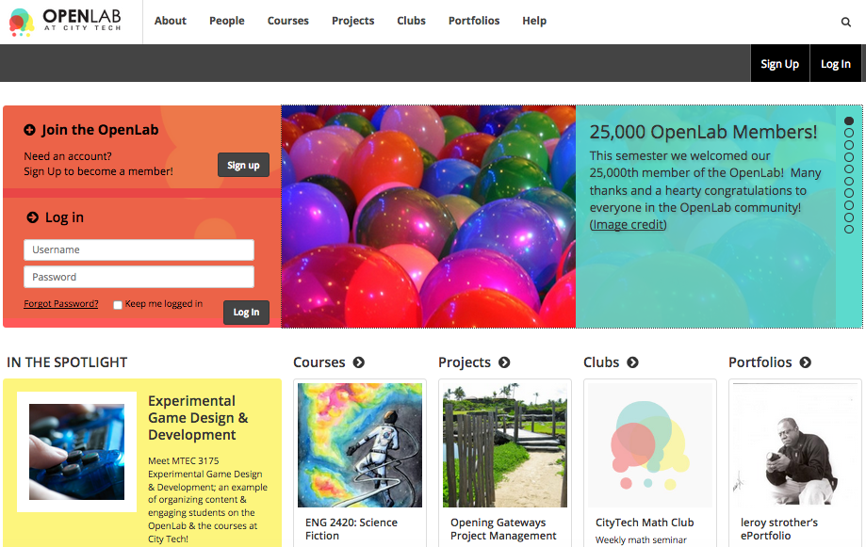
About the OpenLab
openlab.citytech.cuny.edu

Slide 4
Goals of the OpenLab
Support teaching and learning
Enable connection and collaboration
Strengthen the intellectual and social life of the college community

Slide 5
Introductions
How are you using the OpenLab?
What would you like the OpenLab to make possible for you?
What about the OpenLab do you want to learn more about?
Notes:
After very briefly introducing ourselves and what we’re going to talk about in the session, ask everyone to write for a minute on each question, then hear from (everyone? Volunteers?) before moving in to more background on the OL and examples they can draw from.

Slide 6
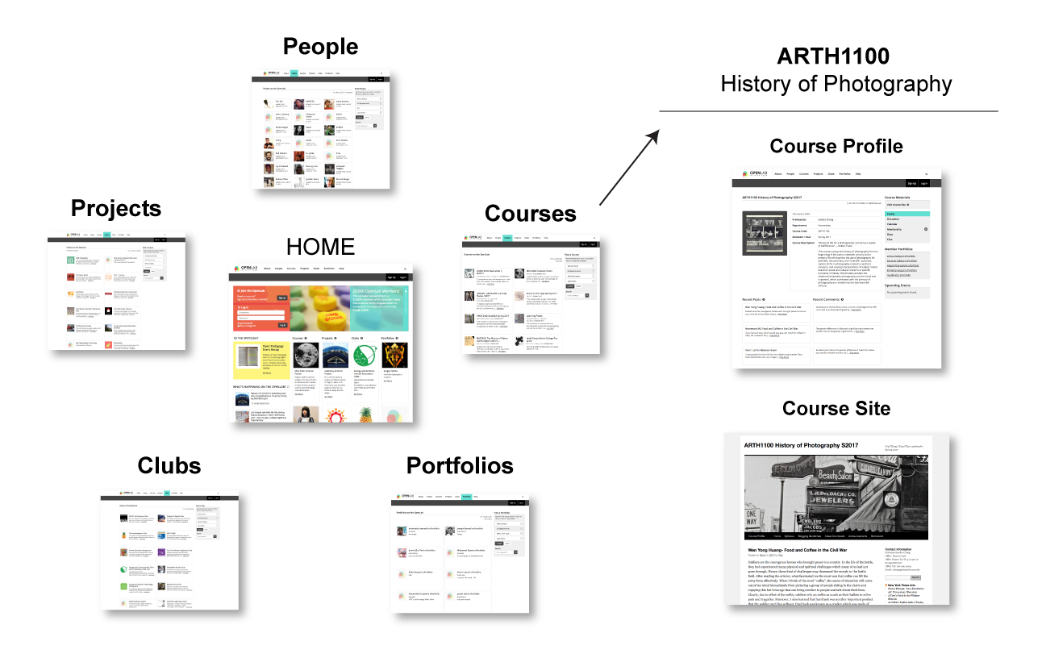
Architecture
Visible & Connected

Slide 7
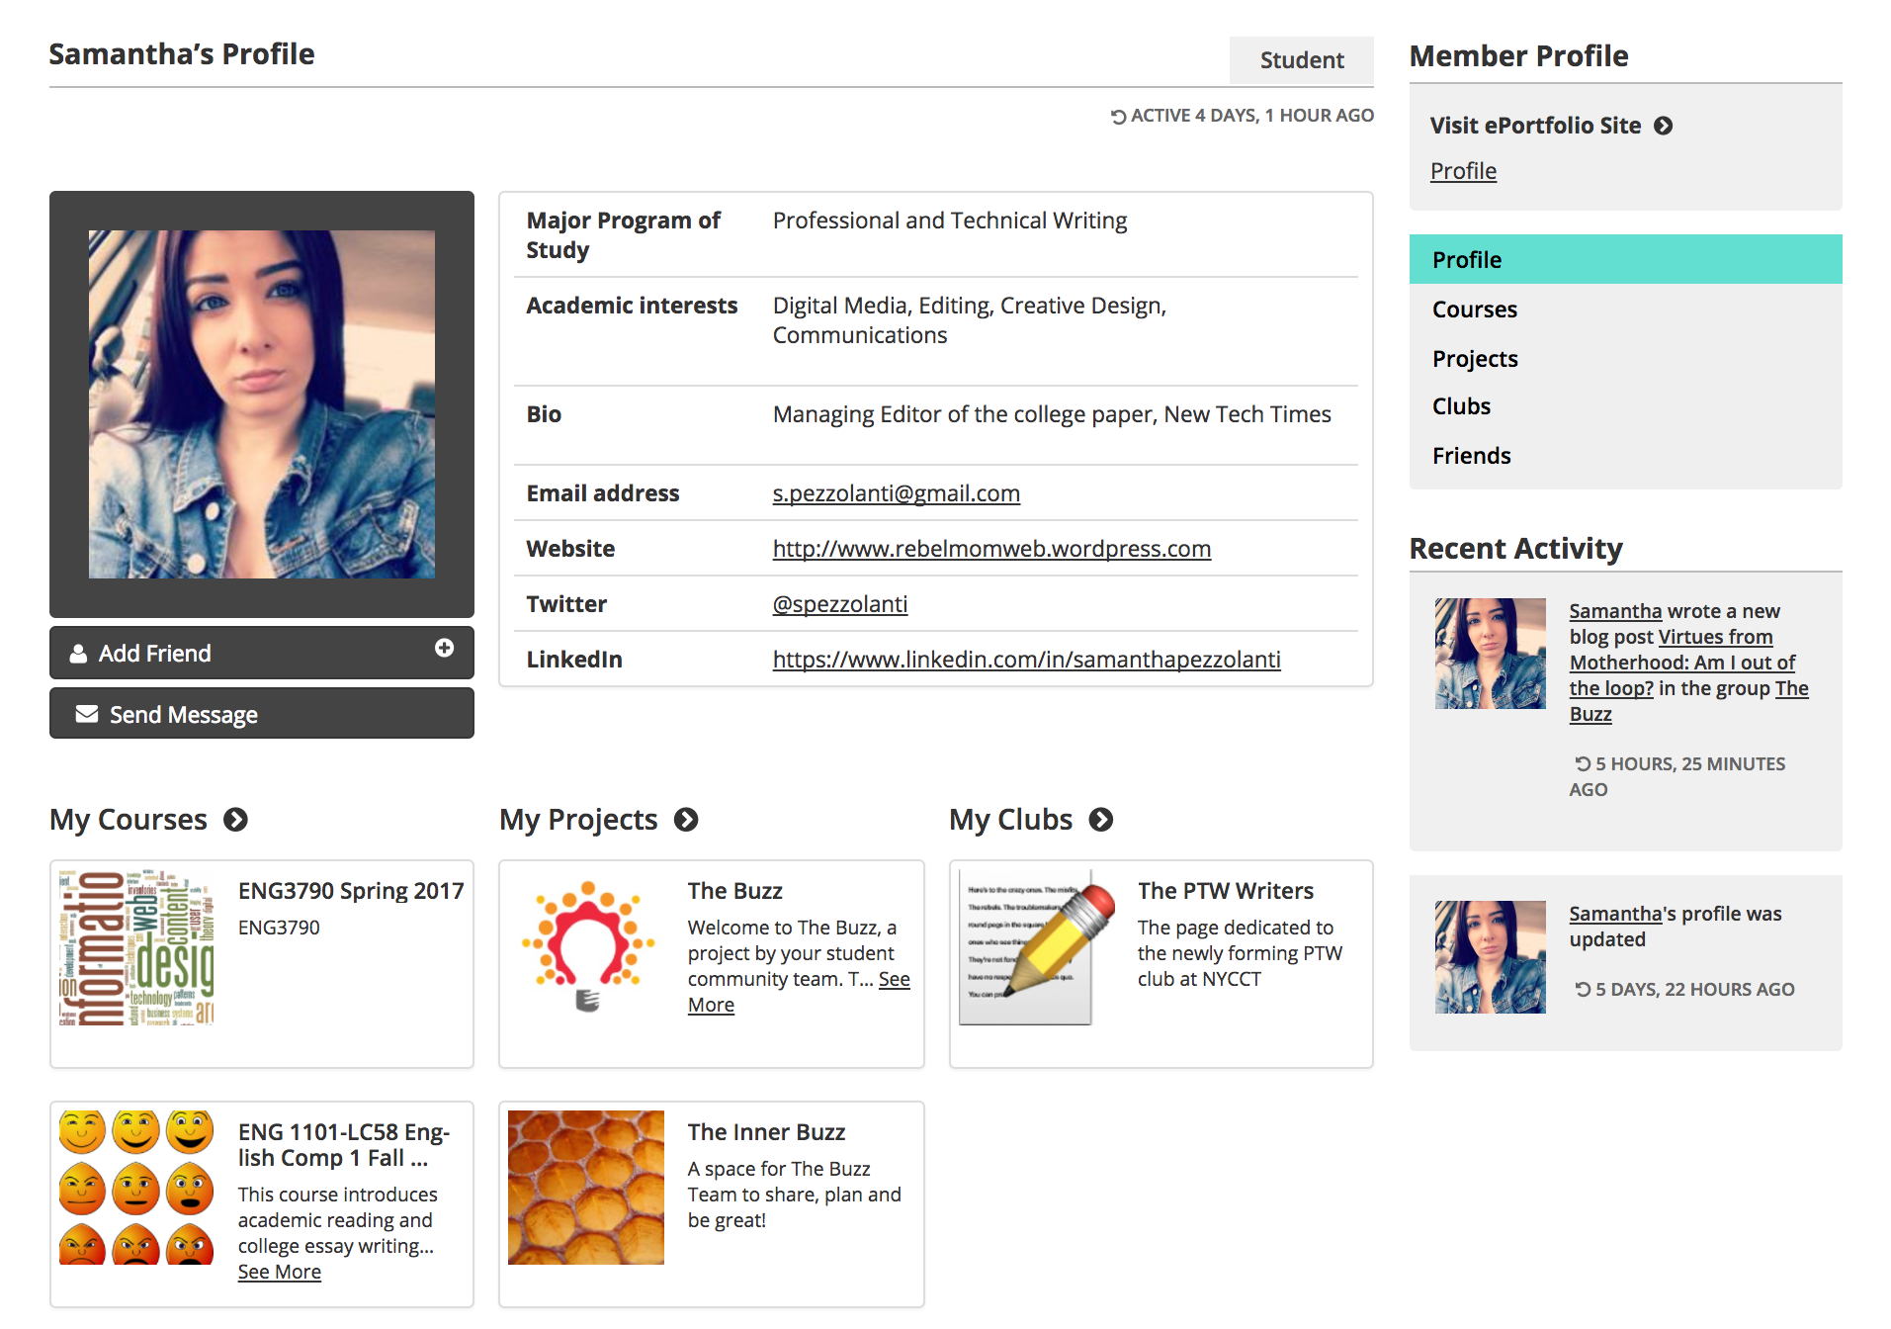
OpenLab Profile
People
Student Profile

Slide 8
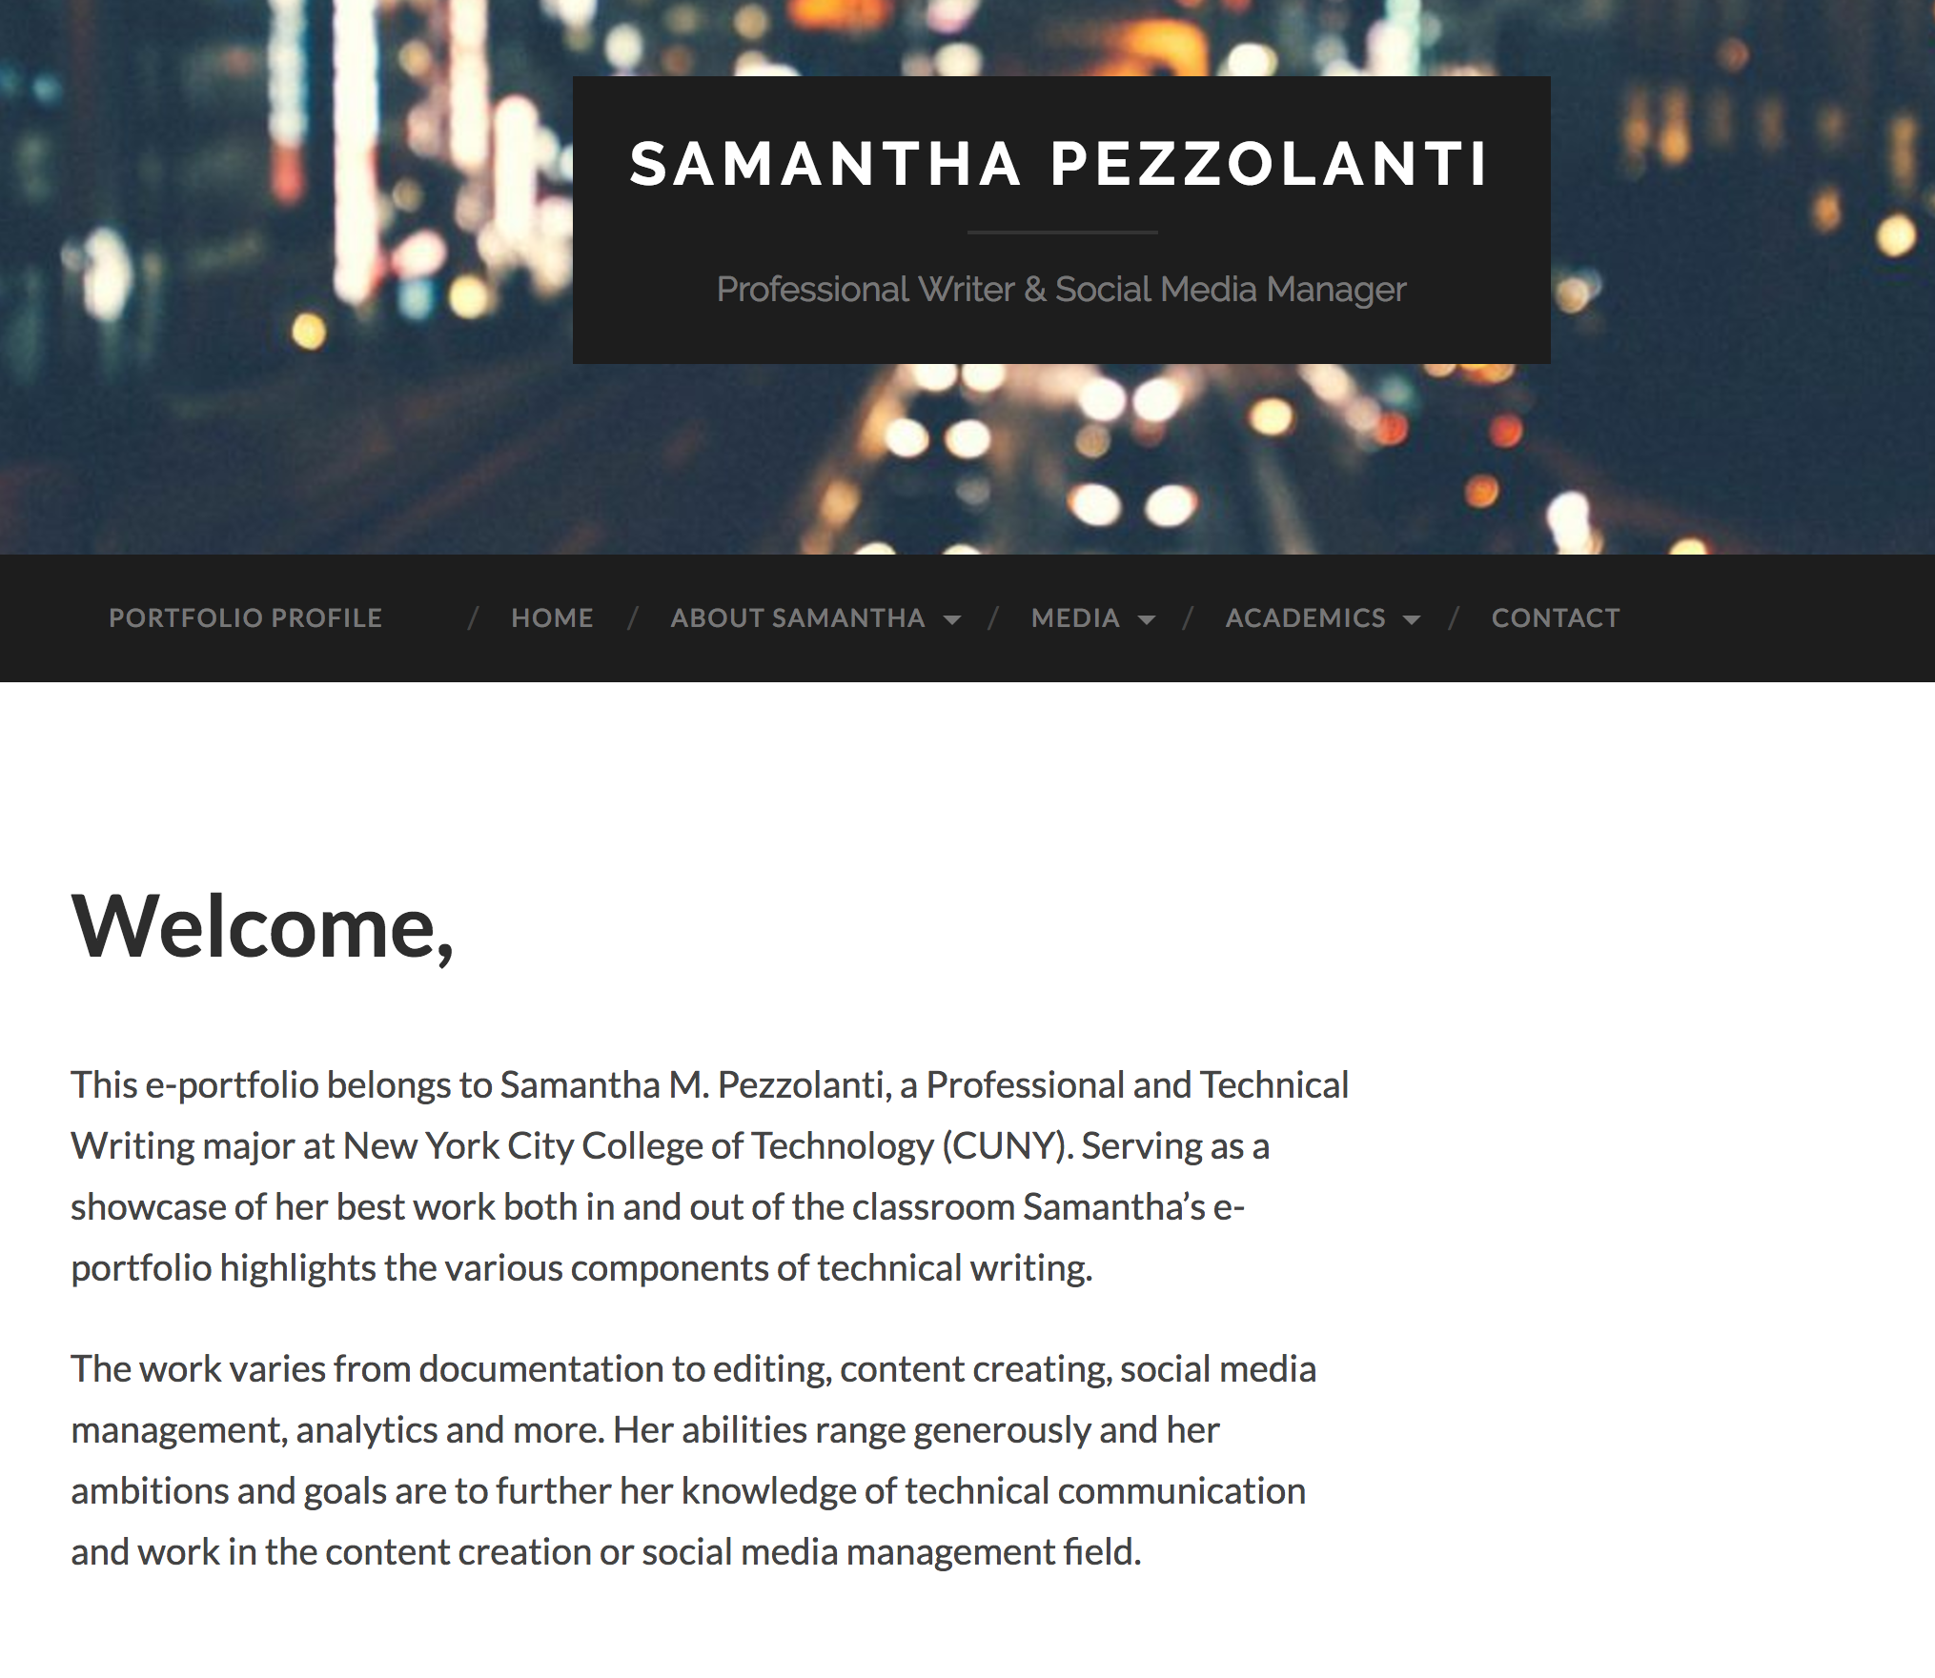
OpenLab Site
People
Student ePortfolio

Slide 9
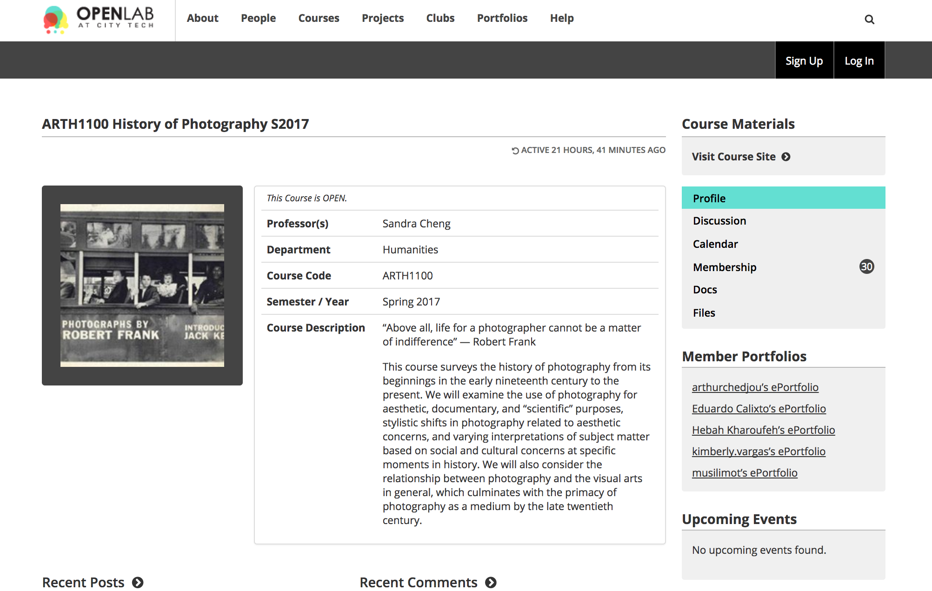
OpenLab Course
People
Course Profile

Slide 10
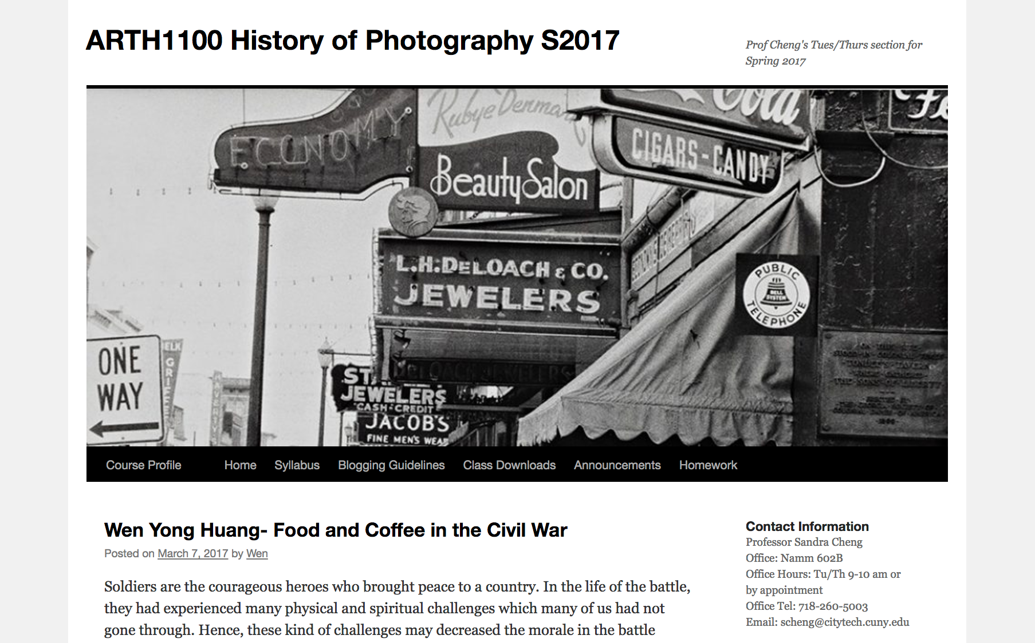
OpenLab Course
People
Course Site

Slide 11
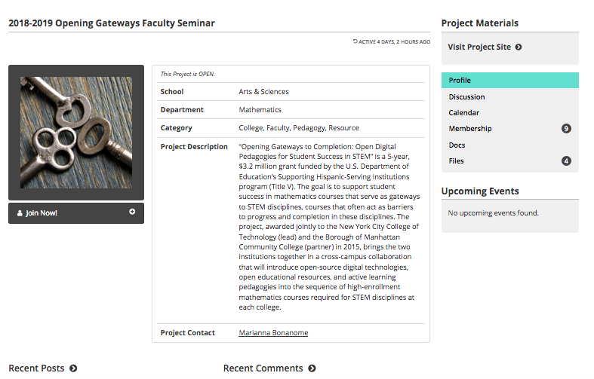
OpenLab Project
People
Project Profile

Slide 12
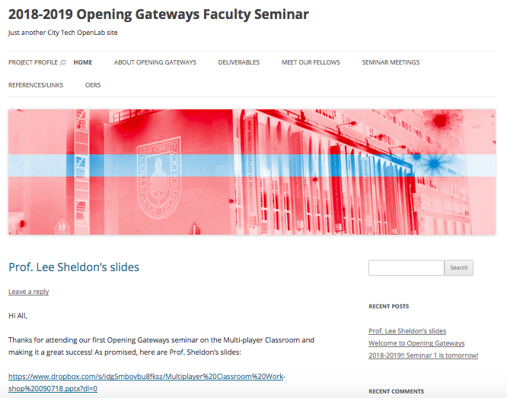
OpenLab Project
People
Project Site

Slide 13
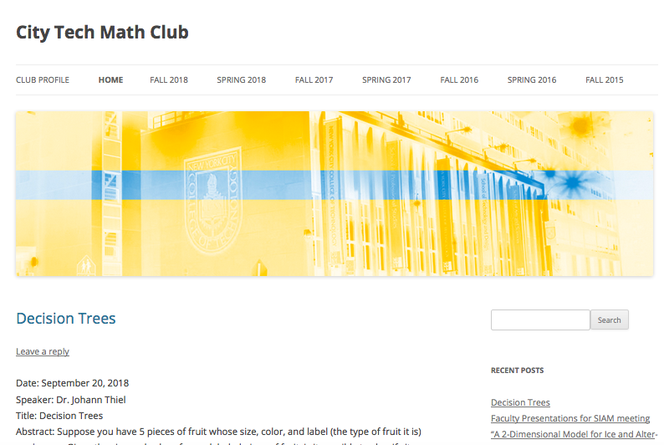
City Tech Math Club
People
Student Club

Slide 14
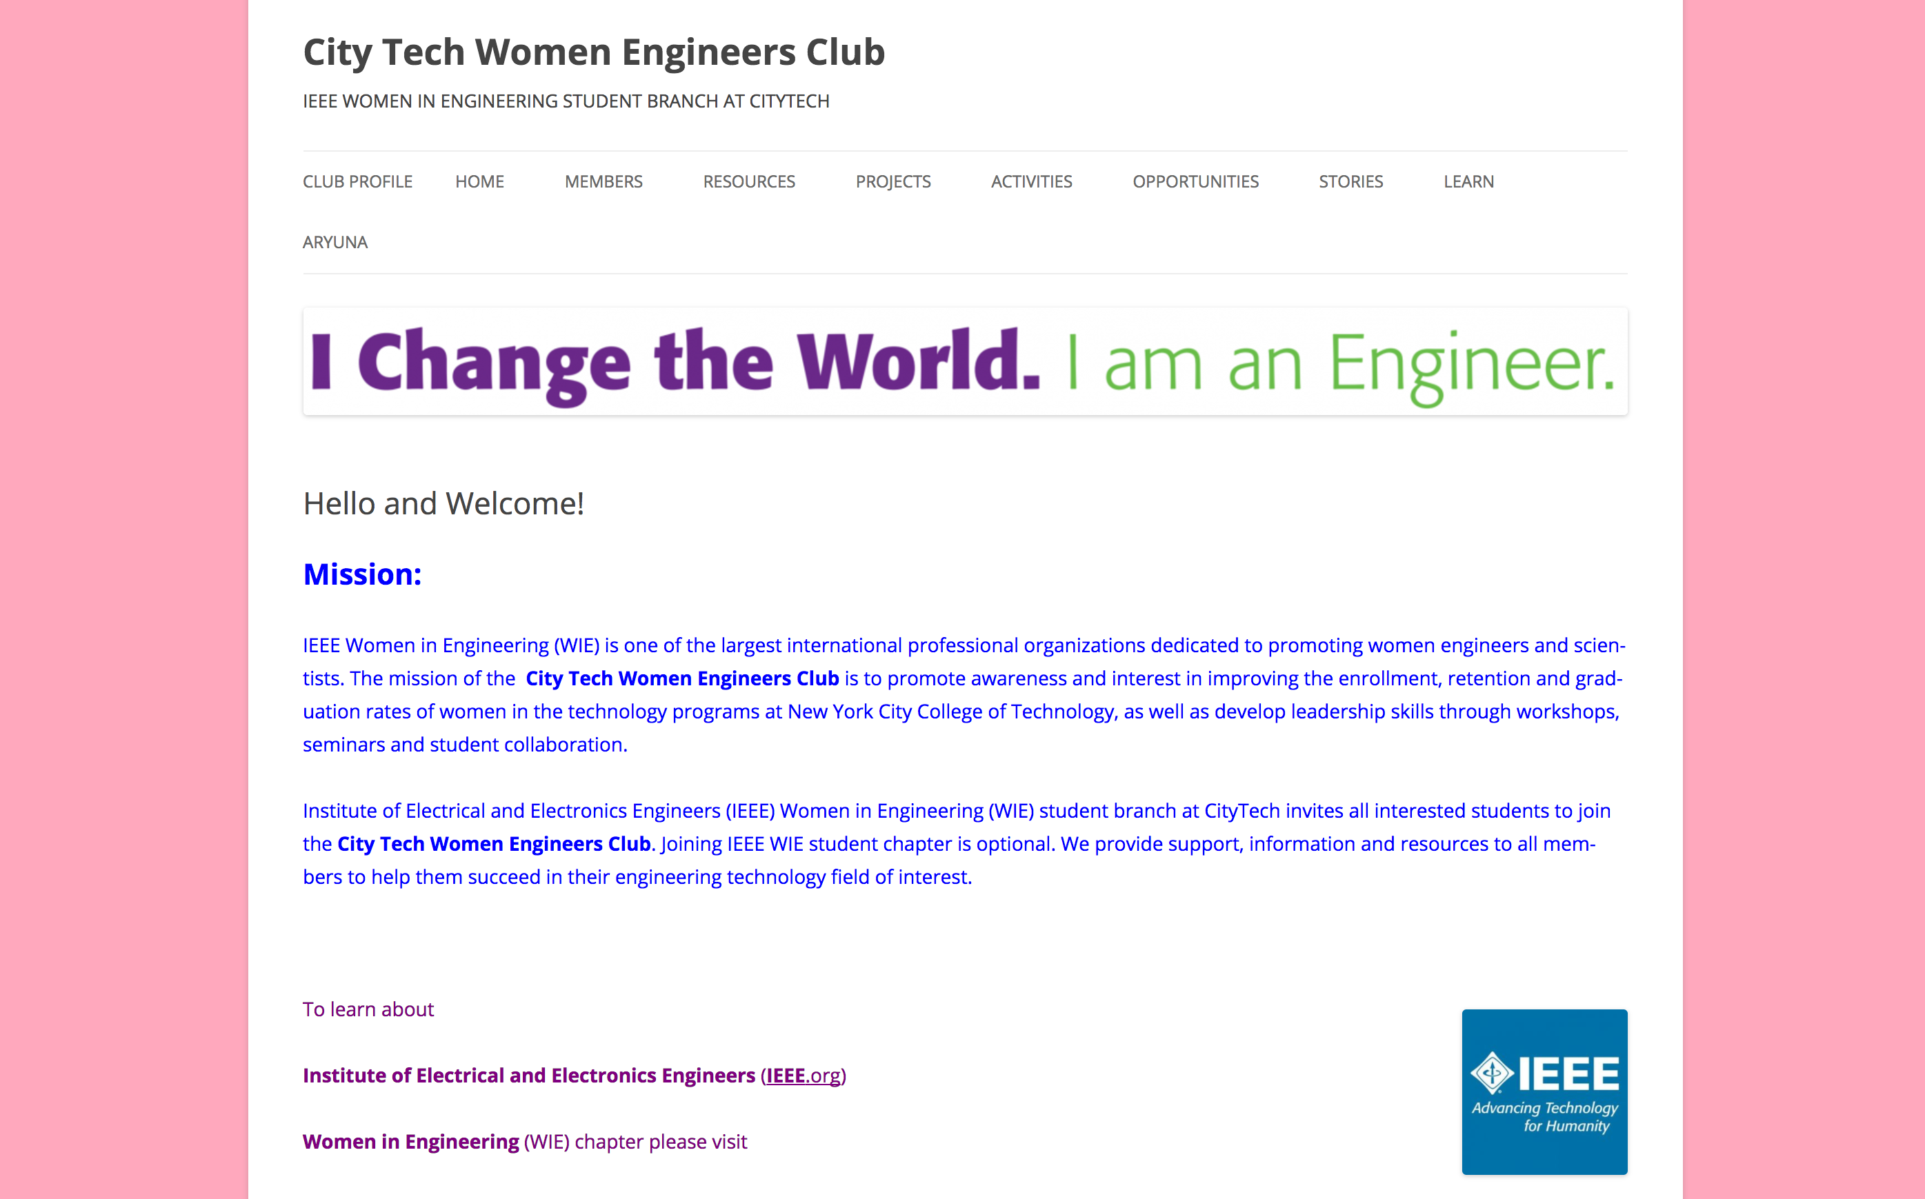
City Tech Women Engineers Club
People
Student Club

Slide 15
Why OPEN? Why LAB?
Unlike closed online teaching systems, the OpenLab allows members across the college to share their work with one another and the world outside City Tech
Like a lab, it provides a space where students, faculty, and staff can work together, experiment, and innovate

Slide 16
From “Listening for Student Voices”—Friend & Morris 2013
If we decide that our classrooms are places where trying happens, then we transform them into laboratories; and in a laboratory, with happy people of varying skill sets working side by side, anyone can make a discovery. As lab managers, then, we do not approach our work as “I’ve solved this problem, let’s see if you can too” but as, “here’s a problem with many possible solutions.” Everyone is invited to try, allowed to fail, encouraged to succeed. Our job becomes making sure that all the appropriate equipment is available for success to occur.

Slide 17

Open Source – Open Collaboration
Image: Shutterstock
Designed for City Tech and beyond

Slide 18


Share, Iterate, and Innovate
  WordPress is an open source publishing platform that powers >25% of the internet and has an active community of skilled developers from all over the world.
  BuddyPress, a WordPress plugin, adds the community networking capabilities that are an essential component of the OpenLab.

Slide 19
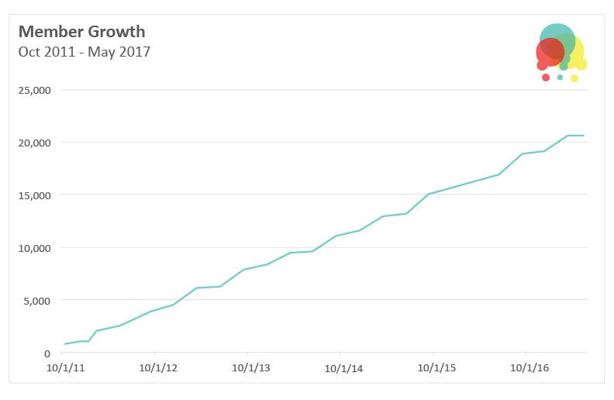
OpenLab Adoption
Fall 2011-Fall 2016

Slide 20
Opening Student Experiences at City Tech
  Supports student learning in Gen Ed core competencies and high impact practices
  Bridges experiential and classroom learning
  Builds student proficiency with digital media, transferrable skills
  Offers professionalization opportunities
  Provides space to network, collaborate, and socialize around shared interests

Slide 21
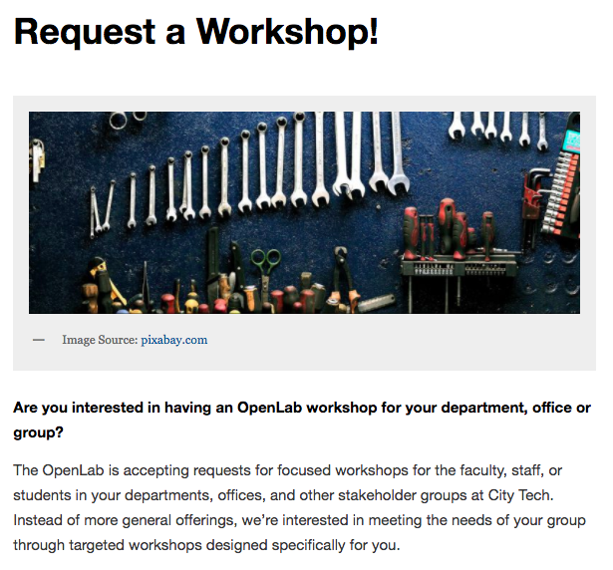
New Feature: Request a Workshop
The OpenLab now offers focused workshops for our members!

Slide 22
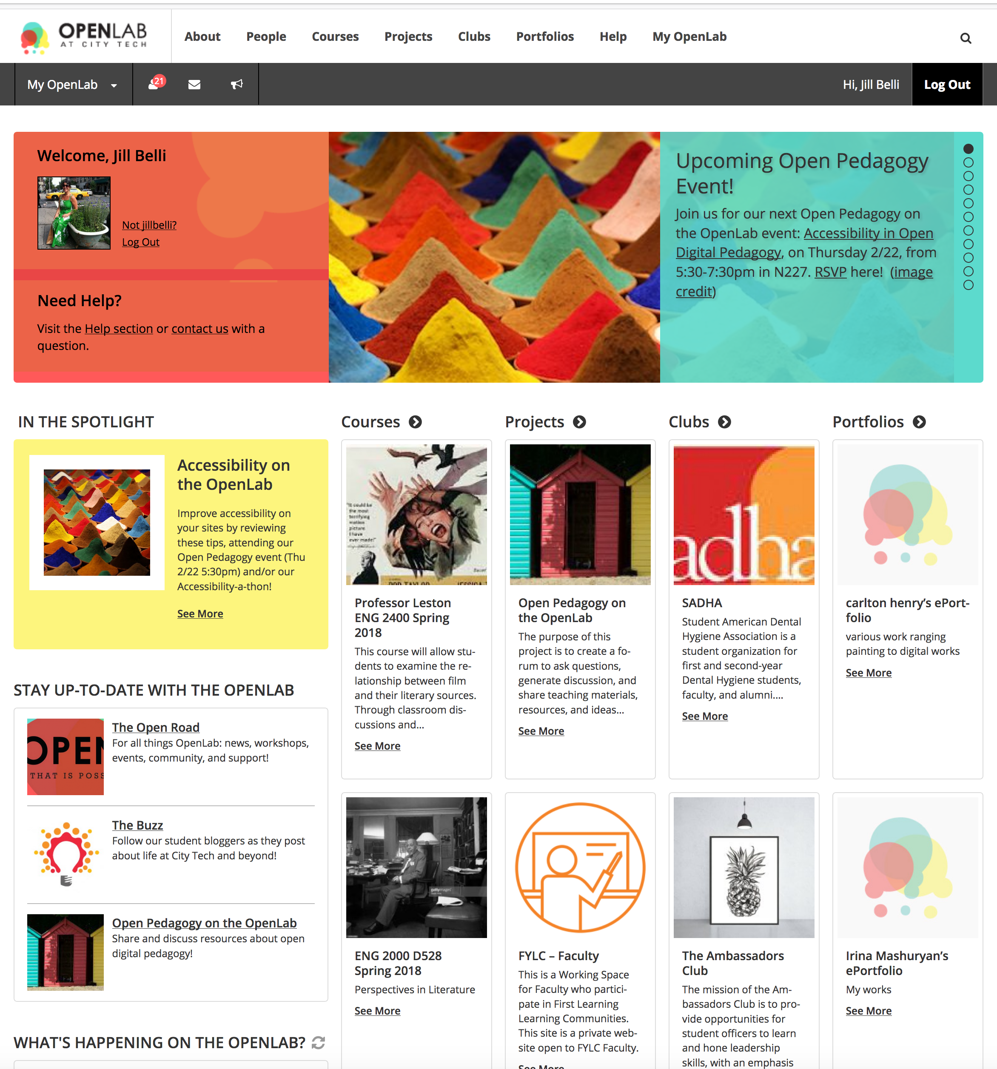
Stay Up-to-Date with the OpenLab
The OpenLab’s three sites (Open Road, The Buzz, Open Pedagogy) now featured on homepage!

Slide 23
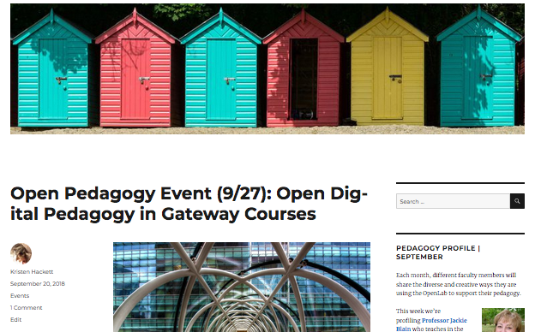
Open Pedagogy on the OpenLab
Attend our series of events and join the discussion online!
Notes:
Add info about upcoming events—here, or at the end? Both?

Slide 24
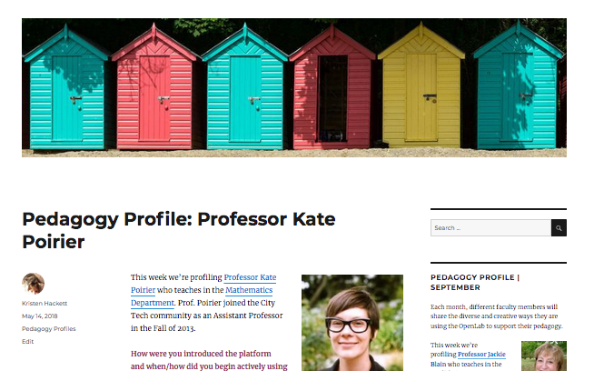
Open Pedagogy on the OpenLab
Attend our series of events and join the discussion online!

Slide 25
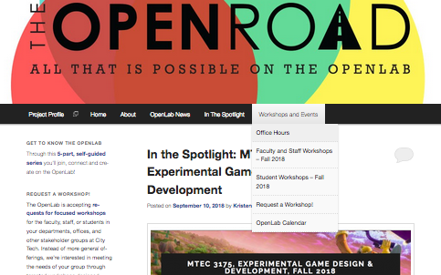
Building Community in OpenLab Courses
Examples of low-stakes assignments from across the disciplines

Slide 26
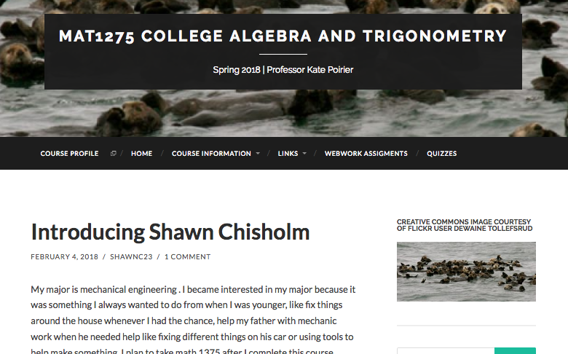
Building Community in OpenLab Courses
Examples of low-stakes assignments from across the disciplines: Introductions

Slide 27
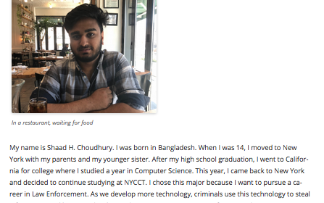
Building Community in OpenLab Courses
Examples of low-stakes assignments from across the disciplines: Introductions, Prof. Halleck, MAT1372 F18

Slide 28
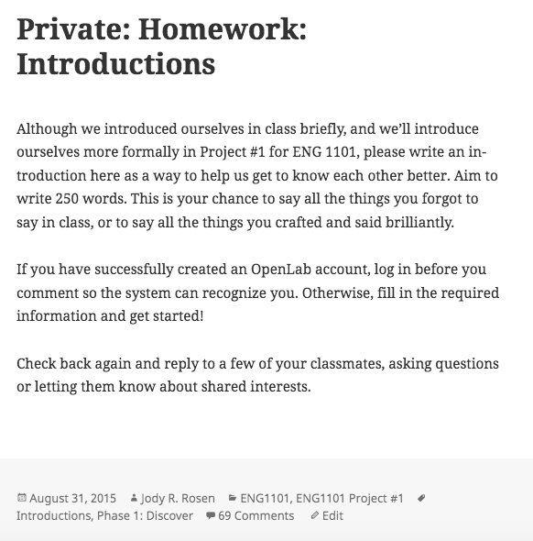
Building Community in OpenLab Courses
Examples of low-stakes assignments from across the disciplines: Introductions

Slide 29
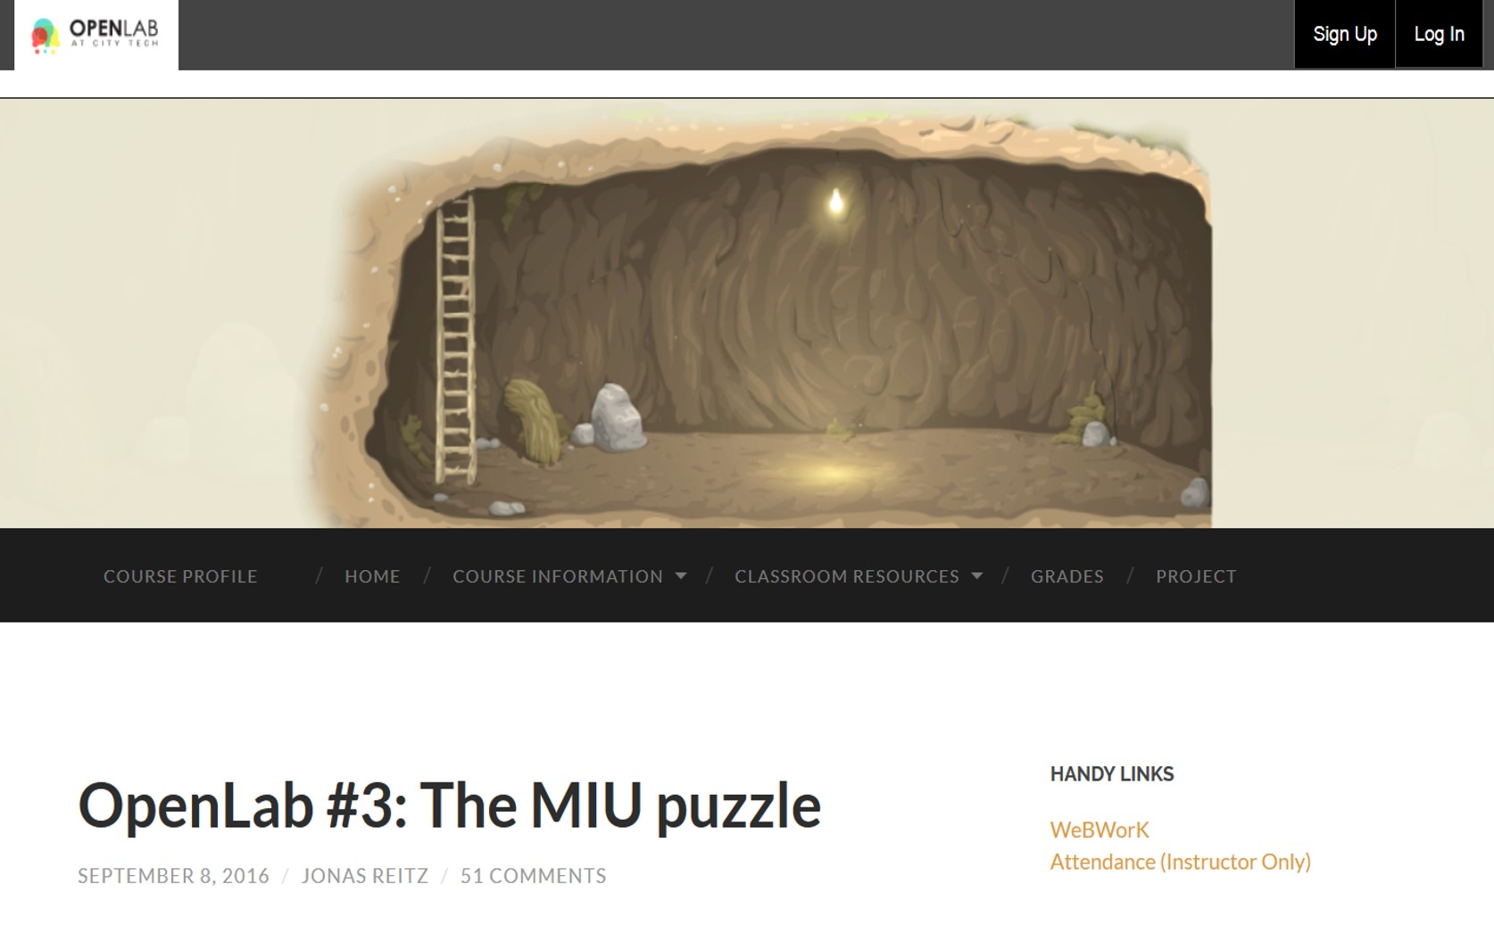
Building Community in OpenLab Courses
Examples of low-stakes assignments from across the disciplines

Slide 30
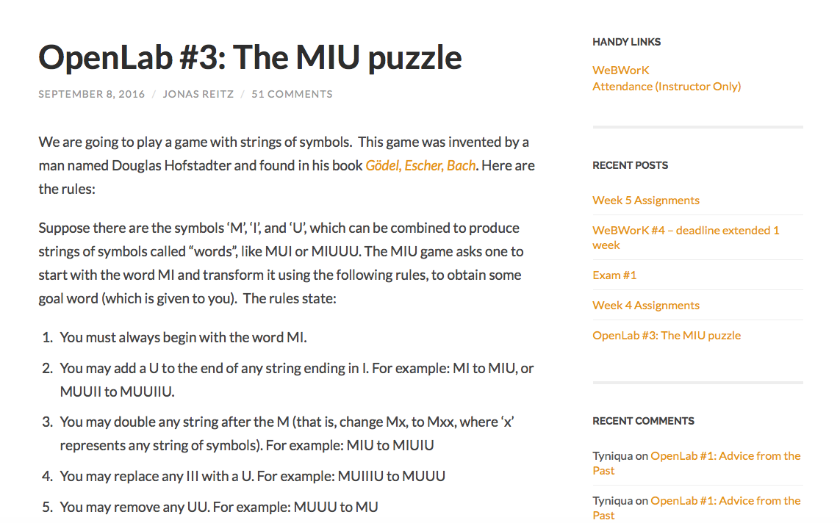
Building Community in OpenLab Courses
Examples of low-stakes assignments from across the disciplines

Slide 31
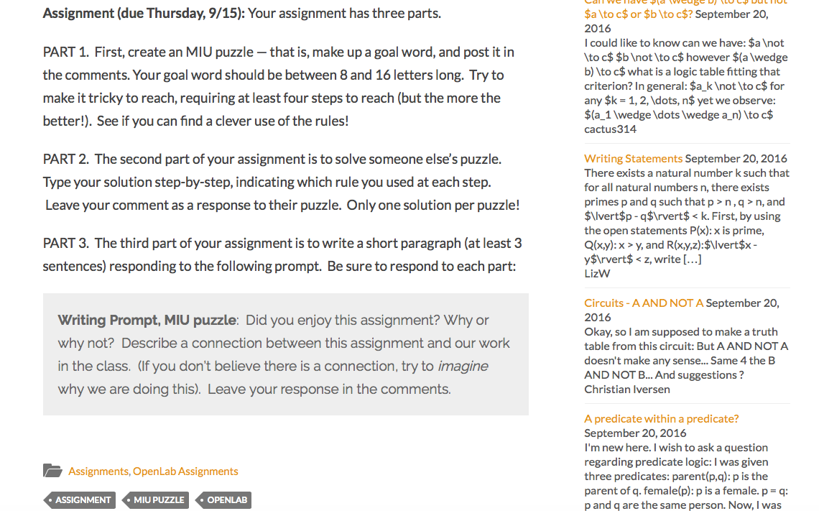
Building Community in OpenLab Courses
Examples of low-stakes assignments from across the disciplines

Slide 32
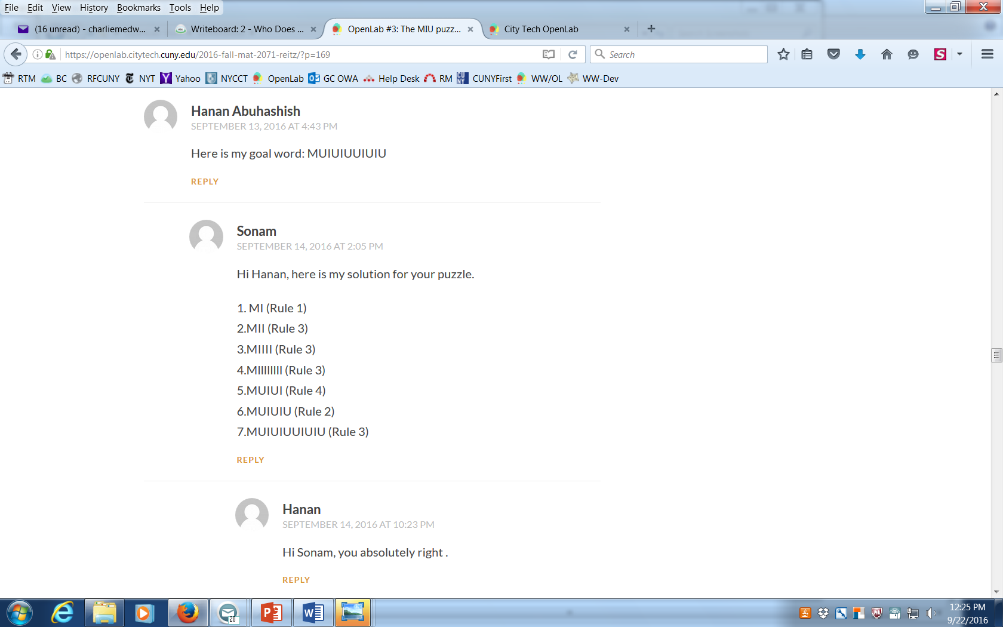
Building Community in OpenLab Courses
Commenting for posing and solving MIU puzzles—Prof. Reitz

Slide 33
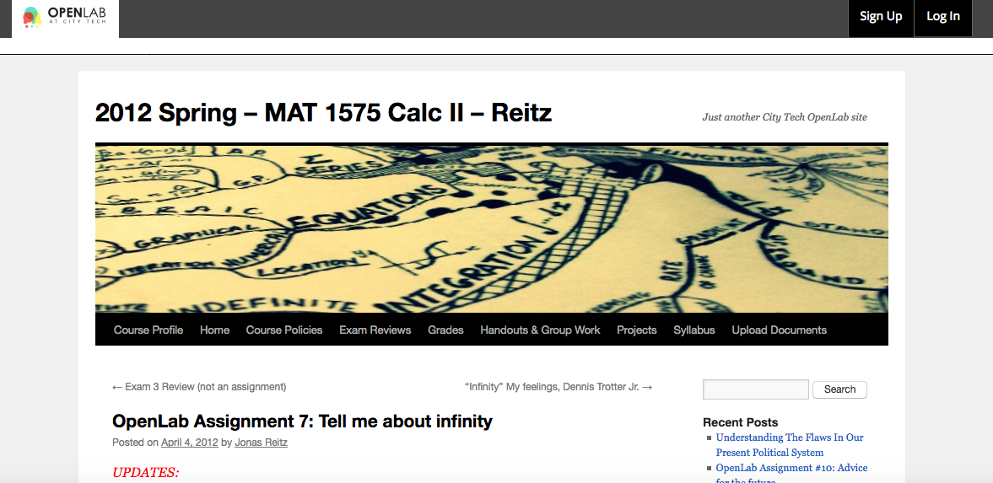
Building Community in OpenLab Courses
Mathography assignment: Tell me about infinity—Prof. Reitz

Slide 34
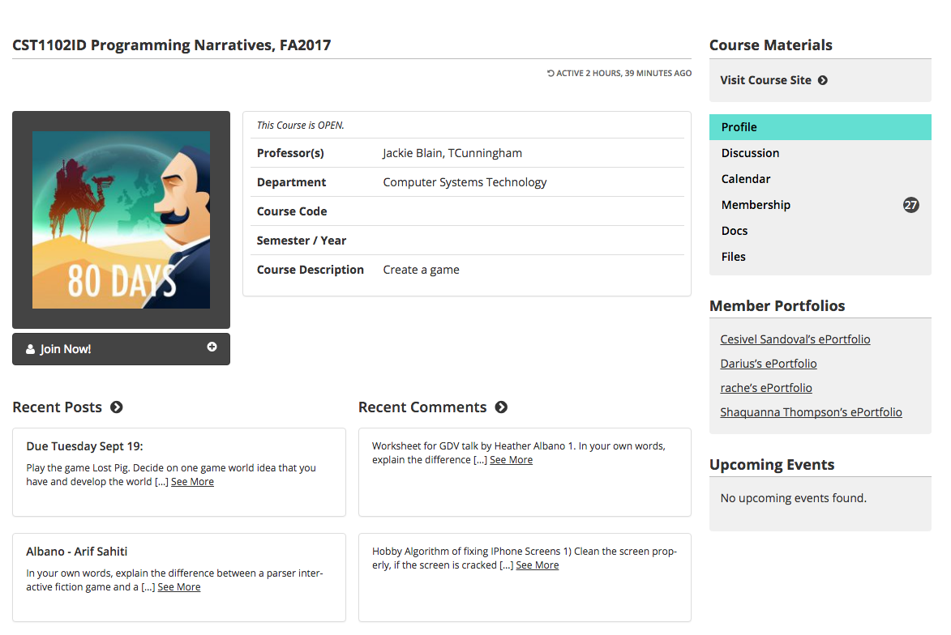
Building Community in OpenLab Courses
Hobby Algorithm: CST1102ID Programming Narratives, SP17—Profs Blain and Cunningham

Slide 35
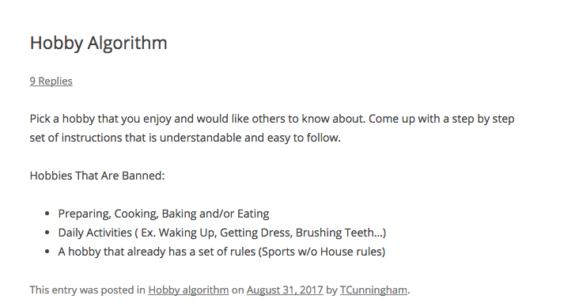
Building Community in OpenLab Courses
Hobby Algorithm: CST1102ID Programming Narratives, SP17—Profs Blain and Cunningham

Slide 36
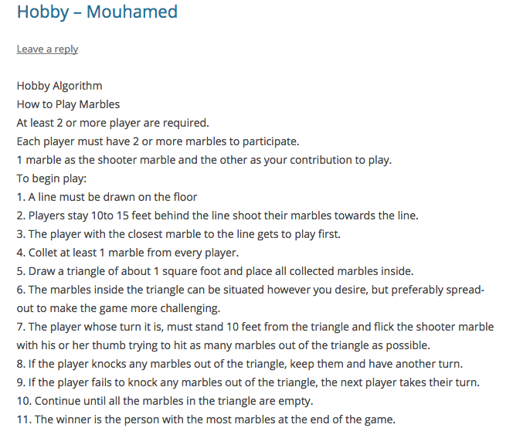
Building Community in OpenLab Courses
Hobby Algorithm: CST1102ID Programming Narratives, SP17—Profs Blain and Cunningham

Slide 37
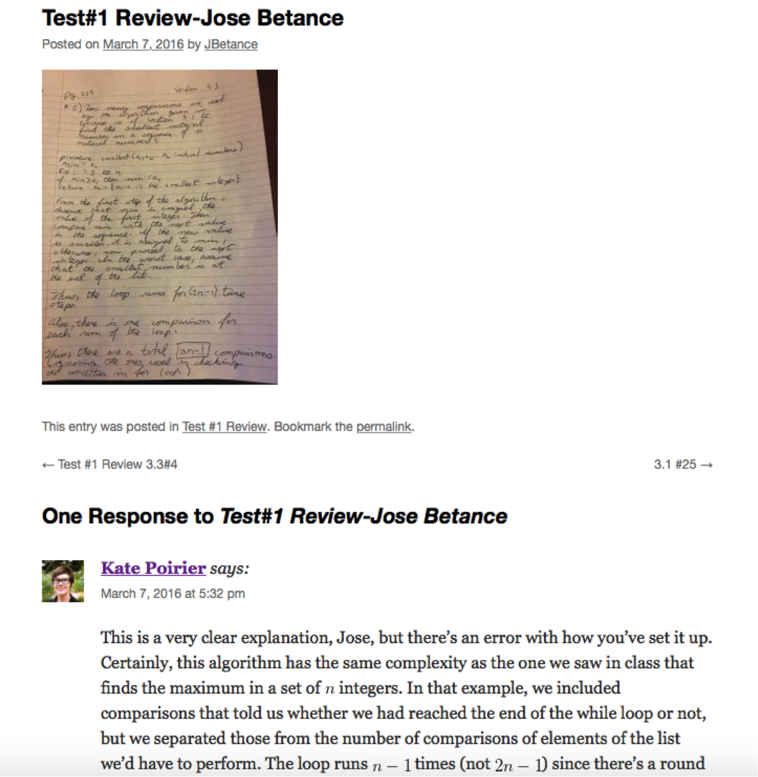
Building Community in OpenLab Courses
Examples of low-stakes assignments from across the disciplines

Slide 38
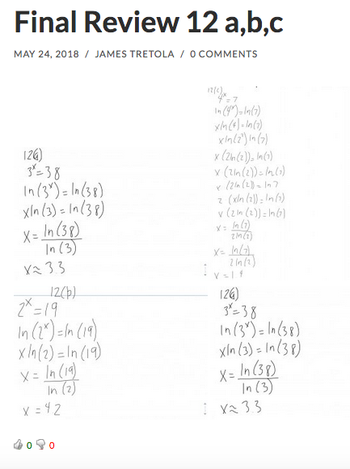
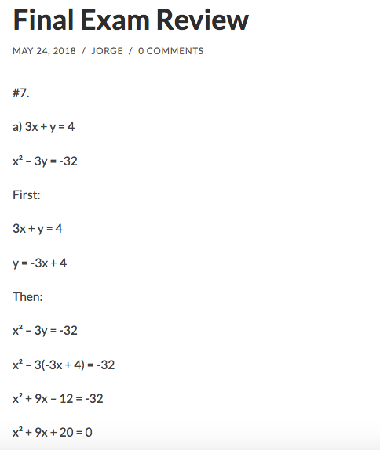
Building Community in OpenLab Courses
Final Exam Review: Kate Poirier
Notes:
handwritten

Slide 39
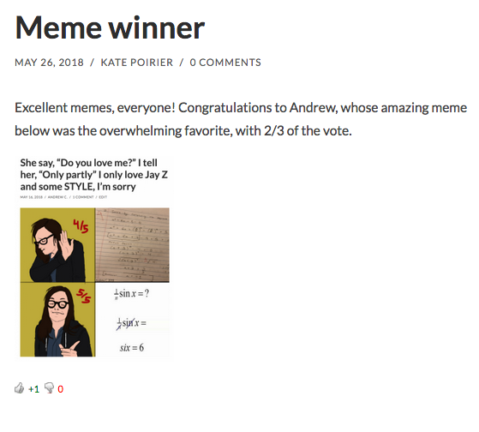
Building Community in OpenLab Courses
Extra-Credit Memes and Student Choice: Kate Poirier
Notes:
handwritten

Slide 40
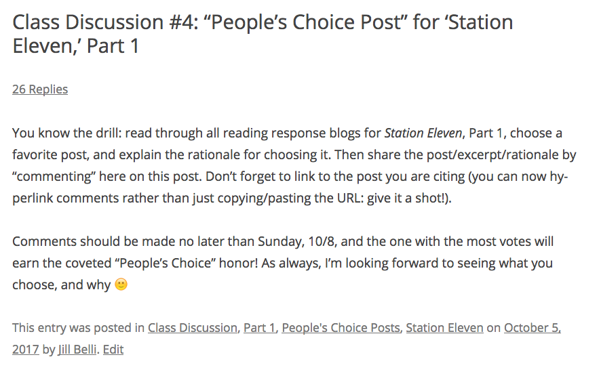
Building Community in OpenLab Courses
Professor Jill Belli | ENG 2001: Introduction to Fiction | Fall 2017

Slide 41
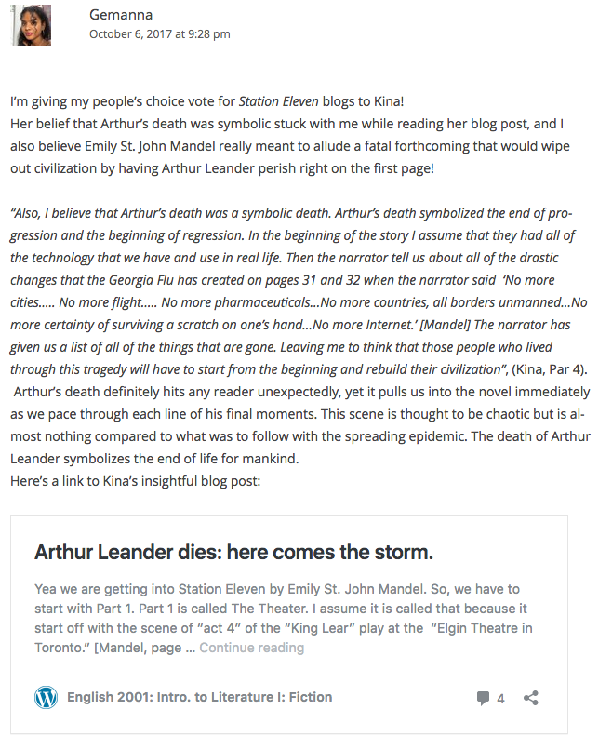
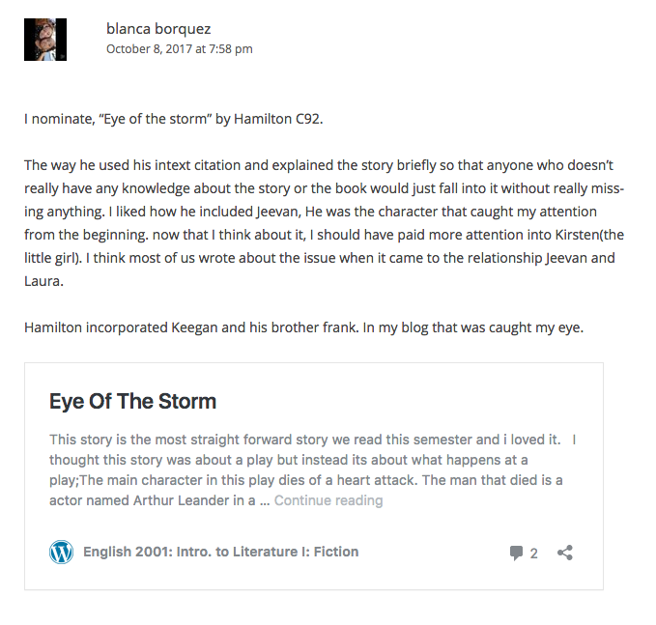
Crowdsourcing activity (“People’s Choice”)
People
Professor Jill Belli | ENG 2001: Introduction to Fiction | Fall 2017

Slide 42
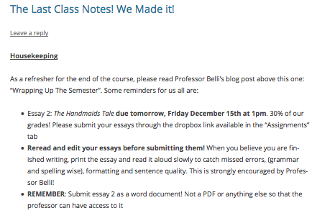
Building Community in OpenLab Courses
Shared Notetaking—Prof. Belli, ENG 2001 F17
Notes:
Add screenshot from Jill’s course—student notetaking

Slide 43
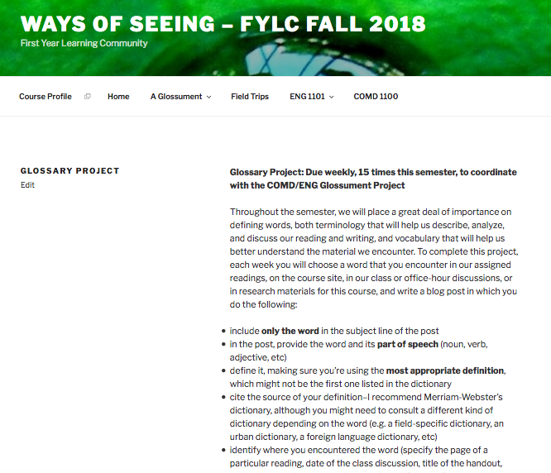
Building Community in OpenLab Courses
Glossary Project—Prof. Rosen

Slide 44
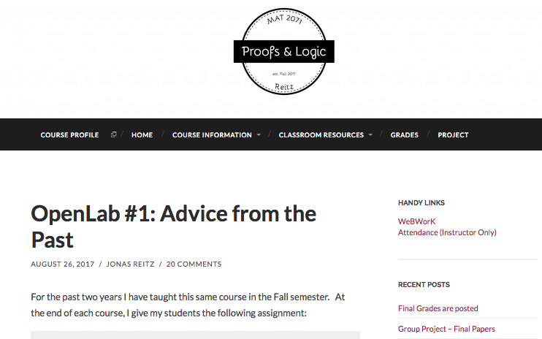
Building Community in OpenLab Courses
Advice from the Past: Prof. Reitz

Slide 45
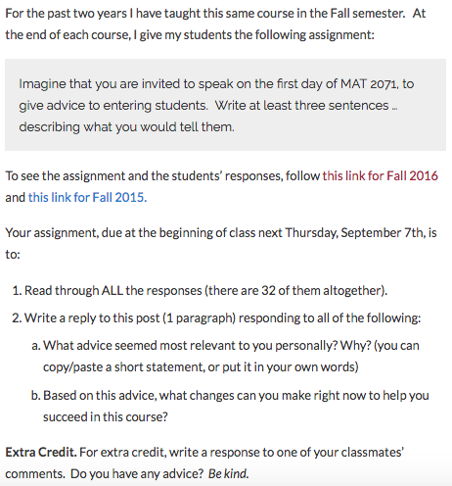
Building Community on the OpenLab
Advice from the Past: Prof. Reitz

Slide 46
Building Community in OpenLab Courses
Thinking about the examples we just discussed and what’s possible on the OpenLab, what’s one low-stakes way you can use the OpenLab to promote active learning for students in your courses?
Examples of low-stakes assignments from across the disciplines: Reflection

Slide 47
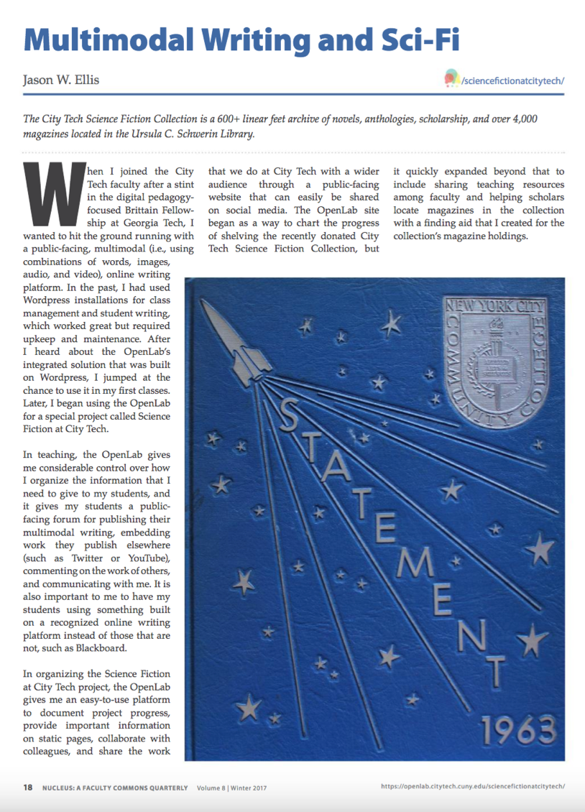
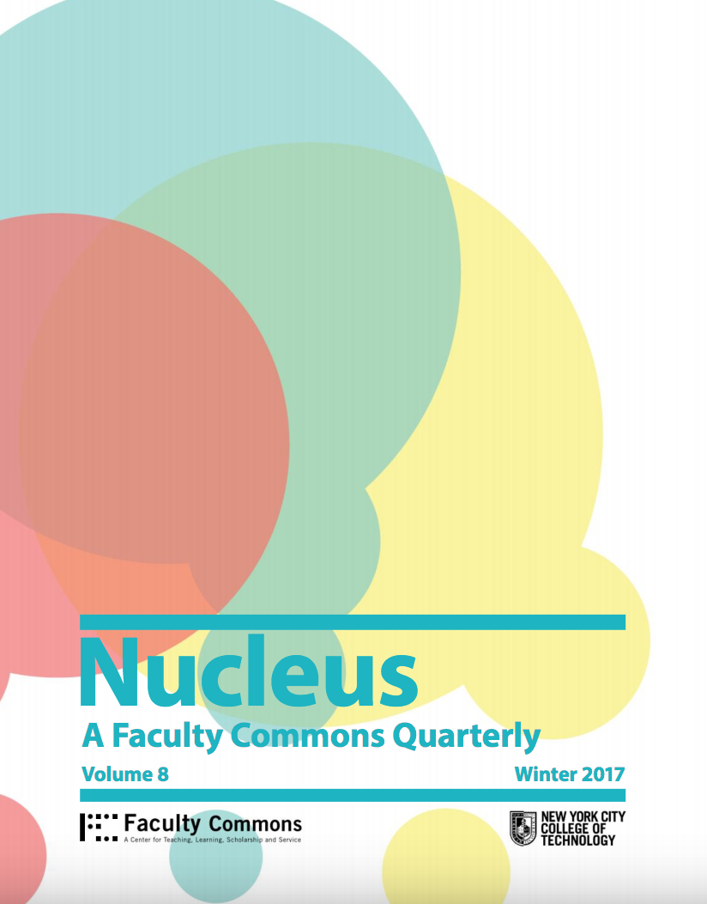
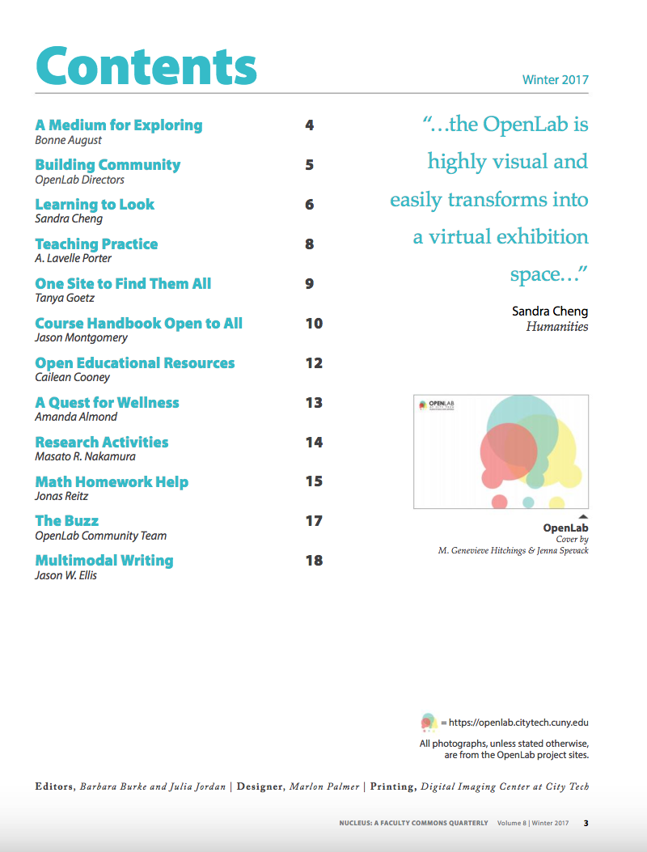
tinyurl.com/OLnucleus
Read this special issue to learn innovative ways faculty across the college are using the OpenLab

Slide 48
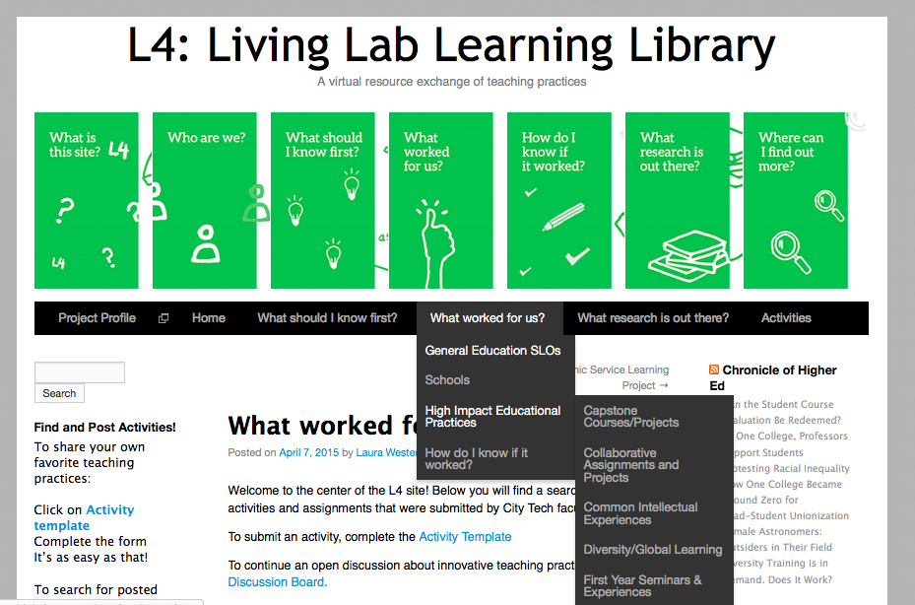
The L4
An open bank of assignments submitted by faculty at City Tech and beyond!
A virtual resource exchange of teaching practices
Open to colleagues within and outside City Tech
No membership required to view or post
https://openlab.citytech.cuny.edu/l4/
(Or simply google it! – L4 City Tech)

Slide 49
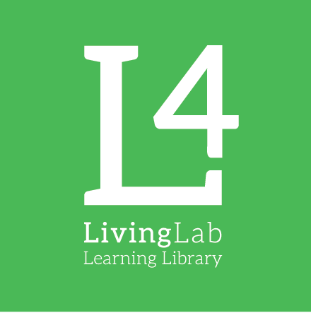
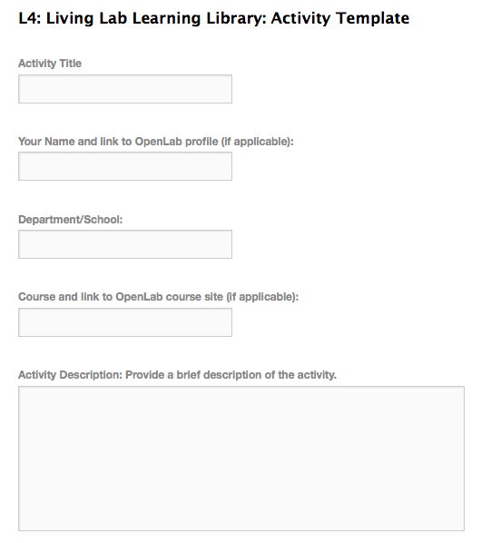

Activity Template Form
Created to simplify submission process
Online fillable
For activities from homework assignments to semester-long projects
SIMPLE and FAST

Slide 50
Reflections: Open Pedagogy on the OpenLab
How useful was this workshop for you?
How did this workshop help you to think more intentionally about your pedagogy?
How effectively did the workshop provide you with ideas for course assignments?
How are you going to use the OpenLab next semester in your courses?

Slide 51
Thank you!
Email: openlab@citytech.cuny.edu
URL: openlab.citytech.cuny.edu
Twitter: @CitytechOpenLab

