Slide 1

Color!
Perception, theory and use!
GRA 1111
Graphic Communications Workshop
Notes:
Who would like to define the terms in context with our discussion Perception, theory and use

Slide 2
What is light?
GRA 1111
Graphic Communications Workshop

Slide 3
What is light?
Simply, light is a name for a range of electromagnetic radiation that can be seem by the human eye.
GRA 1111
Graphic Communications Workshop

Slide 4
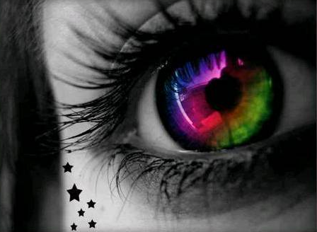
What is light?
Simply, light is a name for a range of electromagnetic radiation that can be seem by the human eye.
GRA 1111
Graphic Communications Workshop
Image: Courtesy Pantone

Slide 5
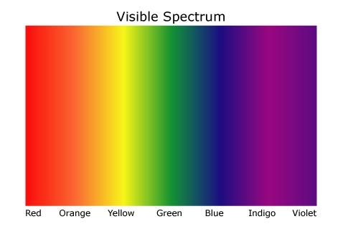
What is light?
Simply, light is a name for a range of electromagnetic radiation that can be seem by the human eye (ROYGBIV).
GRA 1111
Graphic Communications Workshop
Image: Google Images

Slide 6
What is light?
Light is only one part of the electromagnetic spectrum including radio, microwave, infrared, visible, ultraviolet, x-ray and gamma rays.
GRA 1111
Graphic Communications Workshop

Slide 7
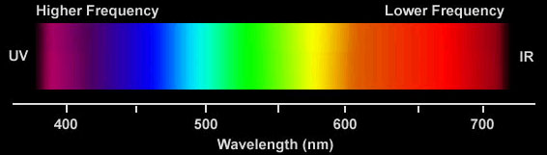
What is light?
Light is only one part of the electromagnetic spectrum including radio, microwave, infrared, visible, ultraviolet, x-ray and gamma rays.
GRA 1111
Graphic Communications Workshop
Image: Courtesy Pantone

Slide 8
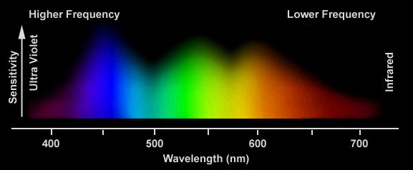
What is light?
Light is only one part of the electromagnetic spectrum including radio, microwave, infrared, visible, ultraviolet, x-ray and gamma rays.
GRA 1111
Graphic Communications Workshop
Image: Courtesy Pantone

Slide 9
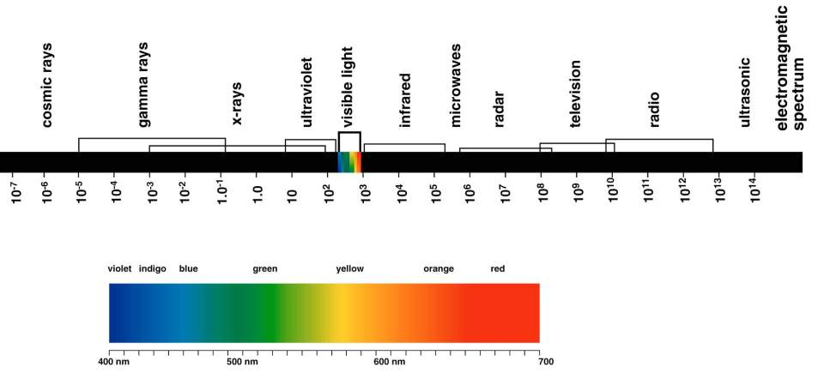
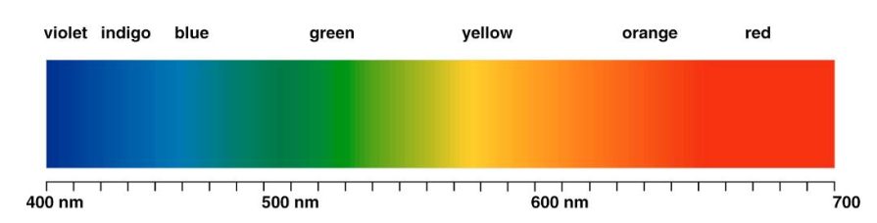
What is light?
GRA 1111
Graphic Communications Workshop
Image: Courtesy Pantone

Slide 10
What is color?
Color, is the visual perception, a human perception that allows us to “view” the categories called red, blue, yellow, green and others.
GRA 1111
Graphic Communications Workshop
Image: Courtesy Pantone

Slide 11
What is color?
Color, is a visual sensation that involves a light source, an object and a viewer.
GRA 1111
Graphic Communications Workshop
Image: Nick Patrissi

Slide 12
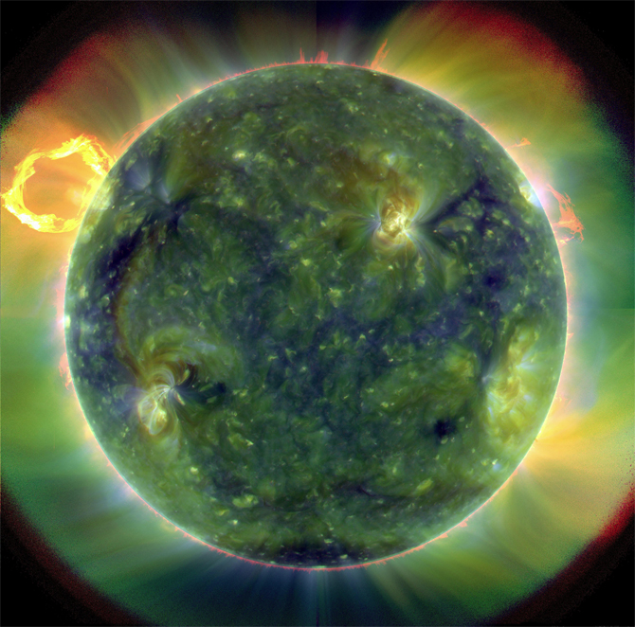
What is color?
Color, is a visual sensation that involves a light source, an object and a viewer.
GRA 1111
Graphic Communications Workshop
Image: NASA

Slide 13
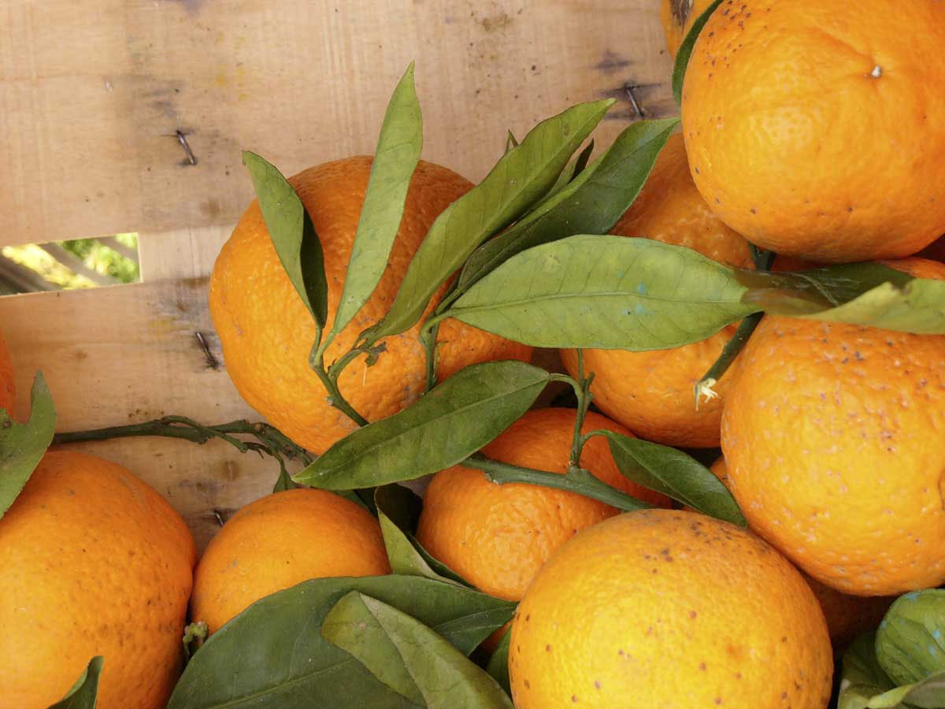
What is color?
Color, is a visual sensation that involves a light source, an object and a viewer.
GRA 1111
Graphic Communications Workshop
Image: NASA, Thaddeus B. Kubis

Slide 14
What is color?
Color, is a visual sensation that involves a light source, an object and a viewer.
GRA 1111
Graphic Communications Workshop
Image: NASA, Thaddeus B. Kubis, Pantone

Slide 15
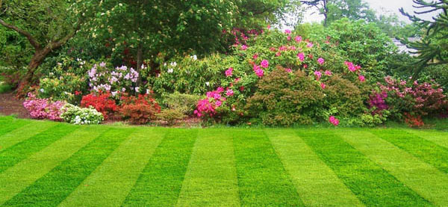
What Color is Grass?
A. Green?

Slide 16
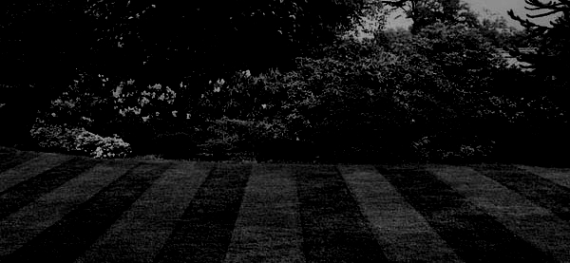
What Color is Grass
at Night?
B. Grey???

Slide 17
What is color?
Why, does red look red, or green look green?
Red looks red and green looks green because the items (red or green) absorbs all other colors, reflecting the colors red, or green.
GRA 1111
Graphic Communications Workshop

Slide 18
What is color?
Why, does red look red, or green look green?
When any object is exposed to light, it reflects the color in the prism that it cannot absorb.
GRA 1111
Graphic Communications Workshop

Slide 19
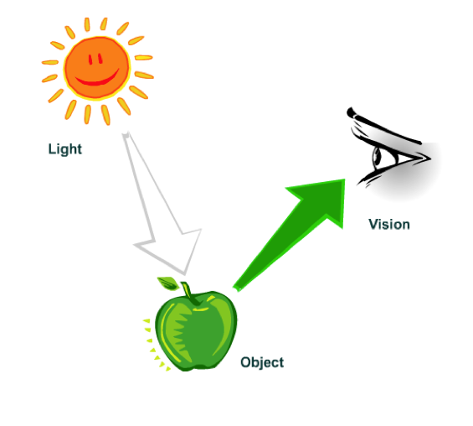
What is color?
Why, does red look red, or green look green?
GRA 1111
Graphic Communications Workshop
Image: Nick Patrissi

Slide 20
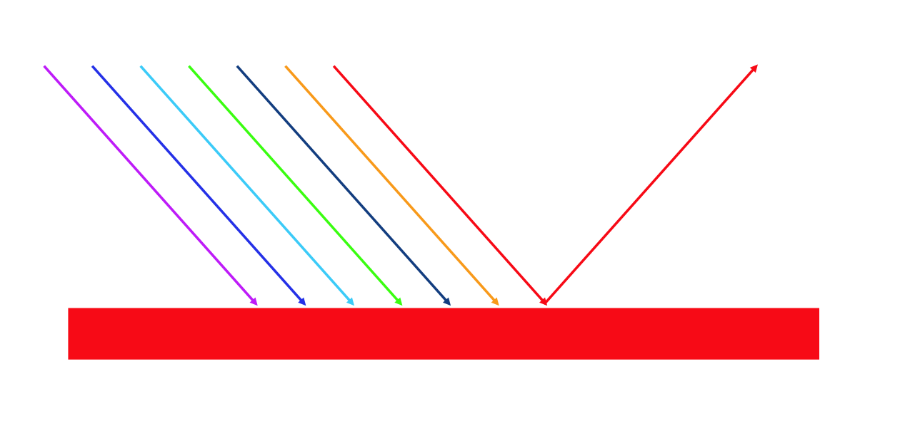
What is color?
Why, does red look red, or green look green?
GRA 1111
Graphic Communications Workshop
Image: Nick Patrissi

Slide 21
Is light the same as color?
GRA 1111
Graphic Communications Workshop

Slide 22
Is light the same as color?
Light: reflected, absorbed, or transmitted
An object is "colored,” because of the light it reflects—all other colors are absorbed into that specific object.
GRA 1111
Graphic Communications Workshop

Slide 23
What is color?
Color can also confuse the mind and need to be used with understanding and care.
Blue
Brown
Green
Yellow
Red
GRA 1111
Graphic Communications Workshop

Slide 24
What do you see?
GRA 1111
Graphic Communications Workshop

Slide 25
Blue
GRA 1111
Graphic Communications Workshop

Slide 26
Brown
GRA 1111
Graphic Communications Workshop

Slide 27
Green
GRA 1111
Graphic Communications Workshop

Slide 28
Yellow
GRA 1111
Graphic Communications Workshop

Slide 29
Red
GRA 1111
Graphic Communications Workshop

Slide 30
What did you see?
GRA 1111
Graphic Communications Workshop

Slide 31
What is color?
The Stroop Effect!
GRA 1111
Graphic Communications Workshop
Notes:
The Stroop effect is the finding that naming the color of the first set of words is easier and quicker than the second.
In psychology, the Stroop effect is a demonstration of interference in the reaction time of a task. When the name of a color (e.g., "blue," "green," or "red") is printed in a color not denoted by the name (e.g., the word "red" printed in blue ink instead of red ink), naming the color of the word takes longer and is more prone to errors than when the color of the ink matches the name of the color. The effect is named after John Ridley Stroop who first published the effect in English in 1935.

Slide 32
What is color?
The Stroop Effect!
Blue
Brown
Green
Yellow
Red
Blue
Brown
Green
Yellow
Red
GRA 1111
Graphic Communications Workshop
Notes:
The Stroop effect is the finding that naming the color of the first set of words is easier and quicker than the second.
In psychology, the Stroop effect is a demonstration of interference in the reaction time of a task. When the name of a color (e.g., "blue," "green," or "red") is printed in a color not denoted by the name (e.g., the word "red" printed in blue ink instead of red ink), naming the color of the word takes longer and is more prone to errors than when the color of the ink matches the name of the color. The effect is named after John Ridley Stroop who first published the effect in English in 1935.

Slide 33
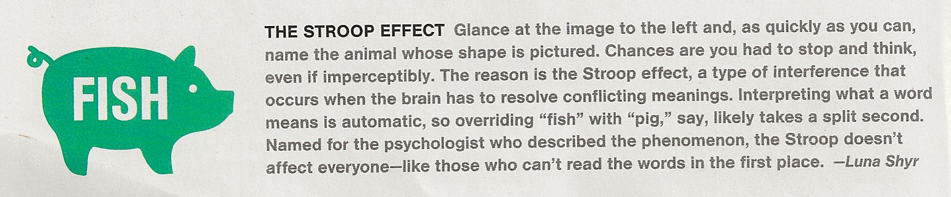
GRA 1111
Graphic Communications Workshop
GRA 1111
Graphic Communications Workshop
The Stroop Effect
National Geographic Magazine August 2011

Slide 34
What is color?
The Stoop Effect!
GRA 1111
Graphic Communications Workshop
Image: National Geographic Society
Notes:
The Stroop effect is the finding that naming the color of the first set of words is easier and quicker than the second.
In psychology, the Stroop effect is a demonstration of interference in the reaction time of a task. When the name of a color (e.g., "blue," "green," or "red") is printed in a color not denoted by the name (e.g., the word "red" printed in blue ink instead of red ink), naming the color of the word takes longer and is more prone to errors than when the color of the ink matches the name of the color. The effect is named after John Ridley Stroop who first published the effect in English in 1935.

Slide 35
Why is color important?
GRA 1111
Graphic Communications Workshop

Slide 36
Why is color important?
  Over 78% of all perceptions are done by eye.
  Over 65% of all purchasing
  decisions involve color.
GRA 1111
Graphic Communications Workshop
Source: Pantone Color Institute

Slide 37
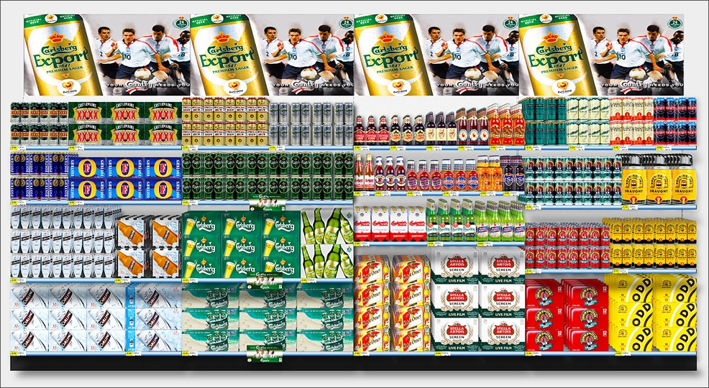
Why is color important?
GRA 1111
Graphic Communications Workshop
Source: ÜBERANGST

Slide 38
What is color?
For the graphic designer, art director, photographer, illustrator and printer color is:
Tool
Underline
Scream
Attention
A visual smack in the face
Bold face type
An action item
Focus
GRA 1111
Graphic Communications Workshop

Slide 39
What color?
GRA 1111
Graphic Communications Workshop

Slide 40




Slide 41
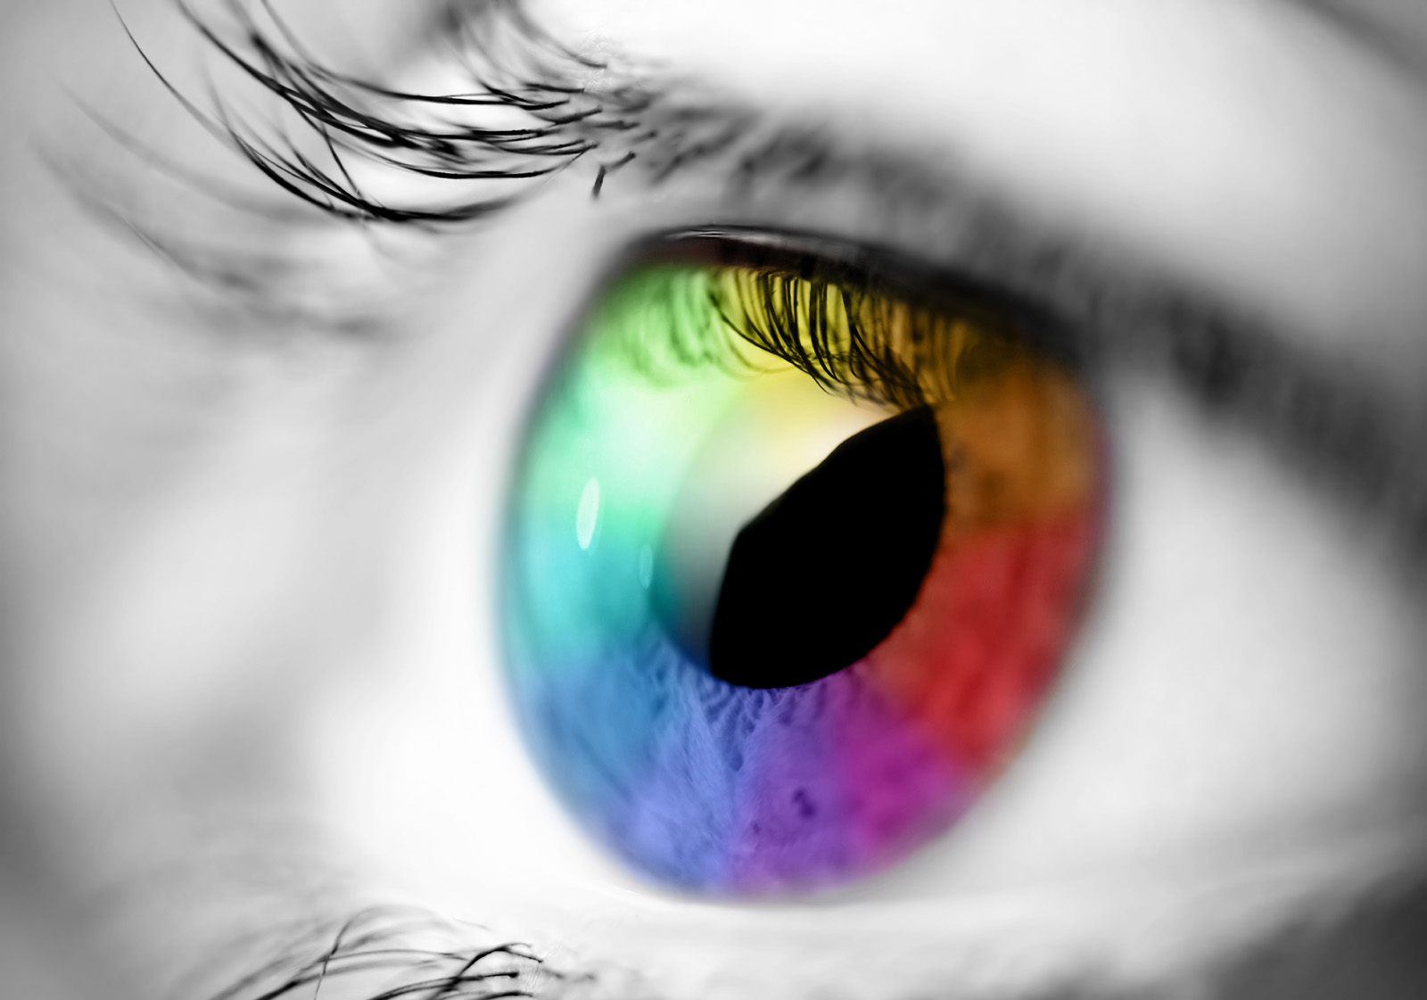
Eye on Color

Slide 42
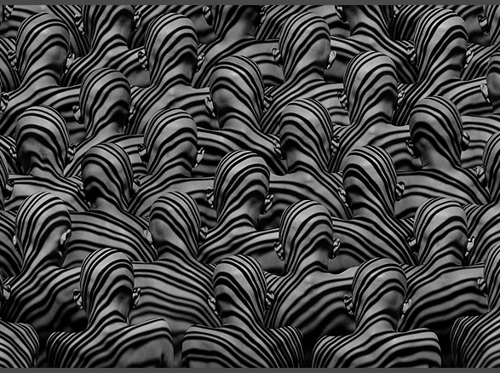
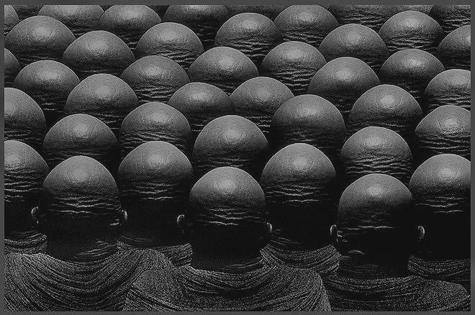
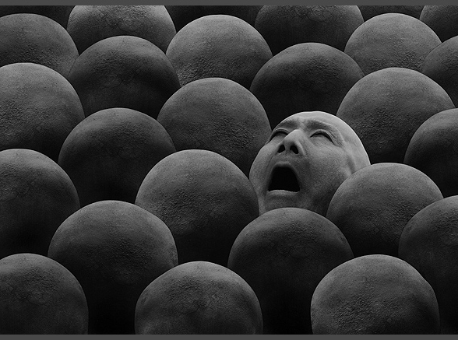
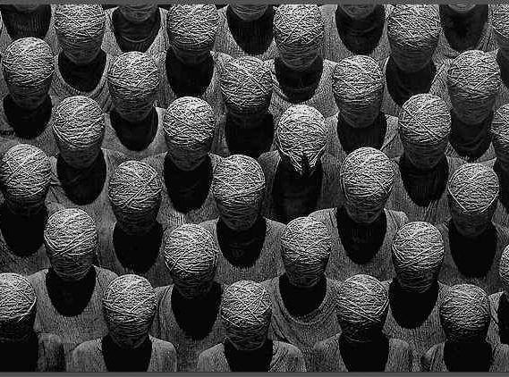
Notes:
Could anyone imagine living in a black and white world?
This is a question I once heard someone ask in a trend presentation and for a split second you try to imagine what the world would look like if there was no color but of course that is not the reality.

Slide 43
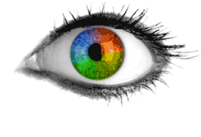

The color of
Ideas
How we see color.
Creating & mixing colors.
Printing colors.
        Spot colors
        Digital colors
Color gamut & spaces
About Pantone colors
Color workflow + Communication

Slide 44
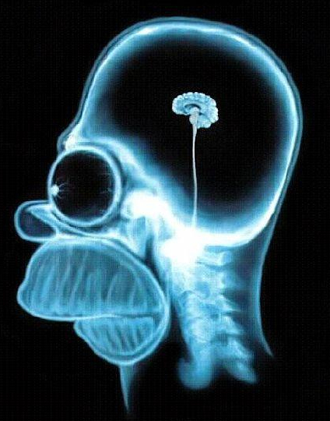
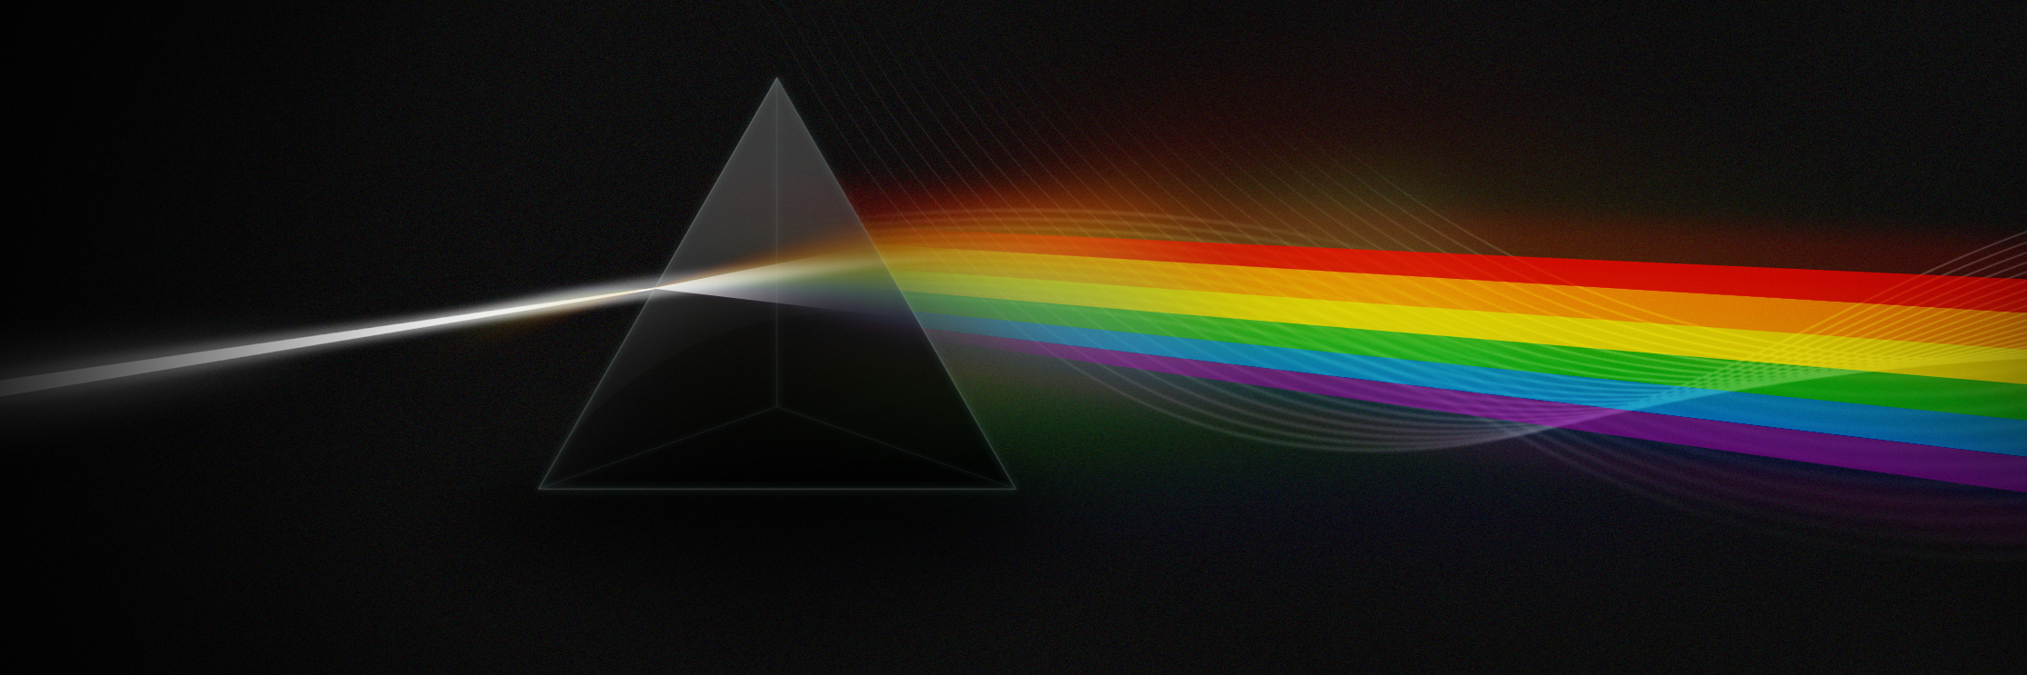

What is
Color?
Color is the byproduct of the spectrum of light, as it is reflected or absorbed, as received by the human eye and processed by the human brain.

Slide 45
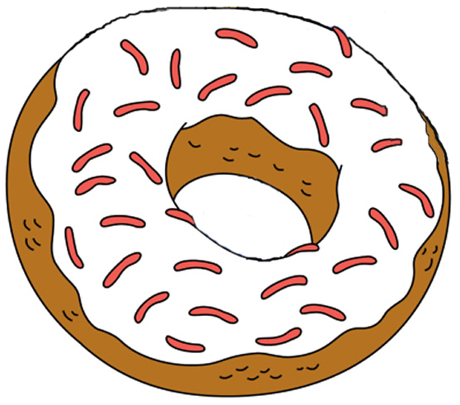
The Human
Visual System.

Slide 46

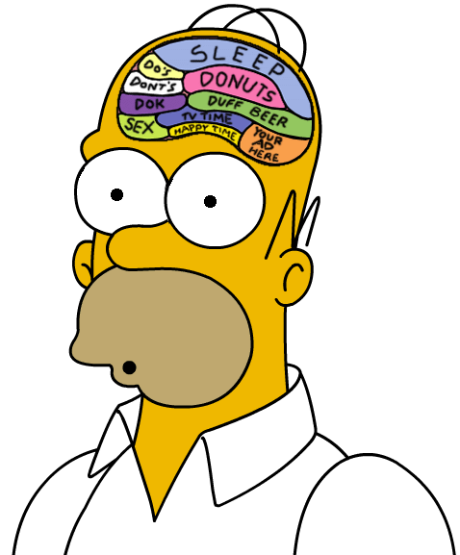

The Human
Visual System.

Slide 47
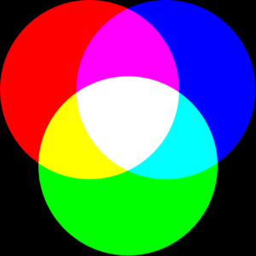
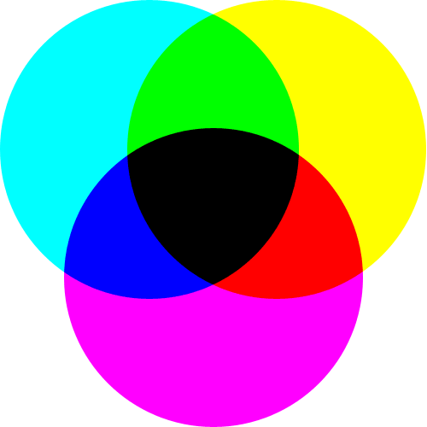
Creating
Color
Additive
There are two ways to create the colors we want. One is based on light, the other on inks.
Subtractive
Notes:
Note Page 65 in the Pocket Pal
Additive colors means when projected or added together they will result in white light.

Slide 48
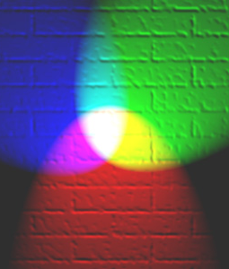
Additive
Color
Additive
Additive color mixing system is used in computer monitors, TV sets, and to illuminate actors on stage.
Notes:
Note Page 65 in the Pocket Pal
Also called RGB
Additive colors means when projected or added together they will result in white light.

Slide 49
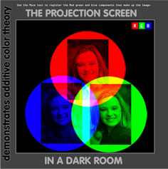
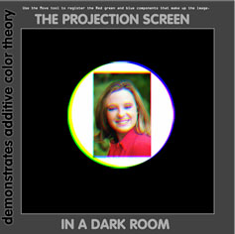
RGB
Color
Each color of the spectrum has a specific frequency. Adding these colors of light together increases the number of frequencies present and the more colors you add the closer it becomes to white.

Slide 50
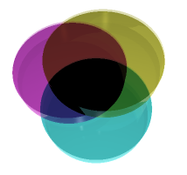
Subtractive
Color
Subtractive
Layers of glass vividly show how semi-transparent layers of color combine on paper into spectrum of CMY colors. K (black) is added in printing because it is more black and for economic reasons.
Notes:
Note Page 65 Pocket Pal
When an additive primary color is subtracted form white a new color results, Cyan, Magenta, Yellow are Subtractive colors
Black is added for shadows and to provide deep tones

Slide 51
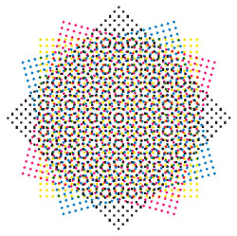
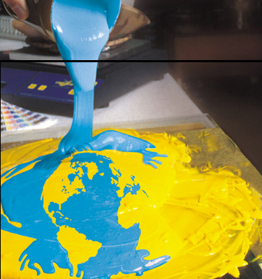
Spot :: Process
Color
Solid Mixed
Digital Screen

Slide 52
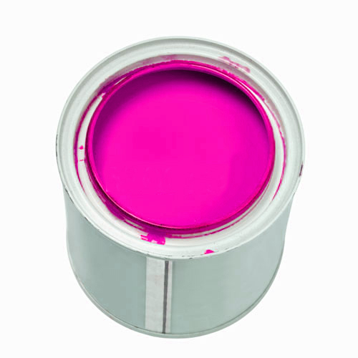
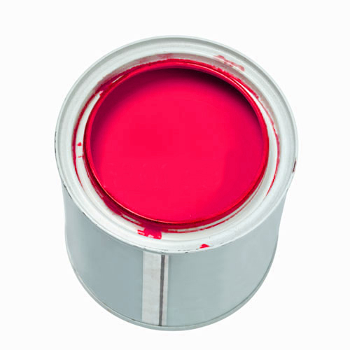
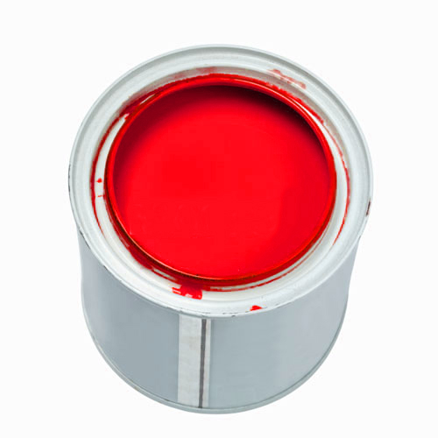
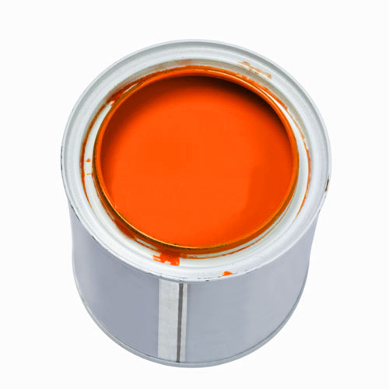

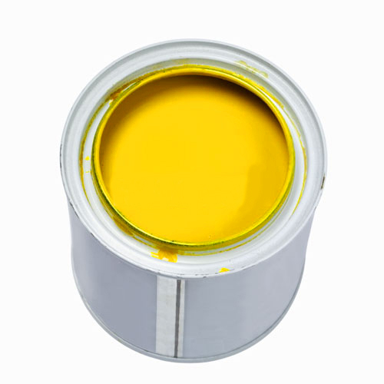
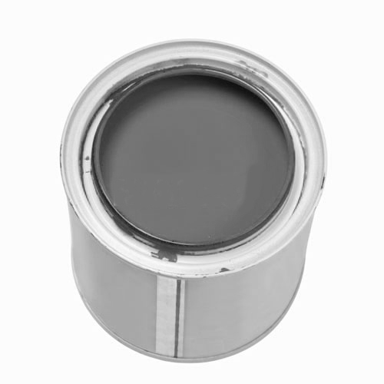
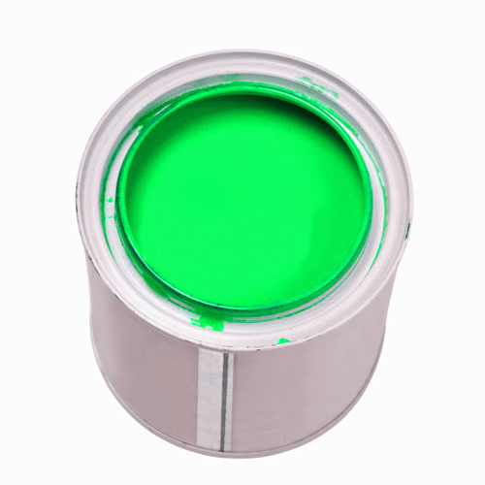
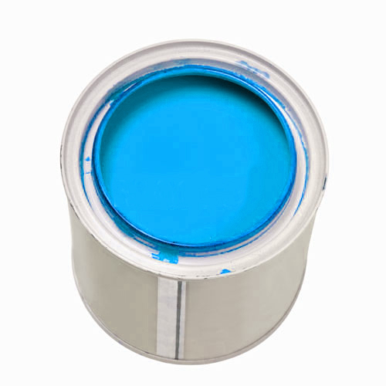
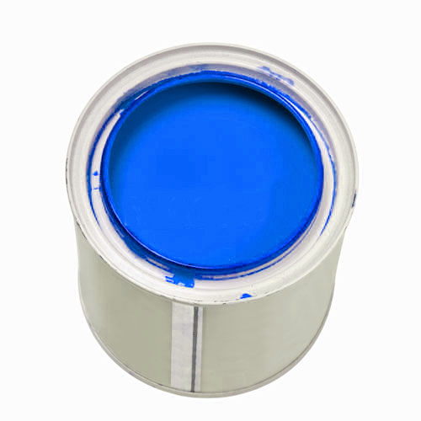
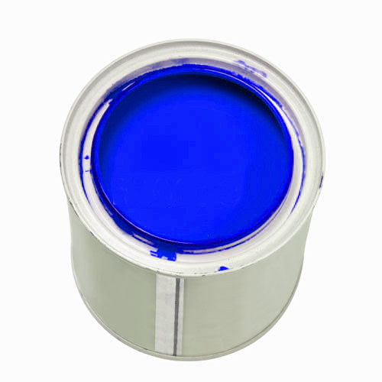
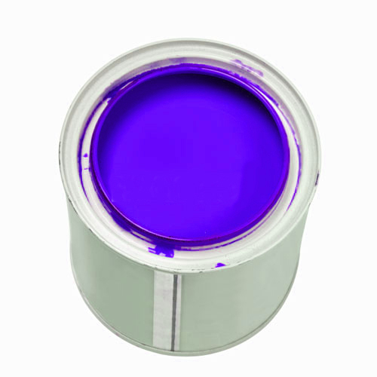
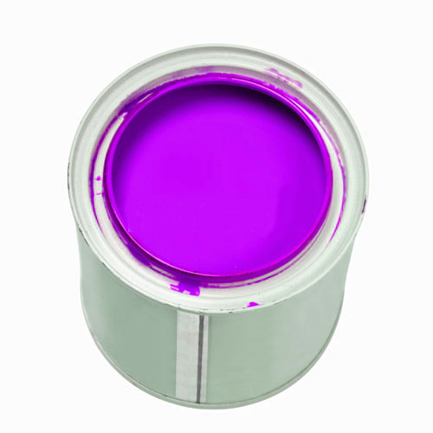
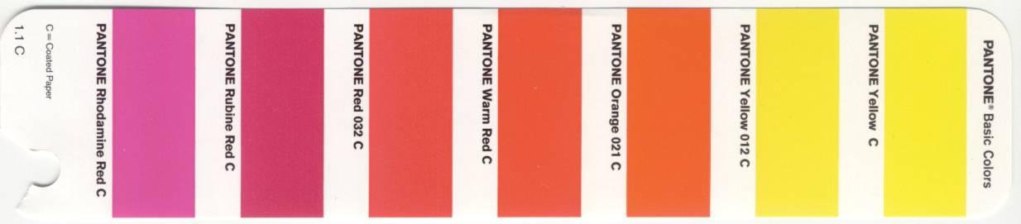
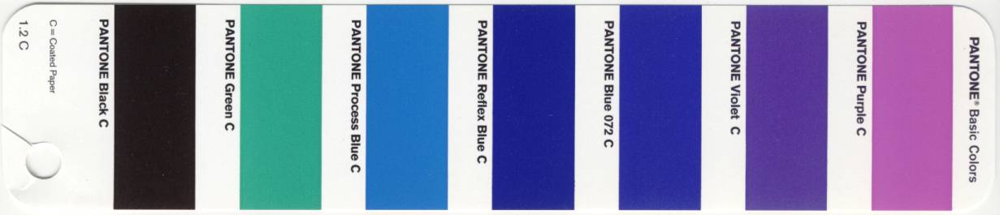
Spot
Color.

Slide 53

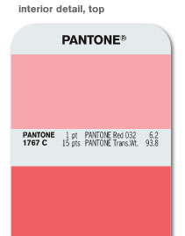
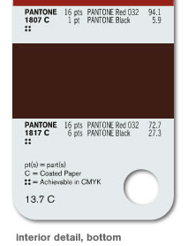
Spot
Color.
u
Color #
Mixing formula in parts & weight
v
Achievable in CMYK identifier
w
u
v
FORMULA GUIDE
/solid coated
w

Slide 54
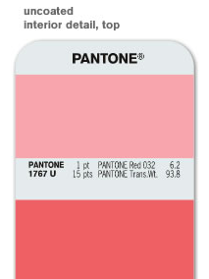
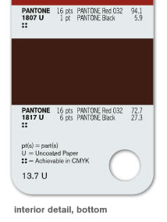
Spot
Color.
u
Color #
Mixing formula in parts & weight
v
Achievable in CMYK identifier
w
u
v
w
FORMULA GUIDE
/solid uncoated

Slide 55


Spot
Color.
u
Color #
Mixing formula in parts & weight
v
Achievable in CMYK identifier
w
u
v
w
FORMULA GUIDE
/solid matte

Slide 56


Spot
Color.
u
Color #
Mixing formula in parts & weight
v
Achievable in CMYK identifier
w
u
v
TINTS
/coated
w

Slide 57


Spot
Color.
u
Color #
Mixing formula in parts & weight
v
Achievable in CMYK identifier
w
u
v
TINTS
/uncoated
w

Slide 58

Spot
Color.
u
Color #
Mixing formula in parts & weight
v
Achievable in CMYK identifier
w
u
v
COLOR BRIDGE
/coated
w

Slide 59
Spot
Color.
COLOR BRIDGE
/uncoated

Slide 60

Process
Color
In offset lithography, the density of CMYK inks can not be varied in continuous fashion across an image, so a range is produced by means of halftoning.

Slide 61

Process
Color
When printed, the overlapped dots of the colors reproduce the full color image.

Slide 62


Slide 63


CMYK
Color.
u
Color #
Mixing formula in parts & weight
v
Achievable in CMYK identifier
w
u
v
4 COLOR
PROCESS GUIDE
/coated
w

Slide 64
CMYK
Color.
u
Color #
Mixing formula in
parts & weight
v
Achievable in
CMYK identifier
w
u
v
4 COLOR
PROCESS GUIDE
/uncoated
w

Slide 65


CMYK
Color.
u
Color #
Mixing formula in parts & weight
v
Achievable in CMYK identifier
w
u
v
4 COLOR
PROCESS GUIDE
/coated euro
w

Slide 66



Xerox digital chips

Slide 67

Color
Gamut
When working with digital images, we use color models to describe these colors. There are a number of them and each use a different way of describing colors.

Slide 68
u
rgb work space
v
Adobe rgb space
w
Srgb space
x
CMYK ink space
y
xxx
Hexachrome® ink space

Slide 69

PANTONE
HEXACHROME®

Slide 70


Slide 71

Viewing
Color

Slide 72
Viewing
Color
In offset lithography, the density of CMYK inks can not be varied in continuous fashion across an image, so a range is produced by means of halftoning.

Slide 73





Slide 74

Identify
Color.
COLOR CUE 2

Slide 75

Calibrate
Color.
i1 display 2

Slide 76

Calibrate
Color.
ColorMunki
Design

Slide 77

Calibrate
Color.
huey

Slide 78


Slide 79


Slide 80


Slide 81


Slide 82




Textile
Color.
FASHION + HOME
/guide

Slide 83





Plastics
Color.
Opaque + transparent

Slide 84



Color
Forecasting.
Design direction updated every season,
color palettes, signature prints, and trends

Slide 85




Color
Knowledge.
Books on color psychology, usage, color palettes and trends.

Slide 86
Color
Workflow.
CREATE
ASSEMBLE
DELIVER
OUTPUT
Understanding the process.

Slide 87


CREATE

Slide 88



CREATE

Slide 89

CREATE

Slide 90

CREATE

Slide 91


ASSEMBLE

Slide 92









DELIVER
Understanding the process.

Slide 93




OUTPUT
Understanding the process.
Xerox iGen3™ - Digital Press
Xerox – Color Printers
Agfa – Imagesetters
Epson – Wide format Printers

Slide 94


OUTPUT
Understanding the process.
Heidelberg - Offset Press

Slide 95

dorisbrown.info

Slide 96

Color Spaces
Gradation
of the Color
Spaces:
Visible Space
Screen
PANTONE®
Print

Slide 97
Printed Color?
GRA 1111
Graphic Communications Workshop

Slide 98



Simulation of continuous tone color
Setting the angle of the halftone screens
differently, creates the the illusion of
continuous tone color.

Slide 99

Simulation of multiple tones of color
Using halftone screens to create the percentage of each primary color and overprinting we achieve not only grey, but also the simulation of multiple tones of color.

Slide 100



Slide 101
Risks in Color Evaluation
by a Human Being
+ Wrong/insufficient light source
+ No color memory
+ Every person has a different perception
+ 8% of males have defective color vision, 0.4% of females
+ Color perception is affection by surrounding colors

Slide 102




Next Problem:
Color Communication
I’m thinking pale pink. Not too red.
With a hint of blue. And a bit flirty but
sophisticated.”
“Understand.”

Slide 103

The PANTONE PLUS Series
The Next Generation of the
PANTONE MATCHING SYSTEM®

Slide 104

The PANTONE PLUS Series
Gives designers what they’ve been asking for:
  More colors

Slide 105

The PANTONE PLUS Series
Gives designers what they’ve been asking for:
  More colors
  Chromatic arrangement
  Provides more intuitive
  color selection!

Slide 106

The PANTONE PLUS Series
Gives designers what they’ve been asking for:
  More colors
  Chromatic arrangement
  Digital tools
  COLOR MANAGER SOFTWARE

Slide 107


The PANTONE PLUS Series
Gives designers what they’ve been asking for:
  More colors
  Chromatic arrangement
  Digital tools
  iPhone® applications

Slide 108


The PANTONE PLUS Series
Gives designers what they’ve been asking for:
  More colors
  Chromatic arrangement
  Digital tools
  iPhone® applications
  Text-weight stock

Slide 109

The PANTONE PLUS Series
Gives designers what they’ve been asking for:
  More colors
  Chromatic arrangement
  Digital tools
  iPhone® applications
  Text-weight stock
  Retains
  PANTONE MATCHING SYSTEM
  Color standards

Slide 110

336 NEW COLORS!

Slide 111

336 New Colors
We are pleased to announce that 336 New Solid Colors will be added to the PANTONE PLUS SERIES on April 24, 2012.
The 336 New Colors enrich the current PLUS SERIES palette, providing a more comprehensive selection.
All color families were extended to include a wider variety of values, saturation and undertones – from subtle pastels and reliable mid-tones to the intensity of the deep tones, vivid brights and vital, nuanced neutrals.
The New Colors were inspired by the PANTONE Goe™ System and add depth and breadth to the PLUS SERIES Color Library with fresh hues that did not previously exist.

Slide 112

336 New Colors Technical Notes
The new colors have the same numbering format as previous PANTONE MATCHING SYSTEM Colors.
Numbers range from 2001 to 2336
The New Colors have been formulated using the existing 14 PANTONE MATCHING SYSTEM Basic Inks. Some new colors have been formulated using up to 4 existing Goe Basic Inks.
All inks are readily available from PANTONE INK Licensees worldwide.
New colors were printed with uniform ink film thicknesses for easy matching on press (1.3g/M² for coated, 1.6g/M² for uncoated).

Slide 113

336 New Colors Solution Updates
PANTONE COLOR MANAGER SOFTWARE will be updated by May 4. This software will easily allow users to update their existing design applications (Adobe, Quark, etc.).
The myPANTONE iPhone and Android app will be updated by early June.
CAPSURE will be update with the new colors by end of May.
ALL these updates will be provided free of charge for existing owners.

Slide 114
COLOR MANAGER
A robust desktop application that updates all of the PANTONE Libraries – more than 9,000 colors in all – and makes them ready to use in QuarkXPress®, Corel® and Adobe® Creative Suite®.

Slide 115
COLOR MANAGER
Automatically updates all PANTONE Color Libraries – and keeps them up to date
Uses PANTONE PLUS Color Bridge values
Builds ICC profile-based device-specific CMYK recipes for any PANTONE Graphics library
Simulates and helps you visualize spot vs. 4-color process
Provides display and print gamut warnings
Synchronizes spot color values to design applications

Slide 116


CAPSURE™
Captures color inspiration from any surface, material or fabric – even small, patterned, multi-colored textures and textiles – and matches it quickly and accurately to a PANTONE Color.

Slide 117
CAPSURE™
CAPSURE comes preloaded with more than 8,000 PANTONE Colors:
The PANTONE FASHION + HOME Color System Library (paper and cotton) for fashion and home
The PANTONE PAINT + INTERIORS Library (paper and cotton) for architecture and interiors
The PANTONE PLUS SERIES Formula Guide (coated and uncoated), the PANTONE PLUS SERIES CMYK (coated and uncoated) and the PANTONE Goe™ System (coated and uncoated) for graphic design, printing and publishing (includes sRGB, Adobe RGB, HTML, Lab and XYZ values for multimedia design)

Slide 118
CAPSURE™
Features
Stores up to 100 color captures
Toggles easily across multiple PANTONE Libraries
Synchronizes with popular design applications, including Adobe® Photoshop®, Adobe Illustrator® and QuarkXPress®
Automatically updates color libraries through CAPSURE Sync
Compact and lightweight – weighs just six ounces (with battery)
Annotates colors with a voice recording and time-and-date stamp
Large 1.75 inch-color viewing screen
Provides harmonious shades and identifies related colors
Powered by a lightweight rechargeable lithium battery

Slide 119
CAPSURE™
Benefits
Saves time and money by efficiently matching virtually any surface to a PANTONE Color
Extracts, displays and matches up to four dominant colors from an intricate pattern
Allows you to create palettes of favorite shades or customize palettes for specific projects
Provides unsurpassed accuracy through advanced illumination and capture technology
Compensates for gloss and surface variations
Ensures accuracy through real-time onscreen preview
Cross-matches any material or surface
Lasts for thousands of measurements on a single charge

Slide 120




Automated Color Picking
Preview
Measure
Pick
Harmonize
Color detail
Save

Slide 121


Palette Application Software
Retrieve saved colors and voice tags from the device.
Accurately visualize colors and create palettes.
View color harmonies.
Synchronize palettes with popular design applications including Adobe® Photoshop®, Adobe Illustrator® and QuarkXPress®.

Slide 122

CAPSURE Sync Tool
Automatically keeps the device up to date with new color collections
  New color ranges
  Specialty collections
  Trend palettes
  Ability to update color schemes, add new color libraries

Slide 123
Corporate ID Program
Maintains the integrity of a company’s corporate colors (critical in establishing brand identity)
Uniquely geared toward benchmarking company colors
Commonly used to show standards for corporate identity, product color and packaging standards

Slide 124
Corporate ID Program

Slide 125




Corporate ID Program

Slide 126





Corporate ID Program

Slide 127
http://www.pantoneview.com

Slide 128
Sources?
Pantone.com
SAPPI.com - Press check
Printing.org = Designing for Success in Prepress
Printing.org – 10 Steps to Successful Press Oks
www.hutchcolor.com
www.idealliance.org
GRA 1111
Graphic Communications Workshop

Slide 129
Printed Color?
Back Table!
Process Color CMYK, plus the fifth color
PMS Chips/Samples
Print Samples
GRA 1111
Graphic Communications Workshop

Slide 130


Slide 131


Slide 132


Slide 133
Posters
http://idealliance.org/
GA 1209
Impositions, Plates & Proofs

Slide 134
Color Management
A system for ensuring that colors remain the same regardless of the device or medium used to display the colors. This is extremely difficult because different devices use different technologies and models to produce colors. In addition, color is highly subjective. The same colors look different to different people.
GA 1209
Impositions, Plates & Proofs

Slide 135

What is a Halftone Screen?
AM Screening

Slide 136

Amplitude (size) Modulated (altered) Screening
Dots per inch, angled to reduce the visibility of the pattern,
normal angle for a single color is 45 degrees

Slide 138
Simulation of multiple tones of color
Using halftone screens to create the percentage of each primary color and overprinting we achieve not only grey, but also the simulation of multiple tones of color.

Slide 139
Simulation of continuous tone color
Setting the angle of the halftone screens
differently, creates the the illusion of
continuous tone color.

Slide 140
Digital Halftone Imaging
http://www.hpl.hp.com/research/isl/halftoning/index.html
Introduced in the 1970’s
Built using pixels (picture elements)
Often called bitmap images
8 bit grayscale has 256 levels of tone
Measured by dots per inch

Slide 141

Digital Halftone Imaging
The FM Screen
AKA stochastic or frequency modulated screening.
The dot size is constant and varies the number of dots.
http://www.professionalprinting.com/fm-and-am-screening-comparison/

Slide 142


Digital Halftone Imaging
The FM Screen
Measured in microns not dots.

Slide 143
Reproduction Guidelines
35-micron screen used for newspapers
75 line screen for newspapers (AM)
10-micron screen used for sheet fed printing
150 line screen for higher quality printing (AM)

Slide 144





Digital Halftone Imaging
Dot gain (clockwise)

