Slide 1
INTERNATIONAL DESSERTS
WEEK 13
EASTERN ASIA
SOUTH EASTERN ASIA
Eylin Flores

Slide 2
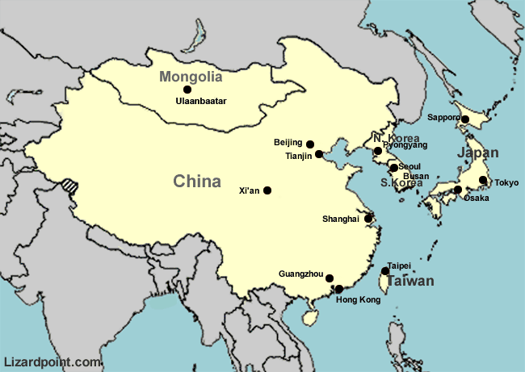
EASTERN ASIA
China
Dem. People’s Rep. of Korea
Hong Kong SAR
Japan
Macao, China
Mongolia
Republic of Korea

Slide 3
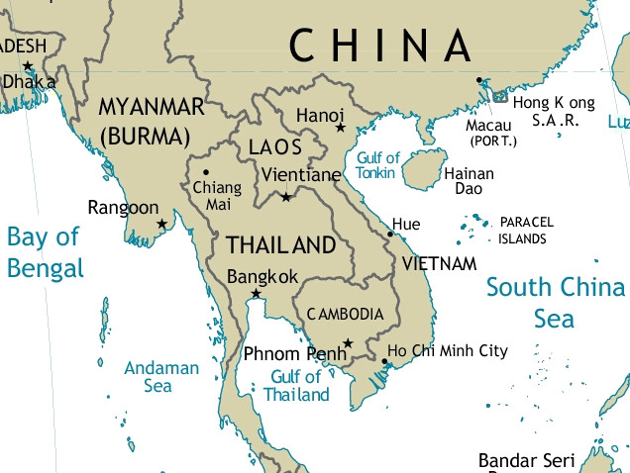
SOUTH EASTERN ASIA
Brunei Darussalam
Cambodia
Indonesia
Lao People’s Democratic Republic
Malaysia
Myanmar
Philippines
Singapore
Thailand
Timor-Leste
Vietnam

Slide 4
Natural Food Sources
Rice**
Vanilla beans
Tropical fruits: mangos, coconuts**, papayas, durians, bananas, rambutan, breadfruit, pineapple
Fish
Meats
Spices: turmeric, peppers, ginger and saffron
Taro
Yams
Notes:
More than ¾ of Southeast Asian population is agri-culture based.
Rice is the staple food throughout the regions.
Fish is consumed twice as much as other meats.

Slide 5
Cultural Influences
China has had the greatest influence on the Asian continent
Spanish – Philippines: flan, adobo, cocido
French bread – Cambodia, Laos, Vietnam
Indian merchants brought Hinduism and Buddhism across the mountains into Laos, Thailand, Malaya, Cambodia, South Vietnam etc. bringing their traditions such as not eating meat.
Spice Trade
Notes:
India and China are the ones who have affected them the most. In southeast Asia, people eat with their hands-on mats. Western influences are the reason why a lot of modern homes use tables, chairs, and utensils. Spice Trade, focused in eastern Indonesia, eventually led to the European colonization and intervention into Southeast Asia. Spices were in great demand in India and China, as well as Europe.

Slide 6
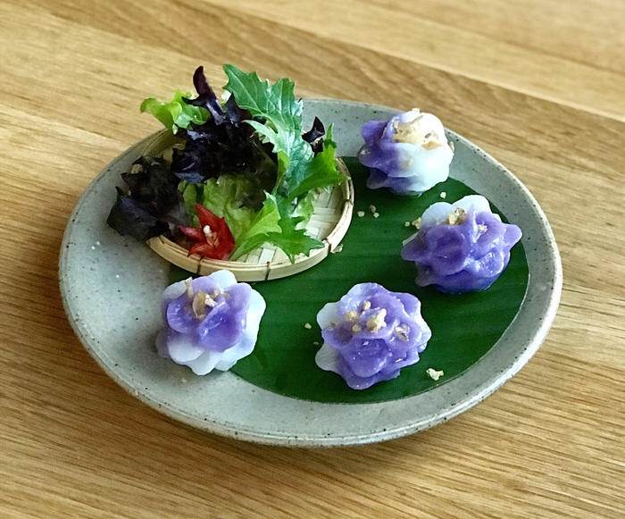
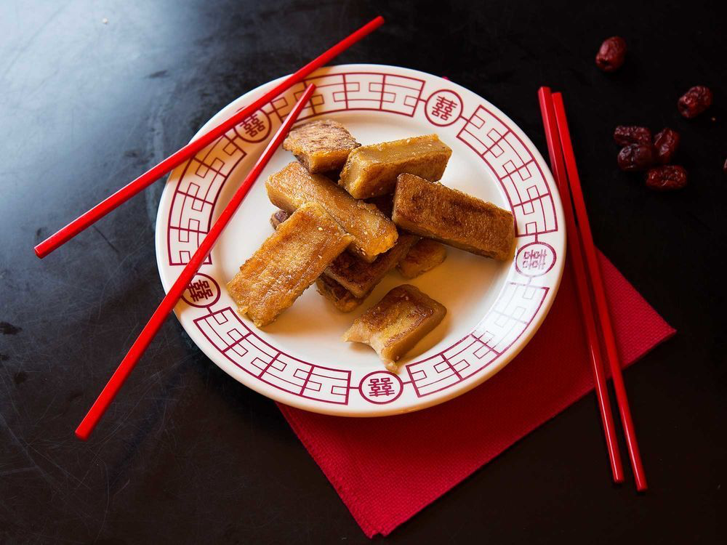
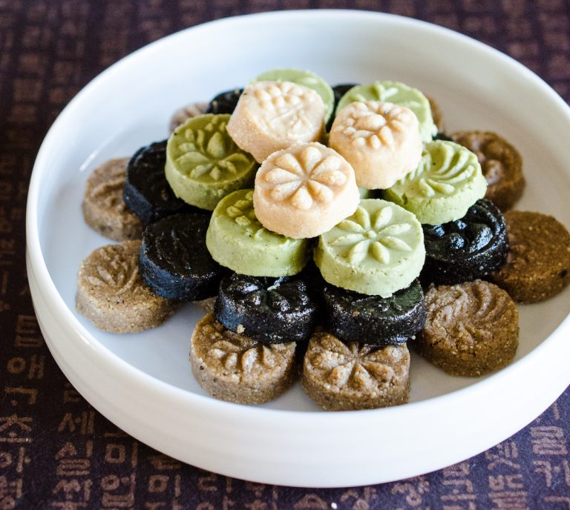
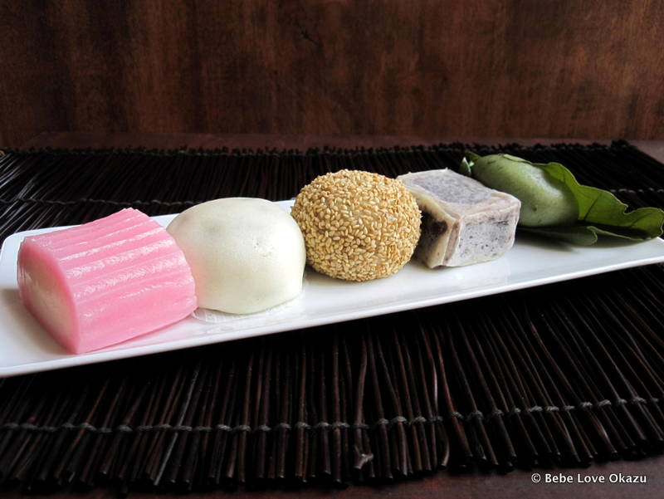
Holiday Items/Dessert Traditions: Lunar New Year
Lunar New Year: Nian Gao, Korean Dasik
Songkran (Thai New Year): Chour mang
Kodomo No Hi (Children’s Day): Chimaki

Slide 7
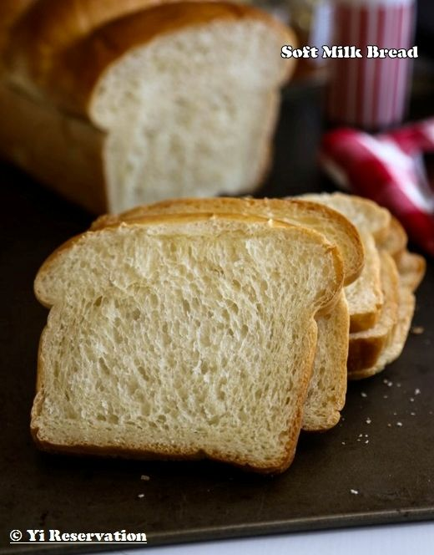
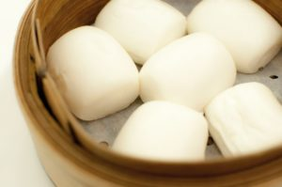
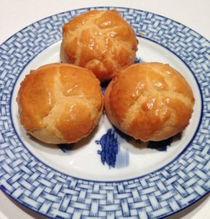
Bread
Po lo bao (Hong Kong)
Chinese Steamed Buns
Hokkaido Milk Loaf
(Japan)
Notes:
Milk loaf: also known as Soft Milk Bread. Light fluffly and melts in your mouth.
Po lo bao: also known as pineapple bun, does not contain or taste like pineapple Usually eaten with butter for breakfast or afternoon tea
Chinese steamed buns: also referred to as Mantou, or if filled they can be called Baozi. Influenced by the mongols. Fillings range from savory to sweet, so they are eaten at anytime, year round.

Slide 8
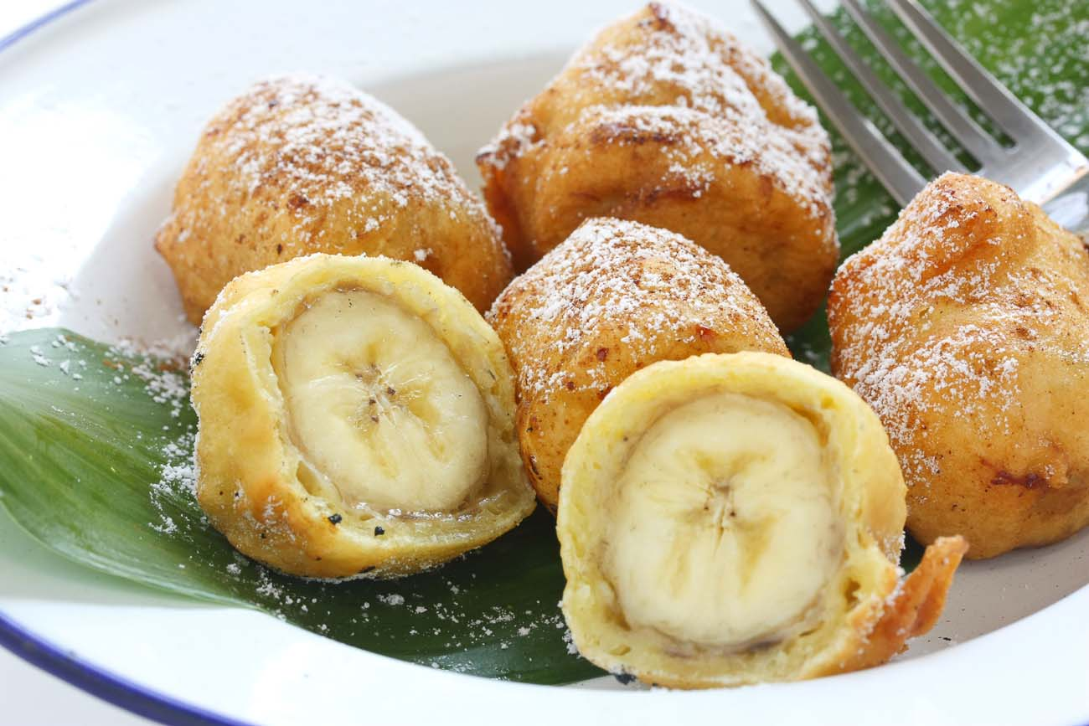
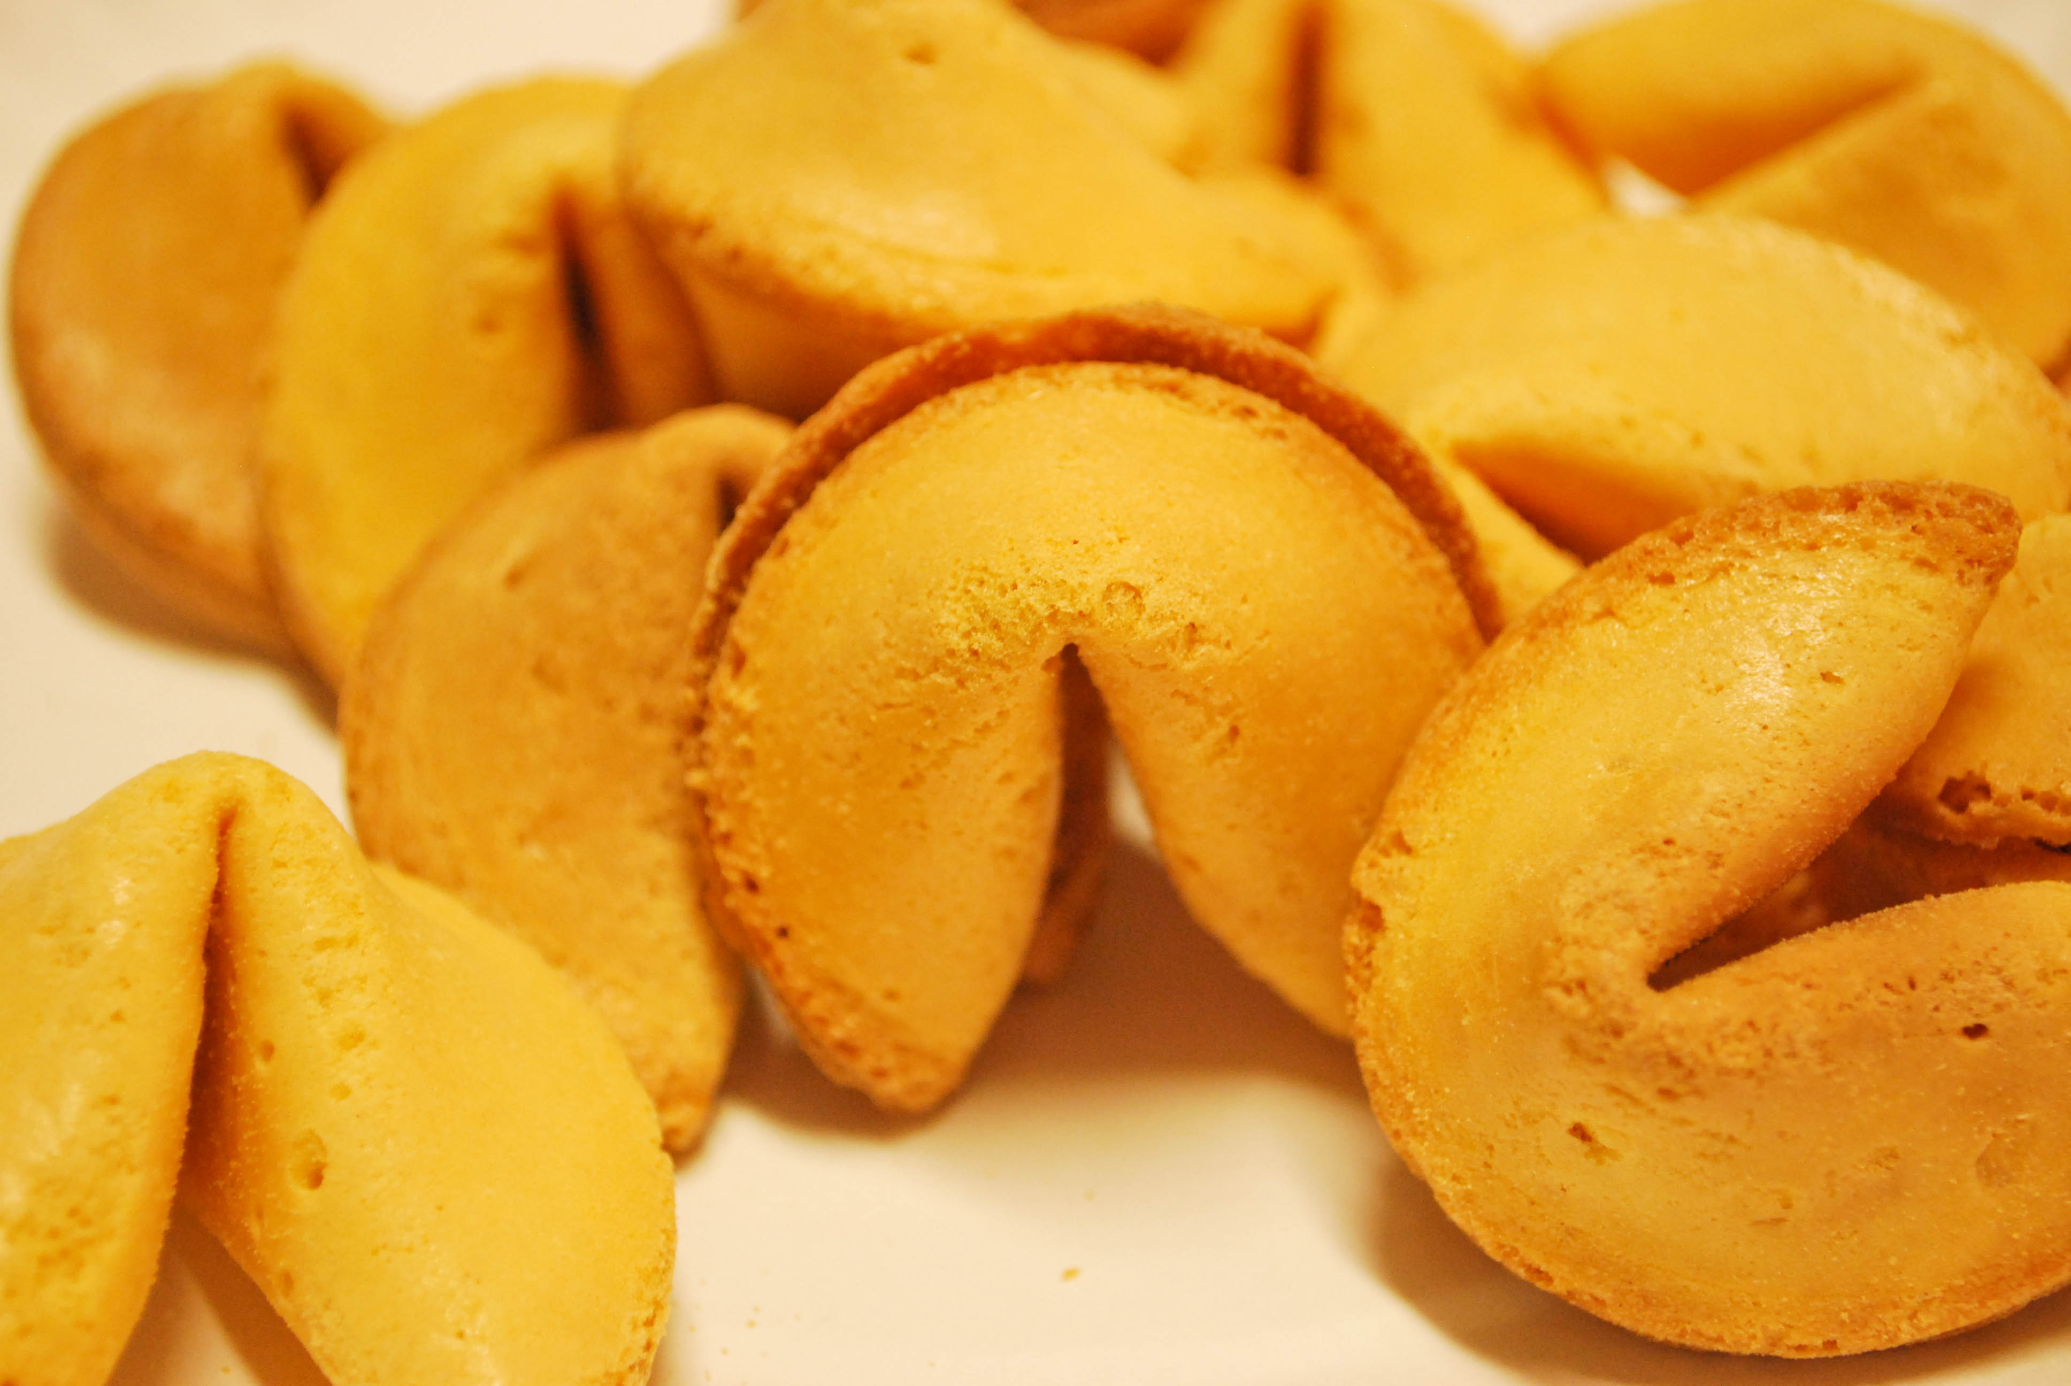
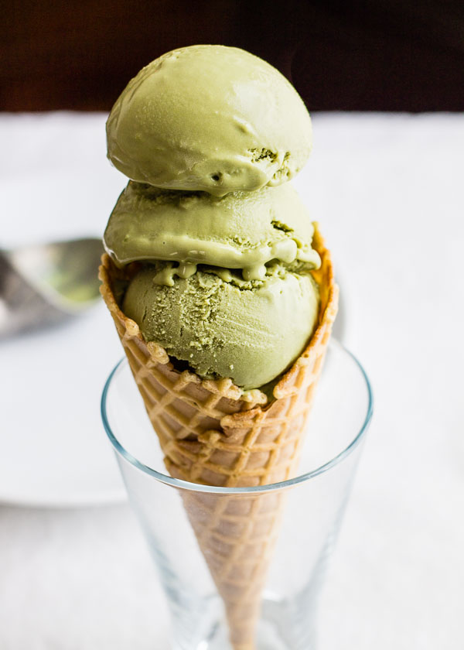
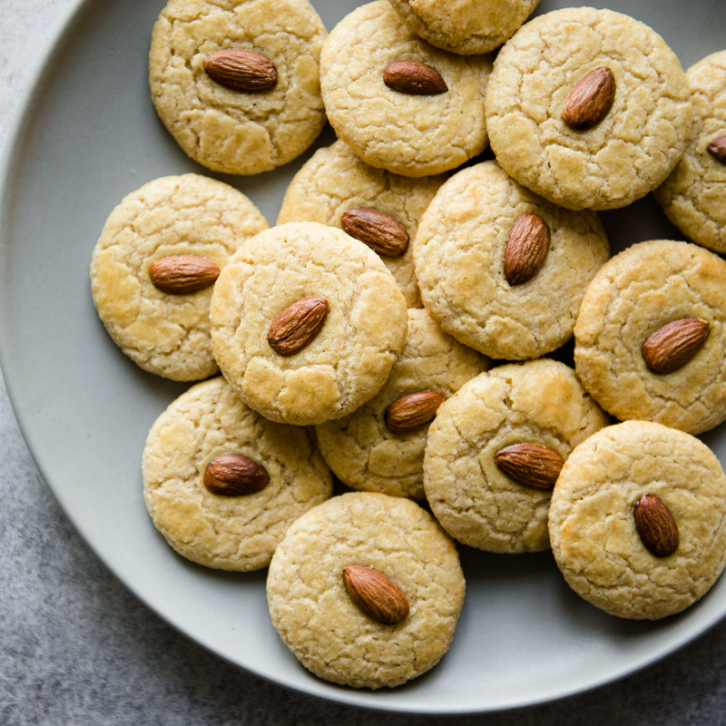
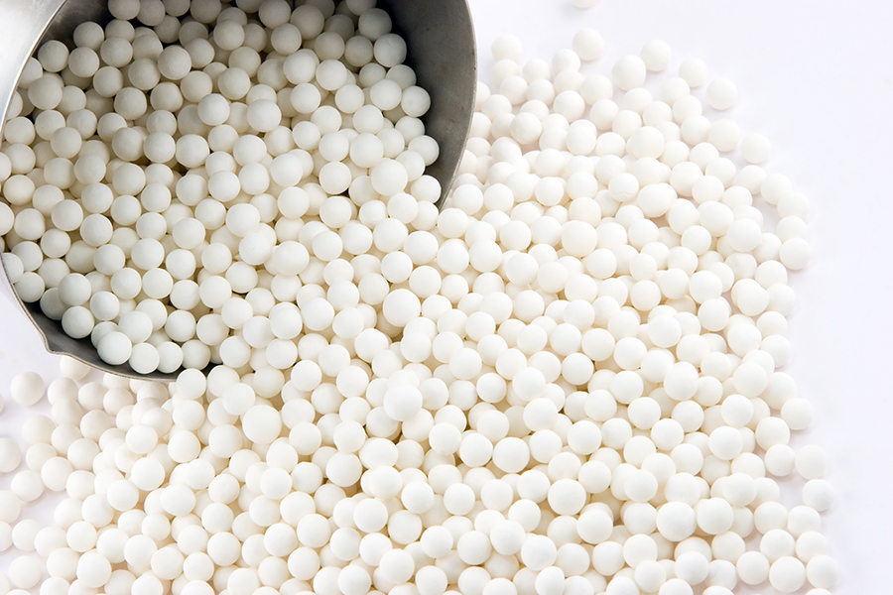
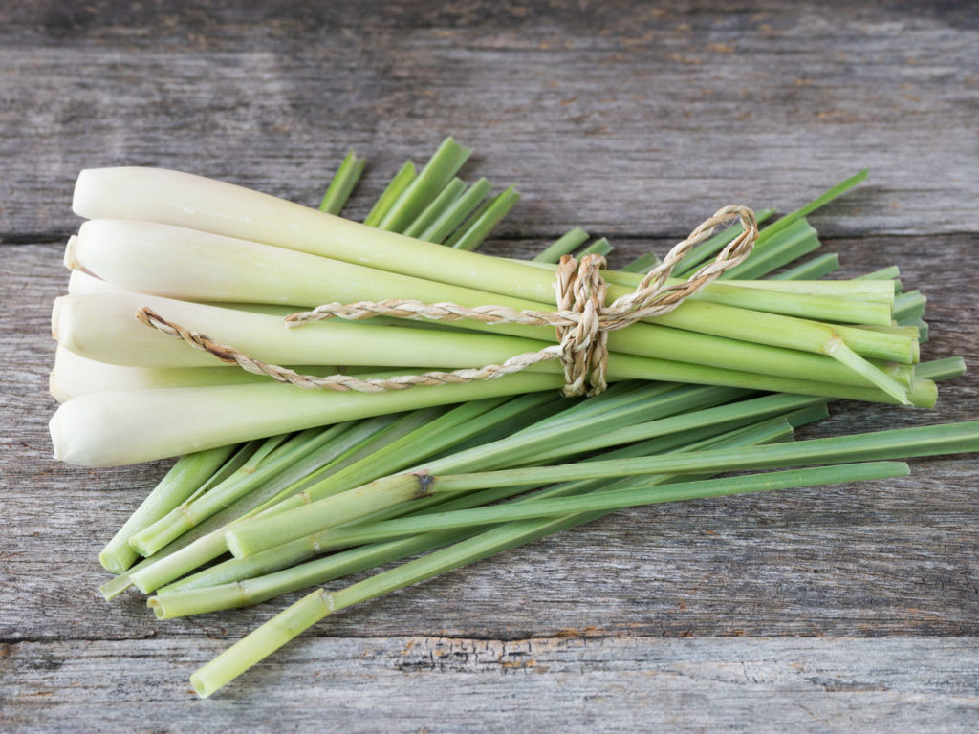
Production for the day
Fun Fact: Fortune Cookies aren’t Chinese
American invention from California
U.S. made them a staple in Chinese restaurants

Slide 9
Reminders
Clean as you go
Follow the proper sanitation rules
Ask for help for anything
Let the steward or I for any needs
Prepare for plating
Don’t touch the rim of the plate
Have fun and enjoy our last day of production!

Slide 10
Sources:
http://japan-guide.com/e/e620.html
https://chinesenewyear.net/desserts/
https://www.fancyfortunecookies.com/Articles.asp?ID=148
https://www.eatbread90.com/traditional-asian-bread-recipe-roundup/
https://kimchimari.com/dasik-korean-tea-cookies-lunar-new-year-sweets/
http://factsanddetails.com/asian/cat62/sub406/entry-2813.html
https://asiasociety.org/education/introduction-southeast-asia
https://www.niu.edu/cseas/_pdf/lesson-plans/k-12/southeast-asian-food-culture.pdf

