Slide 1
Western and South Central
Asia
Week 11~Jodian Burgess

Slide 2
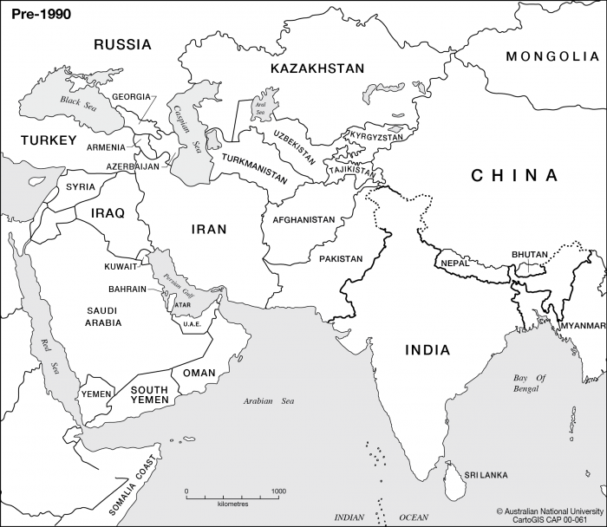
Introduction
The western and South Central Asia region consists of countries like:
India
Sri Lanka
Syria
Pakistan
Afghanistan etc… (Iran, Israel, Saudi Arabia, Turkey, Iraq..)

Slide 3
Most of these countries are considered middle eastern which mean they are in that region (centered on Western Asia).
They all have similar cuisines, however, the food patterns reflect the religions that dominate the lives of those who live there.
The thing they all have in common the most and what they are mainly known for in terms of food are their uses of legumes ( pea family-lentils) and their seasonings/spices and cereals (rice or wheat).

Slide 4
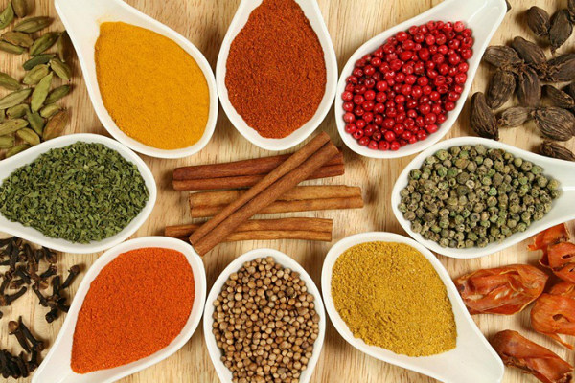
Spices
Garam masala- masala is a blend of spices. Garam masala is a basic blend. It contains; cardamom, cloves, cumin, cinnamon, nutmeg, saffron.
Curry-
Chutney- usually fruits cooked with spices and serves as a decoration for the plate but goes well with curry.

Slide 5
In this cuisine they focus their dishes around what we call sides. Vegetarianism is big in this region so their side dishes are meant to be good enough to stand on their own (meaning without meat):
Naan- whole wheat bread
Samosa- fried pastry with a filling.
Roti
Dal- puree of lentils, spices and other legumes
Rice- usually yellow and seasoned.

Slide 6
This week we’ll be making:
NAME & REGION: Konafa (Knafe in Syria & Lebanon) (Kadaif in Greece and Turkey)
Description: a middle eastern dessert with a base of konafa dessert noodles filled with cheese, baked and then soaked in an orange flavored syrup. It is topped with sprinkled nuts.
2. NAME & REGION: Ras Malai (India)
Description: dumplings made out of chenna (cheese curd), cooked in a sugar syrup, garnished with almonds and pistachio and served with a cardamom and saffron flavored sauce.

Slide 7
3. NAME & REGION: Kulfi (India)
Description: Indian ice cream from the moghuls of
Northern India (we have two variations- cardamom kulfi and a mango kulfi)
Gajjak (sesame crunch)
Made with sesame seeds, butter, sugar and lemon juice
2. Barfi ( a petit four sweet)- thickened milk based
Three variations: -rose water, pistachio and cardamom barfi
-Kajoo (cashew) barfi (this one has rose water as well)
-Badaam barfi ( almond milk fudge)

Slide 8
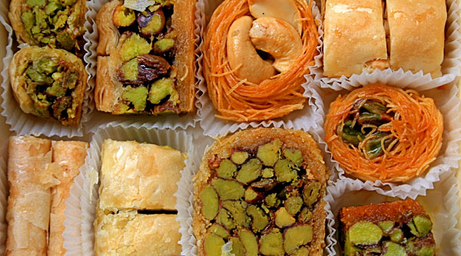
Reminders
~Work together so we can ensure a successful and on time service.
~Pay attention to the time so we can leave
On time.
~Clean after using things.
~Enjoy and have fun!

