Slide 1
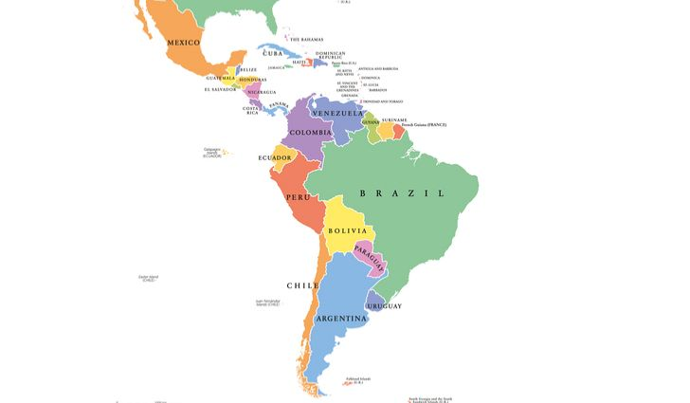
International
Desserts
Week 9
Latin America and Mexico

Slide 2
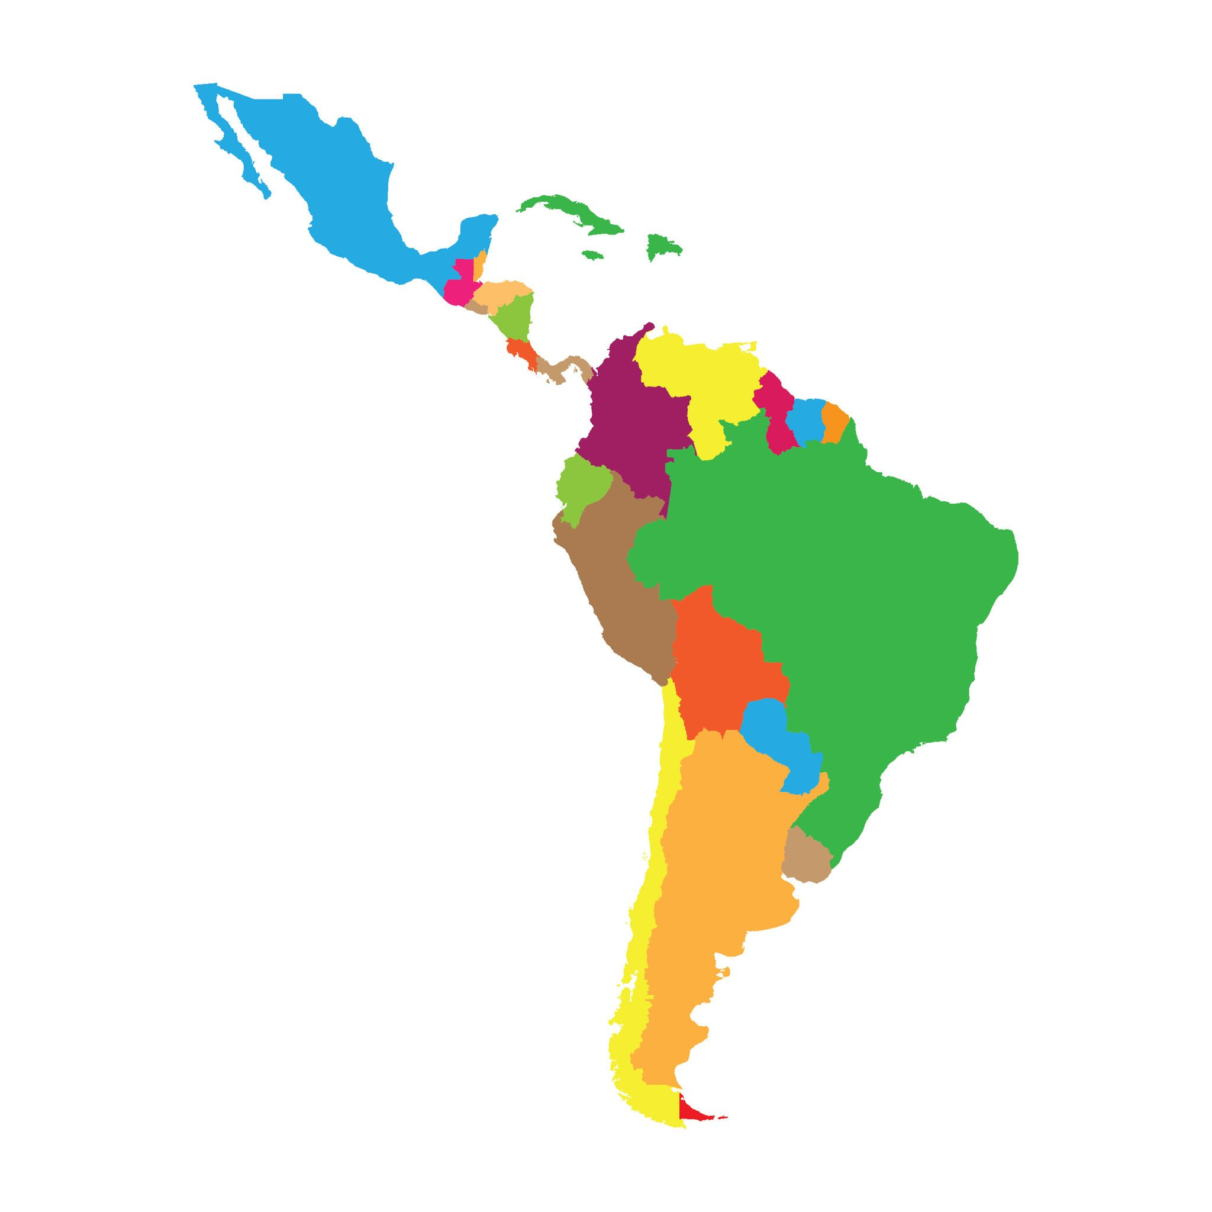
Latin America
North and Central America:
Costa Rica
El Salvador
Guatemala
Honduras
Mexico
Nicaragua
Panama
Belize
South America:
Argentina
Bolivia
Brazil
Chile
Columbia
Ecuador
Peru
Venezuela
Caribbean:
Cuba
Dominican Republic
Haiti
Puerto Rico
Saint Martin

Slide 3
Natural Food Sources
Coffee
Cacao (cocoa)
Rice
Cashews
Brazil Nuts
Avocado
Papaya
Pineapple
Guava
Cape Gooseberry
Tamarind
Dragon Fruit
Passion Fruit
Cassava (yuca)
Chia
Corn
Peppers
Potatoes
Sweet Potato
Tomatillo
Tomatoes

Slide 4
Desserts
Puerto Rico
  Flan: A traditional Puerto Rican dessert with a creamy texture resembling a cheesecake or custard and usually covered in caramel. There are different flavors such as chocolate or coconut but vanilla is the most popular
  Rice Pudding: Rice mixed with either water or milk along with ingredients such as raisins, sugar, cinnamon, vanilla and eggs.
  Coquito: A Puerto Rican beverage made with coconut milk, coconut cream, condensed milk, cinnamon, nutmeg, vanilla and if desired Puerto Rican rum.
Mexico
  Tres Leches: A sponge cake soaked in 3 different kinds of milk; evaporated milk, heavy cream and condensed milk. Sometimes will have fruit in between the layers such as apricots or peaches or as a topping.
  Chocolate Chili Cake: A rich chocolate cake made with ancho chili powder.
Dominican Republic
  Dulce Frio (Dominican Trifle): Made with condensed milk, evaporated milk, egg yolks, vanilla and lady fingers. This trifle is usually topped with meringue (whipped cream if prefered) and fruits which are usually canned.
  Chaca (Cracked Corn Pudding): A delectable yet humble dish of DR. It can be served for either breakfast, lunch, dinner or dessert. Traditionally prepared with dried corn. The skin of the corn is removed and mixed in with hot ashes, ground down in a mortar until the skin becomes loose and finally boiled for a few hours. However, now you can just buy cracked corn.

Slide 5
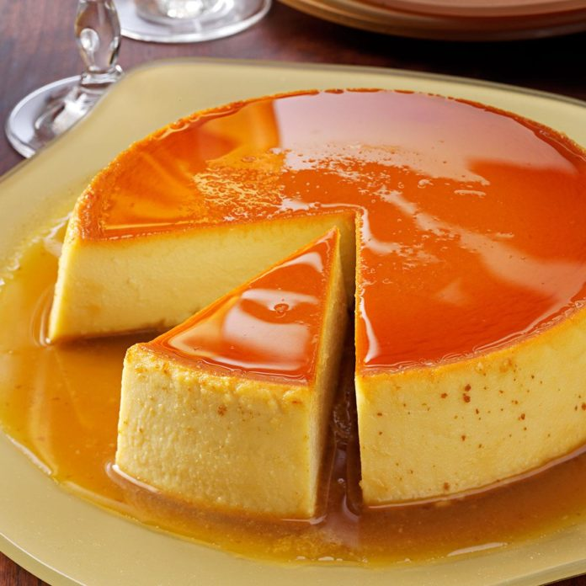
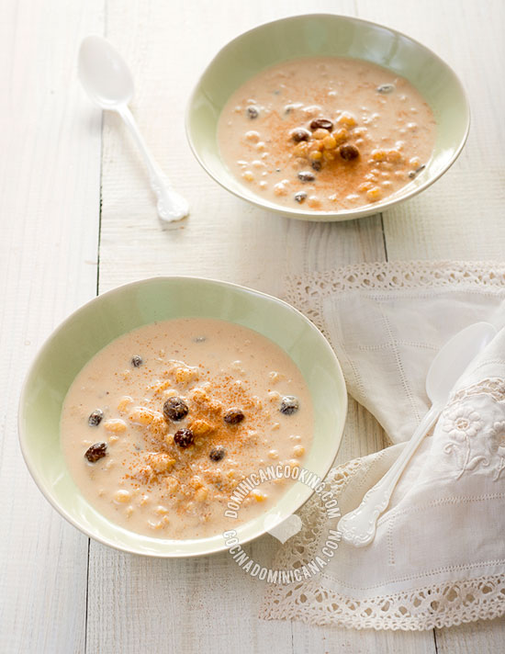
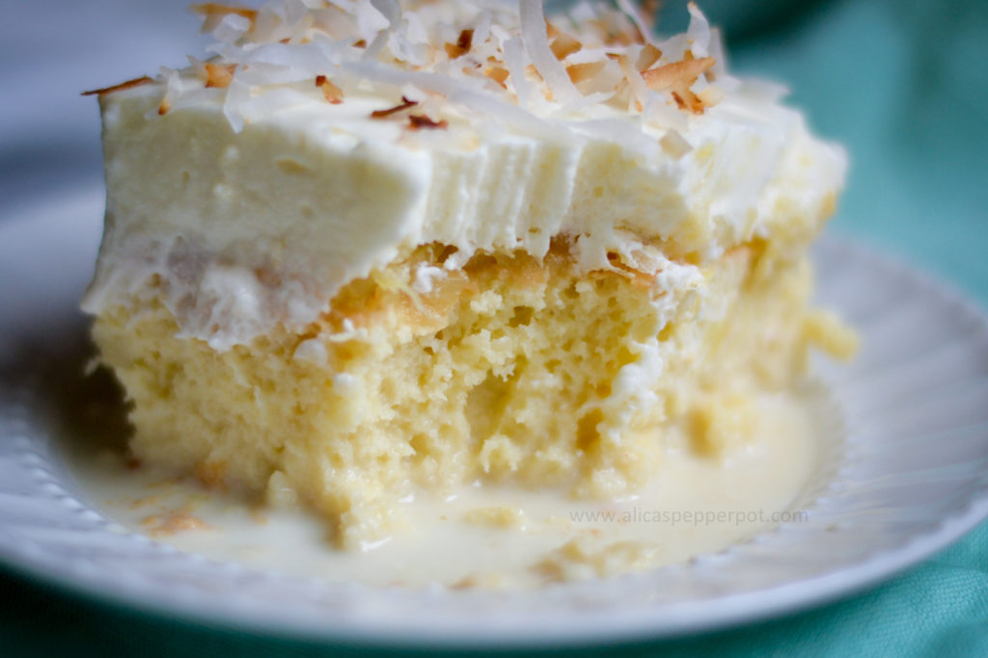
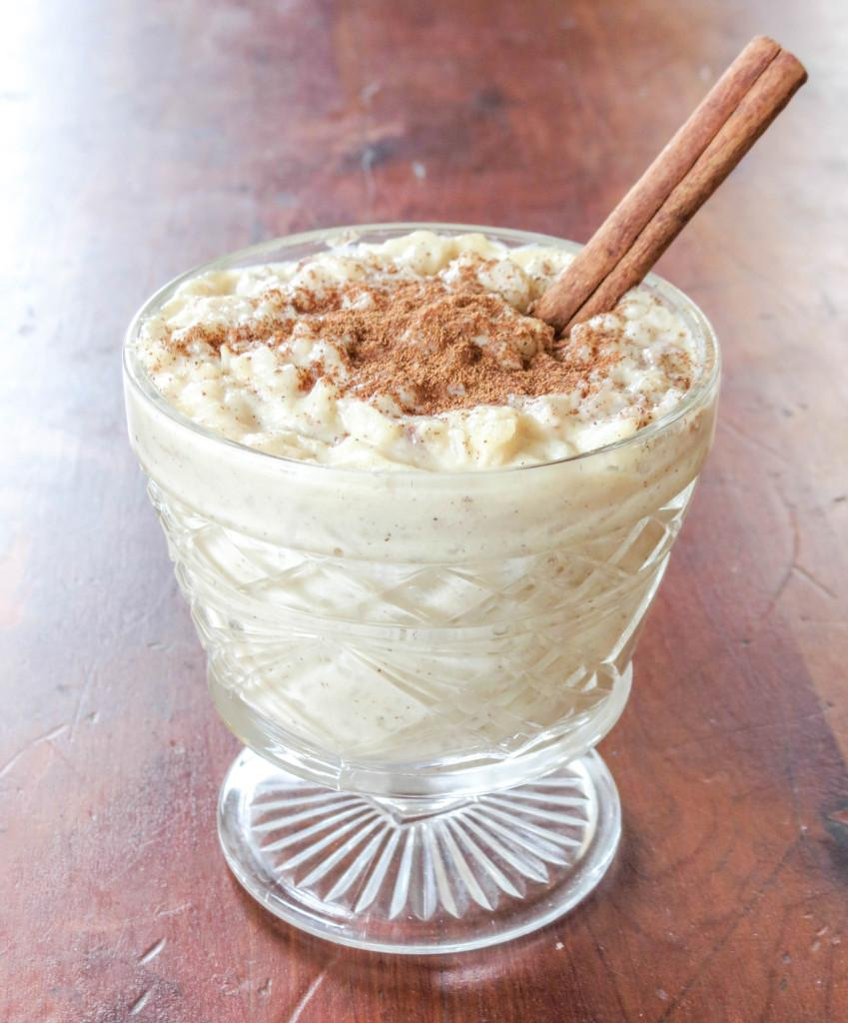
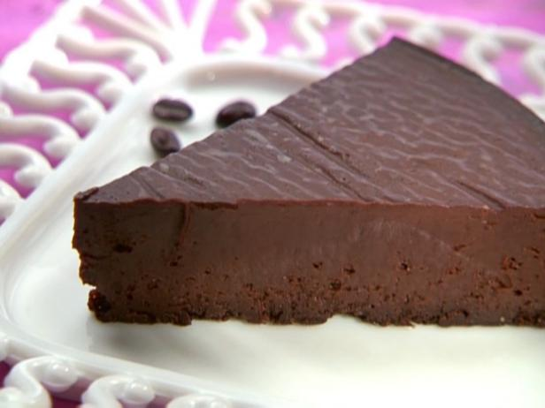
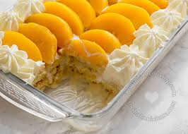
Desserts
FLan
Tres Leches Cake
Chaca
Dulce Frio
Rice Pudding
Chocolate Chili Cake

Slide 6
More Desserts
Cuba
  Flancocho (Flan Cake): A combination of both flan and cake (biscocho). It is made by pouring cake mixture on top of flan mixture and then spread evenly in the cake pan.
  Pastelitos: Small turnovers made with a thin dough, similar to pasta and fried. For a sweeter treat the inside can contain cream cheese and guava paste or for a savory snack it can be filled with beef like an empanada.
Jamaica
  Gizzada: also popular in portugal, this pastry is a tart with a pinched crust, filled with a sweet and spicy coconut filling.
  Coconut Toto Cake: A simple and delicious spiced cake made with coconut milk, brown sugar, flour and spices. It can be eaten hot or room temperature for a snack or dessert.
El Salvador
  Quesadilla Salvadorena: Cake made with queso fresco cheese, milk, flour, butter and eggs. Texture resembles pound cake and can be had with coffee in the morning.
Haiti
  Pain Patate (Potato Bread): Also called sweet potato pudding, a rich dessert made from different spices. Requires a lot of patience to make.

Slide 7
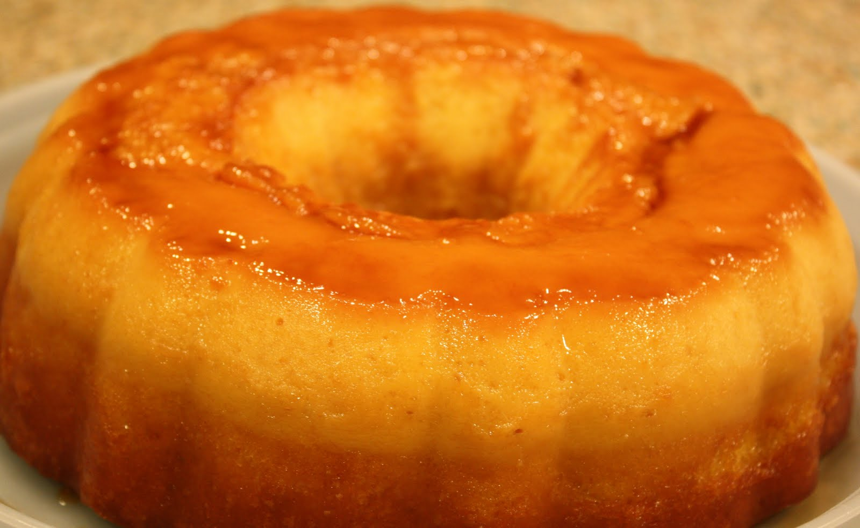
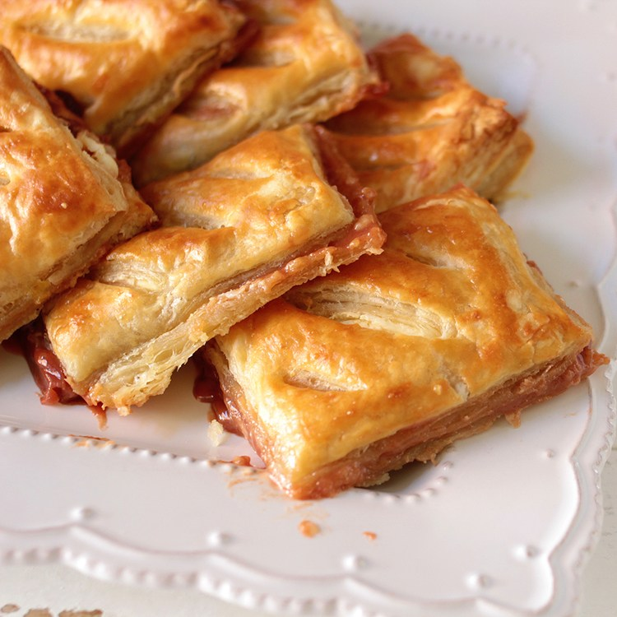
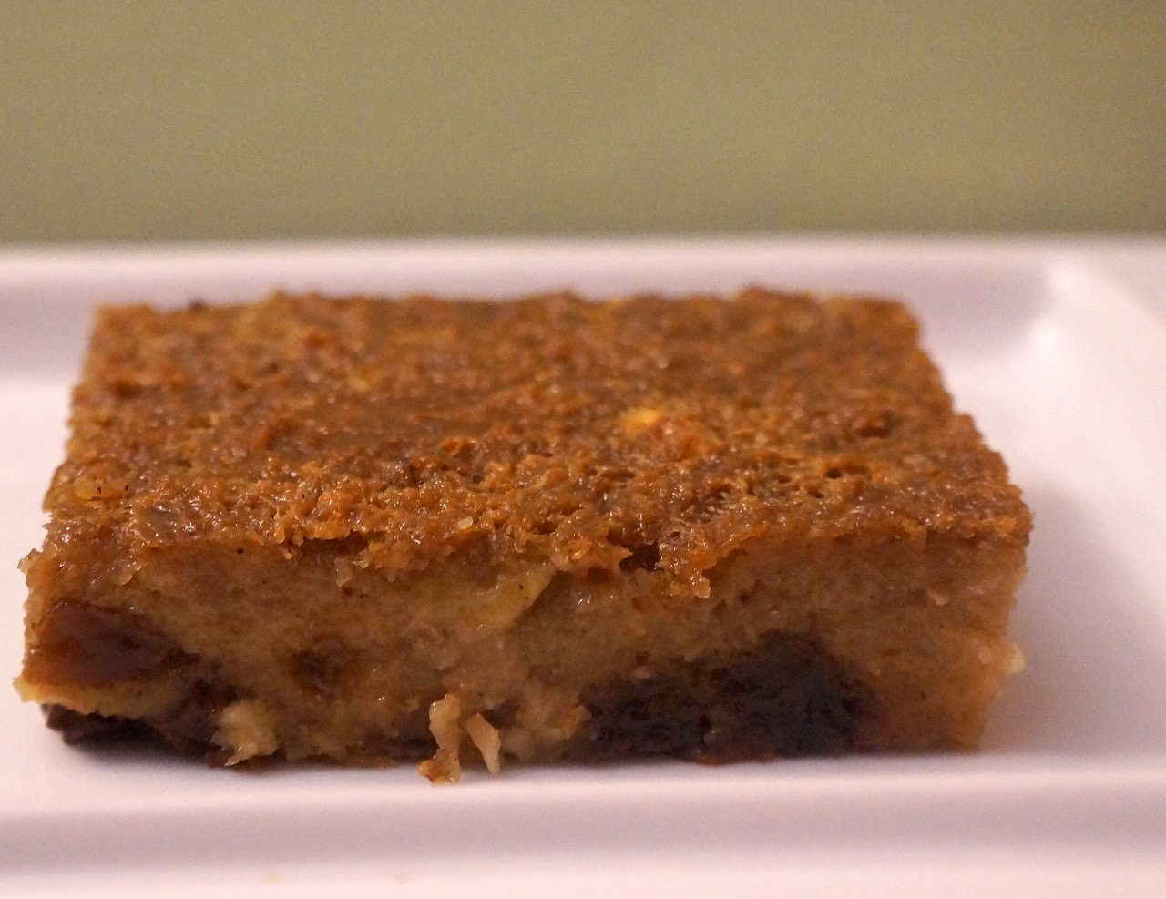
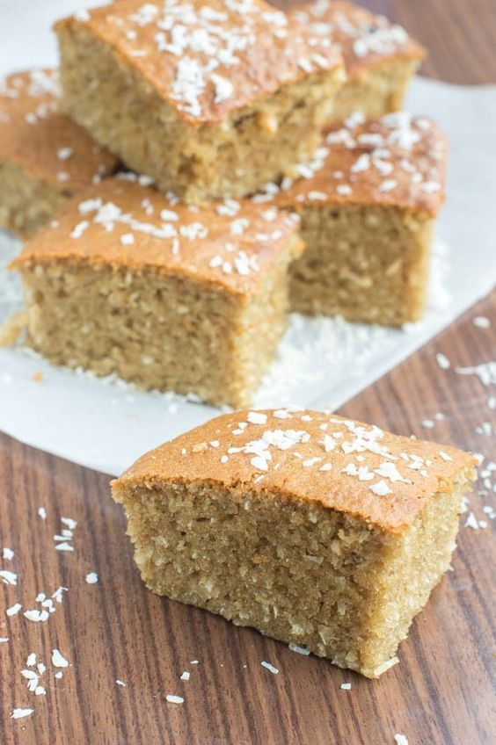
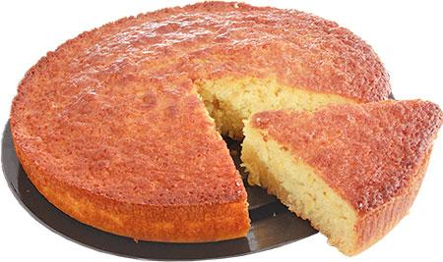
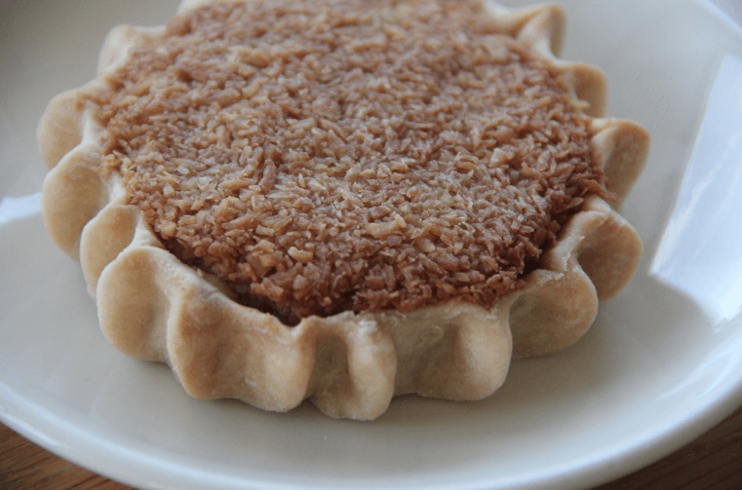
Desserts
Flancocho
Pain Patate
Pastelitos
Quesadilla Salvadorena
Coconut Toto Cake
Gizzada

Slide 8
Cultural Influences
Latin America is a large region starting from Mexico and extending through North America, Central America, South America and parts of the Caribbean.
Latin American countries are very diverse. It possesses both european customs and practices along with traditions brought by Africans during the colonial times.
Religion is primarily Catholicism, brought by the Spanish Conquerors and then later combined with native and African Beliefs.

Slide 9
Holidays
Belens (Bethlehem) is an elaborate scenery with animals and figurines. They are usually huge scenes with many houses, streets, farms, figures and more. Families often set these scenes up in their homes to get ready for christmas.
Midnight Mass, also known as La Misa Del Gallo, occurs on christmas eve. Families go to mass to celebrate their faith.
The Three Kings (Melchior, Gaspar and Baltazar) in latin america are known for bringing children their gifts instead of Santa. The Three Kings is also celebrated on January 6th, not Christmas Day. The kings parade through the town on floats and throw sweets out to the children. When the children return home, they leave their shoes out so the kings can fill them with presents.

Slide 10
References
Fox, E. (2017, November 27). 8 Spanish Christmas Traditions You Need to Know. Retrieved from https://theculturetrip.com/europe/spain/articles/8-spanish-christmas-traditions-you-need-to-know/
https://www.indietraveller.co/a-mini-guide-to-exotic-tropical-fruits/
https://economics.rabobank.com/publications/2015/september/latin-america-agricultural-perspectives/
https://flavorverse.com/traditional-puerto-rican-desserts/
https://www.dominicancooking.com/19682-dominican-desserts-most-popular-recipes.html
http://www.mybigfatcubanfamily.com/2015/11/5-cuban-desserts-that-you-need-to-master/

