Slide 1

Cheese Tasting
Midterm Day

Slide 2
Basic Cheese Storage 101
Keep cheese wrapped in the waxed paper and place it in a loose-fitting food-bag not to lose humidity and maintain the circulation of air.
Cheeses contain living organisms that must not be cut off from air, yet it is important not to let a cheese dry out.
Wrap soft cheeses loosely. Use waxed or greaseproof paper rather than cling film.
Wrap blue cheeses all over as mold spores spread readily not only to other cheeses but also to everything near.
Chilled cheeses should be taken out of the refrigerator one and a half or two hours before serving.
Do not store cheese with other strong-smelling foods. As a cheese breathes it will absorb other aromas and may spoil.
Let cold cheese warm up for about half an hour before eating to allow the flavor and aroma to develop

Slide 3
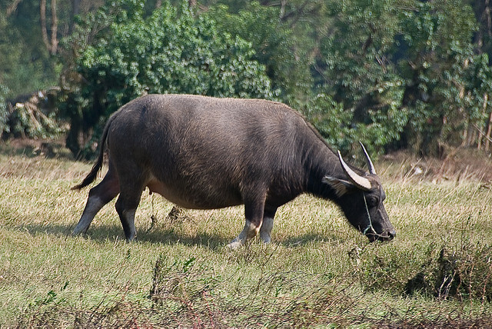
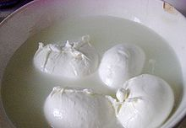
.
Milk Type
Typically either cow, sheep, or goat.
Some cheeses are made from a combination of the three. Mozzarella di bufala is made from the milk of water buffalo.

Slide 4
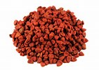
Why is cheese all different colors when milk is white?
What an animal eats determines the flavor cheese. The natural color of the cheese can fluctuate according to the diet of the animal who made milk
Milk contains beta-carotene, the same natural pigment that gives carrots their orange color. Pasture-fed cows produce milk with higher beta-carotene levels in the spring when their diet consists of fresh grass. As a result, their milk produces cheese with a deeper yellow color.
In the winter, when the cow's diet consists mostly of hay, beta-carotene levels drop. Less beta-carotene means whiter cheese.
It often gets its color from the annatto seeds, (achiote) which grow in tropical regions in Central and South America.

Slide 5
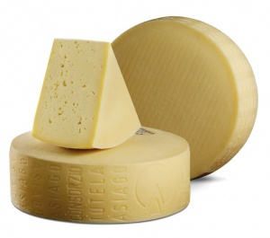
Raw Milk
Raw milk refers to milk that has not been pasteurized. In the United States, cheese made from raw milk must be aged at least 60 days before being sold.

Slide 6
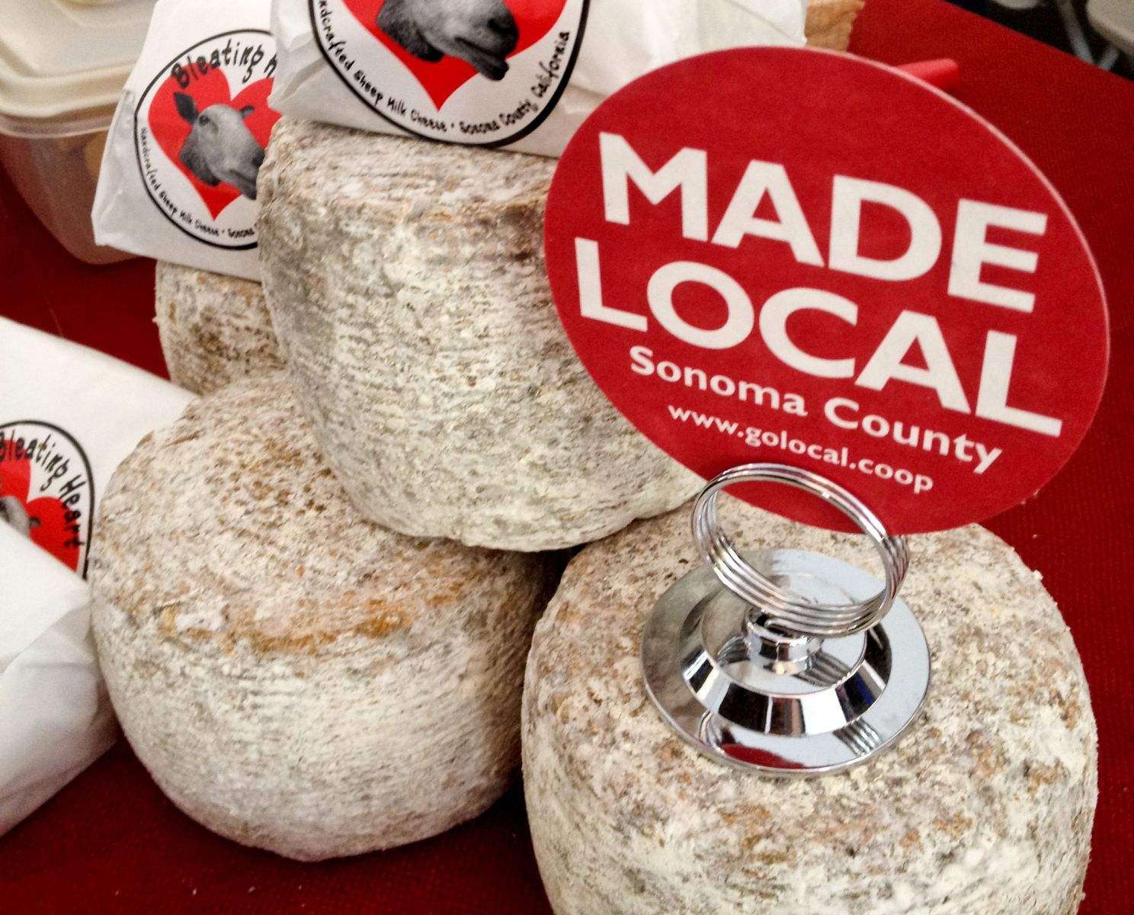
2. Artisanal
Artisanal Cheese
The term artisanal refers to cheese that is handmade, rather than mass-produced in a factory. If the artisanal cheesemakers also raise their own animals for milk
(rather than purchasing milk from another farm) their cheese is considered to be "farmstead" cheese

Slide 7
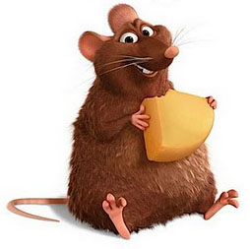
Let’s Have Some Cheese!
We will start with Soft, Mild Cheese

Slide 8
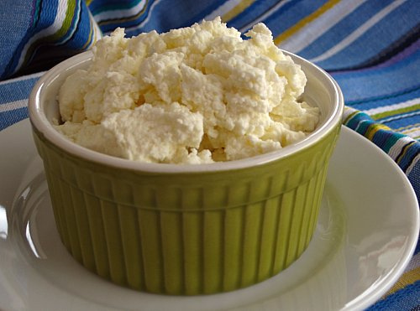
Ricotta
Traditional Italian cheese-makers originally produced Ricotta from whey left behind in the making of Mozzarella and Provolone (Ricotta means "re-cooked").

Slide 9
Mozzarella
Made from pasteurized or unpasteurized cow's or water buffalo's milk
Country of origin: Italy
Region: Campania, Abruzzo, Molise and Puglia
Type: semi-soft, brined
Fat content: 45%
Rind: rindless
Mozzarella cheese is a sliceable curd cheese originating in Italy. Traditional Mozzarella cheese is made from milk of water buffalos herded in very few countries such as Italy and Bulgaria. As a result, most of the Mozzarella cheeses available now are made from cow's milk.
Source-https://cheese.com/mozzarella/

Slide 10
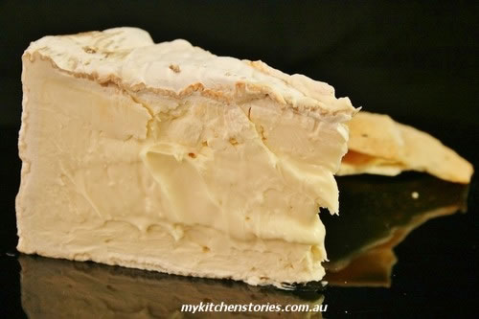
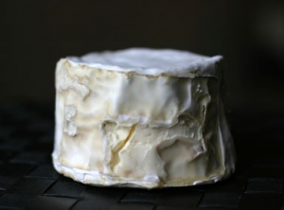
Bloomed Rind
If the outside of a cheese is white and almost fuzzy, it has a bloomy rind. Cheeses like Brie and Triple Cremes have bloomy rinds
Washed Rind
If the outside of a cheese has an orange or reddish hue, it is a sure sign of a washed rind. The exterior of a washed rind cheese is washed in brine and/or alcohol. This keeps the texture of the cheese soft and intensifies the flavor. Most washed rind cheeses have a strong, stinky aroma.

Slide 11
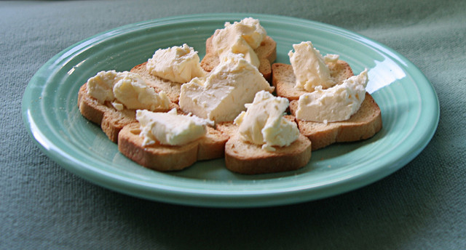
Double Creme
A double creme cheese is a step below a triple creme in terms of richness and milk fat content. The most well-known example of a double creme is Brie. The texture is gooey and runny as opposed to the whipped texture of a triple creme. The flavor of double cremes can be mild or strong and aromatic
Triple Creme
A style of cheese made with the addition of extra cream, bringing the milk fat content up to at least 75%. Triple creme cheeses like Saint Andre have a whipped texture similar to soft butter. The flavor is buttery, salty and typically mild

Slide 12
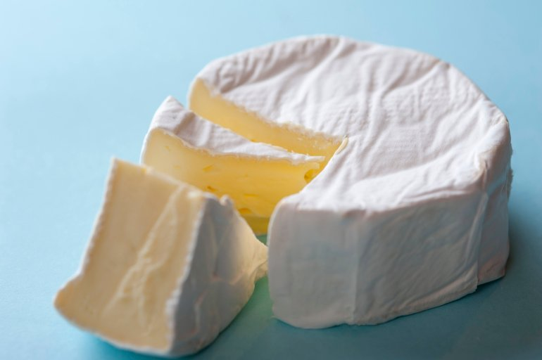
Traditional French Brie
Made from unpasteurized cow's milk
Country of origin: France
Texture: buttery, runny and soft-ripened
Rind: bloomy
Aroma: pronounced, strong
Vegetarian: no
Brie is the best known French cheese and has a nickname "The Queen of Cheeses". Brie is a soft cheese named after the French region Brie, where it was originally created. Several hundred years ago, Brie was one of the tributes which had to be paid to the French kings. source- https://cheese.com/brie/

Slide 13
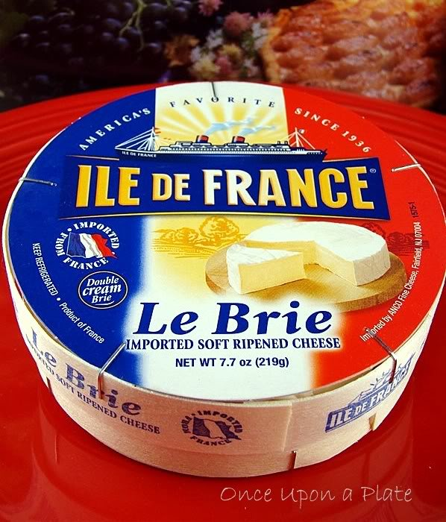
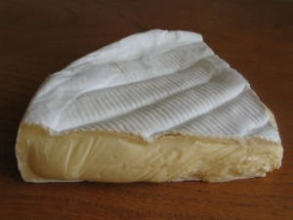
Brie
Made from unpasteurized cow's milk
Country of origin: France
Type: soft, artisan, soft-ripened
Rind: bloomy

Slide 14
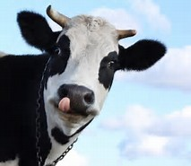
The first Brie we are tasting is made from cow’s milk
Brie is produced from the whole or semi-skimmed cow's milk.
Rennet is added in to raw milk and heated to a temperature of 37°C to obtain the curd.
The cheese is then cast into molds, several layers of cheese are filled into mold and then kept for around 18 hours.
After this the cheese is salted and aged for minimum four weeks.

Slide 15

Now we have Brie made from goat’s milk
Brands of goats' milk brie can vary quite a bit. Typically, however, there is a slight tanginess to goats' milk brie and the texture can be gooey rather than runny. In many cases, goat milk brie is actually milder and less stinky than a ripe cows' milk brie. source-www.thespruce.com/goat-brie-cheese-591434

Slide 16
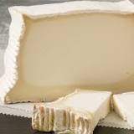
Spanish Leonora
Made from pasteurized goat's milk
Country of origin: Spain
Region: Leon
Type: semi-soft, artisan
Texture: dense and smooth
Rind: bloomy
Leonora is a goat's milk cheese produced in the mountainous region of Leon in north western Spain. Made from the pasteurized milk of Alpine goats, Leonora is a velvety bloomy rind log with a white, slightly flaky paste that is covered in ash. Source- https://cheese.com/leonora/

Slide 17
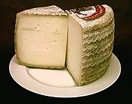
Manchego has a waxed rind
Manchego- the one we are tasting was aged 6 months.
All manchego is made from unpasteurized sheep's milk
Country of origin: Spain
Region: La Mancha
Type: semi-soft
Fat content: 57%
Texture: firm and supple
Aroma: grassy, pleasant
Vegetarian: no

Slide 18
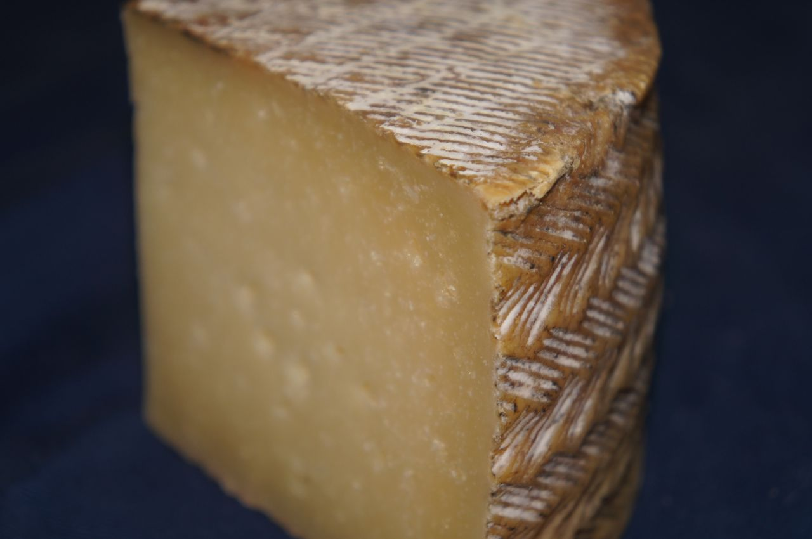
Manchego
The traditional use of grass molds leaves a zigzag pattern on the Manchego cheese.
Authentic Manchego is only made from the Manchego sheep's milk. Manchego cheese is made from both pasteurized and unpasteurized milk. The farmhouse version is produced from unpasteurized milk while the industrial version is produced from pasteurized milk.
The rind is inedible with a distinctive, traditional herringbone basket weave pattern, pressed on it. A typical ear wheat pattern is pressed onto the top and bottom wheels of the cheese. There are specific differences in Manchego cheeses, depending on their aging period.

Slide 19
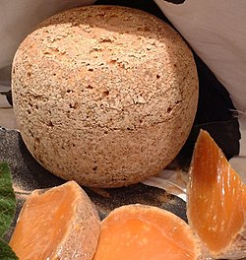
Mimolette –cow’s milk, from France- The orange color comes from the natural seasoning, annatto, which has a sweet, nutty flavor. The cheese has a similar appearance to a cantaloupe melon.

Slide 20
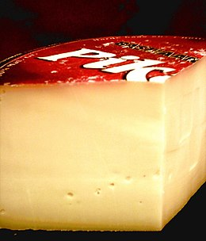
Gouda
Made from pasteurized or unpasteurized cow's, goat's or sheep's milk
The one we are tasting today is from cow’s milk- it is double-creamed
Country of origin: Netherlands
Gouda, or "How-da" as the locals say, is a Dutch cheese named after the city of Gouda in the Netherlands
Source- https://cheese.com/gouda/#

Slide 21
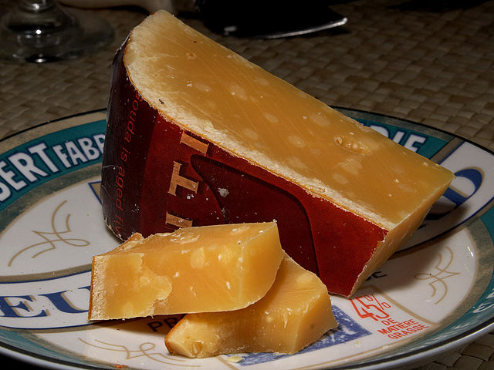
Aged Cheese
This is a broad category referring to cheese with a hard, crumbly texture or a semi-hard texture. Aged can mean several months or several years.

Slide 22
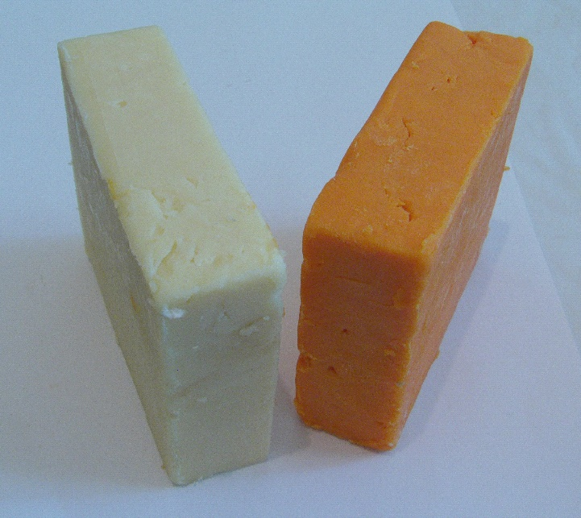
Traditional Cheddar Cheese
Cheddar cheese is natural rind
Made from pasteurized cow's milk
Country of origin: England
Vegetarian: no
During olden days, England was the only place where Cheddar cheeses were made. However, many countries all over the world manufacture Cheddar today.
Any cheese producing company or any of the artisan manufacturers in any corner of the world can label the cheese produced by them as 'Cheddar' since it is not protected like other cheese names or brands.
Almost 90 percent of all cheese sold in the United States is cheddar.

Slide 23
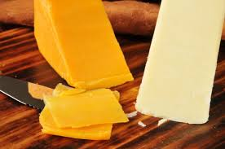
Cheddar Cheese
When it's produced, cheddar cheese is naturally white to light yellow in color
If it is dark yellow or orange it is because annatto seeds or extract were added (if it is inexpensive cheese it is probably treated with food dye to be orange
Color is just a matter
of cultural preference

Slide 24
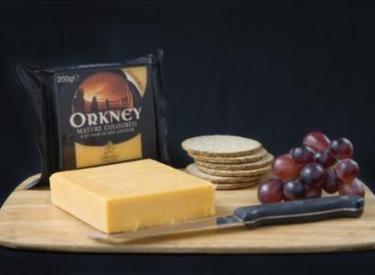
Now we have a Scottish White Cheddar
From Orkney Island. Cows feed on home grown produce, such as barley, turnips and even grains from local brewers. This distinctive blend of produce helps create a milk that's perfectly balanced in terms of fat, protein and lactose.

Slide 25
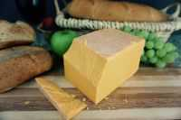
Wisconsin Cheddar
Extra Sharp White, aged 9 months, Cow’s Milk
Wisconsin continues to be the largest cheese producer in the United States, making over 600 different cheese varieties
In 2014, Wisconsin produced 2.9 billion pounds of cheese, accounting for 25.4% of all cheese produced in the U.S
http://www.wisconsindairy.org/assets/images/pdf/WisconsinDairyData.pdf

Slide 26
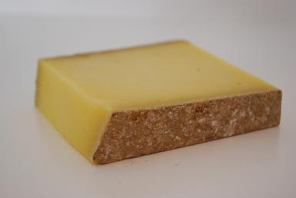
Natural Rind
When some types of cheese age, such as Parmigiano-Reggiano,the surface of the cheese naturally hardens from being exposed to air. Cheeses with natural rinds are sometimes rubbed down with oil, encased with cloth, or covered with foil

Slide 27
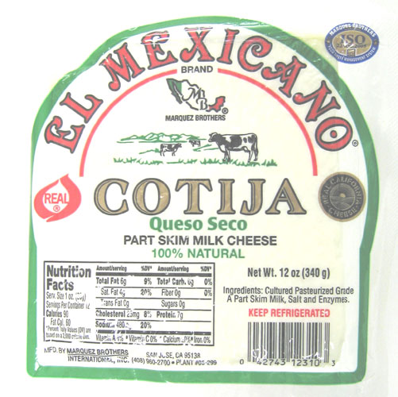
Mexican Cotija
When the cheese is made, it is white, fresh and salty and bears a resemblance to feta cheese
With aging it becomes hard and crumbly and has the nickname "Parmesan of Mexico.”
Cotija cheese is salty and strong flavored
It is firm and does not actually melt. Good
to use for grating on salads, soups, casseroles tacos and tostadas

Slide 28
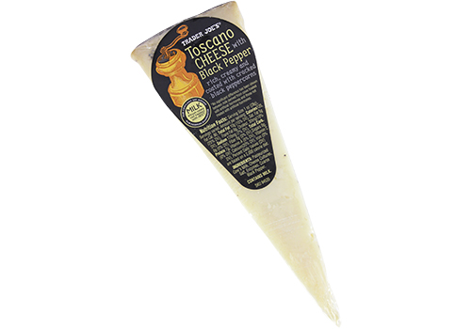
Peppercorn Toscano
Similar to aged Parmesan but sneaks in a subtle creaminess similar to Cheddar.
The one we are tasting today is made with cow’s milk and rolled in black peppercorns

Slide 29
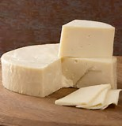
Provolone
Made from pasteurized or unpasteurized cow's milk
Country of origin: Italy
Today, the major production of Provolone takes place in Po valley region, particularly Lombardy and Veneto. Both are granted DOP designation by the European Union to ensure that cheese is produced under strict supervision using specific methods to guarantee supreme quality.

Slide 30
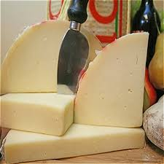
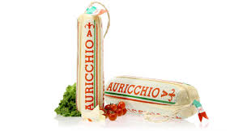
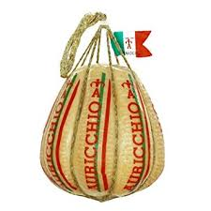
Provolone
The one we are tasting is
AURICCHIO
Sharp, aged 12 months
http://auricchio.it/the-company/our-provolone/?lang=en

Slide 31

Denominazione di Origine Protetta ("Protected Designation of Origin"), or DOP, status under European Union regulations. Prior to 1996 when the PDO system came into operation, many Italian cheeses were regulated under a Denominazione di Origine (DO) system
What? DOP?

Slide 32
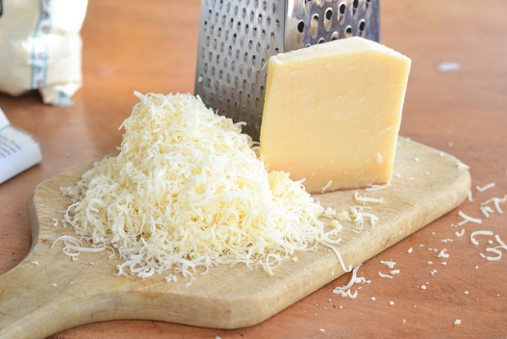
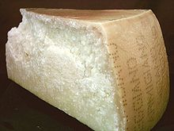
Hard Cheese- Parmigiana Reggiano
Made from unpasteurized cow's milk
Country of origin: Italy
Region: Provinces of Parma, Reggio Emilia, Modena, Bologna , Mantua
Rind: natural
Designation states that for a cheese to be called as Parmesan, it has to be produced from cows grazing on fresh grass and hay.
Parmigiano Reggiano cheese is mostly grated over pastas, used in soups and risottos.
Source- cheese.com/parmesan/

Slide 33
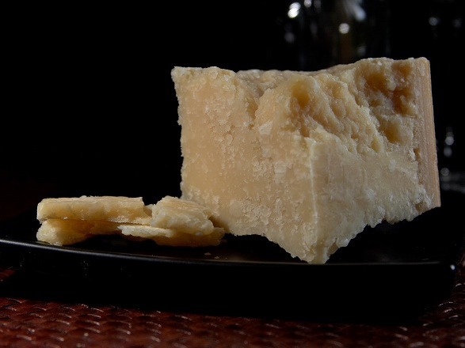
Locatelli
Locatelli is a brand name of cheese and Pecorino Romano is a variety of cheese.
Dating back to ancient Roman times, Pecorino Romano is one of the world's oldest recorded cheeses. Pecorino is an Italian word meaning “from sheep's milk”, and Romano indicates that this cheese is of Roman descent.
All Pecorino Romano is made in either Lazio, Tuscany, or Sardinia during the months between November and June. These three regions have very similar pastures and breeds of sheep, ensuring consistent flavor and quality
Source- www.bestnewyorkfoods.com/locatellicheese-com/historyoflocatellicheese.htm

Slide 34
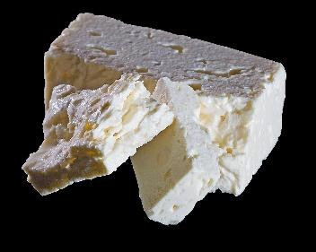
Feta!
Feta is a brined curd white cheese made in Greece from sheep's milk, or from a mixture of sheep and goat's milk.
Similar brined white cheeses produced elsewhere are often made partly or wholly of cow's milk, and they are also sometimes called feta.
Made from pasteurized or unpasteurized goat's and sheep's milk
The cheese is protected by EU legislations and only those cheeses manufactured in Macedonia, Thrace, Thessaly, Central Mainland Greece, the Peloponnese and Lesvos can be called ‘feta’. Similar cheeses produced elsewhere in the eastern Mediterranean and around the Black Sea, outside the EU, are often called ‘white cheese’.
Source- cheese.com/feta/

Slide 35
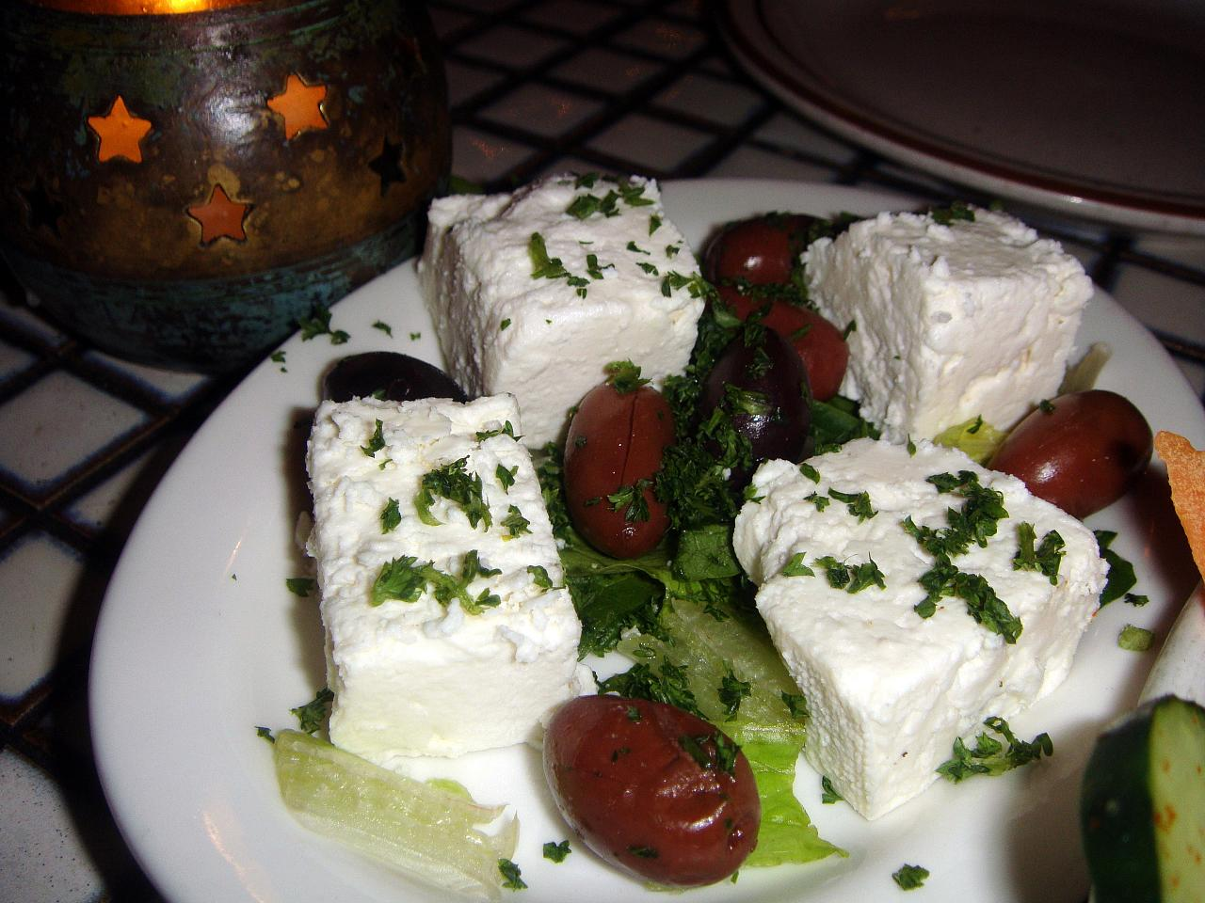
Bulgarian Feta
Sirene is a Feta style brined cheese made in South-Eastern Europe, particularly popular in Croatia, Serbia, Bulgaria, Romania, Albania, the Republic of Macedonia, Greece and also in Israel. It is also known as “white brine sirene” or Bulgarian Feta

Slide 36
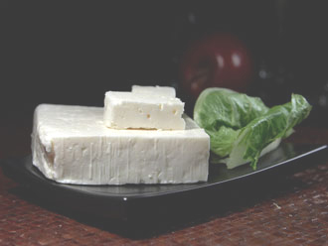
Brined Feta
Wherever feta is made in the world or
whatever you call it, the basic characteristics of feta don't change - salty and tangy with a creamy and crumbly texture.. There are slight variances in flavor and texture depending on what type of milk is used (cow, sheep or goat) and where the feta is made.
Traditionally, feta is a sheep's milk cheese.
Feta has been made in Greece for thousands of years
Many Balkan countries and others (like France, Israel and the United States) also produce feta, although according to the EU Protected Designation of Origin regulations, it should be called a "feta-style" cheese

Slide 37
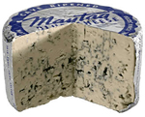
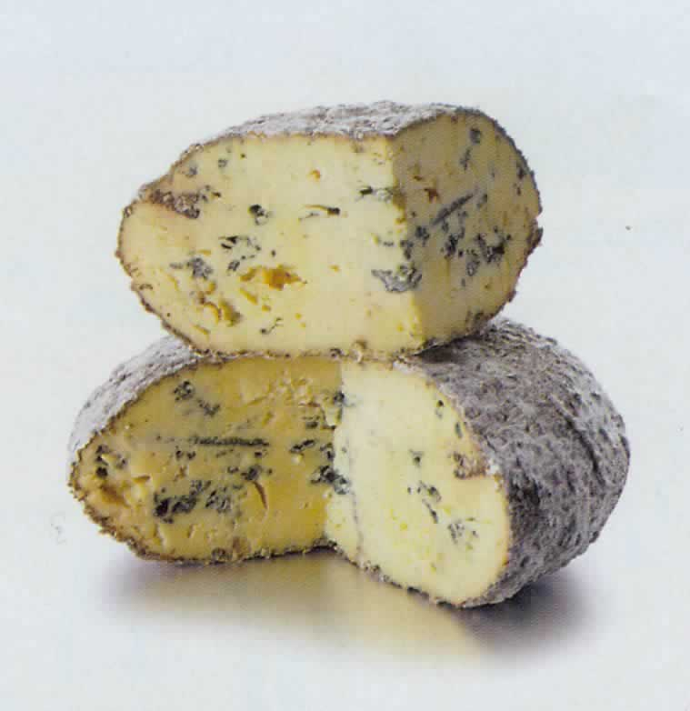
Blue Cheese
A style of cheese that always has blue and/or green veins of mold running through it. The flavor ranges from sweet and salty to pungent. Specific types of mold are needed when blue cheese is made to cause this sort of excessive blueing.

Slide 38
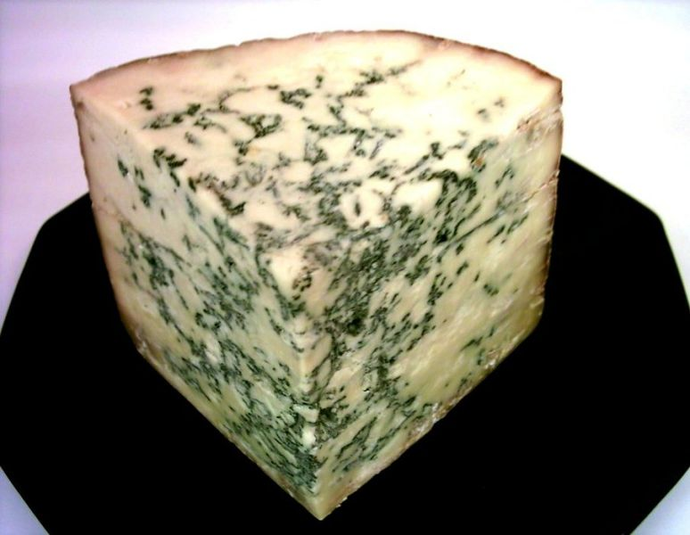
Stilton is the only British cheese to have a Certification Trade Mark and an EU Protected Name
Made from pasteurized cow's milk
Country of origin: England
Region: Derbyshire, Leicestershire, Nottinghamshire
Family: Blue
Type: semi-soft, blue-veined
Fat content: 35%

Slide 39
Stilton
Made from pasteurized cow's milk
Country of origin: England
Region: Derbyshire, Leicestershire, Nottinghamshire
It is the only British cheese to have a Certification Trade Mark and an EU Protected Name.
Traditionally, this cheese has been paired with sherry and port wine. It is also a good choice to go with walnuts, crackers, biscuits and breads.

Slide 40
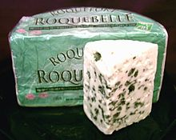
Roquefort
Made from unpasteurized sheep's milk
Country of origin: France
Genuine Roquefort is rich, creamy and sharp, tangy, salty in flavor. It is aged for 5 months
The mold that gives Roquefort its distinctive character (Penicillium roqueforti) is found in the soil of the local caves. Traditionally, the cheesemakers extracted it by leaving bread in the caves for six to eight weeks until it was consumed by the mold. The interior of the bread was then dried to produce a powder. In modern times, the mold can be grown in a laboratory, which allows for greater consistency. The mold may either be added to the curd or introduced as an aerosol through holes poked in the rind. Source=wikipedia.org/wiki/Roquefort

Slide 41
And why doesn’t blue cheese make us sick?
The molds used for cheese cannot produce toxins.
The combination of acidity, salinity, moisture, density, temperature and oxygen flow creates an environment that is far outside the range for these molds.
In fact, this is true for almost all molds in cheese, which is the reason that cheese has been considered a safe moldy food to eat over the past 9,000 years.
No refrigeration right? How do you keep milk products from spoiling?? That’s right. Cheese!!!!!!!!!!!!!!!!!
Source- www.quora.com/Why-is-it-safe-to-eat-the-mold-in-Bleu-Cheese

Slide 42
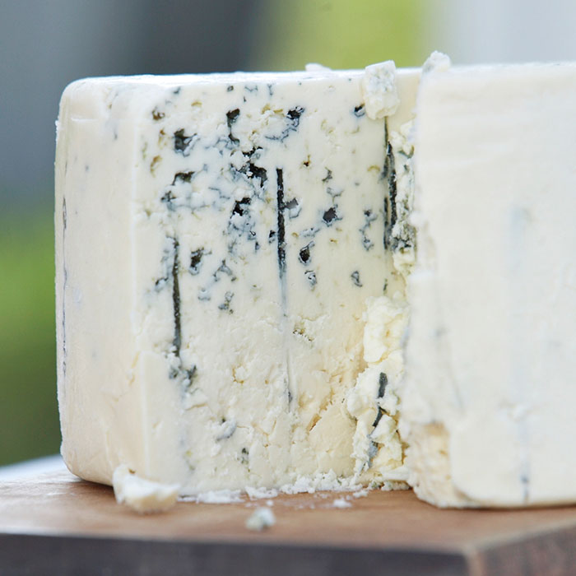
Maytag Blue
Iowa

Slide 43

THE END

Slide 44
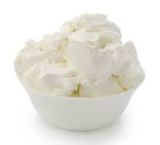
Marscapone
Mascarpone originated in the area between Lodi and Abbiategrasso, Italy, southwest of Milan, probably in the late 16th or early 17th century. The name is popularly held to derive from mascarpa, an unrelated milk product made from the whey of stracchino (a young, barely aged cheese), or from mascarpia, a word in the local dialect for ricotta. Ricotta, unlike mascarpone, is made from whey.
Country of origin | Italy
Source of milk | Cow
Texture | Soft

Slide 45
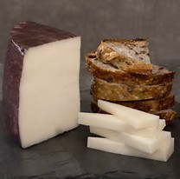
Drunken Goat? (Murcia Al Vino)
Drunken Goat is made from the pasteurized milk of local goats in the town of Jumilla in Murcia, Spain.
Drunken Goat wheels are soaked for two to three days in "doble pasta," or "double paste" wine, thus the "vino" or “drunk” portion of its name.
The cheese is then aged for two and a half months and retains a really pleasant semi-soft texture, and a lingering creaminess.
Source- thespruce.com/spanish-cheese-drunken-goat-591584

Slide 46
Mimolette
Made from cow's milk
Country of origin: France
Region: Lille
Type: semi-hard
Fat content: 40%
Texture: firm
Rind: natural

Slide 47
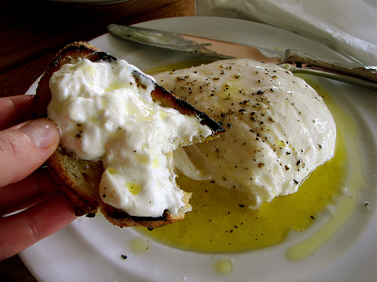
Burrata
The Difference Between Mozzarella and Burrata
Fresh mozzarella cheese is a semi-soft Italian cheese made from cow or water buffalo milk.
Burrata cheese takes the mozzarella one step further — it's mozzarella that's formed into a pouch and then filled with soft, stringy curd and cream.
Source- http://www.thekitchn.com

Slide 48
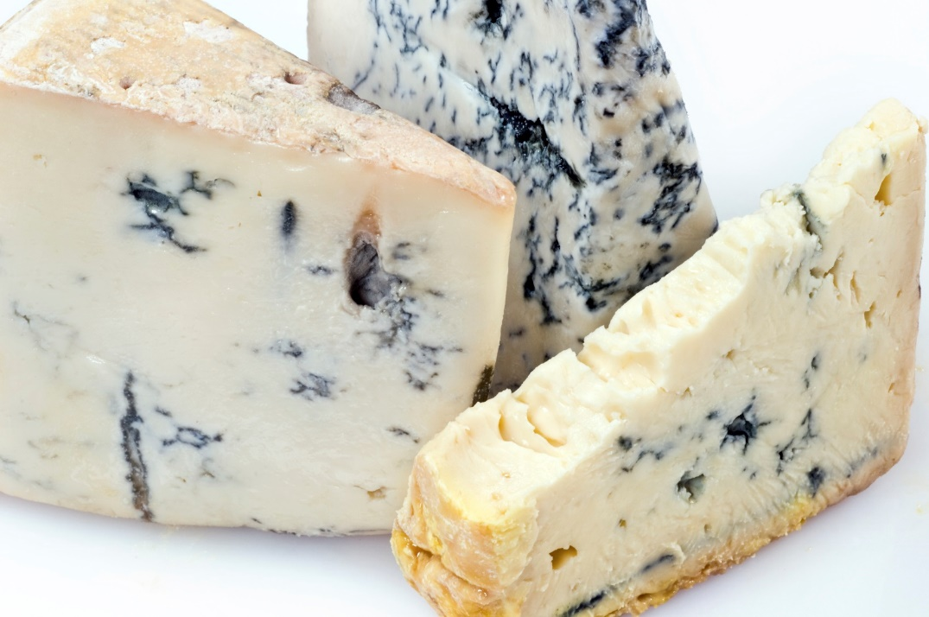
Gorgonzola
Made from pasteurized cow's milk
Country of origin: Italy
Unskimmed cow's milk is used while preparing the cheese. Generally it takes three to four months to attain full ripeness.
Named for the town in the province of Milan, Gorgonzola, Milan.

