Slide 1
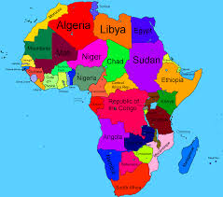
INTERNATIONAL DESSERTS
Week 8
AFRICA
By Felicie

Slide 2




EASTERN AFRICA
DIVERSITY
BURUNDI
COMOROS
DJIBOUTI
ERITREA
ETHIOPIA
KENYA
MADAGASCAR
MALAWI
MAURITIUS

Slide 3
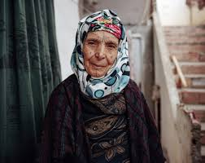
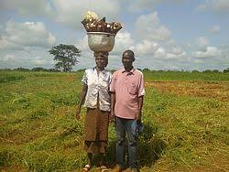

MIDDLE AFRICA
ANGOLA
CAMAROON
CHAD
CONGO
EQUATORIAL GUINEA
GABON
SAO TOME AND PRINCIPE

Slide 4
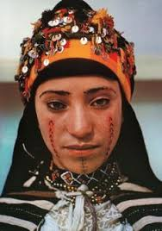
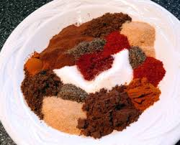
NORTHERN AFRICA
ALGERIA
EGYPT
LIBYAN ARAB JAMAHIRIYA
MOROCCO
SUDAN
TUNISIA
WESERN SAHARA

Slide 5

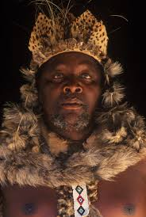
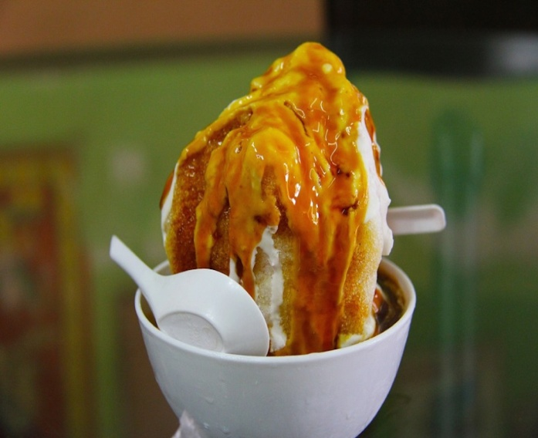
SOUTHERN AFRICA
BOTSWANA
LESOTHO
NAMBIA
SOUTH AFRICA
SWAZILAND

Slide 6
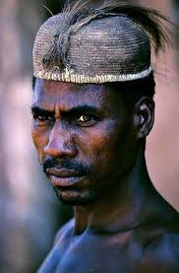

WESTERN AFRICA
BENIN
BURKINA FASO
CAPE VERDE
COTE D’IVOIRE
GAMBIA
GHANA
GUINEA-BISSAU
LIBERIA
TOGO
SENEGAL
MALI
MAURITANIA

Slide 7
Natural Food Sources
East Africa - Wheat, Sorghum, Millet, Pulses, Cassava, Plantains and coconut
North Africa- Vegetables, Fruits, Dates, Cereals and Lentils
Middle Africa- Cassava, Rice, Plantains, Coffee, Ginger and sugar cane
West Africa- Cocoa, Peanut, Sorghum, Millet, Rice, Coffee and Cassava, Yams
South Africa- Maize, Wheat, Cane, Fruits, Citrus and livestock

Slide 8

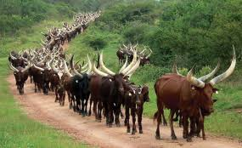
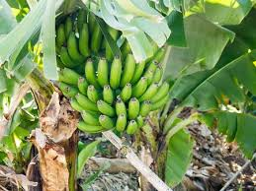
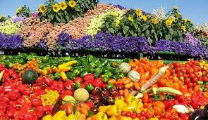
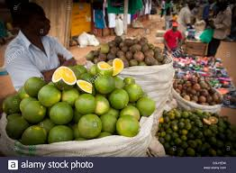
Some Natural Food Sources
Maize
Livestock (Cattle)
Plantains
Fresh Fruits Vegetables
Tubers(yams) & Coconuts

Slide 9
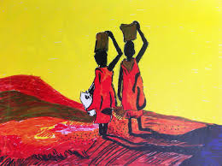
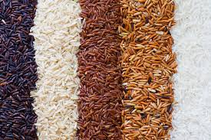
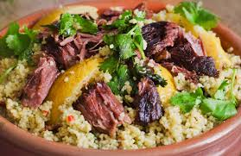
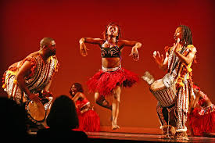

Cultural Influences
Arts & Craft
Exports of grains
Cuisines
Dance
Fashion

Slide 10
Imports that Impact Cuisines
In East Africa, the Indian influence is evident in the adoption of curries and chapattis into their cuisines
Steamed rice is cooked with spices Persian style with cloves, cinnamon and pomegranate juice.
In Northern Africa, because of its proximity to the Mediterranean sea traders and travelers had great influence on their cuisine. Arabs introduced spices like saffron & nutmeg
Phoenicians brought sausages, Carthaginians brought wheat and semolina. Ottoman Turks brought sweet pastries.
Berbers in the region adapted semolina into their couscous.
In Southern Africa Bantu speakers arrived 2000 years ago and brought crop cultivation. French and Dutch has heavy influence in South African cuisine from savory dishes to sweets.
West African customs and food preparation was influenced by hot spices imported from India and grilled chicken from the British.
Central African cuisine has also remained traditional with the exception of widespread use of peanuts, chili peppers and cassava which arrived with the slave trade.

Slide 11
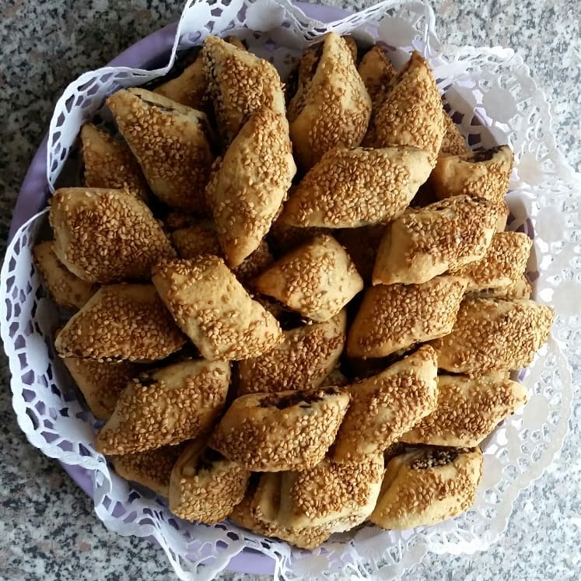
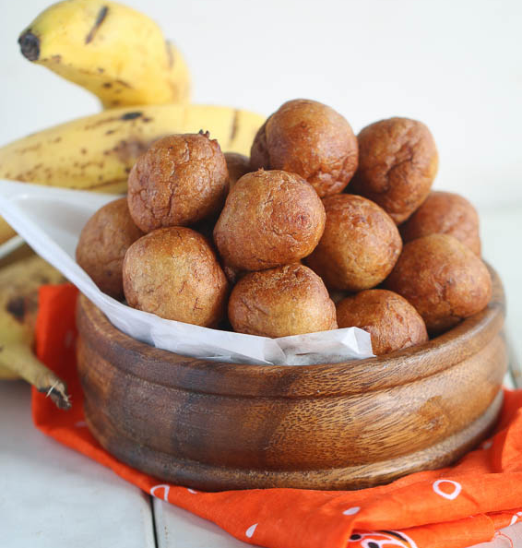
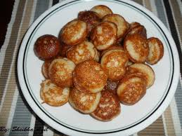
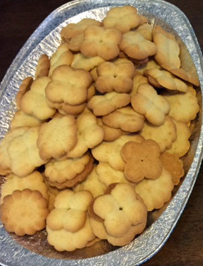
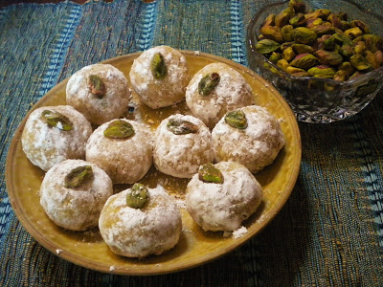
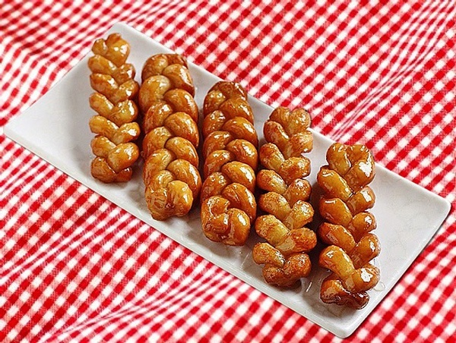
Dessert Traditions
N . African Makroud
East African Vitumbua
W. African Banana Puff Puff
South Africa Koeksusters
Somali Buskud Biscuits
Central African Loz

Slide 12
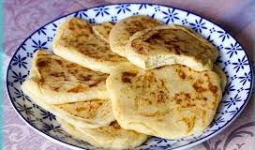
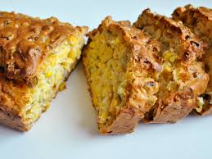
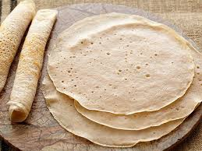
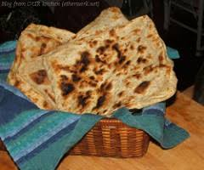
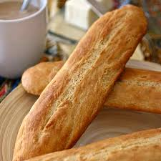
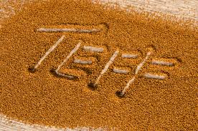
Breads of Africa
North African Msemmen. Fried bread crispy outside. There is sweet and savory version.
South African Mealie Bread. Corn bread made with a steamed pudding with basil and smoked paprika.
East African Injeria
Sourdough risen flat bread. Made out of teff flour, it is slightly spongy in texture.
North African Ragaif
Flat bread stretched for elasticity. Kerchief folded.
West African Tapalapa
Made with wheat, millet and cowpea flour with maize added.
Teff
Low carb super grain.

Slide 13
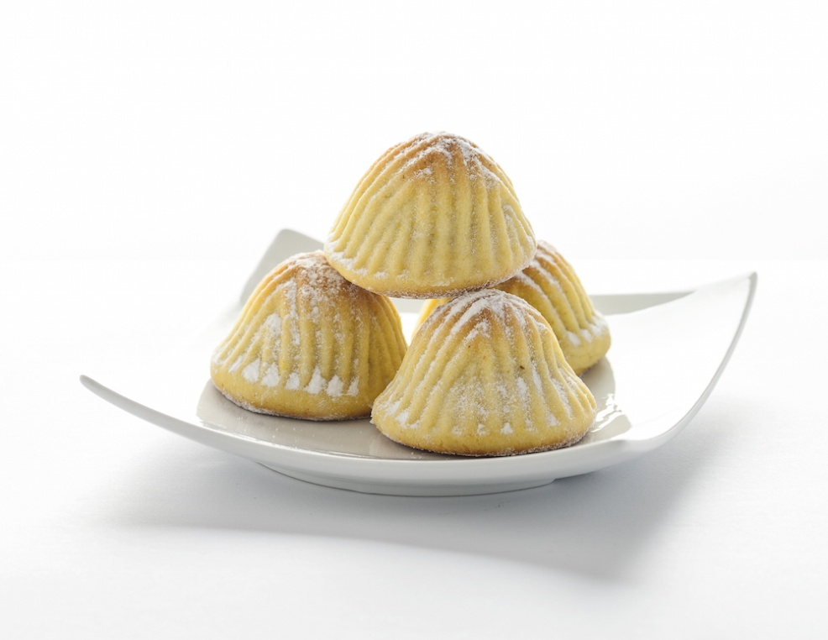

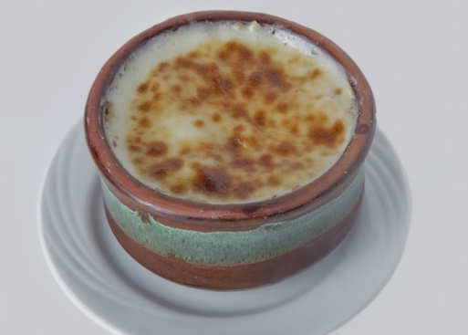
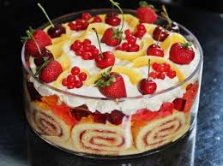
Holiday Desserts
North Africa Maamoul
Is a Moroccan dessert typically eaten around Eid. It is made with ghee, whole milk, orange blossom, water and vegetable oil.
South African coconut ice
This prominent Christmas item in south African homes is made with desiccated coconut, icing sugar and condensed milk. Served ice cold.
Umm Ali
Christmas Trifle

Slide 14
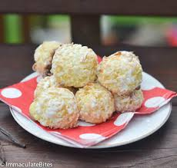
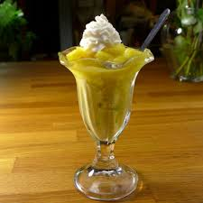
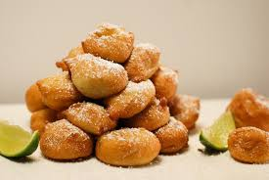
Holiday Desserts
West African Shuku Shuku
Shuku Shuku is a great tasty Nigerian sweet that doubles as a snack and dessert. It is made with shredded coconut, milk, eggs, sugar and bread crumbs. This can be fried or baked. This is popular with kids.
East African Coupe Mt. Kenya
This delicious mango flavored dessert is made with mangoes, heavy cream , flavored with lemons and sweetened with condensed milk. This dessert is topped with a pineapple rum sauce
Central African Beignet
Is a favorite banana fritters treat throughout central Africa. It is made by dipping sliced bananas in a sweet batter and fried.

Slide 15
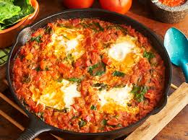
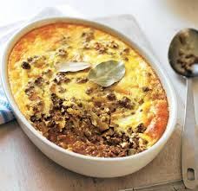
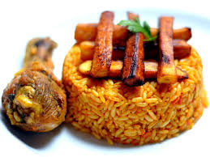
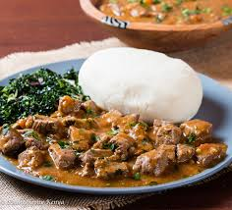
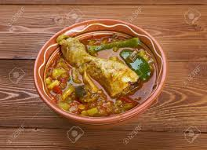
Specialties
North Africa Shakshuka
Tender pieces of lamb or chicken, cooked in special spices and herbs.
South African Bobotie
Curried meat & fruit with a creamy topping.
West African Jollof Rice
This flavorful rice dish is cooked in a spicy tomato puree.
East African Ugali with beef
A starchy polenta-like side dish.
Central African Muamba Galina
Traditional dish made with cassava flour and palm oil.

Slide 16
References
Imma. (2018, September 5) Desserts. Retrieved
from https://www.africanbites.com
Adainoo, B. (2018, April 4) Stay well now. Retrieved
from https://www.staywellnow.com
Desserts From Africa (2018, March 21). Retrieved
from https://www.demand africa.com
Hobbs, J. (2017, July 12). Africa’s favorite dishes. Retrieved from https://www.cnn.com

