Slide 1
INTERNATIONAL DESSERTS
WEEK 2
NORTHERN EUROPE
By:Shenice Charles
Notes:
‹#›

Slide 2
REGIONS OF NORTHERN EUROPE
THE BRITISH ISLES
SCANDINAVIA
THE BALTIC SEA REGION
Notes:
‹#›

Slide 3
NORTHERN EUROPE
Channel Islands
Faeroe Islands
Isle of Man
United Kingdom
  England
  Ireland
  Scotland
  Wales
Baltic Sea Region
  Latvia
  Lithuania
  Estonia
Scandinavia
  Denmark
  Finland
  Iceland
  Norway
  Sweden
Notes:
‹#›

Slide 4

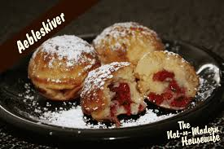
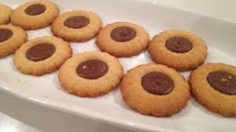
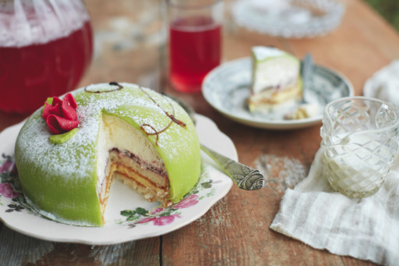
Dessert Traditions
Danish pastry and cookies
kringle
spritsar
fruit soup
shortbreads
yorkshire pudding
green princess cake
Notes:
‹#›

Slide 5
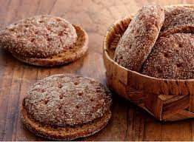
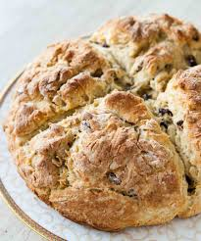
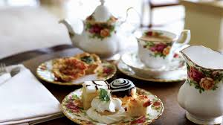
BREADS
  High Tea
  Yeast bread (sally lunn)
  Irish soda breads
  Ruisleipä (Rye bread)
Notes:
‹#›

Slide 6
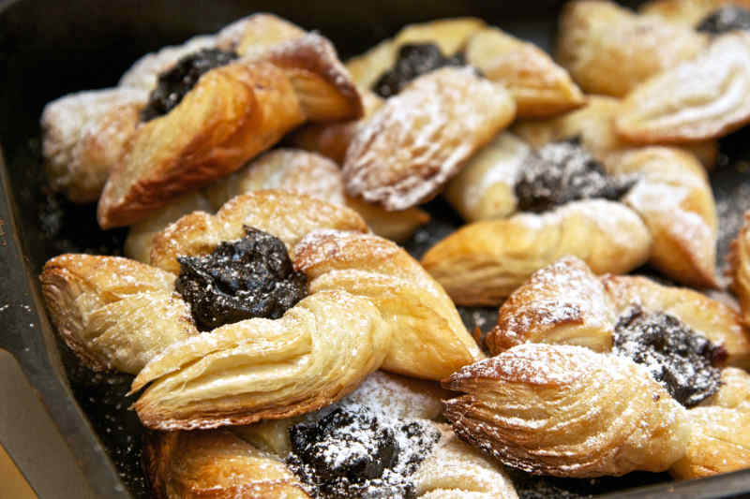
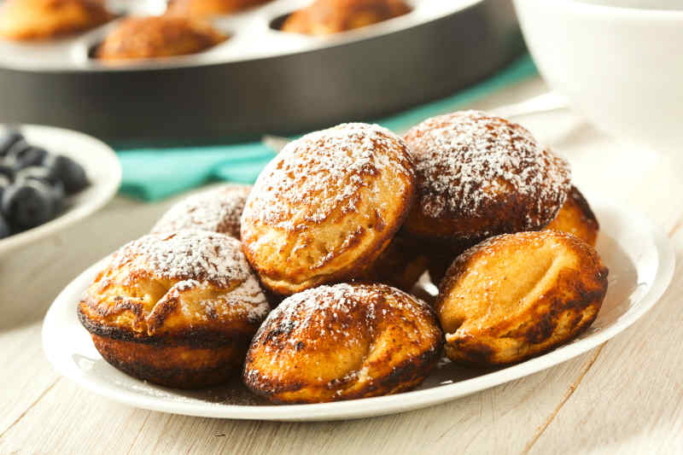
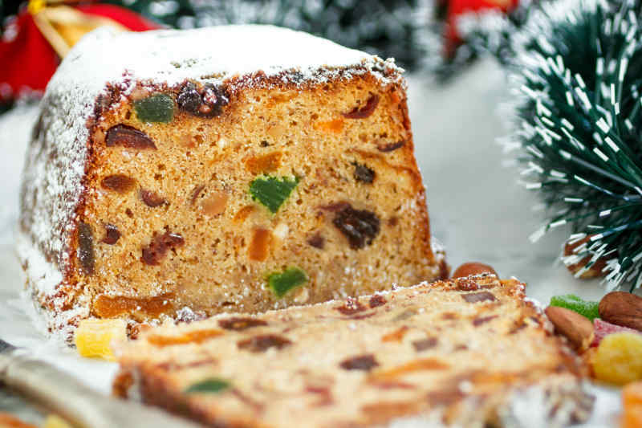
Holiday Items
Plum puddings
Hot cross buns
Aebleskiver (pancake puffs)
Joulutorttu (Finnish Christmas tarts; crafted in the shapes of stars or pinwheels.)
Fruitcake
Notes:
‹#›

Slide 7
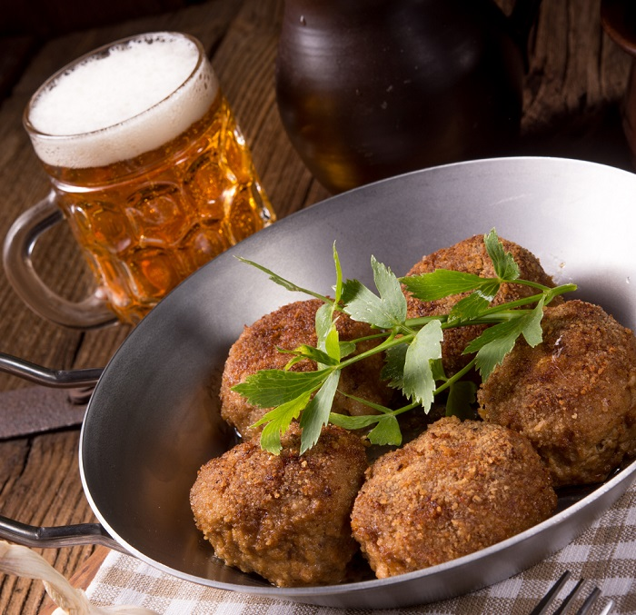
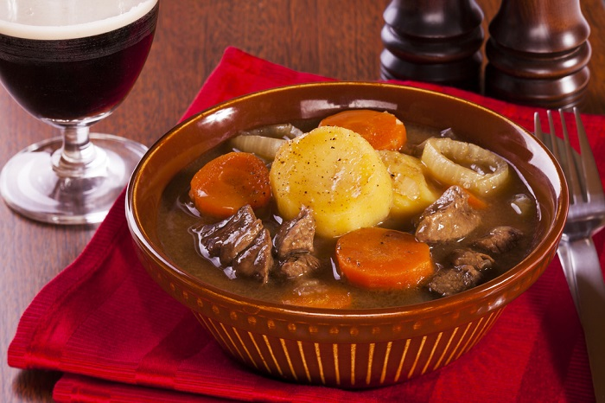
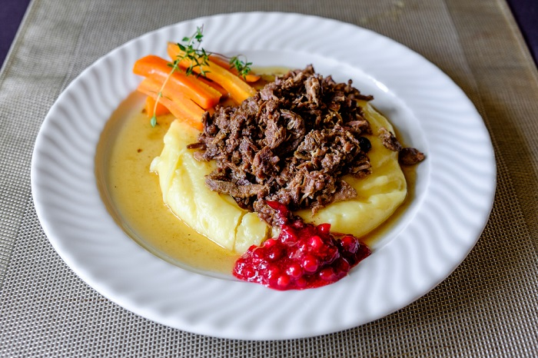
Culturally Specific Meals
Surströmming (lightly-salted fermented Baltic Sea herring)
Frikadeller (crumbed meatballs)
Sautéed Reindeer
Irish Stew
Notes:
‹#›

Slide 8
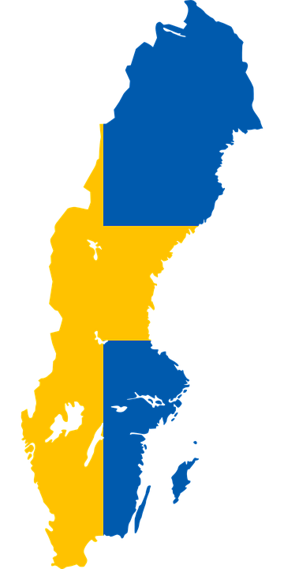
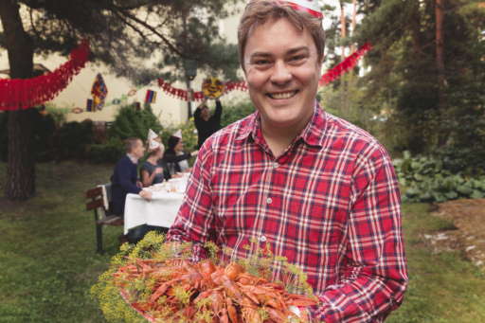
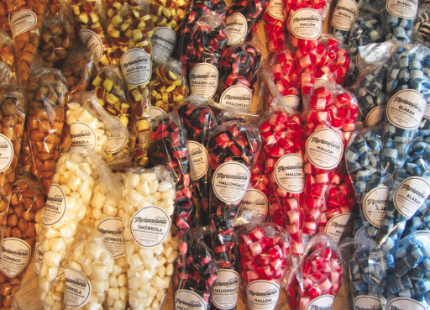
Sweden
Characteristics
love sweets
intriguing mix of flavors
Ingredients
crayfish
mustard, mayonnaise
salmon
potatoes
Dishes
Smörgås
Pickled herring (sill)
Lingonberry jam

Slide 9
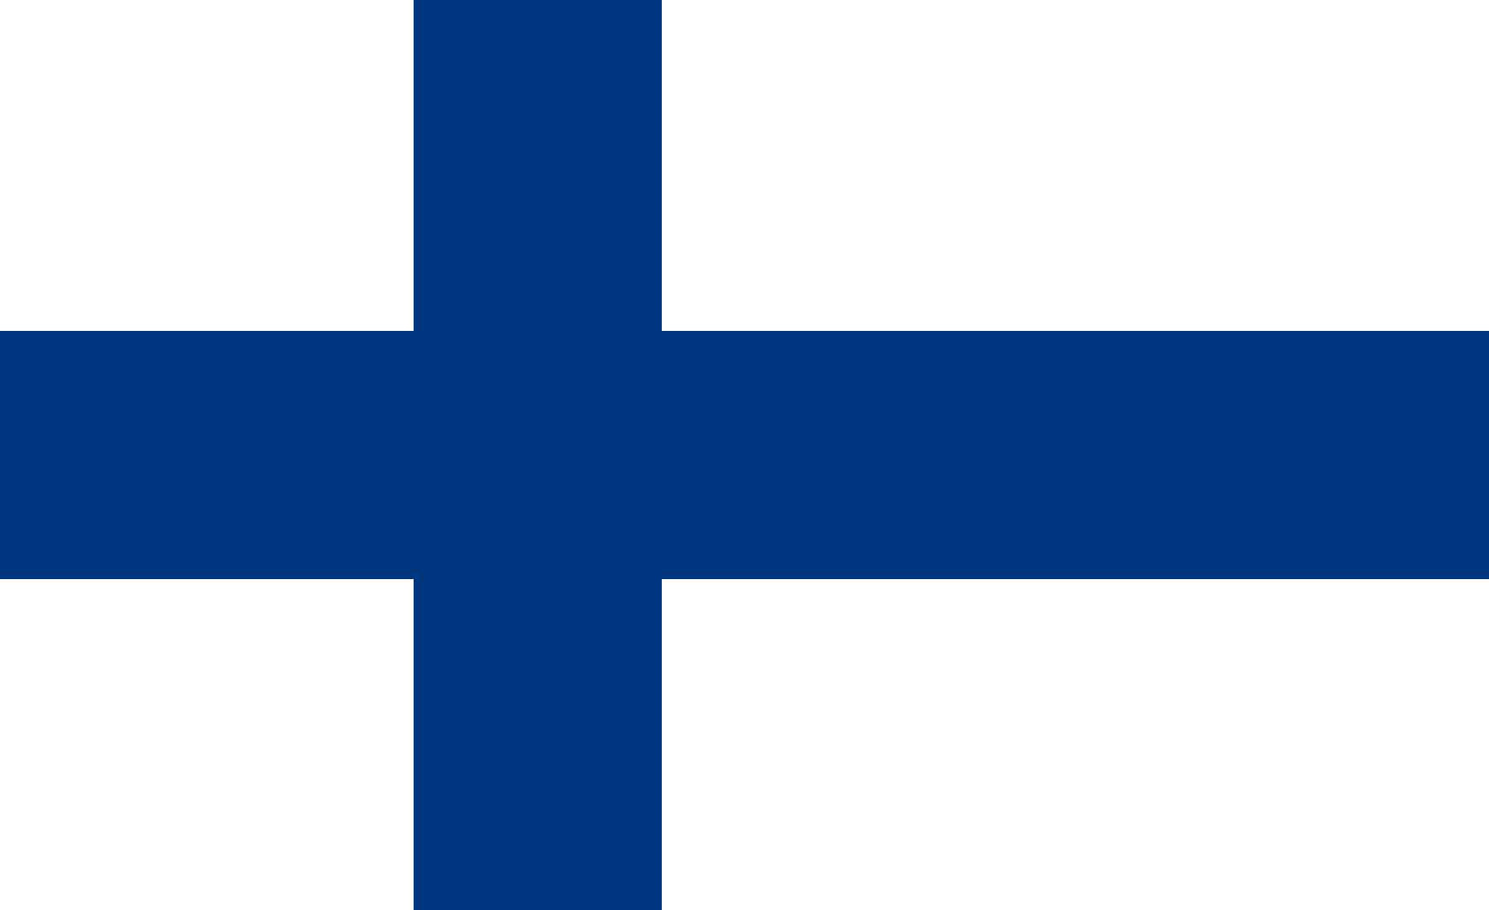
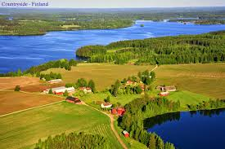
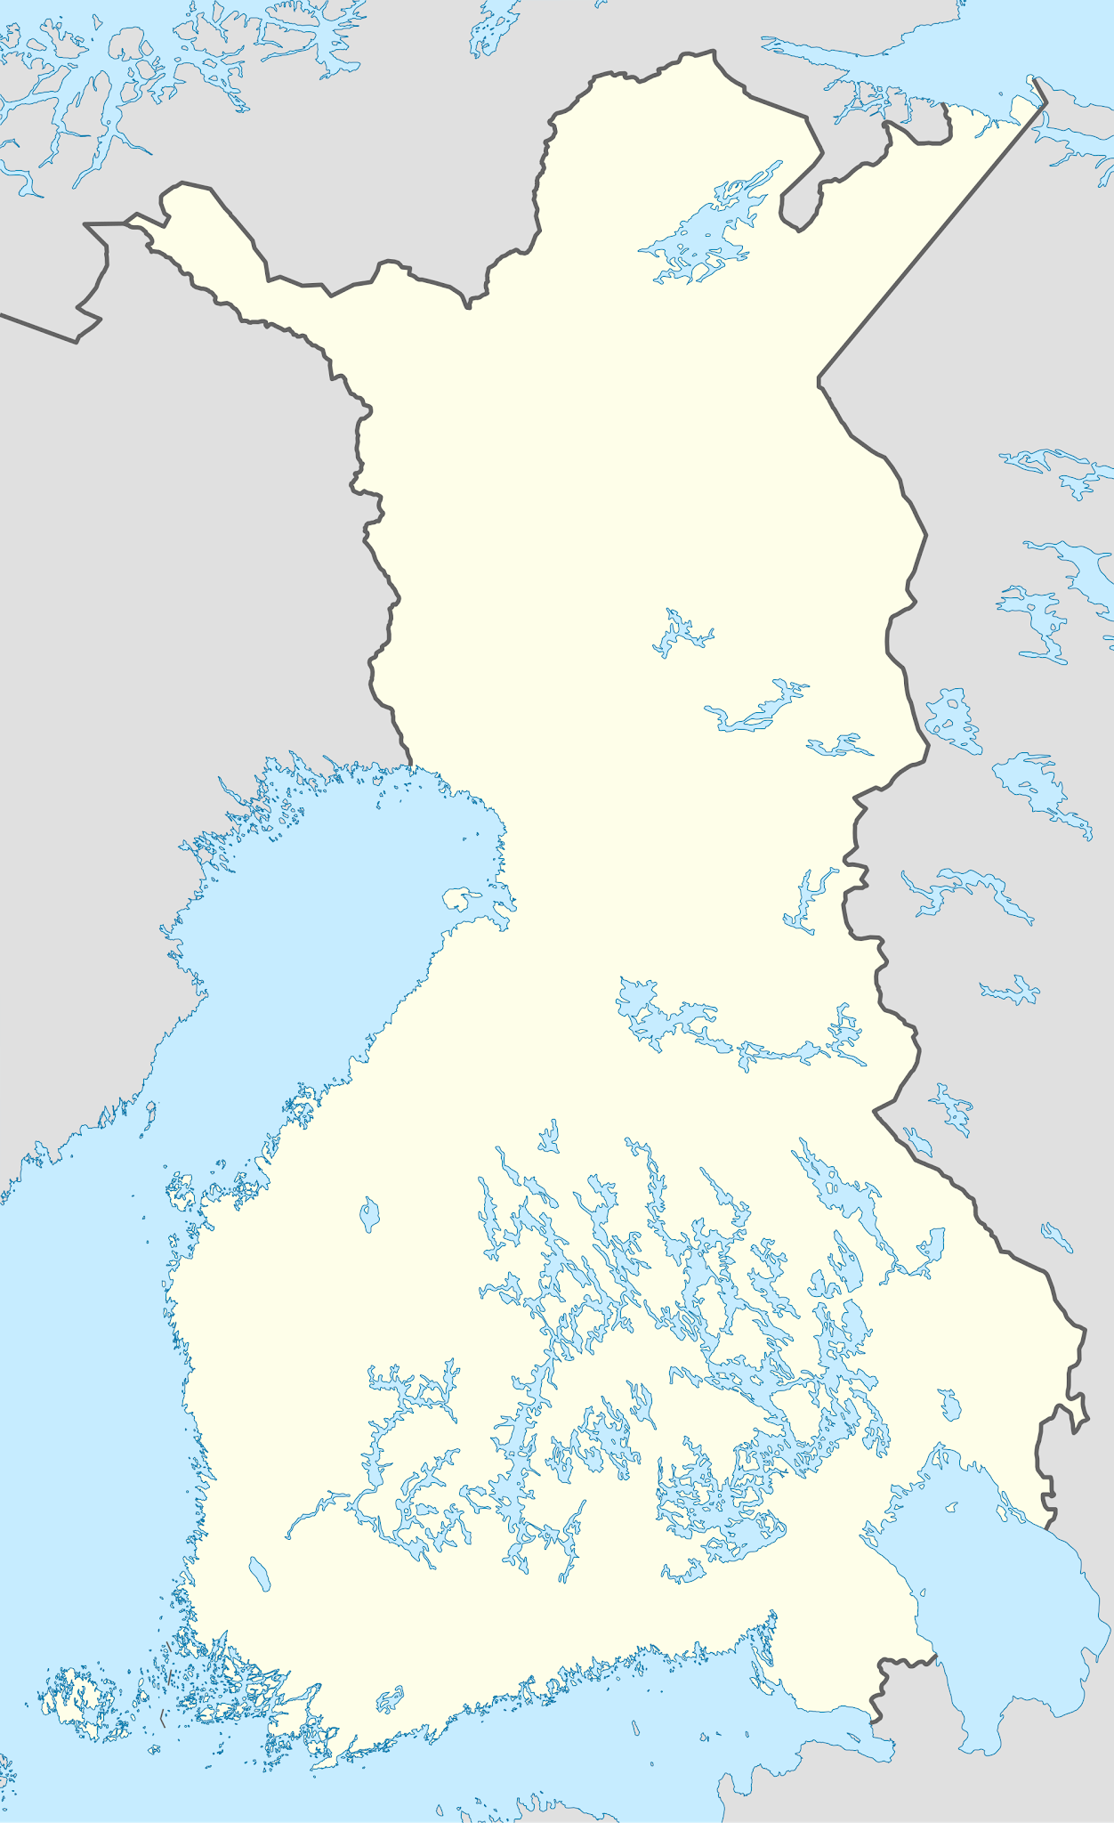
Finland
Characteristics
short growing seasons
farm raise almost all of their foods
Main Ingredients
potatoes and turnips
dairy products
cabbage
mutton, lamb, fish

Slide 10
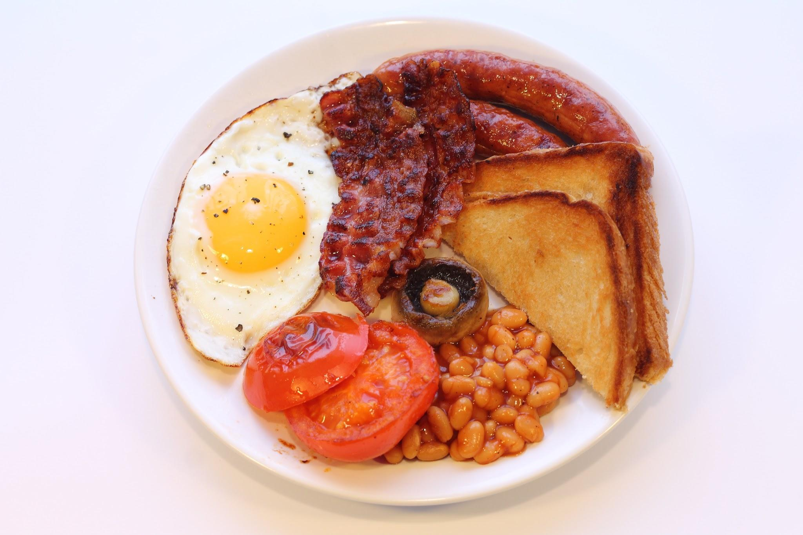
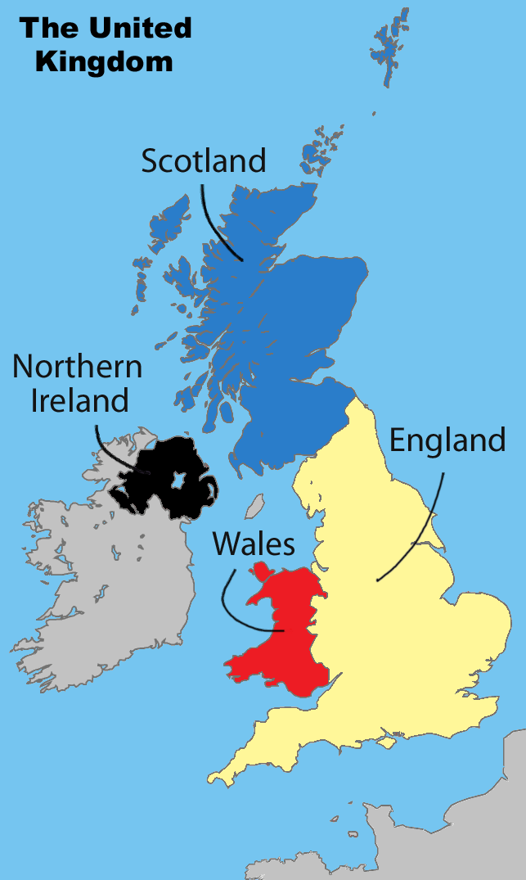
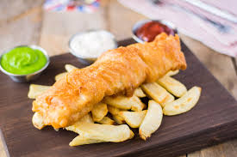
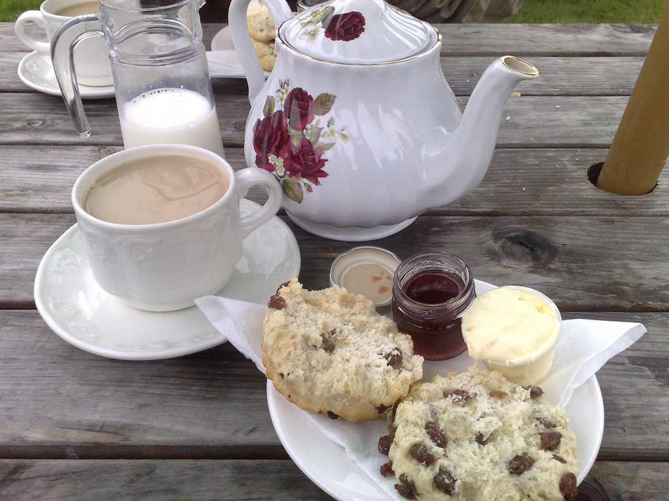
The United Kingdom & Ireland
Afternoon tea is a favorite tradition in the united kingdom
Fish and chips is also a common dish

Slide 11
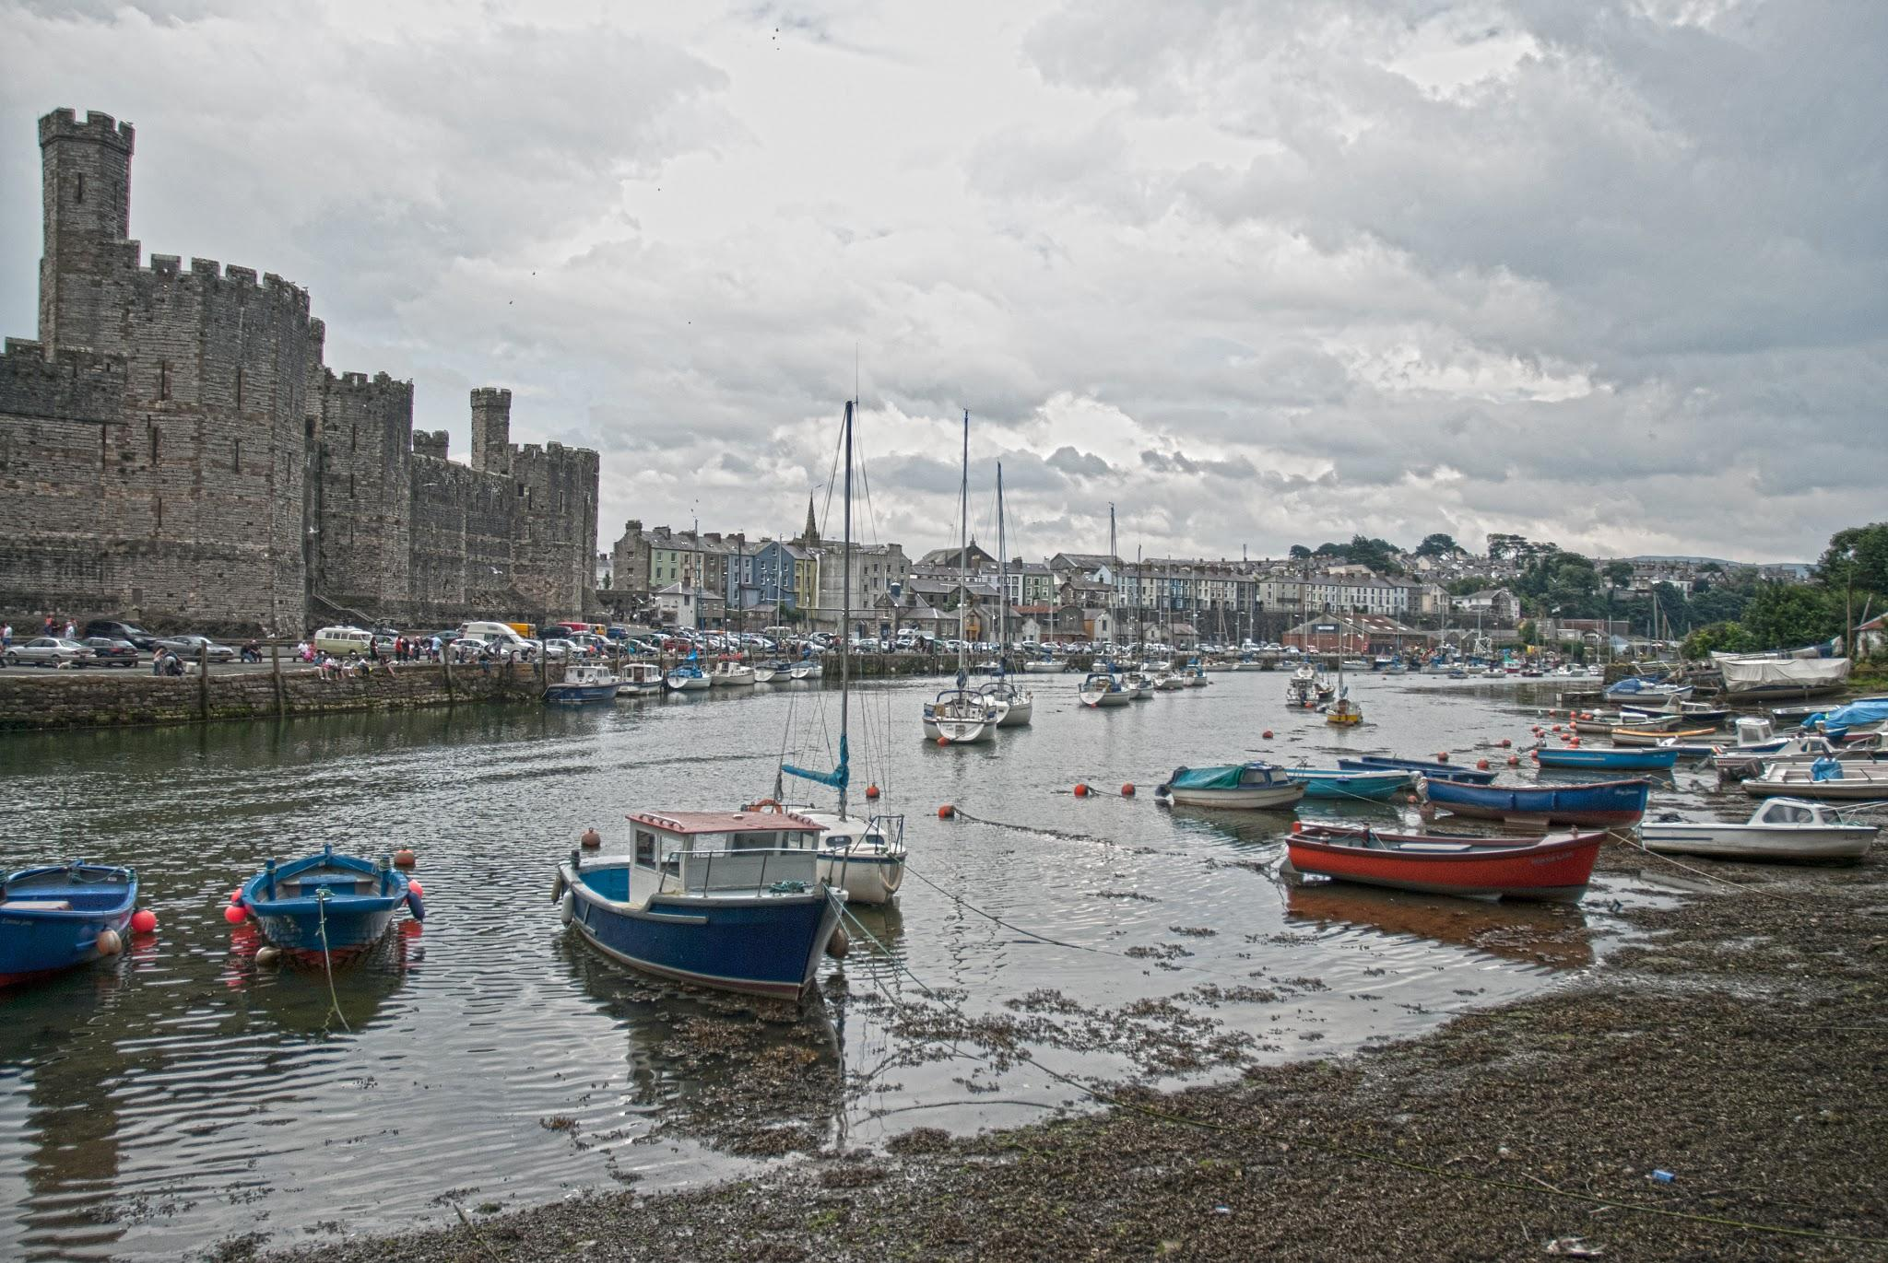
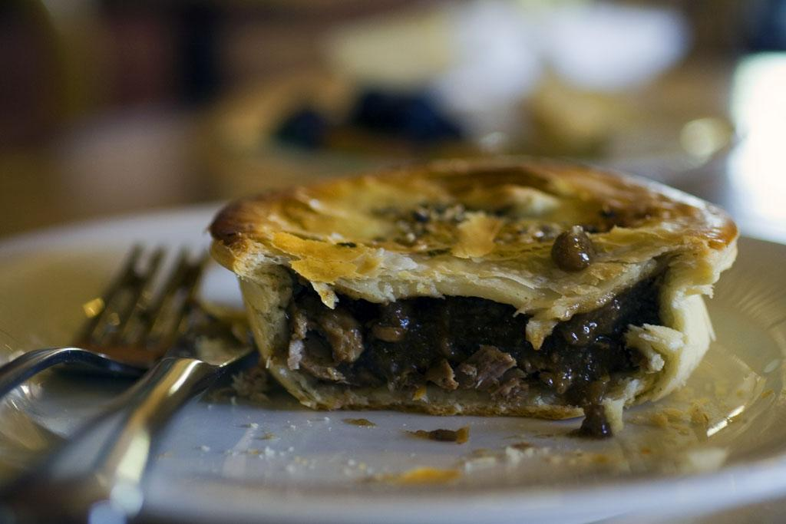
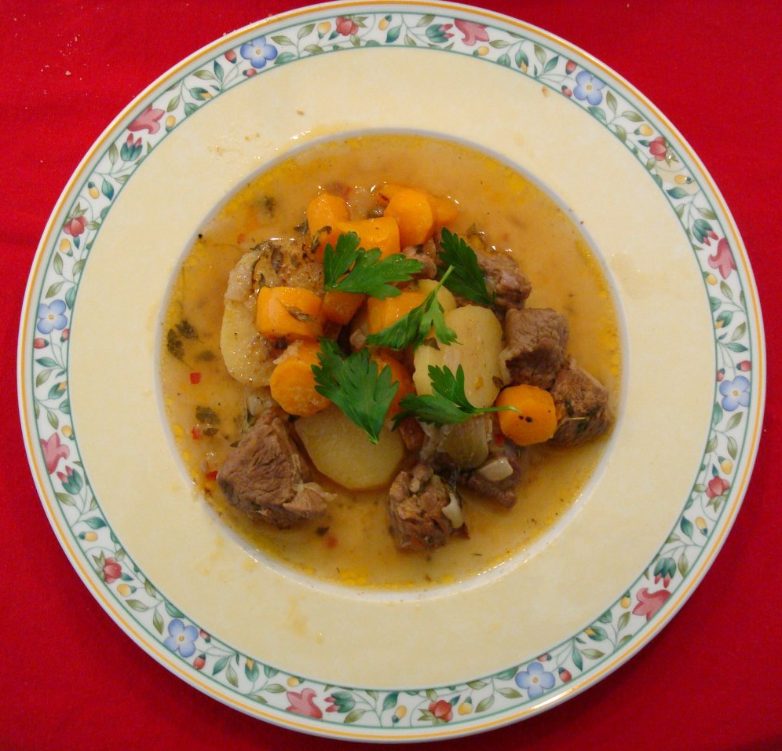

Characteristics
England
most dishes contain meat and 2 veggies
meat pies
desserts (tarts, pies, and curds)
Wales
simplistic baking
thrifty meals
Lots of fish (herring, mackerel, salmon, etc.)
Scotland
oats (haggis is a popular dish)
seafood
meats ( angus cattle and blackface sheep)
Ireland
Stews
Fish pies
Corned beef

Slide 12
The End

