Slide 1
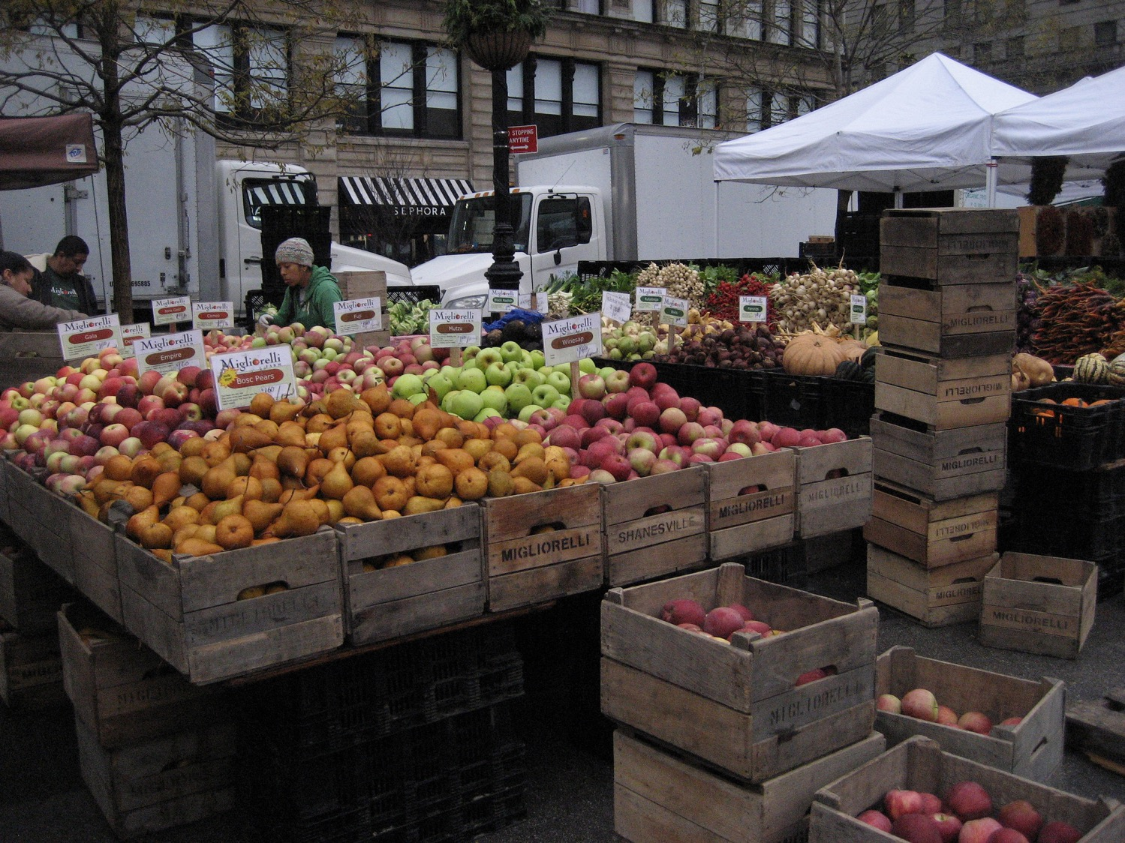
Organic
Local
Sustainable
Heritage/Heirloom
Ethical/Humane
HEALTHY
Artisanal
NATURAL
Foraged

Slide 2
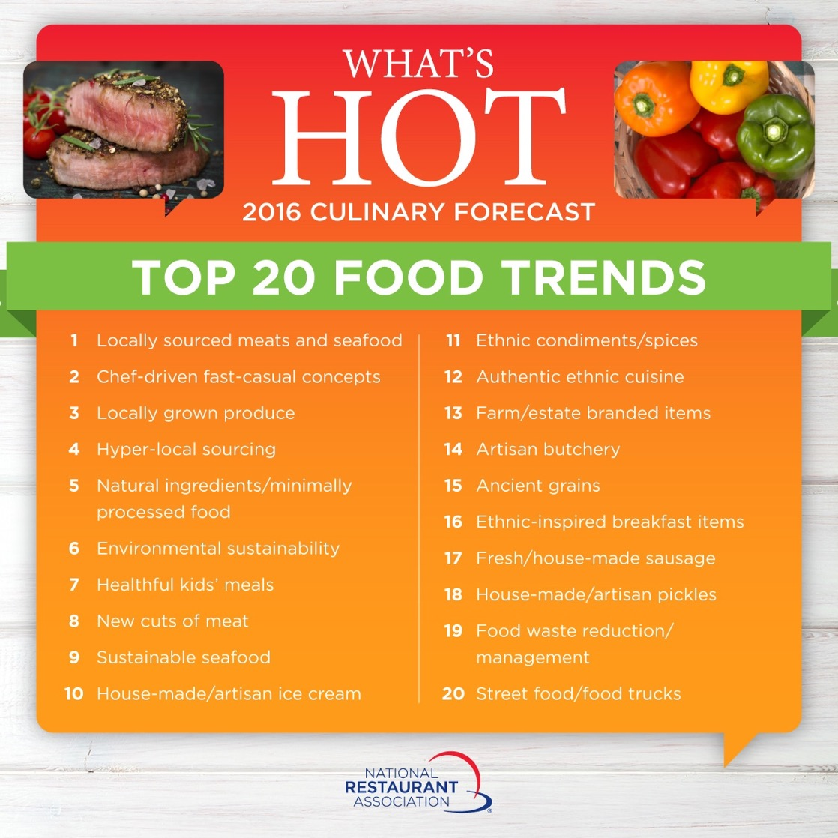

Slide 3
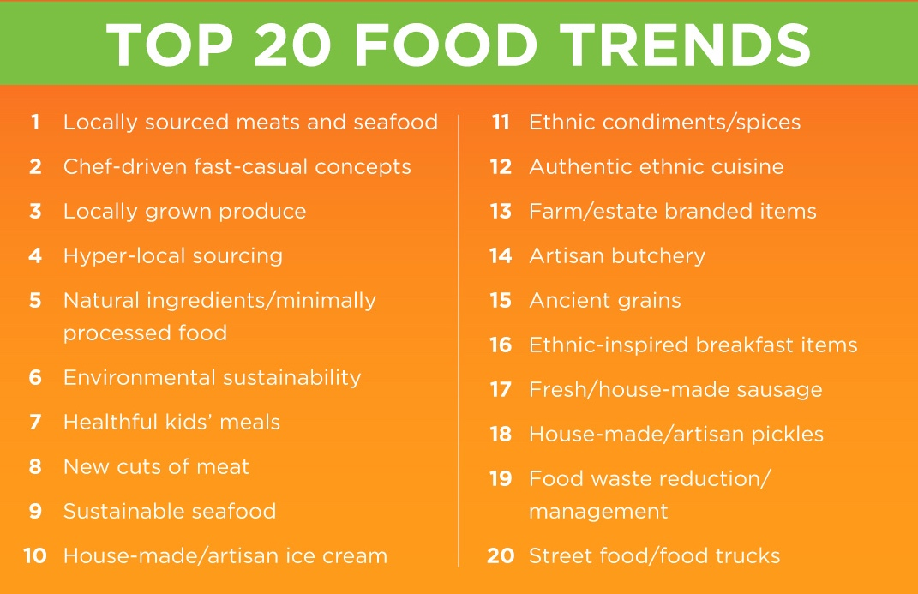

Slide 4
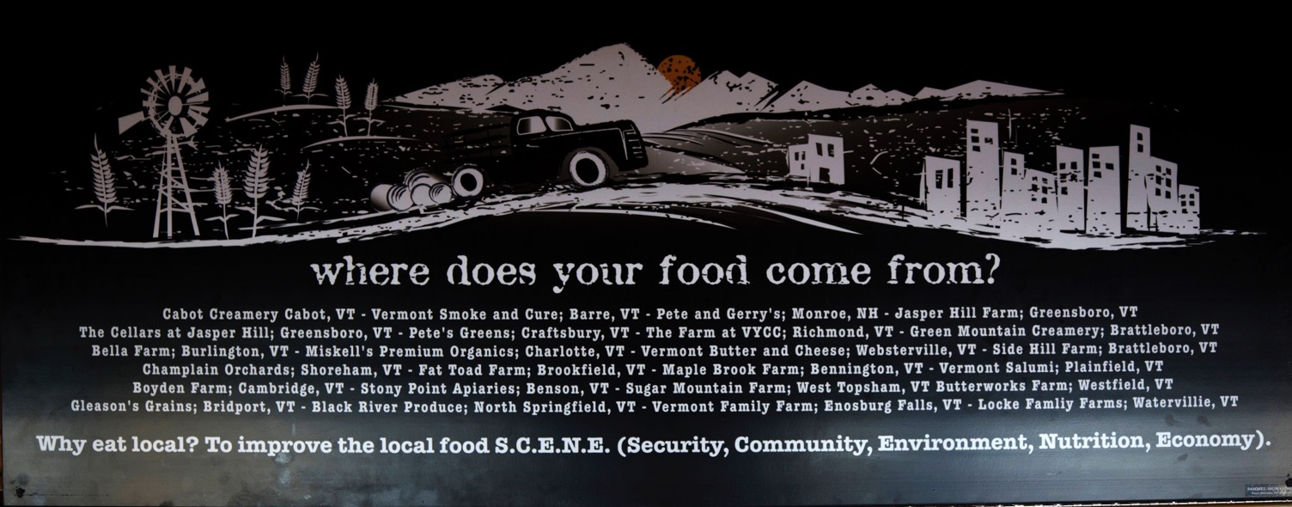
Burlington Airport Cafe

Slide 5
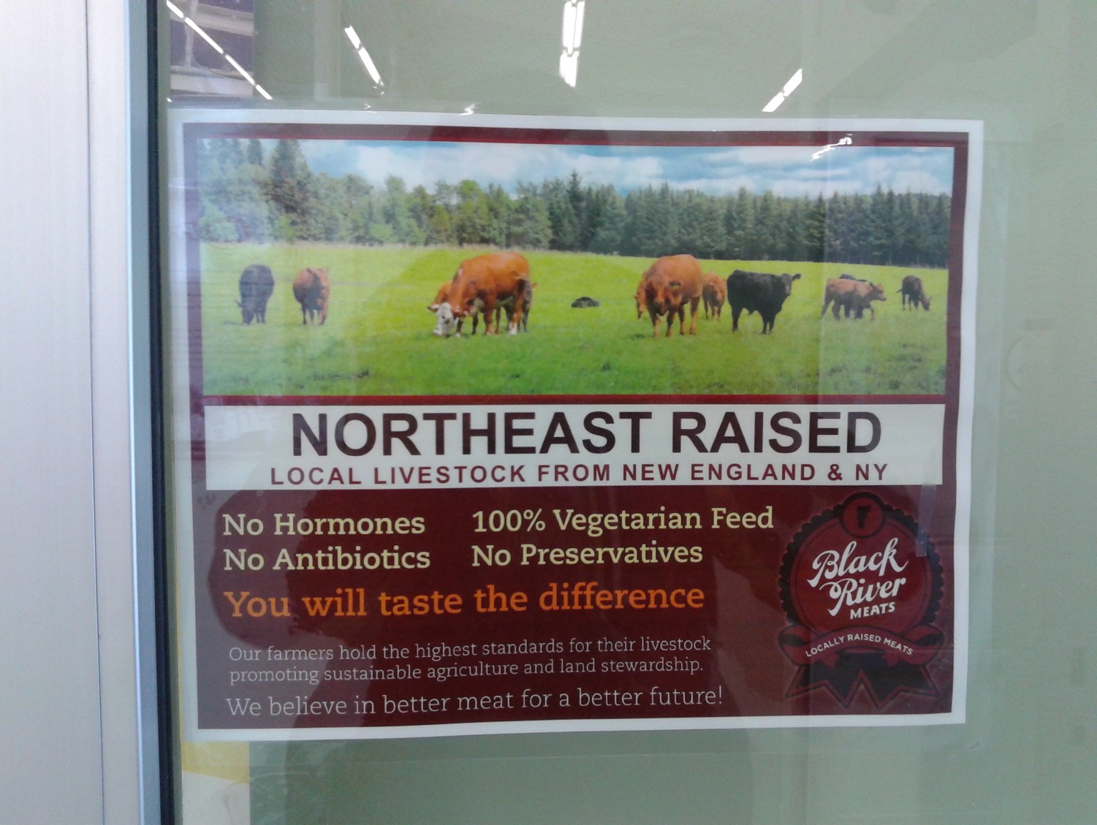
Notes:
Londonderry, VT IGA

Slide 6
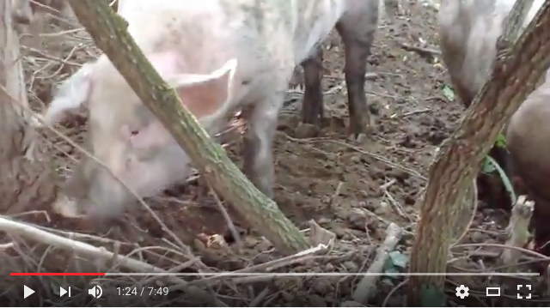
https://www.youtube.com/watch?v=q8PVzaPwg6M

Slide 7
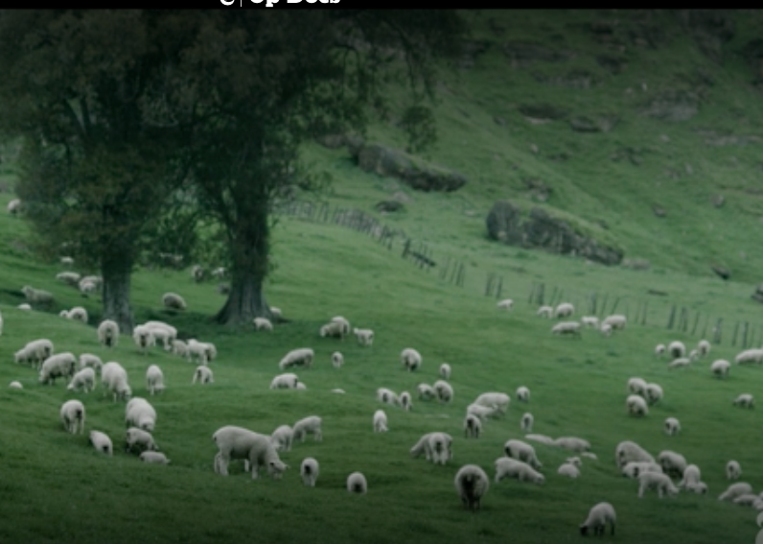
Notes:
http://www.nytimes.com/video/opinion/100000003643167/a-sustainable-chef.html

Slide 8
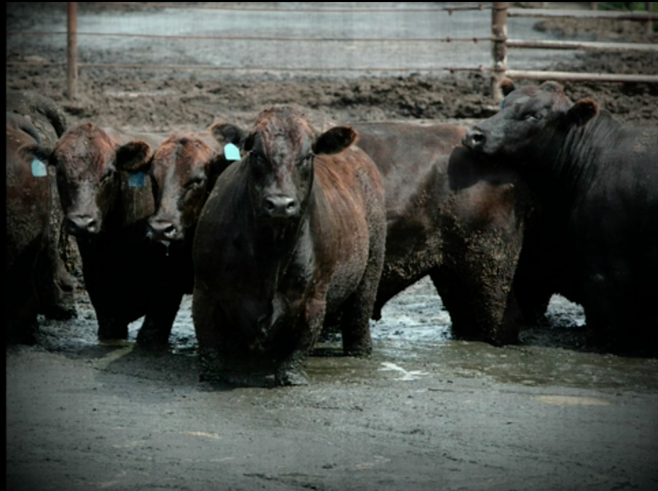
Notes:
http://www.poptech.org/popcasts/michael_pollan_sustainable_food

Slide 9
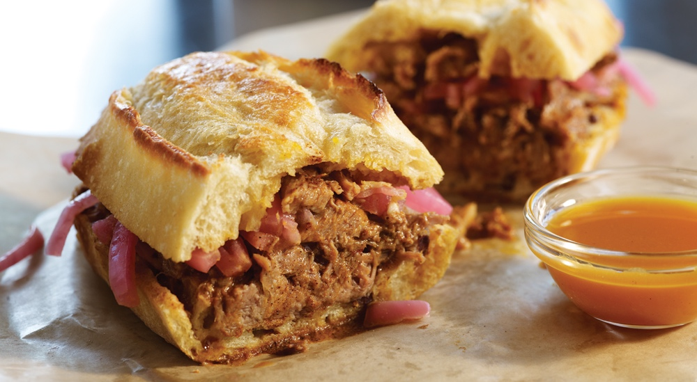
Tortas-Frontera
LOCAL SUPPLIERS
Notes:
http://www.rickbayless.com/restaurants/tortas-frontera/

Slide 10
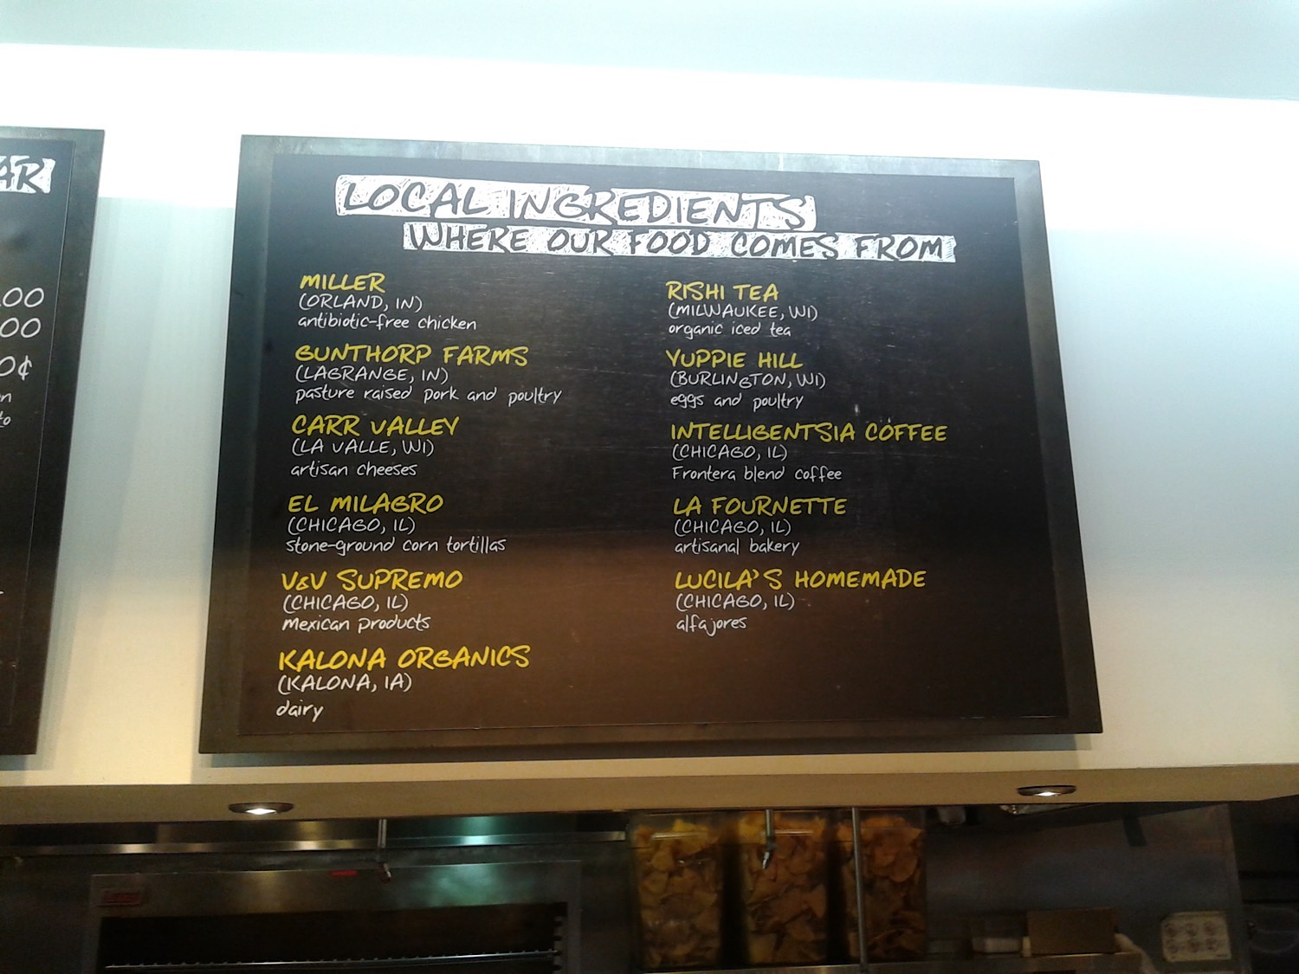

Slide 11
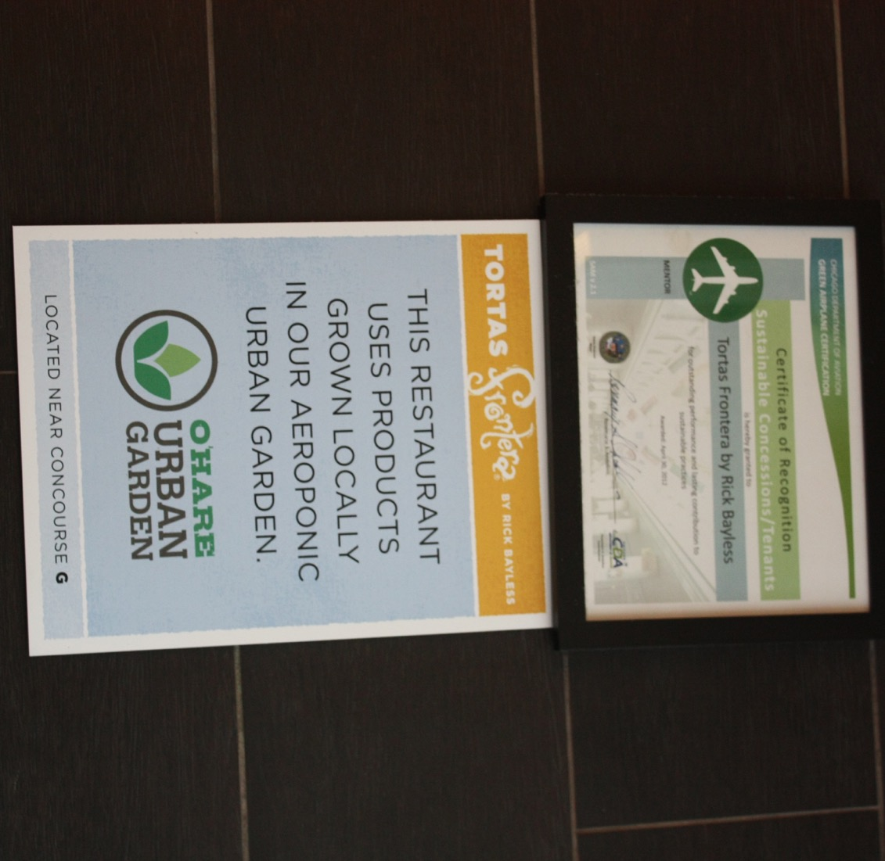

Slide 12
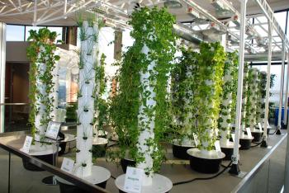
CHICAGO'S O'HARE AIRPORT GOES GREENER WITH THE WORLD'S FIRST VERTICAL FARM
Notes:
https://www.youtube.com/watch?v=AE2Ly1UZgJQ

Slide 13
What is Sustainability?
Sustainability is based on a simple principle: Everything that we need for our survival and well-being depends, either directly or indirectly, on our natural environment.
Sustainability creates and maintains the conditions under which humans and nature can exist in productive harmony, that permit fulfilling the social, economic and other requirements of present and future generations.
http://www.epa.gov/sustainability/basicinfo.htm#sustainability

Slide 14
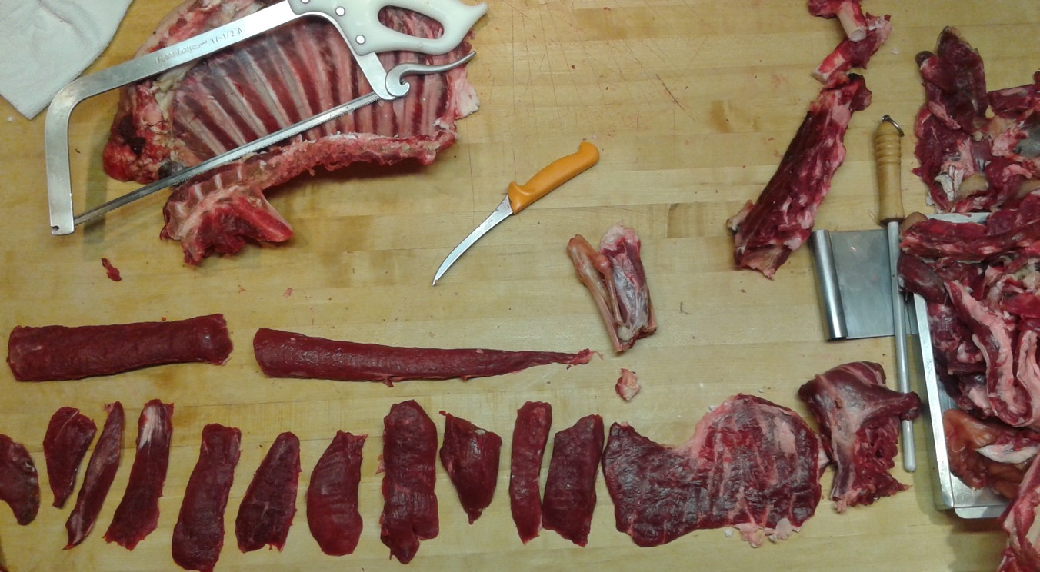

Slide 15
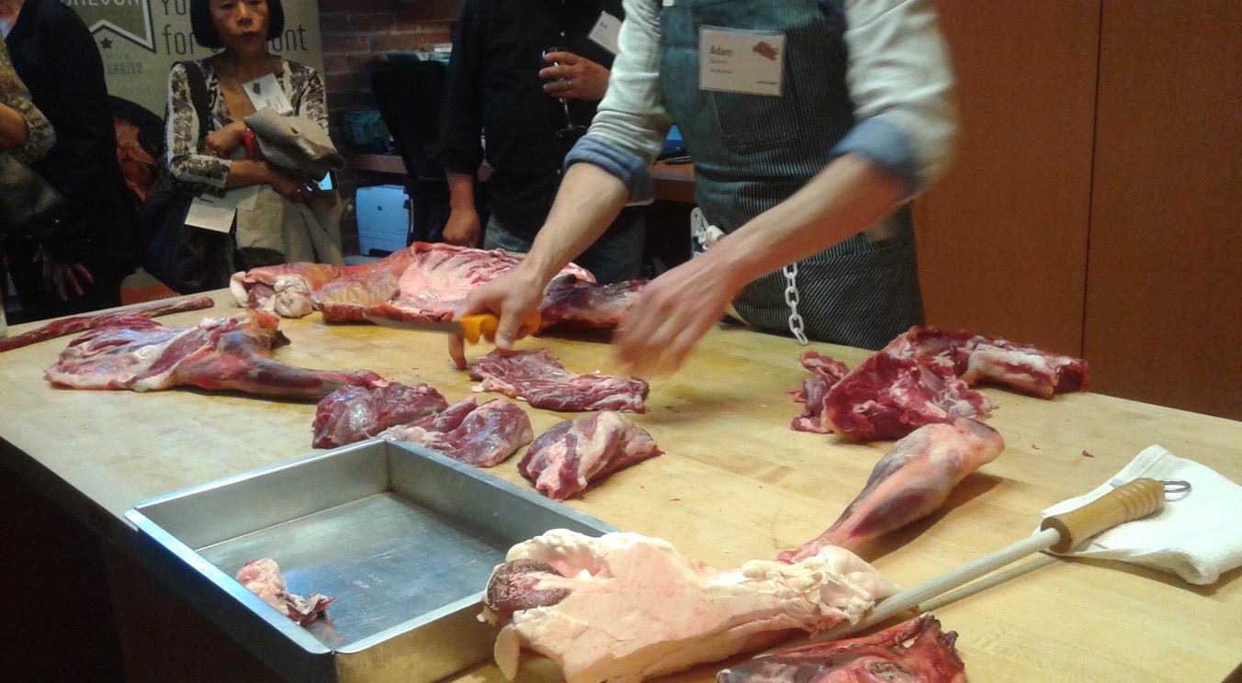
Teaching an Old Goat New Tricks
Notes:
chefs’ collaborative

Slide 16
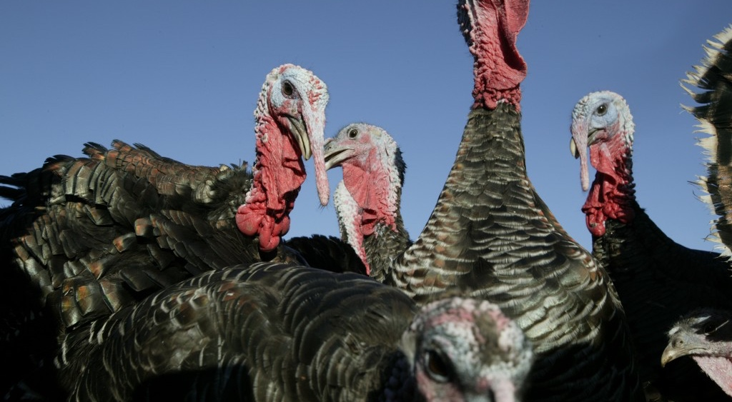
Heritage Breeds
Notes:
http://heritagefoodsusa.com/index.php

Slide 17
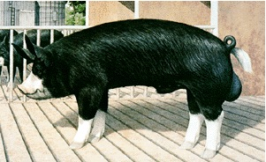
Heritage Breeds
“Red Bourbon and Narragasett Turkeys, Dark Cornish chicken, Buff geese, Berkshire pork, Tunis lamb, Red Poll beef and American bison, are only a few of the wide range of heritage breeds being raised by American farms.” (www.localharvest.org)
The Berkshire: a black pig with lean meat . Occasionally, when commercial white pork becomes too bland and tasteless, some Berkshire genes are used to improve it.

Slide 18
What is Organic?
Organic agriculture produces products using methods that preserve the environment and avoid most synthetic materials, such as pesticides and antibiotics. USDA organic standards describe how farmers grow crops and raise livestock and which materials they may use.
Organic farmers, ranchers, and food processors follow a defined set of standards to produce organic food and fiber.
These standards cover the product from farm to table, including soil and water quality, pest control, livestock practices, and rules for food additives.

Slide 19
Organic farms and processors:
Preserve natural resources and biodiversity
Support animal health and welfare
Provide access to the outdoors so that animals can exercise their natural behaviors
Only use approved materials
Do not use genetically modified ingredients
Receive annual onsite inspections
Separate organic food from non-organic food

Slide 20
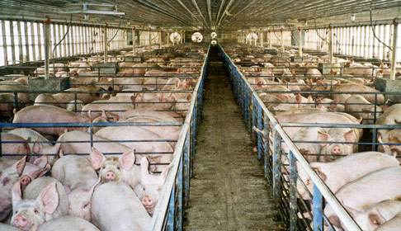
Ethical

Slide 21
USDA Definition of “Natural” Meat
All fresh meat qualifies as "natural."
Products labeled "natural" cannot contain any artificial flavor or flavoring, coloring ingredient, chemical preservative or any other artificial or synthetic ingredient; and the product and its ingredients are not more than minimally processed (ground, for example).
All products claiming to be natural should be accompanied by a brief statement which explains what is meant by the term "natural."

Slide 22
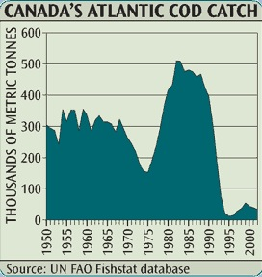
Since 1950, with the onset of industrialized fisheries, we have rapidly reduced the resource base to less than 10 percent—not just in some areas, not just for some stocks, but for entire communities of large [predatory] fish species from the tropics to the poles. Nature, 423, 280-283 (15 May 2003)

Slide 23
Sustainability
www.montereybayaquarium.org

