Slide 1


Introduction to Food & Beverage Management
Culinary Math:
Measurement

Slide 2
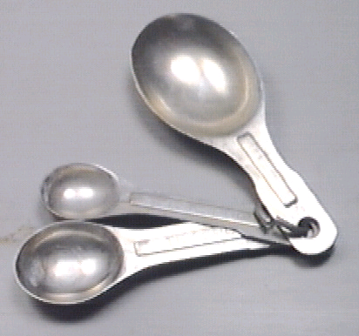
Volume Measures
Teaspoon – tsp

Slide 3
Volume Measures
Tablespoon – tbsp
  = 3 tsp
  = ½ fluid ounce

Slide 4
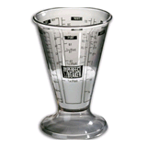
Volume Measures
Fluid ounce – fl. oz.
  = 2 tbsp

Slide 5
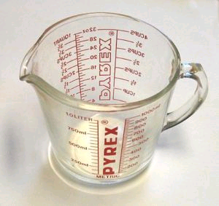
Volume Measures
Cup – c
  =16 tbsp
  = 8 fl. oz.

Slide 6
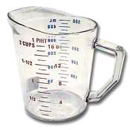
Volume Measures
Pint – pt.
  = 2 c
  = 16 fl. oz.

Slide 7
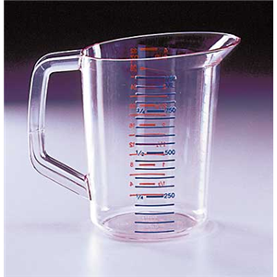
Volume Measures
Quart – qt.
  = 2 pts.
  = 4 c
  = 32 fl. oz.

Slide 8
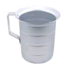
Volume Measures
Gallon
  = 4 qts.
  = 8 pts.
  = 16 c.
  = 128 fl. oz.

Slide 9
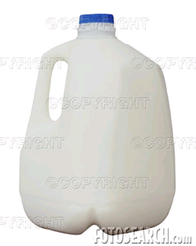
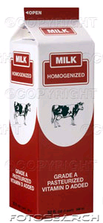
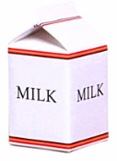
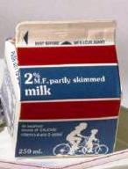
Fluid Milk : Units of Sale
  Gallons = 4 qts = 128 fl. oz.
  Quarts = 2 pts = 32 fl. oz..
  Pints = 16 fl. oz.
  ½ pint = 8 fl. oz.

Slide 10
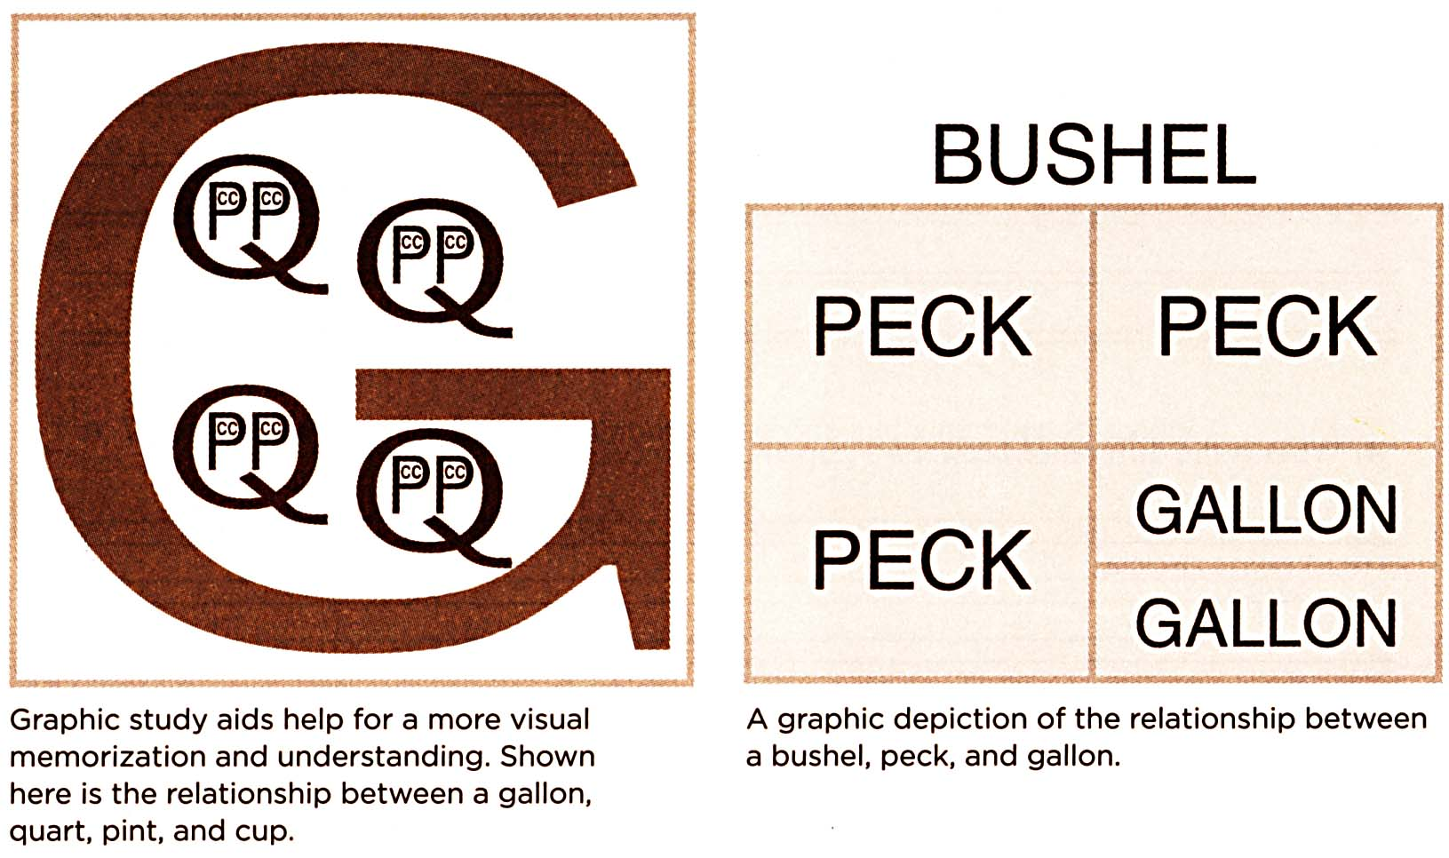

Slide 11
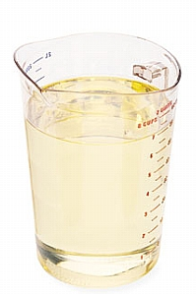
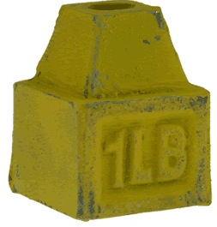
Weight Measures
1 pound = 16 ounces
(= 16 fluid ounces of water only)
  .
=
H₂0

Slide 12
Introduction to Food & Beverage Management
Culinary Math:
Introduction to Fractions

Slide 13
Fractions
numerator
denominator

Slide 14
Adding Fractions
1
8
5
8
+
=

Slide 15
Adding Fractions
1
8
5
8
6
8
+
=

Slide 16
Multiplying Fractions
1
8
5
8
×
=

Slide 17
Multiplying Fractions
1
8
5
8
5
64
×
=
(factors) (product)

Slide 18
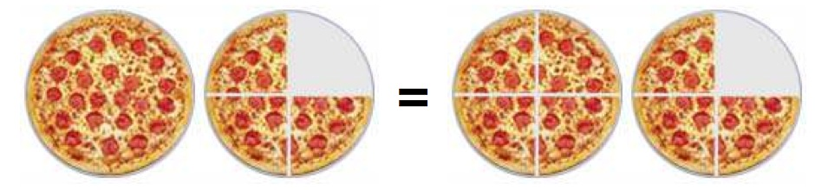
Types of Fractions
3
4
proper
improper
mixed
7
4
3
4
1

Slide 19
Converting Improper Fractions to Mixed
To convert 7/4 into a mixed fraction:
7 ÷ 4 = 1 and a remainder of 3
result is 1 3/4

Slide 20
Adding Fractions with Different Denominators
1
4
2
3
+
=

Slide 21
Adding Fractions with Different Denominators
1
4
2
3
+
=
Find the lowest common multiple of the denominators.
Multiply both numerator and denominator of each fraction by a factor that will yield the common multiple. Add the two fractions together.
The easiest way to do this is simply to multiply the numerator and denominator of a fraction by the numerator of the other fraction.

Slide 22
Adding Fractions with Different Denominators
1
4
2
3
+
=
1
4
3
3
3
12
2
3
4
4
8
12
×
=
×
=

Slide 23
Units seen as Fractions
Express smaller units as a fraction of a larger unit
1 teaspoon = ____ tablespoon
1 ounce = ____ pound
1 cup = ____ gallon
1 pint = _____ quart

Slide 24
Units seen as Fractions
Express smaller units as a fraction of a larger unit
1 teaspoon = 1/3 tablespoon
1 ounce = 1/16 pound
1 cup = 1/16 gallon
1 pint = 1/2 quart

Slide 25
Units seen as Fractions
Express smaller units as a fraction of a larger unit
2 teaspoons = ____ tablespoon
6 ounces = ____ pound
8 cups = ____ gallon
1 1/2 pint = _____ quart

Slide 26
Units seen as Fractions
Express smaller units as a fraction of a larger unit
2 teaspoons = 2/3 tablespoon
6 ounces = 6/16 or 3/8 pound
8 cups = 8/16 or 1/2 gallon
1 1/2 pint = 3/4 quart

Slide 27
Subtracting Fractions with Different Denominators
what is ¾ cup − 2 tablespoons in
a) cups
b) fl. ounces
c) tablespoons

Slide 28
Subtracting Fractions with Different Denominators
what is ¾ cup − 2 tablespoons in
cups
2 tbsp = 1/8 cup
common multiplier is 8
6
8
1
8
5
8
−
=
cup

Slide 29
Subtracting Fractions with Different Denominators
what is ¾ cup − 2 tablespoons in
b) fl. ounces
¾ cup = 6 fl. oz.
2 tbsp = 1 fl. oz.
6 − 1 = 6 fl. oz

Slide 30
Subtracting Fractions with Different Denominators
what is ¾ cup − 2 tablespoons in
c) tablespoons
¾ cup = 12 tbsp
12 − 2 = 10 tbsp

Slide 31
Conversion Factor
A recipe for chili yields 40 portions. You need to make 30 portions.
The original recipe calls for 2/3 cup chili powder. How much chili powder do you now need?
How do you represent (a.) as a factor (in the form of a fraction)?
This is called a conversion factor.

Slide 32
Conversion Factor
30
40
10
10
3
4
÷
=
3
4
2
3
6
12
1
2
×
=
=
conv. chili chili
factor needed

